Slide 1
ANAESTHESIA MACHINE
BY: DR. CHINMAY
UNDER GUIDANCE OF: DR. HINA GADANI (M. D. A. P.)

Slide 2
INTRODUCTION
THE ANAESTHESIA WORK STATION:
COMPONENTS:
Anaesthesia machine
Vaporizer
Ventilator
Breathing system
Scavanging system
Monitors
Durg delivery system
Suction equipments
Data management system

Slide 3
STANDARDS
ASTM: american society for testing and materials

Slide 4
ANAESTHESIA MACHINE COMPONENTS
ELECTRICAL COMPONENTS: as modern anaesthesia machines are powered by electricity.
MASTER SWITCH:
Positions:
OFF: only electical components are active, battery charger and electrical outlets.
ON: both electrical and pneumatic functions are active. By turning the switch on, system checkout is done by some compicated power up procedure. This can be bypassed in the emergency situations and the records are kept for any legal process.
STANDBY: If this option is used for long period, computer information may be corrupted. So system checkout done and machine should be restarted atleast once in 24 hrs.
Oxygen flush and auxillary oxygen connector can be used without turning the master switch on.

Slide 5
3. POWER FAILURE INDICATOR:
may be audible or visible.
4. RESERVE POWER (Batteries):
it may be rechargable (commonly used) or replacable.
Its better to switch over to manual ventilation when power fails in modern machines to preserve the battery for monitors
5. ELECTRICAL OUTLETS: present in some modern machines. And no other high frequency surgical instruments or opertating tables should be connected to these outlets. These outlets cant provide power in case of power failure.
6. DATA COMMUNICATION PORTS: Present in modern machines. Used to connects to different monitors and the data management systems

Slide 6
7. PNEUMATIC SYSTEM:
THE HIGH PRESSURE SYSTEM:
Hanger yoke
Cylinder pressure indicator
Pressure regulator
B. THE INTERMEDIATE PRESSURE SYSTEM:
Master switch
Pipeline inlet connection
Pipeline pressure indicator
Piping
Gas pwer outlet
Oxygen pressure failure divices
Gas selector switch
Second stage regulator
Oxygen flush
Flow adjustment control
C. THE LOW PRESSURE SYSTEM:
Flow meter
Hypoxia prevention safetry devices
Unidirectional valves
Pressure relief dievices
Common gas outlets

Slide 7
High pressure system

Slide 8
HIGH PRESSURE SYSTEM it converts high variable pressure to low constant pressure for use in macine
HANGER YOKE
functions:
Orients and support culinder
Provides gas tight seal
Unidirectional flow
Numbers:
Atleast one yoke for O2 and one yoke for N2O.
Better if 2 yokes are available for O2.
c. Compositions:
Body: it is threaded into the machine.
it has the swinging gate.
Retaining screw: it is in the distal end of the yoke.
conical point of it is shaped to fit in the fonical depression in the cylinder valve.
it helps to achieve a gas tight seal by pressing the cylinder valve outlet against nipple and washer on the yoke
Washer (Bodok seal): it has metal ring with non combustile rubber material.
it should be less than 2.4 mm thick.
          only one washer is used in each yoke

Slide 9
Filter: 100 micrometer. Used to prevent particulate matter from entering the machine. It is present between cylinder and pressure regulator.
Pin index system: this system is used prevent the wrong attachment of cylinders in the machine.
Check valve assembly:
unidirectional: allows gas to enter the machine but does nt allow the opposite. It also prevents transfer of gases from high pressure cylinder to low pressure one.
Mechanism: when pressure in machine exceeds that in the cylinder, the plunger moves to the left, preventing escape of gas from the machine. When cylinder pressure exceeds ,machine pressure, the plunger moves to right and gas flows into machine.
These check valves doesn’t act as permant seal for empty yokes and may aloow a small amount of gas to escape. To prevent this yoke plug is available.
To prevent this transfilling: only one cylinder is open at a time. No yoke should be kept vacant. Either yoke plug or closed cylinder should be applied to it.

Slide 10
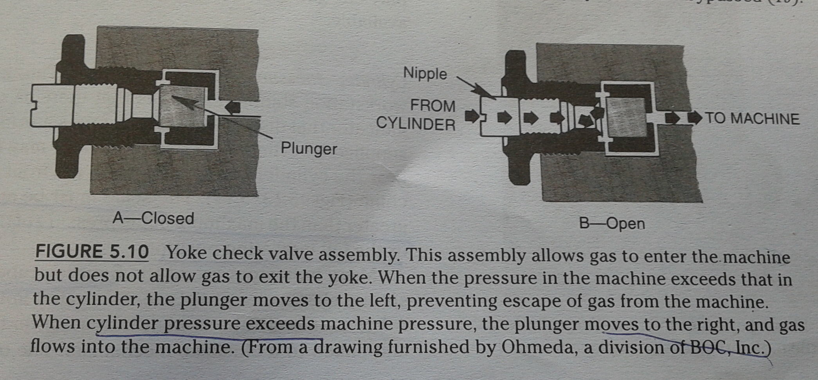
CHECK VALVE ASSEMBLY

Slide 11
How to place a cylinder in yoke:
No oil or grease on the cylinder valve or yoke or applicator s hand.
Cylinder should be supported with foot at the bottom
Nipple and pin index should be matched properly.
It is necessary to ensure that the cylinder is placed correctly before tightening the retaining screw other wise it may damage the safety relief diveice.
Cylinder should be opened thereafter to make sure the cylinder is full and that there is no leak. Most common cause of leak is defective or absent washer

Slide 12
HIGH PRESSURE SYSTEM
CYLINDER PRESSURE INDICATOR / GAUGE
LOCATION: near the cylinder
on the panel.
COLOUR CODED:
COLOUR ZONES:
TYPES:
Bourdon tube: a hollow metal or copper tube is bent into a curve, then sealed and linked to a clockwise mech. The other end is connected to the gas source. An increase in gas pressure inside the tube causes it to straighten. As the pressure falls, the tube resumes ti curved shape. Because the open end is fixed, the sealed end moves . These motions are transmitted to the indicator, which move over caliberated scales. Kilopascals * 100 inside the circle and pounds per square inch on the outside.
when bourdon tube ruptures, the dscaping gas is generally vented from the backside rather than from the front window. The face of the gauge should be made of heavy glass as an additional measure
the span ranges from 180 to 280.
lowest marking btw 6 and 9 oclock position
O2 pressure gauge marked as use no oil
Digital / electronic:
LEDs: open cylinder with ad pressure: green light
open cyliner with inad pressure: flash red
close cylinder: dark
THE SCALE MUS BE ATLEAST 33% GREATER THAN TH MAXIMUM FILLING PRESSUE OF CYLINDER

Slide 13
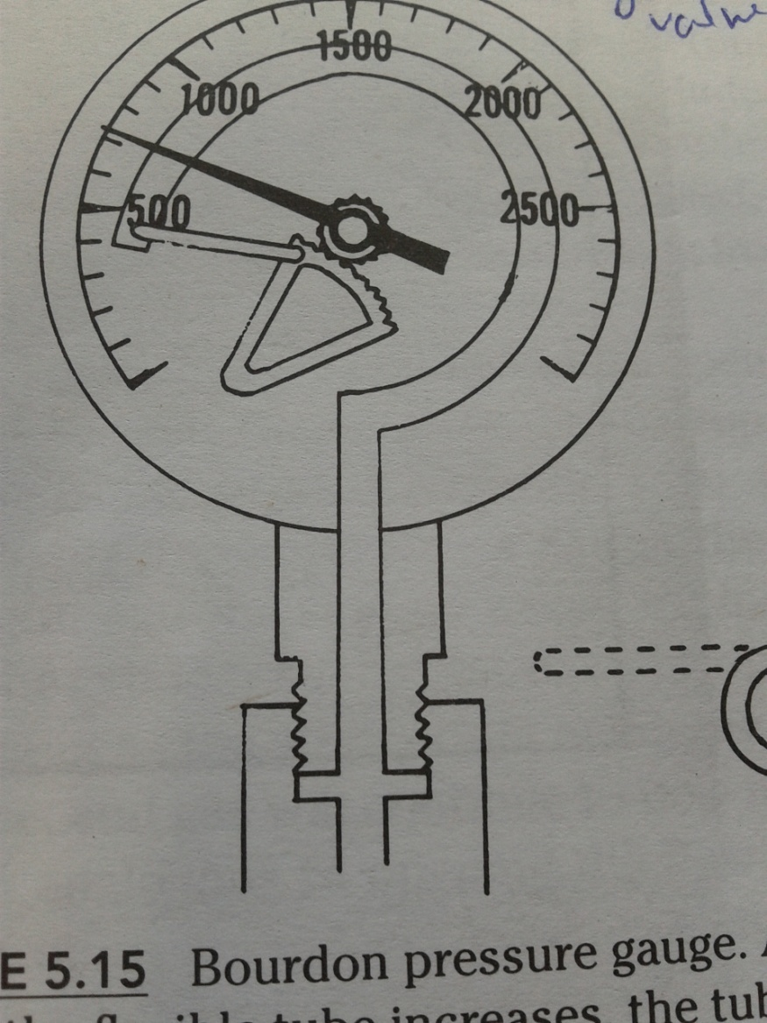

Slide 14
HIGH PRESSURE SYSTEM
PRESSURE REGULATOR
It converts high variable presurre into the low constant pressure. Without it constatnt lateration of flow control valve is needed to maintaint the constant flow as pressure in cylinder falls.
Physical principle of pressure regulator is very complex.
Types: 1. direct acting type based on pressure porportioned reduction theory.
2. indirect acting type based on pressure inversion theory.
The delievery pressure may be adjustable by user or preset by manufacturers.
The flow from cylinder should not exceed more den 10 ml / min whe pressure in the gas pipeline is 345 kpa or 50 psig. This can be accomplished by keeping the pressure delievered by the regulator at a lower leel than pipeline pressure.

Slide 15
Intermediate pressure system

Slide 16
INTERMEDIATE PRESSURE SYSTEM
MASTER SWITCH: already discussed.
PIPE LINE INLET CONNECTION:
They are fitted with threaded noninterchangable diameter index safety system (DISS)
Each inlet contains a unidirectional check valve to prevent the reverse flow of gases from machine to pipeline
They required to have a filter with a pore size of 100 micrometer or less

Slide 17
3. PIPE LINE PRESSURE INDICATOR:
Location: on the panel
Colour coded:
Colour zone:
Types:
1.digital:
2. LEDs: green: adequater pressure / connected
off: inadequate pressure / not connected
dark: transducer is not operable
Check valve:
location: upstream (pipeline side): it will monitor pipe line pressure only.
down stream (machine side): it will monitor pressure in pipeline or in the cylinders. So if pipeline pressure is not adequate and cylinder valve is open, then also pressure indicator shows adequate pressure and pressure decreases when cylinder pressure falls and at that time pipeline pressure is also not there.
SO, CYLINDER VALVES SHOULD ALWAYS REMAIN CLOSED WHEN PIPELINE PRESSURE IS ADEQUATE
THE PRESSURE SHOULD BE BETWEEN 50 TO 55 PSIG (345 TO 380 KPA).

Slide 18
4. PIPING:
They are used to connect the components inside the machine and they must be able to withsand four times the intended service pressure without rupturing.
Leaks:
between pipeline/cylinder pressure reducing system and flow control valve, the leak should not be more then 25 ml / min.
If yoke and pressure reducing system is included than it should not be more than 150 ml / min.
5. GAS POWER OUTLET: it is a source of driving gas for the anesthesia ventilator or to supply gas for a jet ventilator or auxillary o2 flowmeter. Either oxygen or air may be used. In modern anaesthesia machine, ventilator is an integral part of the machine, so outlets are not found on many anaesthesia machines nowadays. There is chances of misconnection as the diss fitting for o2 inlet and o2 power outlet are same

Slide 19
6. OXYGEN FAILURE DEVICES:
Oxygen failure safety device:
if o2 concentration at common gas outlet falls below 19%, this device shuts off or proportionately decreses and ultimately interryupts the supply of n2o.
The flow of o2 and n2o are turned on, the source of o2 pressure is then removed, the fall in o2 pressure is noted on the cylinder or pipeline pressure gauge, it=f the o2 failure safety device is functioning properly, the flow indicator for the n2o will fall to the bottom of the tu e just before the o2 indicator falls to the bottom of its tube
B. Oxygen supply failure alarm:
If o2 pressure falls below 30 psig or 205 kpa atleast a medium priority alarm shall be enunciated within 5 seconds and it shall not be possible to disable this alarm

Slide 20
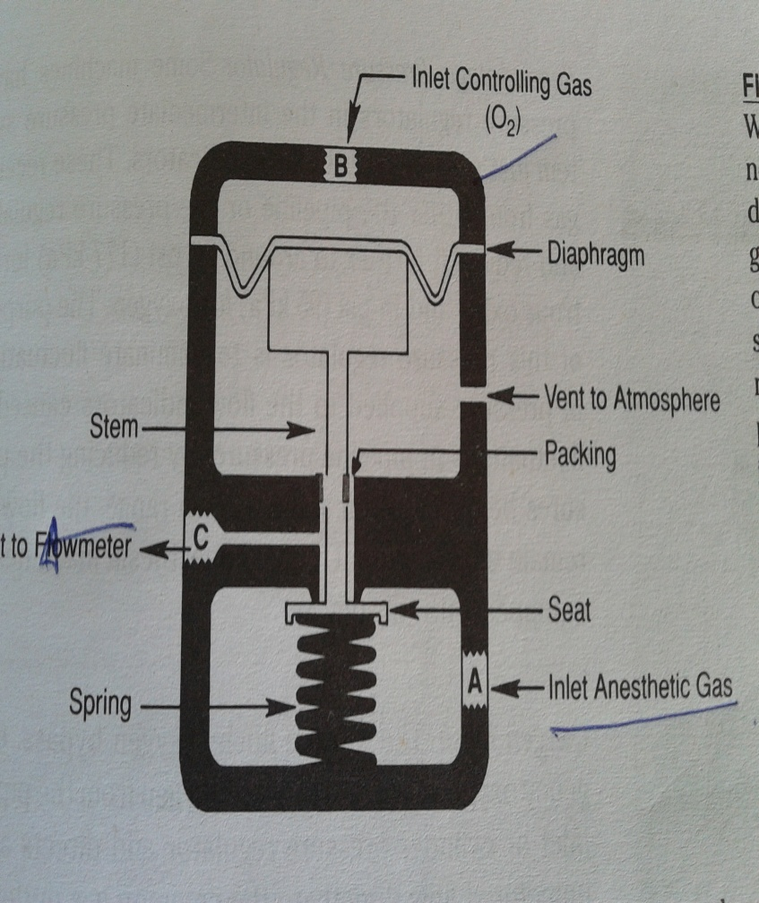
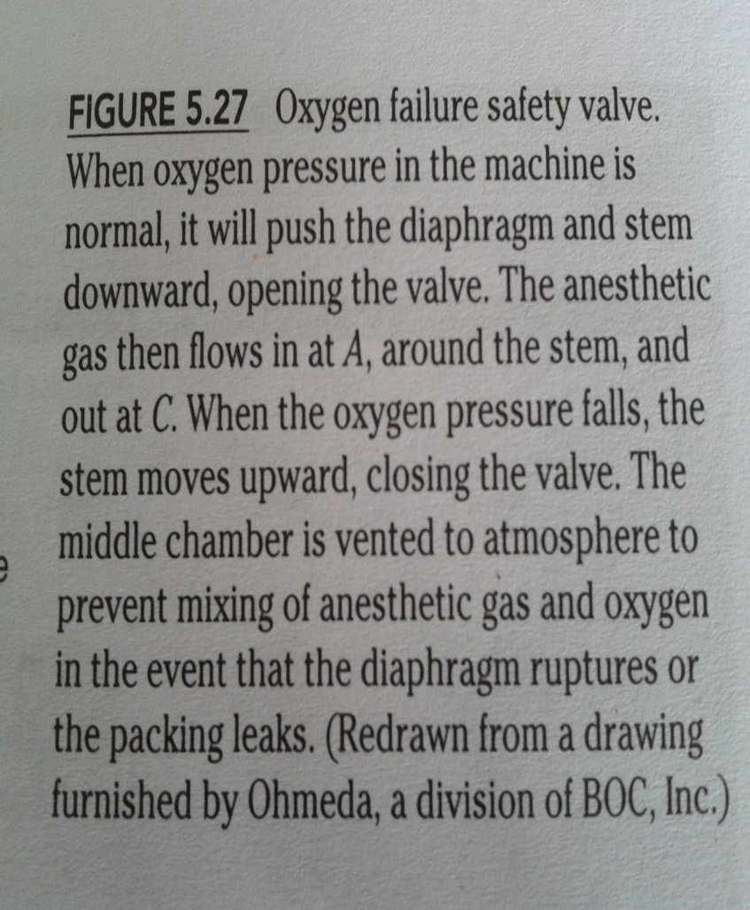
OXYGEN FAILURE SAFETY DEVICE

Slide 21
BOTH OF THE ABOVE DICICE DEPEND ON PRESSURE AND NOT FLOW.
They give protection against
Disconnected hose
Low o2 in pipeline pressure
Low o2 in cylinder pressure
They don’t give protection against
Hypoxic mixtaaure being delievered to patient bcz they don’t prevent anesthetic gas to flow if there is no o2 flow.
Equipment problem
Operator error (partially closed o2 flow)
Misconnection

Slide 22
7. GAS SELECTOR SWITCH: that prevents air and n2o to be used together. They might be electronic or manual.
8. SECOND STAGE PRESSURE REGULATOR:
Two stage [ressure regulation
the gas is supplied at 60 lb / inch2.
Location: just upstream of flow indicator.
It recieves flow from pipeline (preferential use when both are open) or pressure regulator from cylinder and reduces the pressure.
It eliminates the fluctation in pressure in pipeline system by reducing pressure below normal fluctuation range.
It reduces the o2 pr by 20 psig and n2o pr by 38 psig.this difference is necessary for proper funcitoning of o2 / n20 flow linkage
Flow restrictors: present as a constriction in the pipeline upstream of the flow meter. They are not accurate. In case of outlet obstruction, pressure increase in the machine causes damage. To prevent this blow off safety valve may prevent
It is not present in every machine.

Slide 23
9. OXYGEN FLUSH: (02+)
It receives flow from pipeline inlet or cylinder pressure regulator and delievered high unmetered flow directly to the common gas outlet.
It can be turned on and off regardless of the master switch.
Single purpose
Self closing
Button should be guarded by collar to prevent accidental activation
Operable with one hand.
High flow at 35 – 75 L / min.
It s mechanism is shown in the figure.

Slide 24
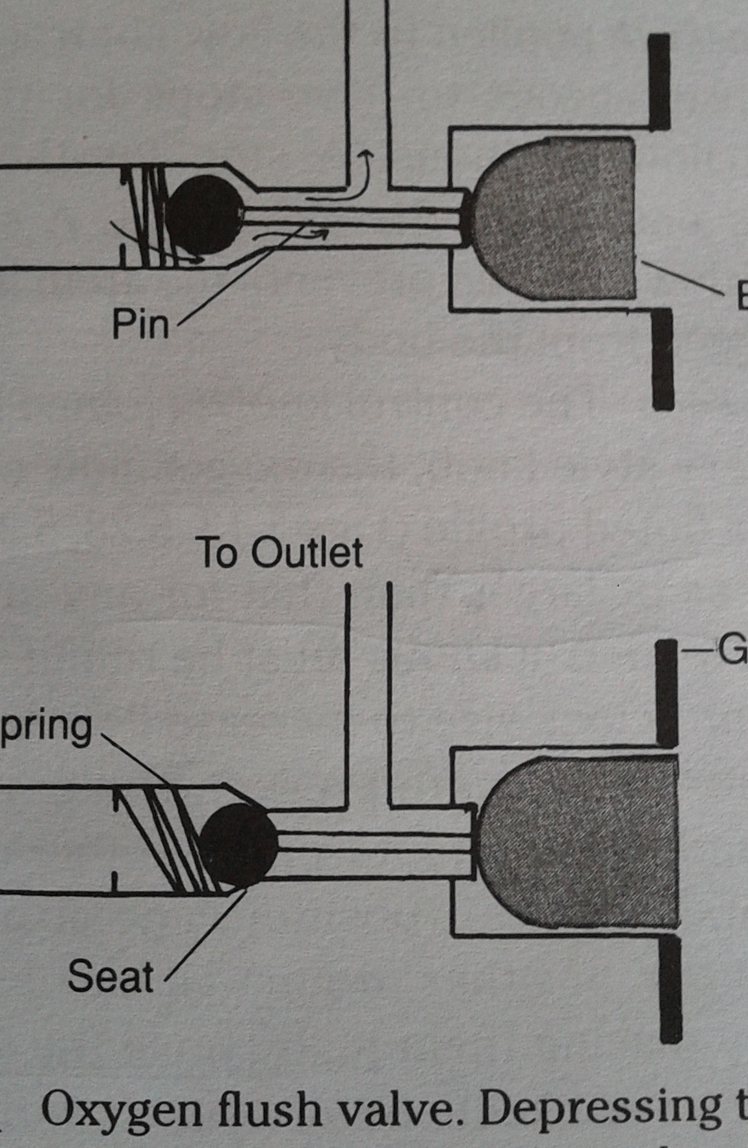
MECH OF O2+

Slide 25
The pressure exerted by o2 flush will be transmitted back to other gas structures I the macine, i.e. flow indicators and vapourizers, and it may changes flow indicator reading and vapourizer output. These pre changes depends on pressure check valves, pressure generated and the relationship of o2 flush to other compoents. Connection should be such that it does not alter the pressure at vaporizer outlet by more than 10 kpa or outpur by more than 20 %.
Hazards associated with malfuncton of o2 flush:
Accidental activation
Internal leakage
Stickin of flush in on position
Barotrauma
Using it to ventilate through a catheter inserted percutaneously has been investigated, som e machines provide sufficient pressure for effective jet ventilation. But they are not recommended for this purpose by most manufactrurers

Slide 26
10. FLOW ADJUSTMENT CONTROL VALVE:
It regualtes the flow of gases to the flow indicators.
Types: mechanical or electronic
Only one flow flow control for each gas.
It must be adjacent to or identigiable with its associated flow meter.
MECHANICAL FLOW CONTROL VALVE
It may have on and off switch. In some machine it is controlled by master switch.
They are used with both types of flowmeters. Electonic and mechanical.
WHEN MACHINE IS NOT IN USE, IT SHOULD BE DISCONNECTED FROM PIPELINE OR CYLINDER SHOULD BE TURNED OFF AND FLOW CONTROL VALVE SHOULD BE OPENED TILL PRESSURE IS REDUCED TO ZEROAND THEN CLOSED.

Slide 27
Compositions:
Body: it screws in the anesthesia machine.
Stem and seat n pin: it has fine treads so that the stem moves only a shoret distance when a complete turn is made. Turning the stem creates a leak between the pin and seat so that gas flows to the outlet.
stop collar for off position prevents from overtightening of the pin in the seat and for max position prevents stem from becoming disengaged from body.
Spring: valve may be loaded with the spring to eliminate any looseness in the treads. It also minimizes flow fluctuations from lateral or axial pressure applied ot the flow control knob.
Colour coded disc: to differentiate easily from other knob.
Control knob: it is joined to stem. O2 knob has flutted profile and it is little larger den others.
LOCATION: high above the surface to prevent accidental change in flow. Or it should be protected by a shield or barrier.
Turn the knob to counterclockwise, will allow the gases to flow.

Slide 28
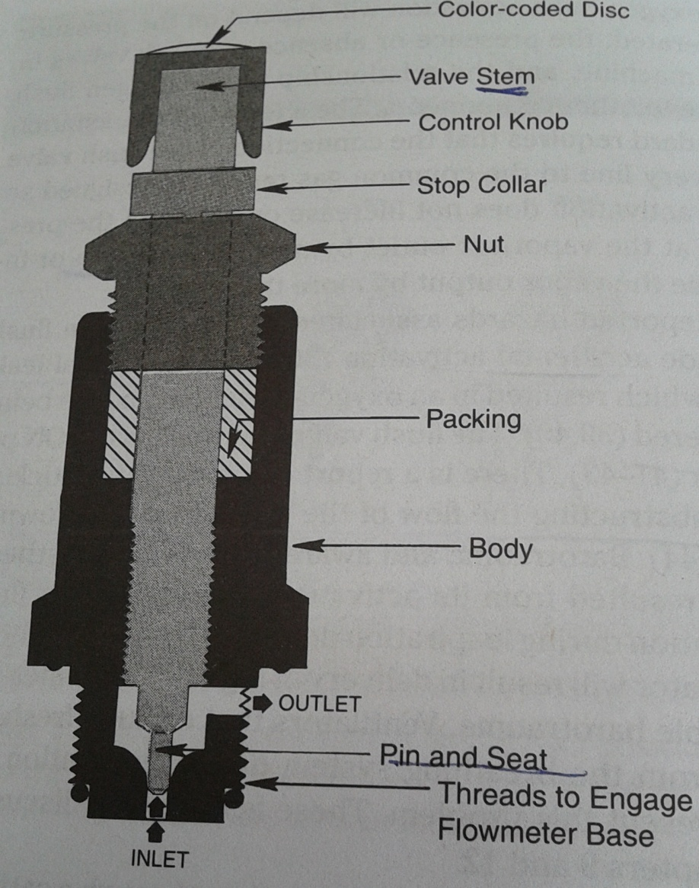
FLOW ADJUSTMENT CONTROL

Slide 29
HAZARDS:
Knob may be loose, or may respond to light touch
If knob left open then gases may leak in the atmostphere or may cause dessication of absorbent
Stem and seat can block the flow.
ELECTRONIC FLOW CONTROL VALVE:
The knob is turned on clockwise to increse the flow.
It utilizes solenoid type of valve.
There is usually a mixing area that collects the gas mixture.
Configuration is that one control alters the o2 concentration and another controls the total flow. If less than 100% o2 is desired than the difference is made up from second gas.
Fow, pressure and temperature sensors are used to maintain accuracy.

Slide 30
Low pressure system

Slide 31
LOW PRESSURE SYSTEM
Pressure in this system is only slightly above atmospheric and variable, depending on the flow from the flow control valves, the presence of back pr devices and back pr from breathing system
FLOW METERS:
It indicates rate of flow of a gas passing through them.
Made up of metal frame enclosing series of flowmeters with thransperant window.
May be mechanical or electronic (representaation of mech flowmeter on a screen or a number of flow).
MECHANICAL FLOWMETERS:
It is highly accurate with an error margin of +- 2 %. It means that lower the gas flow, higher is inaccuracy. (close circuit)
PHYSICAL PRINCIPLE:
Thorpe tube: a vertical glass tube with internally tapered with its smallest diameter at the bottom. There is an INDICATOR inside the tube which is free to move up and down inside the tube.
the indicator floats freely in the tube at a position where the downward force caused by gravity and wieght of the indicator equals the upward force caused by the gas pressure on the bottom of the indicator.
bcz the tube is tapered, the size of opening btw indicator and sides of tube (aka annulus) increases with height and more gas flows through it.
a scale marked on or beside the tube indicates the gas flow rate.
GRAHAM’S LAW: when the constriction is short and wide (high flow), flow is more turbulent and depends on gas density. (orifice)
HAGEN POISEUILLE EQUATION: when the constriction is longer and narrower (low flow), flow is more laminar and depends on gas viscosity. (tube)

Slide 32
Laminar flow
Poisullie eqation. (p1 – p@) *d4* pie / 128 *l *n
D = diameter
L = length
N = viscocity. (pascals sec)
This equation applies on newtonian fluid. Water is newtonian fluid. While blood is not.
If flow needs to be doubled. It should overcome the resistative forces that is twice as great.
Fluid resists flow bcz viscocity.

Slide 33
Turbulent flow
Reynolds number: vpd / n
V= linear viscocity
P= denstiy
D= diameter
N= viscosity
Number > 2000 indicates turbulent flow

Slide 34
Flow meters are caliberated at atmospheric pressure (760 torr) and room temp(20 C). Changes in temp or pressure affects both density and viscosityof gas. As the variation in temp is slight, it does not pose a significant problems. While with the decrease in barometric pr as in highaltitude the actual flow rate will be greater than indicated. This is because atmostpheric pr affects the gas density.
FLOWMETER ASSEMBLY:
Flowmeter tube:
They are made of glass.
Glass tube intended to have a ball indicator have 3 rib guides, which are thickened bars that run the length of the tube. As the tube widens, the space between the indicator and the inside of the tube increases, the rib guides hold the ball indicator in the center of the tube.
They can be single taper tube( where high and low flow are delivered by different tubes) lr dual taper tube( where high and low flow are delivered by same tube and they have two different tapers in the same tube)

Slide 35
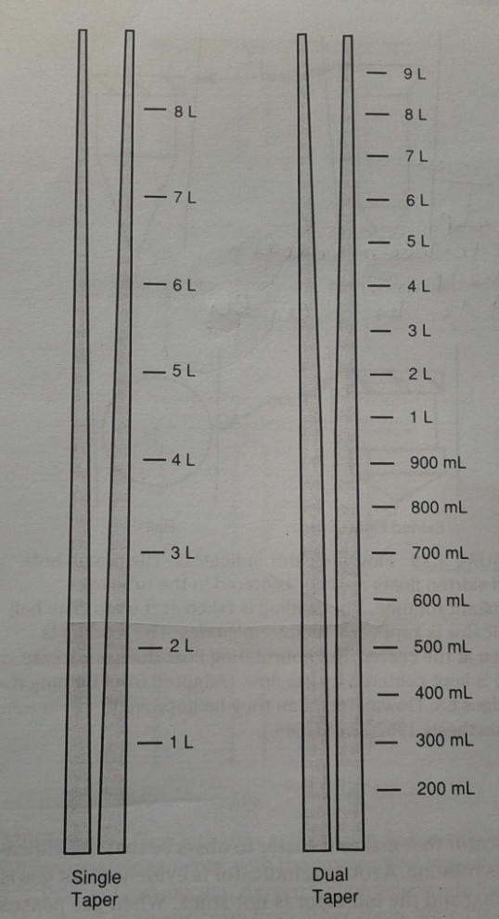
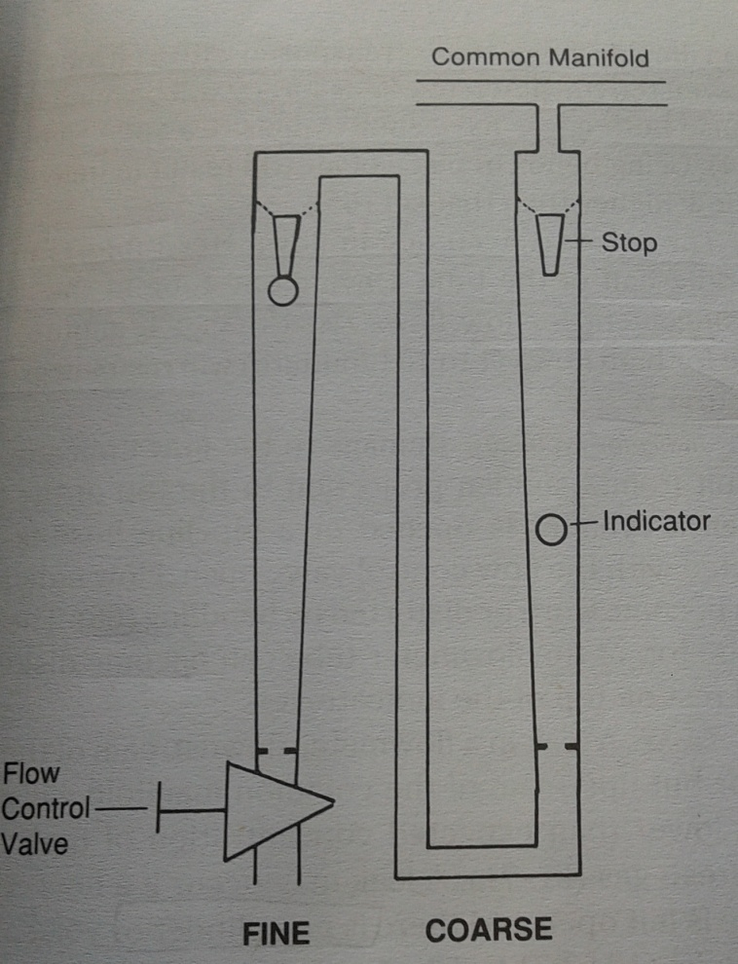

Slide 36
Indicator (float or bobbin):
Made up of aluminium
Free moving device within the tube
Bobbin should be made antistatic to prevent stickin to the wall of flow meter due to static electricity. Static electricity may alter the flowmeter output and even cause anaesthetic explosion,, spraying the outside and / or inside of the flowmeter tube with an antistatic chemical prevents the building up of static electricity.
Non rotating float type indicator: it is designed so that gas flow keeps the float in the center of the tube if tube is kept vertical. Reading is taken at the upper rim.
Rotating indicator: they have an upper rim with a lager diameter. They have slanted grooves cuted into the rim and this groove make the indicator to rotate. If the tube is vertical , then the free spinning movement will keep the indicator in the center. They have a coloured dot on one side of indicator that makes it easier to observe that the indicator is rotating. Reading is taken at the upper rim.
Ball indicator: some time it has two colours that makes it easier to observe that ball is rotating. Reading is taken at the midpoint of the ball.
Stop: it is present at a top of the flowmeter tube that prevents the indicator from plugging the outlet which could lead to damate to the tube. It also prevents the indicator to ascends in the top of the tube where it cant be visualised. It may be spring stop

Slide 37
Scale: it should be either marked on or immediately adjacent to the tube. Unit is liter / min.
Light: useful when machine is used in darkened room.
Flowmeter tube arrangement: When single taper tube is used, tubes are arranged in series (tandem). There is one flow control valve for the both flowmeter tubes. The total flow is not the sum of the two tubes but that shown on the higher flow tube. Series tube increases the accuracy.
Flow meter sequence: it can be a cause of hypoxia. Normal gas flow is from bottom to top and from left to right. So by placing the o2 flowmeter nearest the outlet, a leak upstream from the o2 will results in loss of n2o rather than o2. ASTM workstation standard requires that the o2 flowmeter should be placed on the right side of a group of flowmeter as viewed from the front. There is no consensus on the location of the air or n2o flowmeters as long as they do not occupy the location next to the outlet
Flowmeter assembly should be cleaned at regular intervals.
It should be ensured that during forced positice pressure ventilation, no liqid anaesthtic is forced back to rotameter tubes.

Slide 38
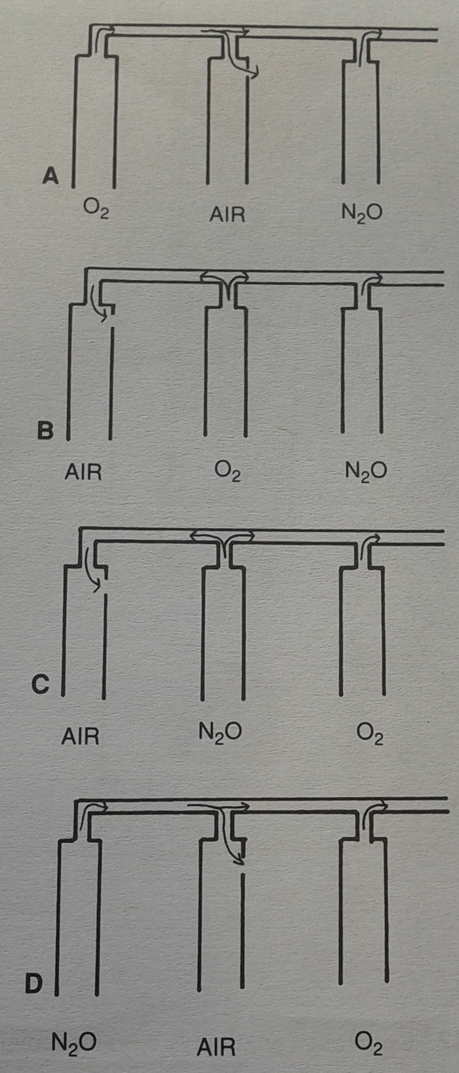

Slide 39
AUXILLARY OXYGEN FLOWMETER
It has its own flow control valve, flow indicator, and outlet.
It has short tube with max flow of 10 / min.
Placed on left side of the machine.
Its activation is independent of master switch
Newer machines it works on both the pipeline and cylinder.
PROBLEMS WITH FLOWMETER:
Inacuuracy: flowmeter scale, tube and indicator must be regarded as an inseparable unit. Tube assembly caliberated for one gas cant be used for a diggerent gas because difference in viscocity and density. The greatest accuracy in the tube is in the MIDDLE HALF of the tube in SERIES arrangements.
Indicator problems
Leaks
Using the wrong flowmeter: this commonly occurs btw n2o and air as o2 flowmeter is kept on the right side of the flowmeter assembly.

Slide 40
ELCTRONIC FLOWMETERS:
The advt of these flowmeter is that this information is avilable in a form that can be sent to a data management system.

Slide 41
HYPOXIA PREVENTION SAFETY DEVICES:
They are made to prevent the operator made the mistakes of delieveing hypoxic mixture.
Mandatory minimum o2 flow:
anaesthesia machine requires a minimum 50 to 250 ml / min flow of o2 before other gases will flow.
min flow decided by either manufacturer or user.
The minimum flow is asctivated when the master switch is turned on.
Disadvt is that a hypoxic mixture can be delivered with only modest anesthetic gas flow.
Minimum oxygen ratio:
This device protect against an operator selected delivery of a mixture of o2 and now having an ow conc below 21 % o2 in fresh gas or inspiratory gas.

Slide 42
Mechanical linkage:
This links two gases, usually o2 and n2o, mechanically. When the min set conc of o2 is reached, this linkage causes both o2 and n2o flow control valve to turn together to maintain the min set conc for o2.
Administering the third gas such as helium can results into hypoxic mixture.
Elecronic linkage:
A computer continuously calculates the max allowable n2o flow for the given the o2 flow.
Alarms.

Slide 43
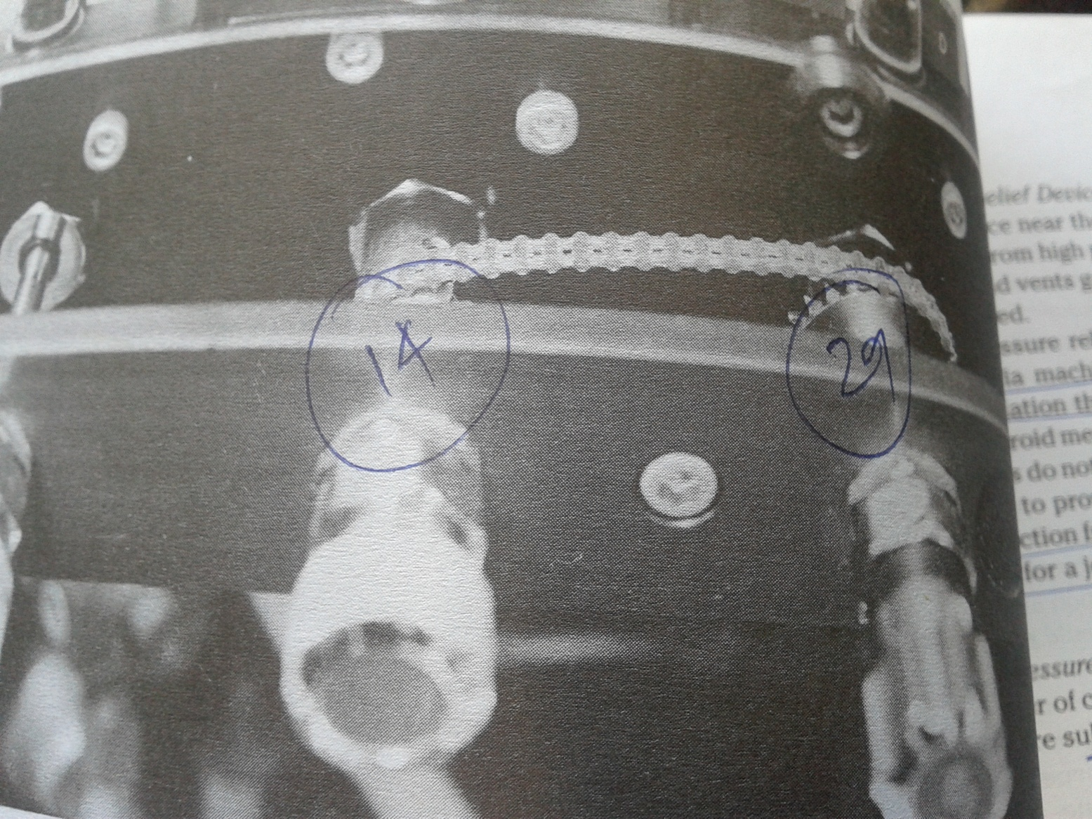
MECH LINKAGE

Slide 44
3.UNIDIRECTIONAL CHECK VALVES:
When ippv or o2 flush is applied, there is back pressure changes at flowmeter and vaporizers. So these unidirectional valves are designed to minimize these effect but they cant prevent it as gas will be continuously flowing form flowmeters.
The valve is located between the vaporizer and the common gas outlet, upstream of where the o2 flush flow joins the FGF.
Testing the breathing system for leak will not detect a leak upstream of the check valve in a machine equipped with a check valve

Slide 45
PRESSURE RELIEF DEVICES:
This device is placed near the common gas outlet to protect the machine from high pressure. The valve opens to atmostphere as preset pressure is reached and vents off the gases.
This device limit the ability of an anesthesia machine to provide adequate pressure for jet ventilation through a catheter inserted through cricothyoid membrane. Some machine provides the connection from the pipeline or intermediate pressure system for a jet ventilation devices.

Slide 46
5. LOW PRESSURE PIPING: they have large number of connections so they are subjected to leakage or breakage
6. COMMON (FRESH) GAS OUTLET:
it is a common location for disconnection.
The breathing system join the machine at the outlet.
It should not be used to administer supplemental o2 to a patient. A vaporizer on the back bar may be accidentally left on, leading to undesired administration of inhalational agent.

Slide 47
IMPORTANT ASPECTS
Power failure
Service
Choosing an anesthesia machine will depend on service, cost, size, suitability of intended use, equipment standardization.

Slide 48
CYLINDER

Slide 49
GASES
NON LIQUIFIED COMPRESSED GAS is a gs that does not liuefly at ordinary ambient temperatures regrdless of the ressure applied. E.g. o2, n2, he, air.
LIQUIFIED COMPRESSED GAS is one that becomes liquid to a large extent in containers at ambient temperature and at pressures fro 25 to 1500 psig. E.g. n2o and co2.

Slide 50
GAS CYLINDERS
COMPONENTS
BODY:
It is made up of steel. But in recent yeas steel carbon fiber cylinder (they hold more gas and are light weight). Cyliders made of aluminium (3AL OR 3ALM) are also availble especially for MRI.
It may be made up of molybdenum to withstand the high pressure
They should never be welded at the end
They have flat or concave base.
They have tapered neck at other end which is fitted with thapered screw threads that attach to the valve.
They may have integral pressure regulator or flow metering devices
2. VALVE:
It is made up of bronze or brass
It is attached to the neck of cylinder.
PORT:
It is the point of exit for the gas.
It should be protected by covering during transit.
STEM:
It is a part of valve body, that is rotated during valve opening.
To close the valve, the stem seals against the seat that is part of valve body and prevent the exit of gas.
To open the valve, the stem moves upwards from the seat and allows the gas to flow through port

Slide 51
PACKED VALVE☹FIG 1.2)
Most cylinder valve are of the packed type where the stem is sealed by a resillient packing such as teflon, which prevednts leaks around the threads. It is of direct acting type bcz turning the stem causes seat to turn.
DIAPHRAGM VALVE: (FIG 1.3)
Closure btw cylinder interiour and atmostphere is accomplished by sunig a seal, metatl o meta and a bonnent nut that clamps one or more circular disks in place.
These disk is separates stem into the upper and lower part, upper stem is actuated by manual or automatic means while lower stem controls the flow.
Advt:
It can be opened fully by one half to three quarter turn, whereas the packed valve requires tow or three full turns.
Seat does not turn and there fore less likely to leak.
No stem leakage can occur because of disk or diaphragm.
It is more expensive. So used when the pressurees are relatively low and no leaks can be allowed as with flammable gases

Slide 52
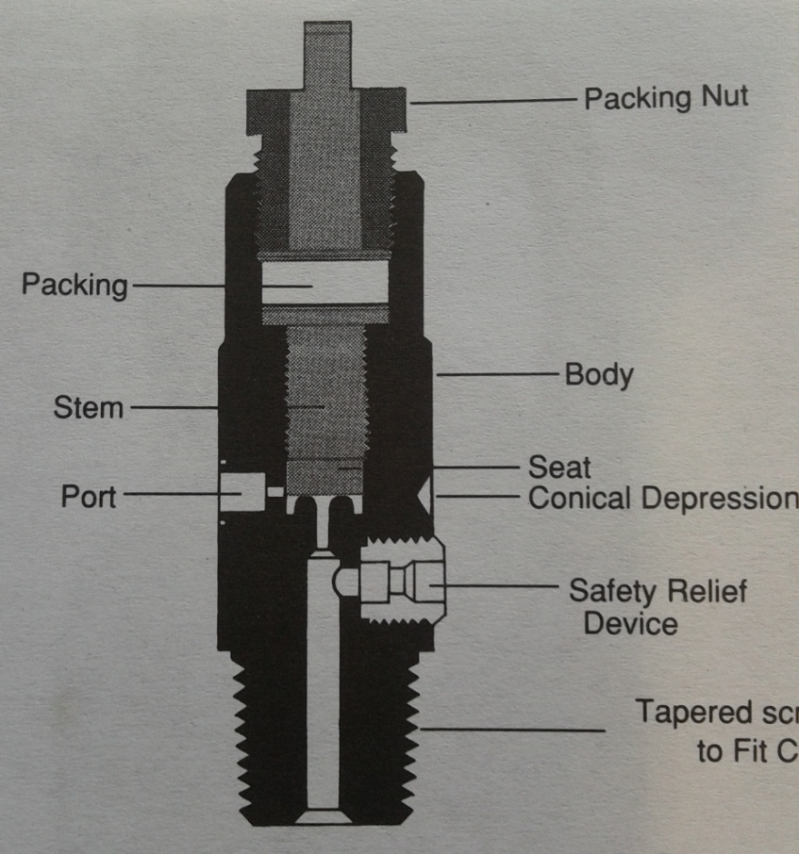
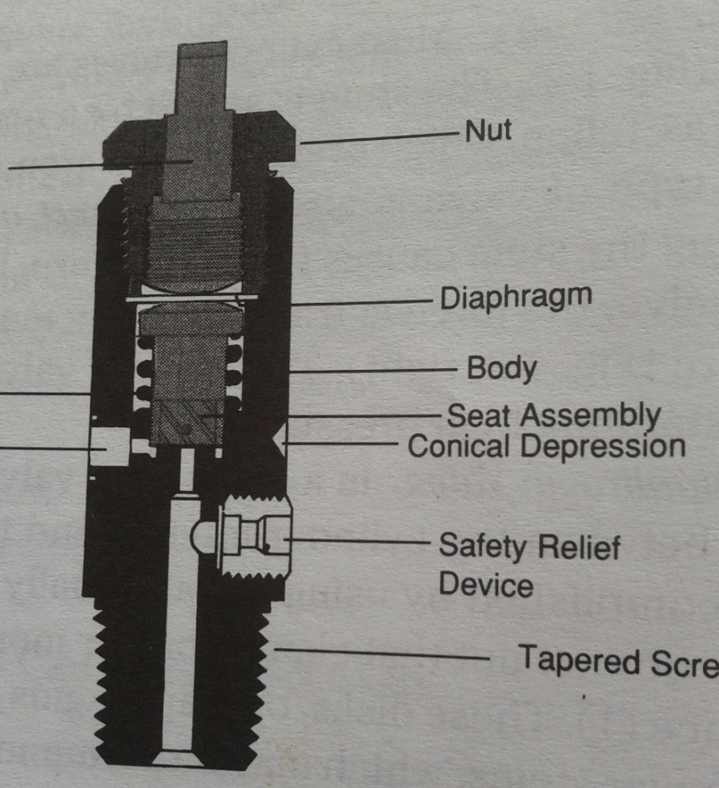
PACKED VALVE
DIAPHRAGM VALVE

Slide 53
3. HANDLE OR HANDLE WHEEL (SPANNER):
Turned counterclockwise to open the cylinder and this causes the stem to turn
it is good practice to attach a handle to each anesthesia machine.
4. PRESSURE RELIEF DEVICES: the purpose of this device is to vent the cylinder s contents to atmostphere when the pressure of the encosed gas increases to dangerous level. They may be cause of leakage.
Types:
RUPTURED DISC:The burst pressure is pressure at which disc is designed to rupture. It protects against excess pressure as a result of high temperature or overfilling. It is of non reclosing type.
FUSIBLE PLUG: the yield temperature is temperature at which the fusible material becomes sufficientlay soft to extrude from its holder so cylinder contents are discharged. (212 f). It protects against high pressure caused by high temperature but not against high pressure caused by overfilling. It is thermally operated and it is also non reclosing type.
COMBINATION OF ABOVE TWO: as this device acts only in the presence of both excessive heat and excessive pressure, they do not provide protection agaisnst high pressure caused by overfilling.
PRESSURE RELIEF VALVE: They are spring loaded device designed to reclose so prevents the discharge of gases once the normal pressue is achieved. They are more susceptible to leak.

Slide 54
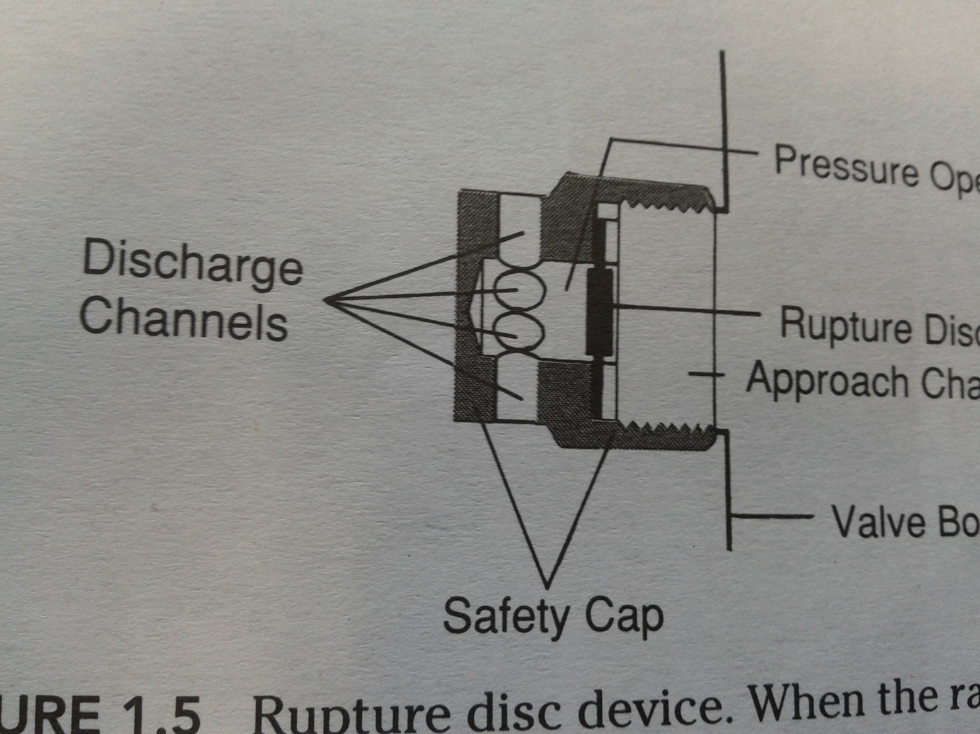

Slide 55
5. CONICAL DEPRESSION:
It is present above safety relief device.
It receives the retaining screw of yoke

Slide 56
6. NON INTERCHANGABLE SAFETY SYSTEM:
It is located btw cylinder valve and the pressue regulator.
PIN INDEX SAFETY SYSTEM:
Introduced in 1952.
A line is drawn through the centre of valve outlet at an angle of 30 to the rivht of valve face.
Other of position are located at intervals of 12.
Diameter of voalve outlet is 7 mm +- 0.2 mm.
Distance btw centre of valve outlet and the centre of pinhole is 14.3 mm and the diameter of pinhole Is 4.8 mm +- 0.1 mm
It consists of holes on the cylinder valve positioned ia na arc below the oulet port.
Pins on the yoke are designed to fit into these holes for particular gas.
It is possible for the yoke to receive any cylinder valve if pins are not on the cylinder.
The pins are of 4 mm in diameter and 6 mm in length except pin 7 which is more thicker.
The 7 hole positions are on the circumference of a circle of 9 / 16 inch radius centered on the port.

Slide 57
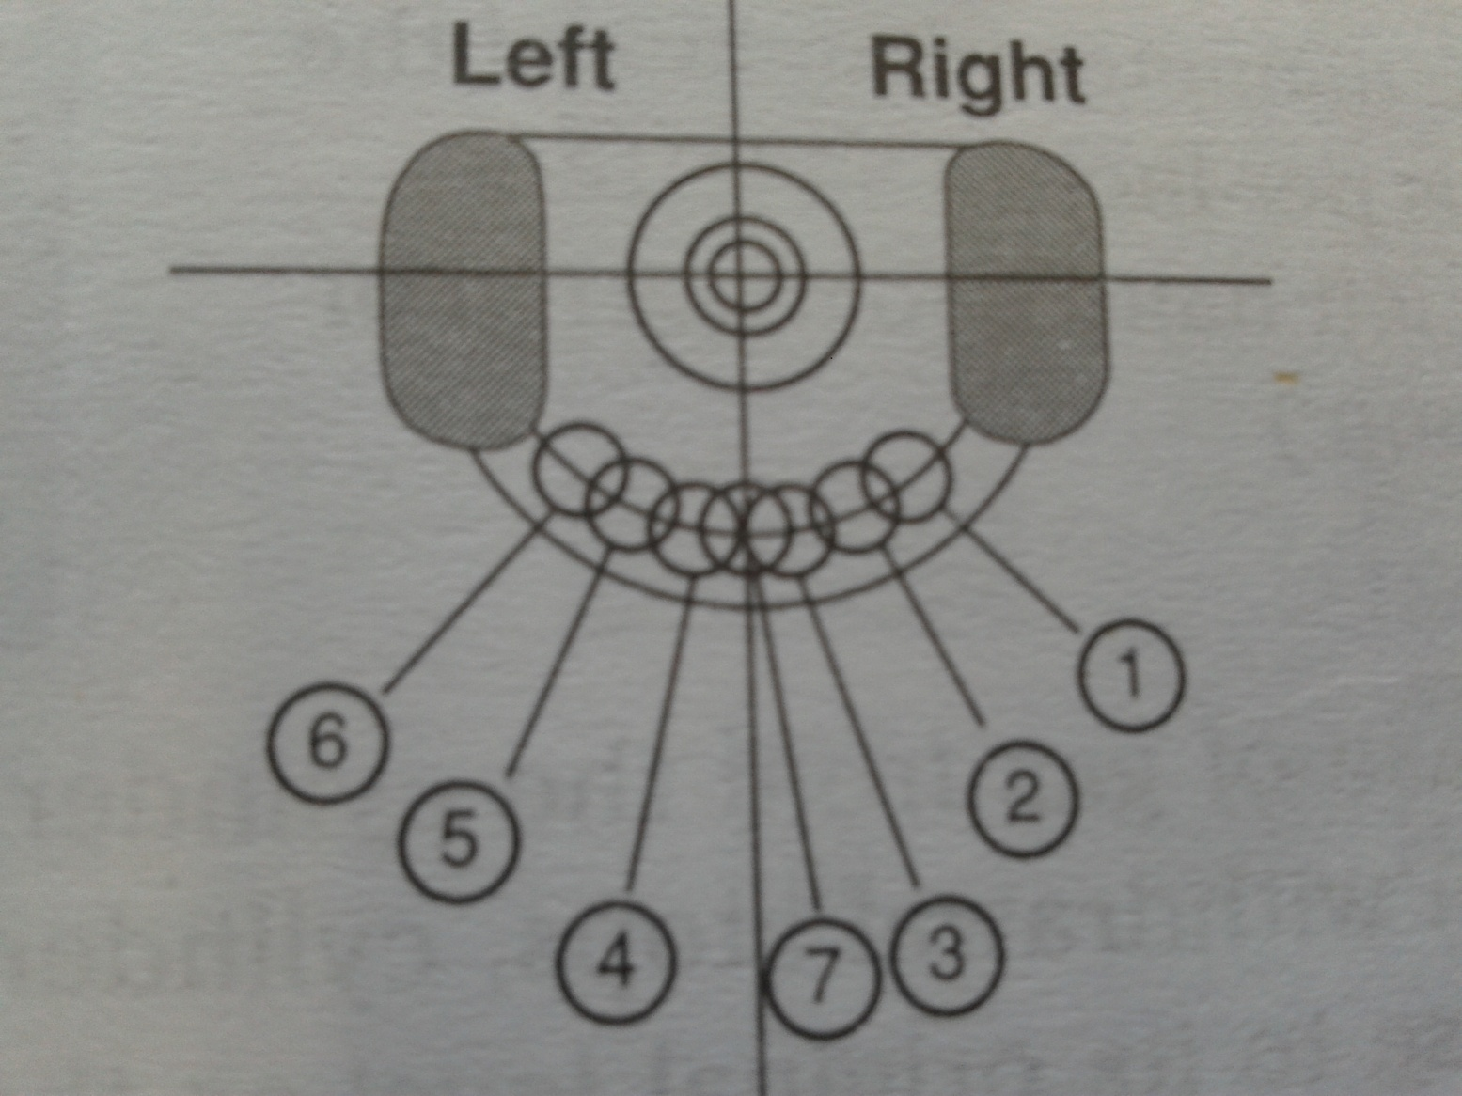

Slide 58
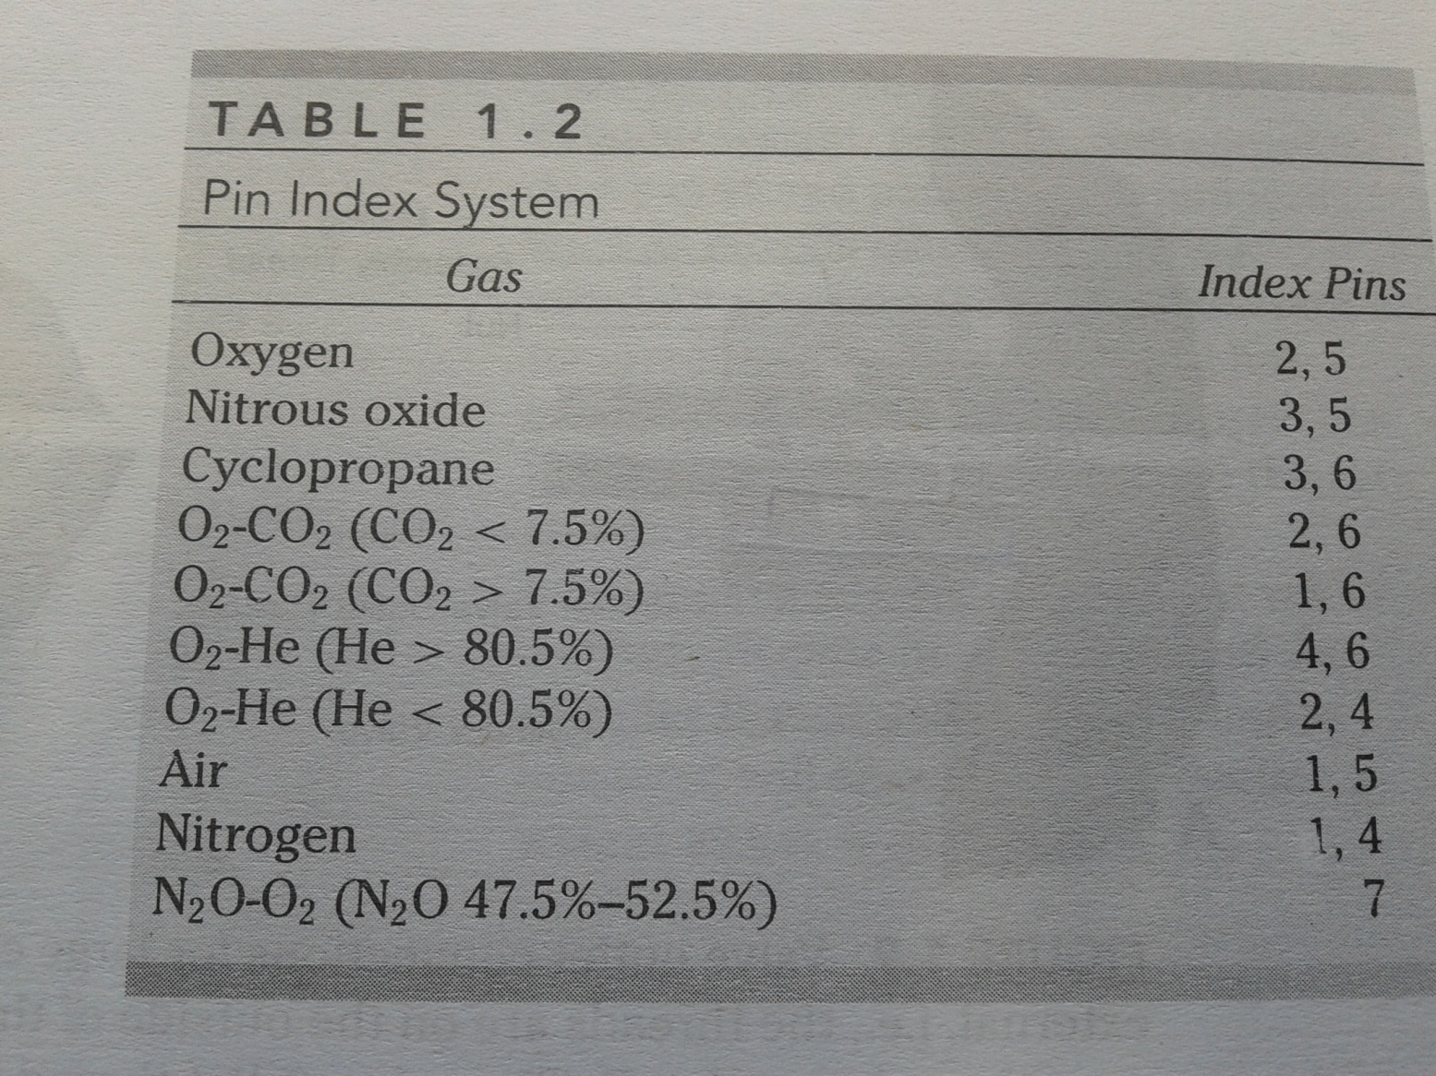

Slide 59
gas | Pressure inside full cylinder (lb / inch 2) | Capacity in E size cylinder | Colour code
Oxygen | 2000 | 625 | Black with white shoulder
Nitrous oxide | 750 | 1590 | Blue
Carbon dioxide | 720 |  | Grey
Cyclopropane | 75 |  | Orange
Entonox | 2000 |  | Blue with white/ blue quarters

Slide 60
B. VALVE OUTLET CONNECTIONS FOR LARGE CYLINDERS:
Large cylinder have threaded outlet (BULL NOSE)
It may be external or internal thread, right handed or left handed, dimeter of cylinder outlet, thread size.

Slide 61
CYLINDER
SIZES
AA (Smallest), thereafter as alphabet increas, the cylinder size increase.
Size E is the most commonly used cylinder for anesthesia machines.
Size H is used for pipeline system

Slide 62
CYLINDER
CONTENTS
Cylinder containing non liquified gas, the pressue declines steadily as the contents are withdrawn. Therefore the pressue can be used ot measure the cylinder pressure.
Cylinder containing liquified gas, the pressue depends on vth vapore pressue of the liwquid and is not an indication of the amoun to fas remaininf in the cylinder as ong as the contents are partly in the liquid phase. So the pressure remains nearly constant until all the liquid has evaporated, after which the pressure declines untill the cylinder is exhausted. Weight can be used to determine the amount of liquid in these cylinder. In practice, weighing cylinder is awkward and not done routinely, while cylinder pressure is observed to confirm that cylinder is fully empty of not.
BOX FROM PAUL

Slide 63
CYLINDER
PRESSUE
Evaporation of liquid and expansion of a gas requires energy in the form of heat, which is supplied mainly by liquid in the cylider, this results in cooling. So if the outer surface of the cylinder containing liquiefied gas is cool, it suggests that residual liquid remains in the cylinder.
As the temp falls, the vapor pressure of the liquid also falls so that a progressive fall in pressure accompanies the release of gas from the cylinder.
If liquid remains when withdrawal stops, cylinder pressue will slowly rise to its original level as temp rises.

Slide 64
CYLINDER
TESTING
PAUL

Slide 65
CYLINDER
FILLING

Slide 66
CYLINDER
COLOR
It should be non fading, durable, water insoluble paint.
In the case of a cylinder containing more than one gas, the colour must be applied in a way that will permit each color to be seen when viewed from the top.
Color coding is commonly used on hoses, connectors, knobs, gauges on medical equipments.
A number of countries besides the U.S. use a color code that differs from international code,.
Box from paul
Because of variation in color tones, chemical changes in pain pigments, lighting effects and difference in color perception by personnel, color should not be used as the primary means for identification of cylinder contents,
Cylinder LABELS are the best method to identify the cylinder contents.
Colour coding wil help in identifying contents from a distance and for sorting purpose and provides a useful checon labelling accuracy.

Slide 67
CYLINDER
MARKINGS
3A 2015: cylinder made up of steel and service pressure is 2015 psig at 70 f
8643: serial number
Manufacturers name
Owners name or symbol
Test date in month and year
Retest date in month and year
5 pointed star: it indicates that cylinder is retested at 10 years instead of 5 years.
+ sign: it indicates that cylinder can withstand excess 10 % pressure than the service pressure marked on the cylinder
SPUN: cylinder have the bottom end closure produced by spinning
PLUG: cylinder have the bottom end closure produced by spinning drilling and plugging.

Slide 68
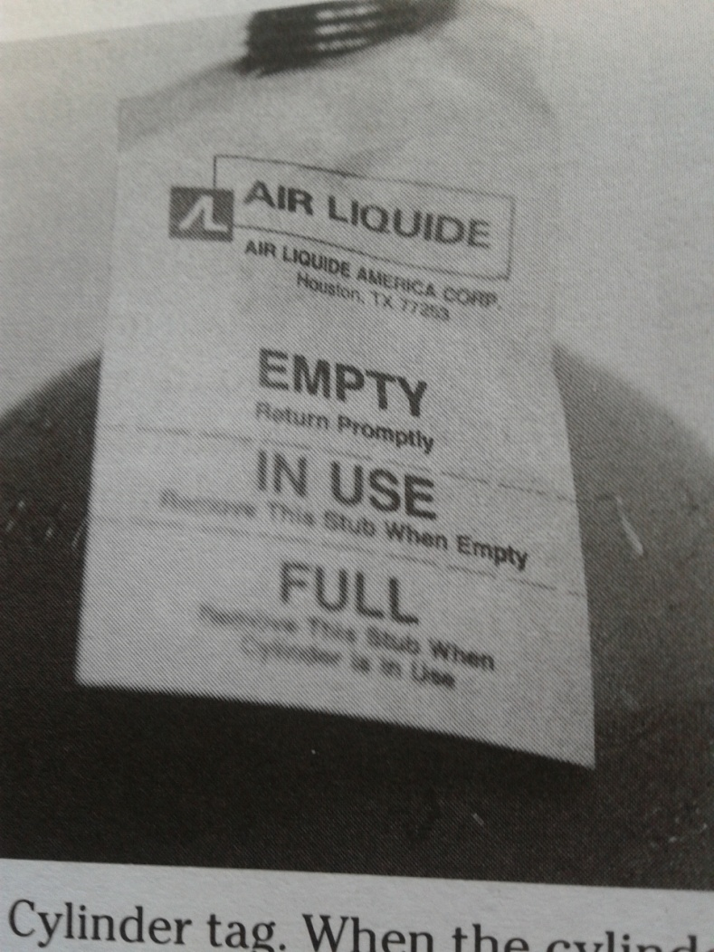
CYLINDER
TAGS
It may be color coded.

Slide 69
IMPORTANT ASPECTS
No part of any cylinder ever be subjected to a temp above 54 c or below -7 c. entonox cylinder should not be kept below 10 c.
Valve should be turned off by using no more forece than necessary to prevent damage to the seat.
The valve is the most eadily damaged part of the cylinder
Cylinders should not be dragged, dropped slide or rolled even for short distance, they are transported by using a cart or carrier made especially for that purpose.
They should never be lifted by the valve.
Deposition of unserviceable cylinders is potentially dangerous and should be done by qualified personnel

Slide 70
The storage area for cylinder should be cool, clean and constructed fo fire resistant materials with adequate ventilation.
Cylinders of nitrious oxide should be stored where the theft of these cylinders is minimized.
Cylinders containin flammable gases should not be kept with oxidizing gases such as o2, n2o and compressed air.
Combustile material should not be kept near cylinders containing oxidizing gases except in shipping cartons wher storage racks are made up of wood.
Small cylinders are best stored in upright positions
Wrapping should be removed from cylinders before the storage
Cylinders should not be drapped.
If the label of cylinder is missing, altered or color and label do not correspond, the cylinder should be retured to the manufacturer unused.

Slide 71
More than one washer should not be used in any case.
The spanner should never be hammered in an attempt to open or close the valve
The person opening the cylinder valve should be positioned so that the valve outlet and or the fae of the pressure gauge points away from all persons.
Cylinder should be open slowly bcz risk of explosion
The cylinder valve should be open slowly till the pressure on the gauge stabilizes and then fully opened.
To detect a leak soapy water can be used.
The valve should always be open when a cylinder is in use.
An empty or nearly empty cylinder should not be kept on anaesthesia machine bcz the risk of transfilling.
The valve should be closed before removing a cylinder from the yoke

Slide 72
hazards
Incorrect cylinder
Incorrect contents
Incorrect valve
Incorrect color
Incorrect labelling
Inoperable valve
Damaged valve
Asphyxia: sudden discharge of large quantity of gas other than o2 from a cylinder into a closed space could displace the air from that spacek, creating a dangerous condition
Fires.
explosions:
Projectile damage: specially to valve should be taken care of.
Nitrous oxide theft
Thermal injury: frost bite
Blocked flow meter:

Slide 73
Contaminated cylinders content:
Medical grade oxygen is required to be 99% pure o2.
Of the remaining 1% or 10000 ppm, not more than 300 ppm of co2, 10 ppm of co, or 5 ppm of n2 cn be present,
No other contaminants are specifically excluded from other 9685 ppm.
A cylinder should not be used if the gas has an odour.

Slide 74
THANKS

