Slide 1

SAI Digital Training
Crafts you can bank on!

Slide 2
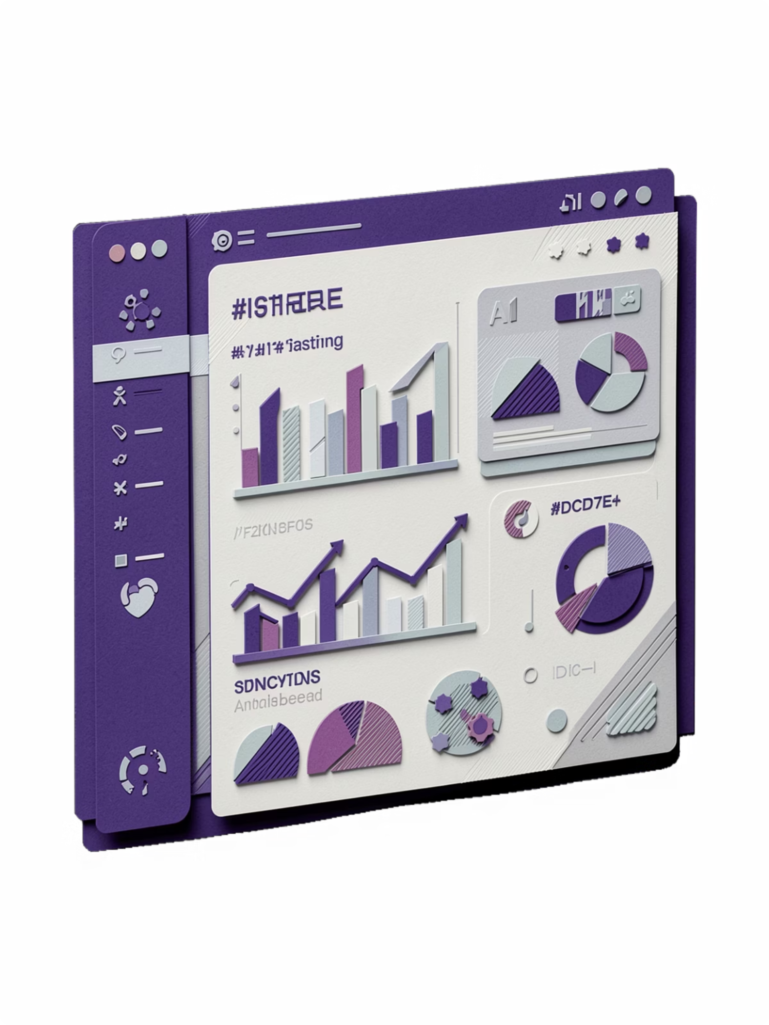
Complete Digital Marketing + AI Programme
Become a certified digital marketing expert in just 45 days. Master 10 essential modules with industry-leading trainers, live projects, and guaranteed placement assistance. Limited seats available.

Slide 3





Why SAI Digital Training
Expert Trainers
Live Projects
Learn from certified professionals with real-world experience
Hands-on case studies that mirror actual industry scenarios
Placement Assistance
Certification
100% job placement support with internship opportunities
Industry-recognised credentials to boost your career

Slide 4

Master 10 Essential Modules
1
2
Digital Marketing Basics + AI
SEO + AI
Foundational principles enhanced with artificial intelligence tools
Search engine optimisation techniques powered by AI insights
3
4
Google Ads
Meta Ads
Paid advertising campaigns across the Google ecosystem
Facebook and Instagram advertising strategies for maximum reach
5
6
WordPress + Canva
Email Automation
Content creation and website management platforms
Automated email campaigns that drive engagement and conversions
7
8
YouTube
AI Content Creation
Video marketing and channel optimisation techniques
Generate compelling content using cutting-edge AI tools
9
10
Analytics
Career Support
Data-driven decision making with comprehensive analytics platforms
Resume building, interview preparation, and ongoing career guidance

Slide 5

45 Days to Career Transformation
Fast-Track Learning
Job Ready
Accelerated 45-day intensive programme designed for aspiring digital marketers and career-switchers seeking practical, fast-track training with AI emphasis.
100% practical training with live projects, industry certifications, and placement assistance. Start earning in digital marketing within 45 days.

Slide 6
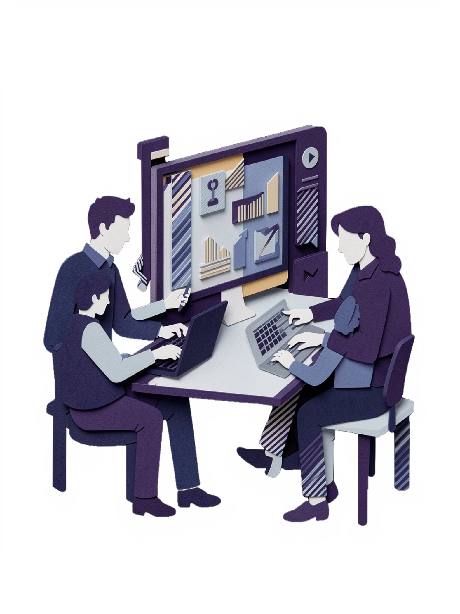



100% Practical Training
Hands-On Projects
Work on real campaigns and case studies
Industry Certifications
Earn recognised credentials
Job Ready Skills
Master tools employers demand

Slide 7

Placement Assistance
1
Internship Placement
Hands-on experience with real clients
2
Career Guidance
Personalised job search support
3
Interview Preparation
Resume building and mock interviews
4
Job Connect
Direct access to hiring partners

Slide 8




Who Should Enrol
Career Switchers
Recent Graduates
Aspiring Entrepreneurs
Freelancers
Transition into digital marketing from any background
Launch your career with in-demand skills
Expand your service offerings and client base
Master digital tools to grow your business

Slide 9

Enrolment Details
Duration
Format
Certification
45 Days Intensive Programme
Live Classes + Practical Projects
Industry-Recognised Certificate
Limited Seats Only! Book your free demo class today and secure your spot in the next batch.

Slide 10

Ready to Transform Your Career
Book Your Free Demo Class Today
Call Us
Visit Us
+91 83092 64432
www.saidigitaltraining.com
Start your journey to becoming a certified digital marketing expert with AI skills that employers demand.

