Slide 1

SAI Digital Training
Crafts You Can Bank On

Slide 2
Business Owners Course
1 Month Practical Training
Transform your business with digital marketing and AI in just 30 days. No fluff, no theory—just actionable strategies that generate leads and increase sales from day one.

Slide 3




Grow Your Business with Digital Marketing + AI
Grow Your Business
Get More Leads
Increase Your Sales
Scale your operations with proven digital strategies
Generate consistent high-quality leads daily
Convert prospects into paying customers

Slide 4
Expert-Led Training That Delivers Results
Expert Trainers
Lead Generation Focus
Learn from industry professionals with proven track records
Strategies designed specifically to attract qualified prospects
Sales Growth Strategy
Practical Implementation
Turn leads into revenue with proven conversion techniques
Hands-on exercises you can apply immediately to your business

Slide 5
6 Comprehensive Modules
Master every aspect of digital marketing that drives business growth
01
02
Business Strategy + AI
Website / Landing Page
Build a digital-first business model
Create conversion-optimised pages
03
04
Meta Ads (Main Focus)
Google Ads Basic
Master Facebook & Instagram advertising
Reach customers searching for your services
05
06
WhatsApp Marketing
Canva Designing Basics
Convert leads through messaging platforms
Create professional graphics for campaigns

Slide 6
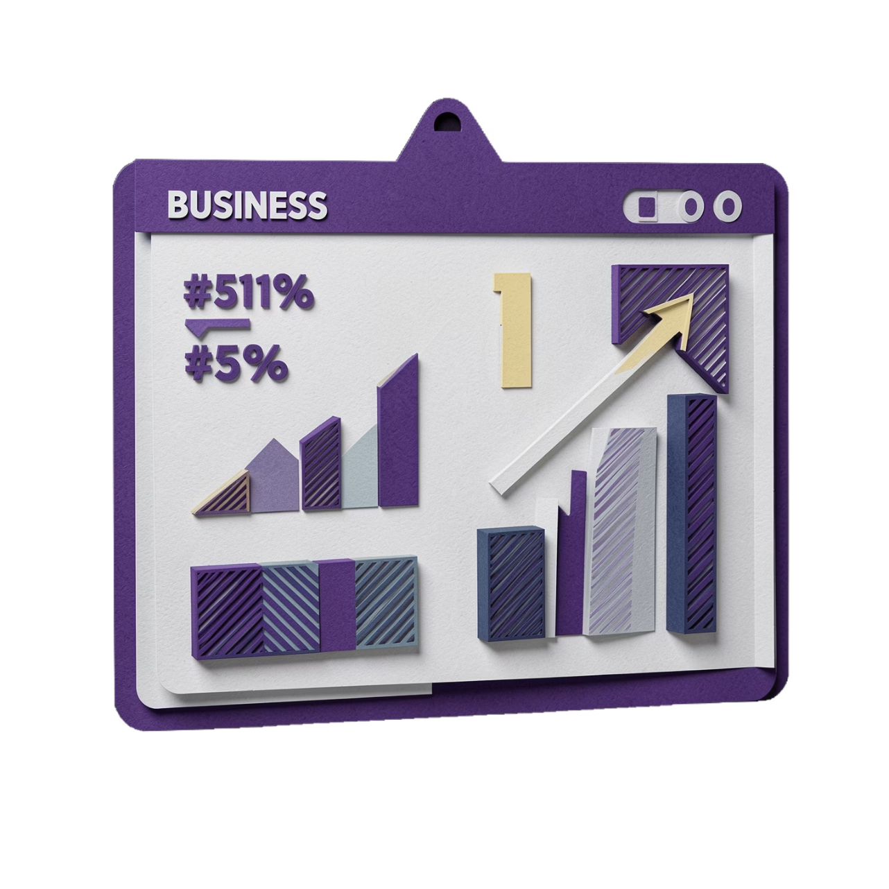
Why This Course Works for Business Owners
ROI-Driven Content
Zero Fluff
Every module focuses on generating measurable returns
Only practical, implementable strategies covered
Fast Implementation
Apply what you learn immediately to your business

Slide 7

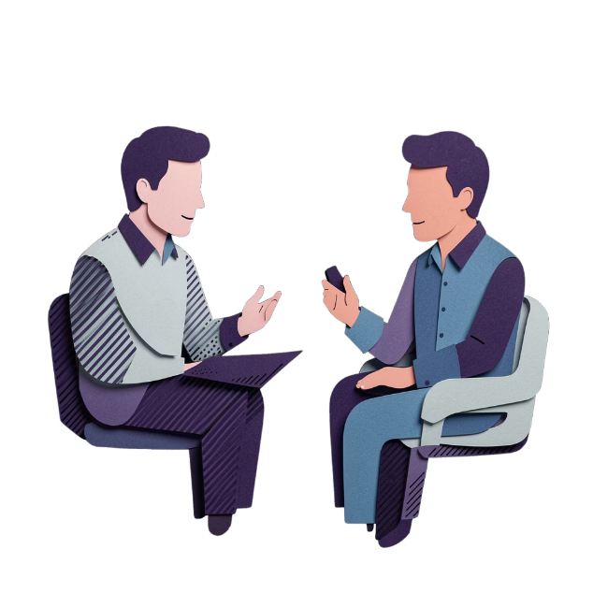
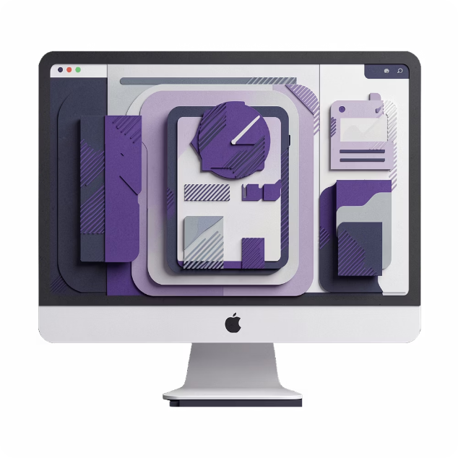
Premium B2B Training Experience
Professional Environment
Personalised Attention
Ready-to-Use Templates
Premium B2B training designed for serious business owners
Expert trainers provide implementation support throughout
Professional templates you can deploy immediately

Slide 8
Limited Seats Available
1 Month = More Sales
Free Demo
Stop Depending on Referrals
Meta Ads, Landing Page, WhatsApp Automation
See the course before you commit
Build a predictable lead generation system

Slide 9
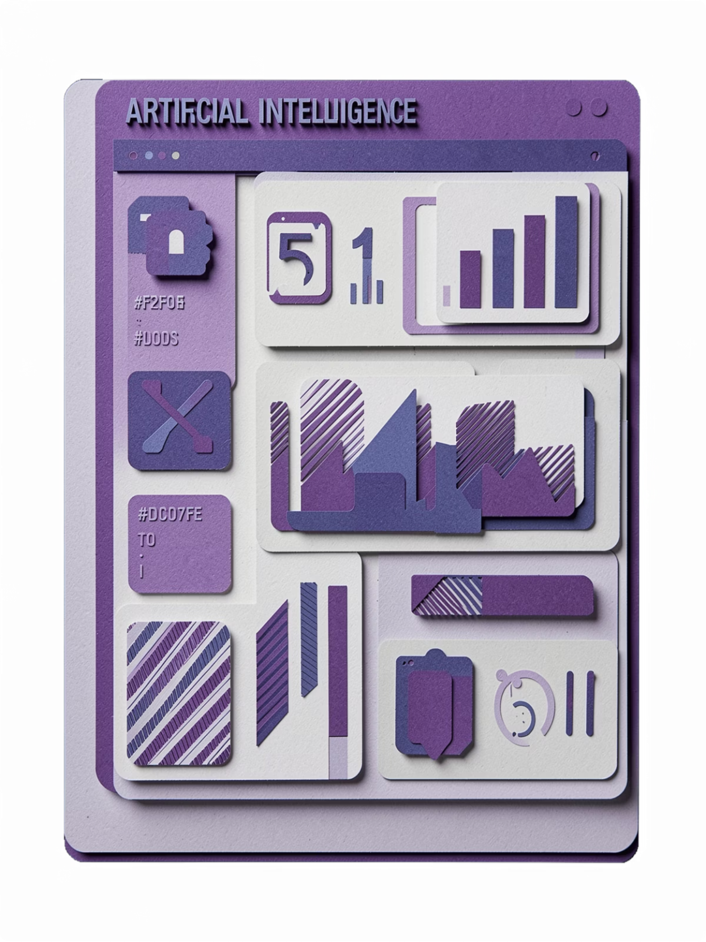
Bonus: AI Tools + Templates
Implementation Support Included

Slide 10
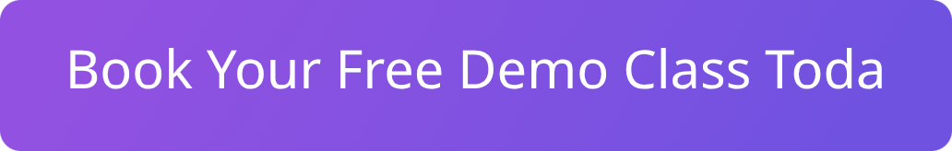
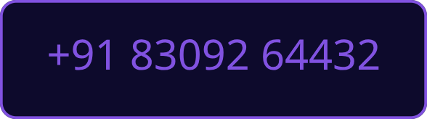
Ready to Transform Your Business?
Stop depending on referrals. Build a predictable lead generation system that works day in, day out.
Connect on WhatsApp | http://www.saidigitaltraining.com

