Slide 1

SAI Digital Training
Crafts You Can Bank On!
Kids Digital Creation Course
Learn • Create • Grow
3-week course for kids ages 10–16

Slide 2

Smart Kids = Better Future
Learn Practical Skills
Be Creative & Innovative
Real digital tools and techniques, not just theory
Design posters, create AI art, edit videos, and more
Build Confidence
Prepare for the Future
Showcase your work and learn through doing
Safe AI and digital awareness for tomorrow's world

Slide 3
Designed for Young Creators
01
02
03
Beginner-Friendly Learning
Creative & Practical Sessions
AI Tools Introduction
No prior experience needed – start from scratch
Hands-on learning in every single class
Safe, age-appropriate AI basics
04
05
Fun Projects & Activities
Boost Creativity & Confidence
Quizzes, challenges, and interactive games
Watch your skills grow with every lesson

Slide 4
7 Modules in 3 Weeks
Week 1: Foundations
1
2
3
Basics of Internet & Digital World
Canva Designing
AI Image Generation Basics
Create eye-catching posters, invitations, and social media graphics with professional templates
Learn safe browsing practices, explore essential digital tools, and understand online safety
Generate and edit stunning images safely using beginner-friendly AI tools

Slide 5
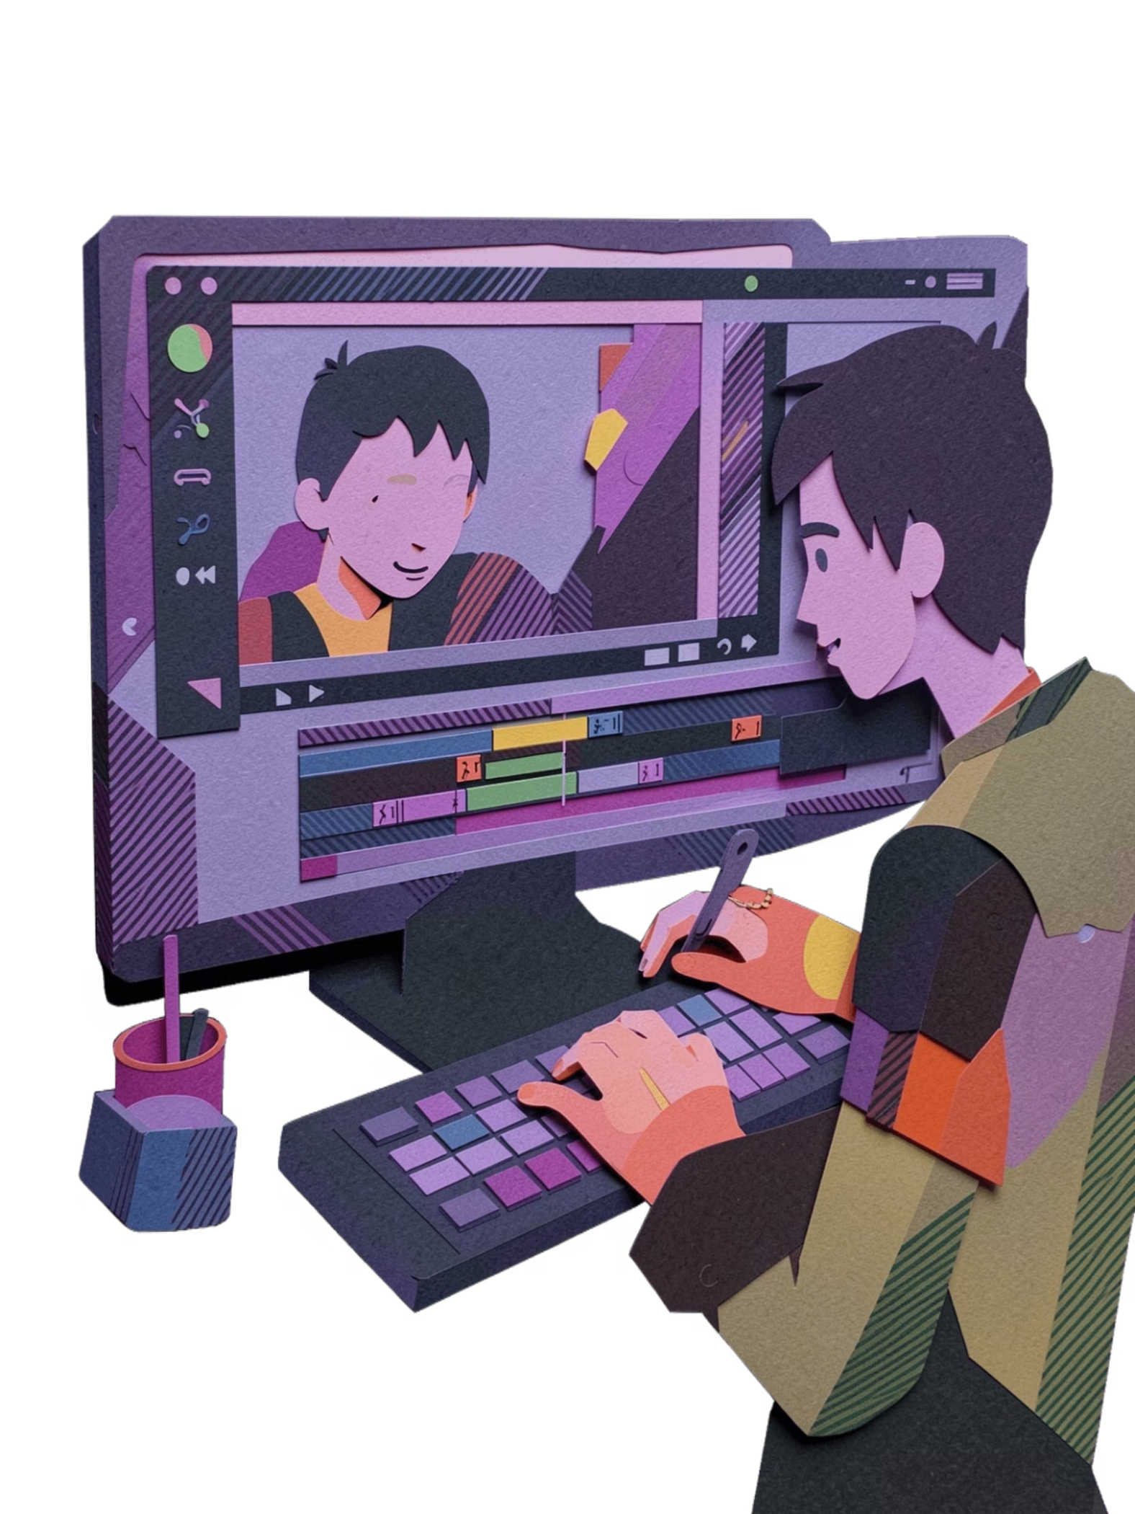
Week 2: Building Skills
YouTube Basics
Explore kid-friendly content ideas, learn video planning, and understand platform safety
Creative Storytelling with AI
Write engaging stories, develop characters, and generate ideas with AI assistance
Basic Video Editing
Cut, trim, add music and effects to create professional-looking videos

Slide 6
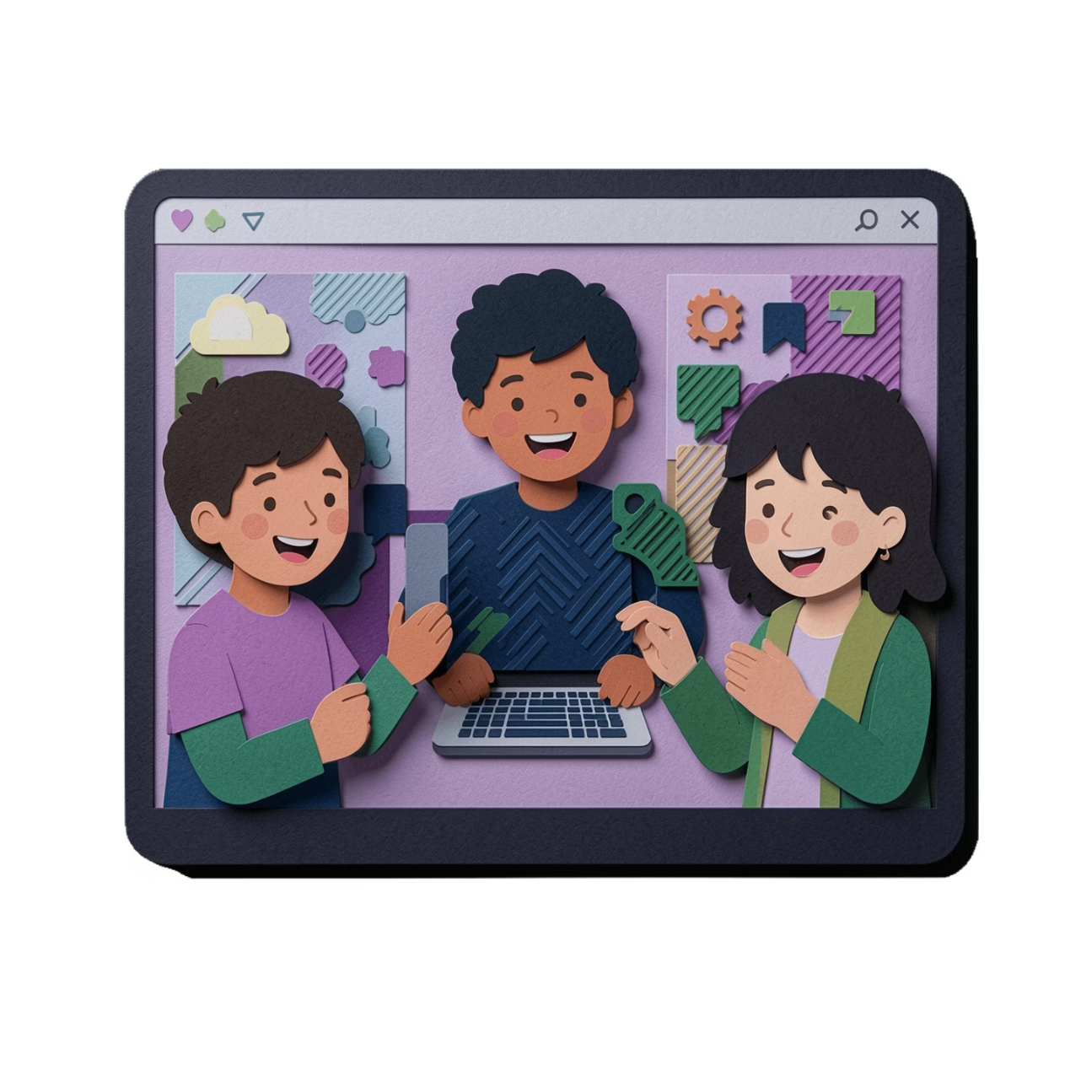
Week 3: Showcase & Celebrate
Fun Digital Projects
Put everything you've learned into action! Create mini projects that showcase your new skills. Build a portfolio of work you can be proud of and share with family and friends.
Bonus: Certificate of Completion – Recognise your achievement with an official certificate

Slide 7
Everything Parents Need to Know
Duration
Mode
3-week intensive course with consistent progress
Online & offline training options available
Outcome
Support
Creative digital skills for life
Parental guidance and regular updates included

Slide 8
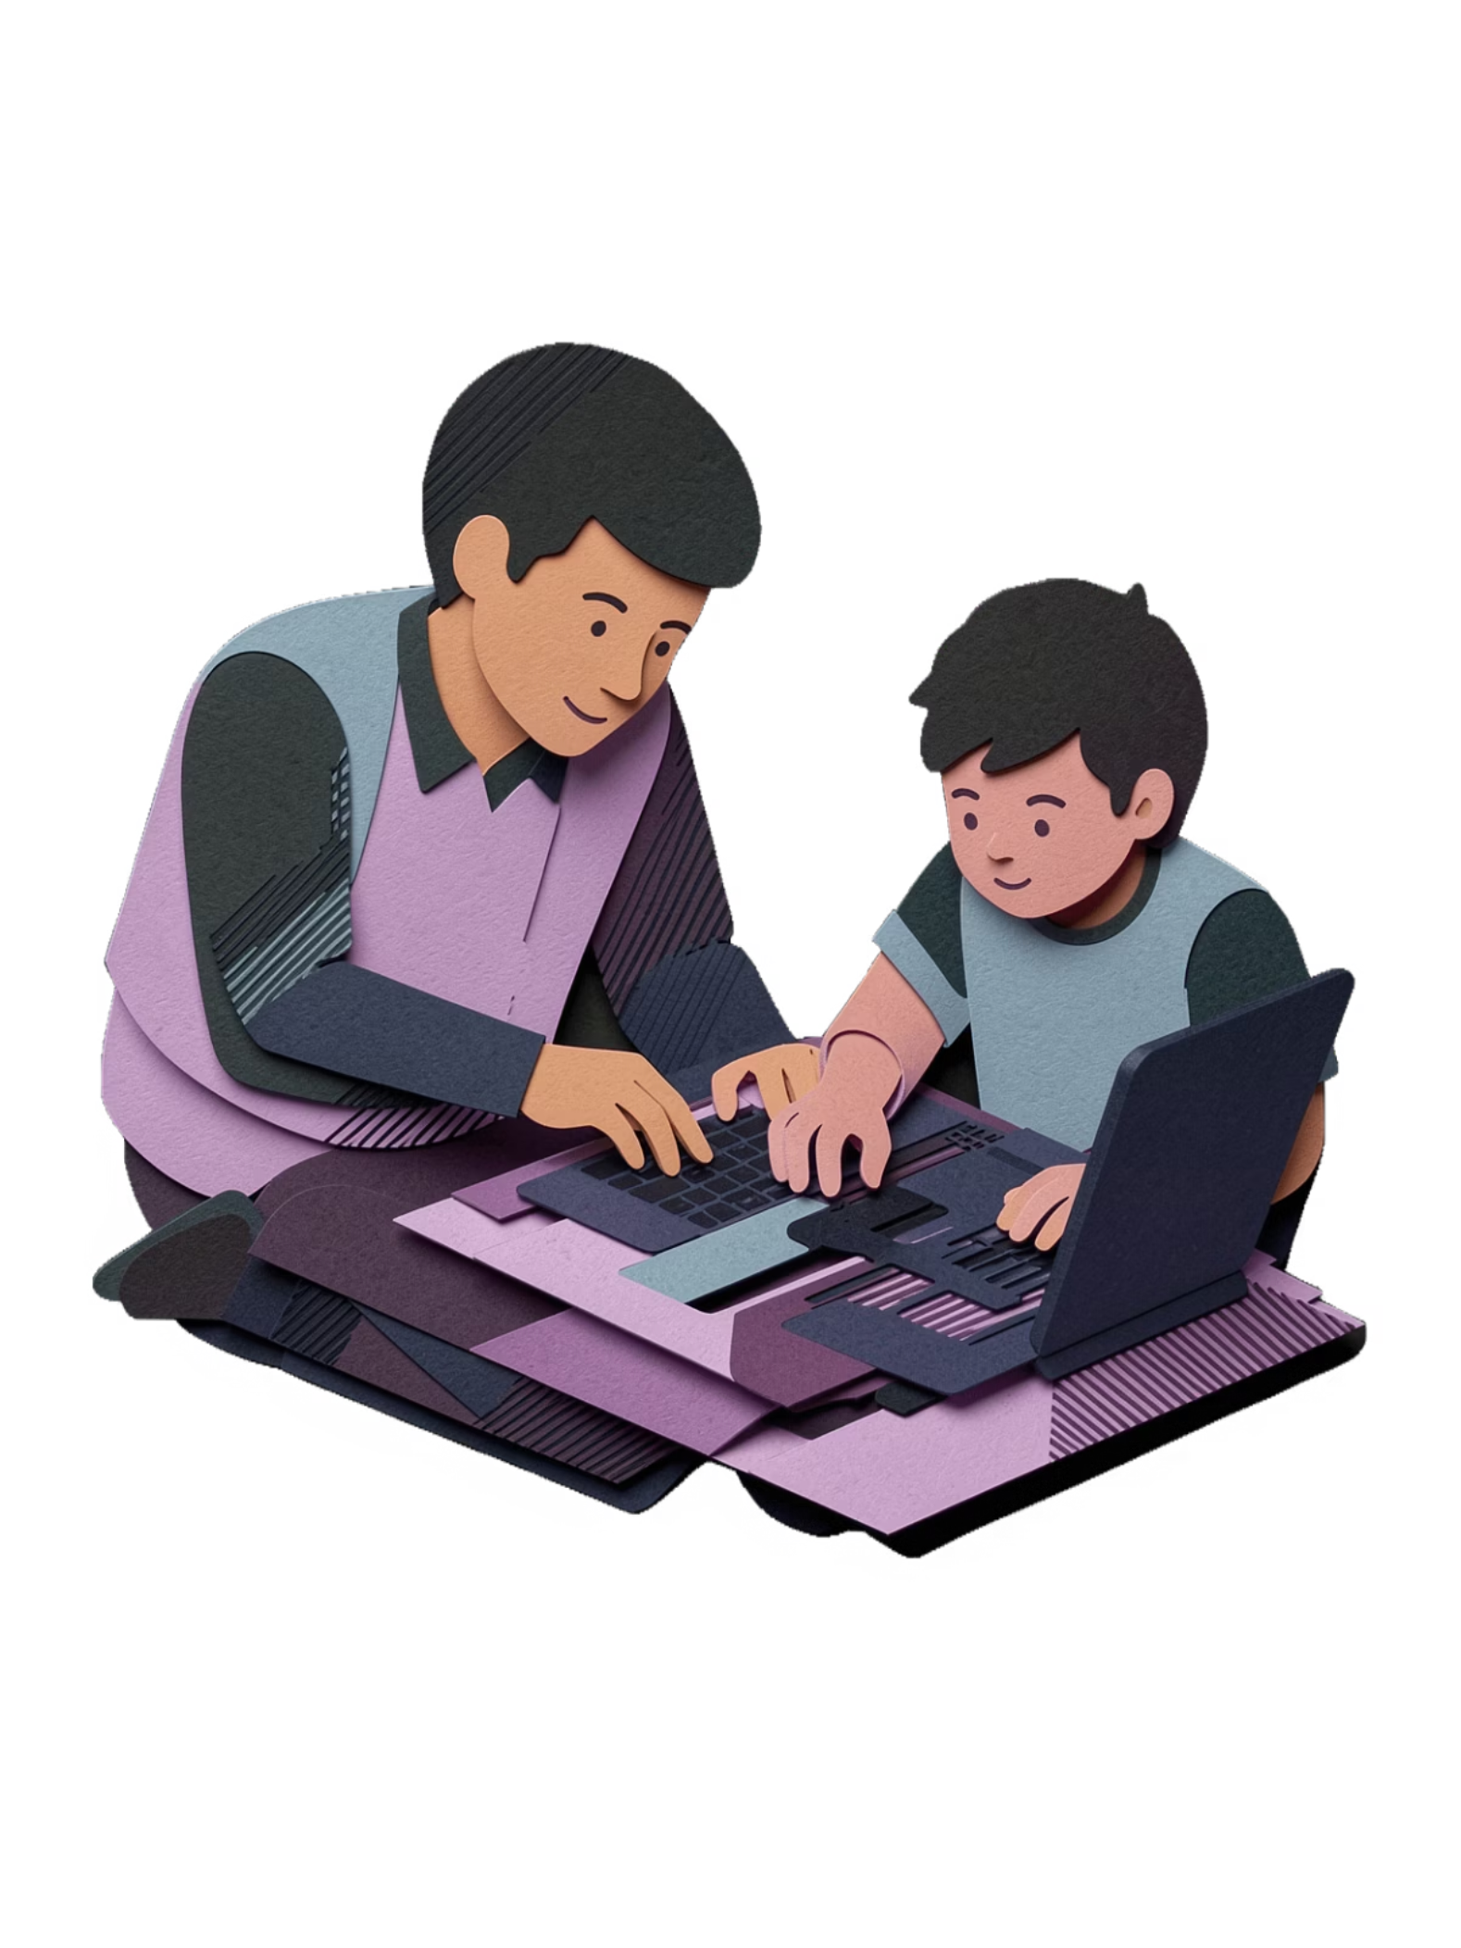
Why Parents Choose Us
Safe & Secure Environment
All activities are age-appropriate with proper online safety measures
Expert Instructors
Trained teachers who understand how to engage young learners
Interactive Learning
Quizzes, challenges, and games keep kids engaged throughout
Future Ready Skills
Prepare your child for tomorrow's digital world

Slide 9
Enrolment Information
Limited Seats!
Flexible Options
Certificate Included
Hurry up – classes fill quickly
Choose online or offline training
Official completion certificate
Contact Information
📞 +91 83092 64432 / 6301676233
🌐 www.saidigitaltraining.com
💬 Connect on WhatsApp

Slide 10
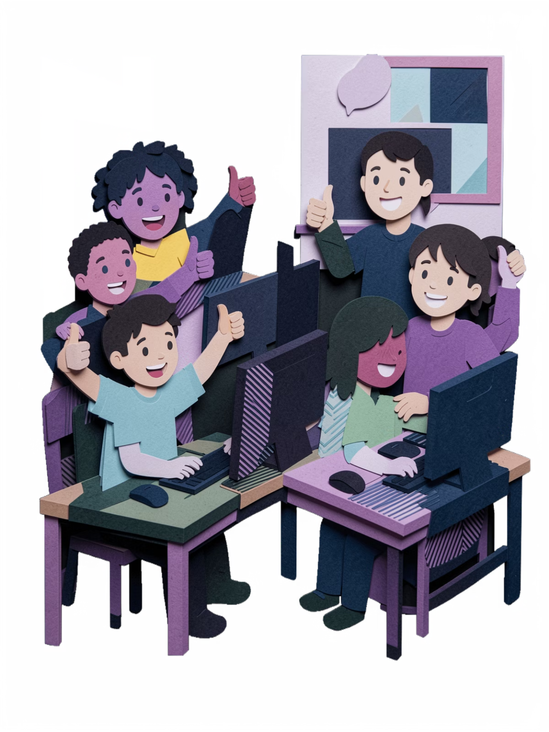

Learn Today, Lead Tomorrow!
Give your child the digital skills they need for the future. Enrol today!

