Slide 1
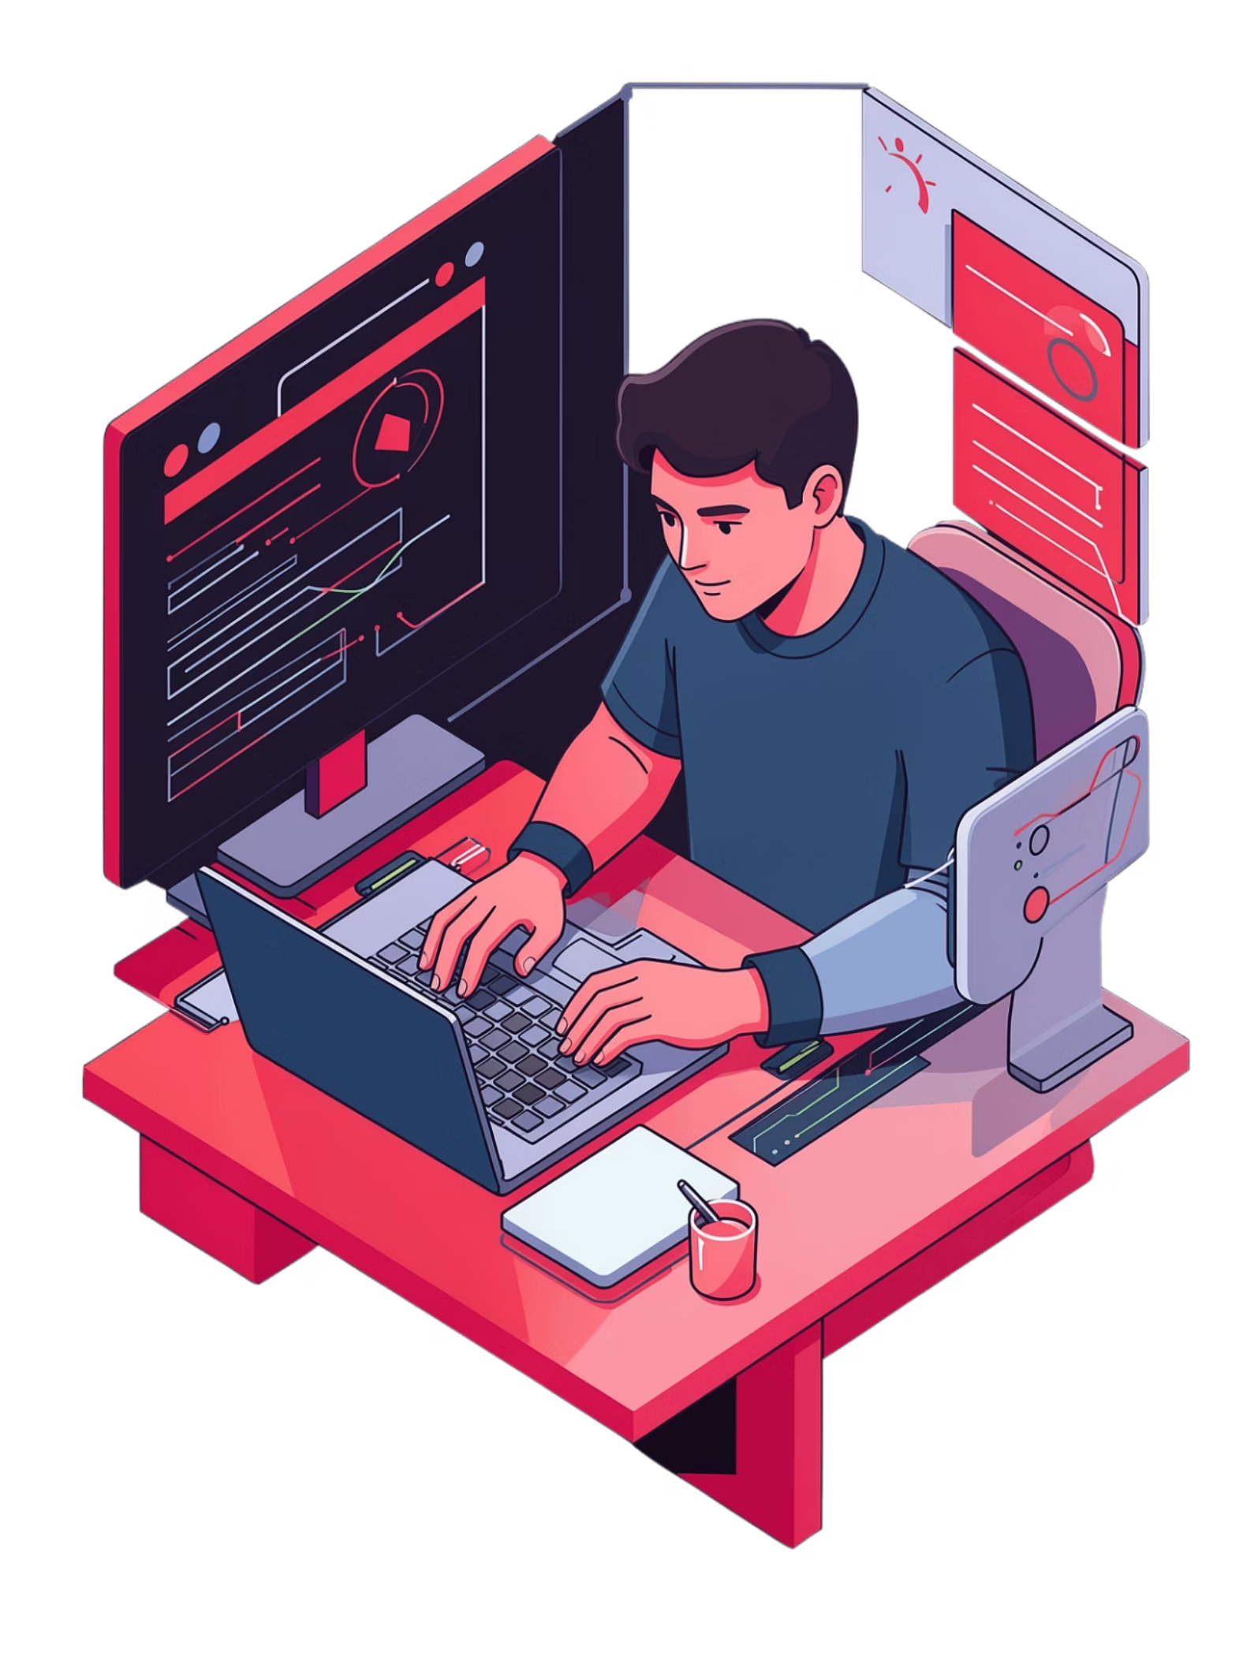
Business Owners Course
Grow your business with digital marketing + AI. One month of practical, hands-on training designed specifically for small business owners and marketing managers.

Slide 2
1 Month Practical Training
Online & Offline
Limited Seats Available
Flexible learning options that fit your schedule. Learn at your own pace with expert guidance every step of the way.
Small class sizes ensure personalised attention and practical implementation support throughout your learning journey.

Slide 3
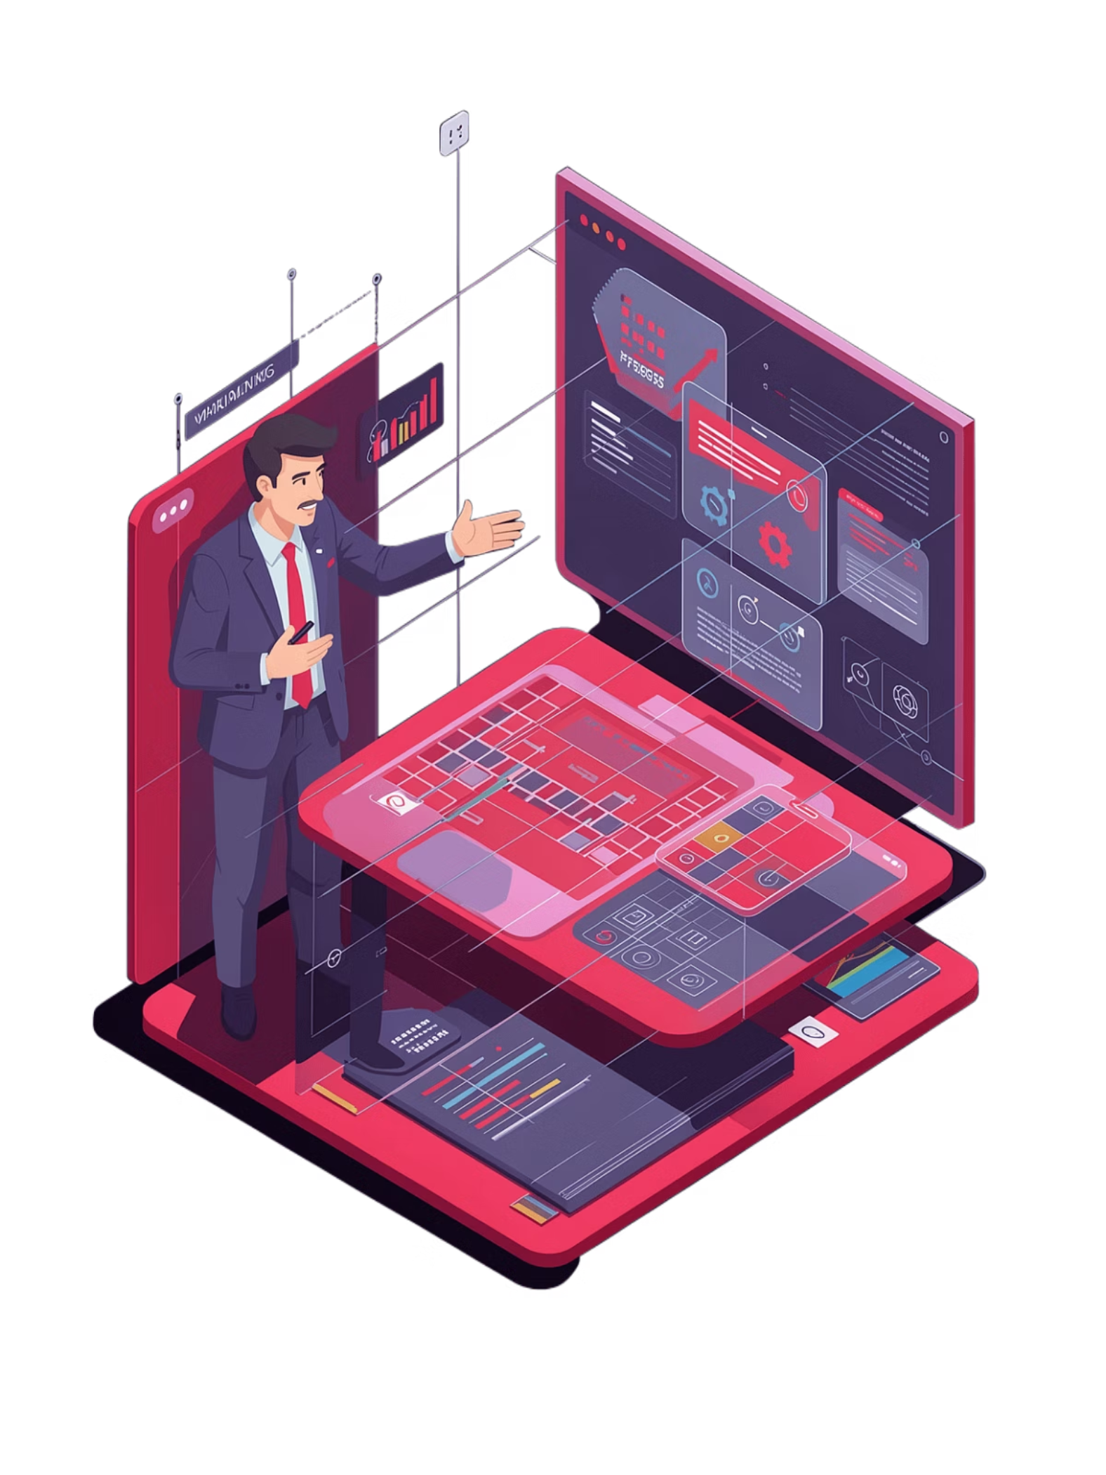
Expert Trainers
Learn from industry experts with proven track records in digital marketing and AI implementation. Our trainers bring real-world experience and practical insights that you can apply immediately to your business.

Slide 4







Course Highlights
Business Strategy + AI
Website & Landing Page
Develop a comprehensive digital strategy powered by artificial intelligence to transform your business operations.
Build professional, conversion-focused websites and landing pages that capture attention and drive results.
Meta Ads (Main Focus)
Google Ads (Basic)
Master Facebook and Instagram advertising with advanced targeting and optimisation techniques for maximum ROI.
Get started with Google Ads campaigns to expand your reach across the world's most powerful search platform.
WhatsApp Marketing
Canva Designing Basics
Leverage WhatsApp Business to engage customers directly and drive sales through personal, targeted messaging.
Create professional graphics and visual content using Canva, the easy-to-use design platform trusted by millions.

Slide 5
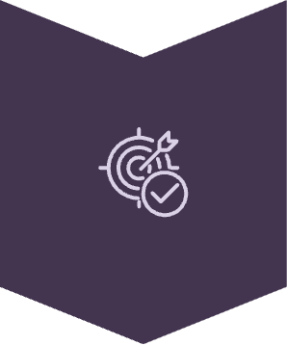
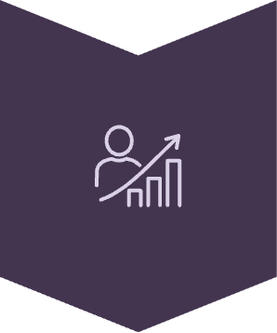

What You'll Learn
Lead Generation Focus
Discover proven strategies to attract high-quality leads consistently through targeted digital campaigns.
Sales Growth Strategy
Transform leads into customers with systematic sales funnel optimisation and conversion techniques.
Practical Implementation
Apply everything you learn immediately with hands-on exercises and real business scenarios.

Slide 6
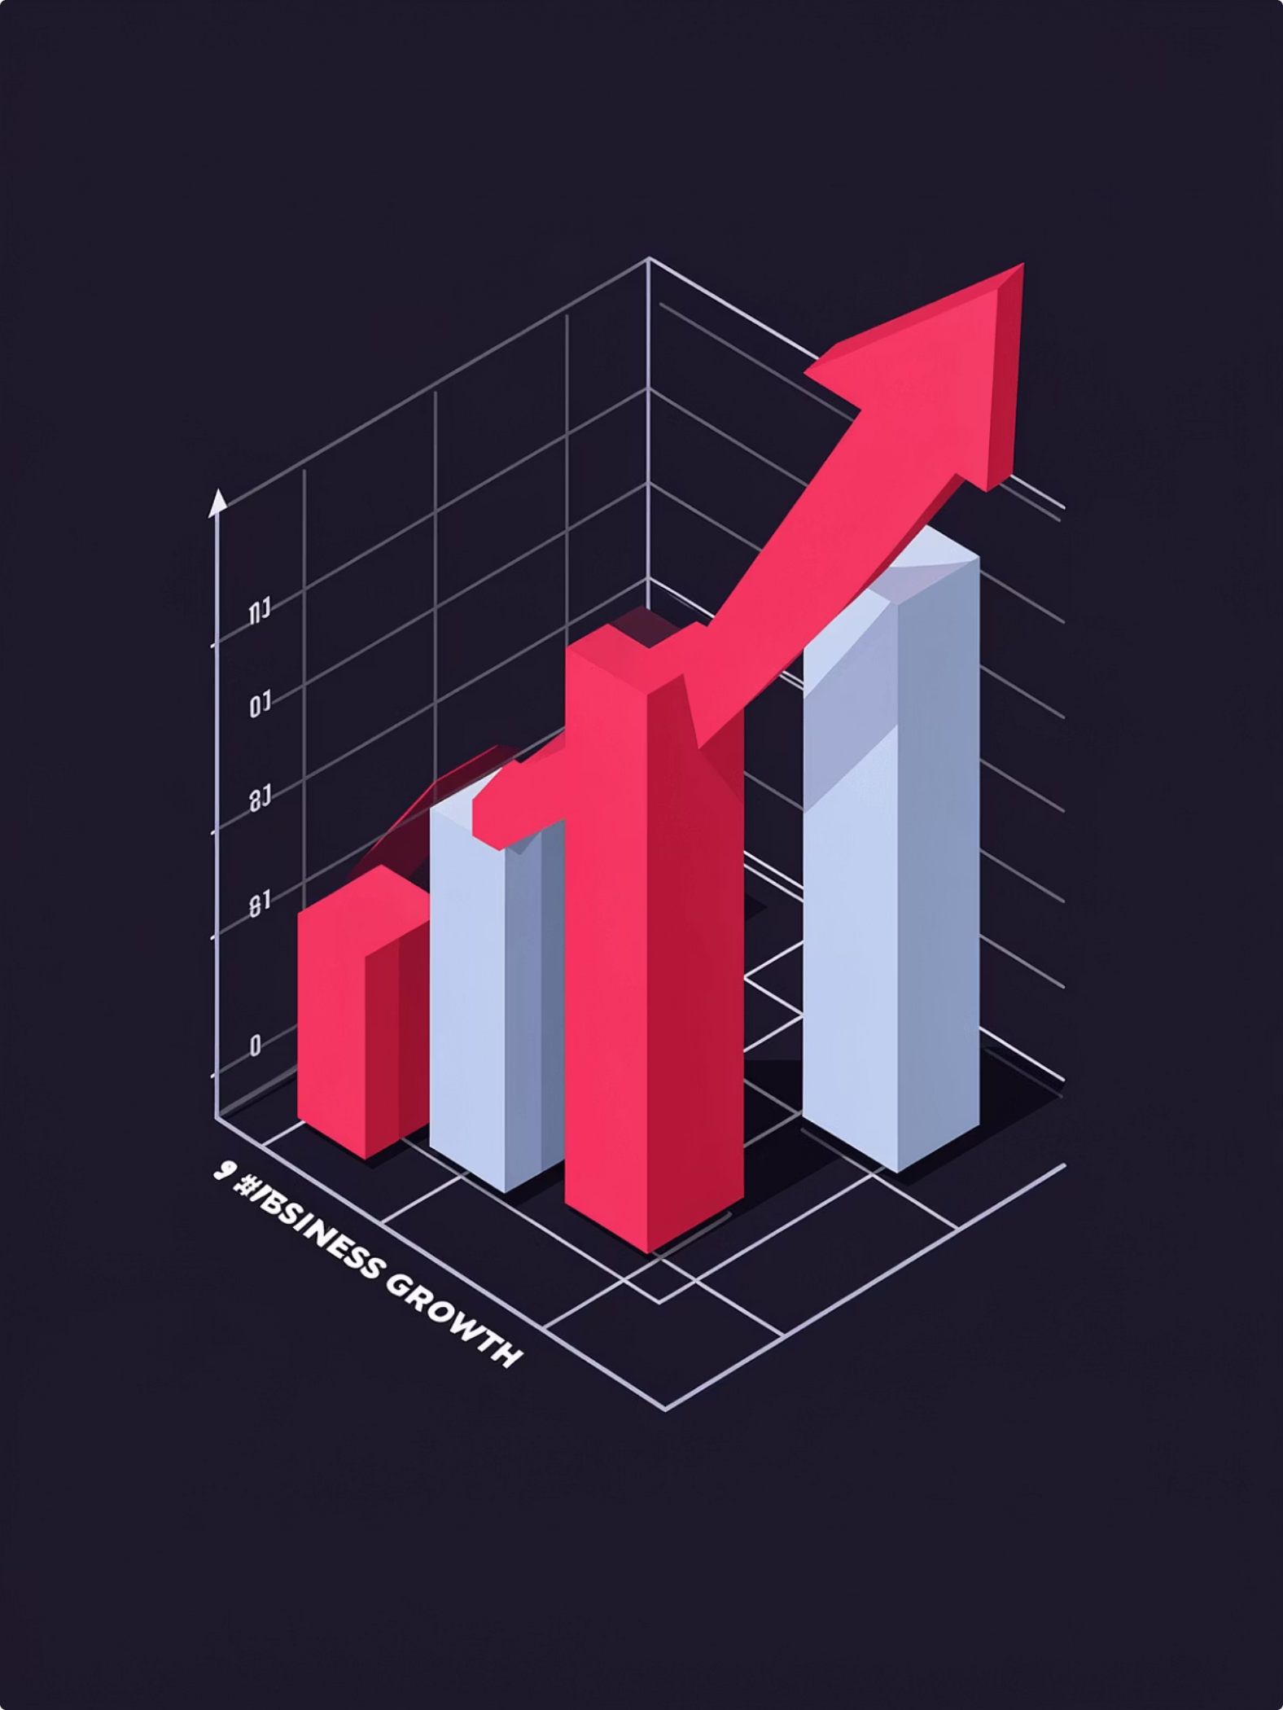
Course Benefits
Grow Your Business
Scale your operations with digital marketing strategies that deliver measurable results and sustainable growth.
Get More Leads
Generate consistent lead flow through optimised campaigns across multiple digital channels.
Increase Sales
Convert prospects into paying customers with proven sales techniques and funnel optimisation.

Slide 7
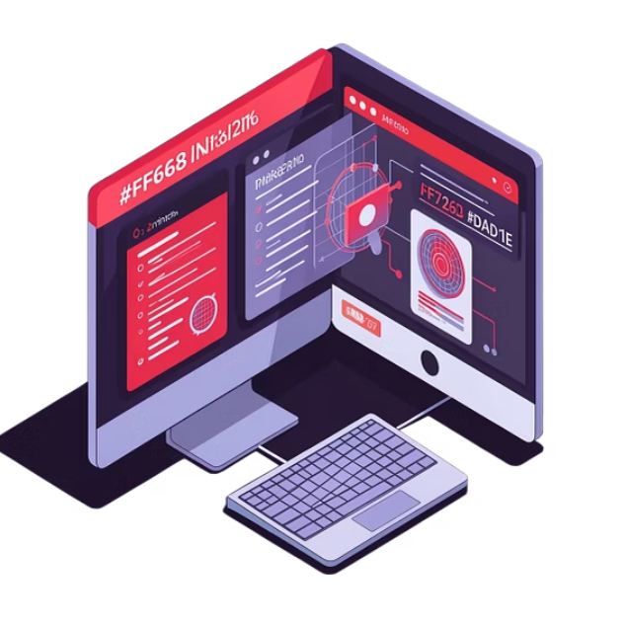
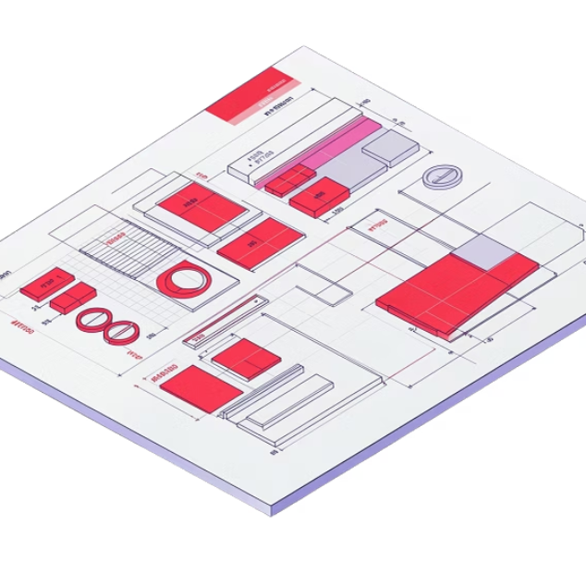
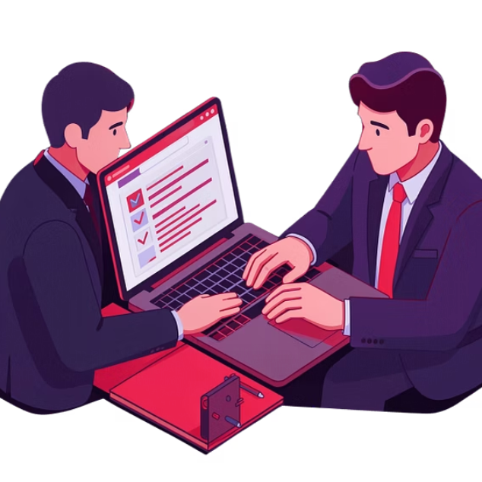
Bonus Materials
AI Tools for Business
Templates & Resources
Implementation Support
Access cutting-edge AI tools that streamline operations, enhance productivity, and give you a competitive edge.
Download ready-made templates for ads, landing pages, and campaigns that you can customise and deploy immediately.
Get ongoing support as you implement your strategies, ensuring you achieve your business goals with confidence.

Slide 8
Who Should Enrol?
Small Business Owners
Marketing Managers
Entrepreneurs
Running your own business and ready to leverage digital marketing to grow your customer base and revenue.
Managing marketing efforts for your organisation and seeking hands-on training in the latest digital tools and techniques.
Starting or scaling a business with digital-first strategies that deliver results without breaking the bank.

Slide 9
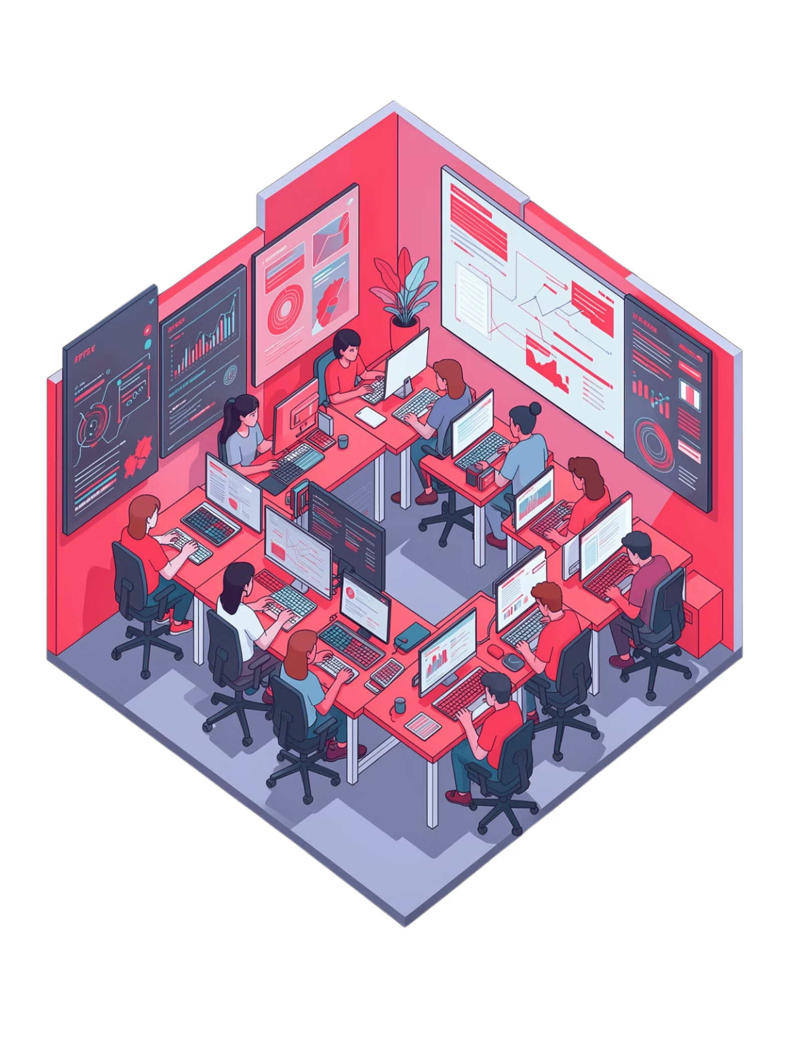
Why Sai Digital Training?
Practical, Not Theoretical
Every lesson includes actionable exercises you can apply to your business immediately.
Expert-Led Classes
Learn from trainers with real-world experience who've helped businesses achieve measurable results.
Flexible Learning
Choose online or offline sessions that fit your schedule without disrupting your business operations.

Slide 10
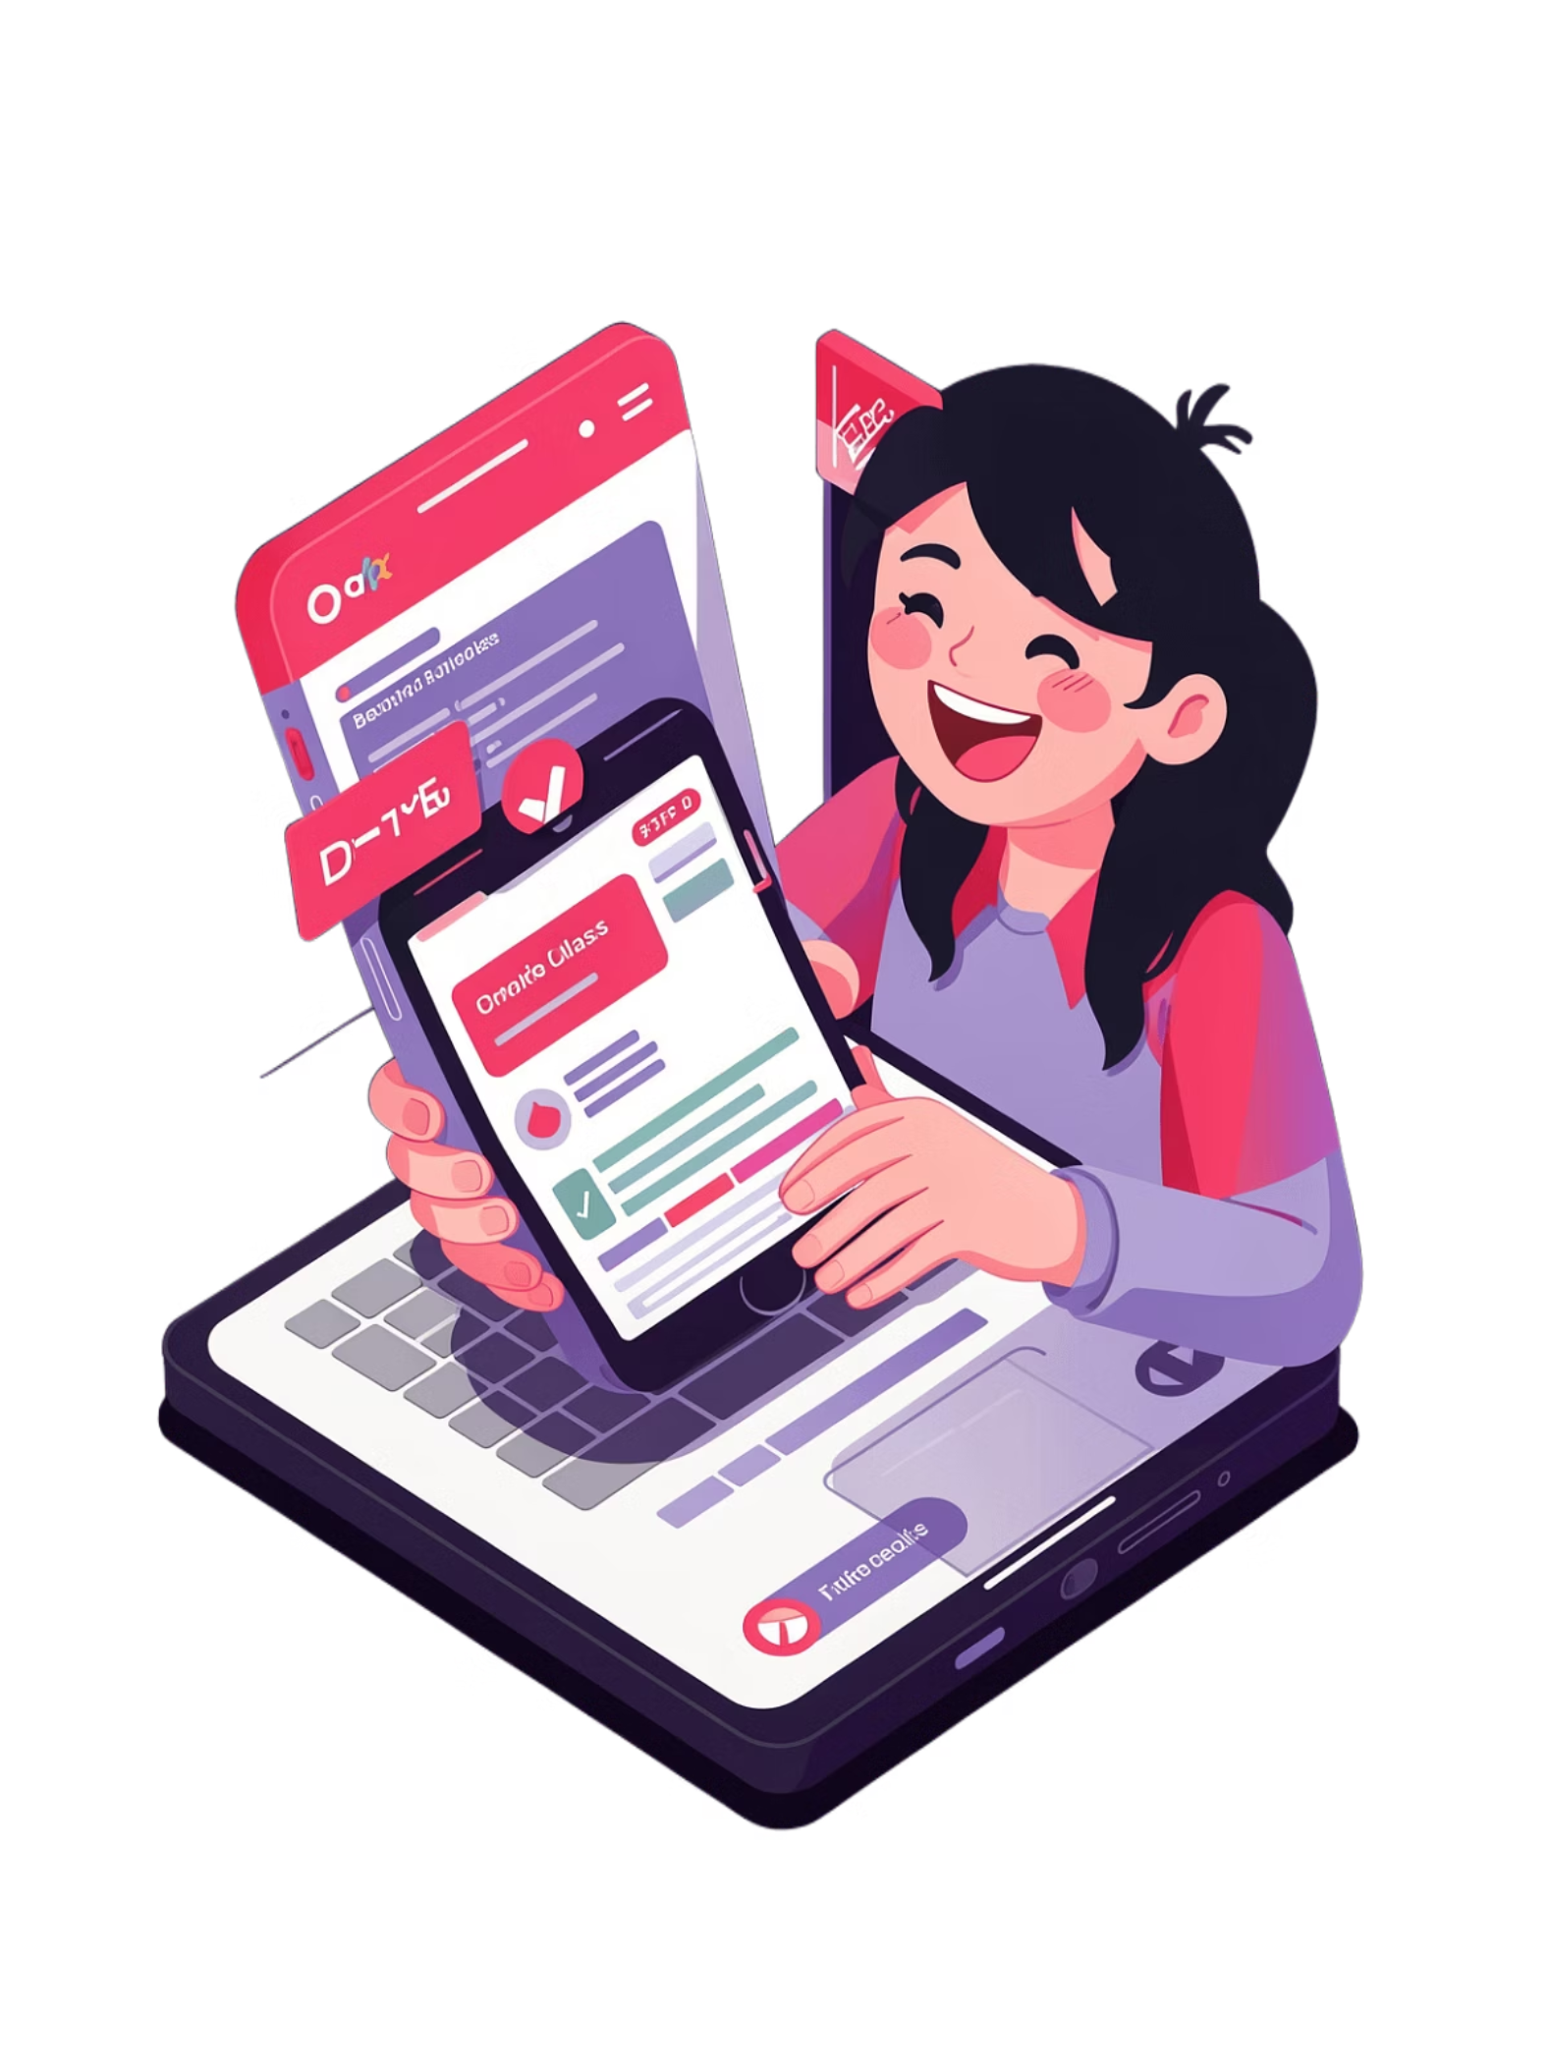
Book Your FREE Demo Class Today!
Limited Seats Only
Enrol Now! Don't miss this opportunity to transform your business with digital marketing and AI.
Experience our training methodology firsthand with a complimentary demo class. See how our practical approach can help you achieve your business goals faster.

