Slide 1


UPLAND POLICE
DEPARTMENT
March 2026

Slide 2
Citywide
March 2026
Priority 1
Average Response Time
0:06:14
Priority 1 calls are in-progress emergencies with an immediate threat to life or an immediate need for assistance.
44 - Traffic Accident Reports
37 - Injury
6 - Non-Injury
238 - Adults arrested
71 - White
33 - Black
117- Hispanic
17 - All other
104 - Group A offenses
35 - Crimes against persons
69 - Crimes against property
Statistics are preliminary and are subject to revision
POLICE DEPARTMENT
Notes:
Left to Edit
Priority 1
Traffic Accident
Group Offenses

Slide 3
Noteworthy Events
March 2026
362 - Moving and Misc. citations
423 - parking citations (Patrol, PSTs)
355 - parking citations (Parking Aid)
48 - Vehicles impounded
14 - DUI arrests
140 - Abandoned vehicles
Training
91 - Employees attended training
532 - Total training hours
3 – Grant Operations
0 - DUI Checkpoint
0 - Traffic Safety Course
2,391– 911 calls were received.
5,529 - Calls for Service
* Certain call types are excluded, i.e., tests, duplicates, etc.
528 - Cases have been processed
Statistics are preliminary and are subject to revision
POLICE DEPARTMENT
Notes:
Still need edits

Slide 4
Quality of Life & Community Events stats
March 2026
Homeless Services
112 – Contacts made
26 – Services rendered, 11 – Total Placements,
1 - DMV Vouchers
21 – Referred Resources- Linkages
4 – Referrals submitted
Impact
31 - Arrests – includes cite releases
7 – drug-related
11 – Trespass, 7 – Warrant arrests,
1 –Possessing a shopping cart
1 - Other
Code Enforcement
198 - Illegal Signs removed,
226 - Cases Closed, 185 – Proactive cases, 7 - Admin cites, 34 -Shopping carts retrieved
Community Events
3/2 – 3/6- Read Across America
3/3- Hero’s Night at Chick-fil-A
3/7 – Upland Little League Opening Day
3/10 – Hero’s Night at Chick-fil-A
3/19 – Neighborhood Watch at Upland Hills Golf Course North
3/21 – Community Impact Day
3/21 – Movers for Mom
3/25 – Upland Jr. High Spring Carnival
Statistics are preliminary and are subject to revision
POLICE DEPARTMENT

Slide 5
Citywide – March 2026
This month, compared to last month
0 Homicides
5 Sexual Offenses
up from 3
30 Assault Offenses
up from 29
Weapons used or displayed:
0 -Firearm, 1 - Knife, 17 - Personal Weapon, 8 - All Other categories
9 Robberies
up from 2
Weapons used or displayed:
2 - Firearm, 1 - Knife, 0 - Strong Arm,
6 - All other categories
9 Burglaries
no change from 9
Type of entry:
9 – Forced 0 – No Force
42 Larcenies
up from 38
Type of larceny:
22 - Shoplifting, 20 - from a motor vehicle, vehicle parts and accessories, 0 - all other categories
9 Motor vehicle thefts
up from 5
Statistics are preliminary and are subject to revision
POLICE DEPARTMENT
Notes:
Still need edits

Slide 6

Citywide
March 2025 vs. March 2026
 | 2025 | 2026 | Change
Priority 1 - Average Response Time | 0:06:02 | 0:06:14 | 3%
Calls For Service | 6,134 | 5,529 | -10%
Traffic Accidents | 30 | 44 | 47%
Injury Accidents | 21 | 37 | 76%
Non - Injury Accidents | 10 | 6 | -40%
Adult Arrests | 223 | 238 | 7%
Group A Offenses | 205 | 104 | -49%
Crimes Against Persons | 66 | 35 | -47%
Crimes Against Property | 140 | 69 | -51%
POLICE DEPARTMENT
Notes:
Still need edits

Slide 7
Citywide - Group A Offenses
March 2025 vs. March 2026
POLICE DEPARTMENT
Notes:
Still need edits

Slide 8
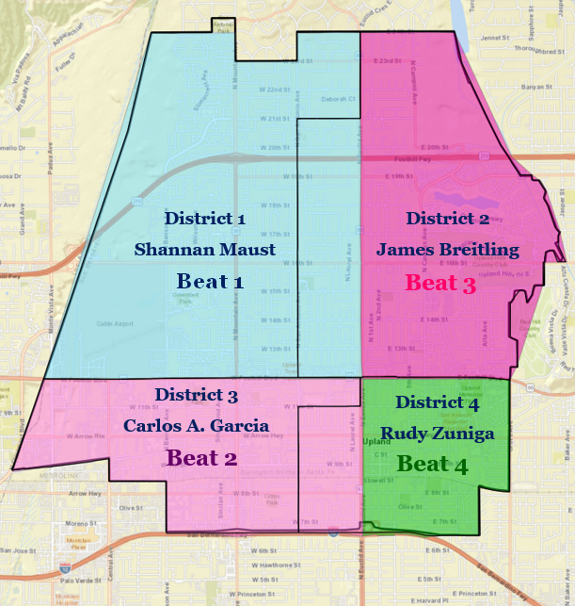
Crimes by Beat
Police Department Beat system is not geographically the same as City Council representation Districts
Beat 1- North of Foothill Blvd and West of Euclid Ave. and South of 24th St.
Beat 2- South of Foothill Blvd and West of Euclid Ave. and North of Interstate 10 freeway.
Beat 3- North of Foothill Blvd and East of Euclid Ave and South of 24th St.
Beat 4- South of Foothill Blvd, East of Euclid and North of Interstate 10 freeway.
POLICE DEPARTMENT

Slide 9
Group A Offenses
Beat 1
Homicides
0
Sexual Offenses
1
Assault Offenses
5
Robbery
1
Burglary
1
Larceny
6
Motor Vehicle Theft
2
March
16
(16%)
POLICE DEPARTMENT

Slide 10
Group A Offenses
Beat 2
Homicides
0
Sexual Offenses
2
Assault Offenses
12
Robbery
2
Burglary
5
Larceny
20
Motor Vehicle Theft
5
March
46
(46%)
POLICE DEPARTMENT

Slide 11
Group A Offenses
Beat 3
Homicides
0
Sexual Offenses
0
Assault Offenses
3
Robbery
3
Larceny
11
Motor Vehicle Theft
0
March
18
(18%)
Burglary
1
POLICE DEPARTMENT

Slide 12
Group A Offenses
Beat 4
Homicides
0
Sexual Offenses
2
Assault Offenses
7
Robbery
3
Burglary
2
Motor Vehicle Theft
2
March
21
(21%)
Larceny
5
POLICE DEPARTMENT

Slide 13
TEST
March 2026
The Upland Police Department and the San Bernardino County Department of Behavioral Health started working together in 2017. TEST is a group of social workers assigned to the Upland Police Department to assist individuals who are a danger to themselves or others. When it is safe to do so, TEST will divert from hospitalizations and incarcerations by linking the client and family to the Department of Behavioral Health and community services to address mental health and substance use. TEST also responds to police department calls for service regarding individuals with Organic Brain Disorders. TEST’s goal is to reduce the repeat calls for service involving repeat callers. TEST accomplishes this by linking and re-linking clients and family members to medical professionals, therapeutic services, and support groups.
The referrals TEST responds to come from the police department directly via calls for service, emails, texts, voicemails, and walk-ins. When calls are generated during the weekend or after hours, officers call CCRT, and a referral is generated for follow-up.
For March 2026, TEST received 18 new referrals, 18 of which were directly from the police department, 18 from calls for service, 0 from walk-ins, and 0 from an email. TEST responded to 18 field calls. TEST responded to 62 follow-up calls. These follow-up cases carry over from the previous month. Most cases are open for a maximum of 59 days. TEST works diligently to minimize repeat calls to the police department when a non-emergency occurs. Clients are encouraged to call TEST to resolve non-emergency issues rather than contacting the police department. There are currently five people who used to call the police department consistently, but no longer do so because of the involvement of TEST.
POLICE DEPARTMENT

Slide 14
Drone Statistics
March 2026
Flights
219
Miles Flown
912.1
Outcomes
Assisted: 130 Calls
Cleared: 2 Calls
Flight Hours
143:50
Arrests
~ 19
Number is approximate, and subject to change
POLICE DEPARTMENT

Slide 15
Additional Useful Information
For more information regarding specific geographical crime data, visit www.crimemapping.com and enter your zip code
Police Department information line (909) 946-7624
Police Department Dispatch non-emergency line (909) 982-1331
Report Graffiti in the City (909) 931-4127
Office of the Chief (909) 946-7624 ext. 3201 or mblanco@uplandpd.org
POLICE DEPARTMENT

