Slide 1
Unlock Your Potential: The Private Lending Masterclass
Welcome to the Private Lending Masterclass, a comprehensive guide designed to equip you with the knowledge and skills needed to excel in the dynamic world of private lending. This presentation will cover everything from understanding the market to scaling your business, offering practical insights at every step.
HM
by Henry Majebi

Slide 2
The Landscape of Private Lending: Opportunities and Risks
Explore the attractive opportunities within private lending. Understand the potential returns and the types of deals available. Also, recognize the risks and challenges inherent in this market.
Opportunities
Risks
E-book Outline: "The Basics of Private Lending: A Step-by-Step Guide"
Default rates. Liquidity challenges. Economic downturns.
Introduction
Why Private Lending Matters
How Private Lending Can Help You Build Wealth
What You'll Learn in This Guide
Chapter 1: Understanding Private Lending
What Is Private Lending?
How It Differs from Traditional Lending
Key Players in the Private Lending Market
Chapter 2: Getting Started as a Private Lender
The Mindset of a Successful Lender
Legal Considerations and Licensing Requirements
Establishing Your Lending Business
Chapter 3: Evaluating Loan Applications
Understanding Borrower Profiles
Assessing Risk and Creditworthiness
Essential Documentation and Due Diligence
Chapter 4: Collateral and Loan Security
What Is Collateral and Why It Matters
Different Types of Collateral (Real Estate, Vehicles, Gold, etc.)
Calculating Collateral Value (HJ Financial's 3x Rule Explained)
Chapter 5: Structuring a Loan
How to Calculate Interest Rates and Fees
Crafting a Loan Agreement
Payment Schedules and Renewal Terms
Chapter 6: Managing Loans Effectively
Tracking Payments and Interest
Communicating with Borrowers
Dealing with Missed Payments and Defaults
Chapter 7: Growing Your Private Lending Business
Reinvesting Profits
Building Relationships with Brokers and Clients
Expanding into New Lending Markets
Conclusion
Key Takeaways for Aspiring Private Lenders
Next Steps to Launch Your Lending Business
Resources and Tools for Ongoing Learning
Bonus Resources
Sample Loan Agreement Template
Collateral Valuation Worksheet
Recommended Books and Websites

Slide 3
The Landscape of Private Lending: Opportunities and Risks
Explore the attractive opportunities within private lending. Understand the potential returns and the types of deals available. Also, recognize the risks and challenges inherent in this market.
Opportunities
Risks
E-book Outline: "The Basics of Private Lending: A Step-by-Step Guide"
Default rates. Liquidity challenges. Economic downturns.
Introduction
Why Private Lending Matters
How Private Lending Can Help You Build Wealth
What You'll Learn in This Guide
Chapter 1: Understanding Private Lending
What Is Private Lending?
How It Differs from Traditional Lending
Key Players in the Private Lending Market
Chapter 2: Getting Started as a Private Lender
The Mindset of a Successful Lender
Legal Considerations and Licensing Requirements
Establishing Your Lending Business
Chapter 3: Evaluating Loan Applications
Understanding Borrower Profiles
Assessing Risk and Creditworthiness
Essential Documentation and Due Diligence
Chapter 4: Collateral and Loan Security
What Is Collateral and Why It Matters
Different Types of Collateral (Real Estate, Vehicles, Gold, etc.)
Calculating Collateral Value (HJ Financial's 3x Rule Explained)
Chapter 5: Structuring a Loan
How to Calculate Interest Rates and Fees
Crafting a Loan Agreement
Payment Schedules and Renewal Terms
Chapter 6: Managing Loans Effectively
Tracking Payments and Interest
Communicating with Borrowers
Dealing with Missed Payments and Defaults
Chapter 7: Growing Your Private Lending Business
Reinvesting Profits
Building Relationships with Brokers and Clients
Expanding into New Lending Markets
Conclusion
Key Takeaways for Aspiring Private Lenders
Next Steps to Launch Your Lending Business
Resources and Tools for Ongoing Learning
Bonus Resources
Sample Loan Agreement Template
Collateral Valuation Worksheet
Recommended Books and Websites

Slide 4
The Landscape of Private Lending: Opportunities and Risks
Explore the attractive opportunities within private lending. Understand the potential returns and the types of deals available. Also, recognize the risks and challenges inherent in this market.
Opportunities
Risks
E-book Outline: "The Basics of Private Lending: A Step-by-Step Guide"
Default rates. Liquidity challenges. Economic downturns.
Introduction
Why Private Lending Matters
How Private Lending Can Help You Build Wealth
What You'll Learn in This Guide
Chapter 1: Understanding Private Lending
What Is Private Lending?
How It Differs from Traditional Lending
Key Players in the Private Lending Market
Chapter 2: Getting Started as a Private Lender
The Mindset of a Successful Lender
Legal Considerations and Licensing Requirements
Establishing Your Lending Business
Chapter 3: Evaluating Loan Applications
Understanding Borrower Profiles

Slide 5
Evaluating Loan Applications: Due Diligence and Risk Assessment
Master the art of evaluating loan applications. Learn to perform thorough due diligence and accurately assess risks. Mitigate potential losses by making informed decisions.
1
Credit Checks
2
Property Valuation
Evaluate applicant's credit history.
Assess the market value of the collateral.
3
Financial Statements
Analyze borrower's financial health.

Slide 6
Structuring Profitable Deals: Terms, Rates, and Collateral
Structure deals that maximize profit while minimizing risk. Understand the key components of a loan agreement. This includes terms, rates, and collateral requirements.
Set Loan Terms
Determine repayment schedule.
Establish Interest Rate
Balance risk and return.
Secure Collateral
Protect your investment.

Slide 7
Legal and Regulatory Compliance: Navigating the Rules
Ensure your lending practices comply with all applicable laws. Stay informed about regulations. Avoid costly penalties by operating ethically and within the legal framework.
Federal Laws
State Laws
Ethical Practices
Understand federal lending regulations.
Comply with state-specific rules.
Maintain integrity in all dealings.

Slide 8
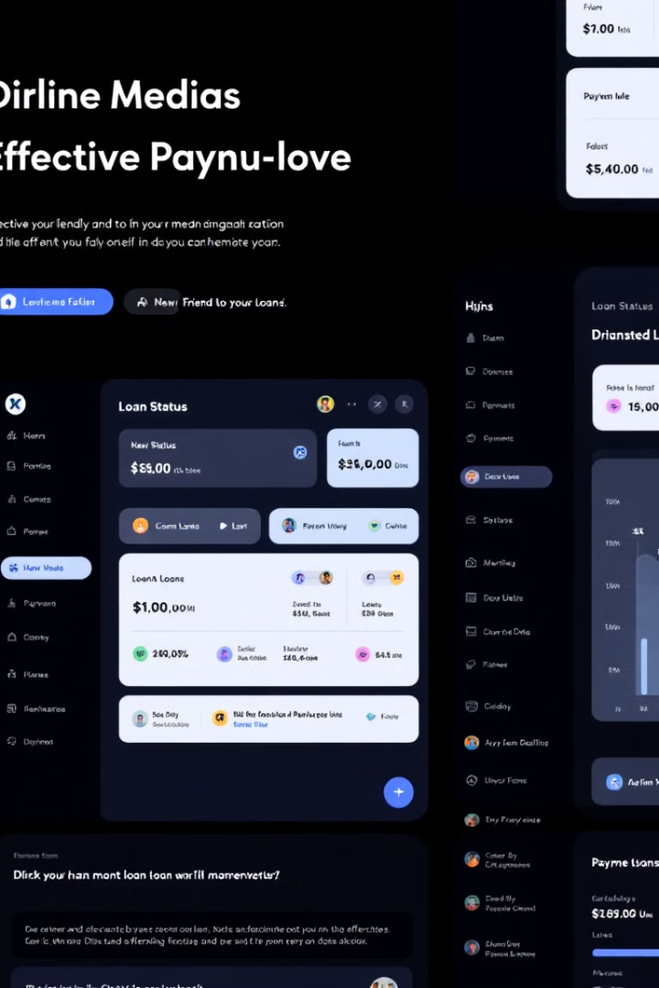
Managing Loans Effectively: Servicing and Collections
Implement effective strategies for loan servicing and collections. Maintain strong borrower relationships and handle delinquent accounts professionally. Maximize recovery rates while minimizing legal issues.
Payment Processing
Communication
Streamline payment collection.
Maintain open dialogue with borrowers.
Collections
Handle delinquent accounts efficiently.

Slide 9
Scaling Your Lending Business: Growth Strategies and Funding
Explore strategies to scale your lending business. Identify new funding sources and expand your reach. Achieve sustainable growth and increase profitability over time.
1
Network
Build strategic partnerships.
2
Seek Capital
Attract new investors.
3
Diversify
Expand your loan portfolio.

Slide 10
Your Journey to Success: Resources, Next Steps, and Q&A
Utilize available resources to continue your education and development. Take clear next steps to implement what you’ve learned. Get answers to your questions and start your successful lending career.
2
Access Additional Resources
1
Review Key Concepts
Implement Strategies
3

