Slide 1
FINANCIAL ANALYSIS :
NVENT (NVT) AND HUBBELL (HUBB)
Isabel Anne Villa Mendoza

Slide 2



Introduction
This presentation reviews key financial ratios, cash flows, and working capital metrics over the past three years, along with a three-year forecast of income and cash flows under conservative assumptions.
Insights highlight each company’s efficiency, profitability, and financial stability.

Slide 3
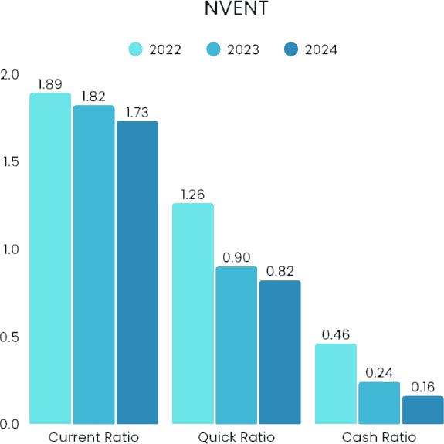
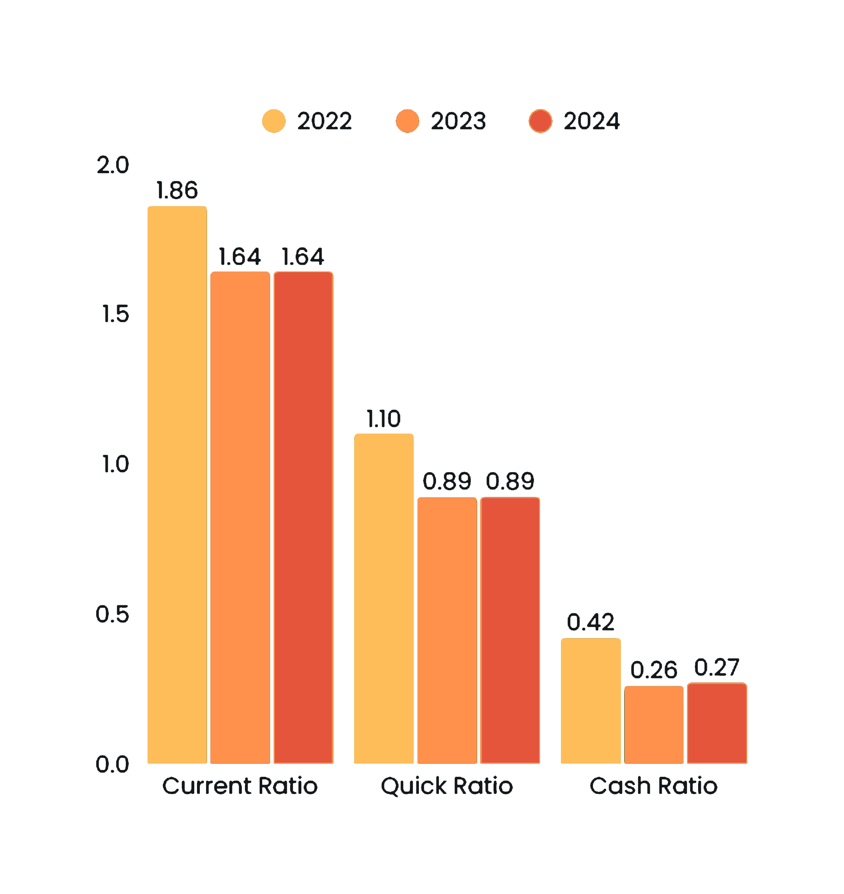
LIQUIDITY RATIOS
HUBB
Current Ratio > 1. Signifies that the current liabilities are covered by the current assets.
Quick Ratio ranging from .82-1.26. Nvent is not reliant on selling inventory to generate sufficient cash.
Cash Ratio ranging from .46 to .16, 2022-2024. Decreased due to increased current liabilities, driven by increase in short-term borrowings and increase in current portion of long-term debt, unearned current revenue and accrued expenses.
Current Ratio > 1 . Signifies that the current liabilities are covered by the current assets.
Quick Ratio decreased from 1.1-.89. Hubbard is not reliant on selling inventory to generate sufficient cash.
Cash Ratio decreased from .42 to .27, 2022-2024. Decreased due to increased current liabilities, driven by increase in short-term borrowings and increase in unearned revenue.

Slide 4
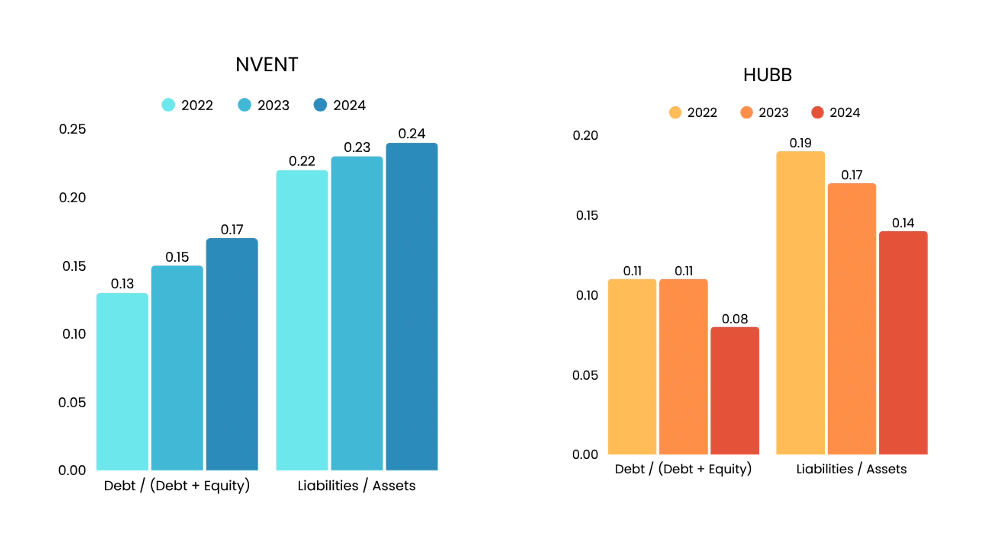
LEVERAGE RATIOS
NVENT has consistently low leverage ratios. While the US market average for Debt/(Debt + Equity) is between 0.25 and 0.30. The Liabilities/Assets ratio is between 0.22 and 0.24, debt is only 22%-24% of its entire market value of assets. NVENT can be considered as a low-risk company.
Hubbard has low leverage ratios. Debt/(Debt + Equity) ranging from .11-.08. The Liabilities/Assets ratio decreased from .19 to .14 from 2022-2024, debt is only 14%-19% of its entire market value of assets. hubbard can be considered as a low-risk company.

Slide 5
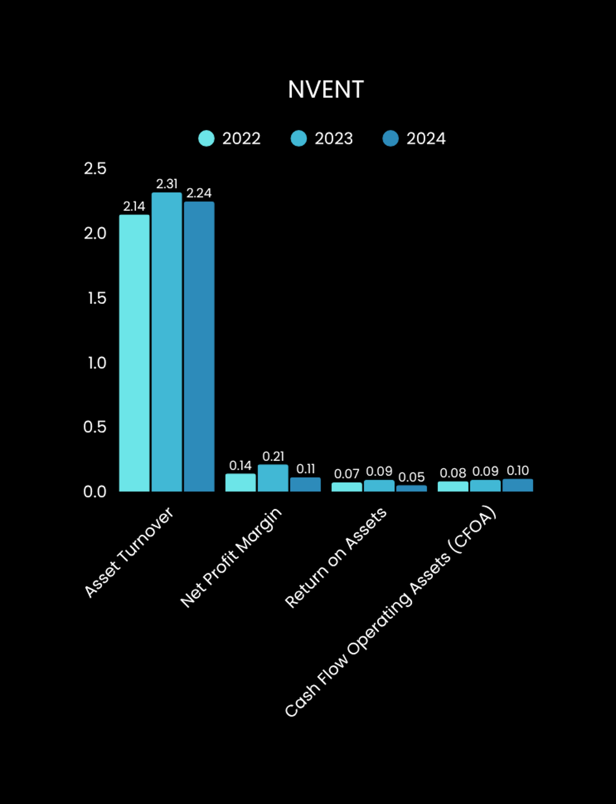
PROFITABLE RATIOS
Asset Turnover (2.14 – 2.31 over three years): Slight fluctuations but overall stable. Assets remained relatively constant.Increase in turnover indicates stronger revenue generation from assets.Nvent effectively utilized its assets to maximize revenue.
Net Profit Margin (.11 – .14, peak of .21 in 2023): Profitability improved, with a strong spike in 2023. Margins remain healthy but slightly lower after the 2023 peak.
Return on Assets:Profitability relative to assets improved from 2022 to 2023.Declined by 0.04 in 2024, signaling a slowdown in asset-based profitability.
Cash Flow from Operations to Assets (CFOA):
Positive upward trend year over year.
Increased from 0.08 in 2022 to 0.10 in 2024.
Demonstrates consistent ability to generate strong operating cash flow from assets.

Slide 6
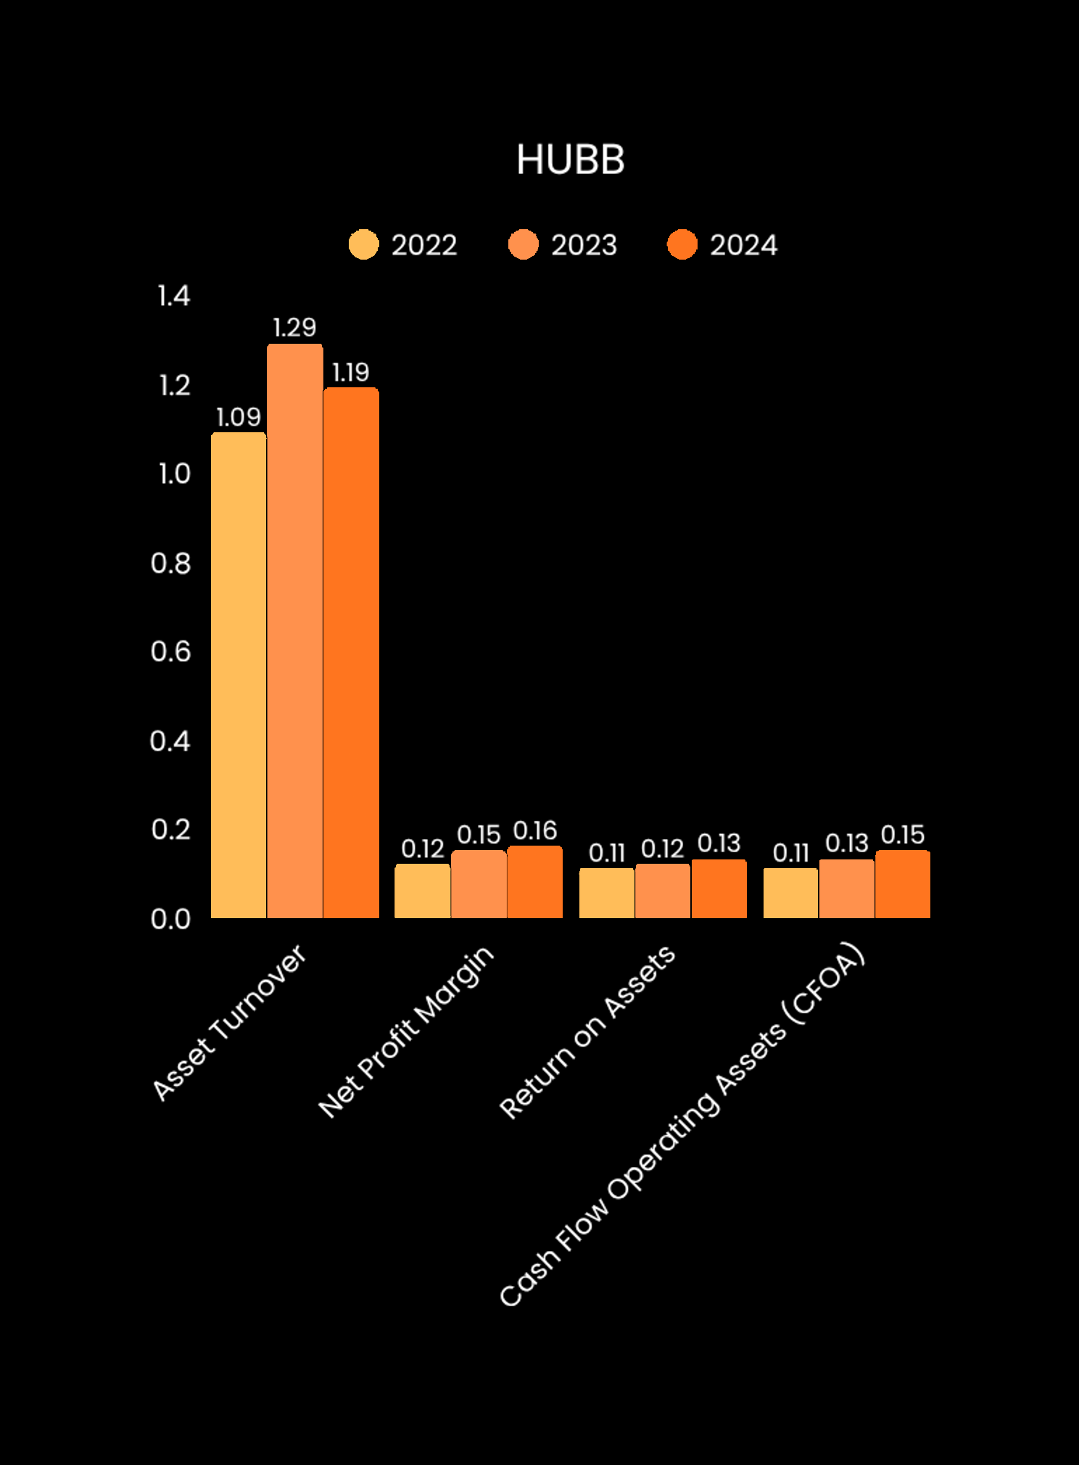
PROFITABLE RATIOS
Asset Turnover: 1.09 - 1.19 over three years): Significant increase from 2022-2023. Increase in turnover indicates stronger revenue generation from assets. .10 decrease from 2023-2024. Overall, Hubbard has effectively utilized its assets to maximize revenue.
Net Profit Margin (.12 – .16): Profitability improved, year-over-year.
Return on Assets: Profitability relative to assets improved from 2022 to 2024 ny .01 year-over-year.
Cash Flow from Operations to Assets (CFOA): Positive trend year over year. Consistent Increased from 0.11 to 0.15 from 2022 to 2024. Demonstrates consistent ability to generate strong operating cash flow from assets.

Slide 7
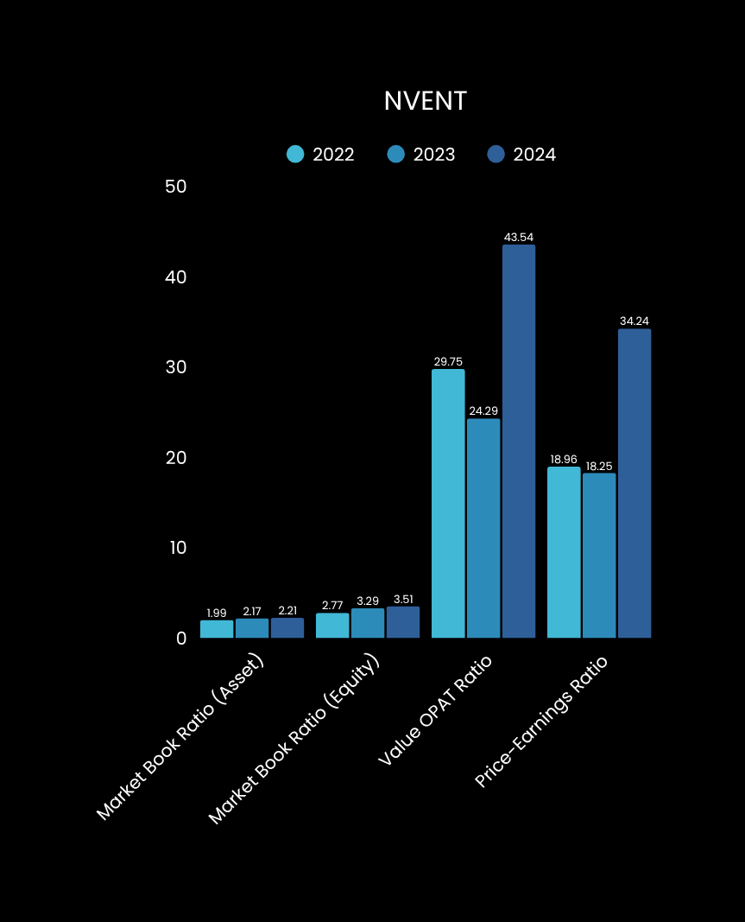
VALUATION RATIOS
Market Book Ratio (Asset): Increased from 1.99 in 2022 to 2.21 in 2024. Indicates the market places a strong value on Nvent’s assets.
Market Book Ratio (Equity): Grew from 2.77 to 3.51 over the period, showing that the company consistently traded well above its book value. Signals strong profitability, low leverage levels, and overall financial strength.
Value OPAT Ratio: The Value to Operating Profit After Taxes (OPAT) ratio showed a significant increase, ranging from 29.75 to 43.54. This indicates that the market was willing to value the company at up to 43.54 times its OPAT in 2024, demonstrating strong expectations of future earnings.
Price Earnings Ratio: The P/E ratio increased substantially from 18.96 to 34.24, placing it well above the market average. This sharp rise reflects growing investor confidence and a willingness to pay a premium price for Nvent’s stock. The higher P/E ratio indicates that shareholders expect continued earnings growth and view Nvent as a strong long-term investment.

Slide 8
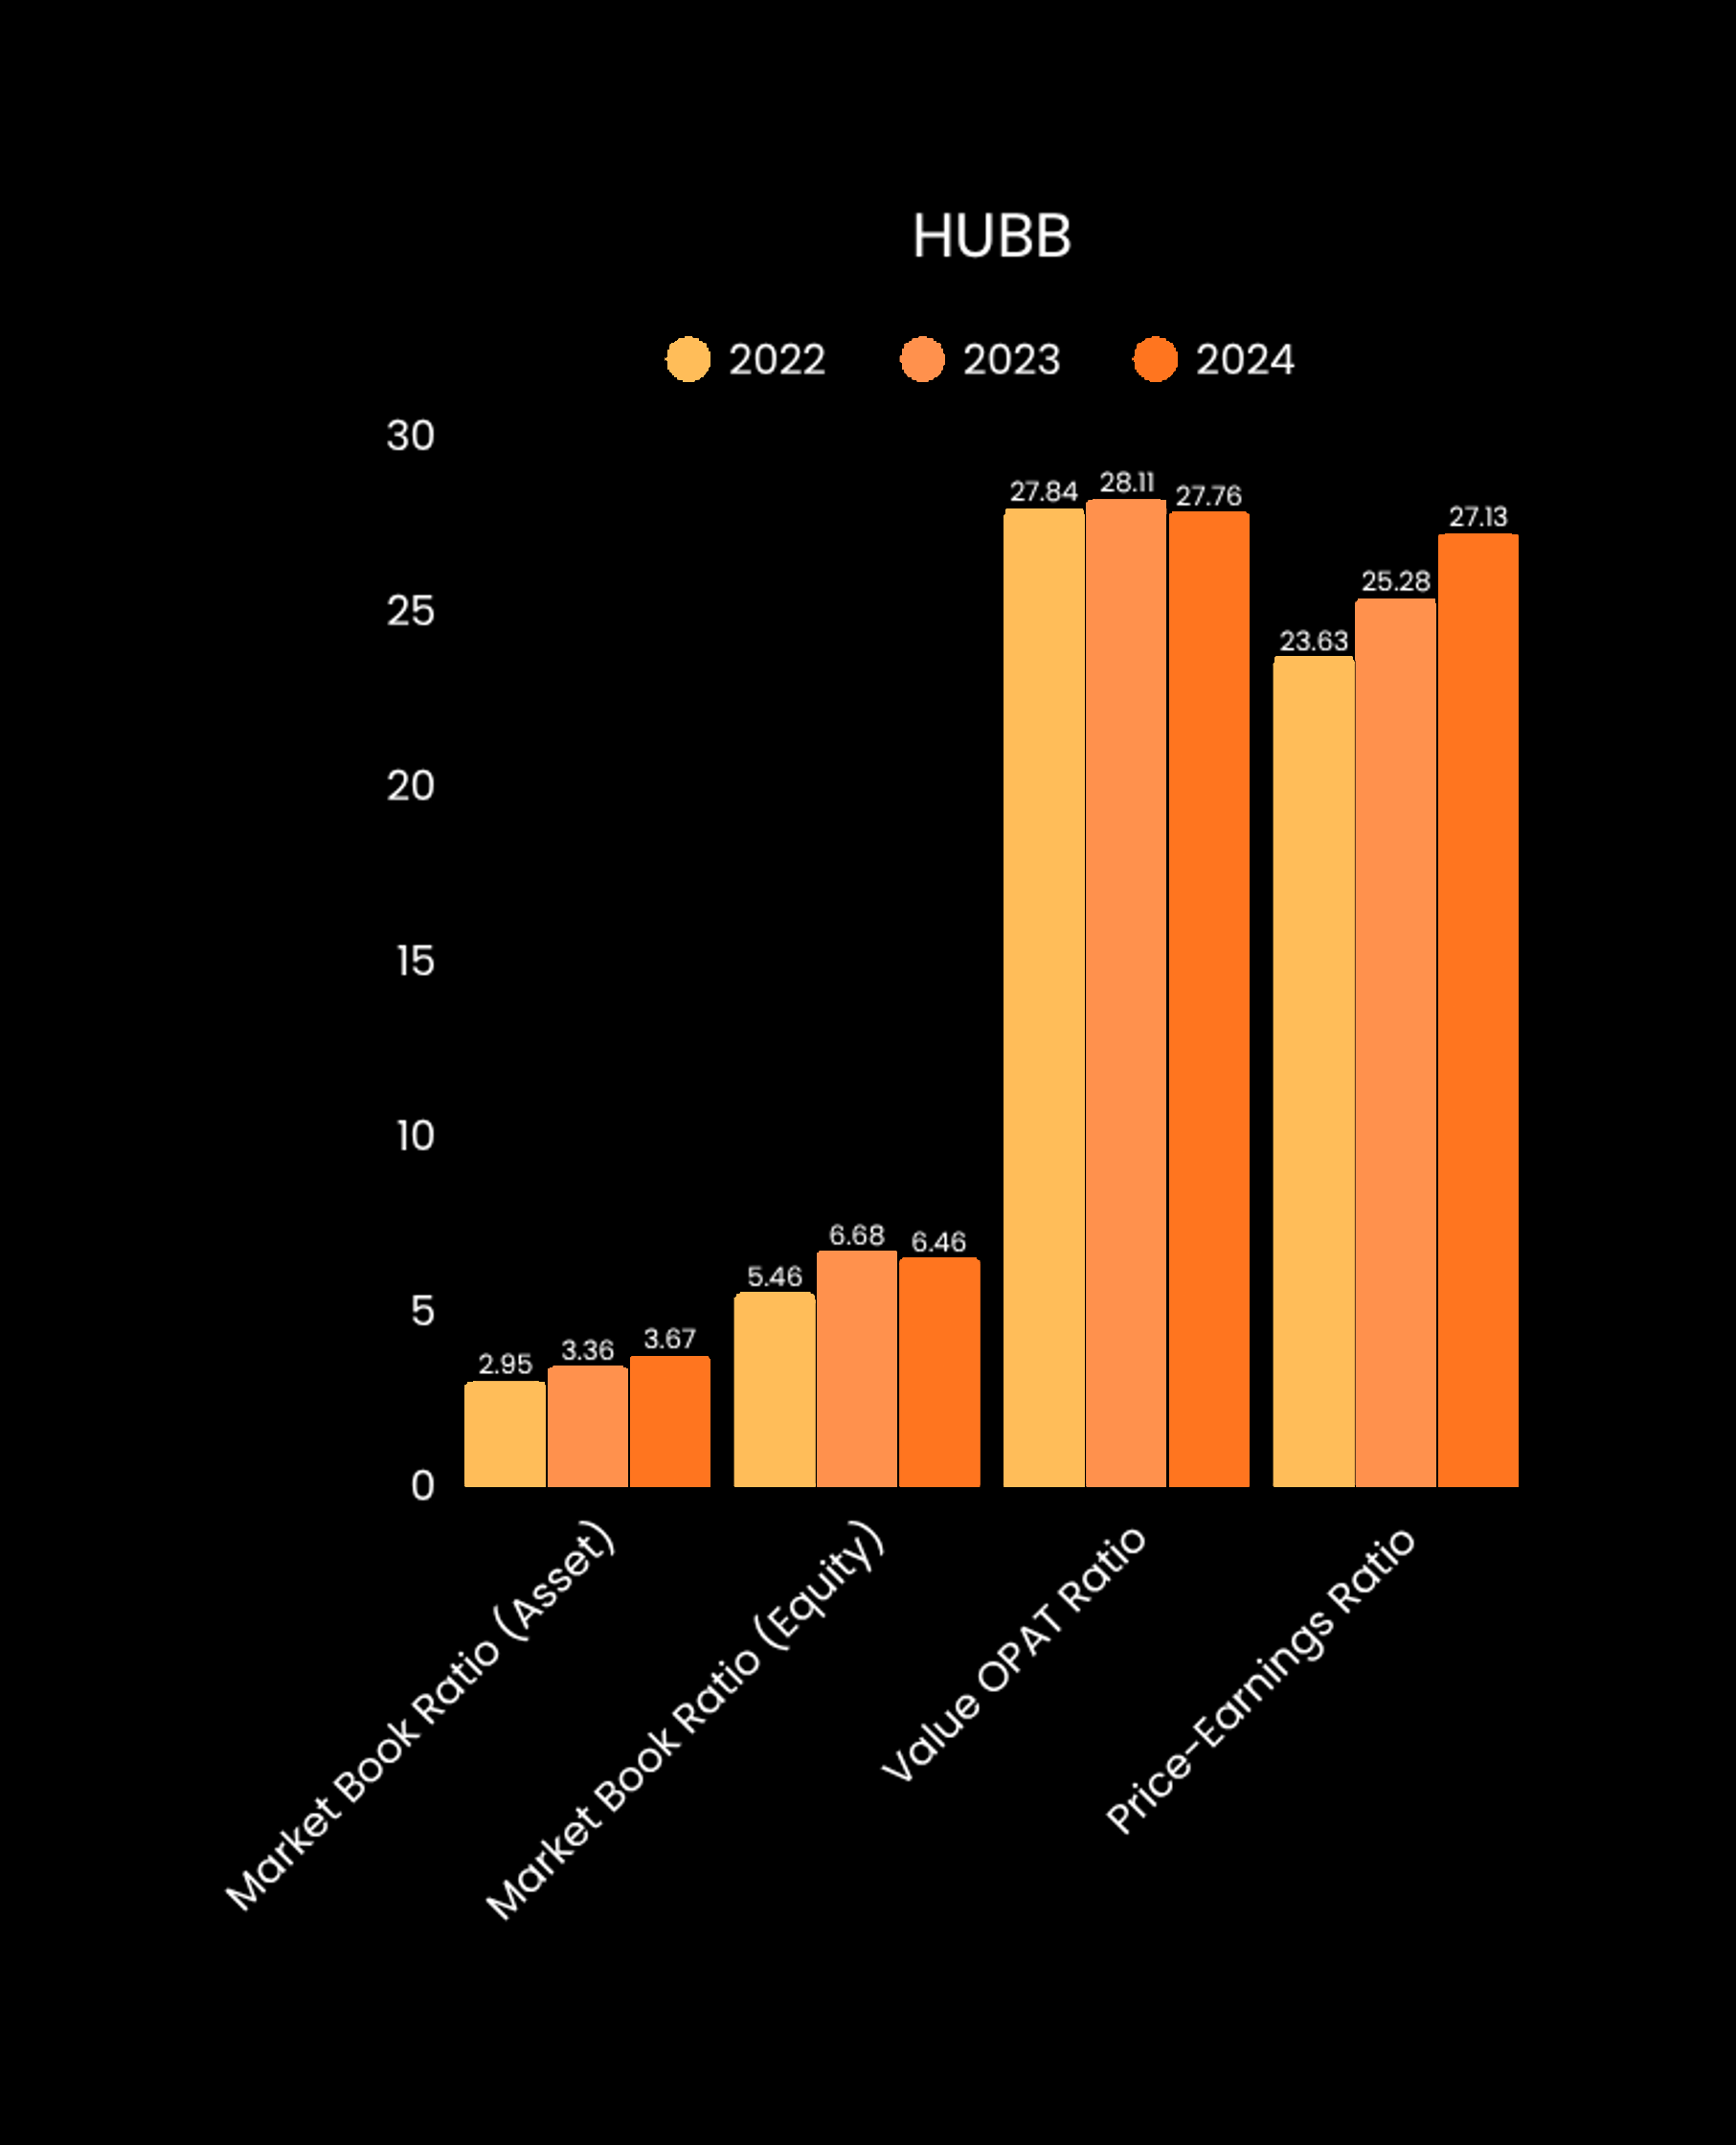
VALUATION RATIOS
Market Book Ratio (Asset): Increased from 2.95 to 3.67 from 2022 to 2024. Indicates the market places a strong value on Hubbard’s assets.
Market Book Ratio (Equity): Grew from 2.77 to 3.51 over the period, showing that the company consistently traded well above its book value. Signals strong profitability, low leverage levels, and overall financial strength.
Value OPAT Ratio: The Value to Operating Profit After Taxes (OPAT) ratio showed a significant increase, ranging from 29.75 to 43.54. This indicates that the market was willing to value the company at up to 43.54 times its OPAT in 2024, demonstrating strong expectations of future earnings.
Price Earnings Ratio: The P/E ratio increased substantially from 18.96 to 34.24, placing it well above the market average. This sharp rise reflects growing investor confidence and a willingness to pay a premium price for Nvent’s stock. The higher P/E ratio indicates that shareholders expect continued earnings growth and view Nvent as a strong long-term investment.

Slide 9
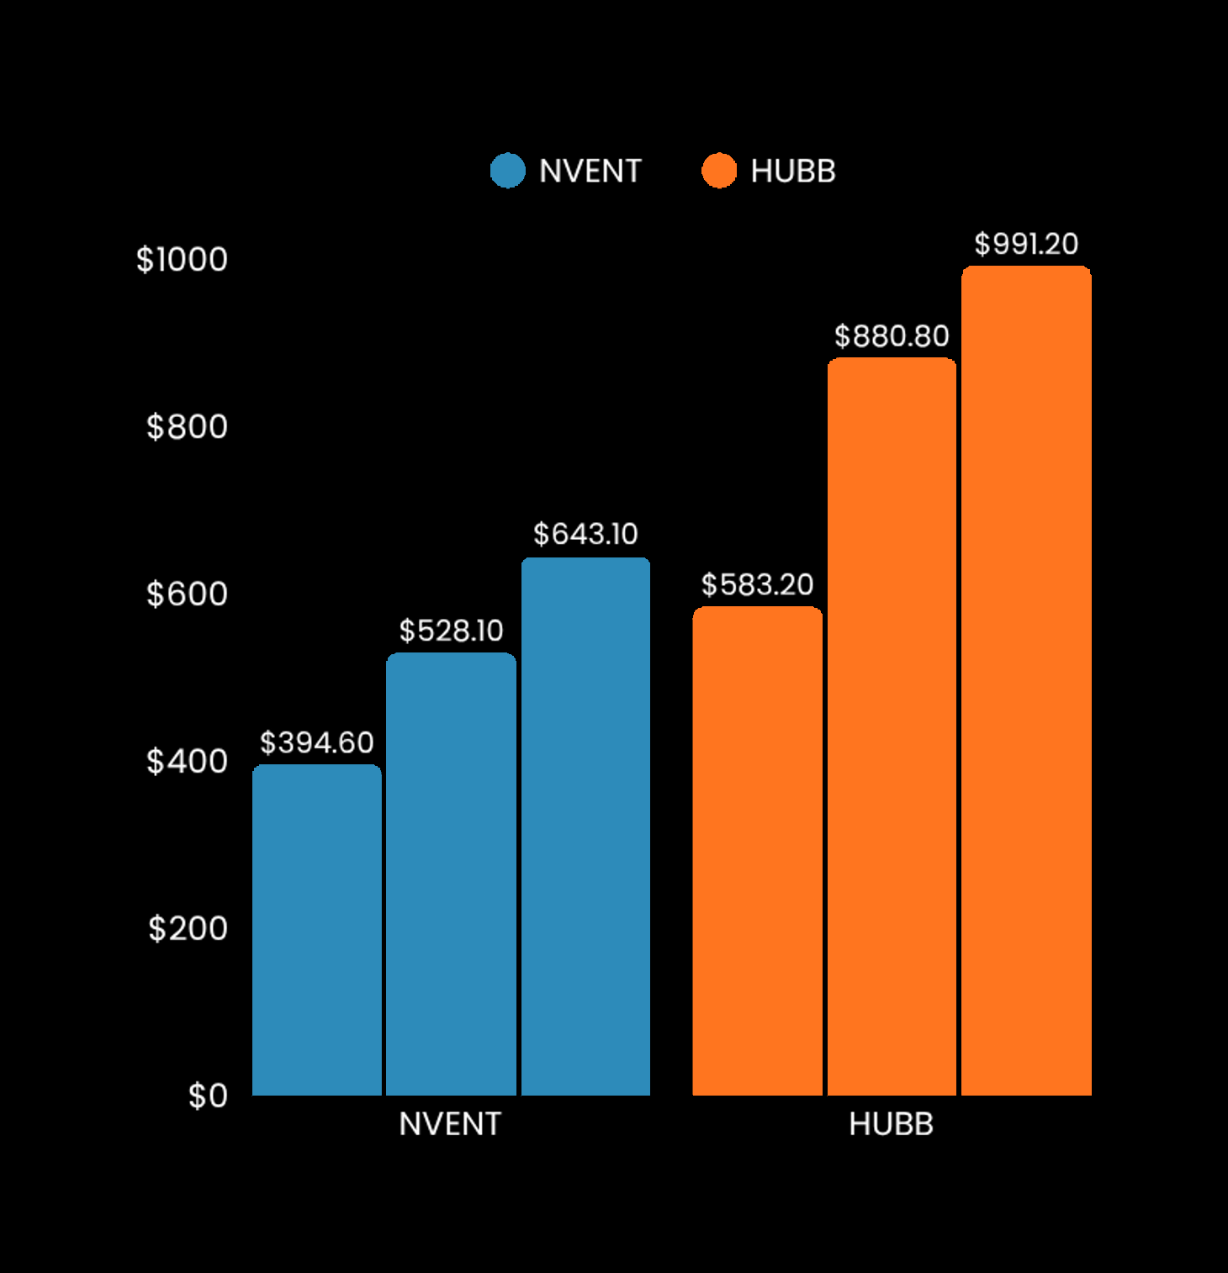
CASH FROM OPERATIONS
Nvent consistently generated strong operating cash flow, increasing from $394 million in 2022 to $643.10 million in 2024. This steady growth reflects the company’s ability to convert its operations into cash efficiently over time.
Hubbell experienced a more substantial increase in cash flow from operations, rising from $583.20 million in 2022 to $991.20 million in 2024. This sharp growth indicates a significant improvement in operational performance and cash-generating capacity.

Slide 10
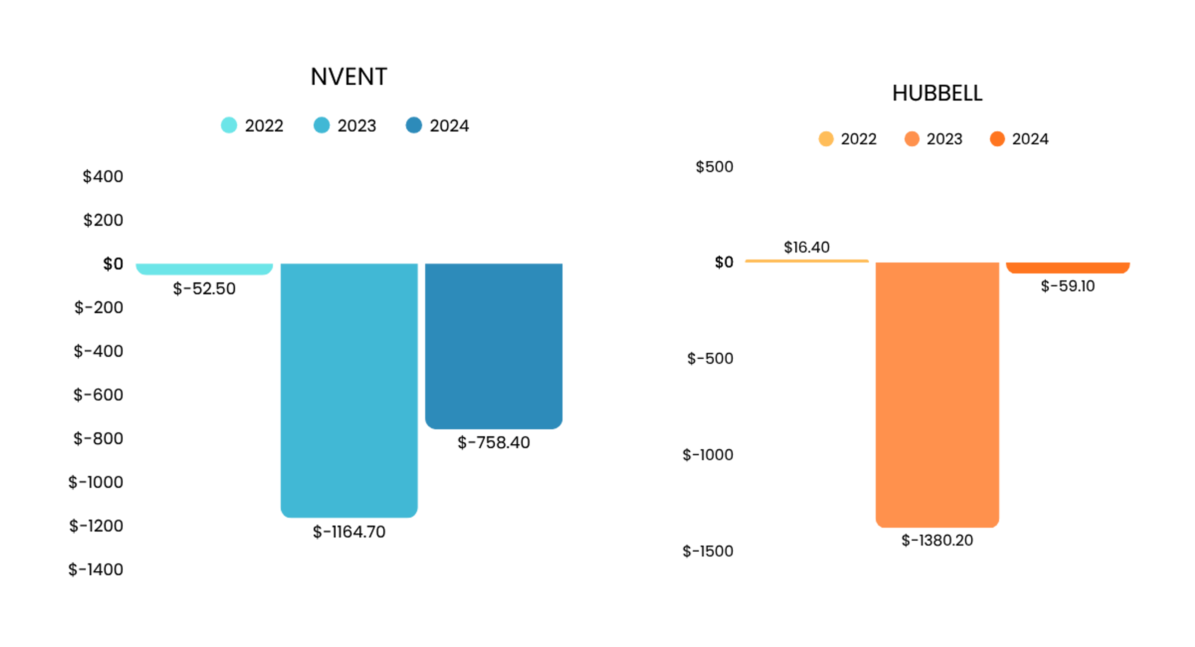
CASH FROM INVESTING
NVENT has consistently low leverage ratios. While the US market average for Debt/(Debt + Equity) is between 0.25 and 0.30. The Liabilities/Assets ratio is between 0.22 and 0.24, debt is only 22%-24% of its entire market value of assets. NVENT can be considered as a low-risk company.
Hubbard has low leverage ratios. Debt/(Debt + Equity) ranging from .11-.08. The Liabilities/Assets ratio decreased from .19 to .14 from 2022-2024, debt is only 14%-19% of its entire market value of assets. hubbard can be considered as a low-risk company.

Slide 11
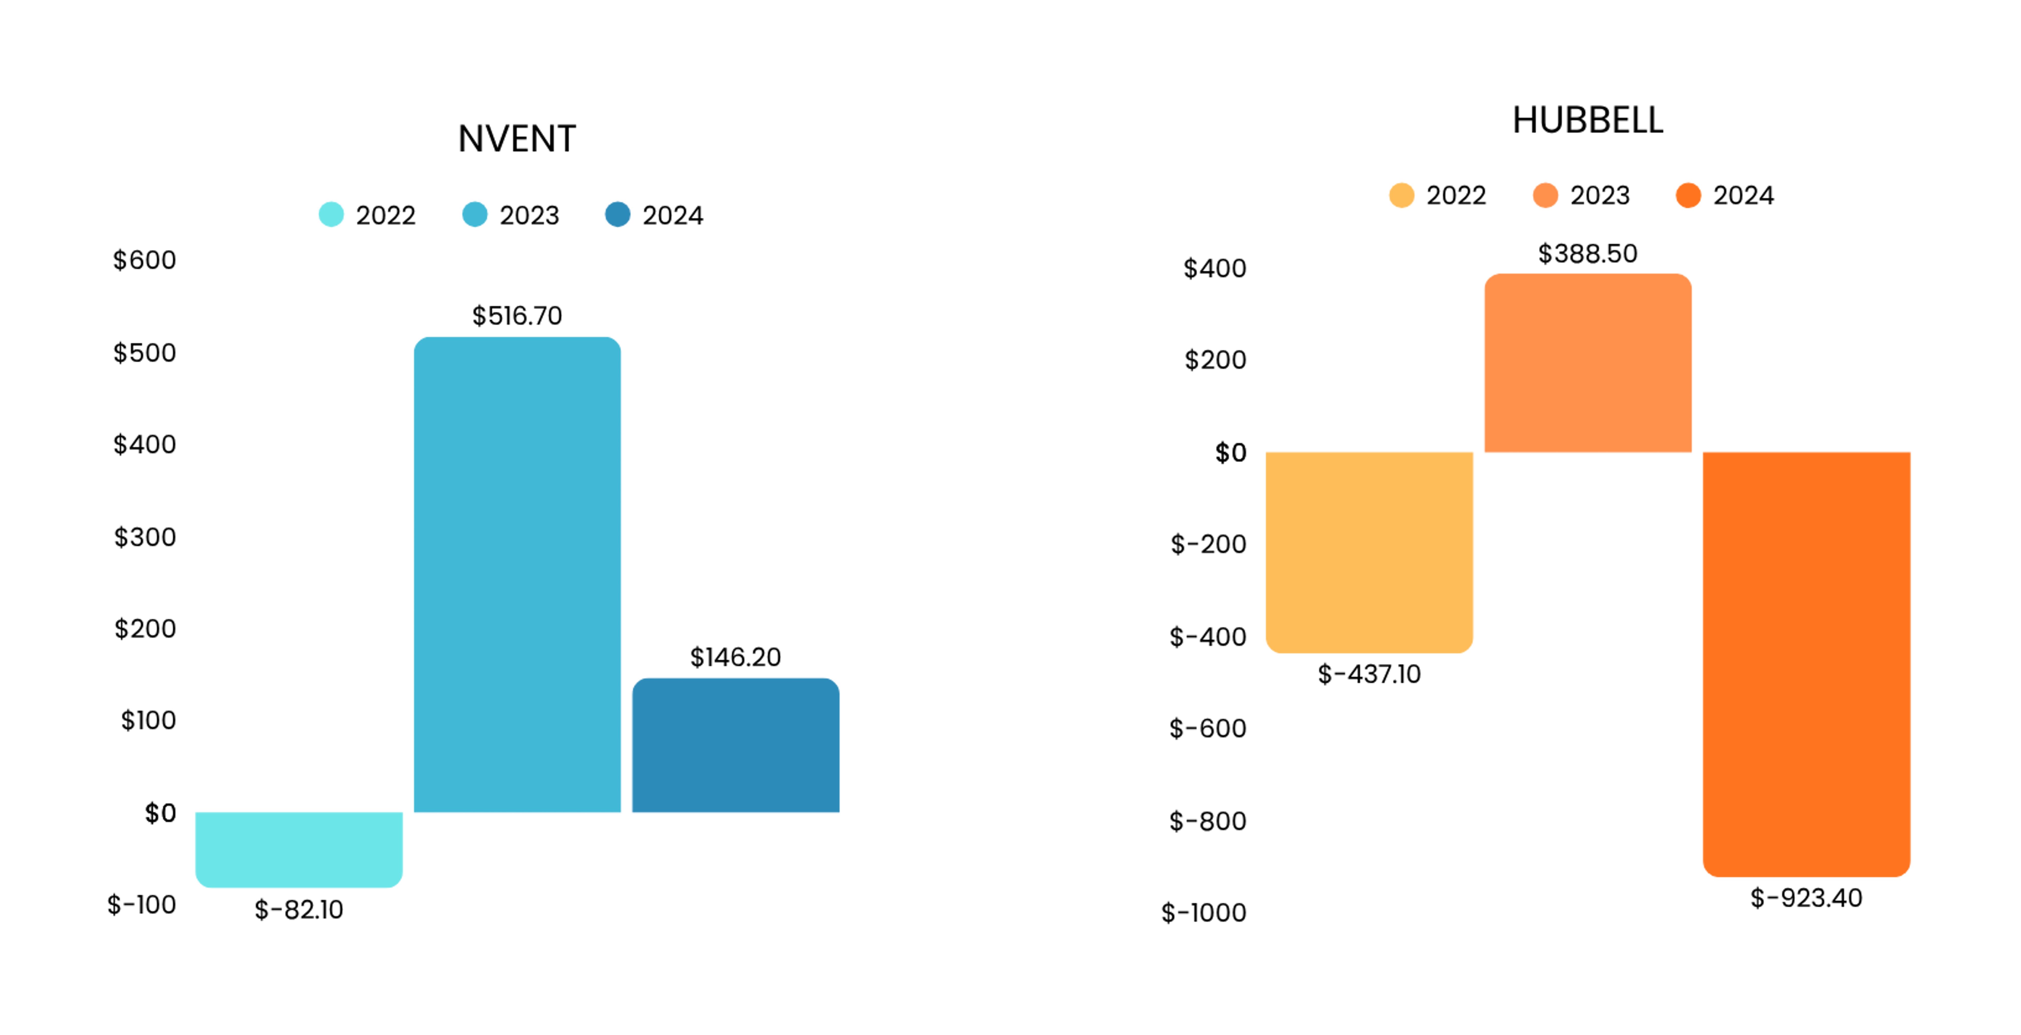
CASH FROM FINANCING
Nvent’s cash flow from financing was negative in both 2022 and 2024, the company used cash to repay debt, distribute dividends, and repurchase common stock. In 2023 the company reported a positive financing cash flow of $516.70 million, indicating it raised more capital than it paid out during that year.
Hubbell’s cash flow from financing was negative in 2022 and 2024, Hubbell used cash to heavily repaid debt, distribute dividends, and repurchase common stock. In 2023 the company reported a positive financing cash flow of $516.70 million, indicating it raised more capital than it paid out during that year.

Slide 12
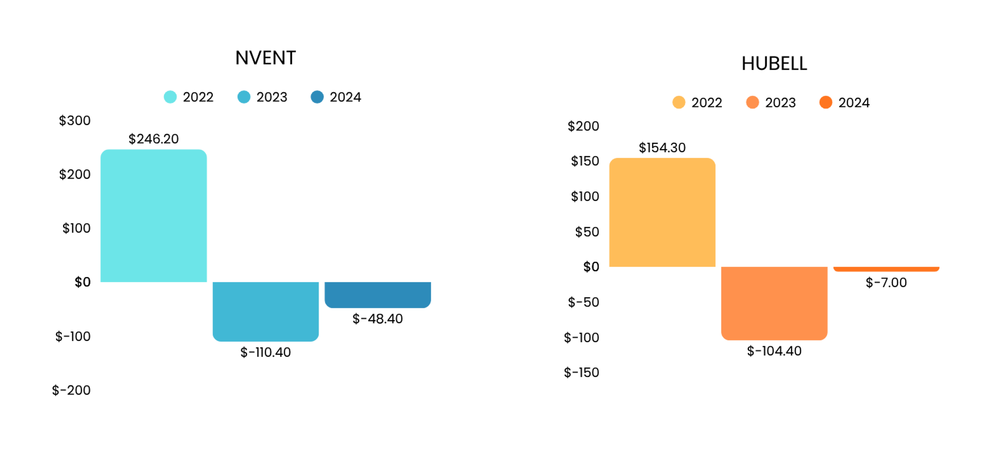
NET CHANGE IN CASH
Nvent’s net change in cash increased by $246.20 million in 2022, but turned negative in 2023 and 2024, with outflows of $110.40 million and $48.40 million, reflecting higher spending or investment than cash inflows in those years. Hubbell followed a similar pattern at lower levels, with cash rising by $154.30 million in 2022, then decreasing by $104.40 million in 2023 and slightly by $7.00 million in 2024. Overall, both companies generated strong cash in 2022 but experienced net cash outflows in the following years. Nvent’s fluctuations were larger, indicating more aggressive investment or financing activity, while Hubbell’s changes were smaller, reflecting more conservative cash management.

Slide 13
RECEIVABLE PERIOD
Nvent has a shorter receivable period compared to Hubbell, meaning it takes Hubell more time to collect payments from customers, from 15.59 days from 2022 to 17.60 days in 2024. In contrast, Nvent’s receivable period remained very short, ranging from 7.71 days to 9.68 between 2022 and 2024, demonstrating faster and more efficient collection of receivables.

Slide 14
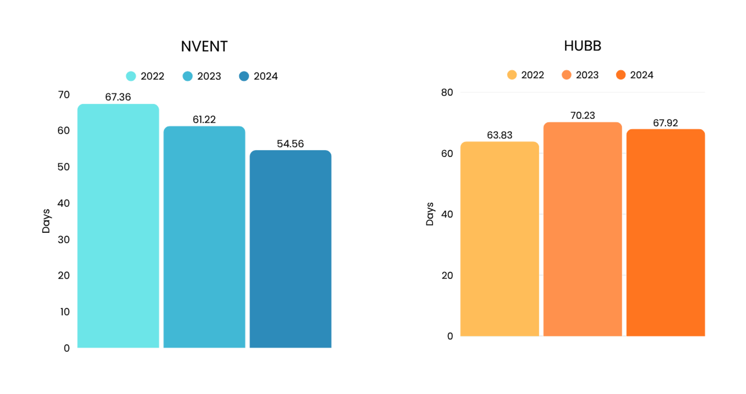
INVENTORY PERIOD
Nvent’s inventory period steadily improved over time, decreasing from 67.36 days to 61.22 days and then to 54.56 days, showing faster inventory turnover and stronger operational efficiency each year.
Hubbell’s inventory period increased from 63.83 days to 70.23 days in 2023, indicating slower turnover, before slightly improving to 67.92 days in 2024, though still higher than its 2022 level. Overall, Nvent became increasingly efficient in managing inventory, while Hubbell experienced a slowdown and did not recover to its initial efficiency.

Slide 15
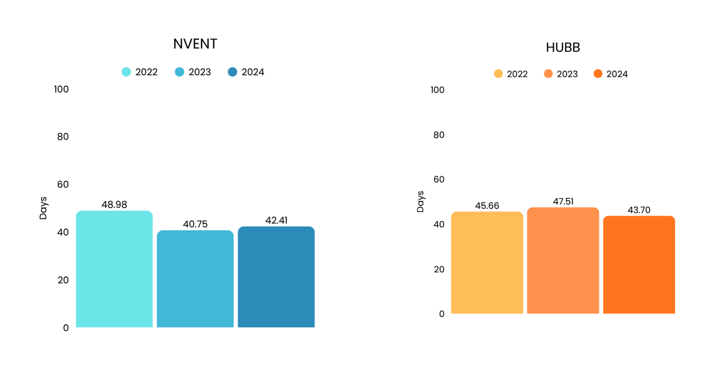
PAYABLE PERIOD
Nvent’s payable period improved from 48.98 days in 2022 to 40.75 days in 2023, before slightly rising to 42.41 days in 2024, indicating overall faster payments to suppliers.
Hubbell’s payable period increased from 45.66 to 47.51 days in 2023, then decreased to 43.70 days in 2024, showing a temporary delay before improving. By 2024, both companies were paying suppliers more quickly than before, but Nvent maintained a slightly shorter payable period, reflecting stronger payment efficiency.

Slide 16
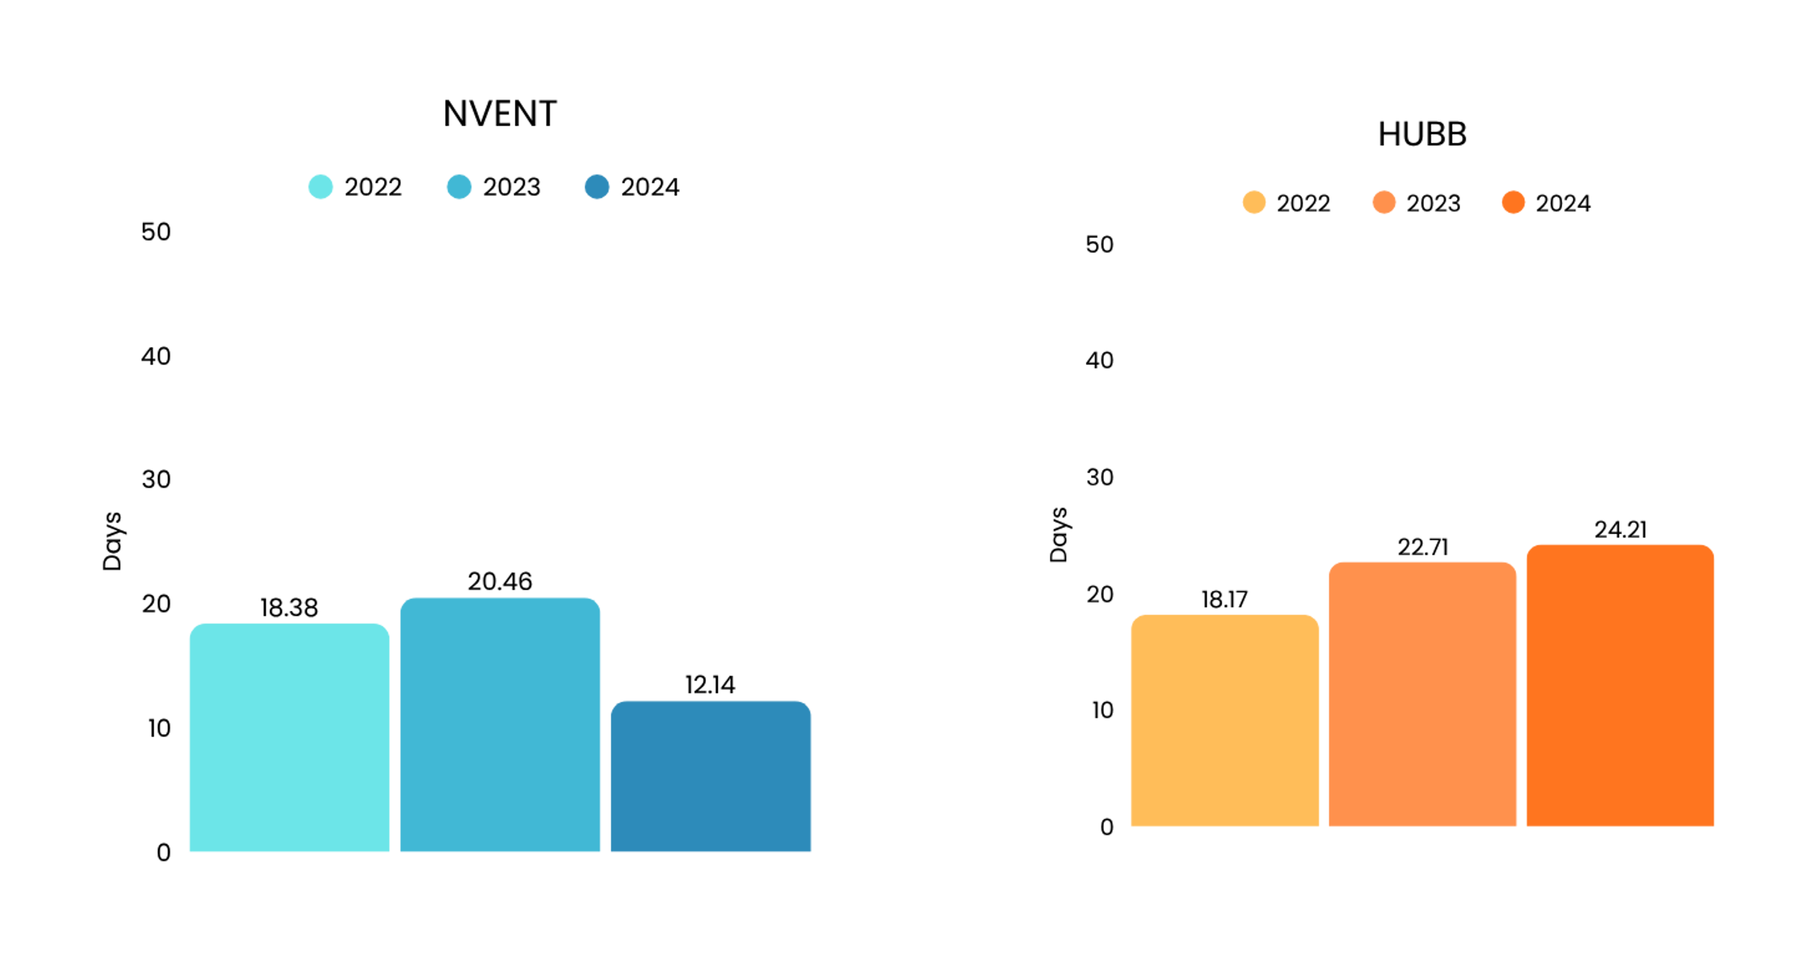
CASH CONVERSION CYCLE
Nvent’s cash conversion cycle initially increased slightly from 18.38 days in 2022 to 20.46 days in 2023, before dropping sharply to 12.14 days in 2024, showing a significant improvement in converting inventory and receivables into cash.
Hubbell’s cash conversion cycle steadily increased from 18.17 days to 24.21 days over the same period, indicating slower cash recovery and declining operational efficiency. Overall, Nvent demonstrated stronger efficiency in managing its working capital, while Hubbell experienced a worsening cash conversion performance.

Slide 17
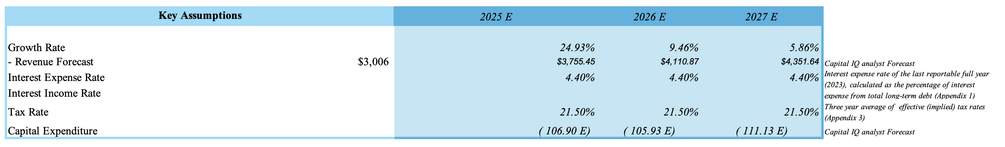
NVENT

Slide 18
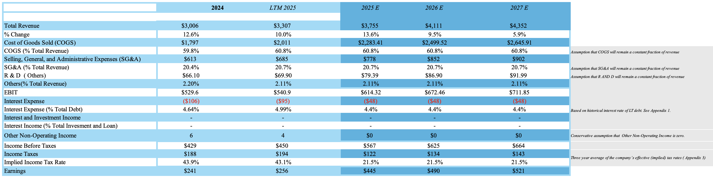
NVENT CONSOLIDATED STATEMENT OF INCOME
(FORECASTED)
(amounts in millions, except per share data)

Slide 19
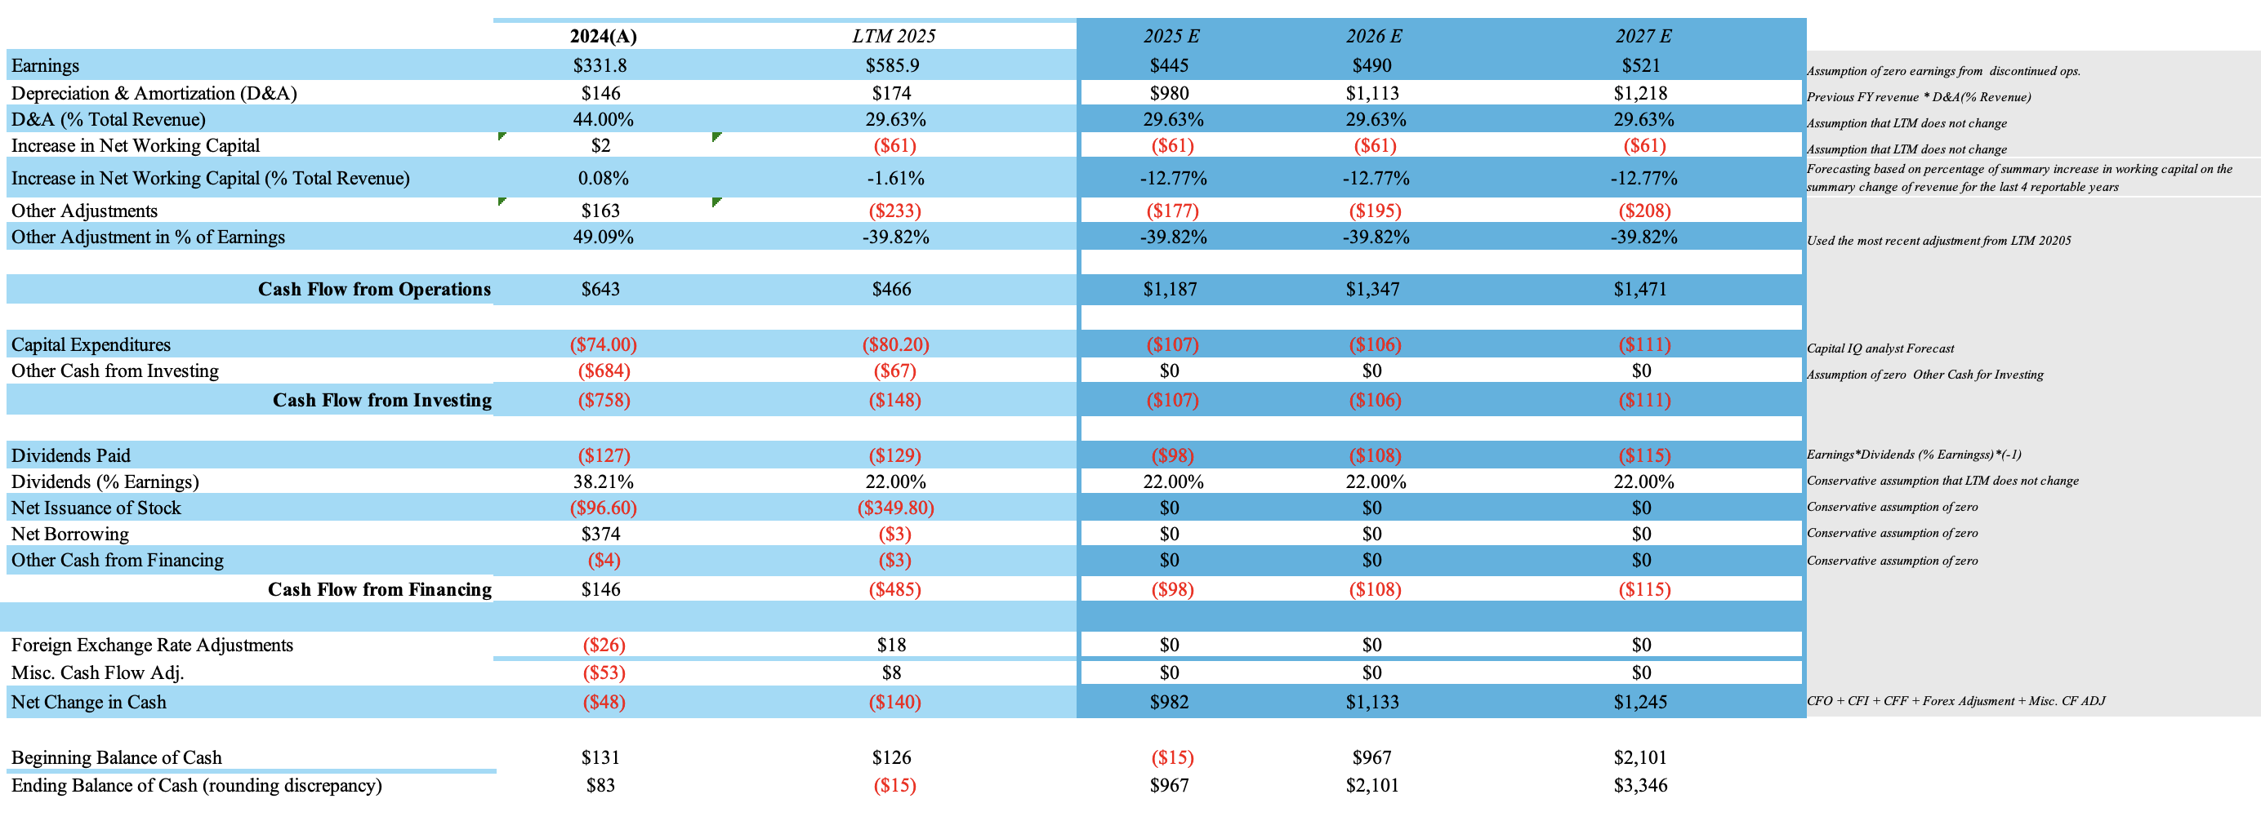
NVENT CONSOLIDATED CASH FLOW STATEMENT
(FORECASTED)
(amounts in millions, except per share data)

Slide 20
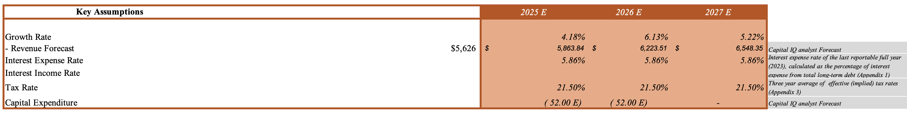
HUBBELL

Slide 21
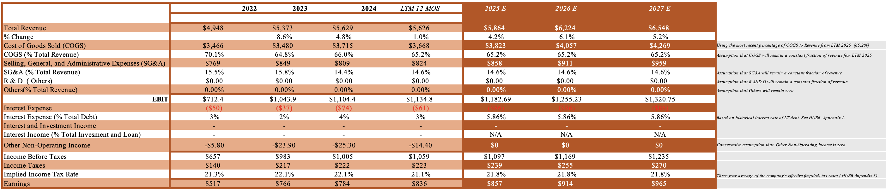
HUBBELL CONSOLIDATED STATEMENT OF INCOME
(FORECASTED)
(amounts in millions, except per share data)

Slide 22
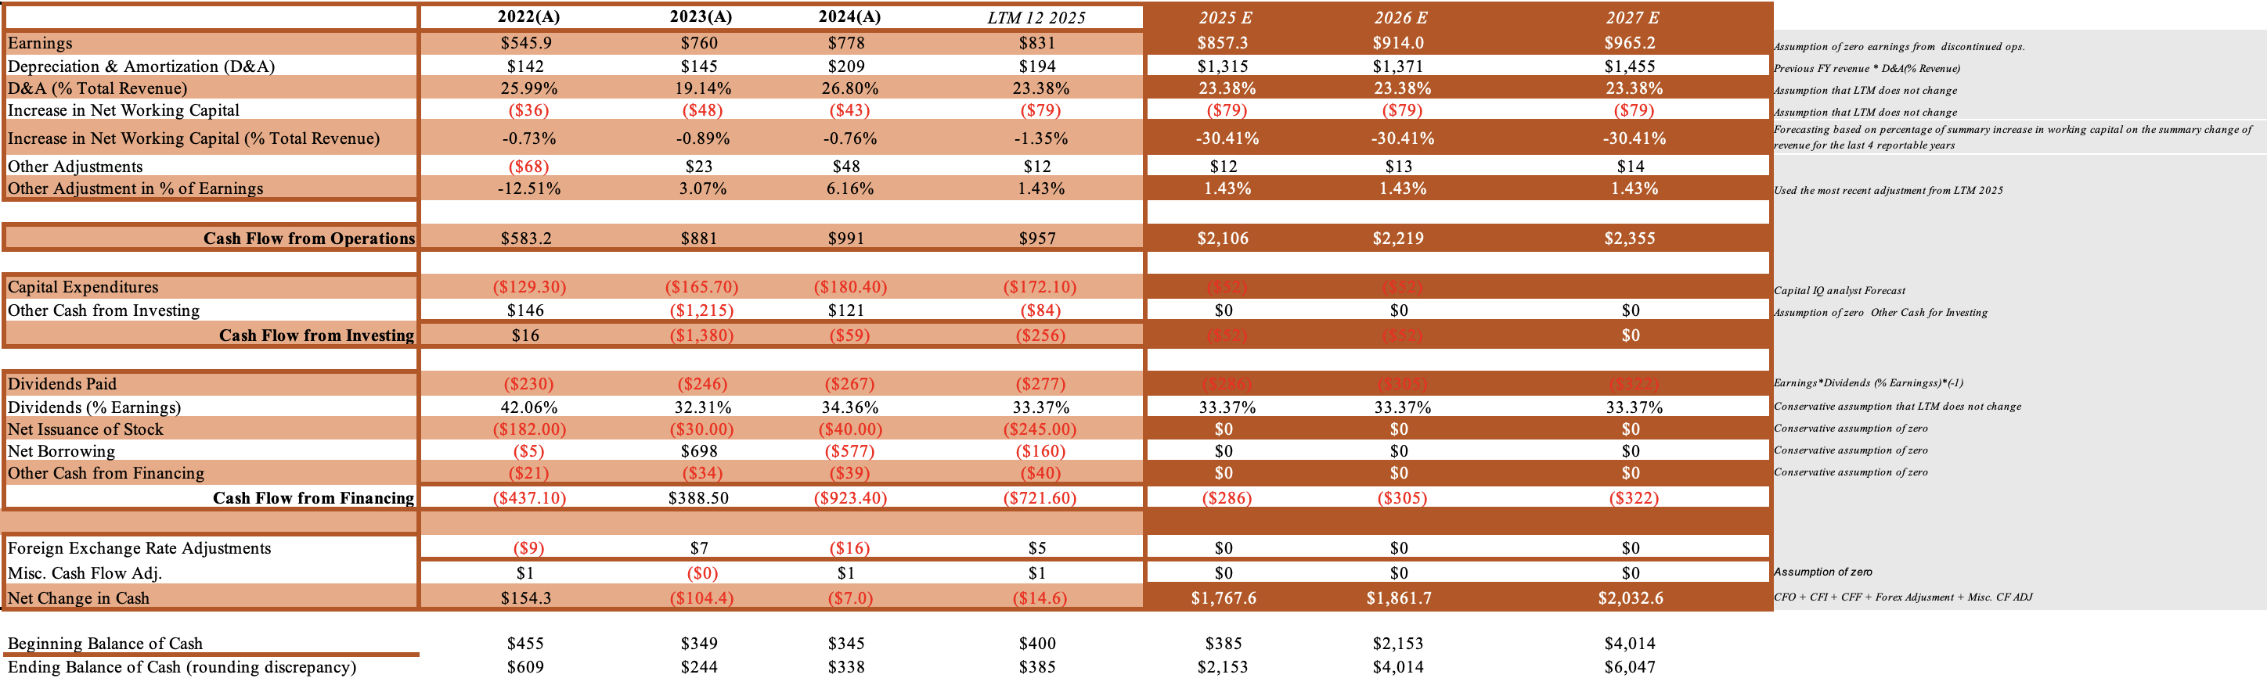
HUBBELL CONSOLIDATED CASH FLOW STATEMENT
(FORECASTED)
(amounts in millions, except per share data)

Slide 23
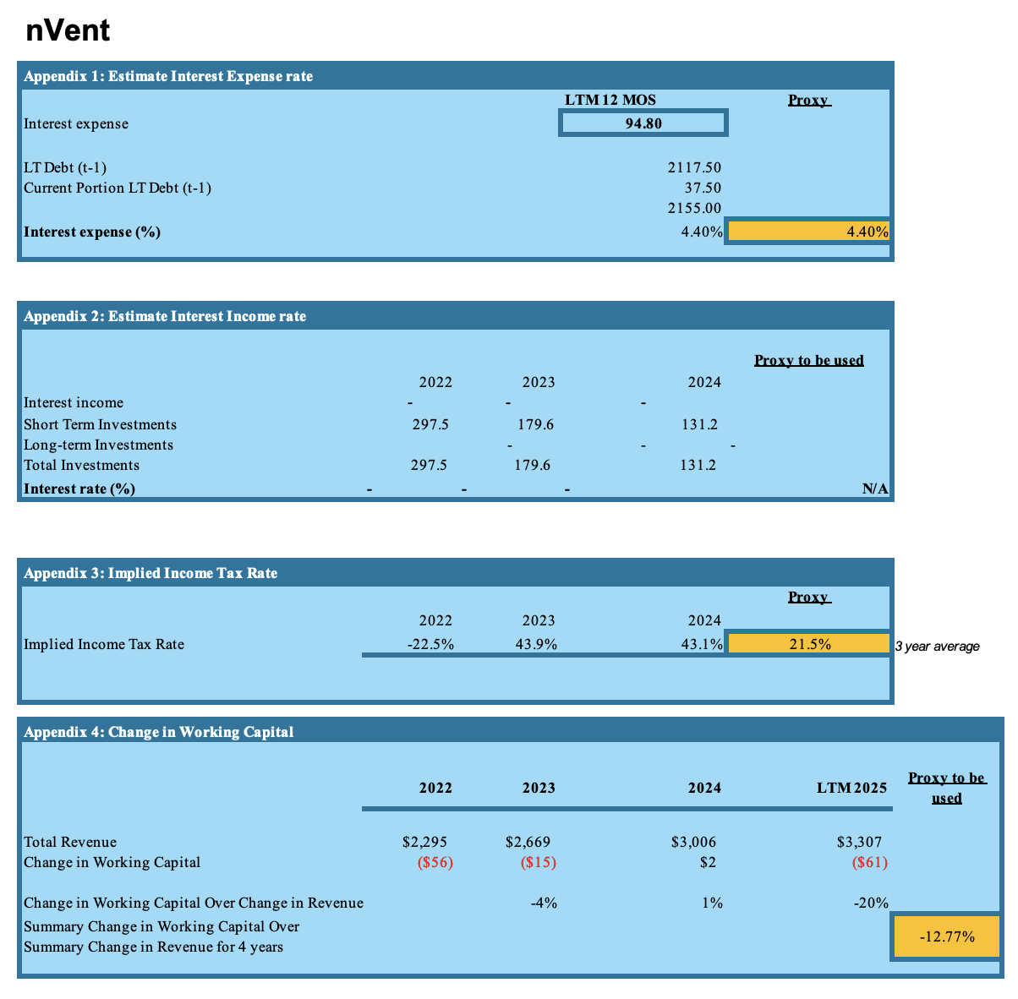
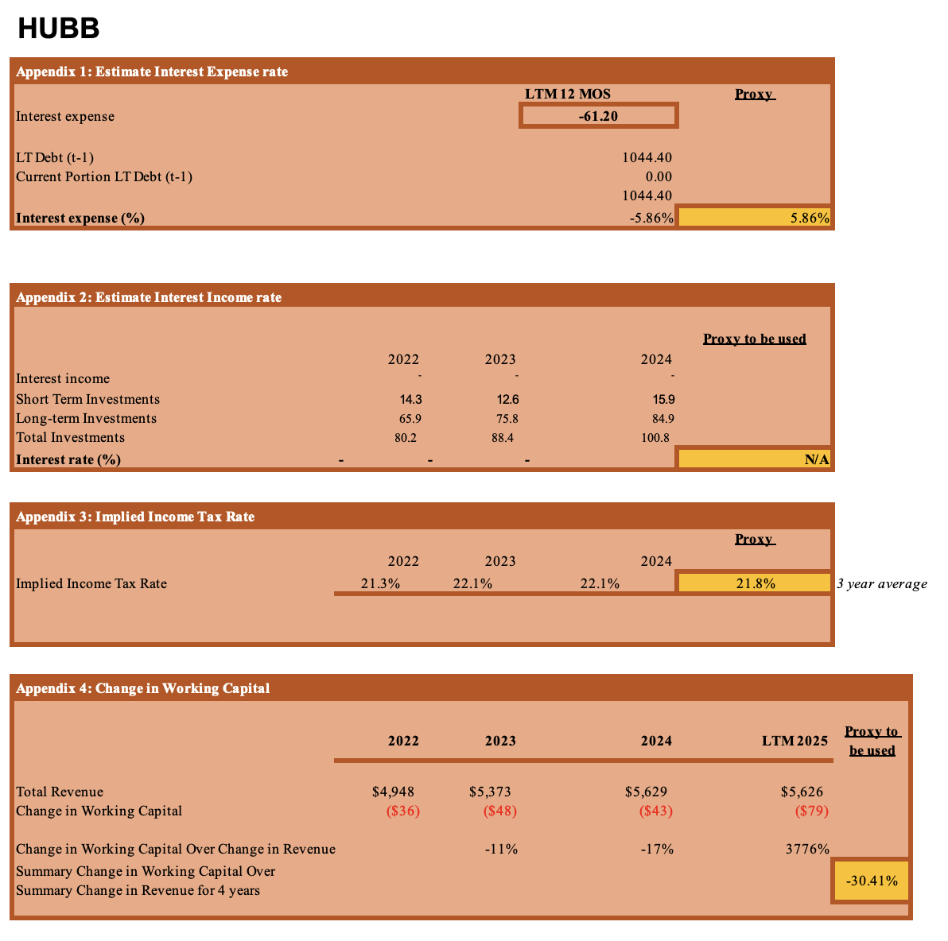
APPENDIX

Slide 24
Thank you
Isabel Anne Villa Mendoza
iavillamendoza@yahoo.com
www.isabelannevillamendoza.com

