Slide 1
FINANCIAL POLICY & PERFORMANCE COMPARISON:
NIKE VS. DECKERS
Isabel Anne Villa Mendoza

Slide 2
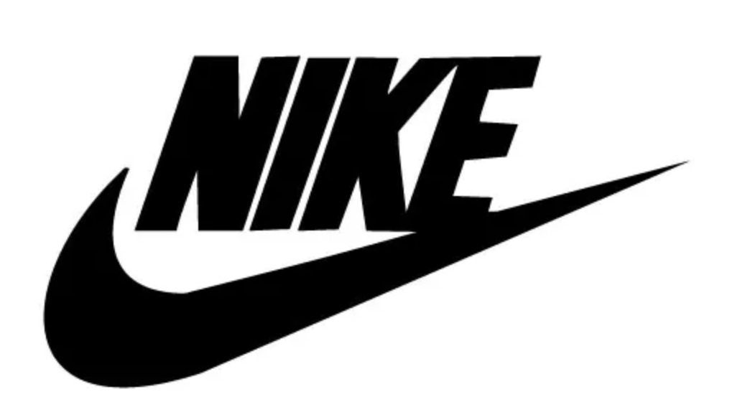
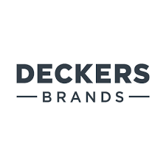
Introduction
  Examines financial policies of NIKE, Inc. and Deckers Outdoor Corporation
  Focus areas: WACC, Capital Structure, EVA, Debt Strategy, Financial Strategy
  Despite major differences in market size, both firms demonstrate how financial policy drives risk management, capital allocation, and value creation

Slide 3

BETA
Company | Beta | Market Sensitivity
Nike | 1.28 | ↑ More volatile than market (amplified movements)
Deckers | 0.99 | ≈ Tracks market closely (stable)
Industry Betas

Slide 4
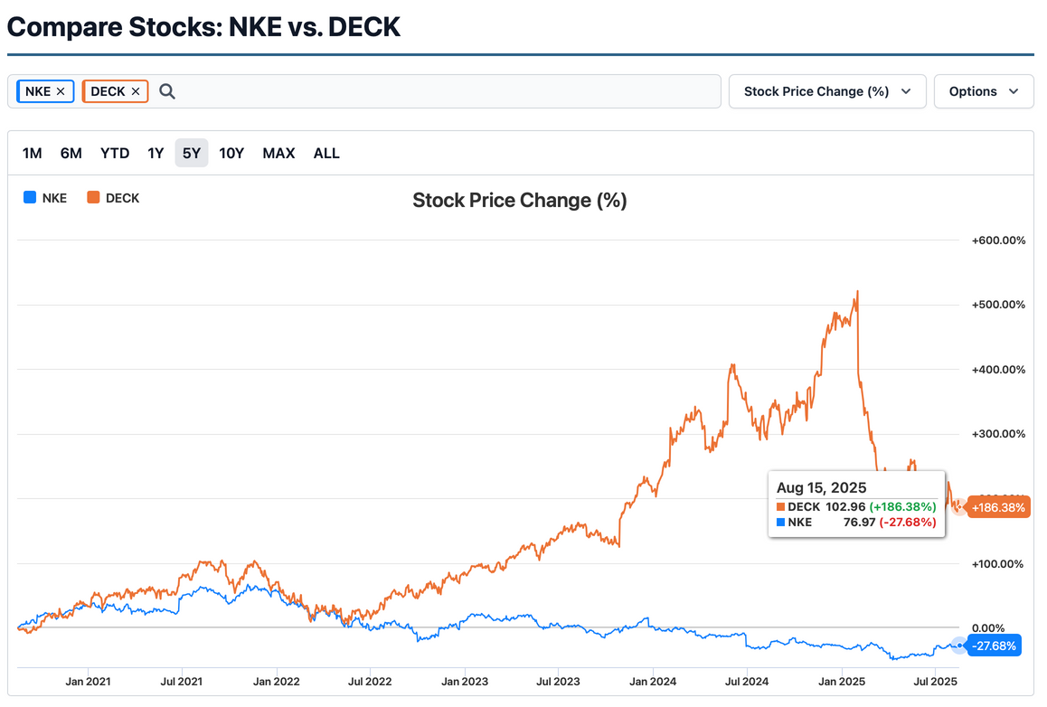
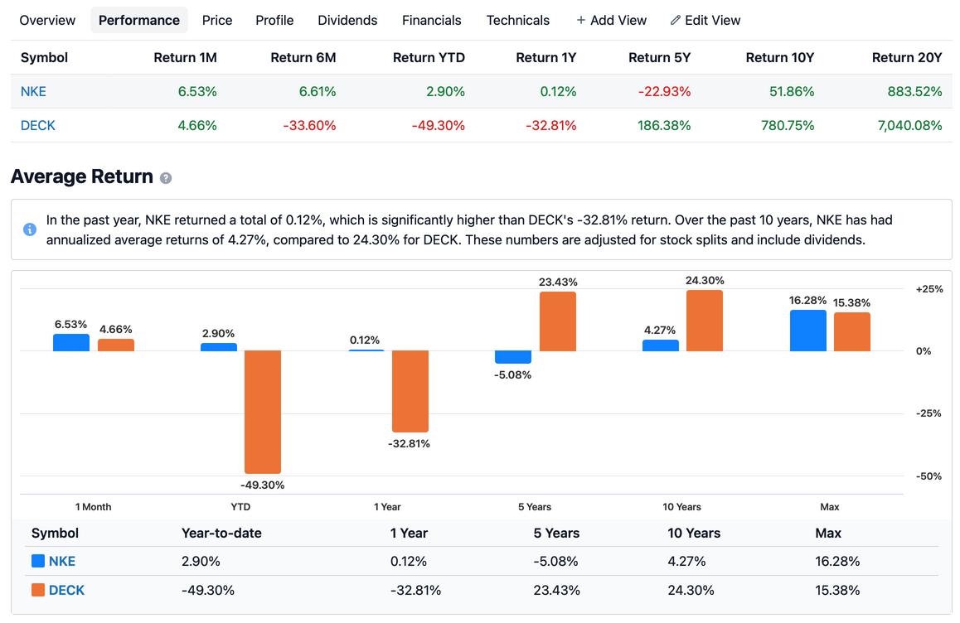
STOCK PERFORMANCE COMPARISON
NKE vs. DECK — Stock Comparison

Slide 5

EBIT INTEREST COVERAGE RATIO
3 Yr Average EBIT Interest Coverage Ratio
  Nike: 19.30
  Deckers: 297.06
  Due to market size difference, Deckers is far better positioned to meet its interest obligations, highlighting stronger financial flexibility compared to Nike.
Company | 3-Year Avg EBIT/Interest Coverage | Insight
Nike | 19.3 | Adequate coverage, but lower financial flexibility
Deckers | 297.06 | Strong coverage, demonstrates high financial flexibility

Slide 6
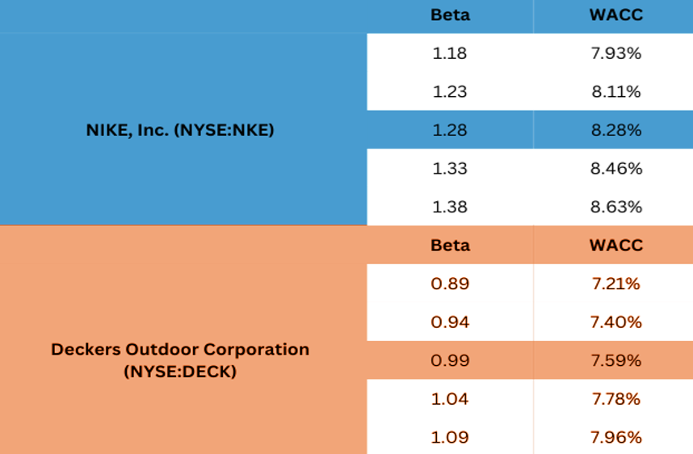
WACC Sensitivity to Beta
  Nike: 7.93% → 8.63%
  Deckers: 7.22% → 7.96%
  Higher beta = Higher WACC

Slide 7
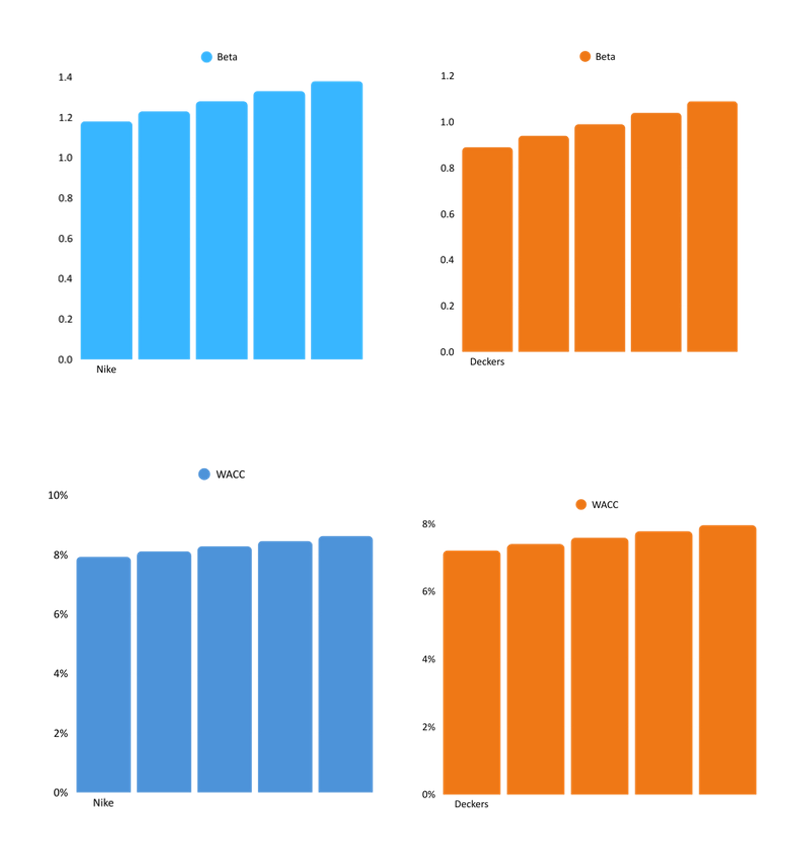
WACC Sensitivity to Beta
  Nike: 7.93% → 8.63%
  Deckers: 7.22% → 7.96%
  Higher beta = higher WACC

Slide 8
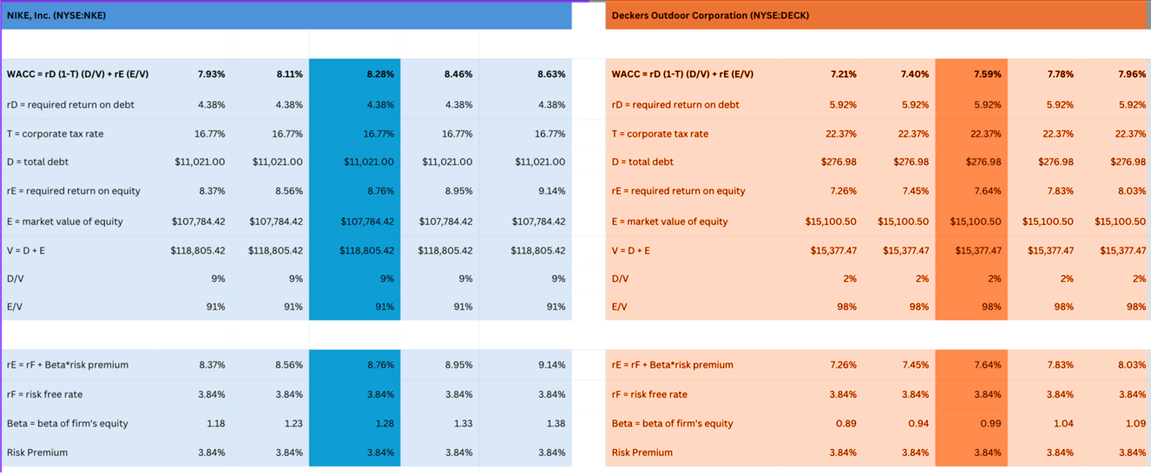
WACC
Weighted Average Cost of Capital
  Nike
    S&P A+ rating → lower cost of debt (4.38%)
    Higher beta (1.28) and leverage (9%) → rE 8.56%
    WACC 8.76%
    Nike’s stronger credit reduces debt costs, but risk and leverage drive WACC higher.
  Deckers
    No public credit rating → higher cost of debt (5.92%)
    Lower beta (0.99) and leverage (2%) → rE 7.64%
    WACC 7.59%
    Deckers keeps WACC lower through conservative financing.
*In Millions of the reported currency, except per share items.

Slide 9
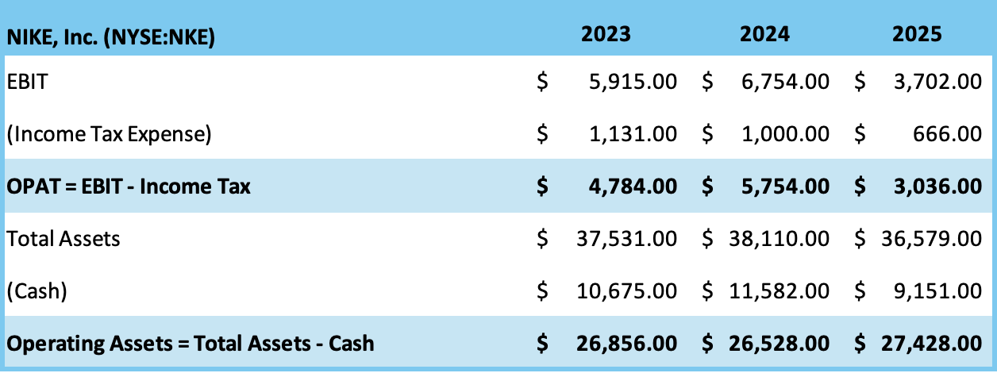
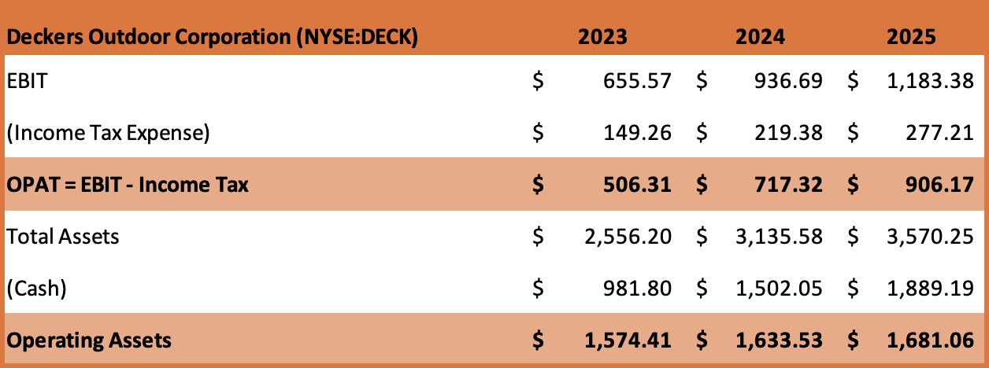
OPAT and Operating Assets
*In Millions of the reported currency, except per share items.

Slide 10
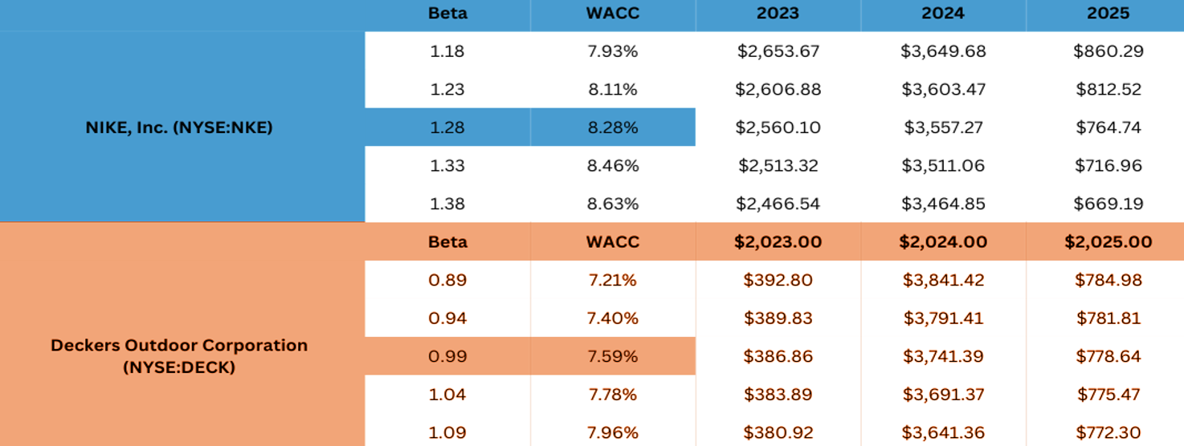
ECONOMIC VALUE ADDED (EVA)
Nike’s EVA
2023 – Solid Value Creation: EVA of $2.56B shows efficient capital use and strong profitability.
2024 – Peak Performance: EVA surged to $3.56B, reflecting superior operational results and shareholder value creation.
2025 – Decline: EVA fell to $764.74M (↓79%), indicating profitability pressures and reduced efficiency, though still positive.
Deckers’ EVA
2023 – Modest Value Creation: EVA at $386.86M, indicating limited but positive returns above capital costs.
2024 – Exceptional Growth: EVA jumped to $3.74B, showing outstanding operational performance and strong value creation.
2025 – Sharp Decline: EVA dropped to $778.64M, down significantly from 2024, signaling reduced efficiency but still positive value creation.
*In Millions of the reported currency, except per share items.

Slide 11
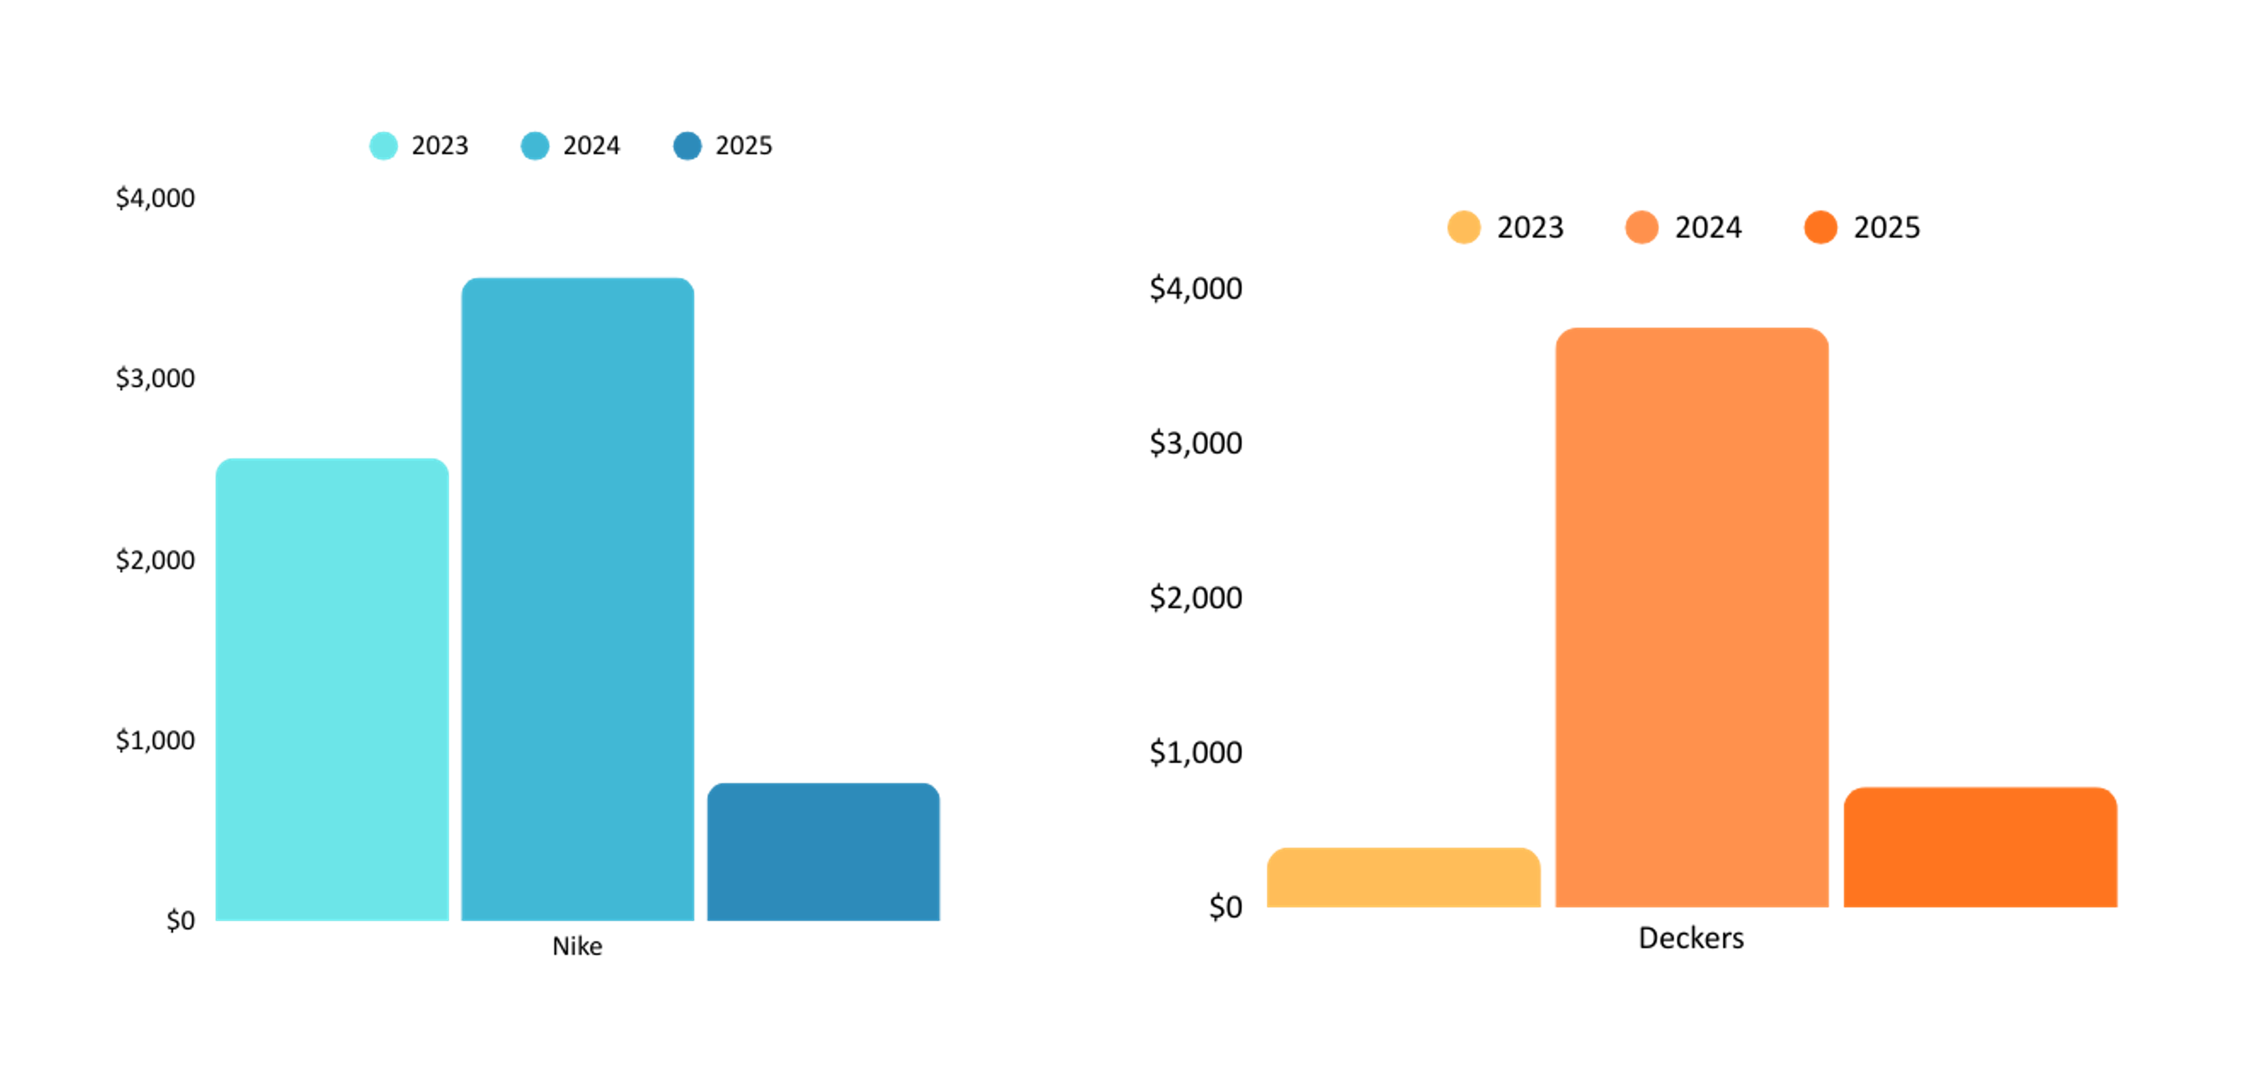
ECONOMIC VALUE ADDED (EVA)
  From FY 2023 to 2025, both Nike and Deckers maintained positive EVA, showing both firms created real economic profits even after factoring in the cost of capital (WACC), with results holding steady under beta adjustments.
  Nike’s EVA increased from $2,560 in 2023 to $3,557 in 2024 before dropping to $765 in 2025.
  Deckers showed a similar pattern, climbing from $387 in 2023 to $3,741 in 2024, then falling to $779 in 2025

Slide 12
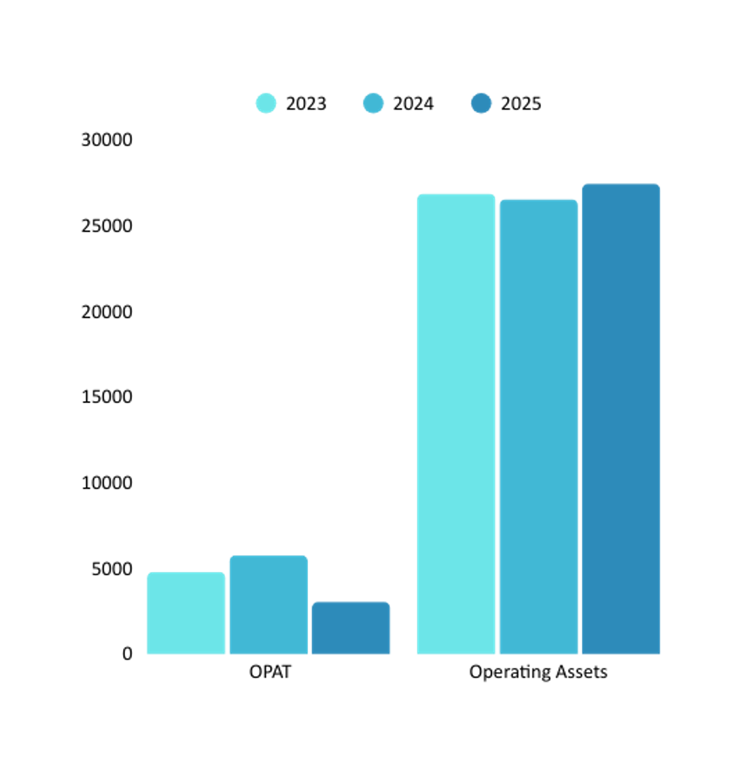
NIKE
  2023–2024: Nike’s OPAT grew from $4.8B → $5.8B despite stable operating assets, showing improved efficiency and stronger returns.
  2025: OPAT dropped to $3.0B even as operating assets slightly increased, indicating lower profitability and weaker asset utilization.
  Nike’s returns peaked in 2024, but 2025 signals margin pressure or cost challenges despite asset growth.
*In Millions of the reported currency, except per share items.

Slide 13
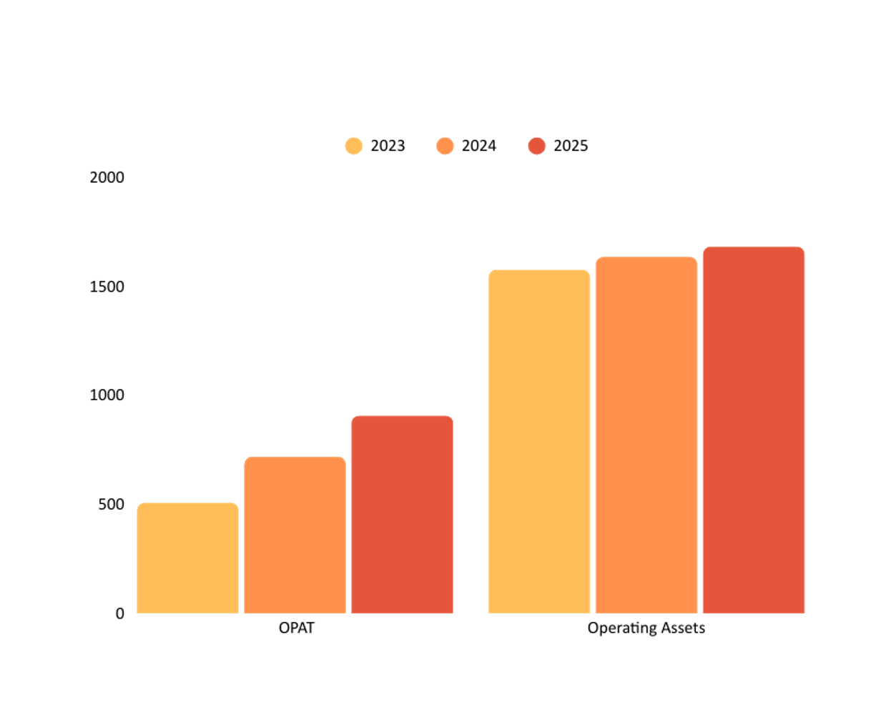
DECKERS
  Decker’s OPAT increased steadily from $506M → $906M (2023–2025), nearly 80% strong growth in 3 years.
  Operating assets grew moderately ($1.57B → $1.68B), but OPAT rose faster, signaling improving returns.
  Deckers shows consistent profitability gains and superior efficiency in converting assets into earnings.
*In Millions of the reported currency, except per share items.

Slide 14
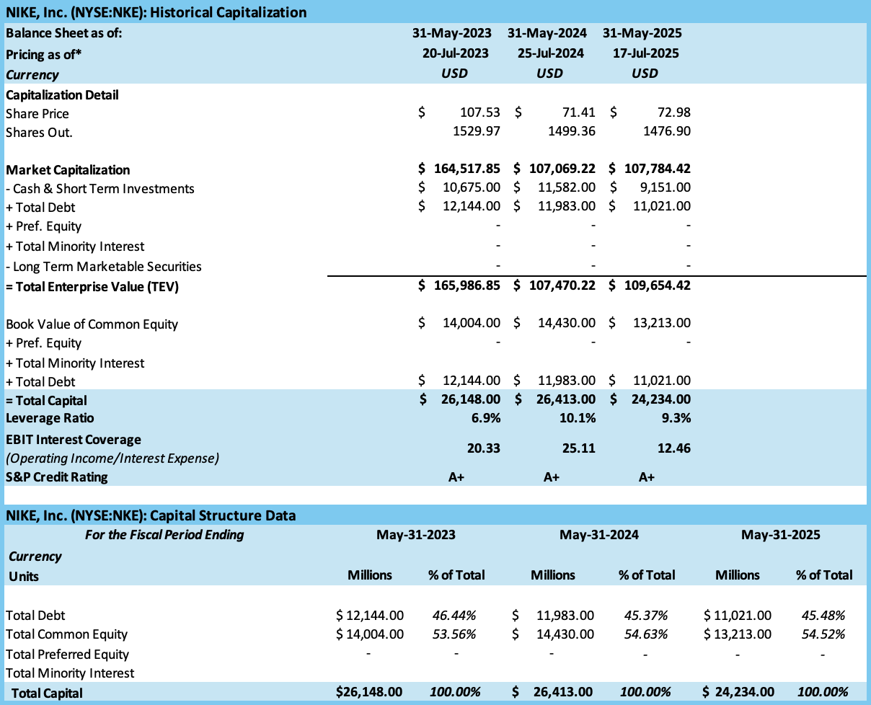
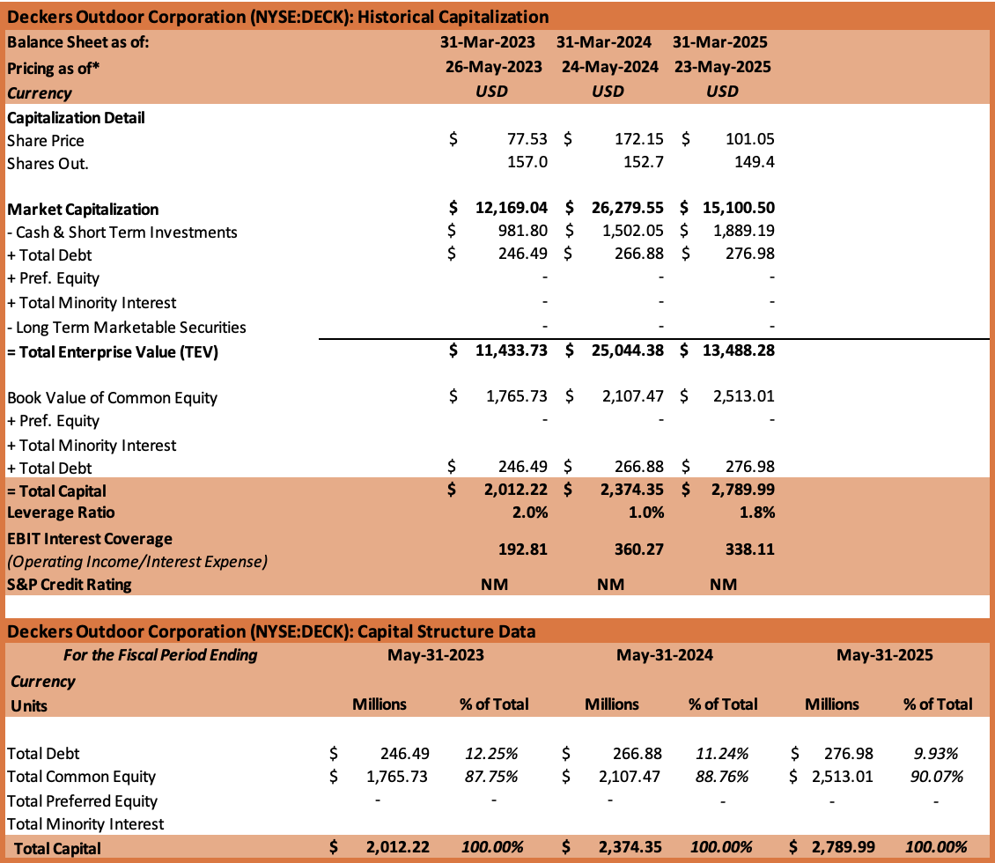
CAPITAL STRUCTURE
*In Millions of the reported currency, except per share items.

Slide 15
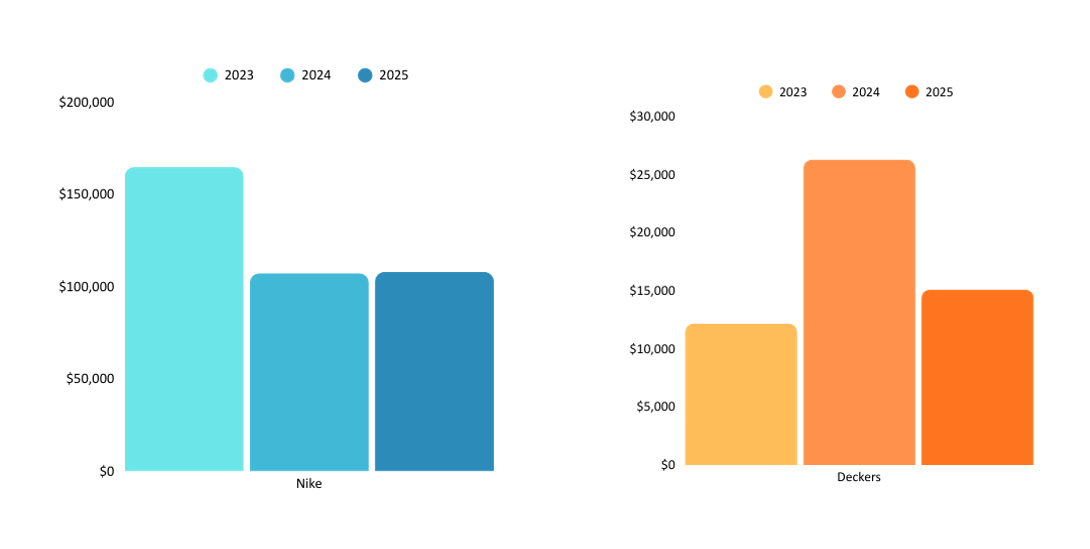
MARKET CAPITALIZATION
  Nike fell from $164.5B (2023) to $107B (2024). Stayed flat at $108B in 2025. Shows stability but no strong recovery.
  Deckers grew from $12.2B (2023) to $26.3B (2024). Dropped to $15.1B in 2025, still above 2023.Indicates growth potential but volatility.
*In Millions of the reported currency, except per share items.

Slide 16
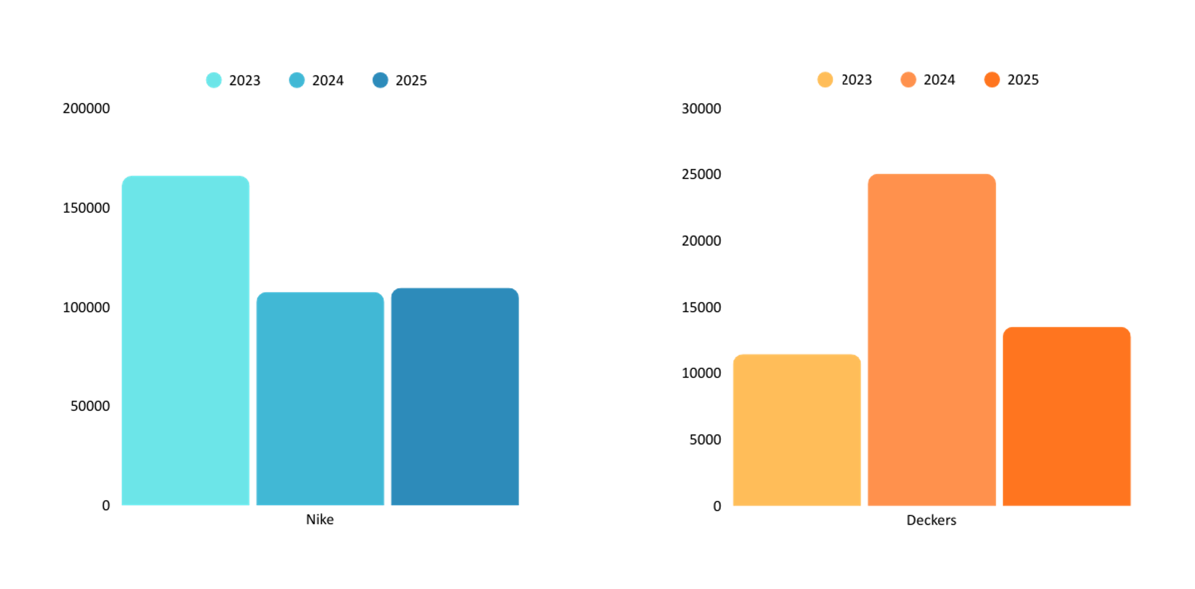
TOTAL ENTERPRISE VALUE
  Nike dropped from $166B (2023) to $107B (2024). Slight rebound in 2025 ($110B). Large, stable but slow recovery. Nike showed scale & resilience.
  Deckers increased from $11.4B (2023) to $25B (2024). Fell back to $13.5B (2025). High growth potential, but volatile. Deckers movements play with fluctuations.
*In Millions of the reported currency, except per share items.

Slide 17
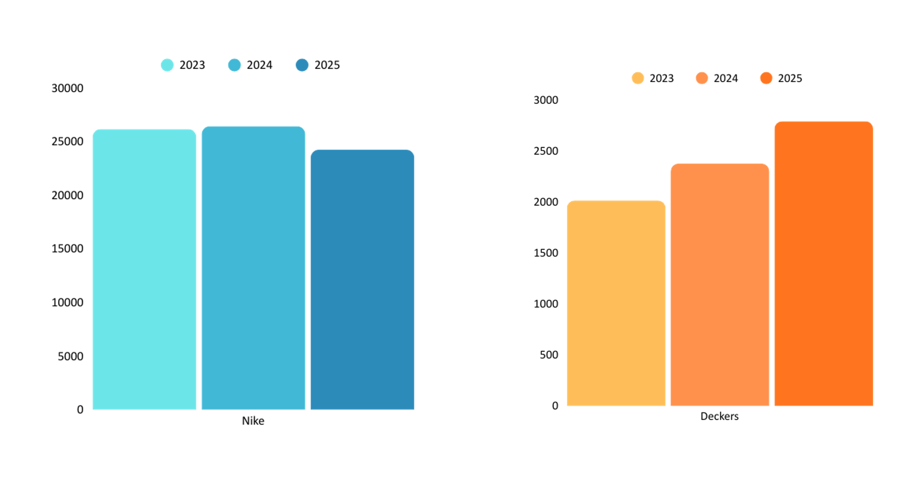
TOTAL CAPITAL
  Nike stayed relatively steady ($26.1B → $26.4B) in 2023–2024. Slight decline in 2025 ($24.2B). Signals stable but slightly contracting capital base.
  Deckers gradual growth from $2.0B (2023) to $2.8B (2025). Reflects consistent capital expansion to support growth.
*In Millions of the reported currency, except per share items.

Slide 18
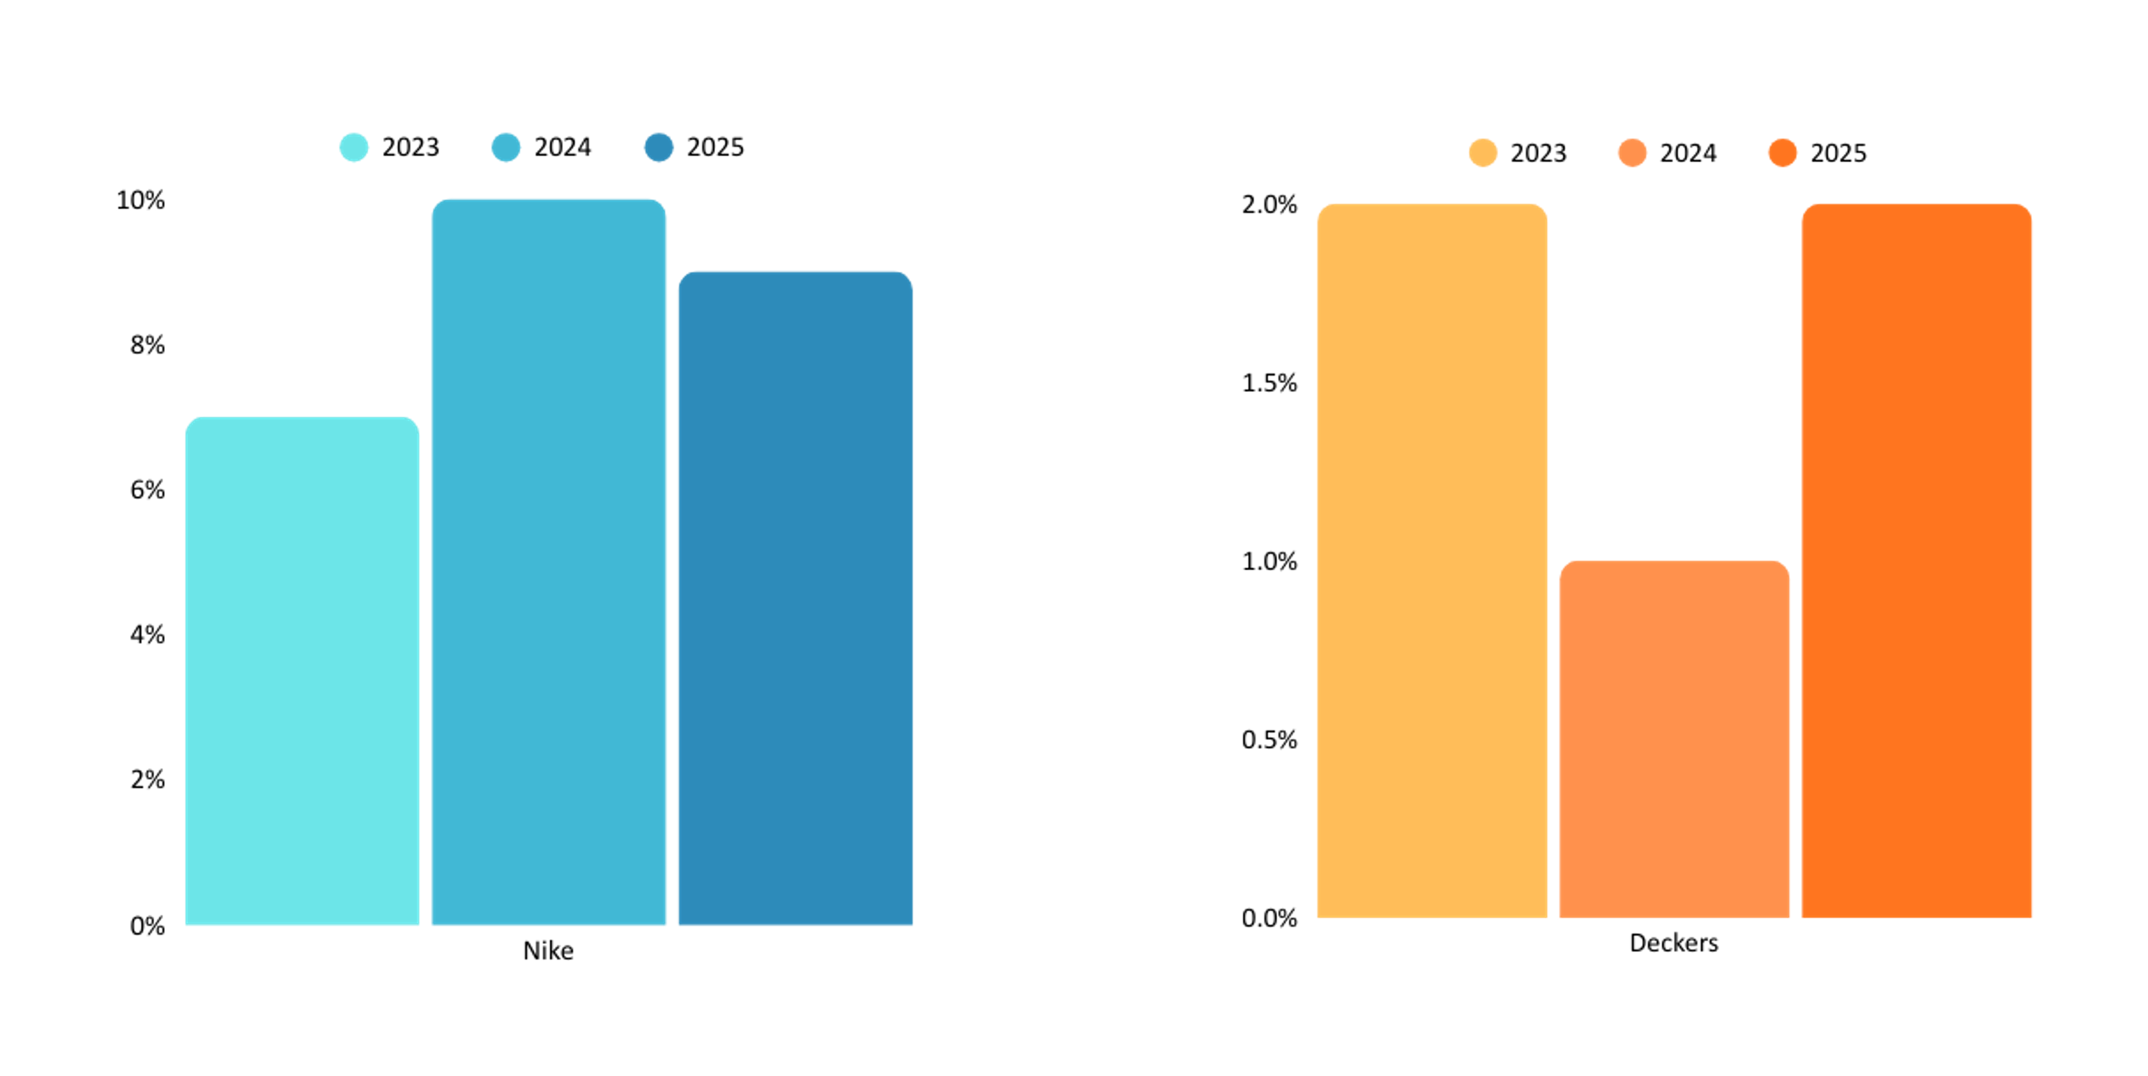
LEVERAGE RATIO
  Nike rose from 7% (2023) to 10% (2024). Slightly lower in 2025 (9%). Indicates moderate reliance on debt, but within manageable levels.
  Deckers very low leverage (1–2% across 2023–2025). Reflects a conservative financing strategy, relying mostly on equity.

Slide 19
CREDIT RATING
Company | Credit Rating (S\&P) | Outlook / Notes
Nike | A+ (S&P) | Stable under S&P. Strong brand and scale but facing margin pressures.
Deckers | (Not publicly rated) | No public credit rating available; coverage limited, requires premium sources or IR disclosure.
Key Factors Affecting Nike’s Rating
  EBIT Interest Coverage Ratio: (2023)20.33%,(2024, 25.11%,(2025)12.46% → compatible with A+ rating
  Leverage Ratio (Past 3 Years): 6.9% – 10.1%
  Benchmark: Median A-rated firm = 16.4% leverage
  Nike’s leverage consistently below median (16.9%, 10.1%,9.3%) supports stronger rating
  A+ (one notch above A) is consistent with slightly lower leverage & solid coverage
  Rating appears justified given financial profile
  Deckers has no public credit rating (S&P, Moody’s, Fitch)
  Deckers minimal debt levels reduce need for external rating. Risk assessment relies on financial fundamentals

Slide 20
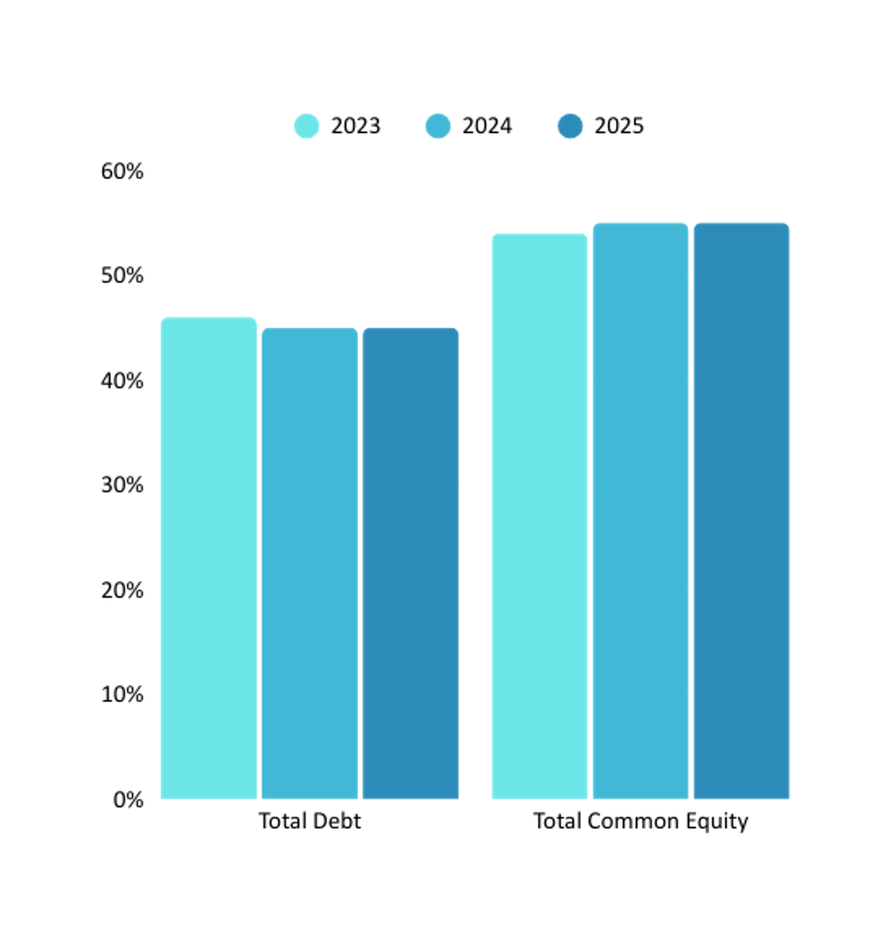
NIKE
  Total Debt: Stable at 45% across 3 years.
  Total Equity: Slightly increased from 54% → 55%.
  Trend: Balanced and consistent capital mix, showing financial stability.
  Nike maintains a conservative debt–equity balance, signaling low risk and strong equity backing.

Slide 21
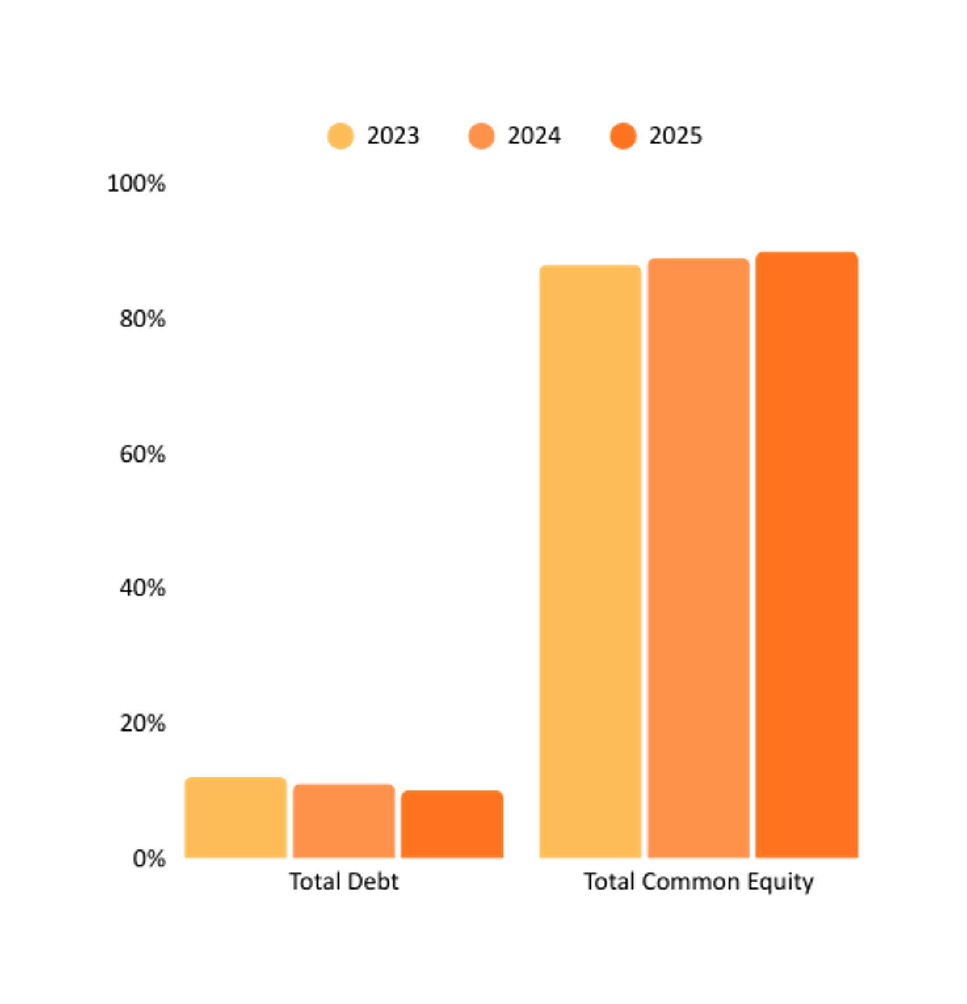
DECKERS
  Total Debt: Declined from 12% → 10%, showing reduced reliance on borrowing.
  Total Equity: Increased from 88% → 90%, highlighting a strong equity base.
  Trend: Deckers follows a very conservative financing approach, relying heavily on equity.
  Compared to Nike, Deckers is less leveraged and more equity-driven, signaling lower financial risk but limited debt-financed growth.

Slide 22
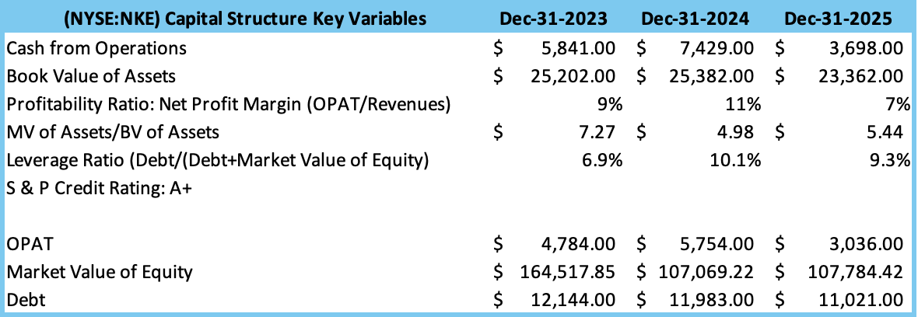
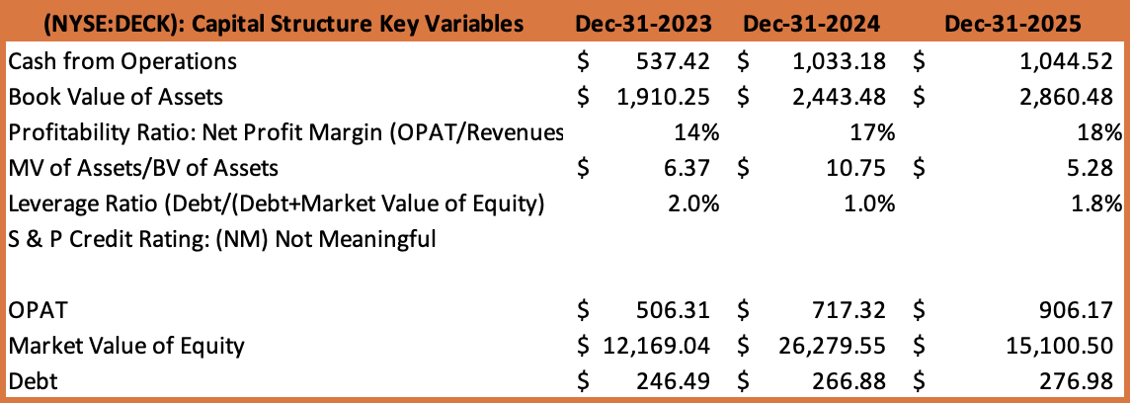
TRADE OFF THEORY
*In Millions of the reported currency, except per share items.

Slide 23
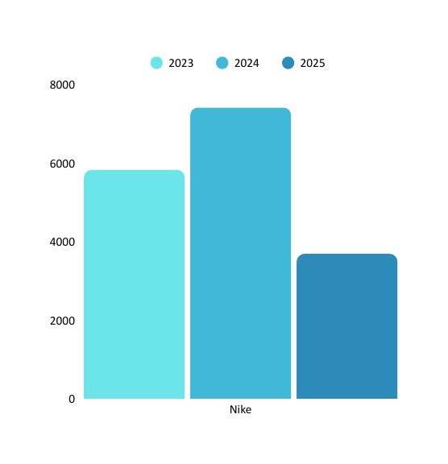
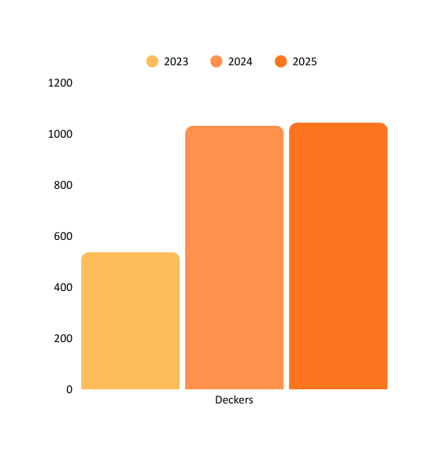
CASH FROM OPERATIONS
  Nike has strong growth from $5.8B (2023) to $7.4B (2024).Sharp drop in 2025 ($3.7B),suggesting operational or cash flow pressures. High but volatile cash flow.
  Deckers has more modest scale but steady growth. $0.54B (2023) → $1.03B (2024) → $1.04B (2025). Reflects consistent cash generation despite smaller size. Lower absolute cash, but stable upward trend.
*In Millions of the reported currency, except per share items.

Slide 24
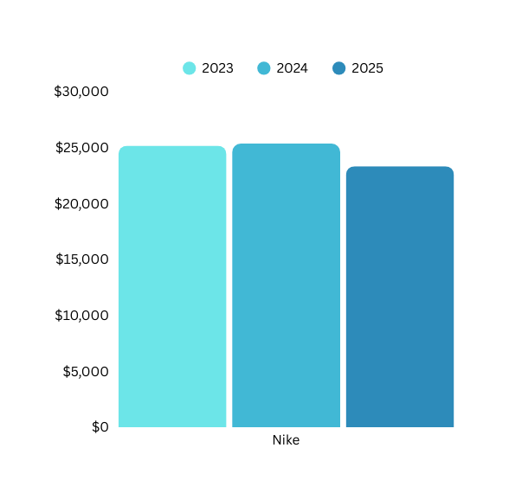
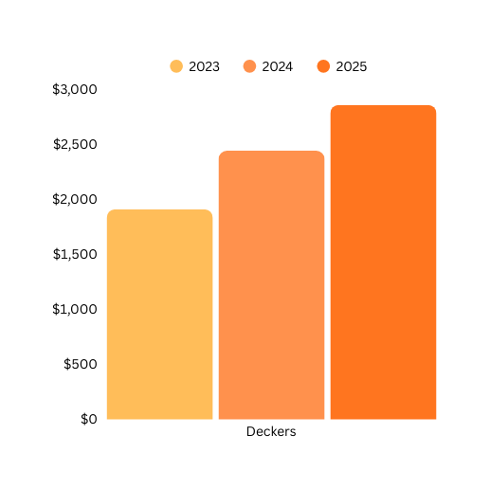
BOOK VALUE OF ASSETS
  Nike’s book value remained steady around $25B, with a slight dip to $23.4B in 2025, reflecting a stable but mature asset base. A strong signal of scale and stability.
  Deckers’ book value rose steadily from $1.9B → $2.9B, showing consistent asset growth and ongoing investment. Deckers’ justification of growth trajectory.
*In Millions of the reported currency, except per share items.

Slide 25
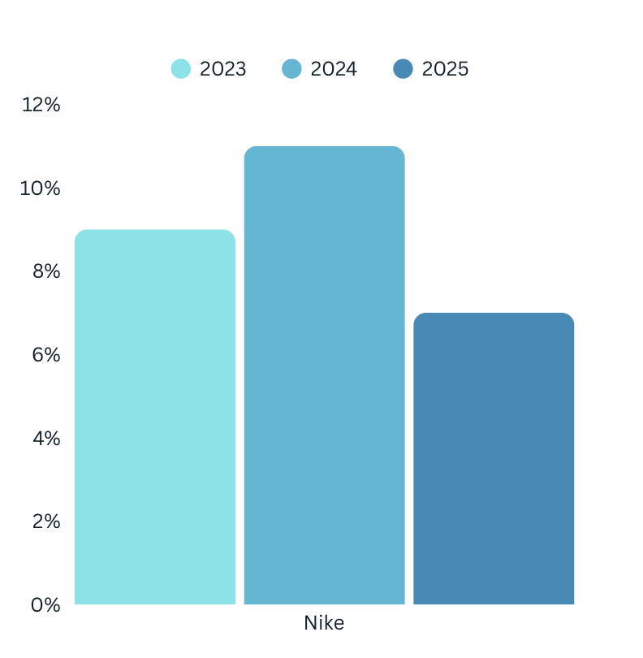
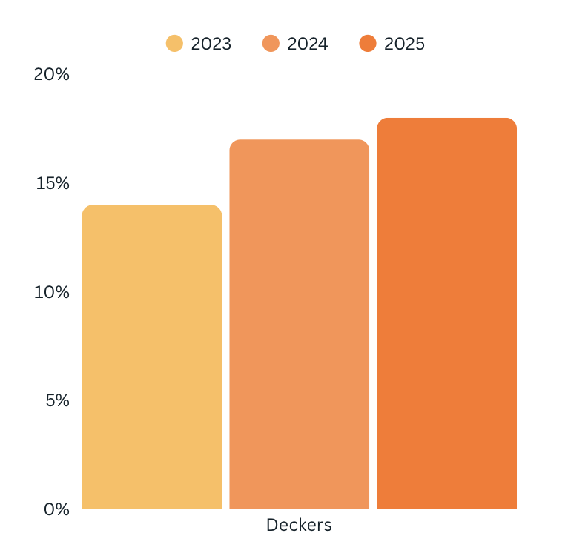
PROFITABILITY RATIO
  Nike improved from 9% (2023) → 11% (2024). Declined to 7% (2025), signaling margin pressure despite scale. Nike has large but volatile profitability.
  Deckers kept strong and rising: 14% → 17% → 18%. Indicating sustained margin expansion and operational efficiency. Deckers has smaller scale but stronger and improving profitability.

Slide 26
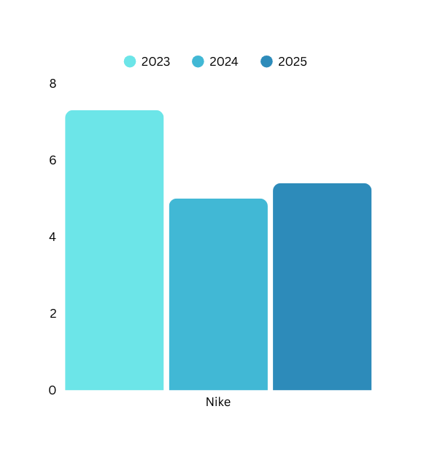
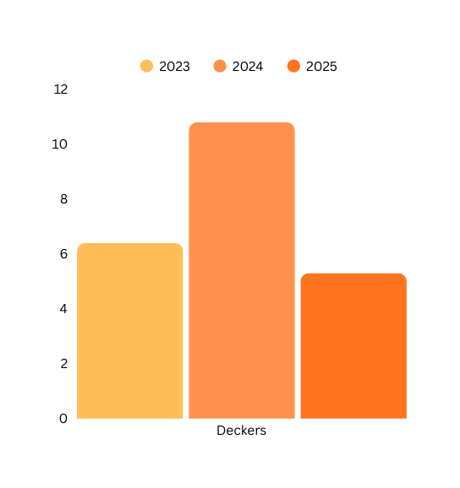
INVESTOR CONFIDENCE PREMIUM
MV of Assets/BV of Assets
  Nike's premium declined from 7.3× (2023) → 5.0× (2024), slight rebound to 5.4× (2025). Reflects reduced but steady investor confidence — assets still valued well above book.
  Deckers jumped to 10.8× (2024) before normalizing at 5.3× (2025). Indicates a peak optimism phase, followed by a market correction.
  Both firms enjoy strong market premiums vs. book value. While Nike signals stability, Deckers’ volatility shows potential upside swing.

Slide 27
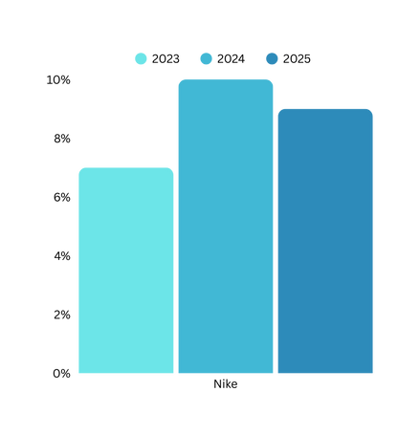
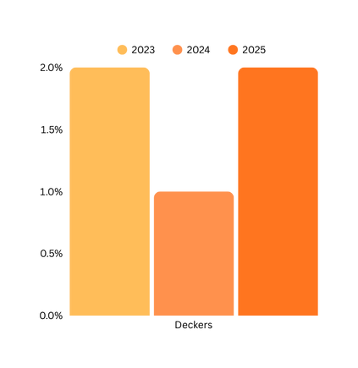
LEVERAGE RATIO
  Nike rose from 7% (2022) to 10% (2023). Slightly lower in 2024 (9%). Indicates moderate reliance on debt, but within manageable levels.
  Deckers signals very low leverage (1–2% across 2022–2024). Reflects a conservative financing strategy, relying mostly on equity.

Slide 28
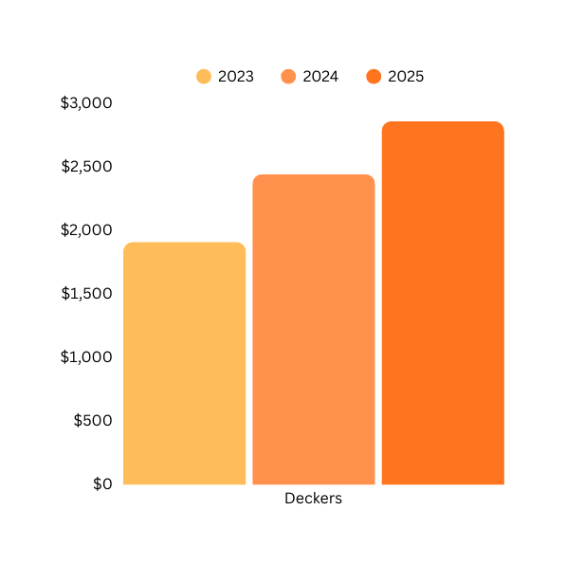
OPERATING PROFIT AFTER TAX (OPAT)
  Nike’s OPAT stayed high at $25B in 2023–2024, but dipped to $23.4B in 2025, indicating slight margin pressure or slower profitability growth. Nike has a scale advantage but facing modest decline
  Deckers OPAT grew strongly from $1.9B → $2.9B, reflecting efficient operations and expanding earnings base. Deckers showing rapid profit growth momentum.

Slide 29
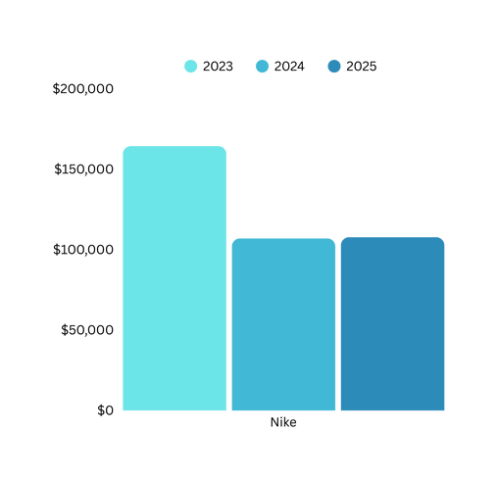
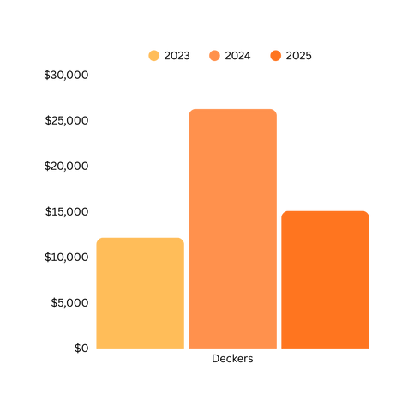
MARKET VALUE OF EQUITY
  Nike declined from $164.5B (2023) → $107.1B (2024). Remained flat in 2025 ($107.8B). Reflects loss of investor confidence and stagnant valuation after the drop. Large but declining/stagnant valuation.
  Deckers is more volatile, signaling sharp growth $12.2B (2023) → $26.3B (2024) . Fell to $15.1B (2025). Suggests rapid shifts in market perception, driven by performance momentum and correction. Deckers as a smaller firm with higher volatility, showing both growth potential and correction risk.

Slide 30
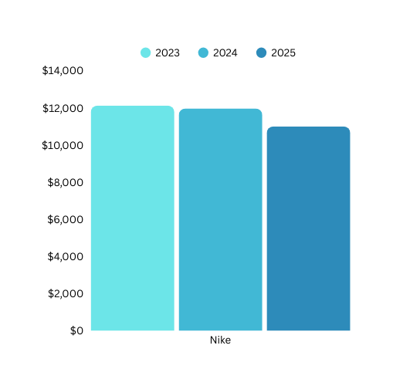
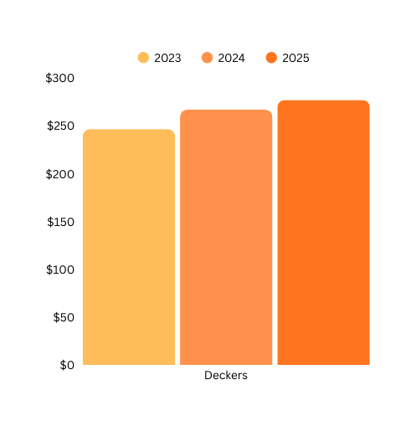
DEBT
  Nike‘s debt has a gradual decline from $12.1B → $11.0B. Indicates a deleverage strategy, reducing financial obligations. Nike has high debt load but trending downward.
  Deckers’ low absolute debt, rising slightly from $246M → $277M. Reflects conservative borrowing, maintaining a light debt structure. Deckers has minimal debt, showing financial flexibility and low risk exposure.
  By taking on more debt, Nike and Deckers can reduce its taxable income through interest expense deductions.

Slide 31
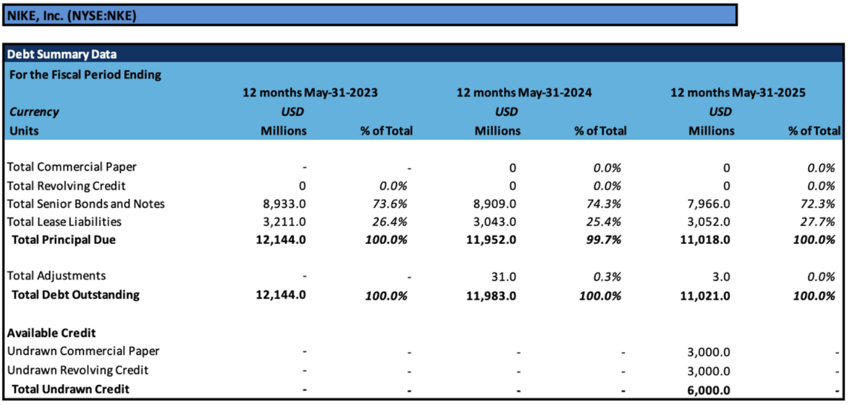
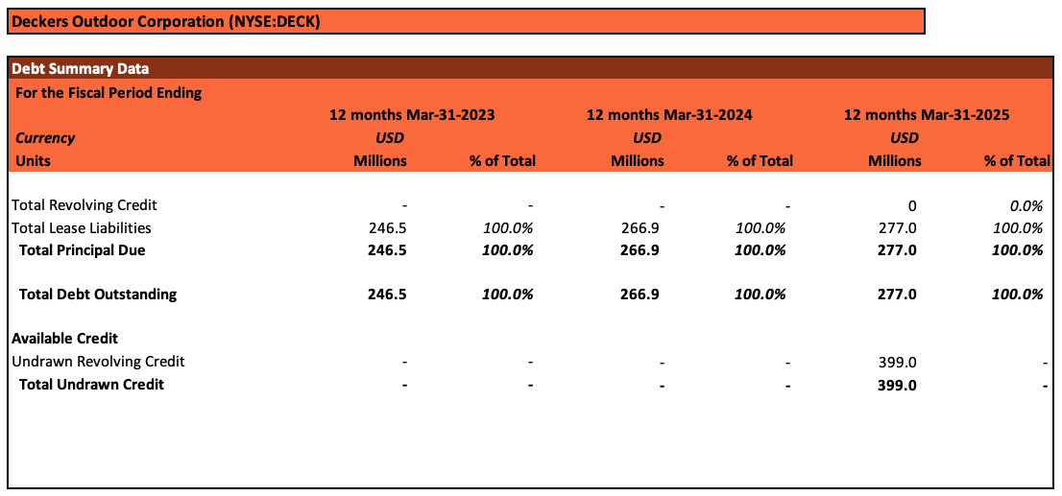
DEBT STRUCTURE
*In Millions of the reported currency, except per share items.
*In Millions of the reported currency, except per share items.

Slide 32
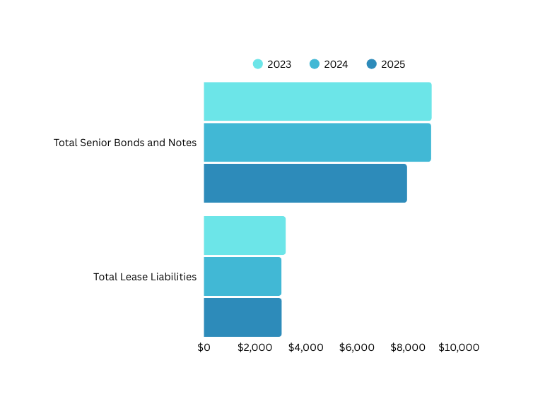
NIKE’S DEBT COMPOSITION
  72.3% of debt in Senior Bonds & Notes – primary funding source. Senior Bonds & Notes declined from $8,933M (2023) → $7,966M (2025). This indicates gradual reduction in long-term debt, possibly through repayments or refinancing.
  Lease Liabilities slightly decreased from $3,211M (2023) → $3,052M (2025). Shows stable lease commitments, suggesting consistent use of leased facilities/assets.
  Nike is deleveraging moderately, improving its financial flexibility while maintaining stable operational leases.

Slide 33
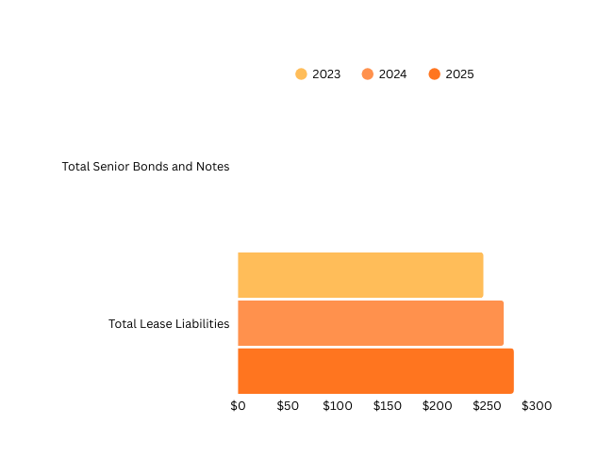
DECKERS’ DEBT COMPOSITION
  Senior Bonds & Notes, none outstanding across 2023–2025. 100% of Debt Lease.
  Deckers shows conservative capital structure with no reliance on bond financing.
  Lease Liabilities increased from $246M (2023) → $277M (2025).
  Growth reflects greater use of leased facilities or retail spaces, supporting expansion.
  Deckers operates with minimal financial leverage, funding growth largely through equity and operations, while lease obligations remain the main fixed commitment.

Slide 34

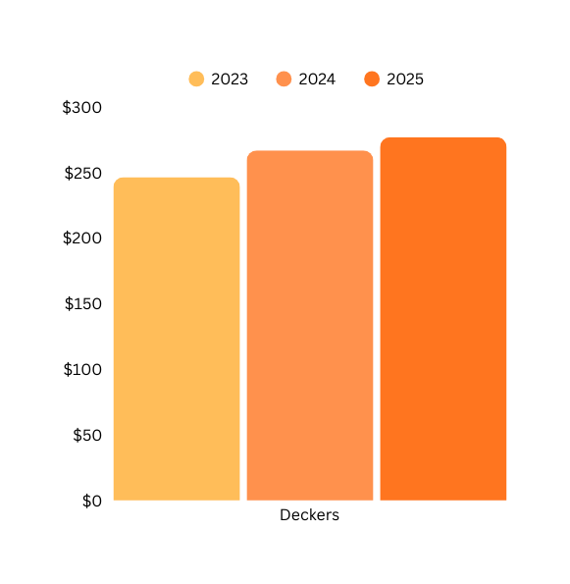
TOTAL DEBT OUTSTANDING
  Nike‘s debt declined from $12.1B → $11.0B, showing a gradual deleveraging trend. Reflects strong cash flows enabling repayment and a strategy to reduce financial risk. Nike is actively managing and reducing a large debt base.
  Deckers’ debt remained minimal, rising slightly from $246M → $277M. Outstanding debt increase tied mostly to lease obligations, not traditional borrowing. Deckers operates with negligible debt, maintaining a low-risk balance sheet.

Slide 35
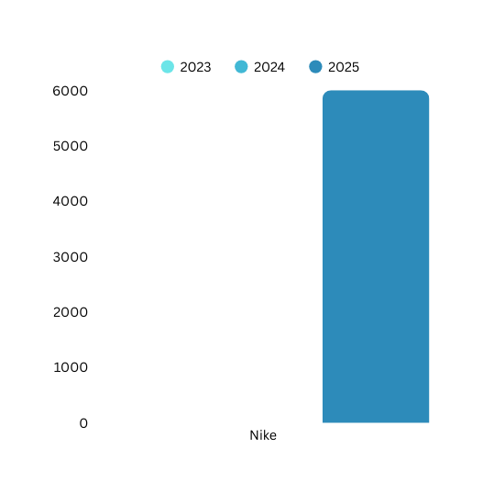
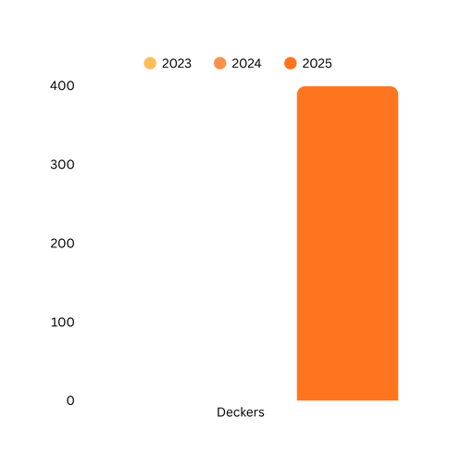
TOTAL UNDRAWN CREDIT
  Nike’s undrawn debt is $6.0B. Very large liquidity cushion. Provides ample flexibility for debt repayment, investments, or unforeseen shocks. Nike maintains global-scale financial flexibility with massive undrawn facilities.
  Deckers undrawn credit is $399M. Much smaller, but proportional to its size and low leverage profile. Ensures sufficient backup funding for operations and moderate expansion. Deckers relies on a leaner credit line but balances this with its minimal debt burden.

Slide 36
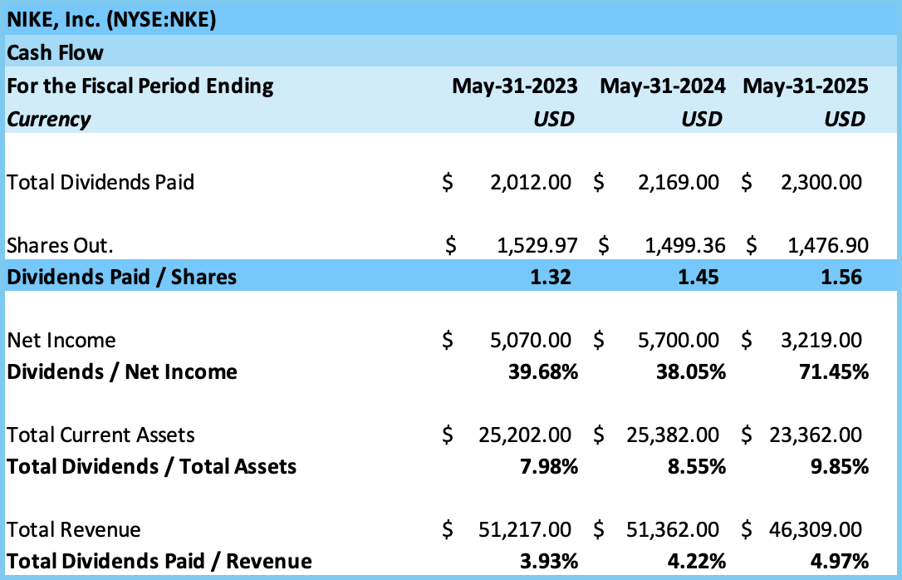
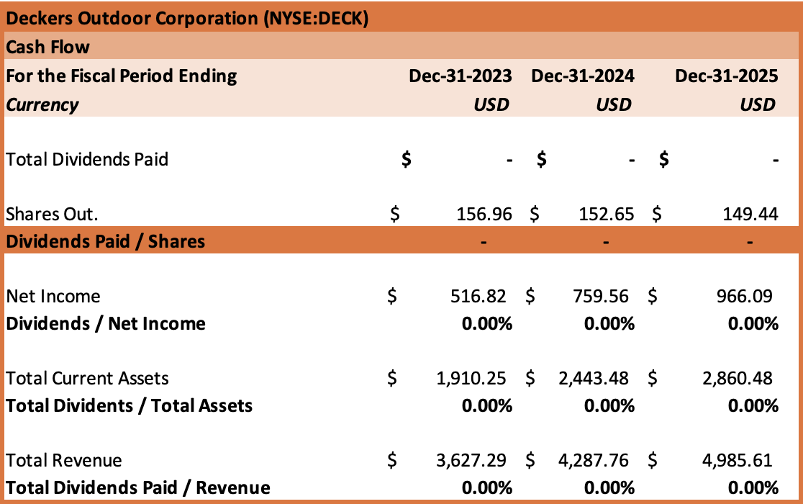
DIVIDEND POLICY
Dividends per share increased: from $1.32 to $1.56
Dividend payout ratio: ranged 39.68% – 71.45%
Indicates a high proportion of net income returned to shareholders
Reflects strong commitment to annual dividend growth
Attractive to income-oriented investors seeking steady returns
No formal dividend policy in place
Company chooses to retain earnings to reinvest in growth
Returns to shareholders are delivered mainly through share repurchases
Strategy reflects a focus on expansion and flexibility, rather than fixed payouts
Attractive to growth stock -oriented investors
*In Millions of the reported currency, except per share items.

Slide 37
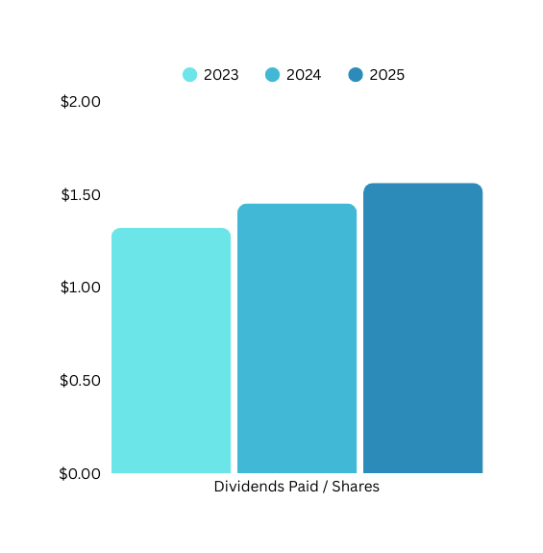
NIKE’S DIVIDENDS PAID PER SHARES
  Nike’s dividends paid per share $1.32 → $1.45 → $1.56 over three years. Shows a steady upward trend in shareholder payouts. Reflects Nike’s commitment to returning value to investors despite market and earnings fluctuations. Signals financial stability and confidence in future cash flows.

Slide 38
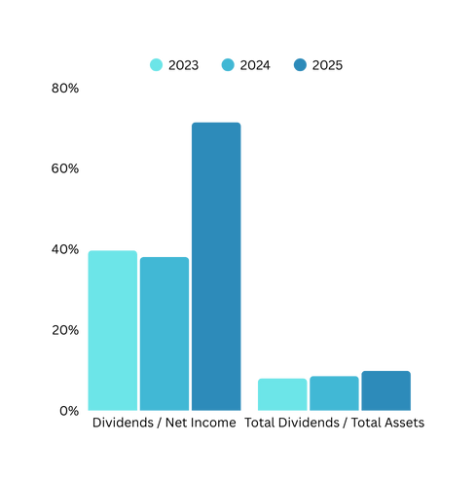
NIKE’S DIVIDENDS PAYOUT
AND ASSET COVERAGE
  Nike’s dividend payout in 2023: 39.7%, 2024: 38.1% 2025: 71.5%. Indicates Nike typically pays out 40% of profits, but in 2025 the payout ratio nearly doubled, a deliberate increase in shareholder returns.
  Nike’s asset coverage has a gradual increase from 8.0% (2023) 8.6% (2024) and 9.9% (2025). Shows dividends are becoming a larger share of total resources, reflecting a mature shareholder-oriented strategy.
  Nike is shifting from a balanced payout (40%) toward a more aggressive dividend policy in 2025, prioritizing shareholder returns over reinvestment.

Slide 39
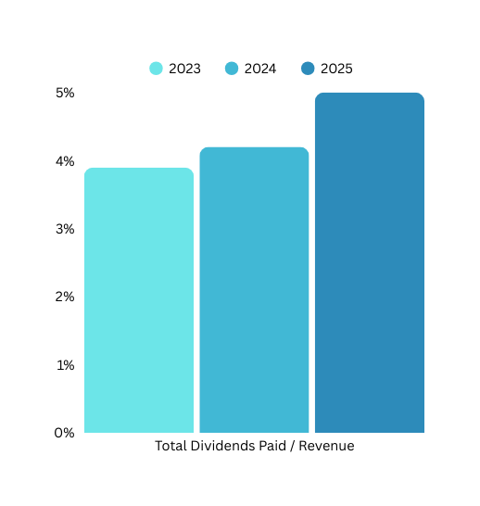
NIKE’S DIVIDENDS PAID
AS % OF REVENUE
  2023: 3.9% , 2024: 4.2% , 2025: 5.0%
  Dividend payments are consuming a growing share of revenue each year.
  Rising from under 4% in 2023 to 5% in 2025 shows Nike’s increasing commitment to return cash to shareholders.
  This trend reflects a stable and maturing business model, with management signaling confidence in sustained cash flows. Nike is gradually shifting toward higher shareholder payouts, balancing growth investments with consistent returns.

Slide 40


REPURCHASE STOCK POLICY
*In Millions of the reported currency, except per share items.

Slide 41


REPURCHASE OF COMMON STOCK/REVENUE
  Nike has been returning far more than its annual revenue to shareholders via aggressive buybacks, though the pace is declining year over year. Nike’s strategy is highly shareholder-centric.
  Deckers maintains modest and steady repurchases, signaling a more conservative capital return policy. Deckers takes a balanced approach, prioritizing reinvestment while still rewarding shareholders.

Slide 42


REPURCHASE OF COMMON STOCK/NET INCOME
  Nike consistently spends as much or more than its net income on share repurchases, highlighting an aggressive shareholder return strategy.
  Deckers allocates a large share of earnings to buybacks, but at a lower and declining rate, suggesting a more balanced approach between reinvestment and shareholder returns. Deckers is disciplined, gradually reducing repurchase intensity while still rewarding shareholders.
  Both firms prioritize buybacks as a key capital return tool.

Slide 43
Nike vs. Deckers – Financial Policy Comparison
Nike Corporation Financial Policy Assessment
  Leverage ratio: 6.9% – 10.1%, well below U.S. firm median (25%–30%). Indicates conservative financing; potential to increase firm value by issuing additional debt
  Profitability: Net Profit Margin steady at 23%–25%, demonstrates strong earnings generation
  Economic Value Added (EVA): Consistently positive with a sharp decline in 2025
  Interest Coverage: 3-yr average 19.30 → strong ability to meet obligations
  Credit Rating: S&P A+ stable outlook → reflects low financial risk
  Stock Risk: 5-yr Beta 1.28 → More volatile than market (amplified movements)
  Distribution Policy: Coca-Cola distributes nearly all net income via dividends & repurchases
  Attractive for income-seeking investors
  Nike follows a prudent financial policy—balancing profitability, low leverage, and stability. Potential upside exists by moderately increasing debt to enhance value while maintaining credit strength.
Deckers Outdoors Financial Policy Assessment
  Leverage Ratio: 1.8% – 2.0% (far below U.S. median 25%–30%). Very conservative financing; room to add debt and increase firm value
  Profitability: Net Profit Margin 14.2% – 19.4%. Strong and stable earnings generation
  Economic Value Added (EVA): Consistently positive but experienced decline in 2025 Interest Coverage: 3-yr average 297.06x. Exceptional ability to cover debt obligations
  Credit Rating: Unavailable
  Stock Risk: 5-yr Beta 0.99 → moves in line with overall market
  Distribution Policy: No formal dividend policy in place
  Deckers is financially very safe but under-leveraged. It has room to issue additional debt to optimize capital structure and consider a shareholder distribution policy to enhance investor value.

Slide 44

References
  Betas. (n.d.). https://pages.stern.nyu.edu/~adamodar/New_Home_Page/datafile/Betas.html
  Log In | S&P Capital IQ. (n.d.-a). https://www.capitaliq.com/CIQDotNet/Financial/BalanceSheet.aspx?CompanyId=291981
  Log In | S&P Capital IQ. (n.d.-b). https://www.capitaliq.com/CIQDotNet/Financial/IncomeStatement.aspx?CompanyId=291981
  Log In | S&P Capital IQ. (n.d.-c). https://www.capitaliq.com/CIQDotNet/Financial/CashFlow.aspx?CompanyId=291981
  Log In | S&P Capital IQ. (n.d.-d). https://www.capitaliq.com/CIQDotNet/Financial/Capitalization.aspx?CompanyId=291981
  Log In | S&P Capital IQ. (n.d.-e). https://www.capitaliq.com/CIQDotNet/Financial/CapStructureSummary.aspx?CompanyId=291981
  Log In | S&P Capital IQ. (n.d.-f). https://www.capitaliq.com/CIQDotNet/Financial/CapStructureDetails.aspx?CompanyId=291981
  Log In | S&P Capital IQ. (n.d.-g). https://www.capitaliq.com/CIQDotNet/Financial/KeyStats.aspx?CompanyId=327333
  Log In | S&P Capital IQ. (n.d.-h). https://www.capitaliq.com/CIQDotNet/Financial/IncomeStatement.aspx?CompanyId=327333
  Log In | S&P Capital IQ. (n.d.-i). https://www.capitaliq.com/CIQDotNet/Financial/BalanceSheet.aspx?CompanyId=327333
  Log In | S&P Capital IQ. (n.d.-j). https://www.capitaliq.com/CIQDotNet/Financial/CashFlow.aspx?CompanyId=327333
  Log In | S&P Capital IQ. (n.d.-k). https://www.capitaliq.com/CIQDotNet/Financial/Capitalization.aspx?CompanyId=327333
  Log In | S&P Capital IQ. (n.d.-l). https://www.capitaliq.com/CIQDotNet/Financial/CapStructureSummary.aspx?CompanyId=327333
  NKE vs. DECK — Stock Comparison Tool. (n.d.). StockAnalysis. https://stockanalysis.com/stocks/compare/nke-vs-deck/

Slide 45
Isabel Anne Villa Mendoza
iavillamendoza@yahoo.com
www.isabelannevillamendoza.com

