Slide 1
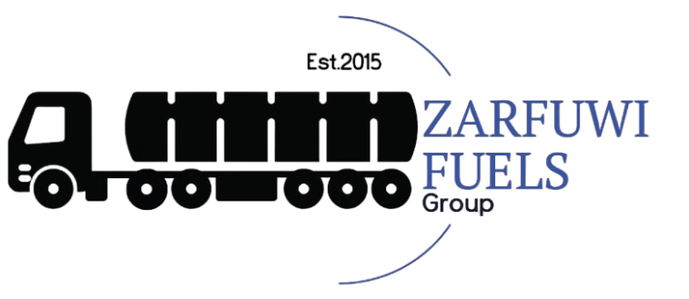
Business Profile

Slide 2
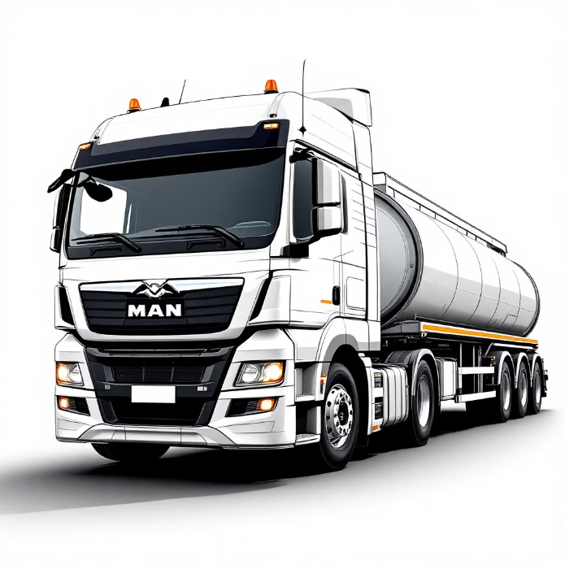
1. About Us
Zarfuwi Fuels Group is an emerging transport operator established in 2015 to provide fuel transport services in the oils industry around South Africa, currently operating from Pretoria, South Africa.
We are committed to keeping high safety standards, operational excellence and customer satisfaction. The company specialises in providing secure transportation and timely delivery of various fuel product to a diverse range of customers.
Our modern fleet, well trained drivers and strategic logistics ensure efficient and cost effective solutions tailored to meet our customers needs.

Slide 3
2. Mission Statement
Vision
Mission
Business Values
To become an important global energy company that has a positive trade balance.
Our Mission is to be a trustworthy, reliable and reputable fuel transportation partner delivering a comprehensive fuels solution to all our customers whilst being environmentally responsible.
Reliability
Efficiency
Safety conscience
Compliant

Slide 4
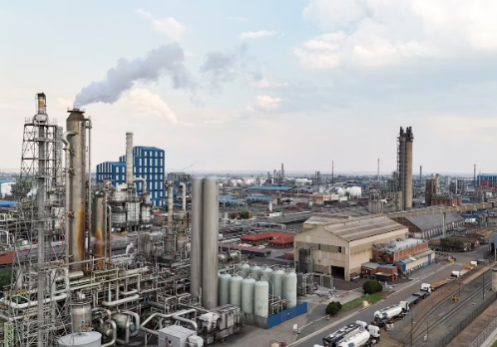
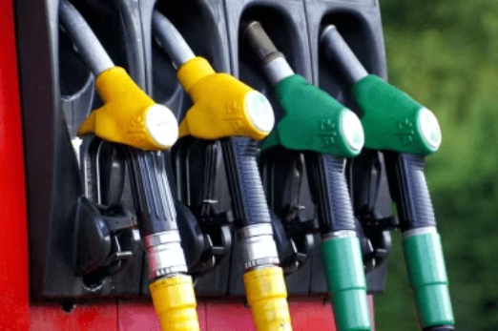
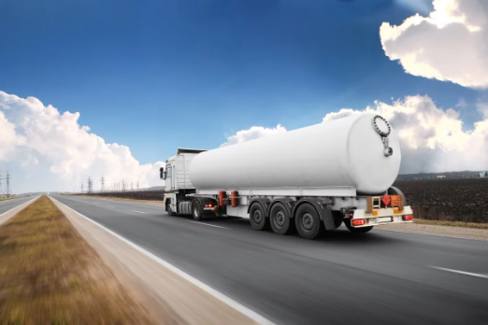
3. Services Offering
Primary Transportation
Secondary Transportation
Value Added Services
Terminal to Terminal: To transport a range of liquid fuels (diesel, ULP, aviation fuel and paraffin) from refineries to depots.
Depot to Retail/ End user: To transport a range of liquid fuels from Depots to Retail gas station or directly to the end user such as the mining sector (B2B).
Emergency fuel delivery.
Fuel Management Services.
Fuel Delivery updates.

Slide 5
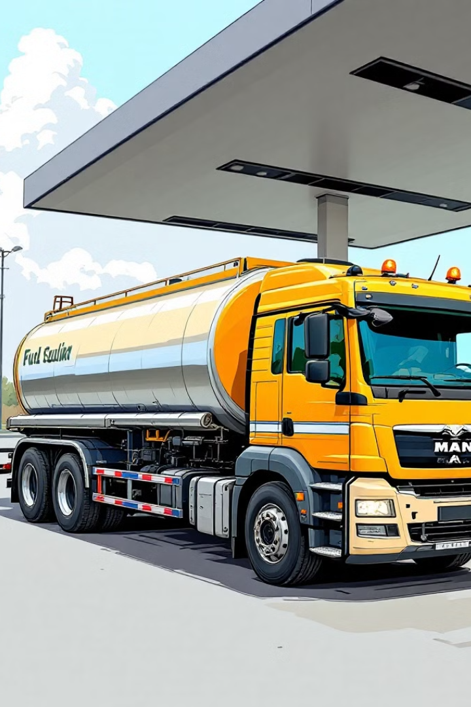
4. Our Strengths
Safety First: We prioritise safety in all aspects as laid down by the South African Government and legislature.
Reliability and Timeliness: We are committed to on-time delivery.
Experienced Team: Our team consist of well trained drivers to handle fuel transportation, logistics manager and quality manager.
Modern Fleet: We operate a modern fleet of specialised fuel transport vehicles and present day state of the art tankers.
Technology-Driven Solutions: We aim to take advantage of leveraging technology to optimise logistics.
Environmental Responsibility: We are committed to minimise our environmental impact through efficient operations.

Slide 6


5. Target Markets
Primary Markets
Secondary Markets
Large-scale fuel distributors and wholesale companies.
Government and Municipalities.
Mining companies
Independent fuel retailers.
Construction companies.
Agricultural farming operations
Aviation and Transportation companies.
Industrial and manufacturing companies.

Slide 7






6. Competitive Advantages
Competitive pricing
Customised Solutions
Strong Customer relationship
We offer competitive pricing on large volumes (economies of scale).
We provide customised transport solution to meet unique customer needs.
We strive to achieve long term partnership with our clients through exceptional service and support .
Value Added Services
Technology
Flexibility
We offer our customers emergency fuel deliveries and technical advice.
We work tirelessly to integrate emerging technology for sustainable operations.
We target opportunities where large companies are falling short.

Slide 8
7. Commitment to Safety and Compliance
Zarfuwi Fuels Group is committed to adhering to the highest safety standards and regulatory compliance in all our operations. We maintain all necessary licenses and permits, comply with industry regulations and prioritise the safety of our drivers, our clients, and communities we serve.

Slide 9

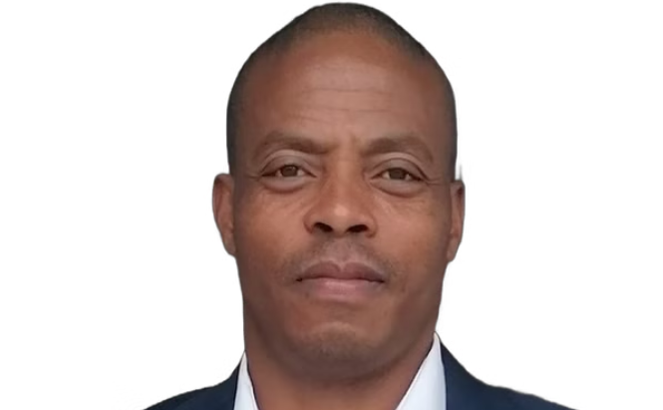
8. Contact information
MD: Mpho Tsotetsi
COO: John Monageng
Driving strategic vision and leading the company towards success.
Ensuring smooth operations and optimizing logistics.
Contact Details
Contact Details
Telephone: +2781 461 2259
Telephone: +2782 506 7743
Email: mpho@zarfuwifuelsgroup.co.za
Email: kgaga@zarfuwifuelsgroup.co.za

