Slide 1


Changing the Shape of Aging in Lexington
Roxanne Cheney RN, MSN
Chair, A Caring Place Village

Slide 2
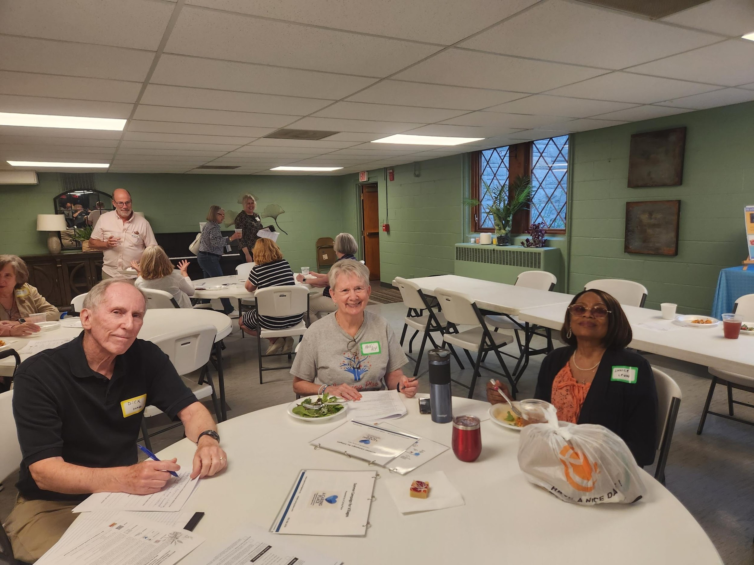
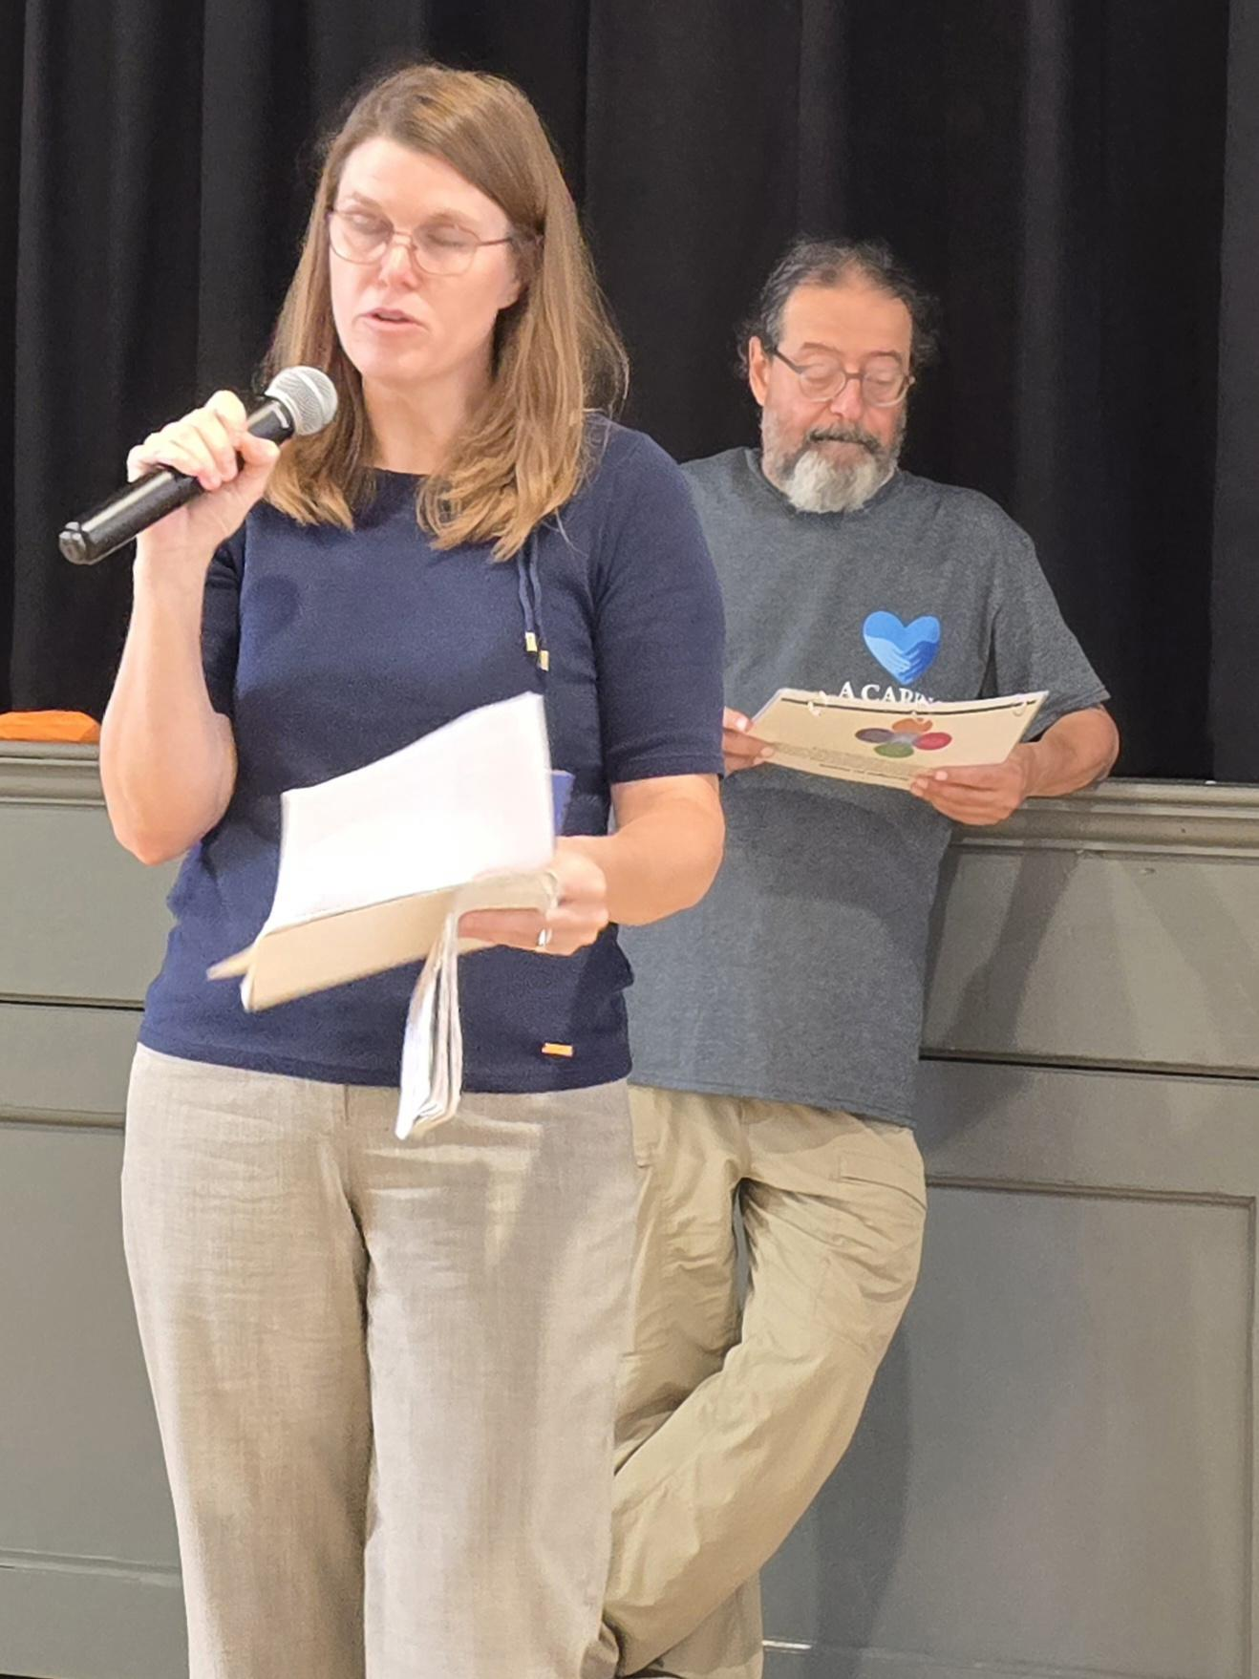
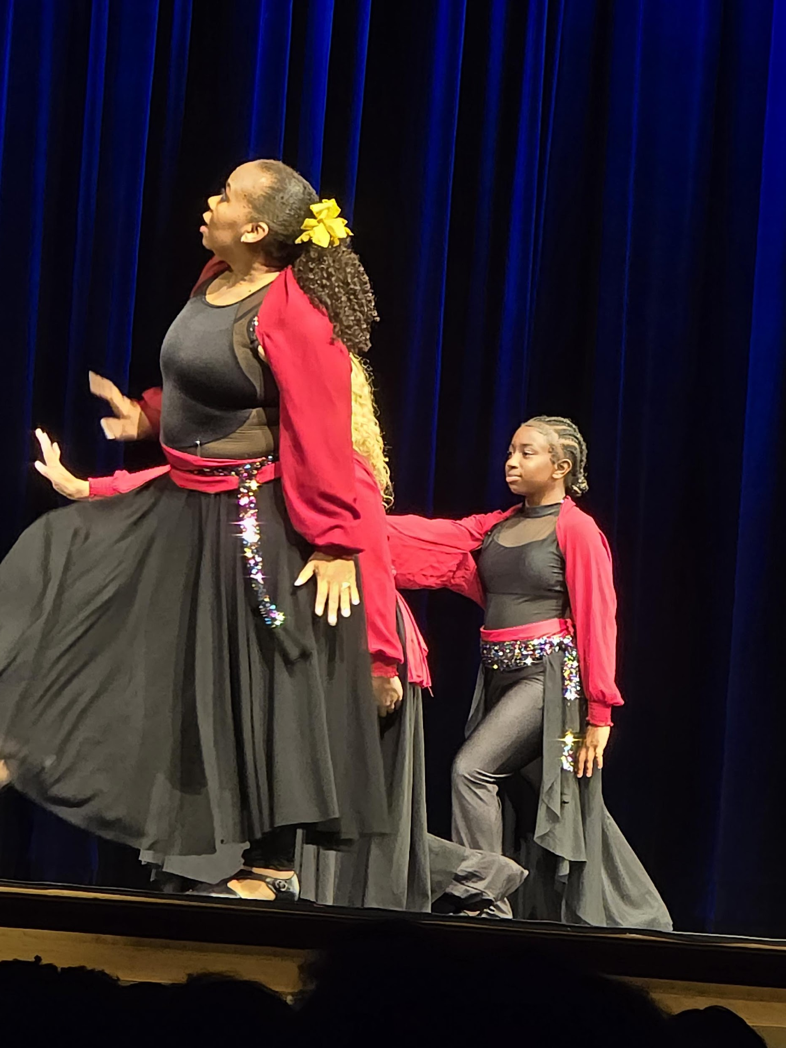
ABOUT A CARING PLACE VILLAGE
Mission: Support older adults and individuals with disabilities so they can remain independent, socially connected, and engaged in their communities for as long as possible.
Health Impact: Loneliness is a major health issue in the United States causing premature aging, co-morbidities, and early death.
Economic Impact: Untreated loneliness drives up the cost of healthcare and social services.
Solution: Loneliness is treatable with public health interventions, such as Villages are doing: rebuilding community, trust, and belonging.

Slide 3
IMPLEMENTING OUR MISSION:
Relationship programs: Telephone comfort care, Zoom chit chats, home visits when member ready, small community gatherings, annual events, and a card ministry.
Education: Volunteer orientation, on going community education, mandatory annual reviews, on-going leadership training.
Health and Lifestyle for members: Weekly zoom exercises, stress management classes, mentored volunteer opportunities, catered noon meals.
Resource Allocation: connecting older adults with community services, healthcare, and support networks
Intergenerational approach through our UK Undergrad ACP Chapter which offers exposure to the older adult for the student and an opportunity to share wisdom from the older adult
Advocacy for the older adult and disabled as the need arises.

Slide 4
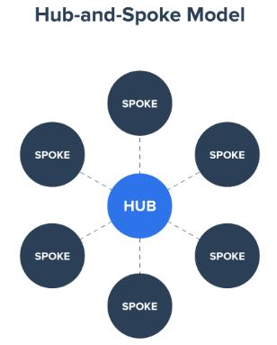
VILLAGE TO VILLAGE NETWORK
We are a member of the Village to Village Network (VtV Network) which is a national, nonprofit membership organization that helps communities establish and manage Villages—grassroots, community-based networks where neighbors help neighbors so older adults can age in place with dignity, connection, and independence.
Currently there are 425 villages across the United States and more are joining daily.
Notes:
Common model is Hub and Spoke and graphic

Slide 5
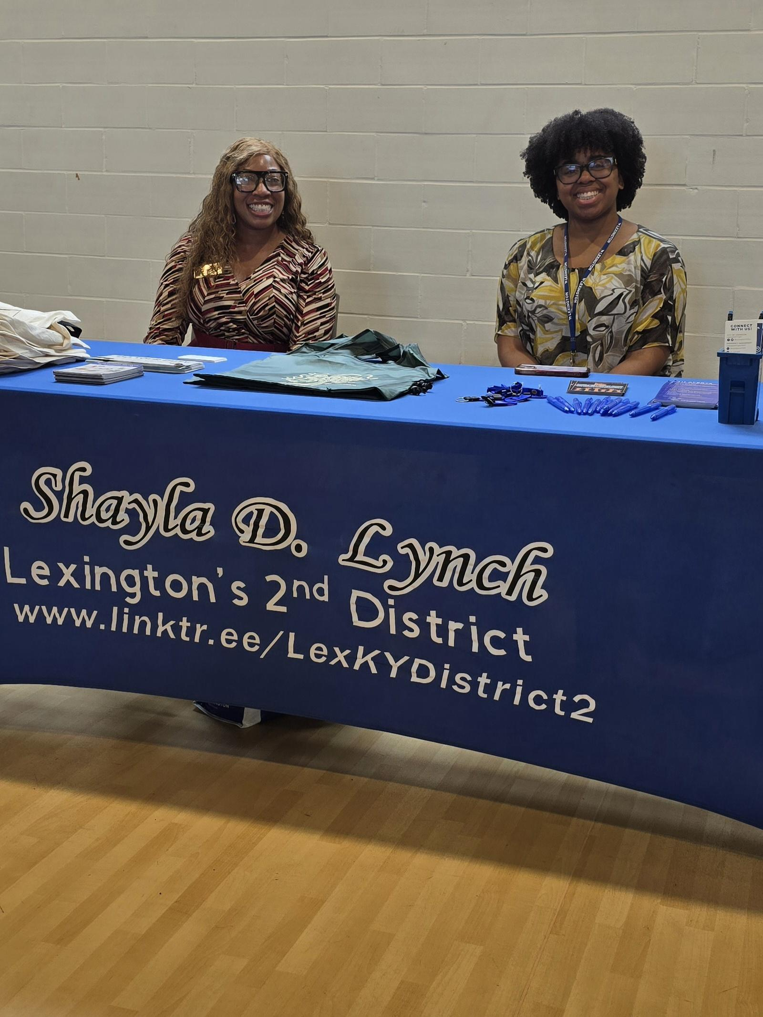
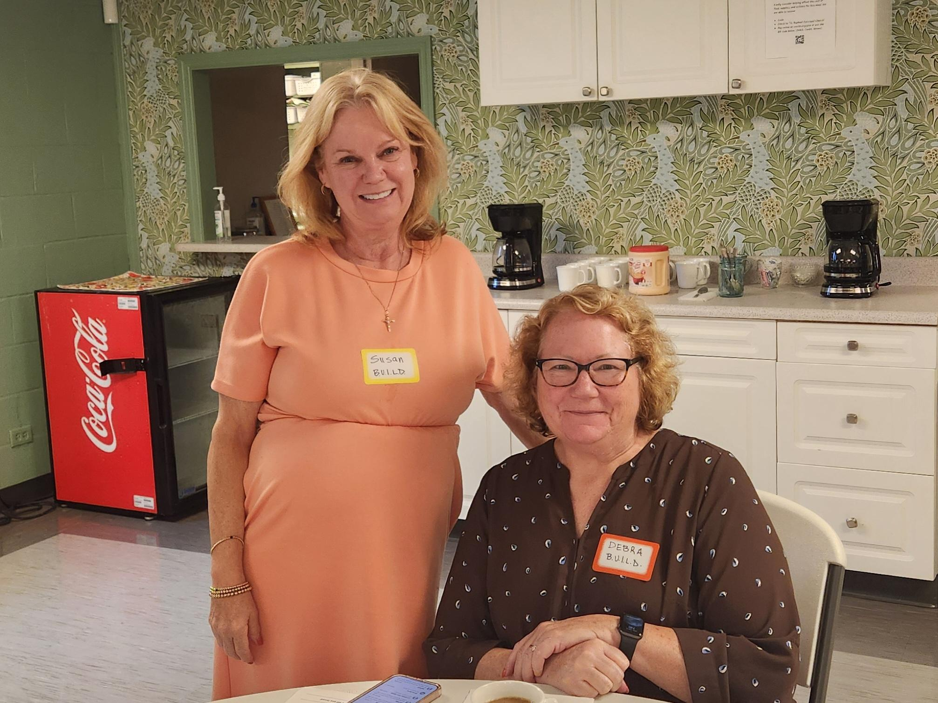
WHY LEXINGTON?
Growing Senior Population per Census
Nearly 15% of Fayette County residents are age 65+ in 2020
By 2030, that number will approach 22% (1 in 5 residents)
Living Alone per Neighborhood Data
About 30% of Lexington’s seniors in the Gainesway neighborhood live alone (isolation increases risk of depression, dementia, falls, elder scams, and elder abuse)
Healthcare Costs & Strain
Older adults account for a disproportionate share of healthcare use
Aging-in-place models like Villages can reduce costs and ER visits
Per an AARP study, more than 90% of seniors want to stay in their homes and neighborhoods

Slide 6
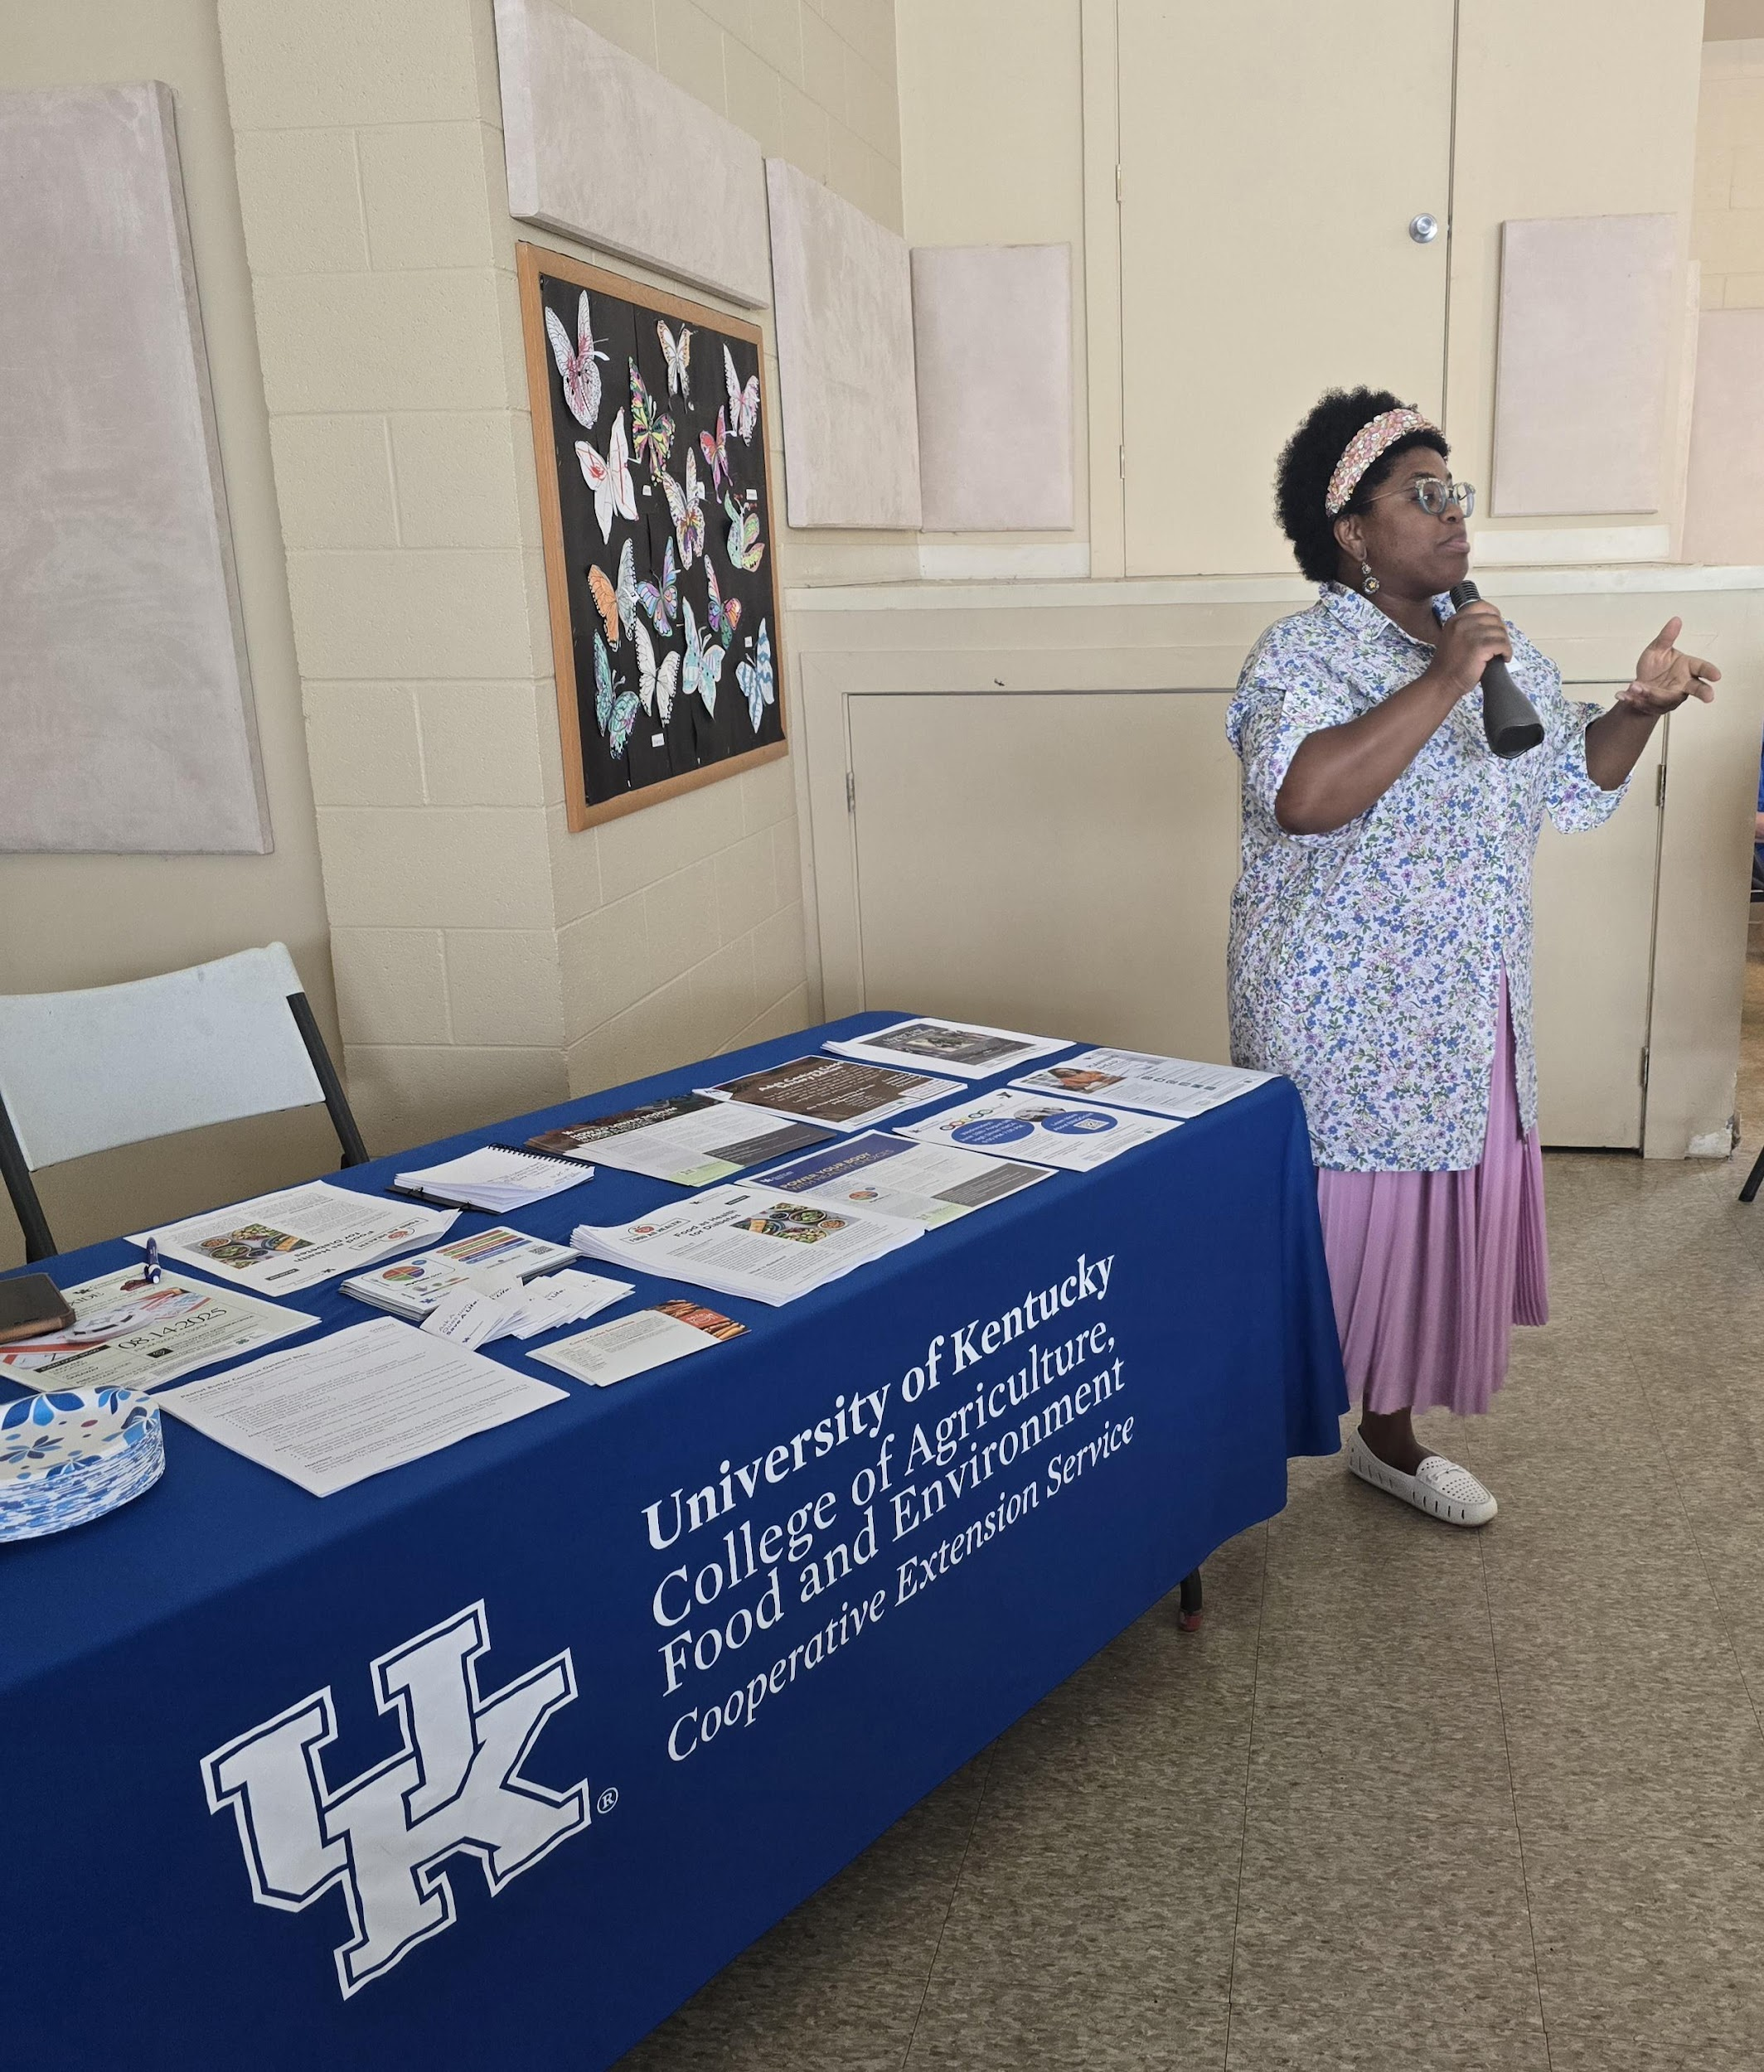
THE SUMMER CAMPAIGN
Purpose: Explore whether Villages are possible and needed in Lexington
With a generous $150,000 grant from the City of Lexington, A Caring Place Village was able to conduct a feasibility study in partnership with the University of Kentucky College of Social Work, College of Medicine, and College of Education
Conducted city-wide outreach and engagement
UK Researchers attended every event, coming early and staying late, working with every individual to complete the needs assessment.
At each event, we provided a welcoming milieu complete with a light lunch and fellowship.
Events were noted as town halls as our councilmembers were present to encourage all to provided needed feedback

Slide 7
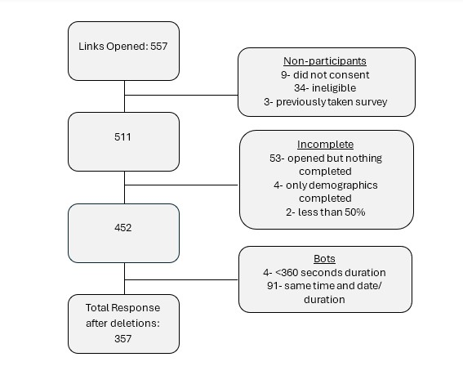
COMMUNITY NEEDS ASSESSMENT

Slide 8
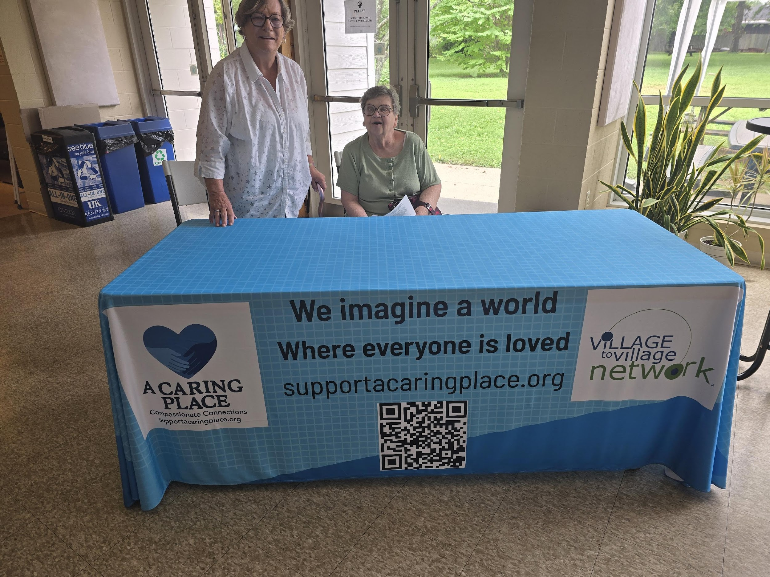
CAMPAIGN STATISTICS: June-August
30 Events
25 Health Note Speakers
460 Attendees
960 Volunteer Hours
Zip codes throughout Lexington are represented in the data
Many councilmembers participated

Slide 9
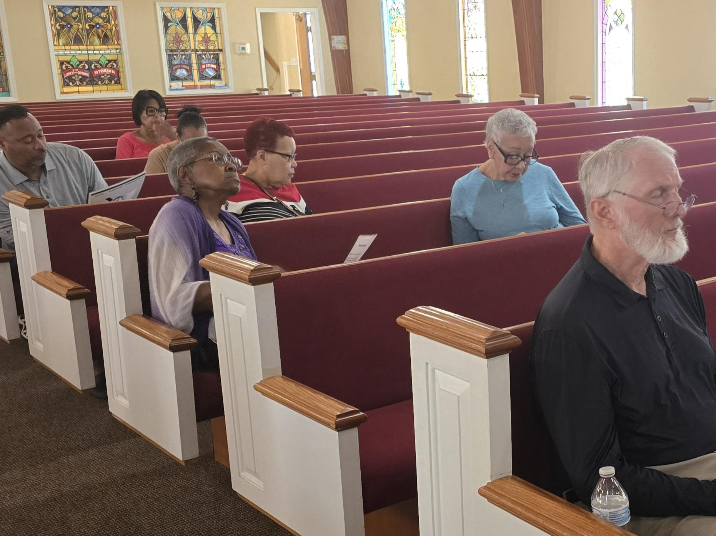
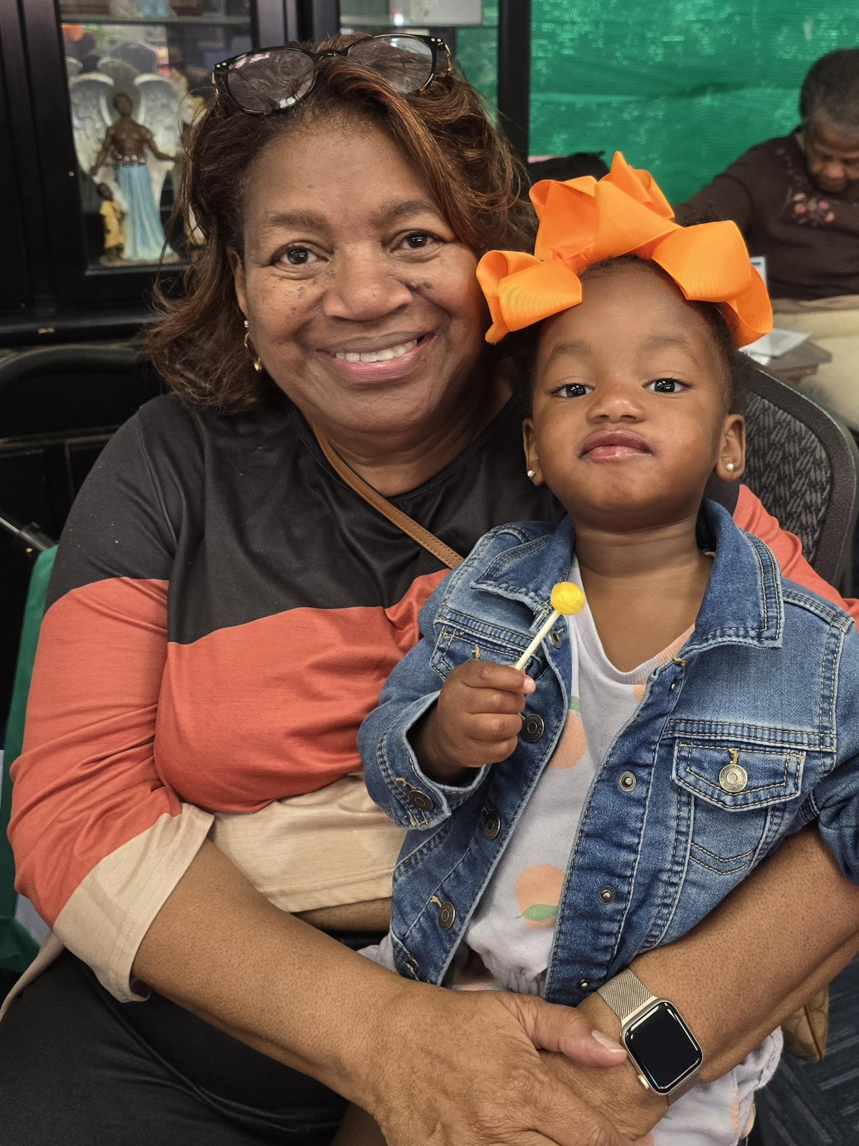
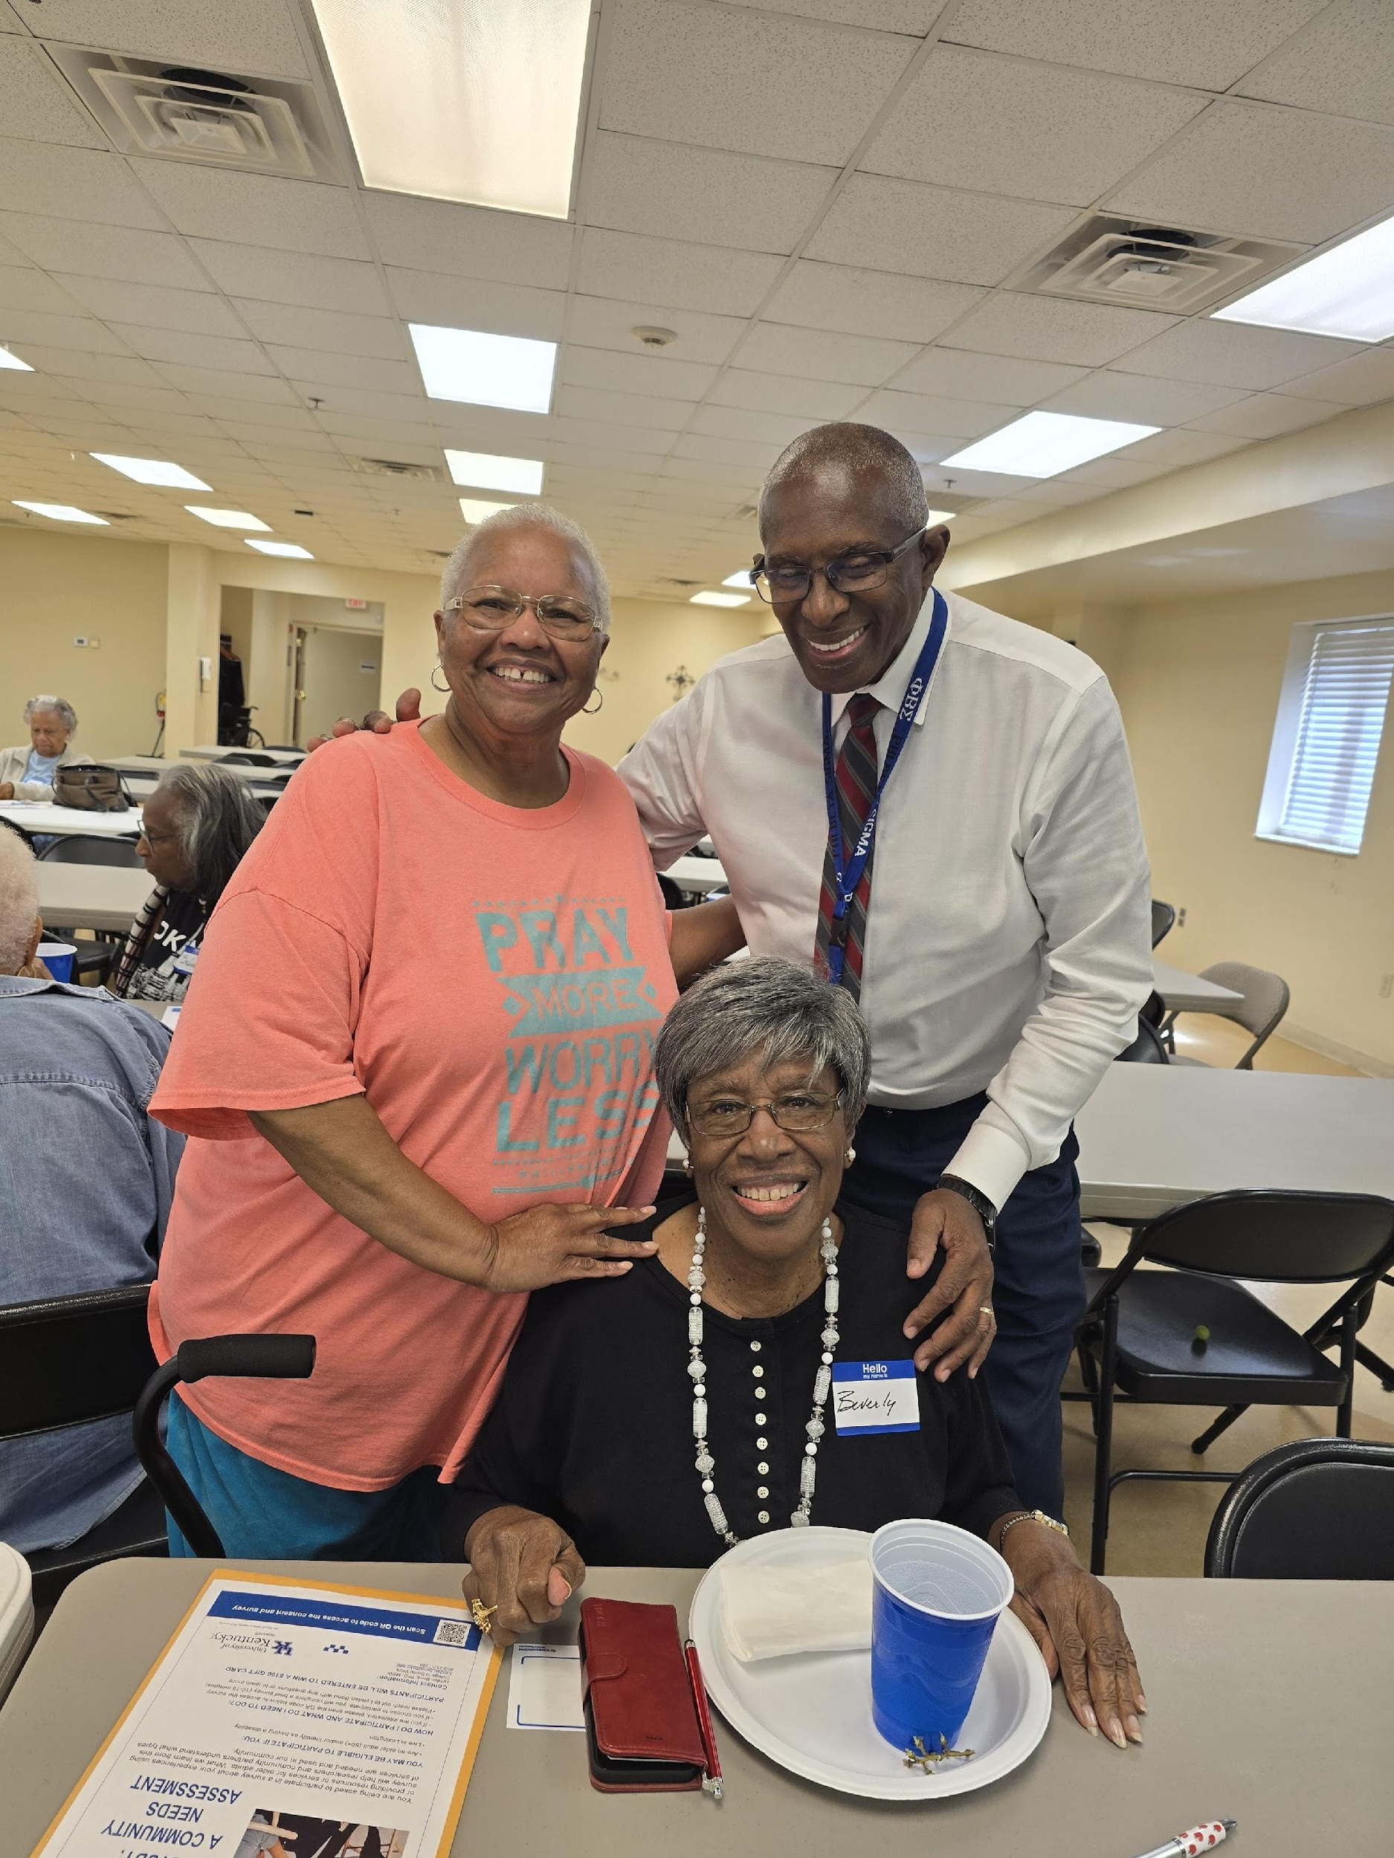
ONE MOVEMENT
"Together, with many community partners, we are changing the shape of aging in Lexington."

Slide 10
SIX SCOPES OF WORK
Community Needs Assessment – Still on-going: Dr. Latimer College of Medicine and Social Work and Dr. Bond College of Social Work
Technology Needs Assessment – Continuing to investigate better and more economical options such as Club Express or Helpful Village: Dr. Oldham: College of Education
Revenue Streams – 4 major potential sources (Alex Chadwell Masters, Education, University of Kentucky)
HOAs – completed one listening session – additional session scheduled for Nov 15th at Golfview Estates
Subsidized Senior Homes – completed all 3 listening sessions: Ballard Griffith Towers, Ashland Terrace, and Briarwood.
Village Program Assessment – Continuing to collect data: Dr. Oldham

Slide 11
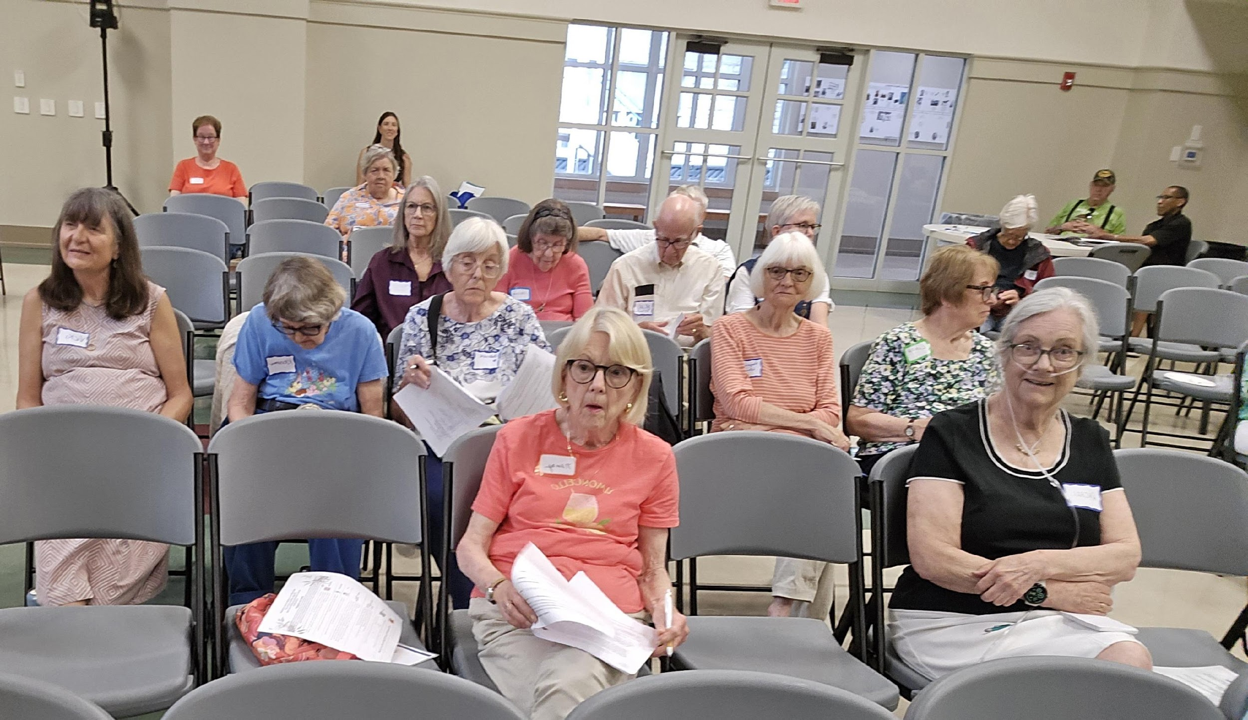
HOW FUNDS WERE ALLOCATED
Total Amount: $150,000
UK – $90,000
A Caring Place - $60,000

Slide 12
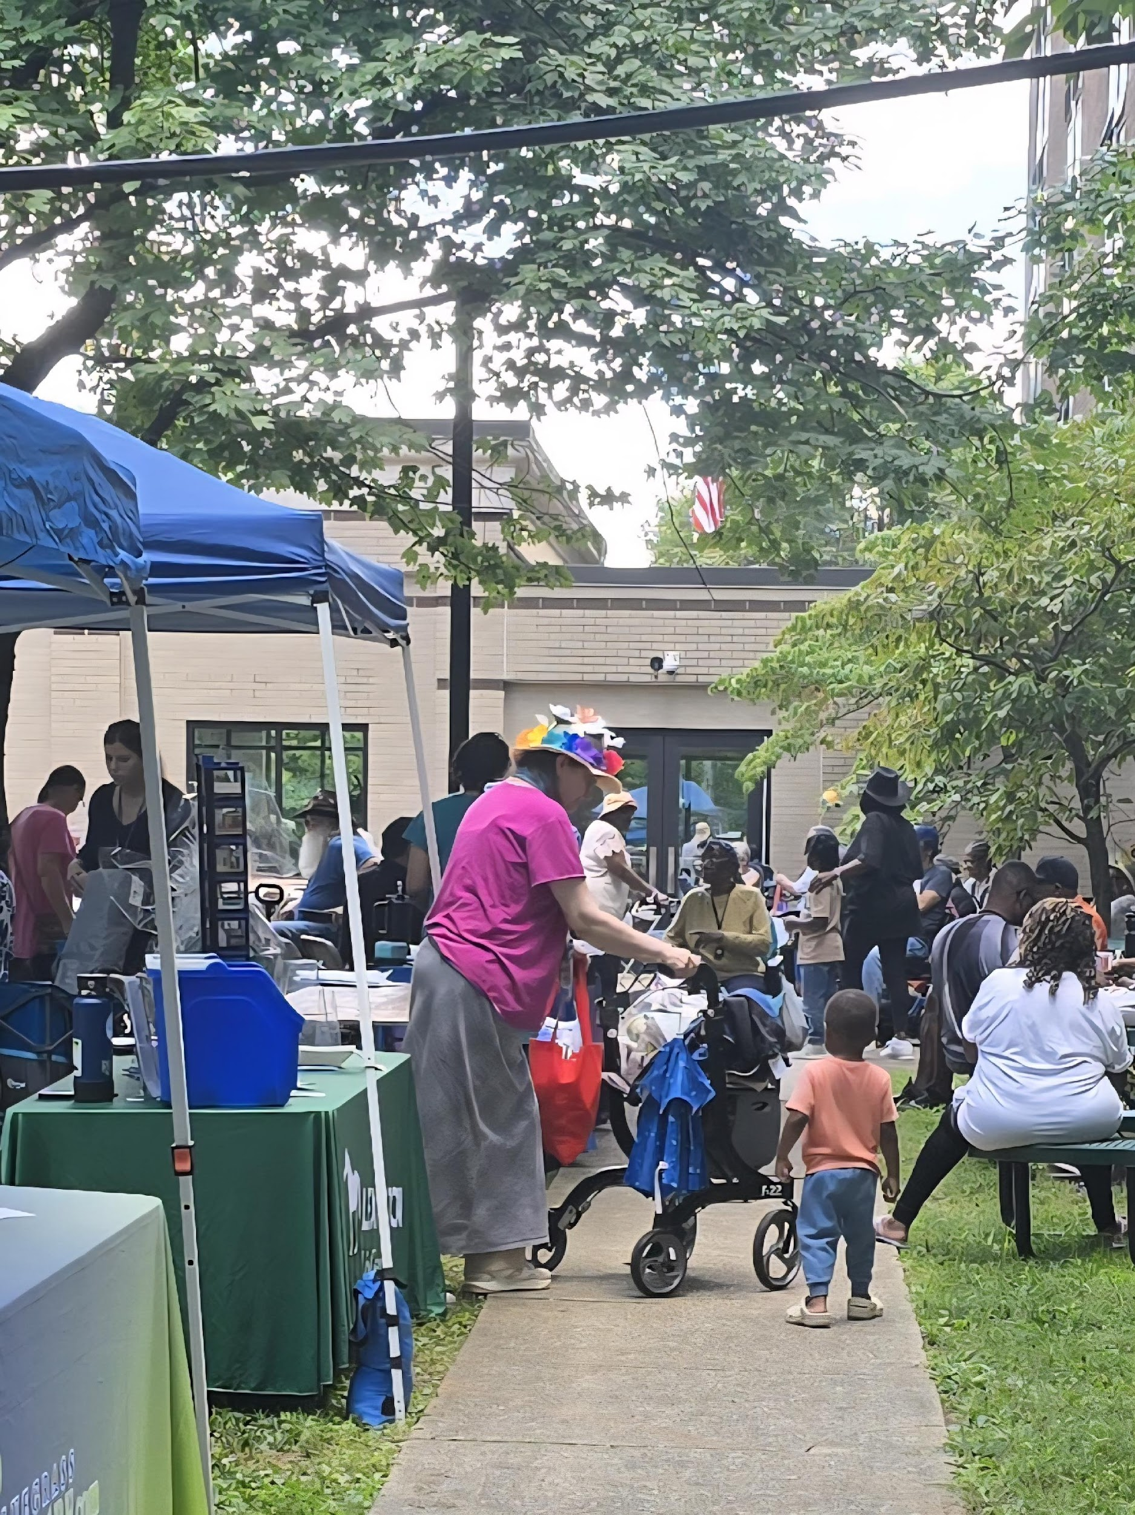
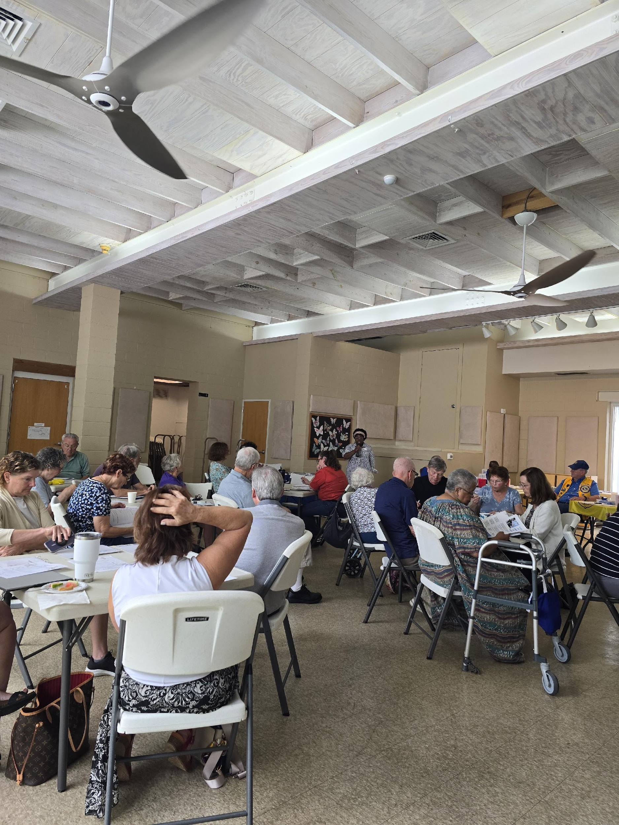
COMMUNITY RESPONSE
After the campaign events, several Lexington neighborhoods expressed strong interest in becoming part of the Village initiative.
These neighborhoods see value in being officially recognized as “spokes” or “circles” within the Village hub model.
Continued phone calls and requests for additional events and more information as the momentum we have generated continues to spread across Lexington!

Slide 13
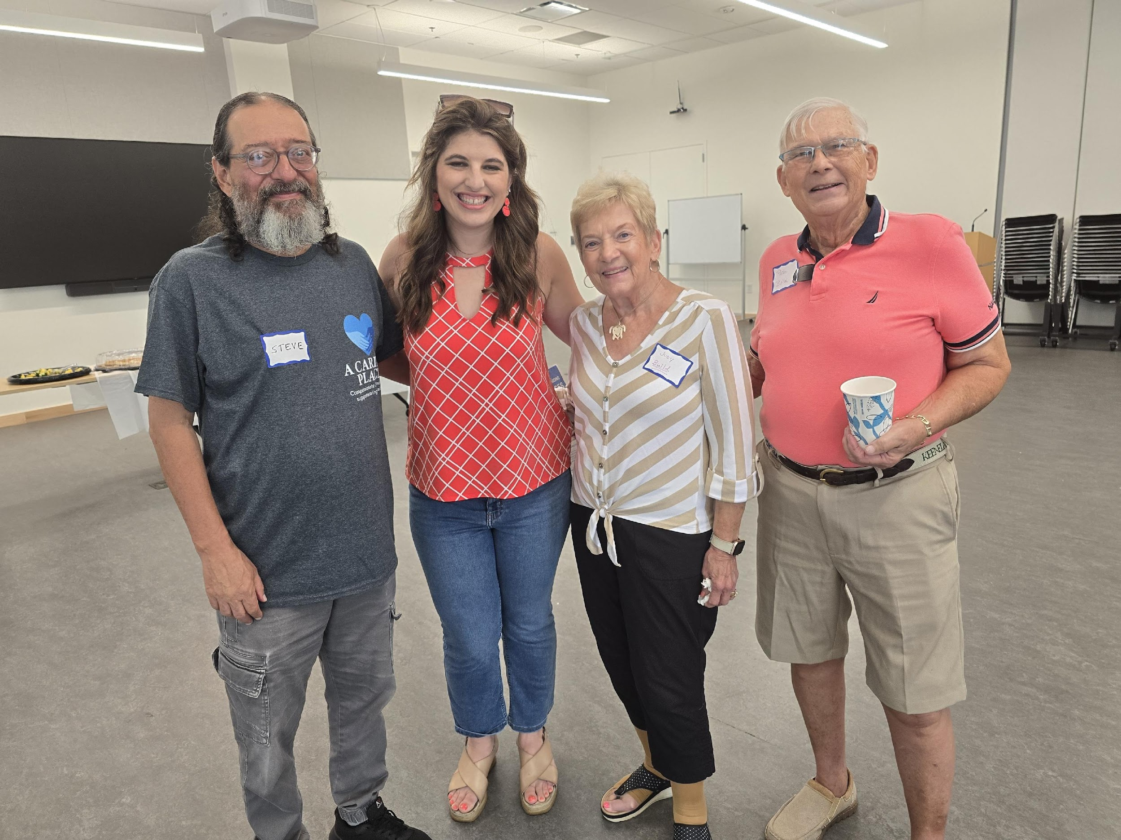
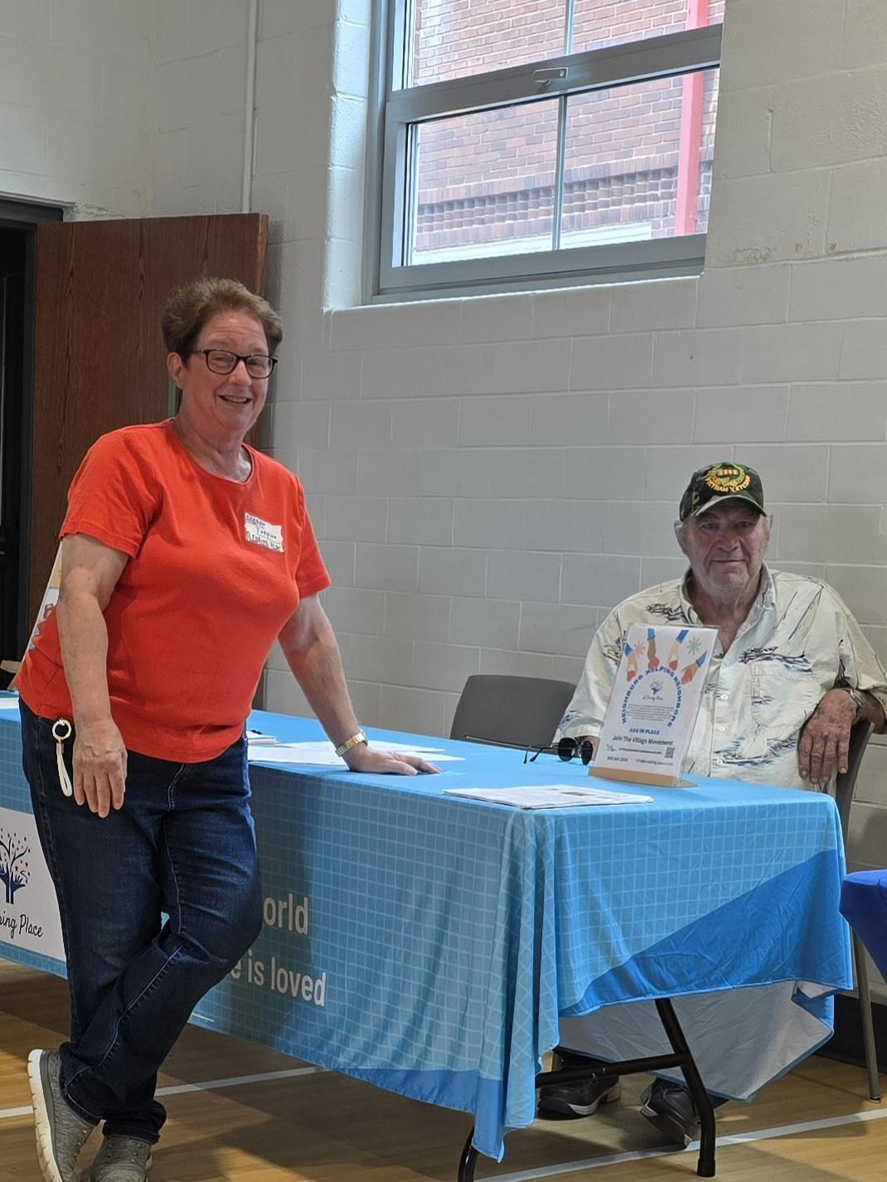
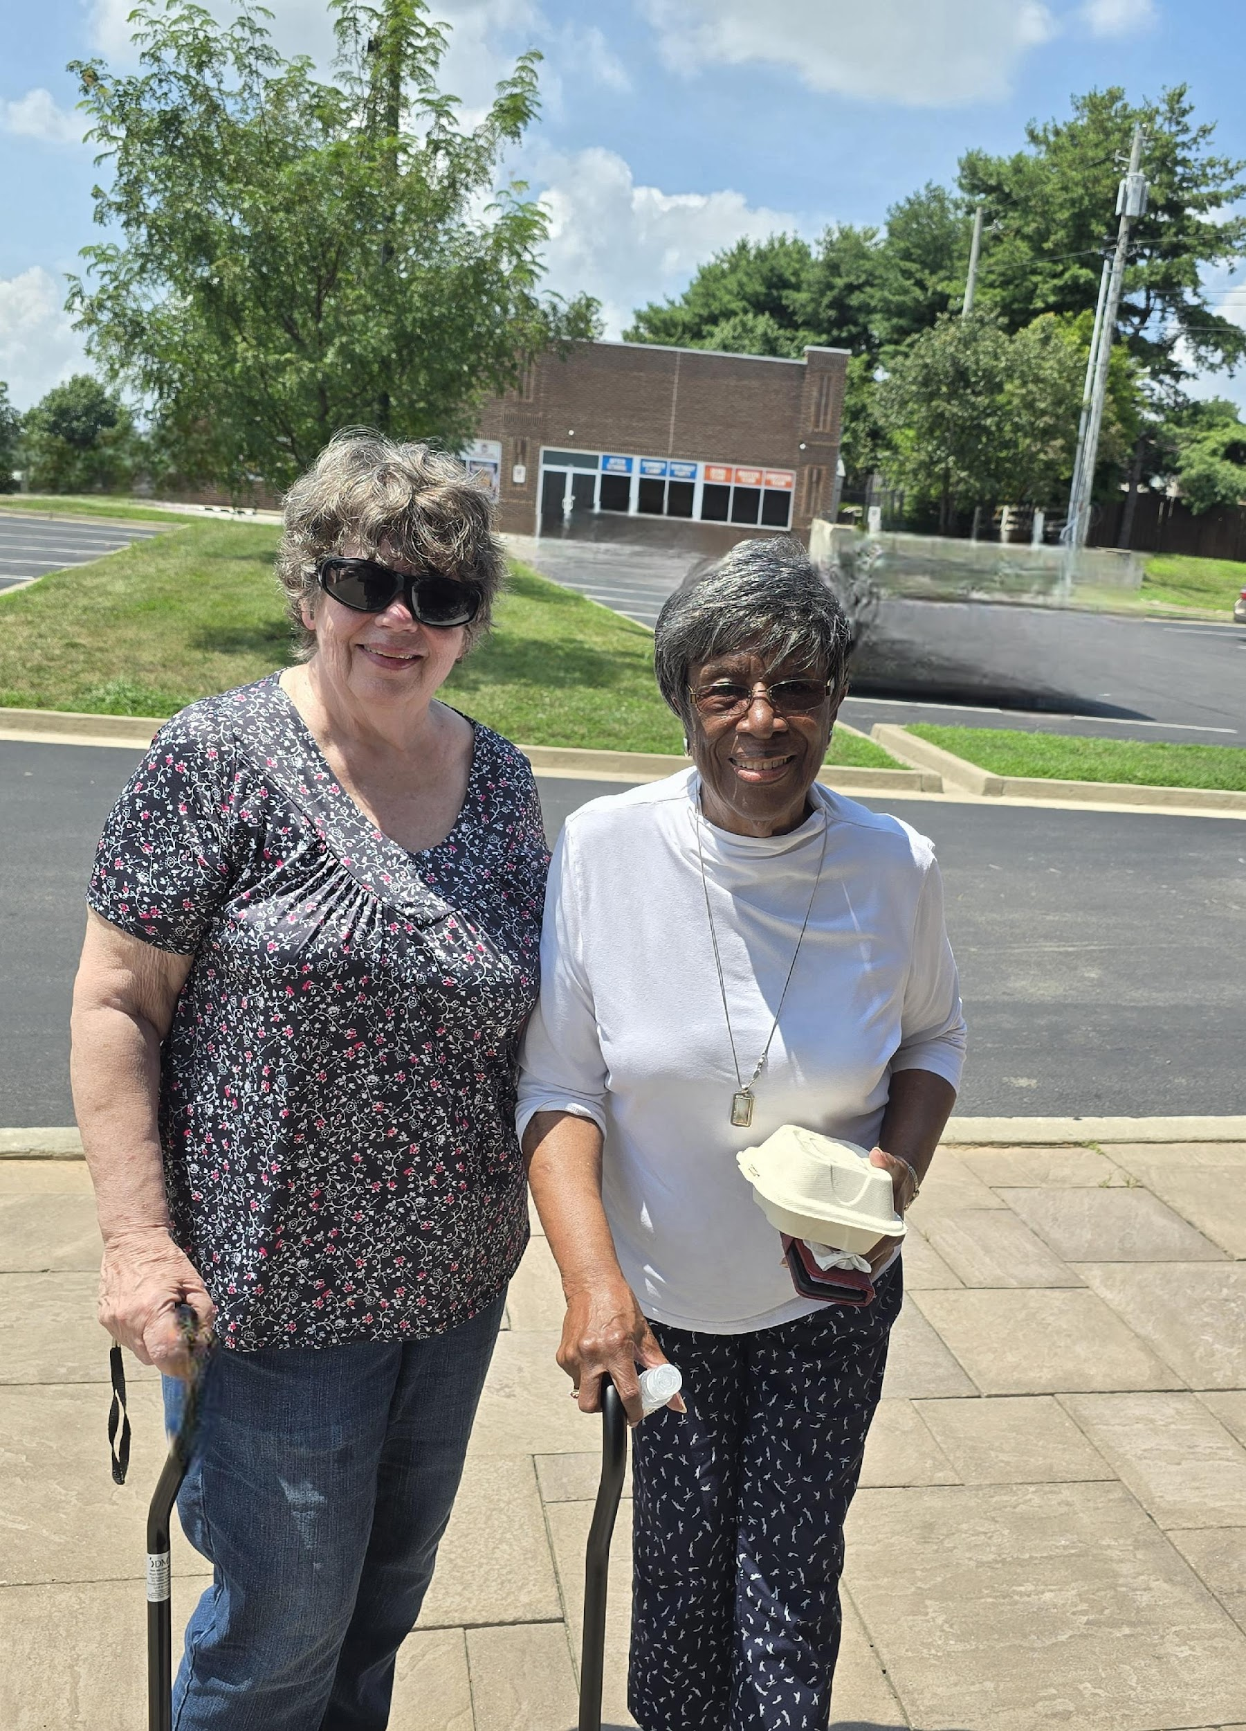
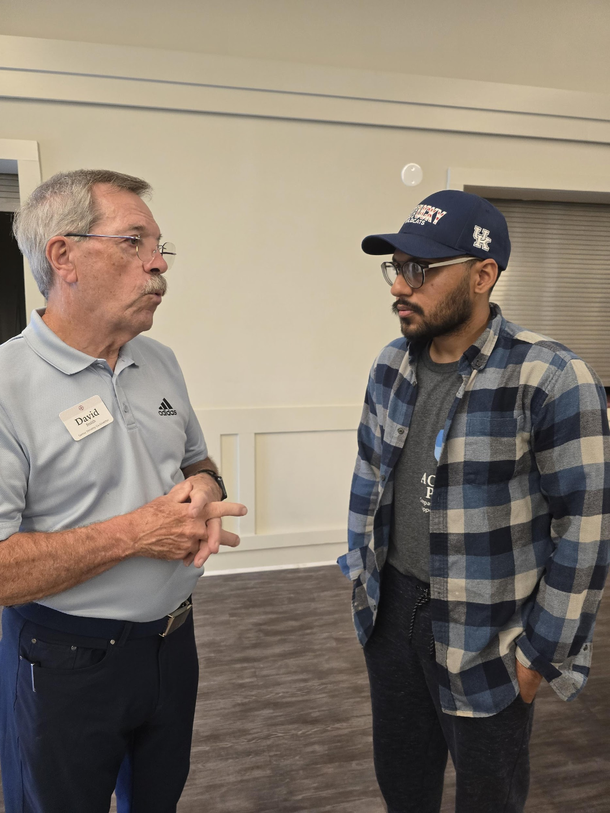
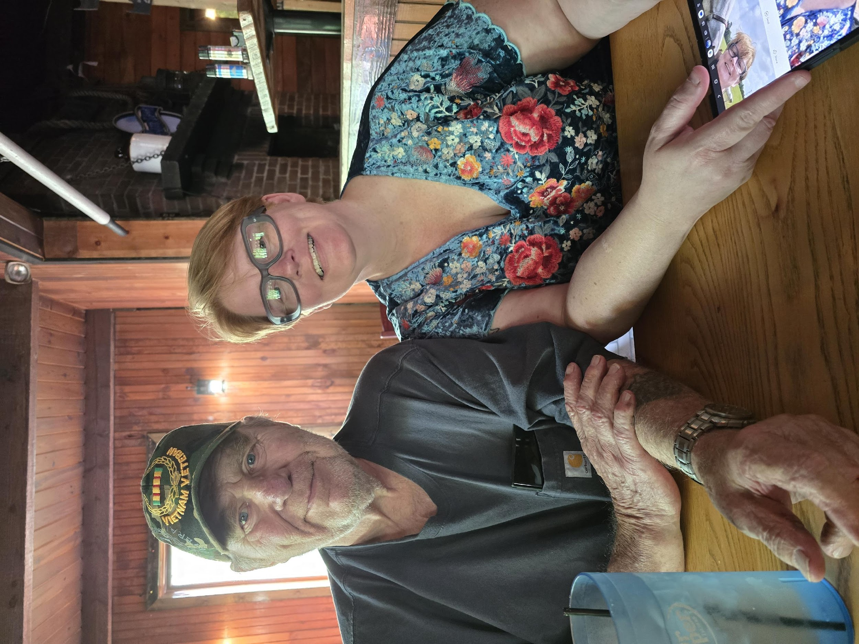
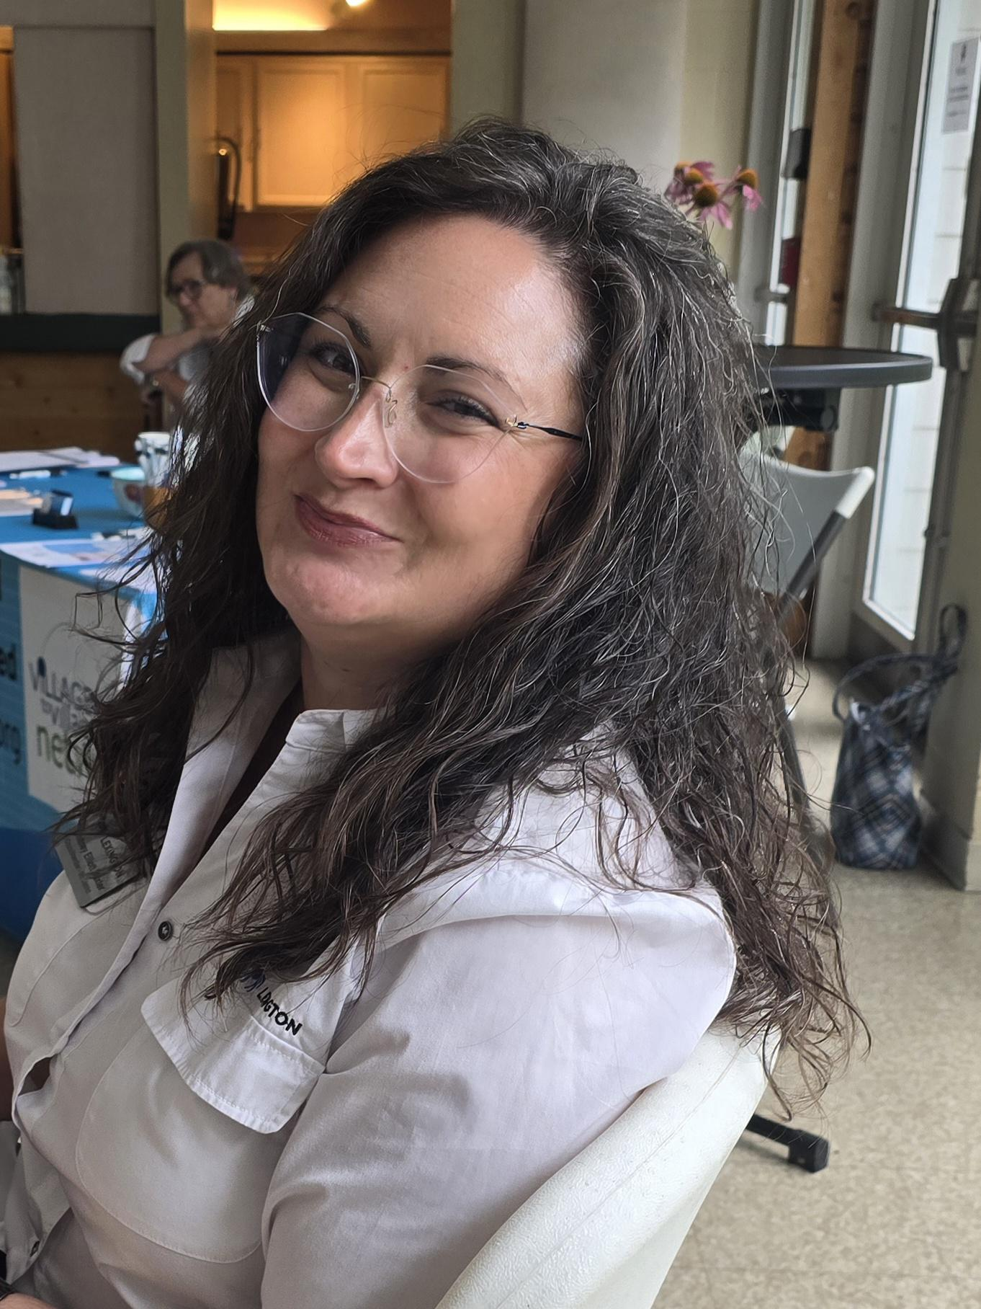
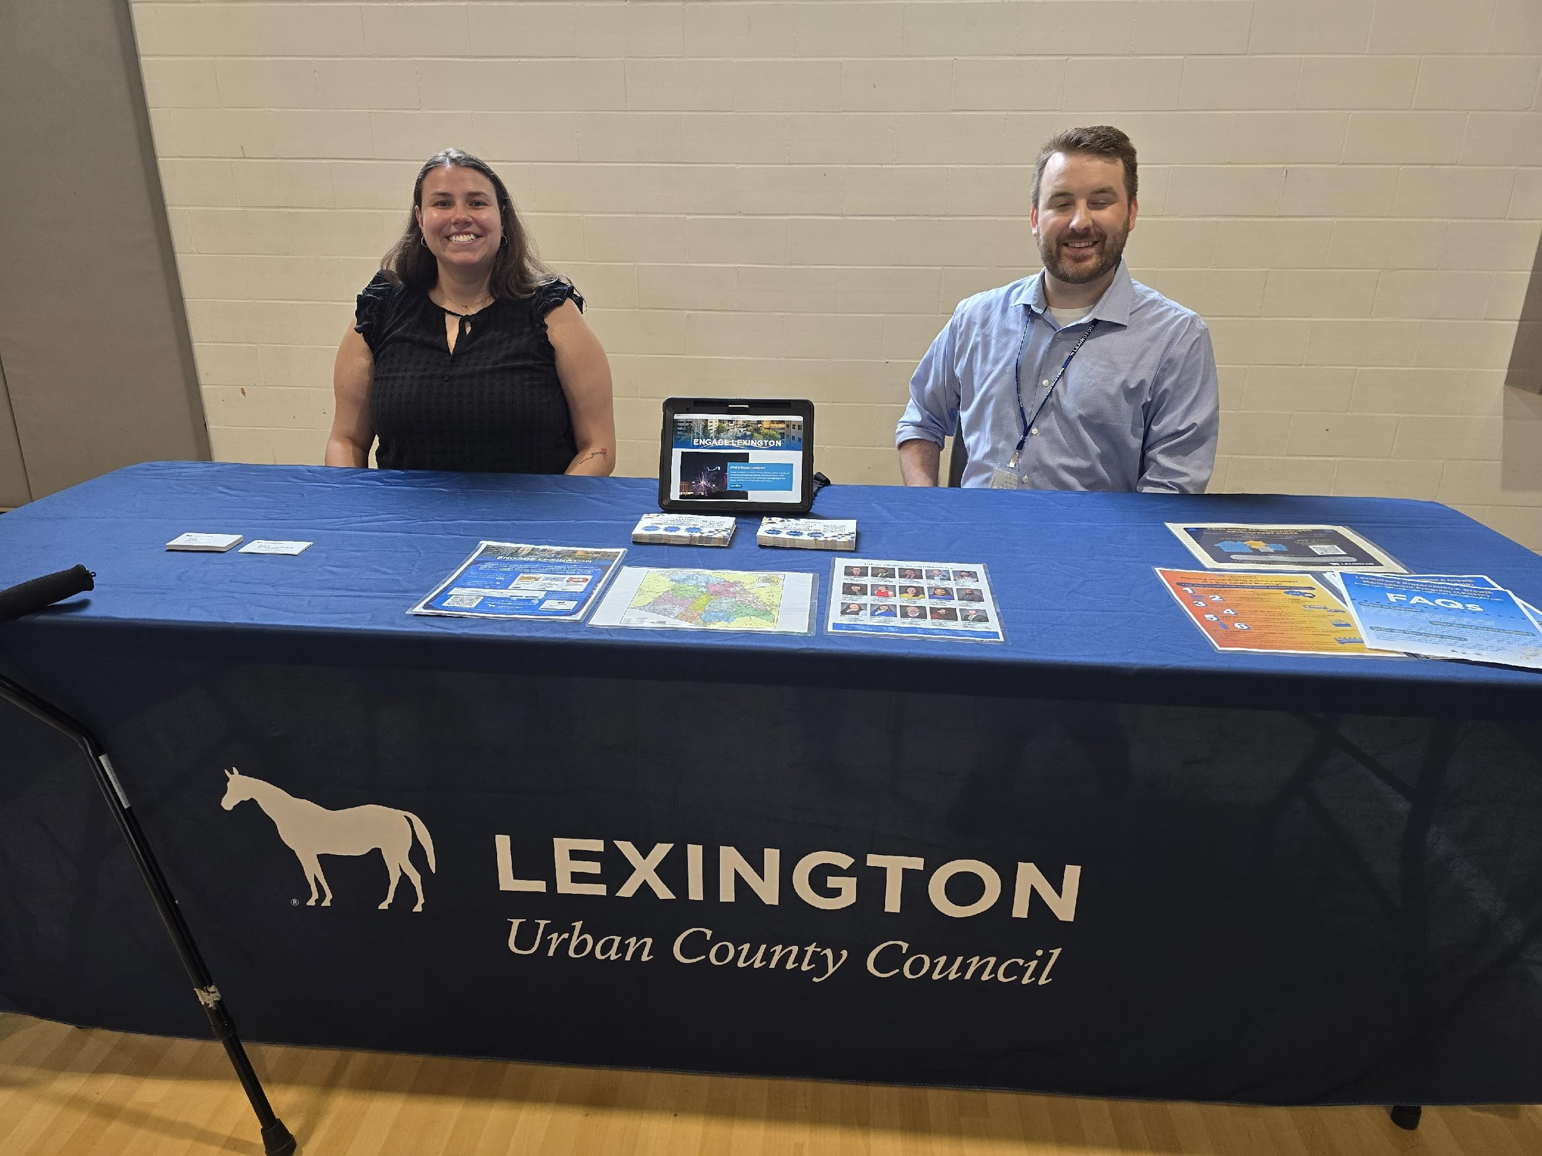
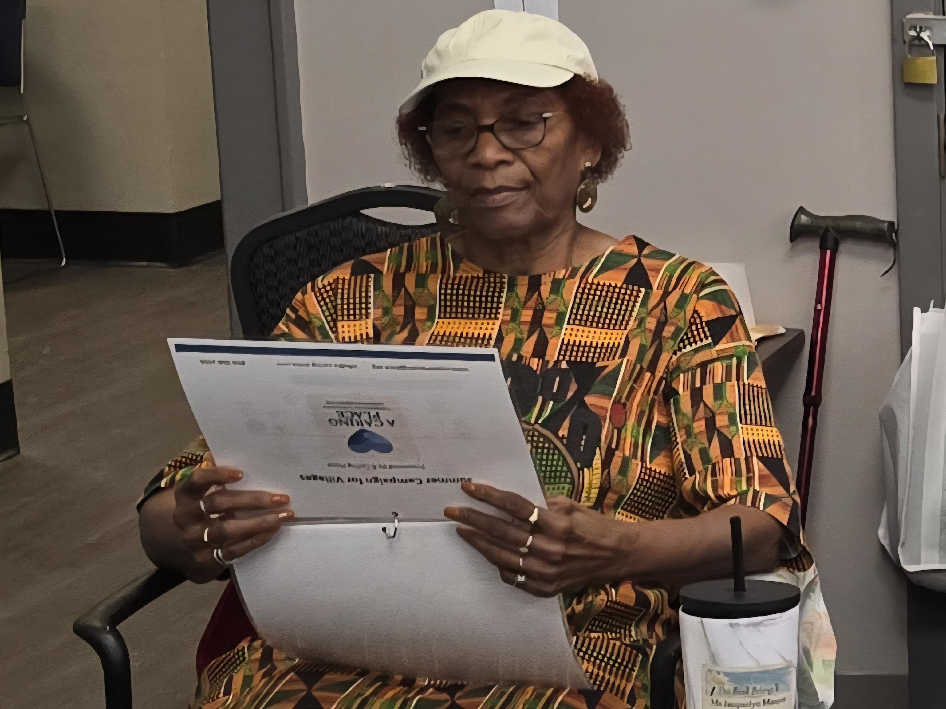
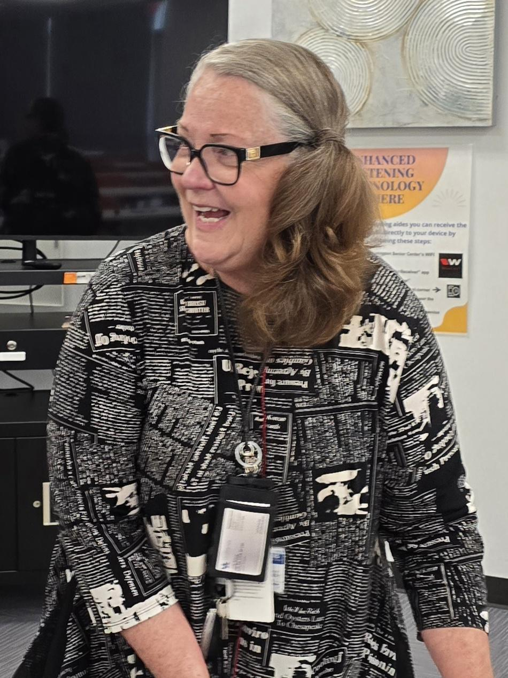
NOW WHAT? BUILDING THE FUTURE

Slide 14

STEP 1: ANALYZE THE DATA
Data collection for all 6 scopes of work should be finalized and preliminary analysis begun by January 2026

Slide 15

STEP 2: CRAFTING OUR STORY
Communicate via effective marketing our established mission, vision, and values
Communicate impact to members, volunteers, funders, and agencies

Slide 16
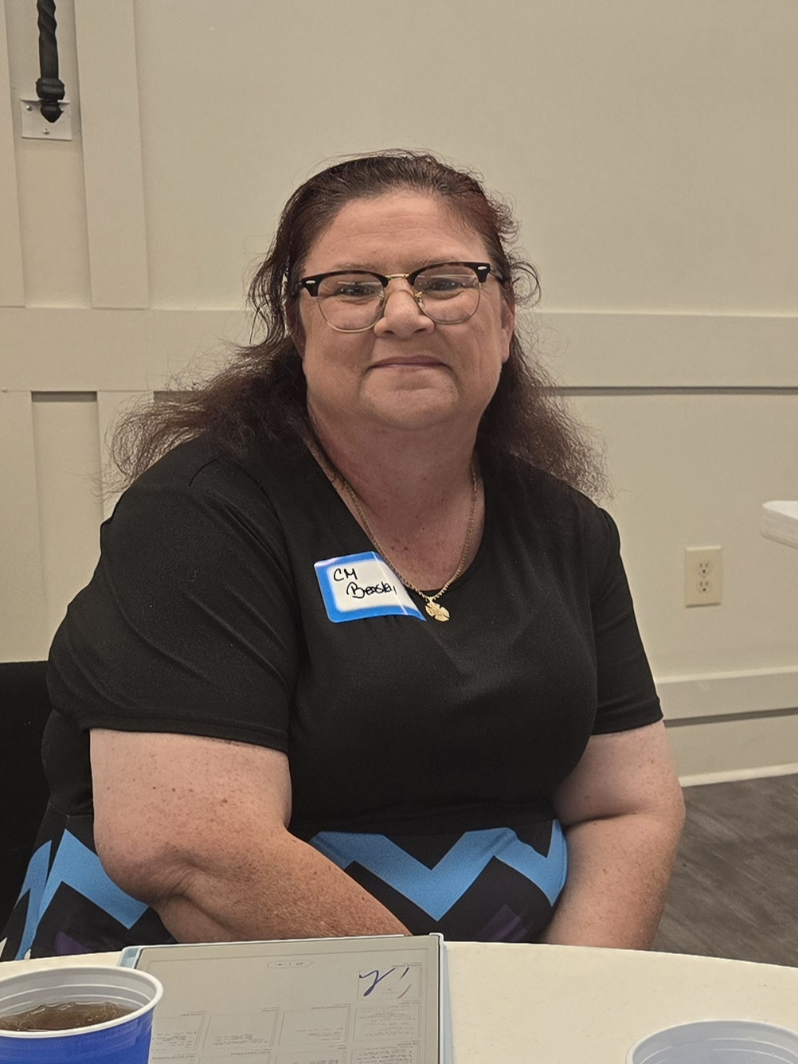
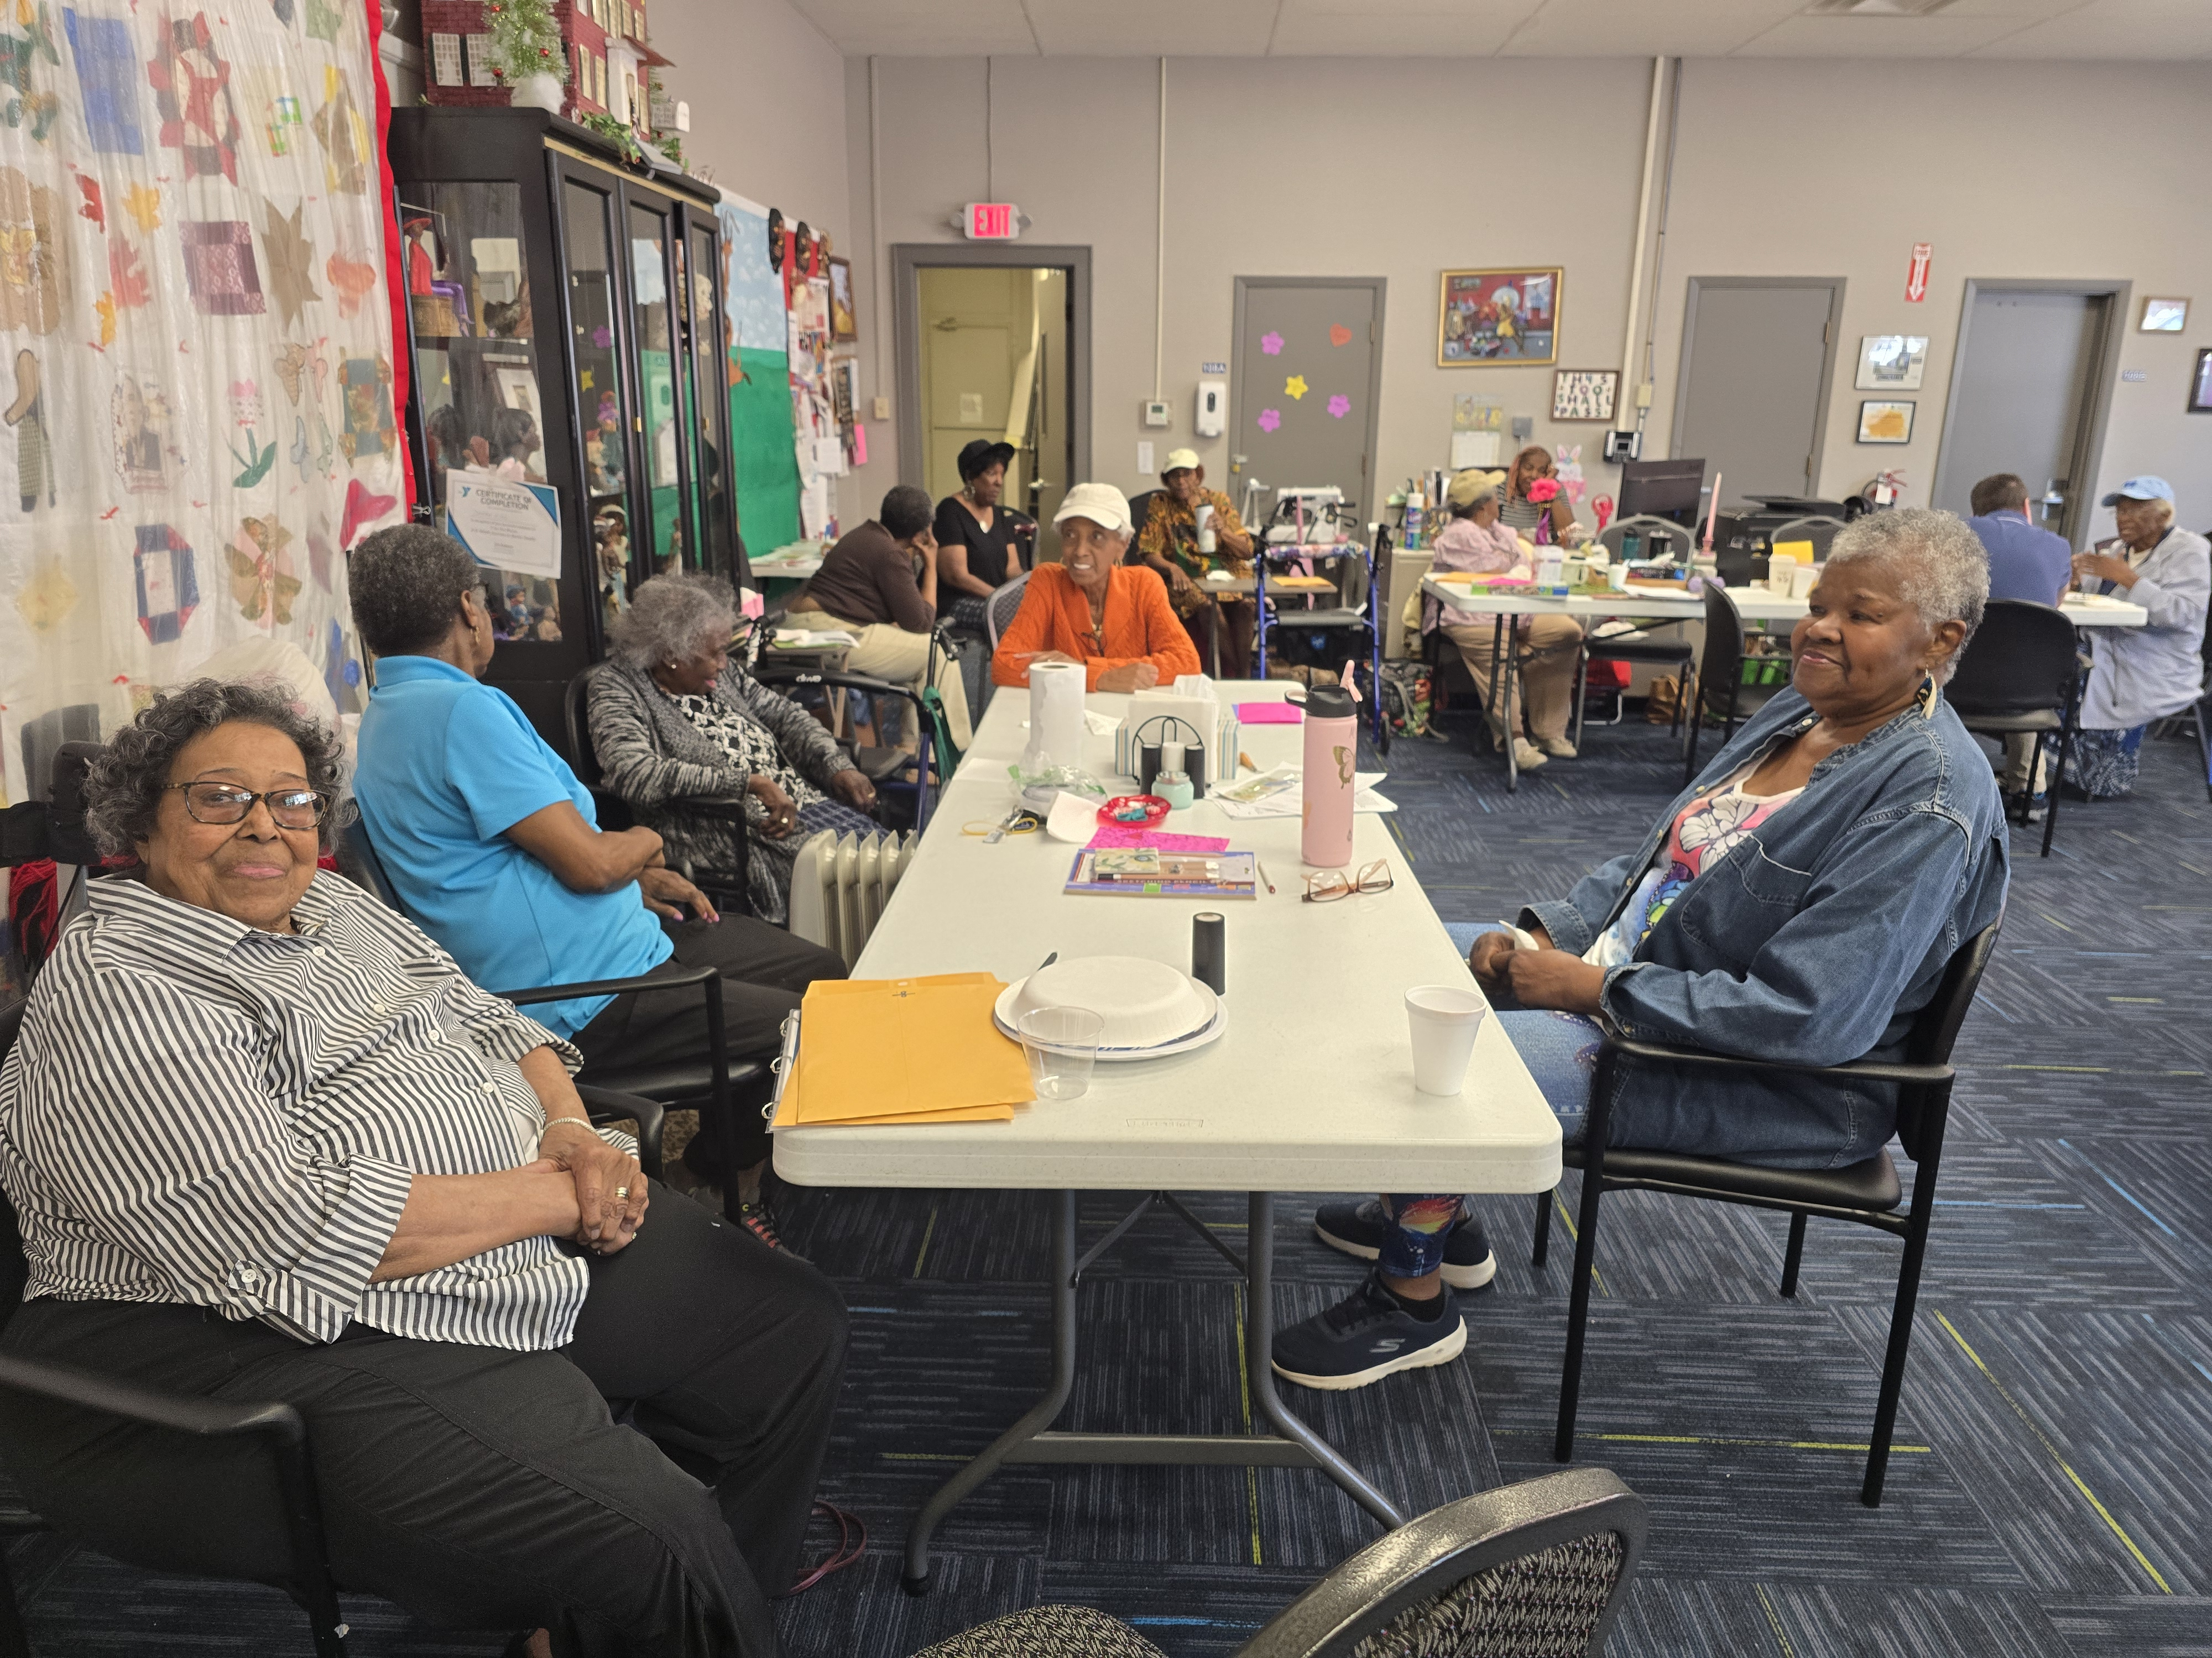
STEP 3: Distribute the results
Return results to stakeholders who supported our assessments (i.e. community, eldercare community caregivers, council members)

Slide 17
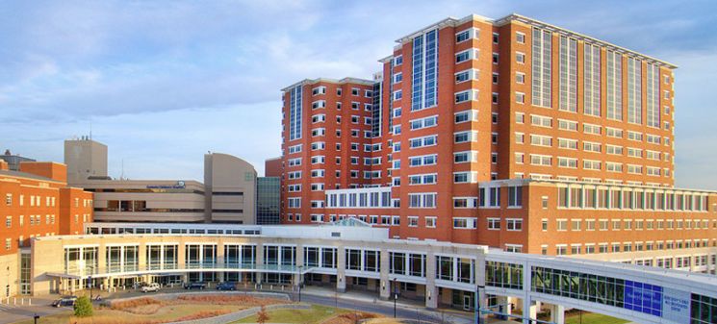
STEP 4: HOSPITAL COLLABORATION
Formalize collaboration with hospital administrators
Add hospital representatives to the Board

Slide 18
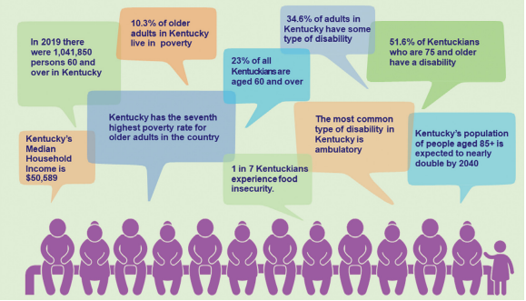
STEP 5: CONNECT TO STATE PLAN
Align with Kentucky State Aging Master Plan
Ensure Village efforts are part of broader policy goals

Slide 19
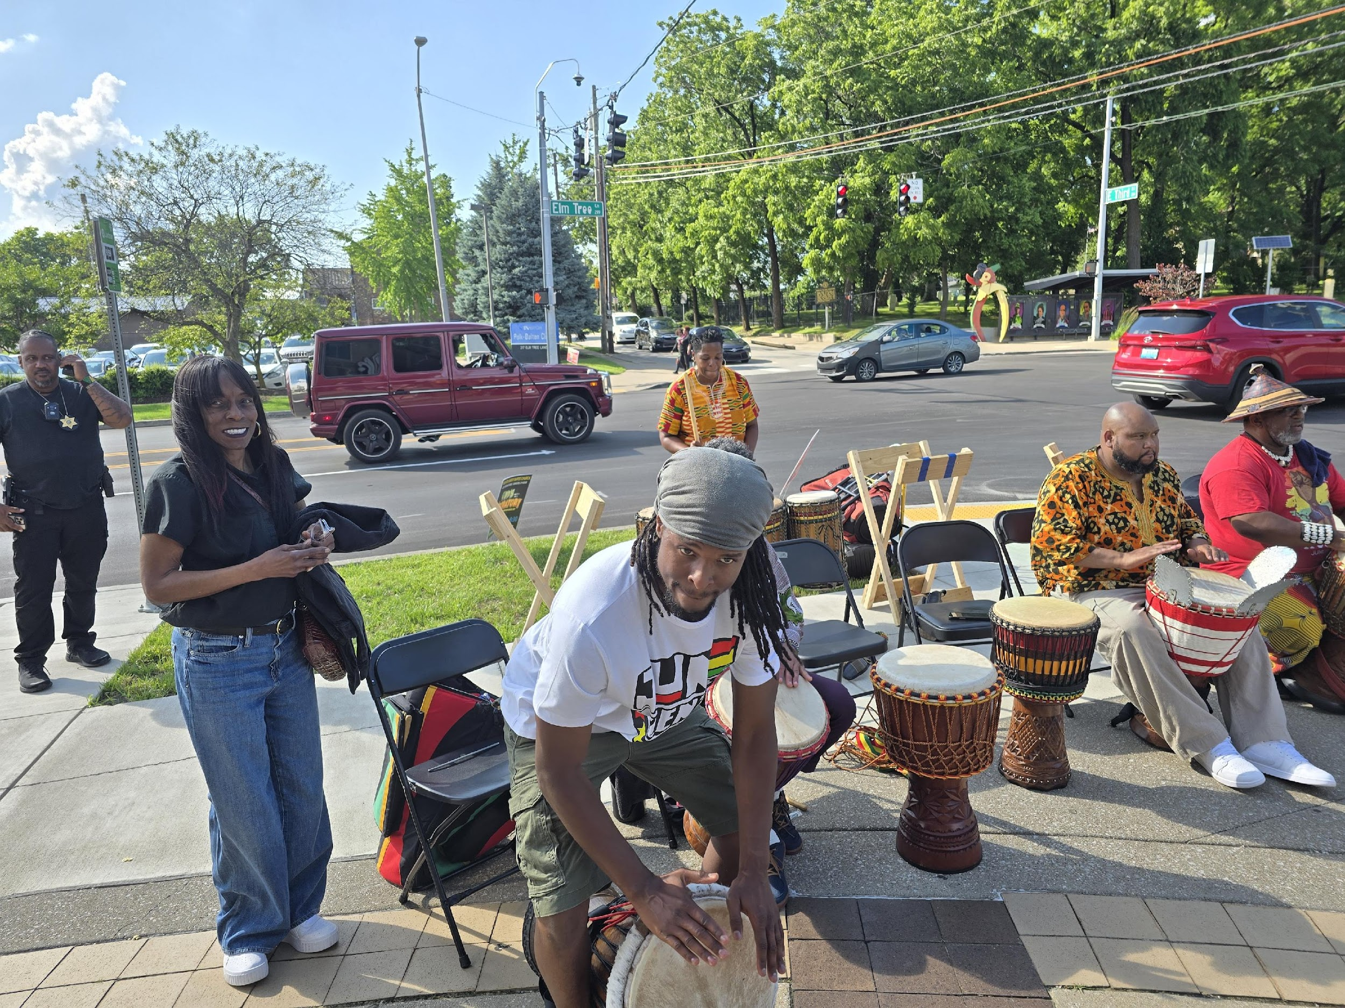
STEP 6: EXPAND PARTNERSHIPS
Identify partners at local, state, and federal levels
Explore additional opportunities for funding, training, and services

Slide 20
STEP 7: ORGANIZATIONAL DEVELOPMENT
Establish defined roles within the Resource Center (hub) + Social Circles (spokes)
Modify present bylaws to ensure inclusion of the hub and spoke business model.
Develop an MOU with Beaumont/Gardenside (combined neighborhoods) to pilot test
Notes:
ACP to be hub, combined neighborhood as spoke

Slide 21
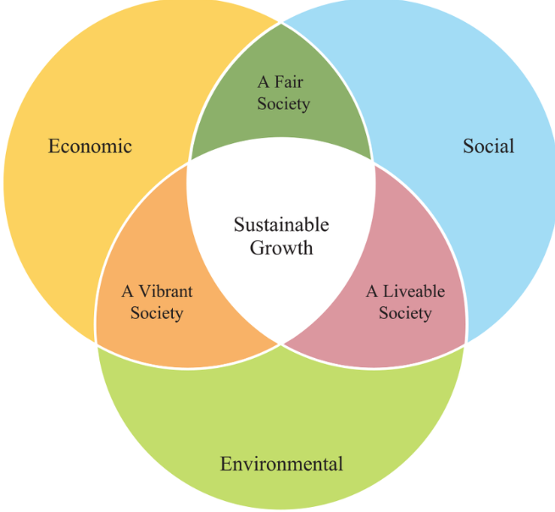
STEP 8: SUSTAINABILITY & GROWTH
Identify and apply for seed funding opportunities
Determine budget & membership dues
Develop Member & Volunteer Handbooks
Use needs assessment to guide services

Slide 22
ACKNOWLEDGEMENTS
People who work in eldercare – their skill, knowledge and compassion is awesome! Including Alzheimer’s Assoc., N YMCA, DFL, Silver Lexington, Pastor Jon Roller (BPC), Blue Grass Navigators, Elder Law and SHIP, etc.
City of Lexington – for championing community care and connection
BUILD (26 Lexington Churches) – for your united voice and unwavering commitment to justice: Special Mention of Judy Maxson and Deborah Gerth who went up and above in their contributions.
UK College of Medicine, Education and Social Work – for nurturing the next generation of compassionate professionals
Age Friendly Lexington & Reimagining Home – for envisioning dignity and belonging for all
Host sites – Especially our Churches: Unitarian Universalist, St Raphael’s Episcopal, 2nd Presbyterian, Beaumont Presbyterian, Christ the King Catholic, Tates Creek Presbyterian, St Elizabeth Ann Seton Catholic, St Peter Clavier Catholic
Volunteer Leadership of A Caring Place – for being the heartbeat of our mission with your time, care, and dedication: Stacy Federico, Ann Mendenhall, Sharon Turpin, Steve Katz, Rose Cheney, Patti Burke, Patty Cody, Sue Dozier, Darryl Tacket, Marion Joseph, Ron Cheney, Mark Alexander, Beth Alexander, Deep Patel, Janice Lewis

