Slide 1
Unlock Your Potential: Structured Internships for University Students
Bridge the gap between academic learning and practical industry experience. Discover how our structured internship programs can transform your career prospects. We provide real-world exposure and mentorship to help you succeed.
by Rizwan Khan

Slide 2
About Us: Bridging Academia and Industry
Our Mission
To empower students with practical skills and industry insights through structured internship programs.
Our Vision
To be the leading provider of internship experiences, recognized for excellence and innovation.
Core Values
Integrity
Excellence
Innovation
Collaboration

Slide 3
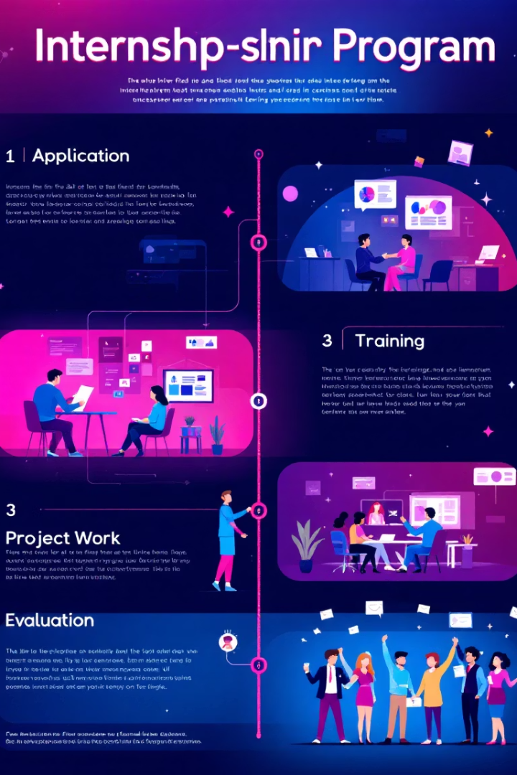
Program Design: Your Path to Success
1
Eligibility
2
Application
Open to all university students with a passion for learning and a strong academic record.
Submit your resume, cover letter, and academic transcripts online. Shortlisted candidates will be invited for an interview.
3
Timeline
Our internships typically run for 1-2months, with flexible start dates to accommodate academic schedules.

Slide 4
Real-World Exposure: Live Industry Projects
Types of Projects
Industries
Engage in diverse projects across various industries, including marketing campaigns, product design, and software development.
Gain experience in industries such as technology, finance, healthcare, and education, matching your career interests.
Technologies
Work with cutting-edge tools and technologies, staying ahead of industry trends and demands.

Slide 5
Mentorship & Support: Guiding Your Journey
Expert Guidance
Receive personalized mentorship from industry experts with years of experience.
Skill Workshops
Participate in workshops to develop essential skills, from communication to technical expertise.
Certificates
Earn a certificate with a rating of completion, validating your skills and experience.

Slide 6
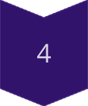
Key Benefits: Transforming Your Future
Practical Knowledge
Gain hands-on experience.
Improved Employability
Enhance your resume.
Expanded Network
Connect with professionals.
Job Opportunities
Potential career pathways.

Slide 7
Next Steps: Start Your Journey Today!
Join Our Community
Rating GMB Account
Transform your future.
Visit Our Website
Cabigo24.
Explore our programs.

