Slide 1
IMRAN AHMED CLIMATE | HUMANITARIAN | ANTICIPATORY ACTION | DISASTER MANAGEMENT

Slide 3
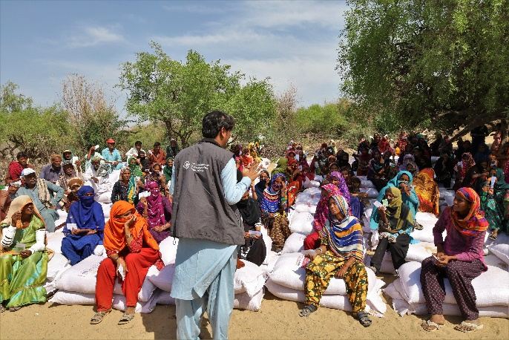
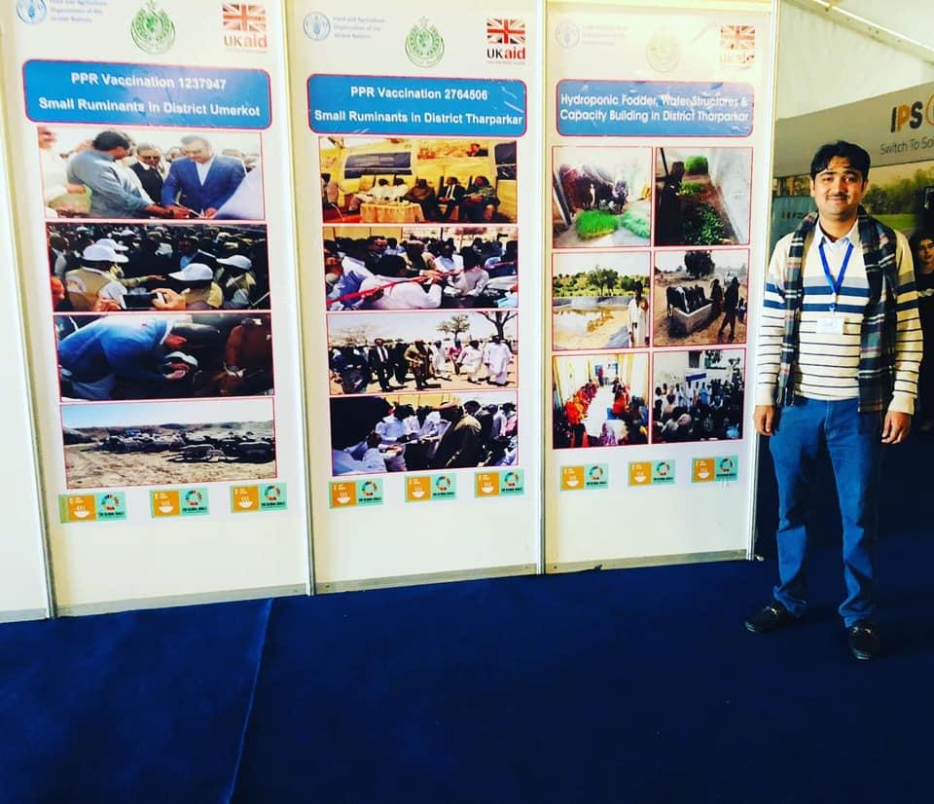
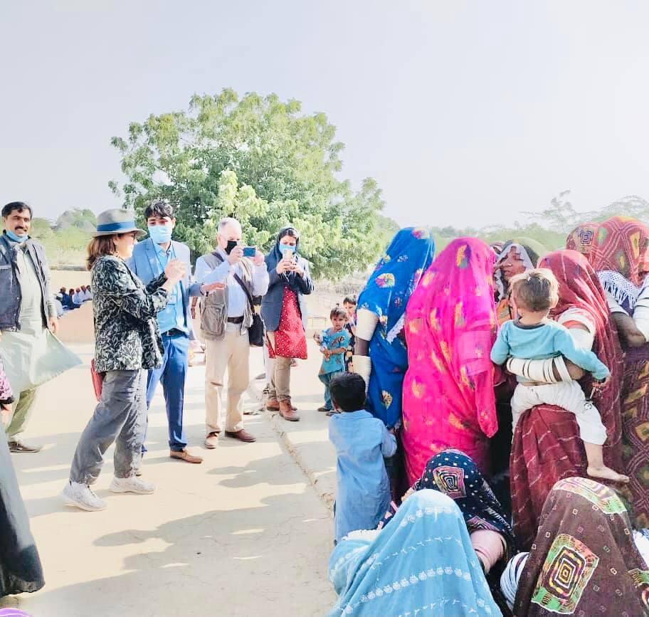

Slide 4
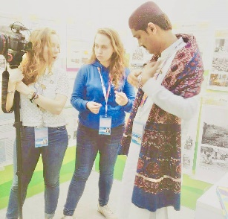
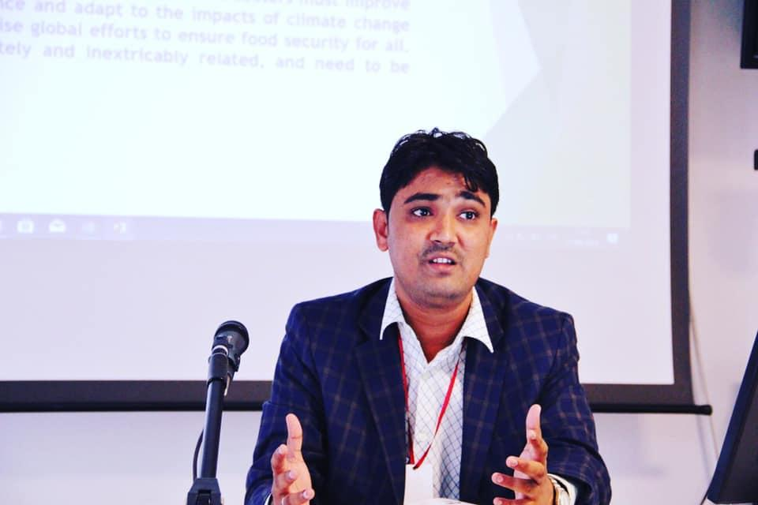

Slide 5
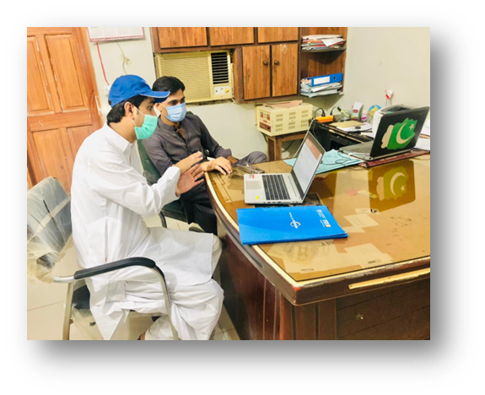
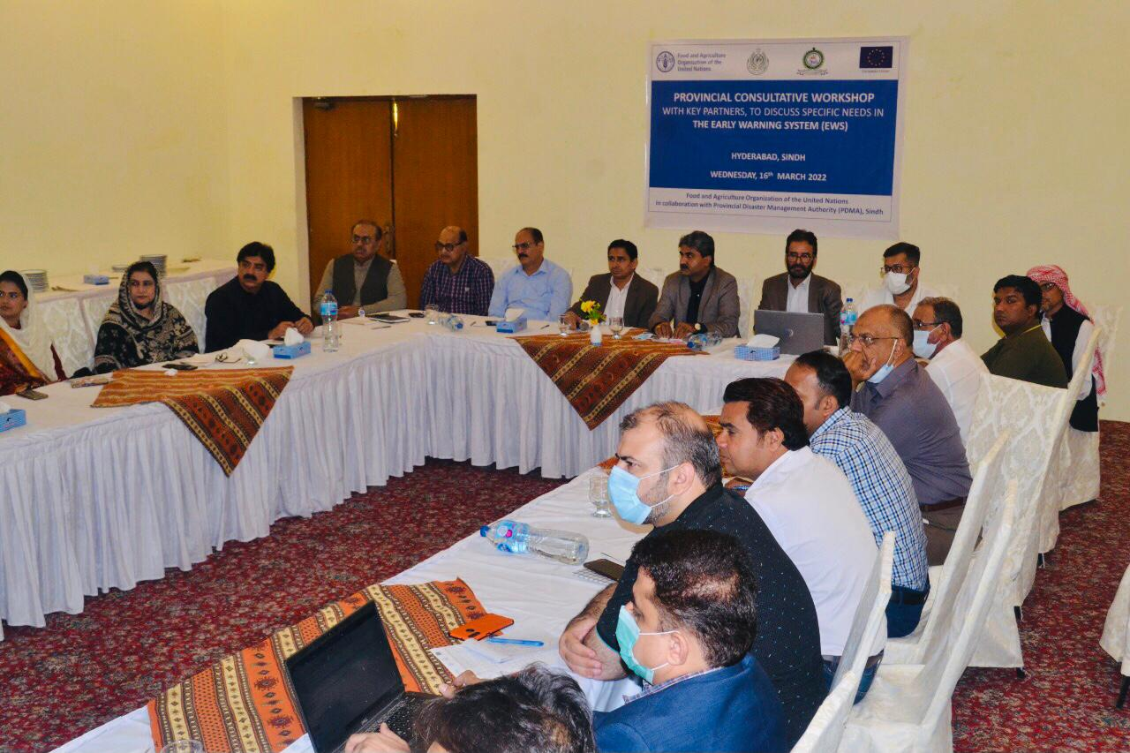
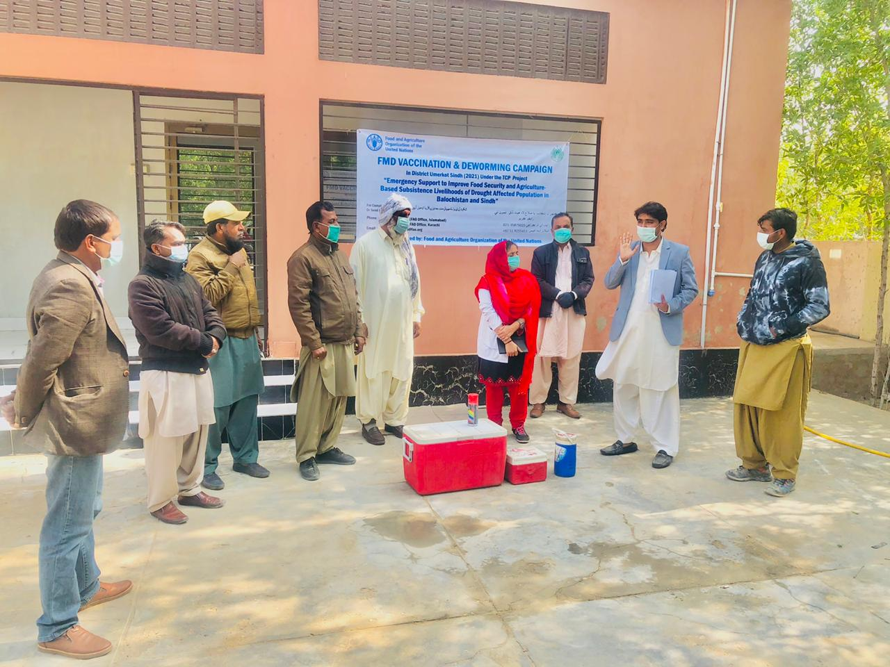

Slide 6
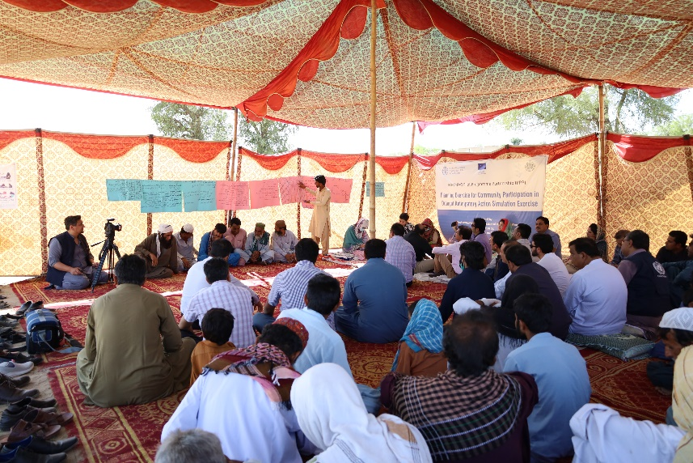
PROJECT MANAGEMENT AND LEADERSHIP: UNITED NATIONS FAO PAKISTAN
IMPACT:
A total of 04 projects are implemented in the 3 districts.
Reached to 457156 families.
Carpet animal vaccination with livestock department (4,764,506)
Distribution of animal compound feed (16096 families)
Drinking water facilities for livestock (33 facilities).
Promotion of kitchen gardening and drought resilient seeds.
Total Cash Assistance 5736 HHs in shape of Anticipatory Action
Coordinated the distribution of agricultural aid to 8 000 household to 2022 flood affected farmers.
Early Warning Early Action model in Tharparkar
Pilot Programme Partnership (PPP) on increasing capacities and scale for Anticipatory Action including through Social Protection systems in Sindh
LONGER TERM RESILIENCE BUILDING INTERVENTIONS.
ECHO PPP 2021-2024
SUSTAINING EWEA MODEL IN THE DISTRICT THARPARKAR 2019-2021
GRASP 2020-2024
SRAS 2021-2024

Slide 7
Early Warning System
EWS is a proactive approach to monitor and predict potential disasters, allowing timely actions to mitigate risks.
Key Components of EWS:
Risk Assessment: Identifying hazard-prone areas and vulnerable populations.
Monitoring & Prediction: Utilizing tools to forecast events like droughts, floods, or extreme weather.
Communication: Establishing effective channels to inform communities and decision-makers.
Preparedness: Training local communities and government officials to respond swiftly.
Contributions at FAO:
Developed early warning tools specific to drought and flood conditions.
Formed 65 district-level technical working groups and Early Warning Committees across Sindh.
Trained 2200+ government staff and farmers on EWS techniques in Sindh.

Slide 8
Anticipatory Action – Building Community Resilience
Purpose:
Preparing for disasters before they occur to lessen the impact on vulnerable communities.
Core Elements of Anticipatory Action:
Trigger Mechanisms: Setting thresholds for action, such as drought or flood warnings.
Pre-Positioning Resources: Ensuring timely access to food, water, and essential supplies.
Community Engagement: Working with local leaders and members to understand and plan for risks.
Simulation Drills: Conducting preparedness exercises to ensure response readiness.
Key Achievements in Anticipatory Action:
Spearheaded drought and flood simulation exercises, involving 2200 plus stakeholders and 1700 households.
Activated drought Early Actions / Anticipatory Action in 2020 and 2024 providing cash assistance and livestock support to 10000 plus vulnerable households.

Slide 9
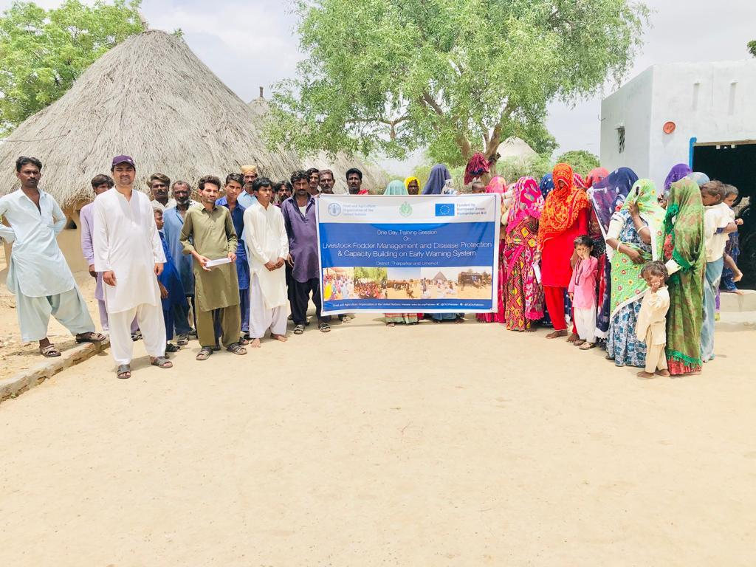

Slide 10
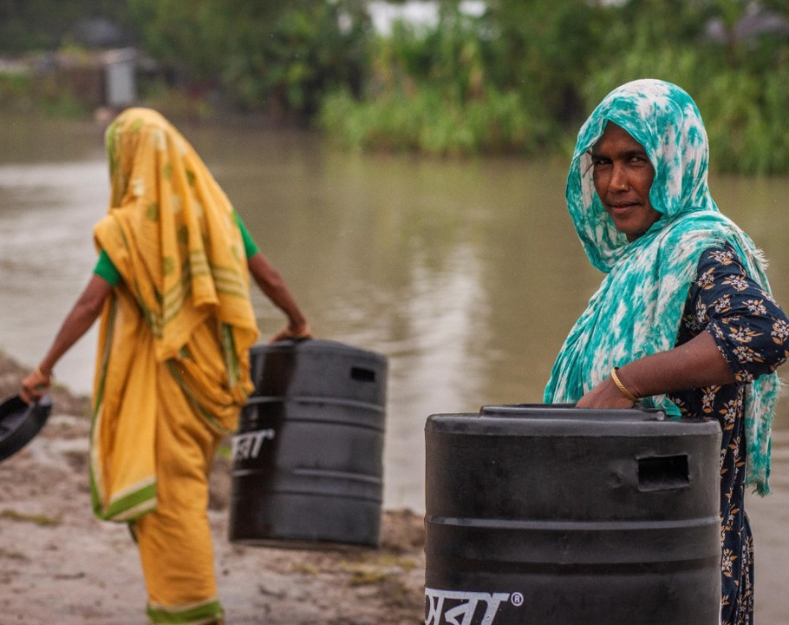
ECHO-FAO PPP
PILOT PROGRAMME PARTNERSHIP (PPP) ON INCREASING CAPACITIES AND SCALE FOR ANTICIPATORY ACTION INCLUDING THROUGH SOCIAL PROTECTION SYSTEMS

Slide 11
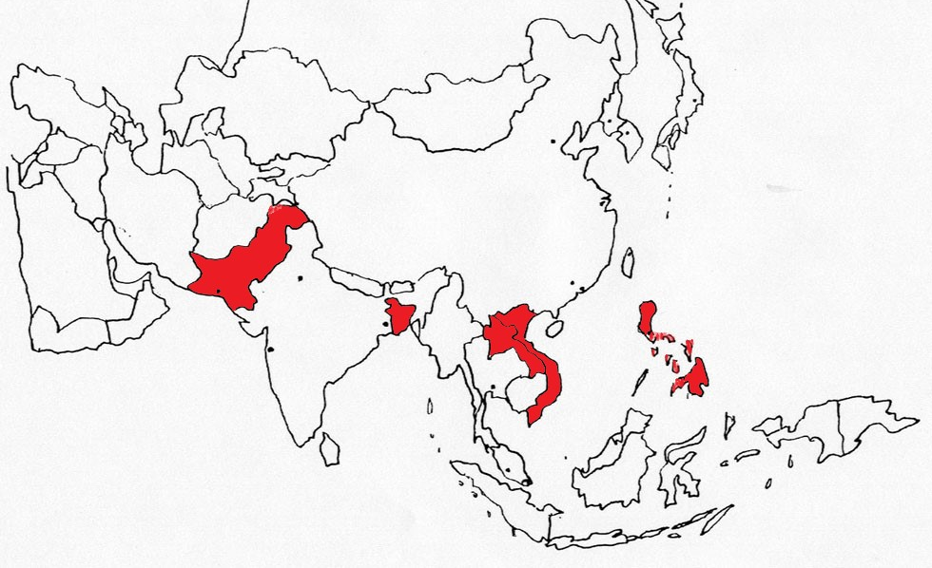
PPP – 5 TARGET COUNTRIES
VIETNAM
PAKISTAN
PHILIPPINES
BANGLADESH
LAO PDR
Regional Office - Bangkok

Slide 12
KEY RESULTS
Result 1: Establishing Anticipatory Action Protocols (AAPs) to be tested and documented in close collaboration with humanitarian and national partners
Result 2: Exploring how Social Protection systems can be adapted to anticipate crises
Result 3: FAO and DG ECHO partnership is enhanced so that multi-risk Anticipatory Actions are implemented, including via expanding or complementing national social protection systems, to protect lives and livelihoods ahead of a shock.
Result 4: Gathering evidence, learning and advocacy on the effectiveness of anticipating crises as a key complement to the existing humanitarian response models

Slide 13
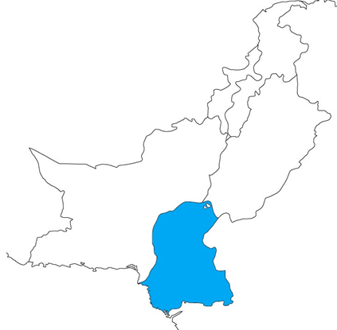
PAKISTAN - PPP
2022 and 2023
Launched AA protocols in Sindh, integrating geospatial analysis, early warning systems, and simulations, benefiting 53,100 people across three districts.
Aligned AA and SRSP approaches between the stakeholders
Enhanced AA coordination at national and provincial levels
Increased evidence on the feasibility and institutionalization of the concepts
Distributed 400 movable silos for flood resilience; concluded AA programs, aiding 7,080 households.
Developed AA-social protection frameworks for 4,936 households, coordinated plans with government, and shared IEC materials.
Strengthened TWGs with 2,200 stakeholders; trained 2,250 in cash programming.
Distributed PKR 114 million to 2,836 drought-affected households; published FAO-ECHO work plans and impact studies.
2021 Baseline
2024 Targets

Slide 14
AAP/SRSP DEVELOPMENT PROCESS
Step 2
+ ToR for Feasibility assessment of AA through SP
Trigger revision
Step 3 – regional consultation in Sindh
+ SP in anticipation feasibility assessment to be implemented
Step 1 Review of historical drought and flood events
Desk Work plus assessment survey
Step 5 – design the delivery plan & estimate budget + presentation of feasibility assessment results
Step 4 ) – validation of AA with communities
+ feasibility assessment ongoing
Step 6 – joint simulation exercise for drought AA
Revised AAPs
+SP in anticipation “pilot”

Slide 15
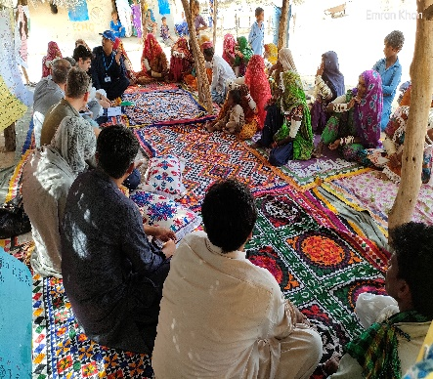
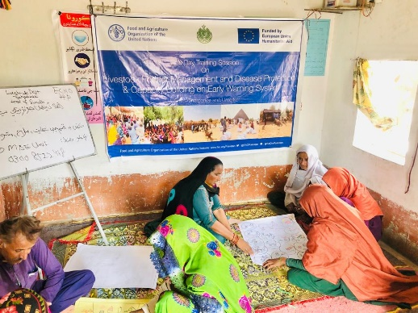
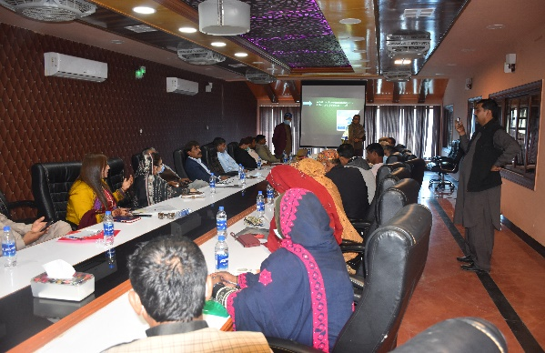
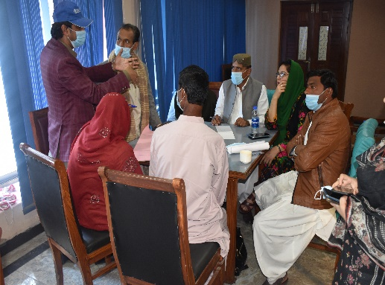
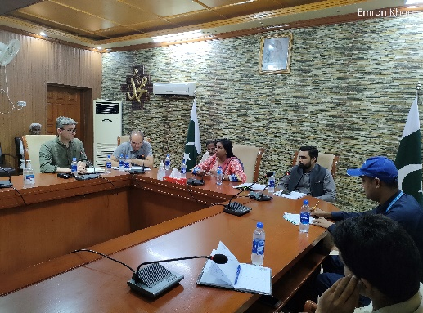
KEY PROJECT ACHIEVEMENTS:
Establishment of Anticipatory Action (AA) Systems:
Development of AA Protocols: Created comprehensive drought and riverine flood protocols using geospatial risk analysis and trigger mechanisms. Benefited 7,080 households (53,100 individuals), 70% of whom were women.
Simulation Exercises: Conducted drought and flood simulations in Tharparkar and Dadu, aiding 1,600 female beneficiaries with anticipatory actions, including cash and fodder support.
Early Warning Systems (EWS): Refined national and provincial EWS, aligning them with AA protocols, and developed an impact-based flood EW roadmap. Strengthened local EW systems at district levels through the dissemination of SOPs.

Slide 16
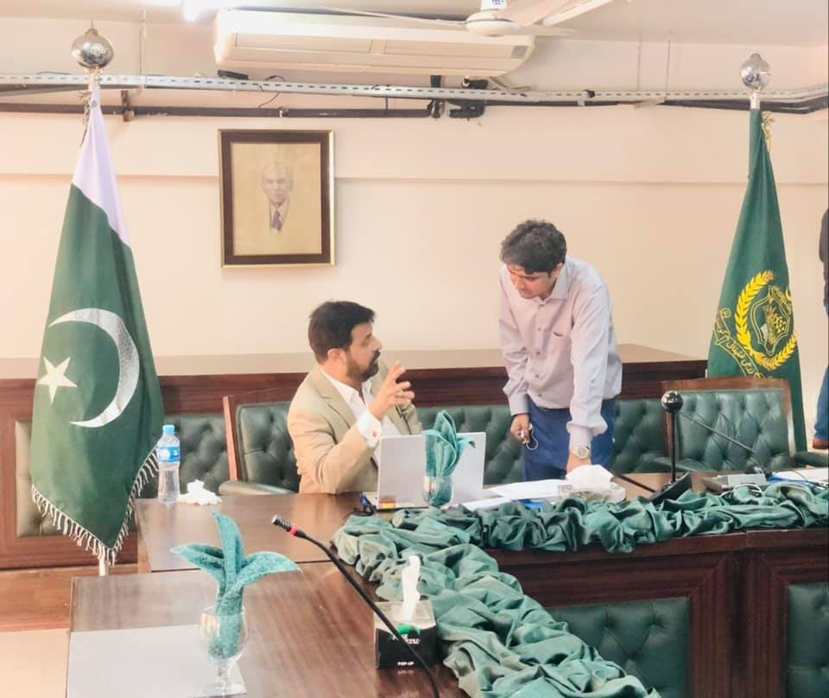
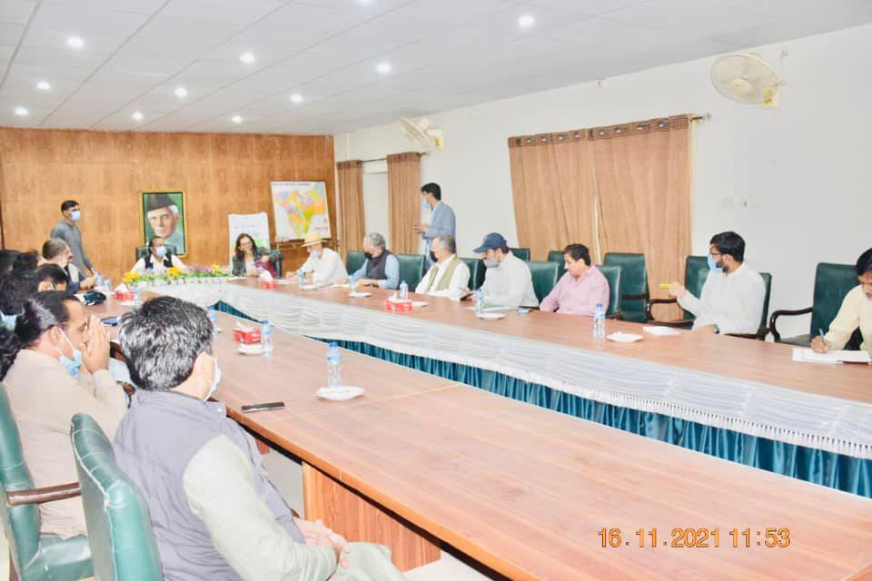
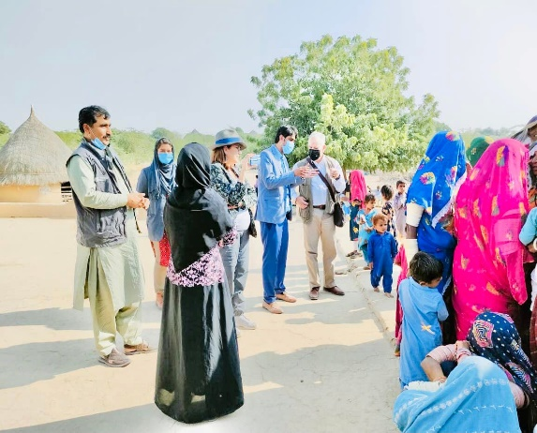
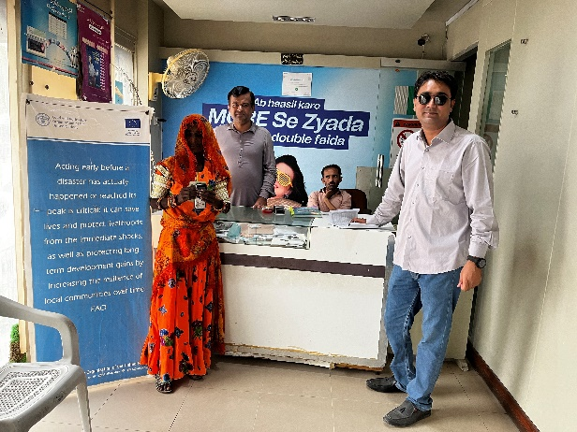
STRENGTHENING OF SOCIAL PROTECTION SYSTEMS:
AA-SRSP Framework: Developed an Anticipatory Action-Shock Responsive Social Protection (AA-SRSP) framework, benefiting 5736 households through harmonized cash assistance approaches.
Cash Assistance Program: Distributed PKR 114 million to 5736 households affected by drought in Tharparkar, Umerkot, and Dadu.
Silo Distribution: Provided 400 movable silos (1,000 kg each) to flood-prone communities in Dadu, aiding in seed and grain storage during displacements.
Capacity Building: Trained 2,250 stakeholders in shock-responsive social protection and cash programming.

Slide 17
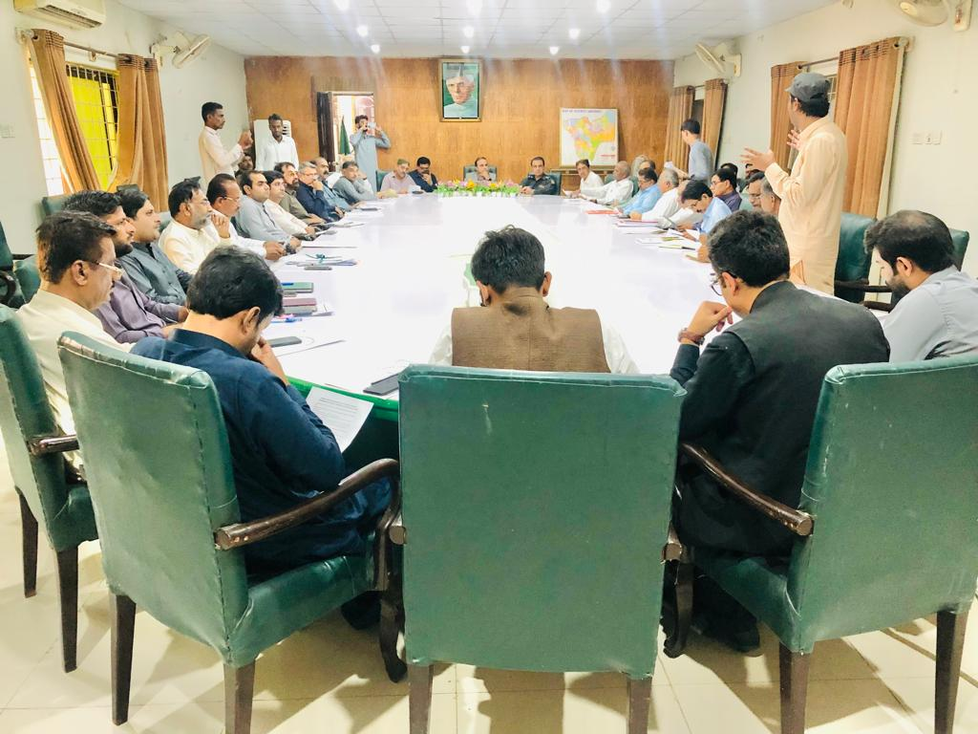
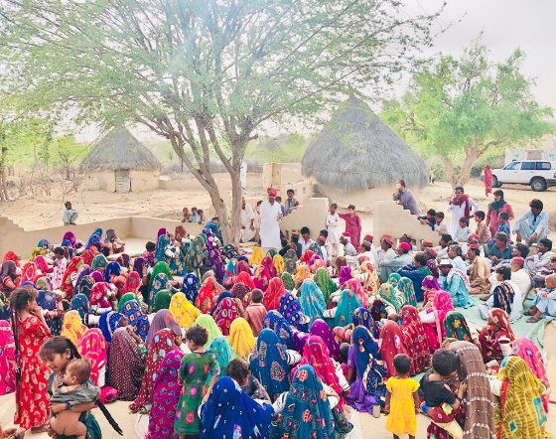
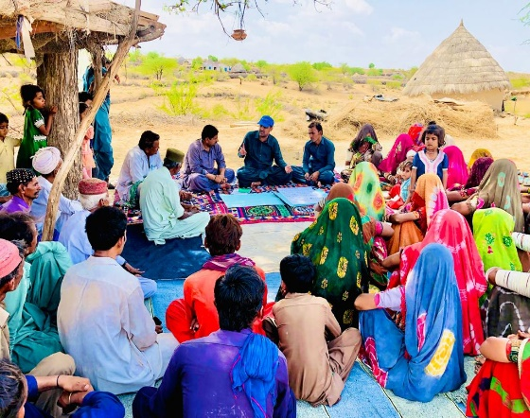
PARTNERSHIP WITH ECHO:
Joint Work Plans: Collaborated on and published joint work plans with ECHO, contributing to steering committee meetings, progress reports, and national advocacy efforts.
Impact Analysis: Conducted studies such as Integrated Phase Classification (IPC) and held parliamentary caucuses to promote evidence-based decision-making.
Drought Trigger Activation: Successfully activated drought and flood triggers in coordination with the PDMA, PMD, Flood Forecasting Division.

Slide 18
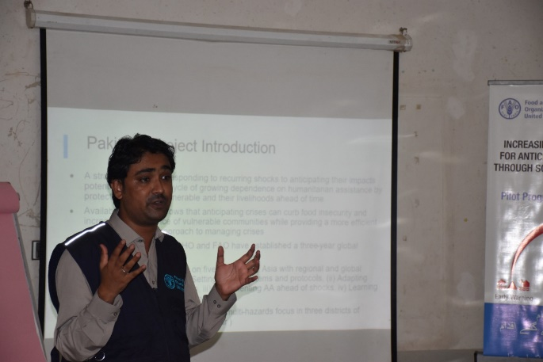
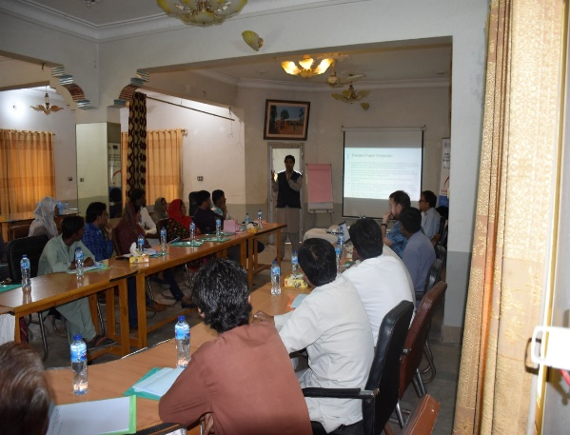
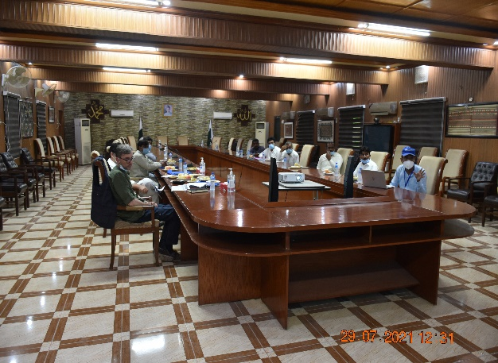
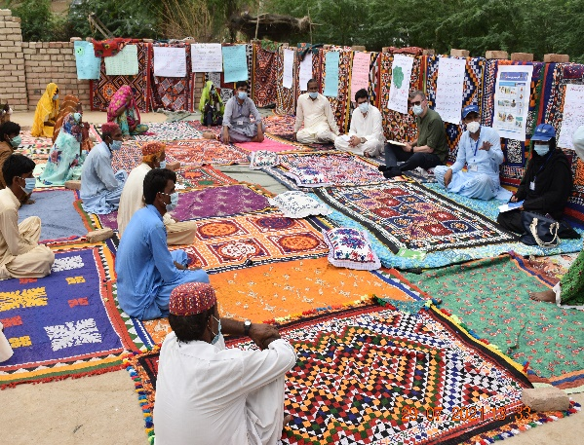
ADVOCACY AND LEARNING:
IEC Materials and Learning Products: Distributed IEC materials to enhance community preparedness. Organized high-impact advocacy events, including a national dialogue platform on AA and resilience.
Capacity Development Events: Fortified the capacity of 10,880 stakeholders through workshops and the establishment of Technical Working Groups (TWGs) at all levels.

Slide 19
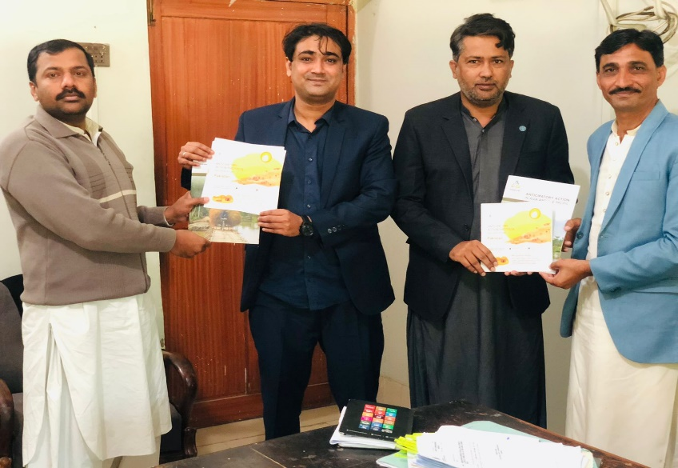
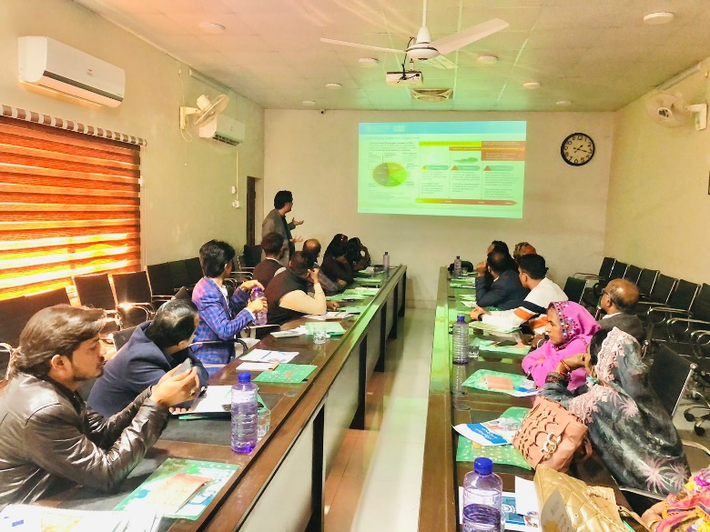
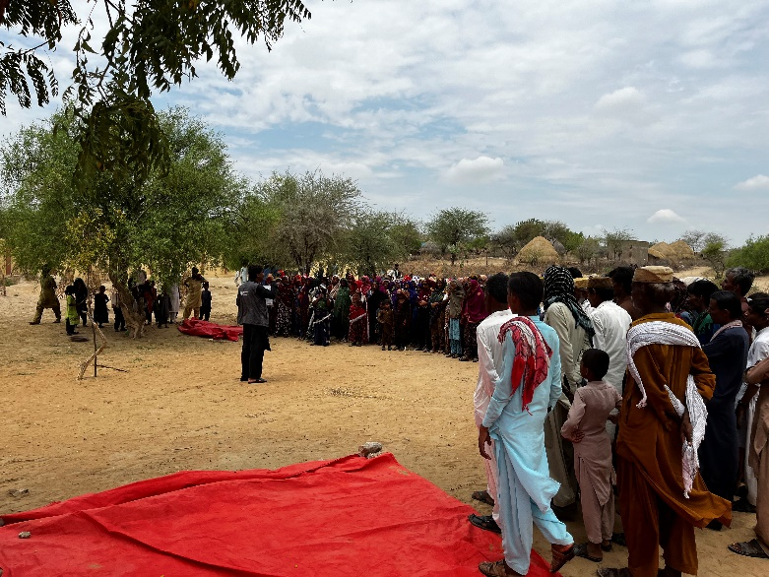
ENHANCED LOCALIZED PLANNING:
Disaster Risk Management Plans: Reviewed and updated DRM plans for Umerkot, Tharparkar, and Dadu. Developed and localized 6 anticipatory action plans, incorporating multi-hazard preparedness measures.

Slide 20
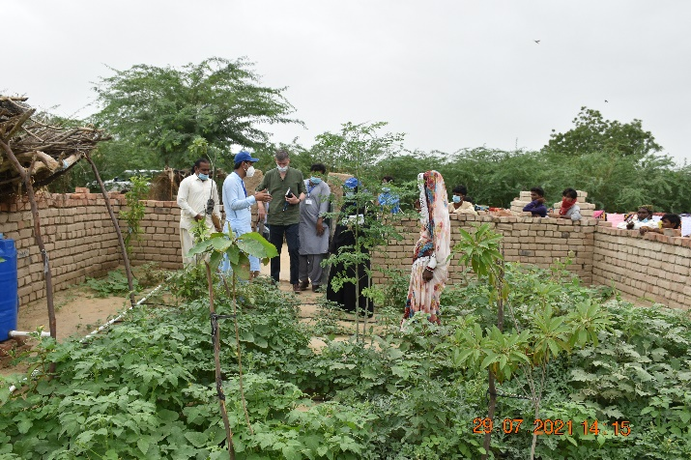
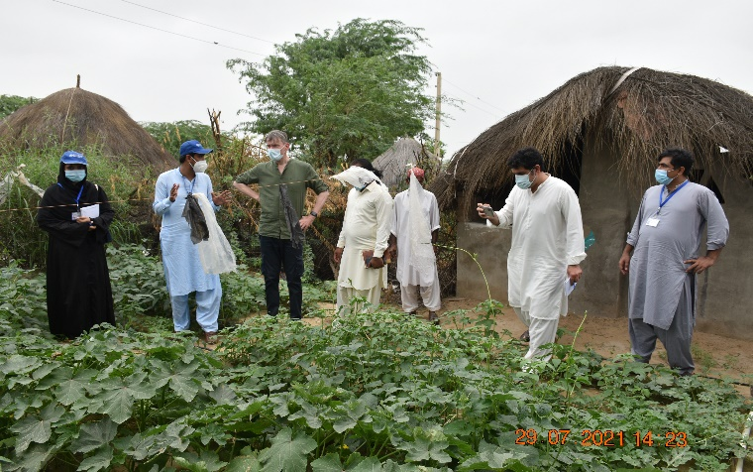
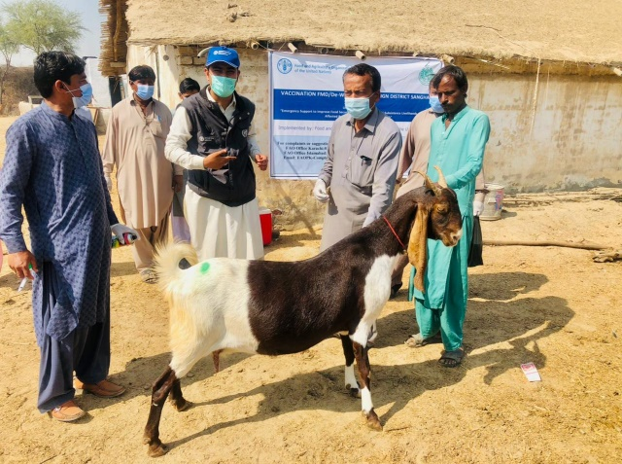
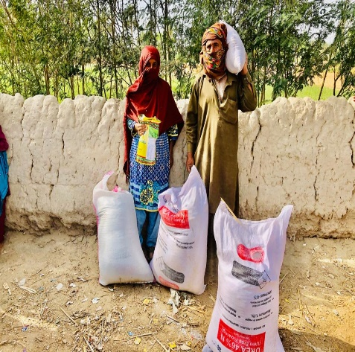
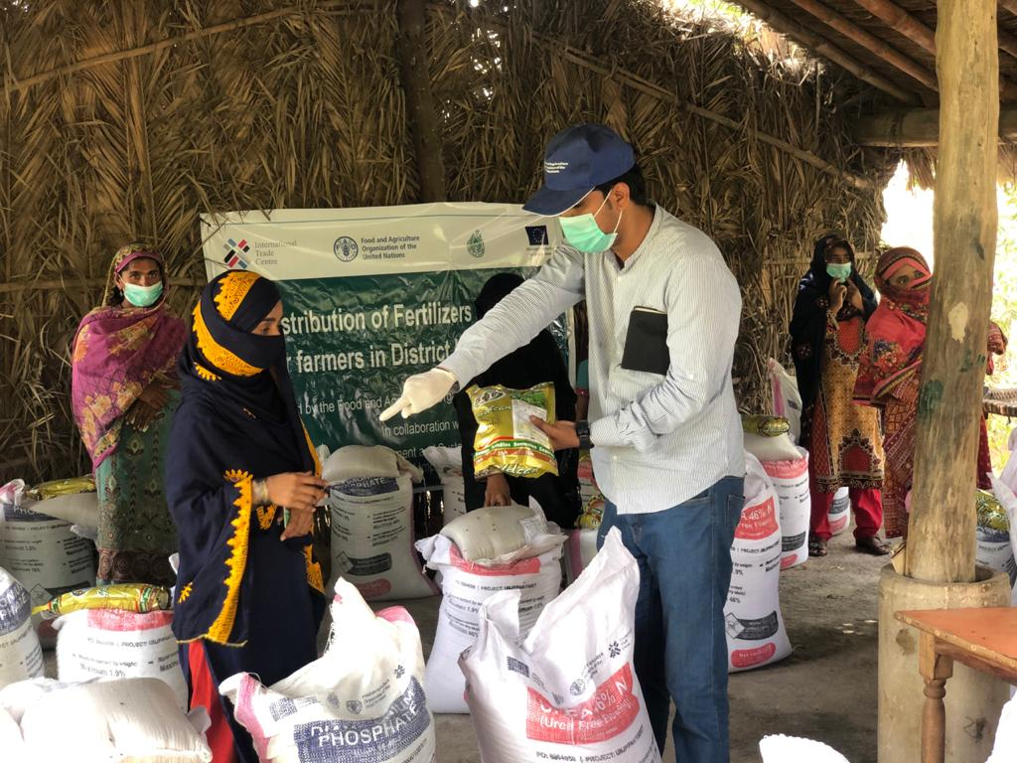
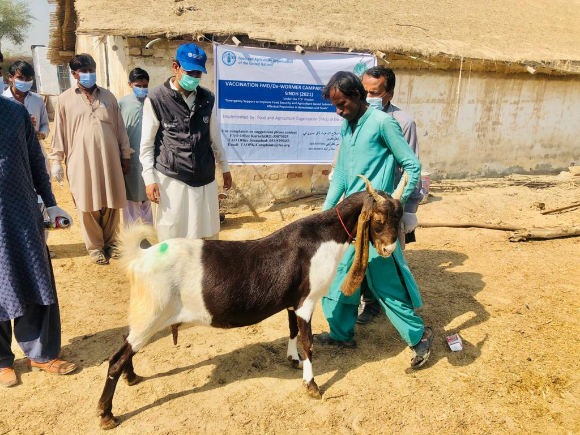
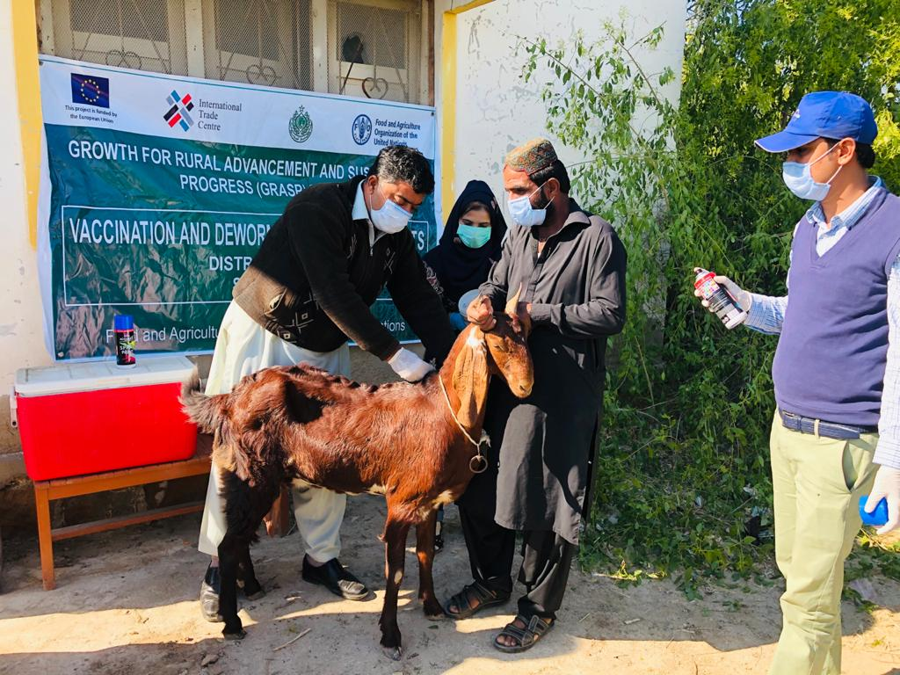
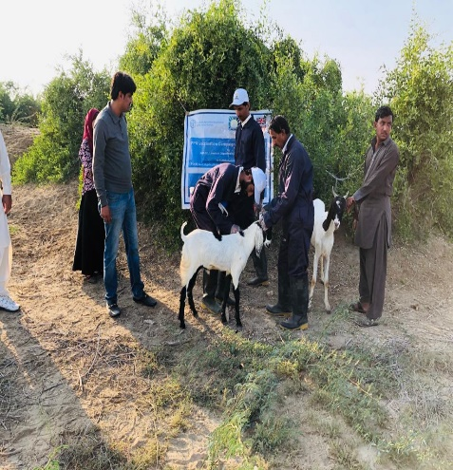
FIELD WORK

Slide 21
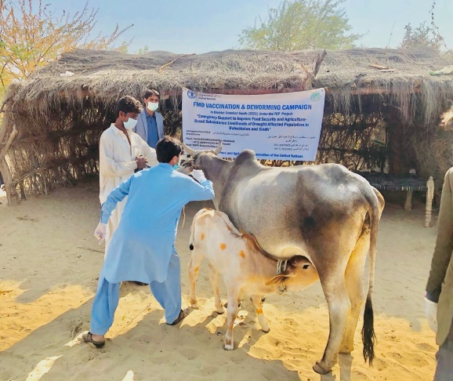
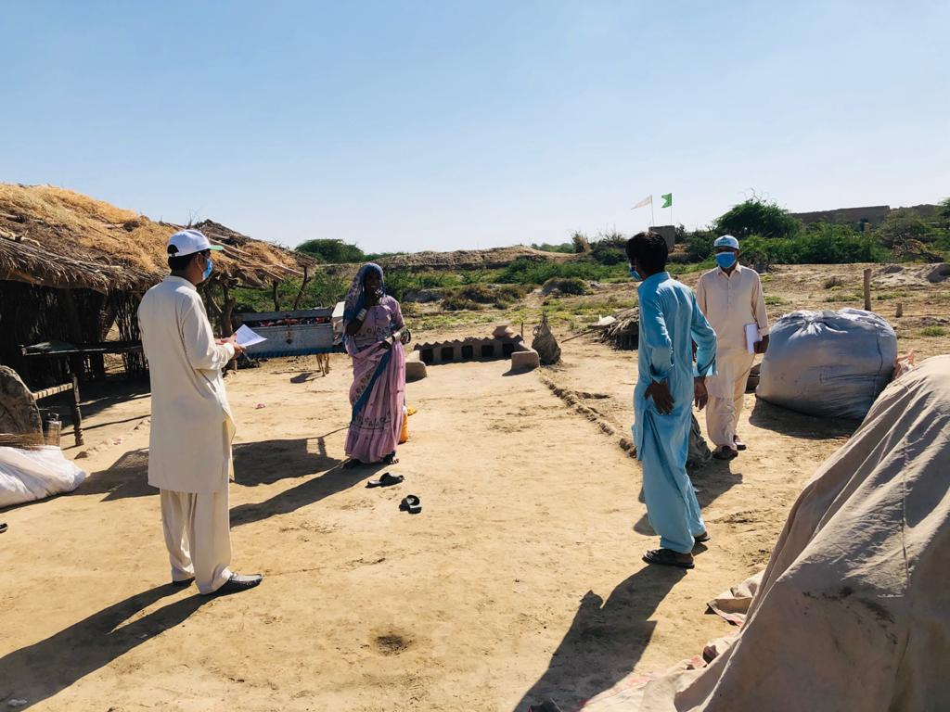
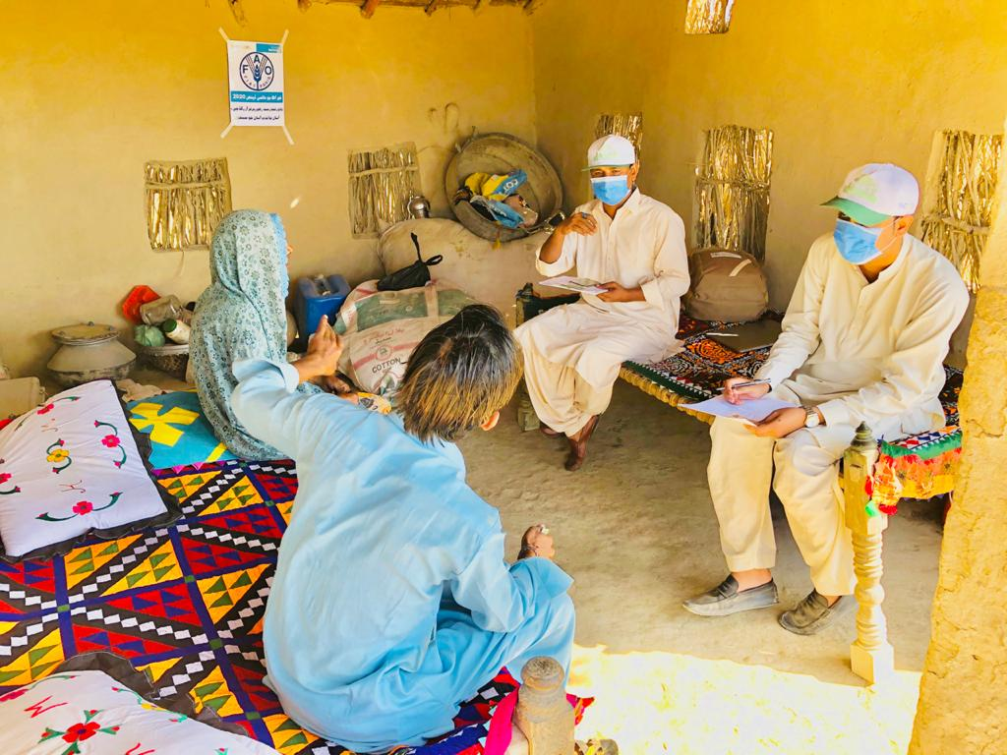
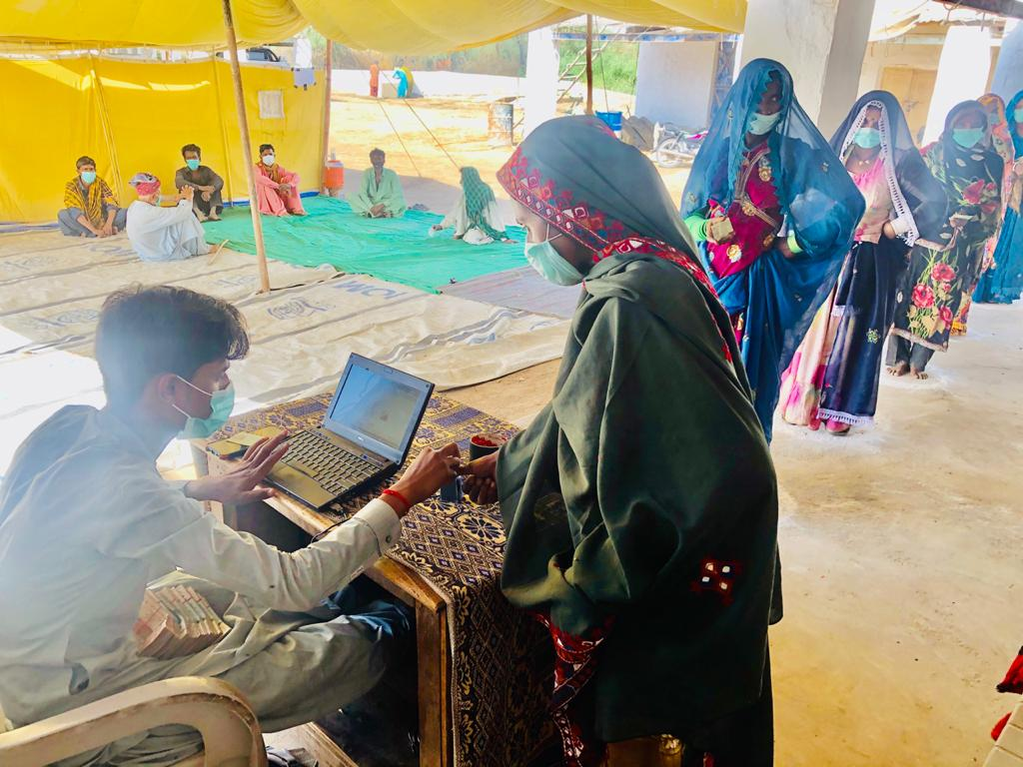
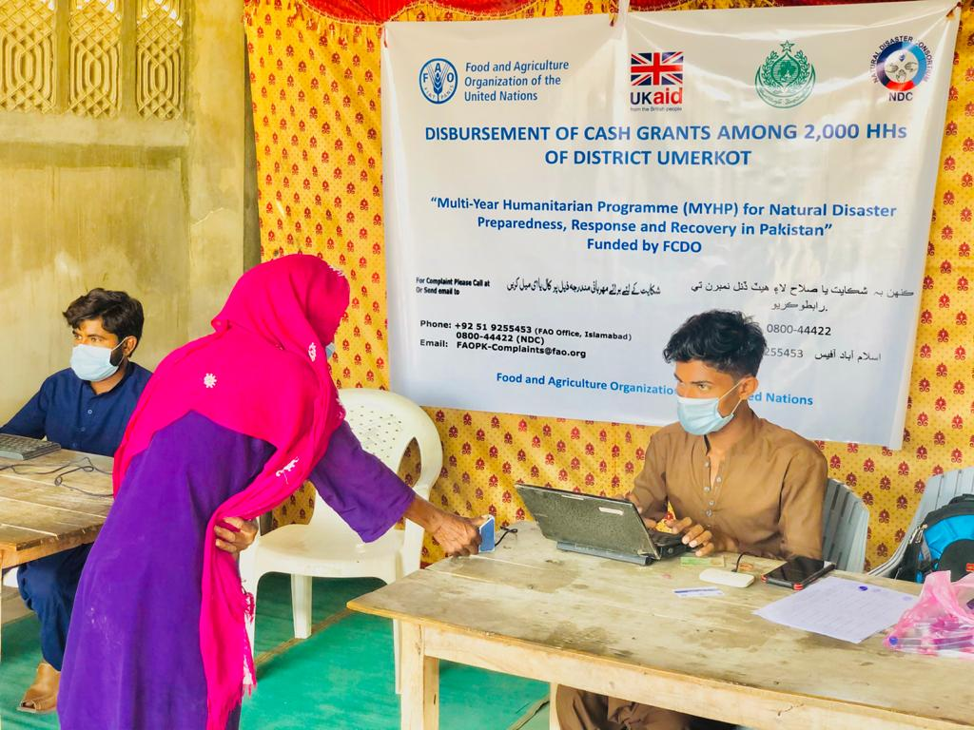
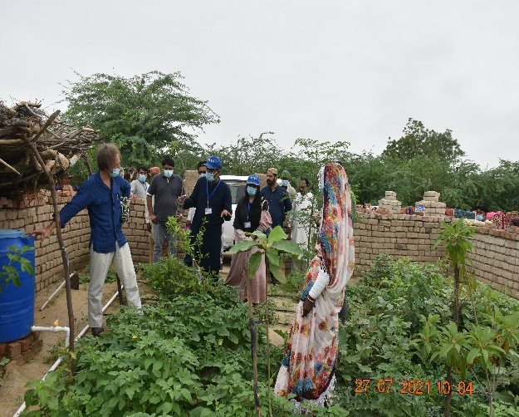
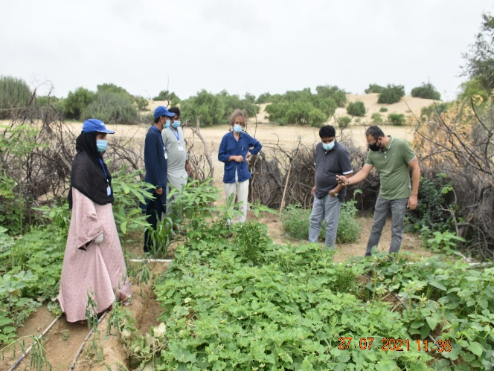
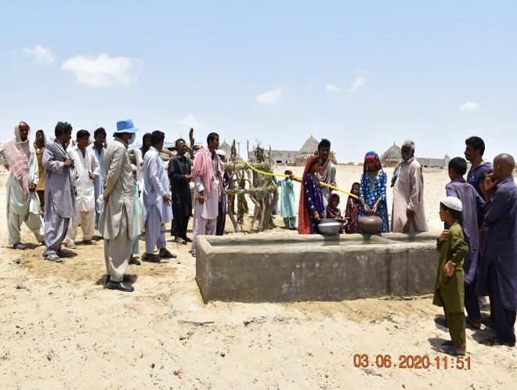
FIELD WORK

Slide 22
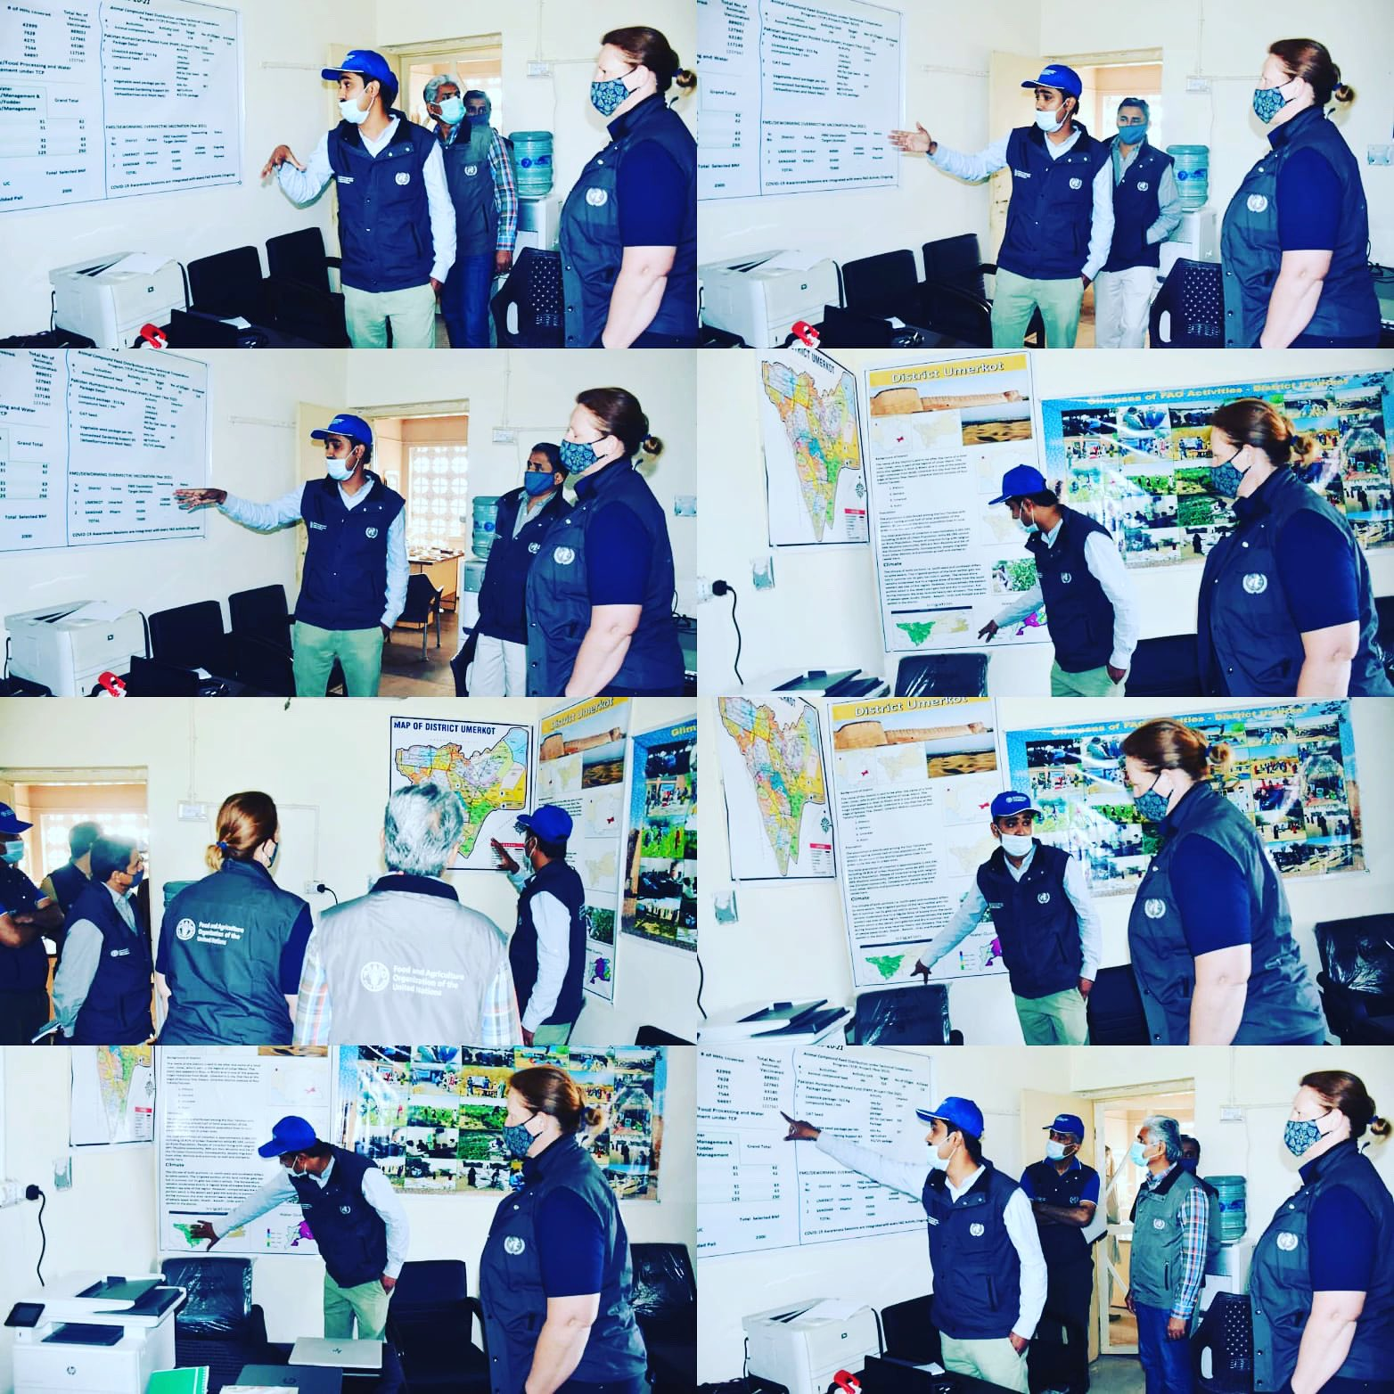
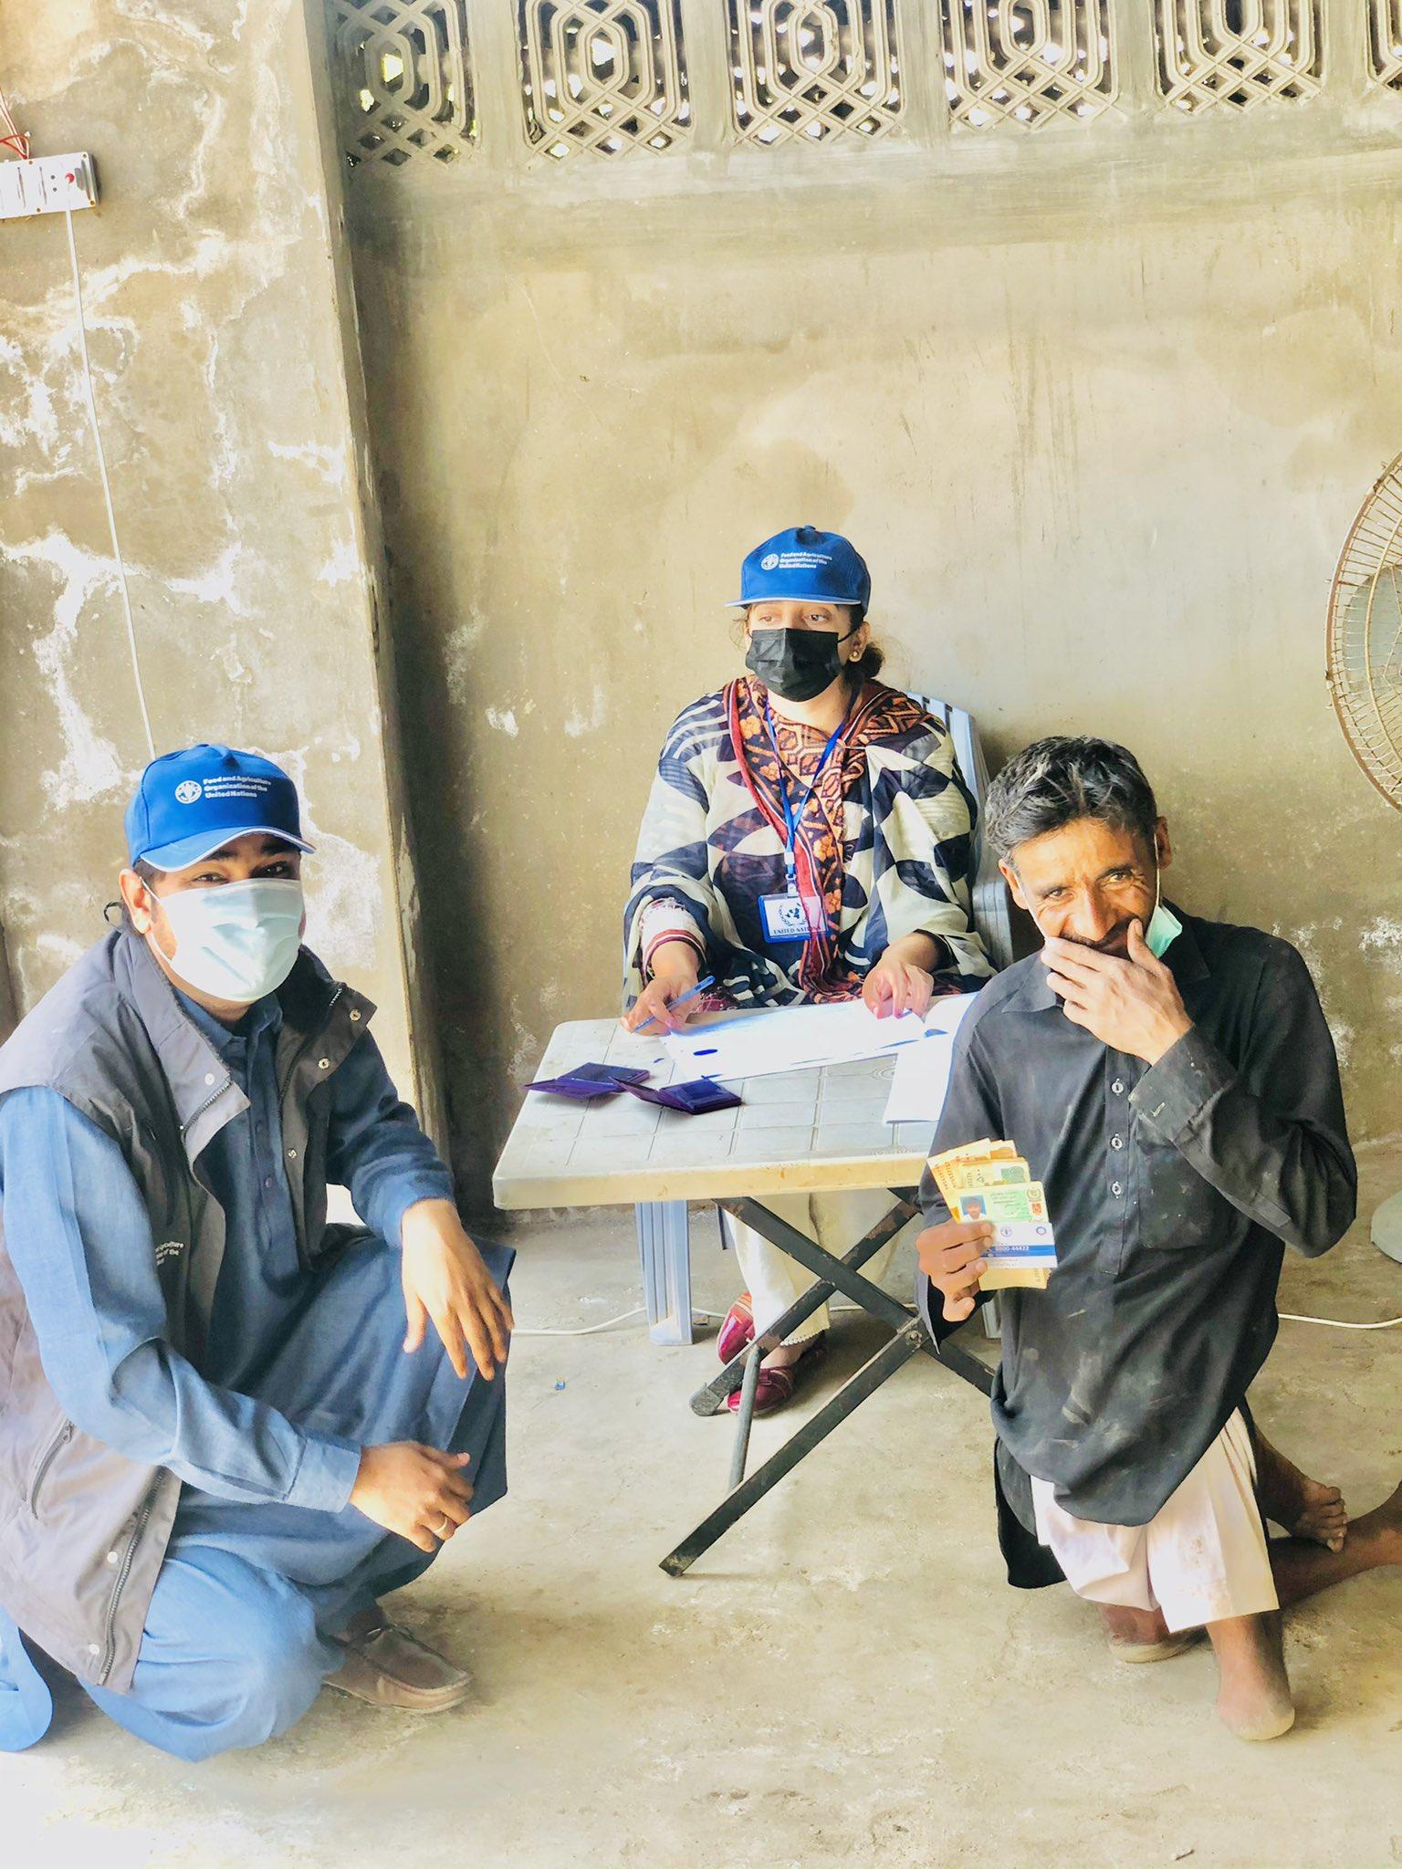
FIELD WORK

Slide 23
FIELD WORK

Slide 24
SUCCESSFULLY DEVELOPED SINDH RESILIENCE STRATEGY

Slide 25
ADVOCACY WORK

Slide 26
In the First Time in History of Pakistan
Launch and Successful Completion of the Early Warning Early Action Project
Pakistan – Tharparkar District
Drought
(2019-2021)

Slide 27
EWEA System
Animal Vaccination against PPR (4 Million small ruminants)
Water Conservation
Animal Compound Feed and Cash Assistance
Resilience
Drought Resilient Crop and vegetable Varieties

Slide 28
DROUGHT EARLY WARNING SYSTEM
Vulnerability
Forecasts
Seasonality

Slide 29
1. Vulnerability: Data on vulnerability are essential to understand how affected people might be able to cope with a potential drought, and tailor early action activities accordingly. Vulnerability indicators rely on the latest assessments conducted by the government, NGOs and international organizations on food security, poverty, markets, performance of previous agricultural seasons, availability and quality of natural resources, among others.
2. Forecasts: Forecast indicators combine national and subnational rainfall and temperature forecasts (PMD) with regional forecasts produced by international institutes (e.g. IRI, NOAA).
3. Seasonality: These indicators allow assessing the performance of the agricultural season in Tharparkar, e.g. vegetation conditions, rainfall, crop and forage stress conditions.

Slide 30
EWEA SYSTEM FOR JUNE 2019 FOR THARPARKAR DISTRICT (THIS TRIGGERING FLAGGED TO INITIATE EARLY ACTIONS

Slide 31
HOW EWEA SYSTEM WORKS
A threshold has been assigned to each indicator. Thresholds are values at which the indicator is sending a worrying signal.
A weight has been assigned to each indicator group and to each indicator, based on their relevance and reliability.
The full list of indicators, thresholds and sources is provided in the tab "Indicators and thresholds“ (above).
The monitoring process should be carried out on a monthly basis (at the beginning of each month). Each month has a dedicated tab with a specific subset of indicators that are relevant for that specific month. The steps described hereafter should be followed to conduct the monthly monitoring exercise.

Slide 32
DECISION MAKING GUIDELINES OF EWEA SYSTEM
Levels | Actions
Monitoring: Total Triggering Score between 0 and 50% | 1) Continue Monitoring; 2) Share update of monitoring with sector partners and discuss findings
Assessment Level: Total Triggering Score between 51 and 69% of triggering score | 1) Contact the EWEA HQ Team for monitoring support and validate evidence; 2) Consider calling for partners meeting; 3) Review of qualitative references; 4) Consider sending field assessment - include a focus on food security and nutrition; 5) Based on outcome, consider developing an early action proposal for funding activation, or continuous monitoring
Action Level: More than 70% of the triggering score | 1) Contact the EWEA HQ Team for monitoring support and validate evidence; 2) In parallel, consider calling for partners meeting and sending field assessment - with a focus on food security and nutrition; 3) Decide if launching preparedness actions or developing an early action proposal for funding activation

Slide 33
SEASONAL CALENDAR

Slide 34
CRISES TIMELINE

Slide 35
EARLY WARNING EARLY ACTION SYSTEM ESTABLISHMENT & IMPLEMENTATION
EWEA System Development
Drought situation in 2019 affecting Tharparkar.
FAO Pakistan’s role as the lead agency for food security and livelihoods.
Decision to pilot the EWEA approach in Tharparkar.
Total funding for the pilot: USD 243,600.

Slide 36
EWEA SYSTEM IMPLEMENTATION TIMELINE
March 2019: Data collection started.
June 2019: First indicators flagged for action, followed by stakeholder meetings.
July 2019: Rapid needs assessment conducted; early actions launched based on EWS and needs assessment.

Slide 37
EARLY ACTIONS IMPLEMENTED
Animal Feed and Mineral Supplements:
2,613 farmers received animal feed.
400 beneficiaries received mineral supplements.
Animal Vaccination:
PPR vaccination in small ruminants; 3,995 households benefited.
Agriculture Inputs and cash assistance:
Mung bean, cluster bean, and millet seeds provided to 2,437 farmers.
Cash disbursement to 2000 farmers.

Slide 38
INSTITUTIONALIZATION OF EWEA
Extensive coordination with government departments to ensure sustainability.
Provincial Disaster Management Authority (PDMA) played a key role in institutionalization.
Collaboration with National Disaster Risk Management Fund (NDRMF) and Sindh Resilience Project (SRP).

Slide 39
FOCUS GROUP DISCUSSION DURING NEED ASSESSMENT (EWEA)

Slide 40
CAPACITY BUILDING TRAINING ON EWEA SYSTEM TO STAKEHOLDERS AND ACTION PRIORITIZATION

Slide 41
ANTICIPATORY ACTIONS IN THARPARKAR

Slide 42
EWEA SYSTEM COMMUNITY MEETINGS PICTURES

Slide 43
EWEA MEETINGS WITH STAKEHOLDERS:

Slide 44
THE PROVINCIAL DISASTER MANAGEMENT AUTHORITY PLAYED A PIVOTAL ROLE IN INSTITUTIONALIZATION PROCESS. DDMA HAS DESIGNATED STAFF IN THE OFFICE OF DEPUTY COMMISSIONER WHO HAS BEEN CAPACITATED BY FAO TO CARRY OUT EWEA SYSTEM DATA COLLECTION, MONITORING AND REPORT GENERATION. IN THIS VEIN, PREVIOUS EWS REPORTS HAS BEEN COMPILED WITH JOINT EFFORTS WITH THE GOVERNMENT.

Slide 45
PRESENTED EWEA SYSTEM TO MUHAMMAD JUMAN DEPUTY DIRECTOR - PDMA & BASHARAT AHMED WATER MANAGEMENT SPECIALIST – WORLD BANK

Slide 46
Setting triggers
Customized/contextual indicators
(36 indicators were set)
Setting Anticipatory Actions
Levels of actions as per triggering scoring.
Monitoring
Data collection, reports generation and circulation
Frequency is set for each indicator
Anticipatory Actions
Here comes humanitarian actors

Slide 47
DROUGHT AA TRIGGER: EARLY WARNING SYSTEM AND MONITORING JULY 2023 – JANUARY 2024

Slide 48
Anticipatory Action Protocols Early Warning System and Trigger Points

Slide 49
Drought Early Warning System Monthly Monitoring Tool

Slide 50
July 2023
Recommendation: Continued monitoring and potential implementation of mitigation measures.
Other indicators remained normal or above-normal.
Rainfall and temperature forecast SPEI3 (standardized precipitation evapotranspiration index) indicated below-normal conditions.
El Niño conditions present.
DEWS score: 35% - moderate drought risk.

Slide 51
August 2023
Recommendation: Continued monitoring and potential preparation for mitigation.
DEWS score: 35% - moderate drought risk.
Similar to July

Slide 52
September 2023
Increased risk:
Recommendation: Continued monitoring and vigilance, with potential initiation of mitigation measures.
Both rainfall observation and SPEI indicated potential drought.
El Niño persisted.
DEWS score increased to 55% - moderate drought risk.

Slide 53
October 2023
Increased Risk
Recommendation: Continued monitoring and preparedness for potential drought impacts.
Rainfall observation and SPEI indicated potential drought.
El Niño persisted.
DEWS score remained at 55% - moderate drought risk.

Slide 54
November 2023
Reduced Drought Risk
Recommendation: Continued monitoring and preparedness, but with less urgency.
El Niño persisted but other indicators mostly normal or above-normal.
Improved situation
DEWS score significantly decreased to 20%

Slide 55
December 2023
Mixed Picture Again
Recommendation: Continued monitoring and vigilance, with potential preparation for mitigation measures.
SPEI Observation indicated potential drought risk.
v Rainfall observation and soil moisture remained normal.
El Niño persisted.
DEWS score increased to 35% - moderate drought risk.

Slide 56
January 2024
Increased Risk
Recommendation: Continued monitoring and preparedness for potential drought impacts.
Rainfall observation and SPEI indicated potential drought.
El Niño persisted.
DEWS score remained at 55% - moderate drought risk.

Slide 58
Information Dissemination Mechanisms for Mitigating Drought Risks
Drought EWS Monthly Monitoring Report
District Early Warning Center
District Administration/ DDMA generates monthly monitoring reports
FAO team provides technical support in data collection, analysis, and report preparation
EW Center shares reports and information with >
Technical Working Group Members (TWG)
Line Departments (Agriculture, Livestock, Water Resources, etc.)
Civil Societies, NGOs and INGOs
EWCs share the information with villagers
Early Warning Committees

Slide 59
RIVERINE FLOOD EARLY WARNING SYSTEM AND MONITORING

Slide 62
Riverine Flood Early Warning Monitoring - Daily Basis

Slide 66
Anticipatory Action
Phase -1
Coordination: District Disaster Management Authority conduct a meeting at the district to start the monitoring process and ensure early warning functionality
Phase – II
Safely evacuate humans and livestock to designated safe places using secure routes.
Provide multipurpose cash assistance to address affected individuals and families immediate and diverse needs.
Early Harvesting of Crops destocking of Livestock: Early Harvesting of Crops and destocking of Livestock, ensure compliance with market rates for crops and livestock in accordance with relevant policies.

Slide 67
THANK YOU ☺
Imran Ahmed Jakhro
For contact: imranahmedjakhro1@gmail.com
LinkedIn: Imran Ahmed Jakhro
Cell# +923454681144

