Slide 1

Yorkshire and Humber School of Anaesthesia and ICM Induction February 11th 2026
Dr Raj Sandhu
Head of School

Slide 2
School Induction
Welcome
How it all works
Introductions / who’s who
Study leave and EDT
Welcome!
Notes:
HELLO and welcome to the 2026 School of Anaesthesia Induction for Yorkshire and the Humber. I am delighted to see so many of you here and I can’t wait to meet you and work with you in years ahead. My name is Raj Sandhu, and it is my honour and pleasure to introduce the Induction.
I hope the day will be informal, social and enjoyable, with an aim to introduce the key areas of information you will need to know in your first few months on the training schemes in Yorkshire in enough detail to be useful but without being overwhelming.
There will be plenty of time to liaise with colleagues and trainees already on the scheme, and plenty of time to ask questions to trainers and supervisors.
I want to specifically thank Dr Louise Murray and Dr Selin Kabadayi and Charlotte Stoneswho have arranged this Induction, whilst also…. I also want to thank the TPDs, RAs and trainees who have helped to develop Induction within Yorkshire and the Humber by providing lectures, workshops, videos for the website, advice, feedback and opportunities for new starters to gain the information that they need. I would be grateful if you could express your thanks to them during the day for giving up their free time to help with the Induction.

Slide 3
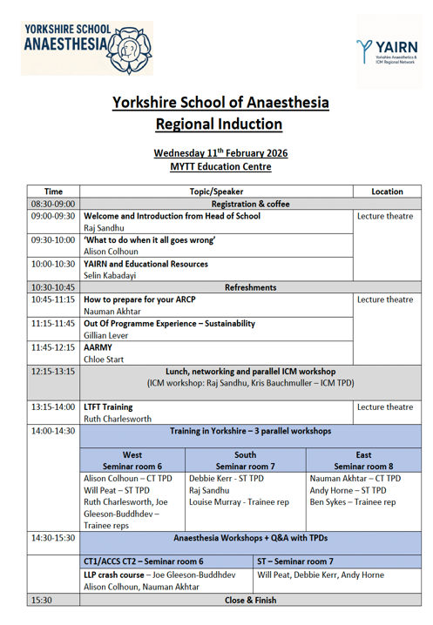

Slide 4
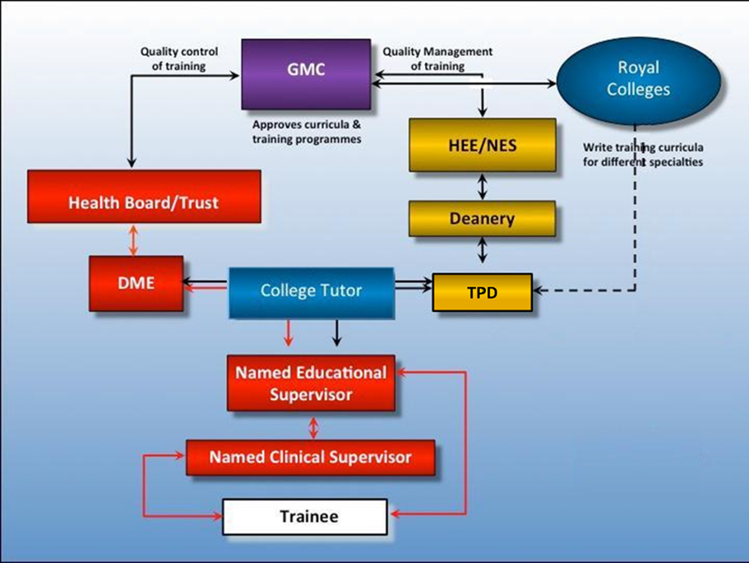

Professional Relationships
HEEYH
(the Deanery)
Department & Trust
External Organisations
Regional Advisor (RA)
Guardian of Safe Working
REPS
Junior Dr REP
BMA REP
Trainee REP
Notes:
When I initially tried to find a graphic to demonstrate the individuals who are looking after you during your training and how they all fit together this was the only example I could find.
This is hugely complicated and doesn’t get us anywhere other than a migraine

Slide 5
Professional Relationships
NHSE / DoH
(the Deanery)
Department & Trust
External Organisations
Notes:
Therefore, I think this graphic is a much simplified version of the previous one and is much better at demonstrating the interconnection of all those responsible for you and your training but demonstrating that YOU, the trainee, are in the centre and those looking after you can be broadly divided into three areas:
The Deanery who manage your training rotation and appraisal process (ARCP)
The Employing Trust that provides your “on the floor” training and manages your employment
And the external organisations and National bodies that set the standards that we all work towards.
.
As a trainee it can be very difficult to understand who is responsible for overseeing the different aspects of your working life and there is usually some overlap between the different agencies.
Often, when you wish to clarify an issue, the first thing to consider is whether it relates to your employment or your training.
In general terms employment queries need to be dealt with by your trust whereas training issues may require input from outside of your trust.
Although this can be confusing, the good thing is that there is ALWAYS support available.
The downside is that there is often a frustrating amount of administrative overlap and, because the agencies are poorly joined up, you may find you need to repeat information.
However, it is your training and by being proactive and communicating well with all parties, major confusion should be avoidable.
To emphasise the importance of you, as a trainee, leading the communication process, this diagram demonstrates the complex inter-relationships around your professional life.
However, it also illustrates the pivotal role fulfilled by the College Tutor – here in the middle of the flow chart, in blue.
I will now attempt to summarise the roles and responsibilities of the deanery, trusts and college before coming back to the college tutor at the end.

Slide 6




External Organisations
RCoA
GMC
BMA
AAGBI
Notes:
The most important external organisation is the Royal College of Anaesthetists.
They oversee the standards for our Specialty, represent anaesthetists on a National Level.
From a practical point of view, they set the curriculum, administer the exams, develop the LLP and recommend eligibility to enter the specialist register upon completion of training with the award of a Certificate of Completion of Training.
The college staff are very helpful and usually respond promptly to enquiries. Please be respectful when contacting them – and consider copying in your TPD so that they are aware of your queries.
The GMC are regulators – of exams, CCTs, curricula and are also responsible for revalidation. You have an obligation to respond to their enquiries and to complete the training survey.
The BMA is the doctors union – if you are a member they will assist you with queries around employment law and working conditions.
The Association is a tremendous organisation which has done a lot of work around wellbeing and fatigue. They have superb resources including exemplary clinical guidelines.

Slide 7
External Organisations
Register with the RCoA
Start to fiddle with the LLP
Look at the Curriculum
Find out who your RA is:
Sue Walwyn / Gemma Woodward (West)
Nimmi Soundararajan / James Stevenson (East)
Martin Feast (South)
RCoA
Notes:
The most important external organisation is the Royal College of Anaesthetists.
They oversee the standards for our Specialty, represent anaesthetists on a National Level.
From a practical point of view, they set the curriculum, administer the exams, develop the LLP and recommend eligibility to enter the specialist register upon completion of training with the award of a Certificate of Completion of Training.
The college staff are very helpful and usually respond promptly to enquiries. Please be respectful when contacting them – and consider copying in your TPD so that they are aware of your queries.
The GMC are regulators – of exams, CCTs, curricula and are also responsible for revalidation. You have an obligation to respond to their inquiries and to complete the training survey.
The BMA is the doctors union – if you are a member they will assist you with queries around employment law and working conditions.
The Association is a tremendous organisation which has done a lot of work around wellbeing and fatigue. They have superb resources including exemplary clinical guidelines.

Slide 8
External Organisations
Register with the RCoA
Start to fiddle with the LLP
Look at the Curriculum
Find out who your RA is:
Sue Walwyn / Gemma Woodward (West)
James Stevenson / Jonathan Dilley (East)
Martin Feast (South)
RCoA
Notes:
The most important external organisation is the Royal College of Anaesthetists.
They oversee the standards for our Specialty, represent anaesthetists on a National Level.
From a practical point of view, they set the curriculum, administer the exams, develop the LLP and recommend eligibility to enter the specialist register upon completion of training with the award of a Certificate of Completion of Training.
The college staff are very helpful and usually respond promptly to enquiries. Please be respectful when contacting them – and consider copying in your TPD so that they are aware of your queries.
The GMC are regulators – of exams, CCTs, curricula and are also responsible for revalidation. You have an obligation to respond to their equiries and to complete the training survey.
The BMA is the doctors union – if you are a member they will assist you with queries around employment law and working conditions.
The Association is a tremendous organisation which has done a lot of work around wellbeing and fatigue. They have superb resources including exemplary clinical guidelines.

Slide 9
NHSE/DoH YH – the ‘Deanery’ Key Responsibilities
Department & Trust: Key Responsibilities
Oversee training
Rotation planning
Assessment – ARCP
Funding (study leave etc)
Recruitment
Entering and exiting training
Support
College Tutors
ES
AiT
Training
Provide clinical experience
Educational supervision
Feedback- SLEs, exception reports
Employment
Uphold Junior Doctor Contract
Ensure safe working conditions through Work schedules, Salaries, Health & well being
Notes:
This induction event is primarily to introduce you to the Training Programme; you will have already had a separate induction event at your trust.
The training programme is run by NHSE Y&H – though this is often referred to by the old name of ‘the Deanery’.
The School of Anaesthesia and ICM is one of several specialty schools. the Heads of School and are supported by a Programme Support Team and 8 TPDs.
You can see the list of the Key Responsibilities of the Deanery on this slide.
Within the Deanery there are many departments with responsibilities such as quality assurance, recruitment, return to training, less-than-full time training and revalidation.
However, it is the school of anaesthesia with whom you will have the most contact – usually via the PS Team or your TPD.

Slide 10
Department/Trust: Key Contacts
Training
College Tutors
Clinical Supervisor
Educational Supervisor
‘Module’ Supervisor
Director Medical Education
Trainee Reps
Employment
Clinical Lead / Director
Guardian of Safe Working
Human Resources/Medical Deployment
Occupational Health
Departmental Admin / Secretaries
Notes:
There are a number of people within the trust who you may need to interact with.
From the training point of view you will have a Clinical Supervisor with whom you will plan your day-to-day work and an Educational Supervisor with whom you will plan your training overall. In some localities the ES and CS will be the same person, in others they may be in different trusts – ask your college tutor for clarification on these roles.
There will also be Clinical Supervisors who are responsible for signing off Units of Training and the College Tutors who will oversee the training for all the anaesthesia/ICM trainees in your trust.
In each trust, the Director of Medical Education oversees training in all specialties, usually Chairs a Junior Doctors forum and reports to the executive board.
From the employment point of view you should find out who your Clinical Lead is and also engage with HR and OH as needed. If you have particular issues around rotas, leave or wellbeing then you may seek the help of the Guardian of Safe working.

Slide 11
Department/Trust: Key Contacts
Training
College Tutors
Clinical Supervisor
Educational Supervisor
‘Module’ Supervisor
Director Medical Education
RD Reps
Employment
Clinical Lead / Director
Guardian of Safe Working
Human Resources/Medical Deployment
Occupational Health
Departmental Admin / Secretaries
Notes:
There are a number of people within the trust who you may need to interact with.
From the training point of view you will have a Clinical Supervisor with whom you will plan your day-to-day work and an Educational Supervisor with whom you will plan your training overall. In some localities the ES and CS will be the same person, in others they may be in different trusts – ask your college tutor for clarification on these roles.
There will also be Clinical Supervisors who are responsible for signing off Units of Training and the College Tutors who will oversee the training for all the anaesthesia/ICM trainees in your trust.
In each trust, the Director of Medical Education oversees training in all specialties, usually Chairs a Junior Doctors forum and reports to the executive board.
From the employment point of view you should find out who your Clinical Lead is and also engage with HR and OH as needed. If you have particular issues around rotas, leave or wellbeing then you may seek the help of the Guardian of Safe working.

Slide 12

College tutors
Notes:
In every anaesthetic department, there will be one or more College Tutors.
These are Consultants with a special interest in education and training who co-ordinate your training, ensure you can access educational opportunities and look out for your welfare.
They should be the first point of contact for information about your working environment and training priorities. Along with your Clinical and Educational Supervisor they will help you with careers advice, wellbeing and if you are struggling.
They have a tough job as they have to balance the needs of the trainees with the needs and capabilities of their department. However, all of them are super-dedicated and work extremely hard behind the scenes of the department to support you. Be nice to them!

Slide 13

Resident Doctor Reps
Notes:
Sometimes there are issues faced by trainees which need to be raised with influential committees. For example, each locality has trainees reps who attend the Specialty Training Committee and meetings of the School board.
Individual hospitals usually have representatives on the Junior Doctor forum.
There are BMA trainee reps and we also have trainees who sit on National Committee at the College and Faculty of ICM.
If you wish to raise an issue with one of the reps ask your College tutor or TPD who to contact – the trainee reps for the school are also named on the school website.
That’s all for now.
The take home message is that there’s lots of help and support – good communication will avoid misunderstandings and if you are not sure who to contact with an issue ask myself, Dr Colhoun, your TPD or the Programme support team for direction.

Slide 14

When to contact your Programme Support Team…
Queries about the ARCP process
Your contact details change
Planning parental leave
Applying for an OOP
Prolonged sick leave (> 2 weeks)
To submit Form R
Straightforward queries about LLP
When you are approaching CCT
Queries around grace period
If you wish to resign
Notes:
HOWEVER PLEASE CHECK THE WEBSITE FIRST!
Essentially the PS Teams provide help to you and to us in order to ensure the smooth running of the programme.
You should always read their emails and respond if required: the team try very hard not to burden you with unnecessary email traffic.
You must inform the PS Team if you are taking time off that may have an impact on your training and you must let them know about parental leave as this affects the timing of rotations.
You should also keep in touch with them about ARCPs and any plans you have around the end of your programme or if you are planning to resign.

Slide 15
Programme Support – recommended contacts
The School of Anaesthesia and ICM is supported by a dedicated Business Manager and Programme Support Manager,
who work in collaboration with Programme Support Coordinators, Officers, Administrators, and Assistants.
STPD currently operates in functional teams.
Nature of query | Preferred email contact
ARCP, CCT & Progression queries. | england.stp-arcp.yh@nhs.net
LTFT applications and queries. | england.stp-ltft.yh@nhs.net
OOP, Acting up, Deferrals & Resignations | england.stp-programmemanagement.yh@nhs.net
Rotation management including Change of placements & changes to dates of placements. | england.stp-rotations.yh@nhs.net
All matters not covered above. | Designated school inbox using the name of your school. england.anaesthetics.yh@nhs.net
Assessment team | Placement & Programme Team
ARCP Planning | Rotation Planning & Management
ARCP Processing | Rotation Validation
ARCP Reviews | New Starter Management
Curriculum and portfolio management | Out of Programme Process
Form R Administration | Acting up Process
Less Than Full Time process | Deferral Process
Faculty Recruitment | IDT Administration
Website and Sharepoint Management | Period of Grace Process
Data Management and TIS Support | Data Management and TIS Support
Notes:
Plain slide with subhead and bullets

Slide 16
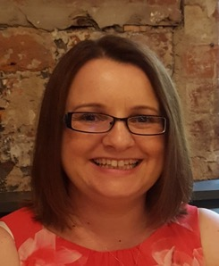
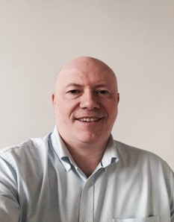
Programme Support Team Anaesthetics & Intensive Care Medicine
Core Anaesthesia, Higher Anaesthesia, ICM and ACCS 3&4
england.anaesthetics.yh@nhs.net
Joanne Aisthorpe
Programme Support Officer
Ian Caslake
Programme Support Administrator
Notes:
Joanne and Ian orchestrate the ARCP process, the publication of the rotations and co-ordinate events such as the Induction and Trainees conference.
They both have superb knowledge about training in anaesthesia and ICM and will be able to help you with lots of your queries.

Slide 17
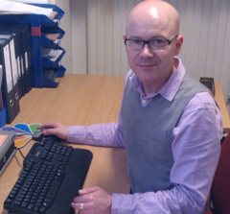
Additional Personnel
ACCS Years 1 & 2
School of EM Programme Support Team
england.emsupport.yh@nhs.net
Deanery Managers
Kellie Wallace
Naomi Koizol
Regional teaching
Helen Turner
england.anaestheticsregionalteachingyh@nhs.net
South Yorkshire Anaesthesia/ICM Admin Support
Andrew Ford
Andrew.ford3@nhs.net
Notes:
In South Yorkshire, the school is supported by Andrew Ford.
Importantly, ACCS training is co-ordinated by the School of EM, whose generic Programme support email is detailed here. Those of you doing ACCS Training will be managed by the School of EM to some extent until you enter your ACCS Year 3 when you are firmly a School of Anaesthesia Trainee.

Slide 18
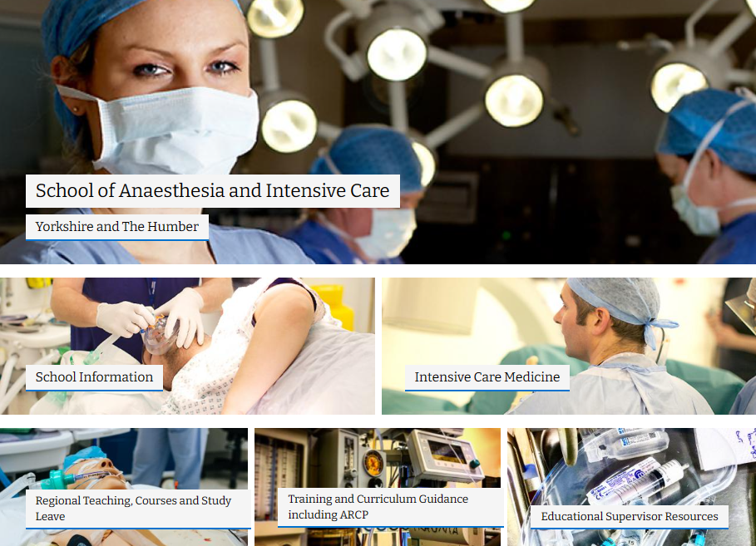
https://www.yorksandhumberdeanery.nhs.uk/anaesthesia
Contacts
Geography
Courses
Links
Info

Slide 19
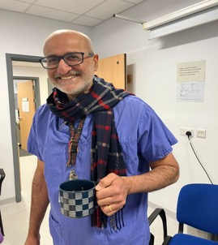
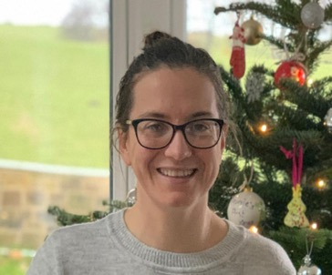
Heads of School
Dr Raj Sandhu (Mid Yorks)
HoS
Dr Alison Colhoun (Leeds)
Dep HoS
Notes:
we work very closely together and we respond jointly to most issues.
We are very happy to receive emails from trainees directly and hope to meet many of you in person during your time in the programme.
We have a superb team of TPDs as seen on the following slides.

Slide 20
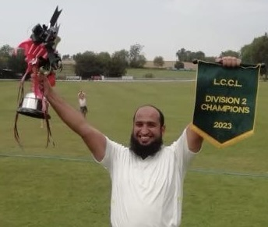
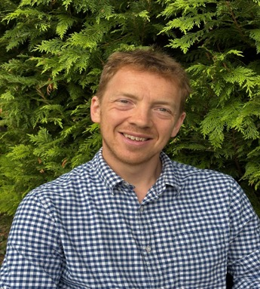
Training Programme Directors: East Yorkshire
Dr Nauman Akhtar (Scunthorpe)
Core Anaesthesia/ACCS
Dr Andy Horne (York)
Specialty Trainees
Notes:
In East Yorkshire we have Nauman Akhtar who oversees Core Training and Andy Horne who oversees Specialty Training.

Slide 21
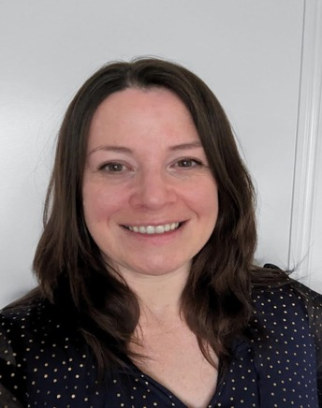
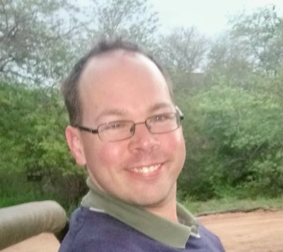

Training Programme Directors: South Yorkshire
Dr Debbie Kerr (Barnsley)
Specialty Trainees
Dr Michael Robinson (Sheffield)
Core Anaesthesia/ACCS

Slide 22
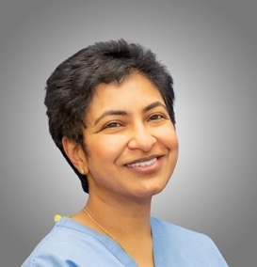

Training Programme Directors: West Yorkshire
Dr Alison Colhoun (Leeds)
Core Anaesthesia/ACCS
Dr Rashmi Menon (Leeds)
Specialty Trainees
Notes:
In West Yorkshire we have Alison Colhoun who oversees Core Training and Rashmi Menon who oversees Specialty Training.

Slide 23
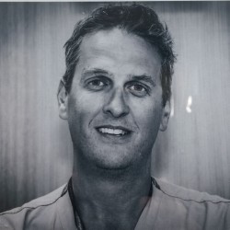
Training Programme Directors: West Yorkshire
Dr Will Peat (Harrogate) Incoming
Core Anaesthesia/ACCS
Notes:
In West Yorkshire we have Alison Colhoun who oversees Core Training and Rashmi Menon who oversees Specialty Training.

Slide 24
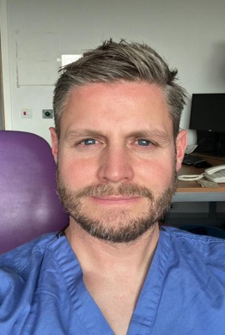
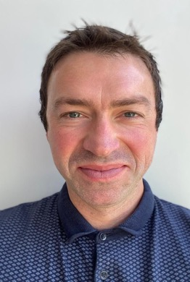
Training Programme Directors: ICM
Dr Kris Bauchmuller (Sheffield)
Dr James Morgan (Bradford)

Slide 25
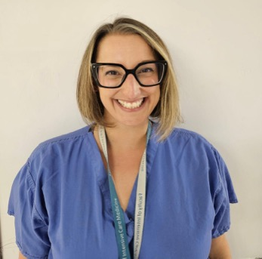
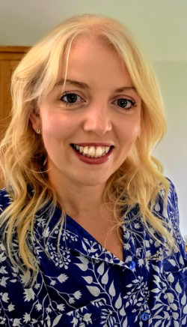
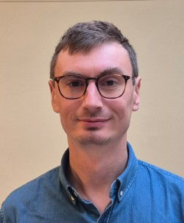
Education leads
Dr Selin Kabadayi (Mid Yorks)
Dr Rohan Farrimond (Barnsley)
Dr Tom Lawrence (Leeds)

Slide 26
Regional Advisors
West Yorkshire
- Sue Walwyn
- Gemma Woodward (Dep RA)
South Yorkshire
- Martin Feast
East Yorkshire
- James Stevenson
- Jonathan Dilley (Dep RA)

Slide 27
When to contact your TPD…
Interruption to training
parental leave
prolonged sick leave
Careers Advice/Planning
Discuss less than full time training
Considering OOPs
Dual training
If you wish to resign
Calculating your CCT
ARCP Queries
Exam results
Passed/Failed/Deferred
Concerns regarding your training
Clinical opportunities
Supervision
Options
You need some support
Something’s not right!
Notes:
Your TPD is responsible for planning your rotation and organising the ARCP process.
You should contact them with any issues that could affect your training such as prolonged leave.
They are an excellent source of advice if you wish to discuss career options such as undertaking Dual Training with ICM, applying for LTFTT or going OOP.
However, they are entirely dependent on you for information: don’t assume that your ES or CT will let the TPD know of your circumstances – there is an understandable concern to maintain confidentiality so you should take ownership of your career progression and personally inform all relevant parties if your circumstances change such that your training is affected.
Please also let them know how you get on with exams – if you don’t tell them your result they will have difficulty planning your rotation. They are not informed directly by the college.
You should also get in touch with them if you are worried about your training or if you are only just managing and want someone to talk to.

Slide 28
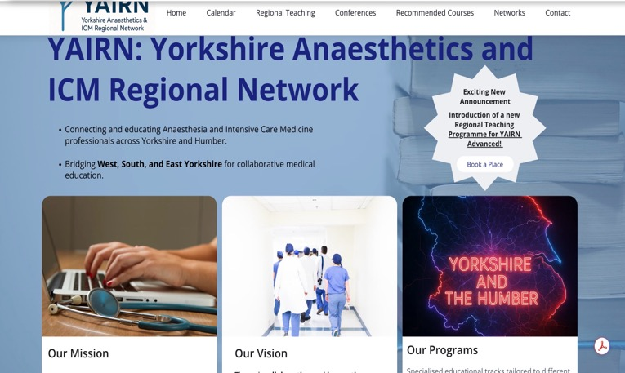
Courses and Study Leave
WHAT?
WHERE?
HOW?
https://www.yorksandhumberdeanery.nhs.uk/anaesthesia/regional-teaching-courses-and-study-leave
https://yairn.co.uk
Notes:
In Yorkshire, ask don’t assume, prospective, national policy, 1 discretionary, first two years likely to be mandatory stuff, ASK IF IN DOUBT, DON’T PAY
Blackoard, help, bookwhen

Slide 29
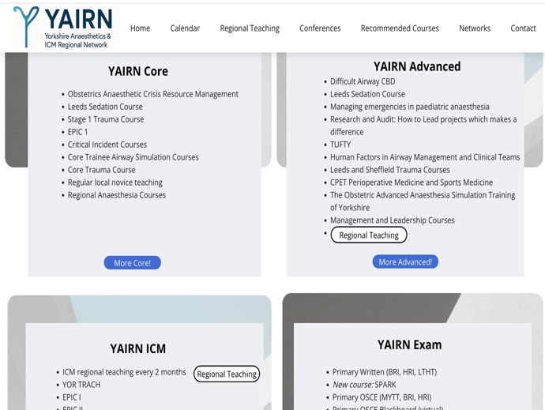
WHAT: Regional/Local Teaching YAIRN
Departmental teaching
Tea Trolley Training
Co-ordinated programmes
CART/START in South
Tufty Club
Stage 1 Teaching (West/East)
Exam support
Lecture courses
VYVA/OSCE/FIVA
Simulation
Regional training courses
BLACKBOARD
Info from TPDs, college tutors, YAIRN website and education leads.

Slide 30
Courses Stage 1 Training
Course | When? | Where?
Novice Programme | During first 3-6m | Local
Critical Incident Course | During first 3-6 m | Local
CVC Course | ACCS 1 or 2/CT1 | Local
Primary Course | Throughout year | Leeds/Hull/Bradford/Sheffield
Exam Preparation Days | Just before SOE/OSCE | Hull/Bradford/Dewsbury
Critical Care Transfer Course | ACCS 2/3 / CT 1/2 | Hull/Bradford/others
Basic Obstetric Anaesthesia, Obstetric Emergencies etc | CT3 / ACCS 4 | Multiple sites
https://www.yorksandhumberdeanery.nhs.uk/anaesthesia/teachingcourses
Notes:
This slide shows a selection of recommended courses for ACCS and Core Training. Please check for contact details using the link.

Slide 31
Courses Stage 2 Training
Course | When? | Where?
Final Course | See website | Hull; Sheffield
Leeds Crammer | Just before exam | Leeds
Airway and fibre-optic courses | ST 4-5 | Leeds/Bradford/ OR Sim opportunities regionwide
Introduction to Regional Anaesthesia | ST 4-5 | Mid-yorks; Sheffield; Hull
MEPA | ST 4-5 | Hull; Leeds; Sheffield
Multi-professional Obstetrics | ST 4-5 | Various
Trauma Study Day | ST 4-5 | Leeds, Sheffield
Additional developmental courses | Post exam | Multiple sites
https://www.yorksandhumberdeanery.nhs.uk/anaesthesia/teachingcourses
Notes:
This slide shows a selection of recommended courses for Stage 2 Training – again, please check using the link to find out about current recommendations especially as some have been affected by the pandemic.

Slide 32
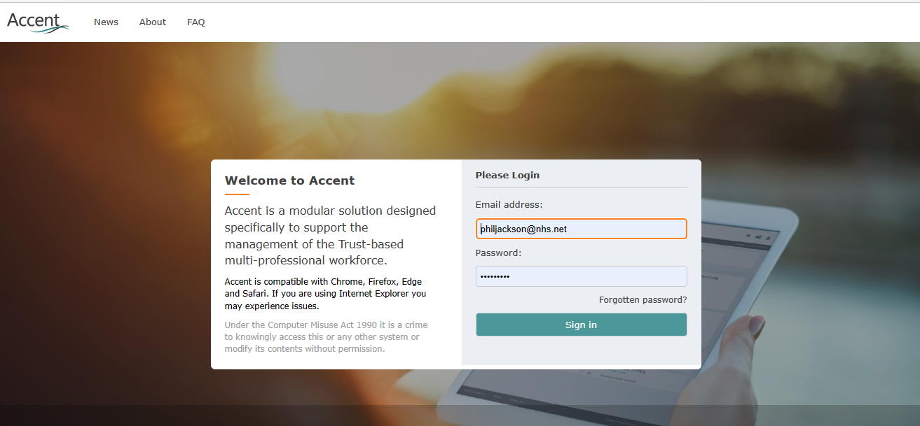
HOW: https://accent.hicom.co.uk/Portal/Live/Web/
ACCENT LEAVE MANAGER: https://accent.hicom.co.uk/Portal/Live/Web/
Sign up with Email you used for HEE (“forgotten password”)
Submit applications early and before parting with any money
If in doubt, ask!
College tutors
TPDs
Heads of School
Notes:
As I have already mentioned, it is extremely important that study leave funding is approved BEFORE a trainee pays course fees/buys train tickets etc.
In addition to checking the study leave policy, please also check the School Website to see which courses are recommended.
If you are unsure please contact your TPD or Heads of School to clarify whether or not something will be funded.

Slide 33
HOW: Accent Leave Manager
ACCENT LEAVE MANAGER: https://accent.hicom.co.uk/Portal/Live/Web/
Sign up with Email you used for HEE (“forgotten password”)
Submit applications early and before parting with any money
If in doubt, ask!
College tutors
TPDs
Heads of School
Notes:
As I have already mentioned, it is extremely important that study leave funding is approved BEFORE a trainee pays course fees/buys train tickets etc.
In addition to checking the study leave policy, please also check the School Website to see which courses are recommended.
If you are unsure please contact your TPD or Heads of School to clarify whether or not something will be funded.

Slide 34

Study Leave Principles
Time vs. funding
Exam leave
Notice
Approval
Location
Relevance
Aspirational
https://www.yorksandhumberdeanery. nhs.uk/professional-support/policies/study-leave
Notes:
Time vs. funding
30 days/year (pro rata if LTFT eg if 50% then 15 days per calendar year)
Your employer grants leave (typically 8 weeks notice required) must be approved by department and ES/CT/TPD
Private study leave at discretion of employing trust/department
Funding is prioritised for educational activity that is relevant to a trainee’s current needs
Activities should be relevant to the curriculum and recorded in a PDP
Courses and educational events within Yorkshire will be given priority
Trainees should access local courses before requesting to attend events further afield
Exam fees are NOT funded
Aspirational leave will only be supported if all other curriculum requirements are met
International leave: unusual in anaesthesia

Slide 35
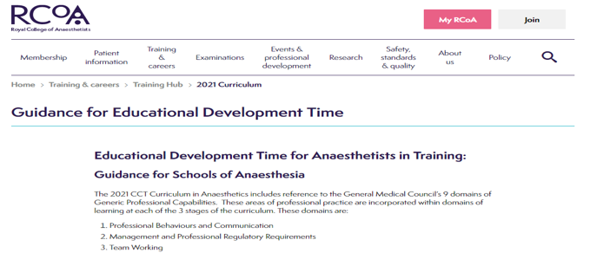
Educational Development Time
Stage 1 &2 = 2h per week
Stage 3 = 4 h per week
Flexible, may be opportunistic
May need to be agreed prospectively with rota team
Must be supported by ES,
Specific objectives must be clear
Activity must be recorded on LLP
May include
educational activity and preparation of educational materials
quality Improvement projects
research
management and leadership activity
other activities which support the development of skills in these areas
https://www.rcoa.ac.uk/training-careers/training-hub/2021-curriculum/guidance-educational-development-time
Notes:
Educational development time has recently been introduced into anaesthesia training and guidance has been produced by the RCoA; I have summarised this on the slide and you can read the full guidance via the link.
Trainees up to ST5 are entitled to 2 hours per week to take up opportunities that will help them to develop key capabilities within the curriculum – this may be especially useful for competences within the Generic Professional Domains.
Arrangements for taking EDT will vary from trainee to trainee and from department to department. There are many advantages to using this time flexibly but always remember that it must be prospectively agreed with your supervisors and/or college tutor and evidence of the activities you undertake during this time must be entered into your portfolio.

Slide 36
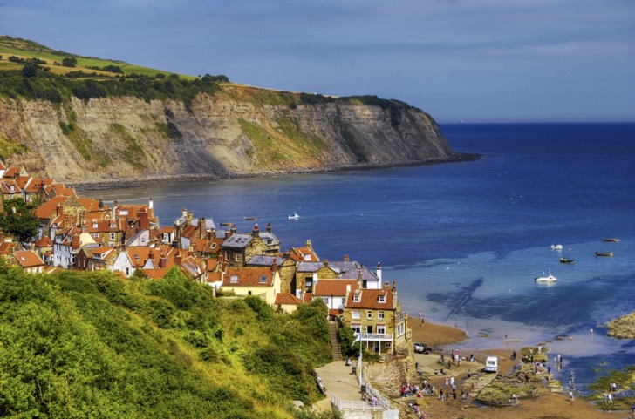
Summary
Great timing!
Fantastic opportunities
Plenty of support
Thank you for listening
Good luck!

