Slide 1
TRAINING IN WEST YORKSHIRE

Slide 2

Welcome to West Yorkshire!

Slide 3
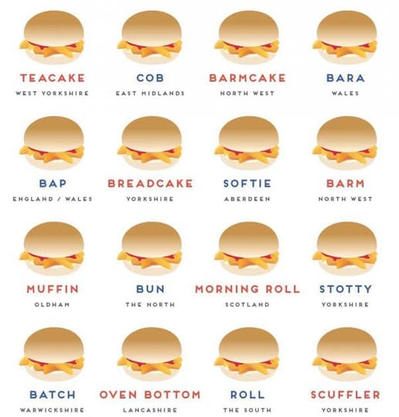
The Essentials…
Ey up → Hello
Ow do → How are you?
Nowt → Nothing
Chuffed → Delighted
Eeh by gum → Good gosh!
Snicket → Alleyway
Gip → Wretch

Slide 4
Hospitals in West Yorkshire
Leeds- LGI + SJUH
Bradford- BRI + St Lukes
Mid Yorks- Pinderfields + Pontefract and Dewsbury
Calderdale and Huddersfield
Airedale
Harrogate

Slide 5
STC Representatives
STC Chair Rima Sinha
Stage 1 Rep Joe Gleeson-Buddhdev
Stage 2 Rep Shaminder Olney
Stage 3 Rep Sean Howells
LTFT Reps Laura Coles & Ruth Charlesworth
IMG Rep Priya Nagaraj

Slide 6


Slide 7
A few pearls of wisdom
Find out your local claiming process + sign up to ACCENT
Sign up to Blackboard for courses and content
Speak to colleagues about where to get sign offs
Familiarise yourself with the curriculum
Don't forget to use your EDT
Join your hospital Whatsapp group

Slide 8
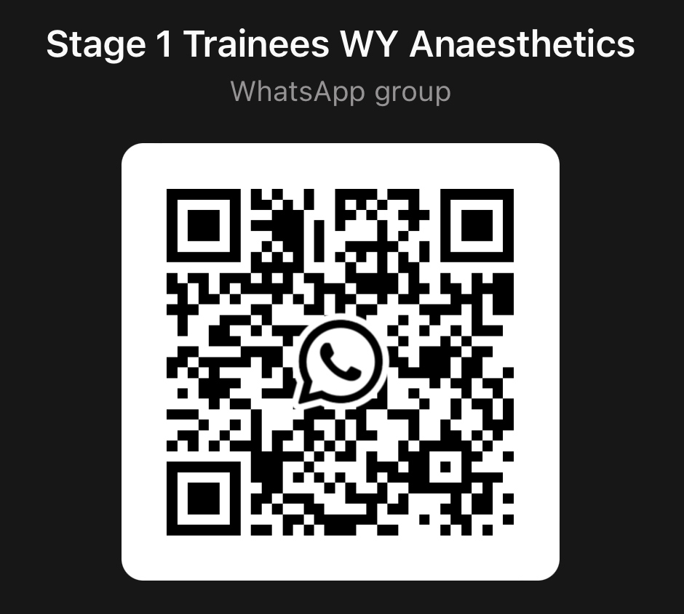
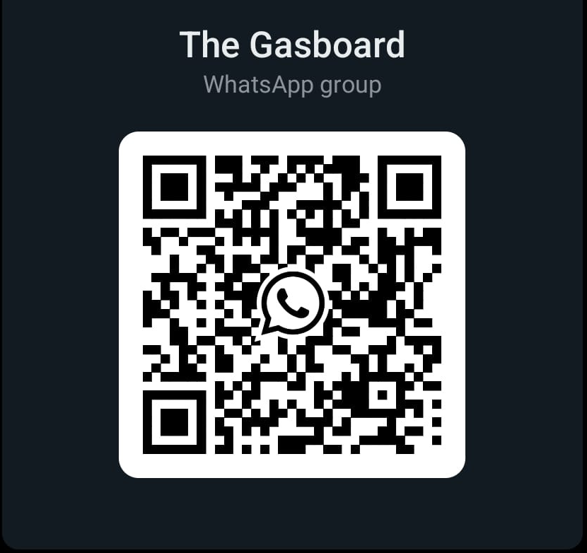
Keep in touch!
School Programme Support
england.anaesthetics.yh@nhs.net

Slide 9

Thank you, any questions?

