Slide 1
Yorkshire & Humber Deanery Induction: South
Dr Louise Murray
ST7 & CAT Co-Chair, South Yorkshire

Slide 2
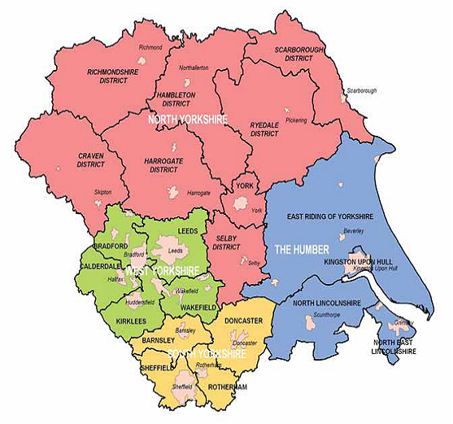
Welcome!
Most compact deanery in UK
Lead employer - STH

Slide 3

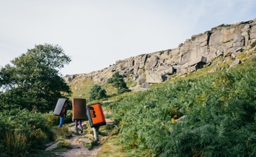





South Yorkshire: The region

Slide 4
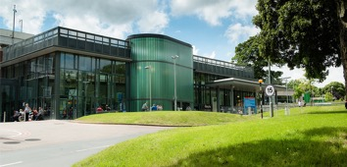
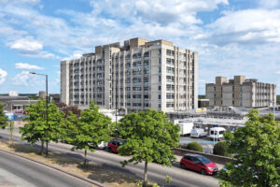
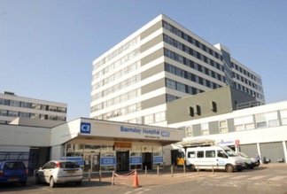
South Yorkshire: Hospitals
Core training mostly in DGHs
Rotherham Hospital (TRFT)
Doncaster Royal Infirmary (DRI)
Barnsley Hospital (BDGH)

Slide 5
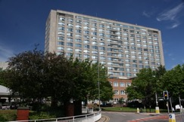
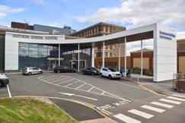
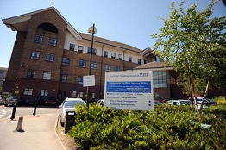
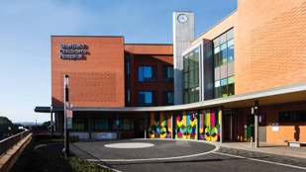
South Yorkshire: Hospitals
Specialty training mostly in Tertiary centres
Usually spend 6 months at a DGH in each of Stage 2 & Stage 3
Royal Hallamshire Hospital (RHH)
Northern General Hospital (NGH)
Jessop Wing, RHH
Sheffield Children’s Hospital (SCH)

Slide 6
General Admin
Portfolio
Keep logbook up to date
Regular meetings with ES + CS, meeting forms, PDP goals
Regional teaching
START/CART
YAIRN website
Study leave
Request at least 6 weeks in advance via Accent, request SL on CLW
Claim expenses back via SEL expenses after the event
Courses: see list of mandatory funded courses
Conferences: 1 funded per stage, subject to TPD approval
ARCPs
Remote. Usually around June if August start, Jan if Feb start
Make sure everything ready well ahead of upload deadline
Upload Form R via TIS self service
Tax relief
Don’t forget to claim for courses and exams!

Slide 7
Training/ Theatre lists
Stage1: Novice Anaes (6m), ICU (6m), Paeds, Obs, Pain, Regional, Sedation, Resus
Stage 2: Neuro, Cardiothoracics, Paeds, Obs, Pain, ICU, Regional, Sedation, Resus/Transfer
Stage 3: Paeds, Obs, Pain, ICU, Regional, Sedation, Resus/Transfer, SIAs
Check & plan ahead re list allocations
Depending on rotation, there may be a resident organising the list allocations (e.g pain, paeds)
Liaise with local service organiser if specific training needs. If at STH, email Jill Bruce to request certain lists

Slide 8

Exams
Plan ahead
Several courses available in the region for Primary + Final FRCA – see YAIRN website
Peer support – find revision buddies
VYVA – free, online, half days, SOE practice. Book early
National courses: Mersey, Coventry, Leeds Crammer
‘Success consists of going from failure to failure without loss of enthusiasm’

Slide 9

Support & Wellbeing
CS and ES are good first ports of call
College Tutor
Guardian of Safe Working, BMA
Occupational Health if needed
CAT – training issues to raise
Coaching via HEE

Slide 10

What is CAT?
Represent training body at STC meetings
Communicate between residents & CTs/TPDs/HoS
Organise YAT & Wellbeing Day, socials & Winter Ball

Slide 11
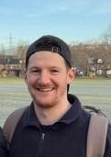
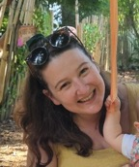
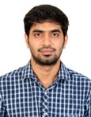
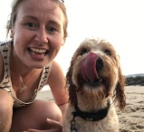
CAT Committee 2026
Tom Smith
Co-Chair +
AoA Rep
Louise Murray
Co-Chair +
ATRG Rep
Iain Mooney
Stage 3 Rep
Luke Addison
Stage 2 Rep
Alistair Jellinek
Stage 1 Rep
Hannah Winder
LTFT Rep
Kim Newton
Wellbeing Rep
Tom Bidmead
Secretary
Rohan Colaco Harris
Out of Training Rep
Emma Brown
Treasurer

Slide 12
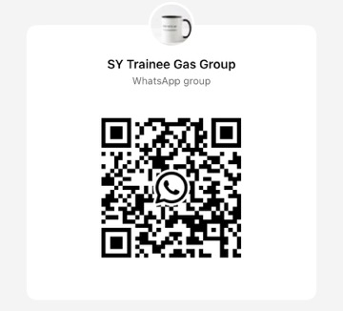
CAT: How to find us
Email: shef.gas.cat@gmail.com
X/Instagram: @shefgascat
In person!
Co Chairs
Louise: louise.murray30@nhs.net
Tom: Thomas.smith55@nhs.net

Slide 13

Any questions?

