Slide 1
ARCPs
Rashmi Menon
Higher TPD for West Yorkshire
1 Sep 2025

Slide 2
ARCP process
ARCP success
Pitfalls

Slide 3
ARCP PROCESS

Slide 4
Annual Review of Competence Progression
The annual review of competence progression is a formal summative process that
  Reviews evidence provided and measures progress through the training scheme-LLP
  Facilitates revalidation by advising the RO-Form R
Timing
  At least once a year
  May be more frequent if
    adequate progress is not demonstrated
    Critical progression point
    Special circumstances-OOP/IDT

Slide 5
ARCP outcomes
Satisfactory Progress:
Outcome 1: Satisfactory progress is being made, and the trainee is developing competencies at the expected rate.
Outcome 6: The trainee has gained all the required competencies and is recommended for completion of the training program (and potentially for a certificate of completion of training (CCT) if applicable).
Developmental Outcomes:
Outcome 2: Development of specific competencies is needed, but no additional training time is required.
Outcome 3: Development of specific competencies is needed, and additional training time is required.
Other Outcomes:
Outcome 4:The trainee is released from the training program. This could be due to lack of progress or other reasons, potentially with or without specified competencies.
Outcome 5: Incomplete evidence was presented, and additional training time may be required to gather the necessary information.
Outcome 8:
The trainee is out of the program for a period, such as for research, a career break, or other approved leave (OOPE/OOPR/OOPC).

Slide 6
ARCP panel
TPD
Postgraduate Dean or their representative (HoS)
RA or Deputy RA
Other educators (ES,CT)
Lay representative

Slide 7
ARCP success

Slide 8
Know when is your ARCP
01
Know what evidence is needed
02
Plan ahead to collect this evidence
03
Submit evidence on time
04

Slide 9
When is my ARCP?
A year after you start your CT1/ST4
Yearly thereafter
3-month notice
england.stp-arcp.yh@nhs.net
1 month notice

Slide 10
What evidence do I need?

Slide 11
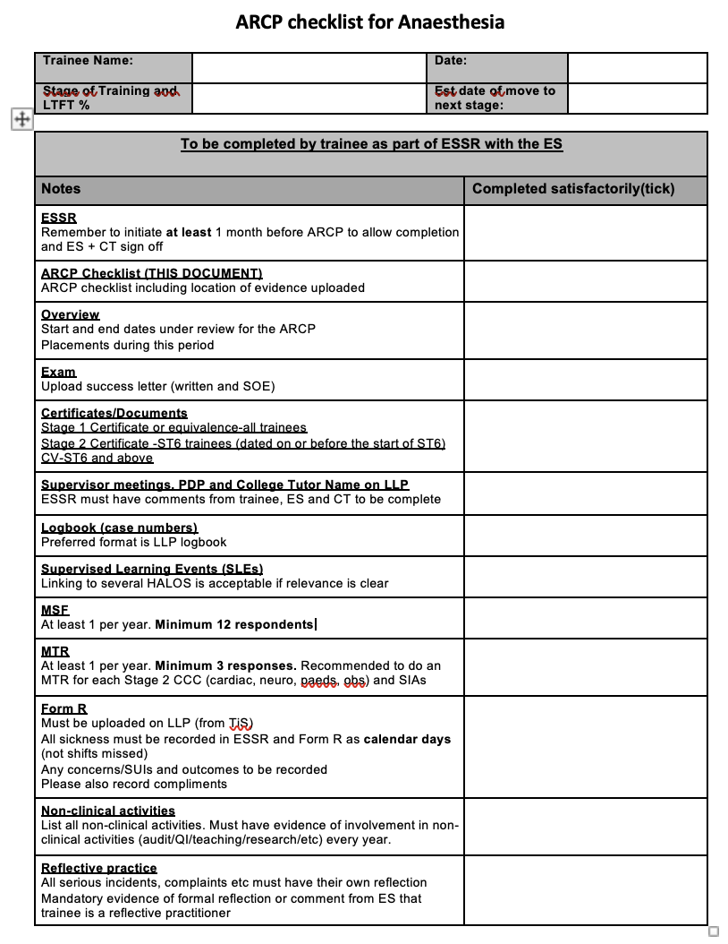
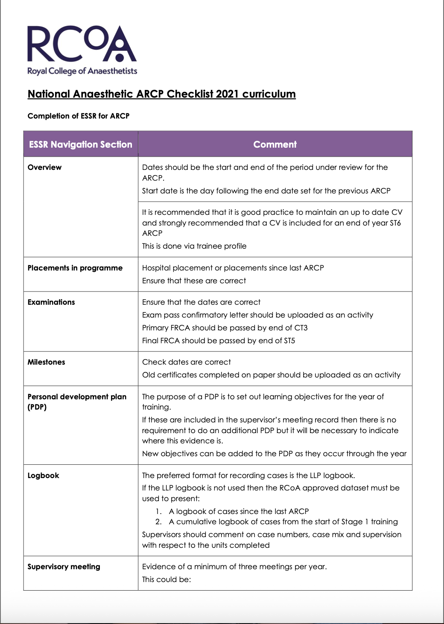
Checklists-RCOA and Local

Slide 13
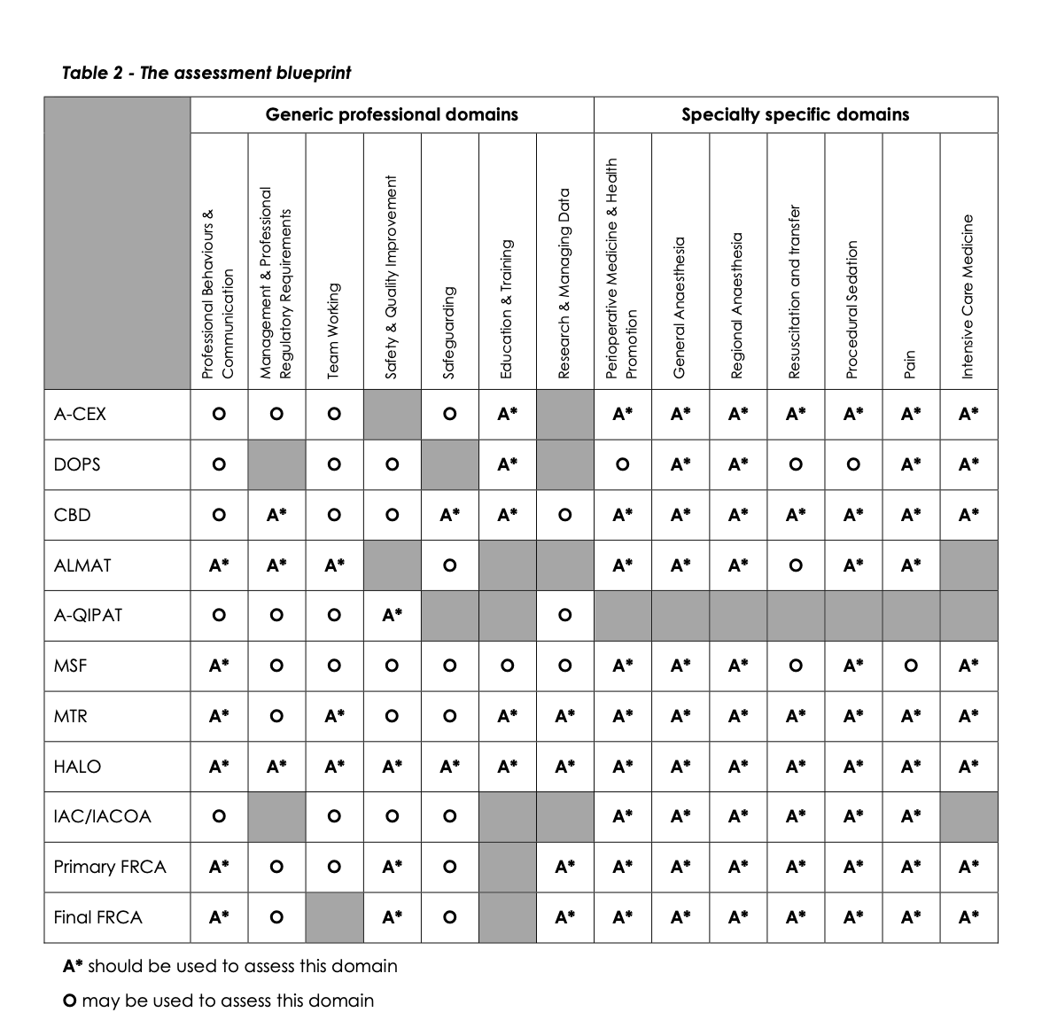
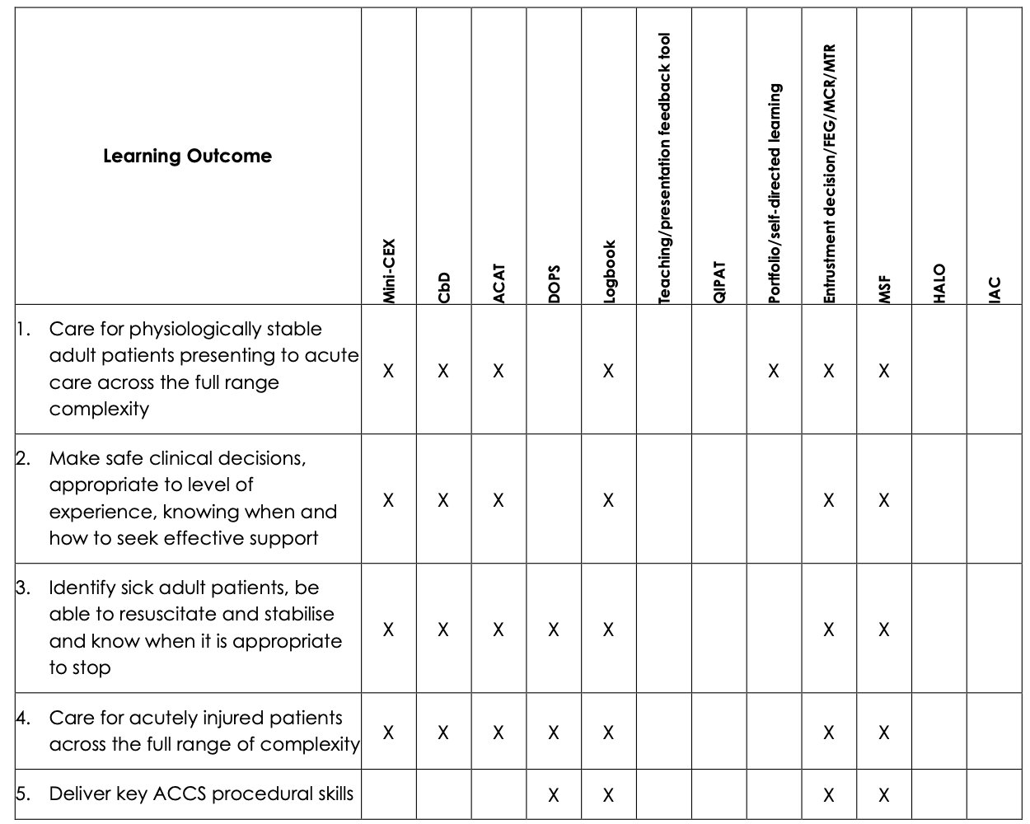
Assessment blueprints ST and CT

Slide 14
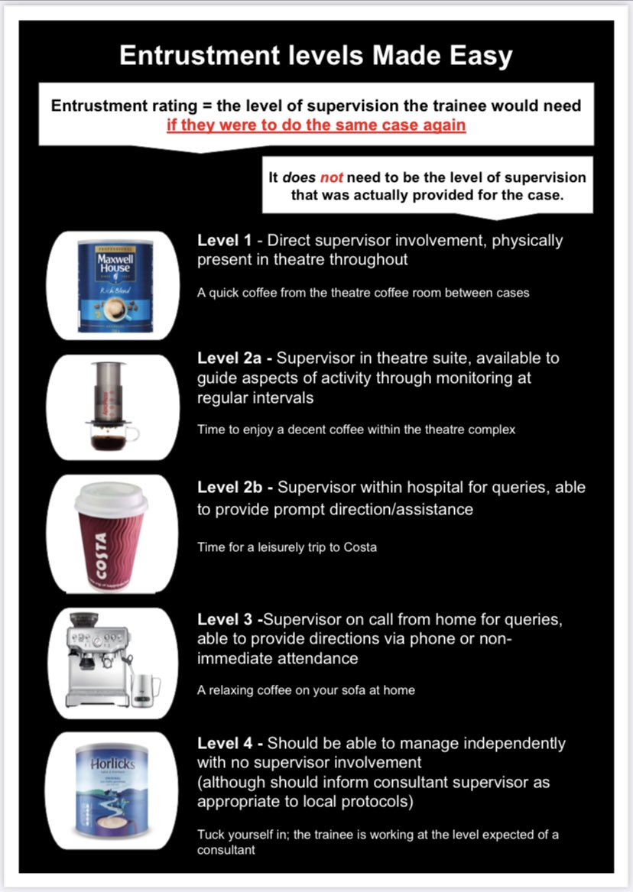
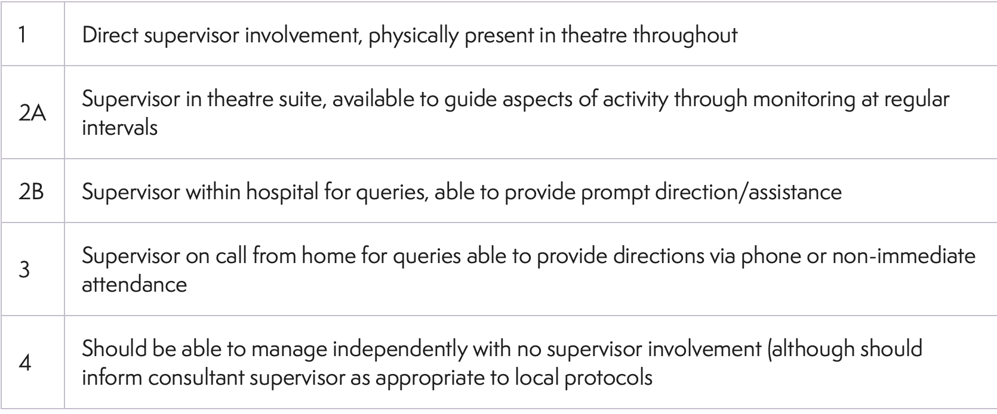
Show progress using SLE supervision levels

Slide 15
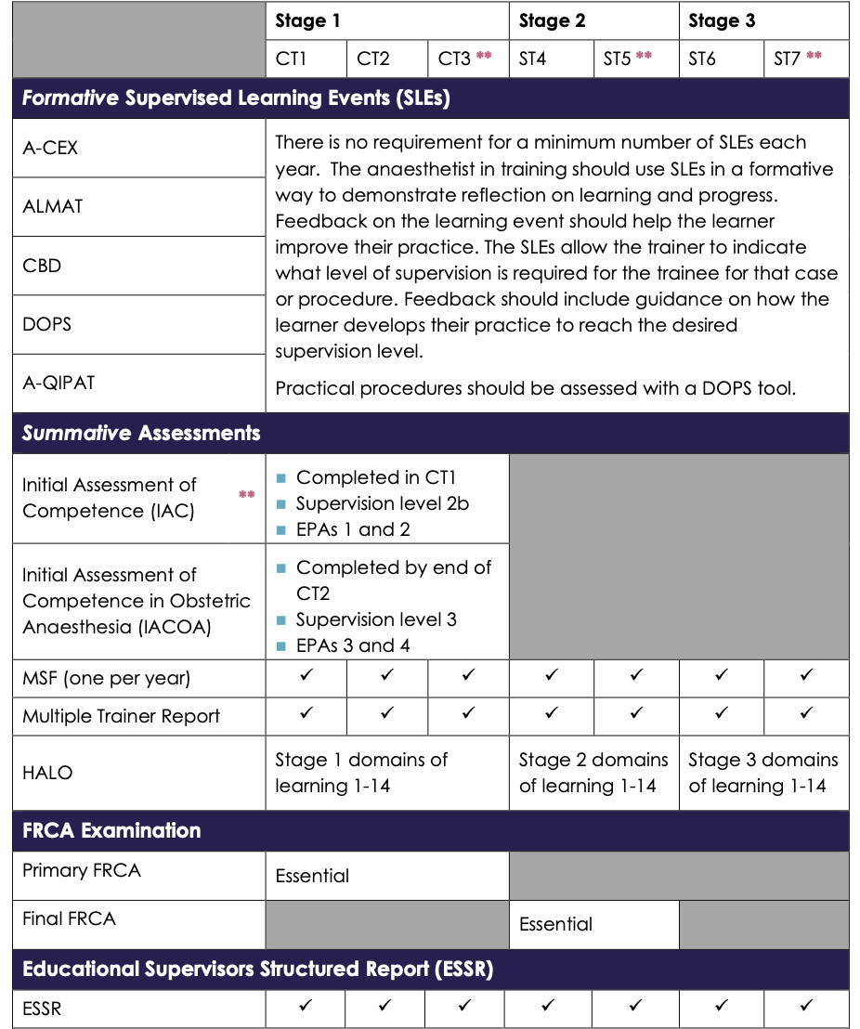
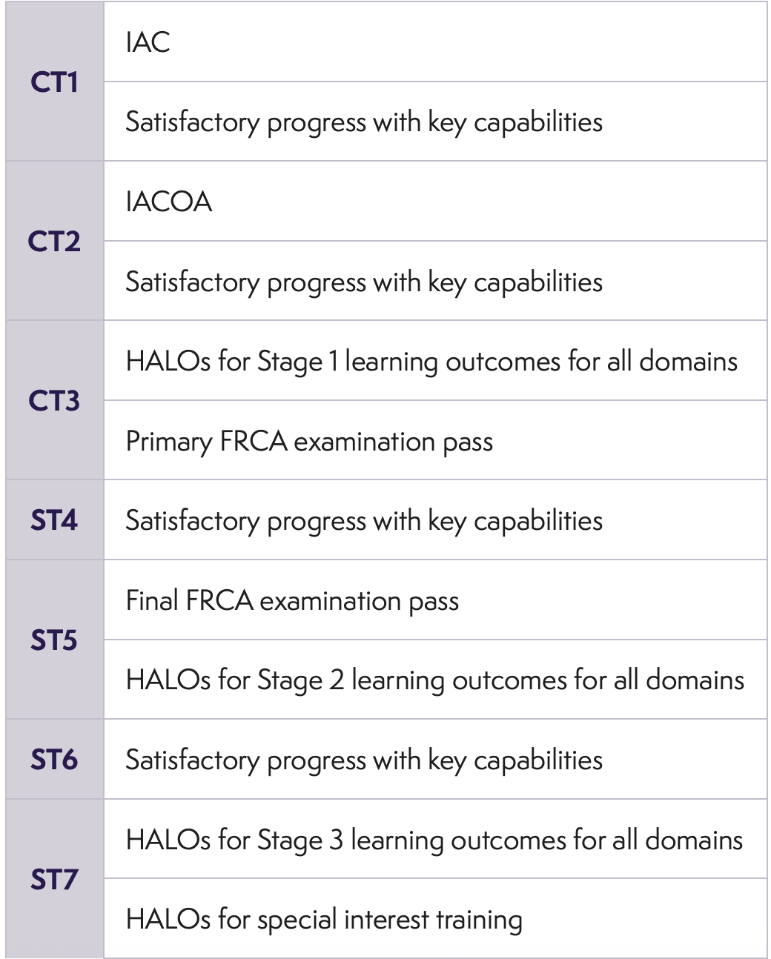
Stage of training requirements

Slide 16
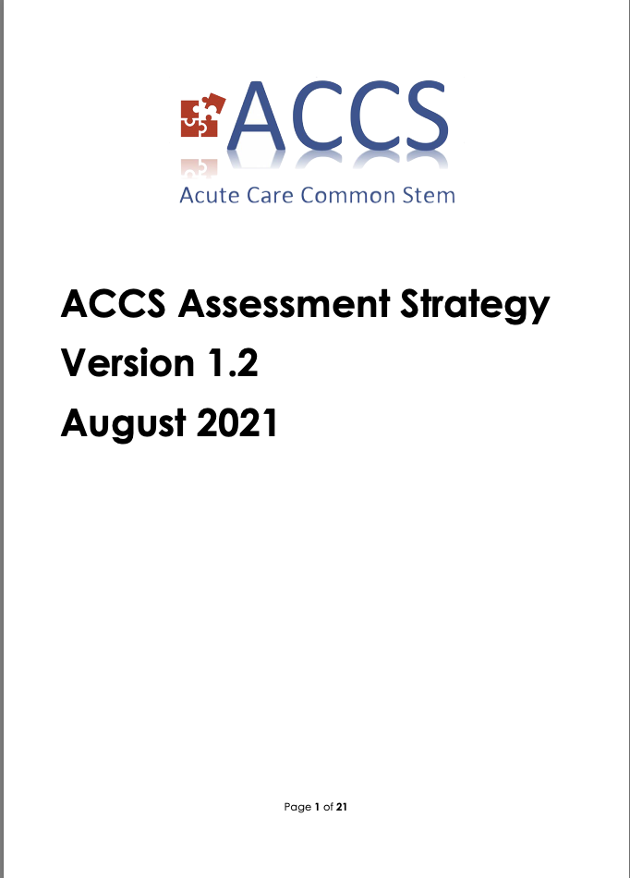


Slide 17
How do I collect evidence?
Plan ahead
ES meeting-set SMART objectives
Collecting evidence throughout the year
Dont forget evidence from on calls esp important in Stage 3

Slide 18
When do I submit evidence?
Start the process early-4-6 weeks
Several steps-you/ES/CT/ARCP panel reviewer
Busy time-exams/rotations
Portfolio lockdown period

Slide 19
Pitfalls

Slide 20
Delayed submission
Incomplete submission-CT name not linked to ESSR-so no CT comments
Evidence present but not linked to ESSR
Form R not linked
Poor evidence of reflections
Communication

Slide 21
Summary

Slide 22
Use the checklists
Start the ESSR early
Communicate
Work on LLP through the year

