Slide 1

Out of Programme Experience
Gillian Lever

Slide 2
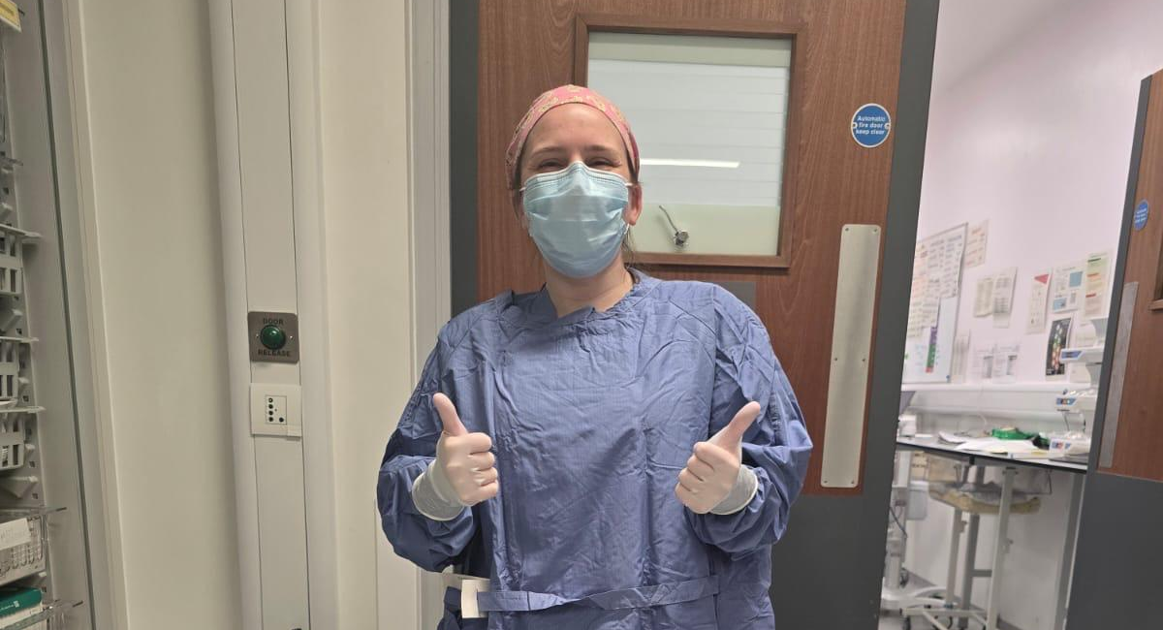

A bit about me…
Leeds grad
Foundation – WY
ACCS – EY
ST – WY
Currently ST5 (FT)
Longstanding sustainability interest
No time/headspace for projects
Notes:
Brief clinical background (ST level, exams done, where you were training-wise)
What was going on at the time:
Post-exam fatigue
Growing interest in sustainability / leadership
Feeling that “doing this on evenings and weekends wasn’t enough”
Why OOPE specifically:
Dedicated, protected time
Chance to go deeper rather than broader
Space to reflect before consultant years

Slide 3
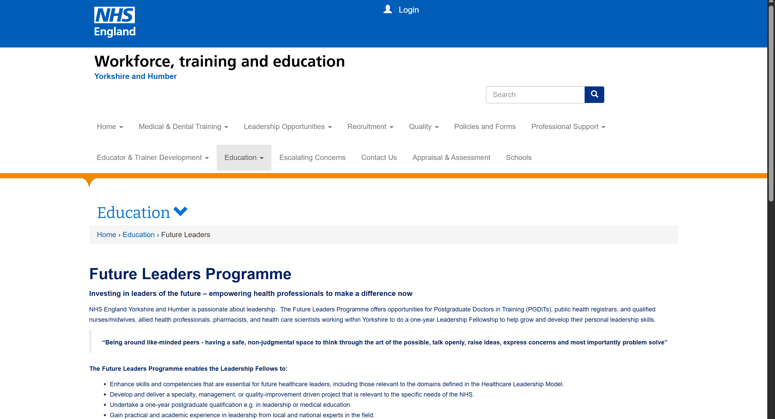
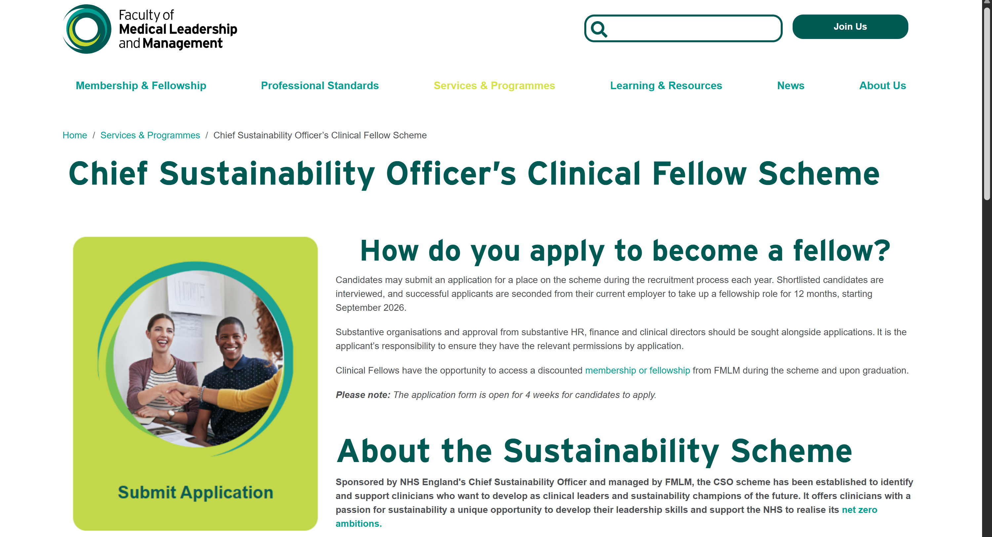
OOPE Options
FLP
  Yorkshire/Humber, range of themes (change yearly), local impact
CSO Clinical Fellow Scheme
  Sustainability people only, national scheme, broader impact

Slide 4
FLP Application Process
FLP website – list of bids, recruitment timeline and contacts for applications
Eligibility criteria – check carefully and check your ARCP date
Complete application form, email to named contact with CV
Shortlisting
Interview
If successful, apply for OOPE (form to TPD to sign)
Confirmation from Deanery

Slide 5
Components of my FLP year
Project
PG cert
Leadership
Reusable theatre hats for LTHT
Reusable textiles working group
Snowballed to other projects
Psychology in the Workplace at Aberdeen
Guide of approved courses
Funding for leadership /education courses
Courses through FLP
  Myers Briggs
  Managing imposter syndrome
  Leadership for clinicians
  Managing challenging conversations
Freedom to do other courses

Slide 6
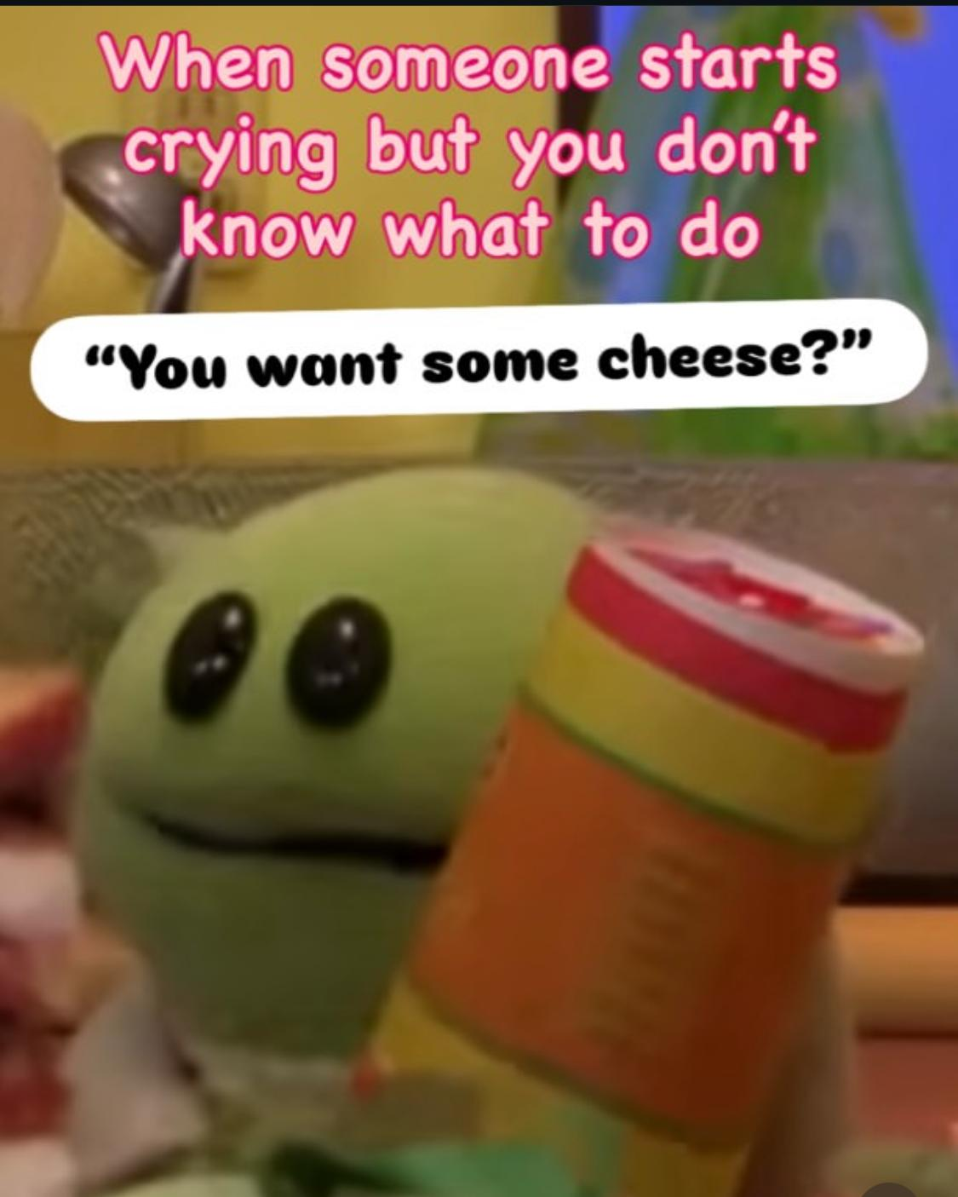
FLP – is it worth it?
Cons
No clinical work (not allowed to locum in office hours unless on AL, can still locum OOH)
(Anxiety about return to clinical)
Can be a big adjustment

Slide 7
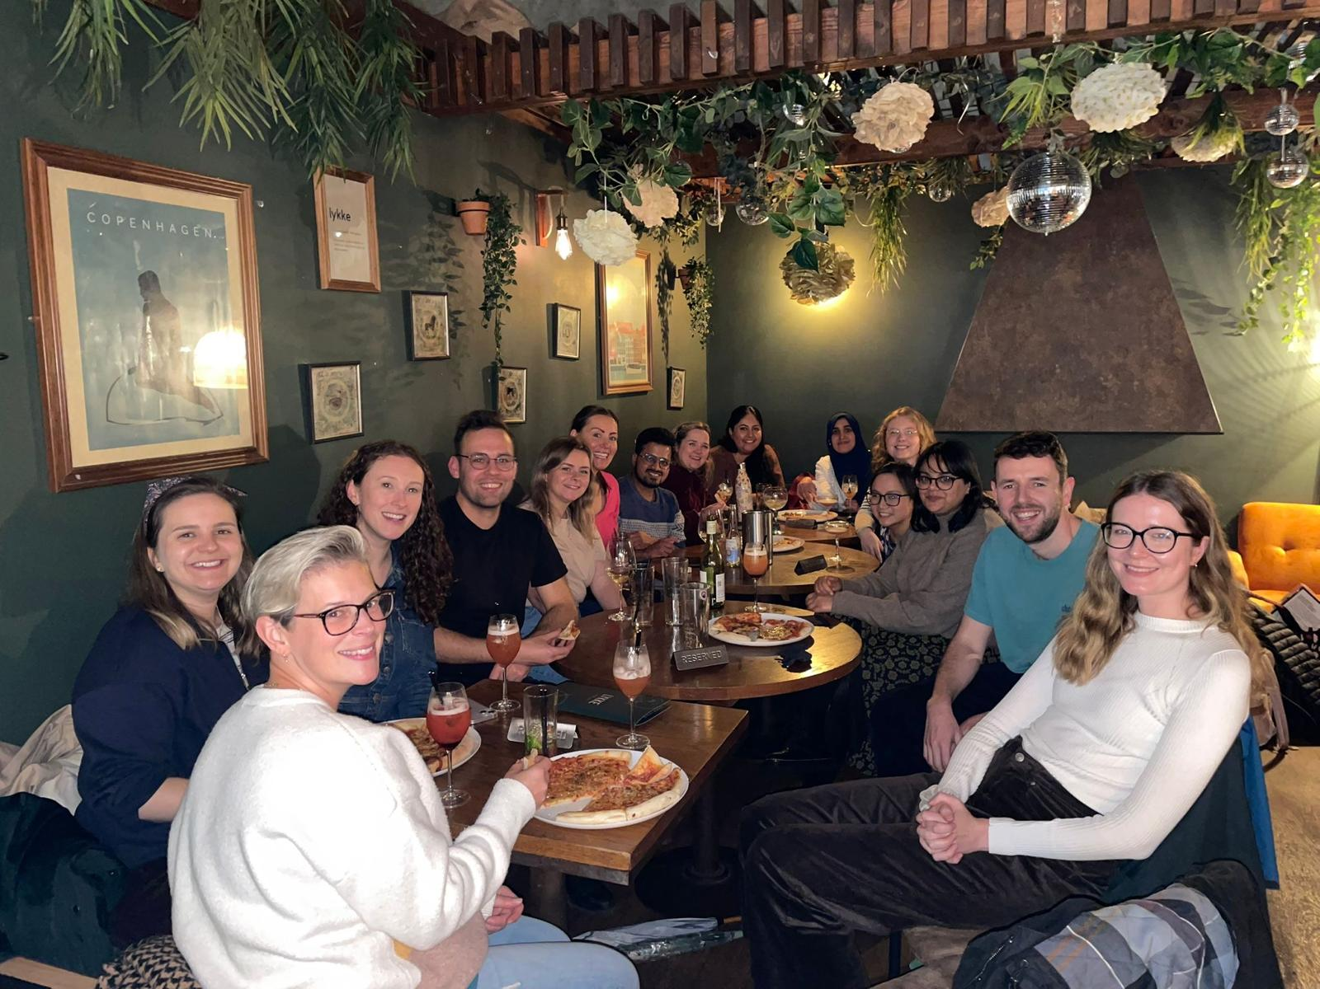
FLP – is it worth it?
Pros
Space to pursue interests
Develop CV/prep for consultancy
Meet lovely people and network!
No nights/weekends/swapping
Hybrid/flexible working
WELLBEING+++

Slide 8
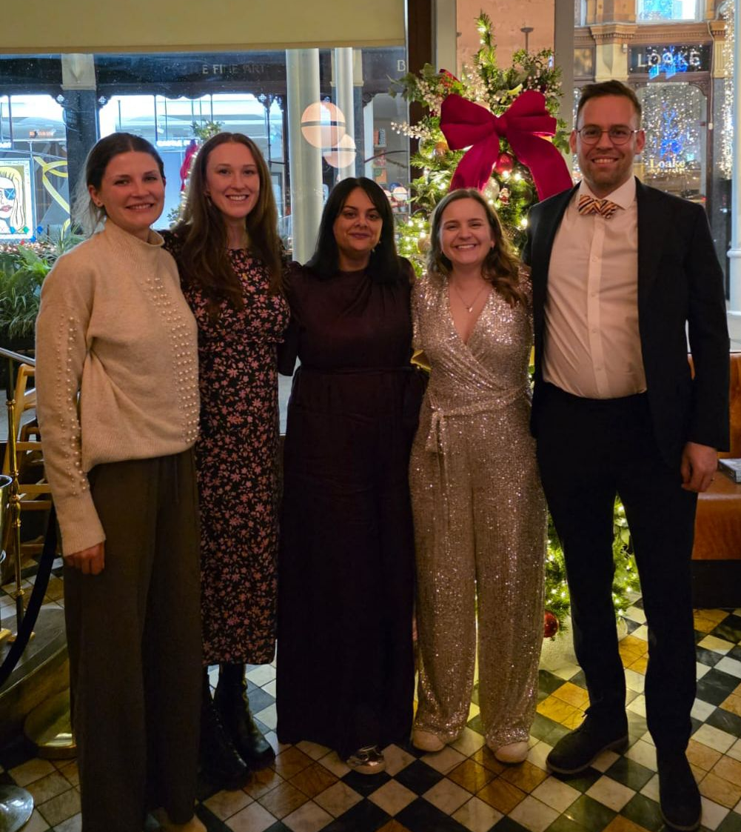
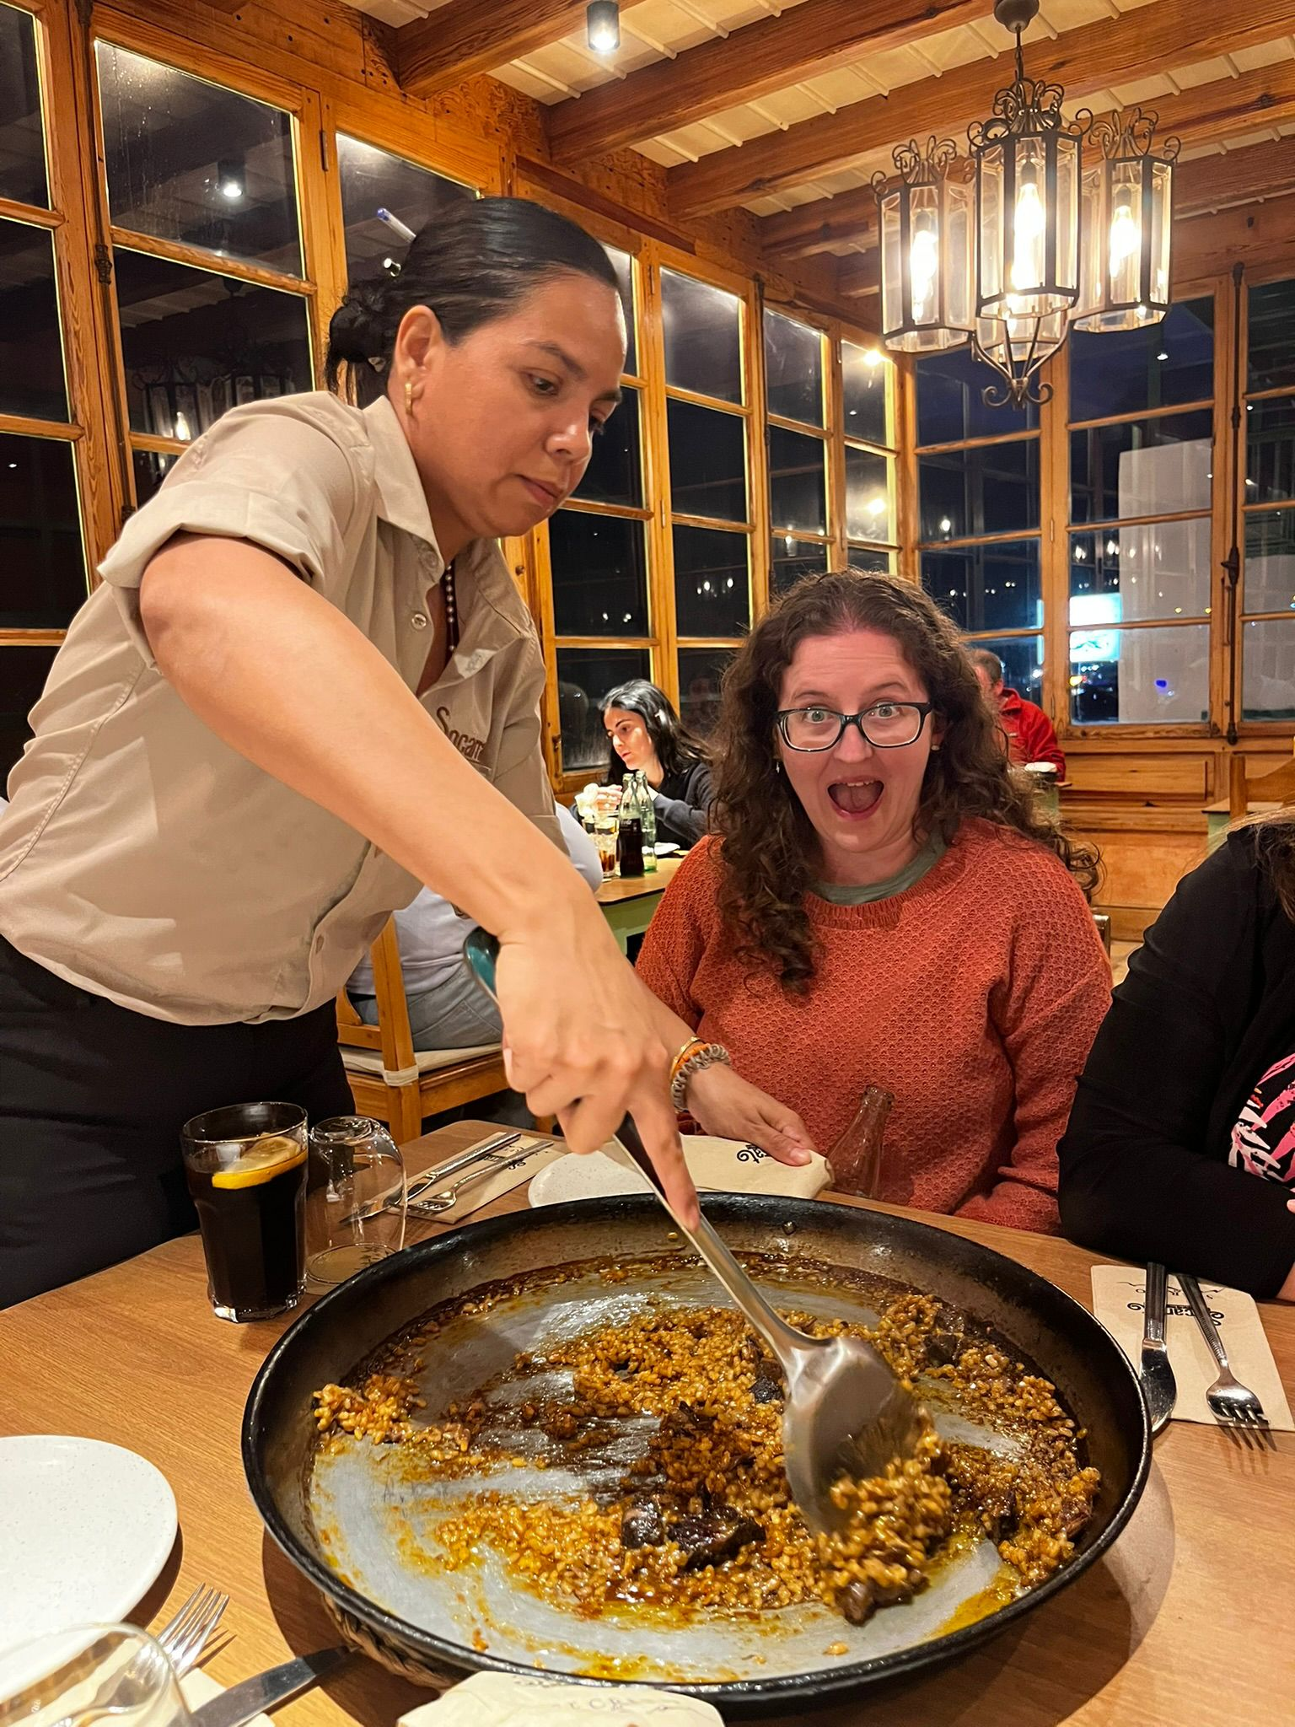
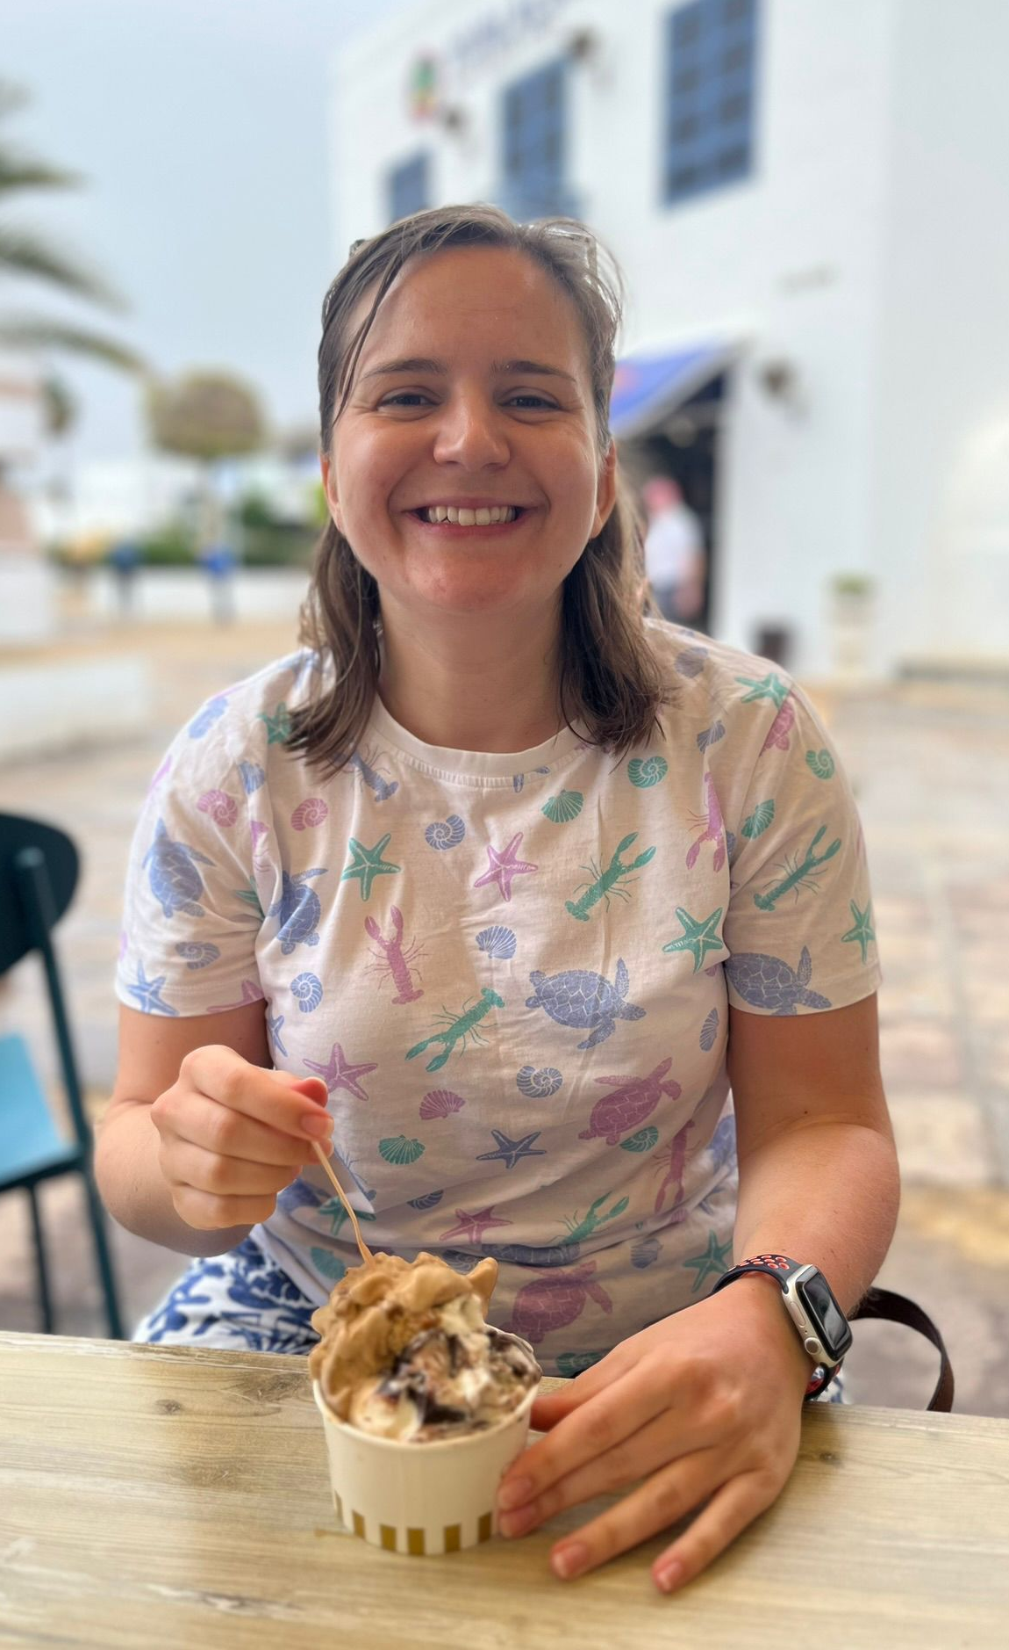
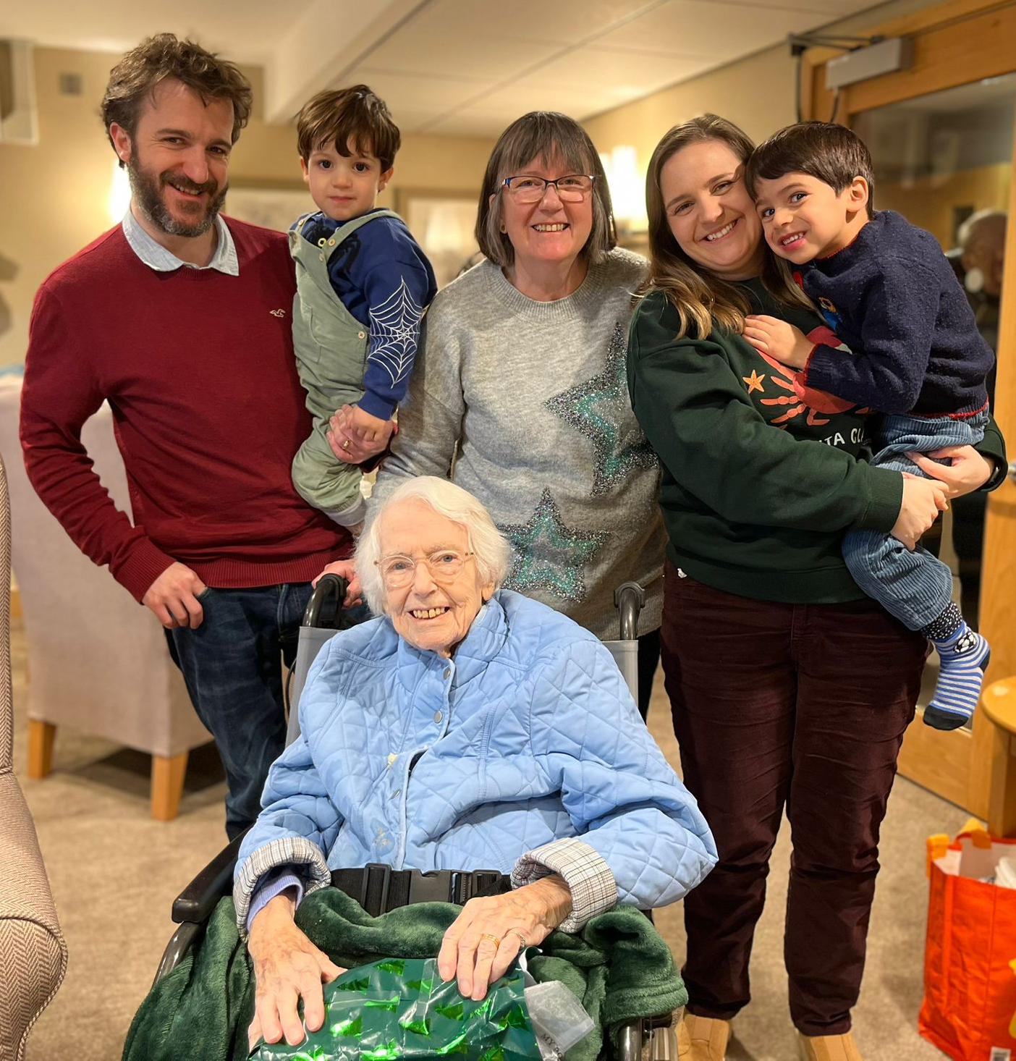
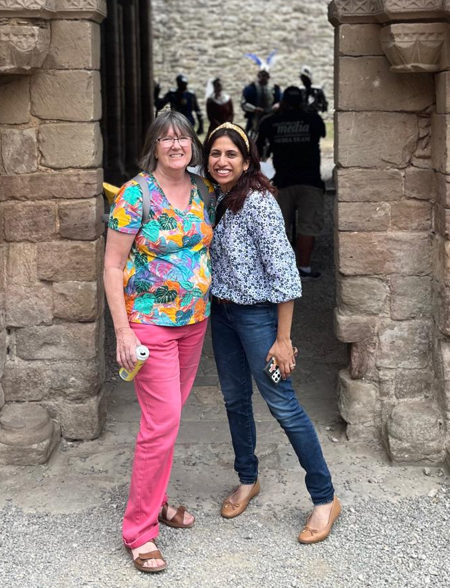
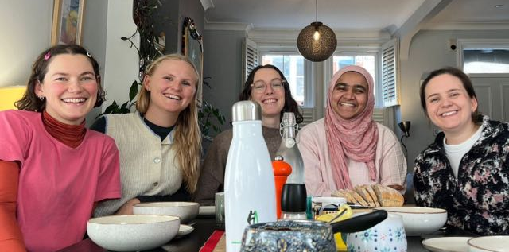
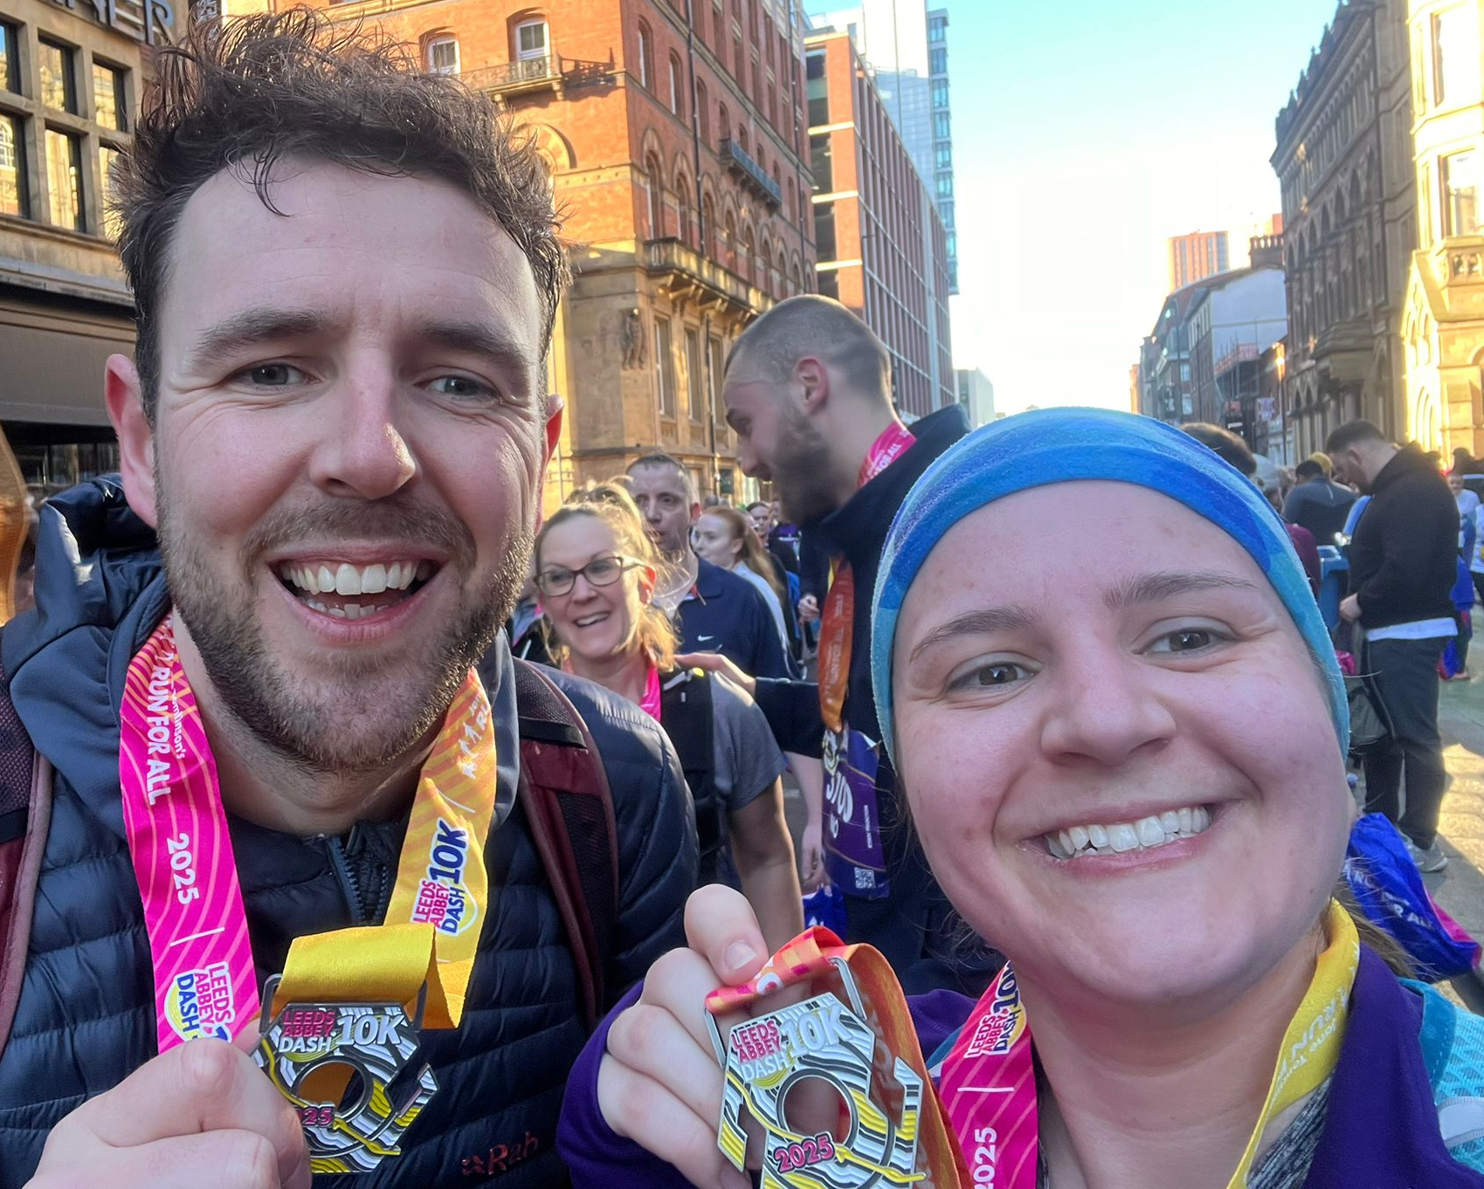
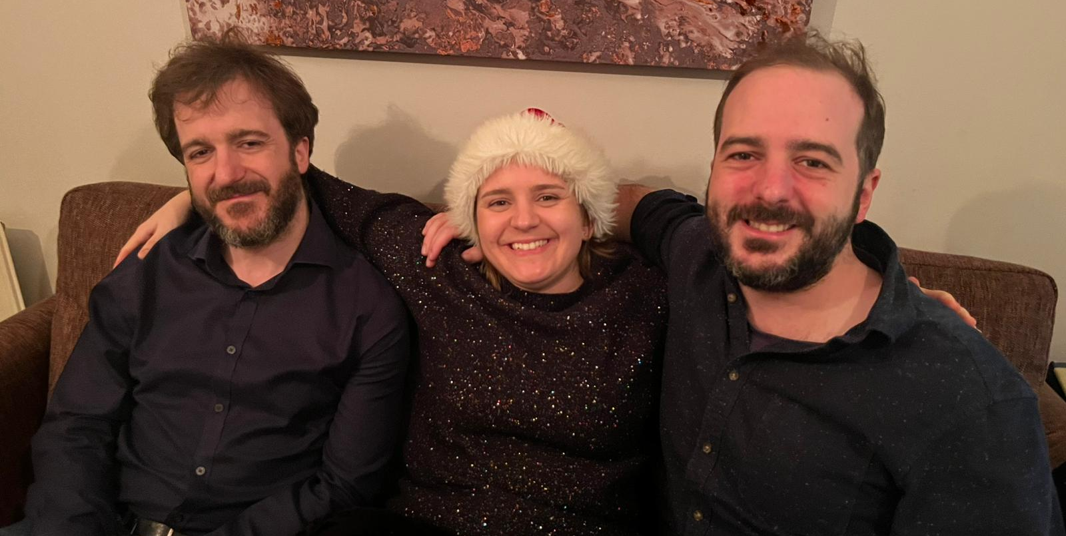
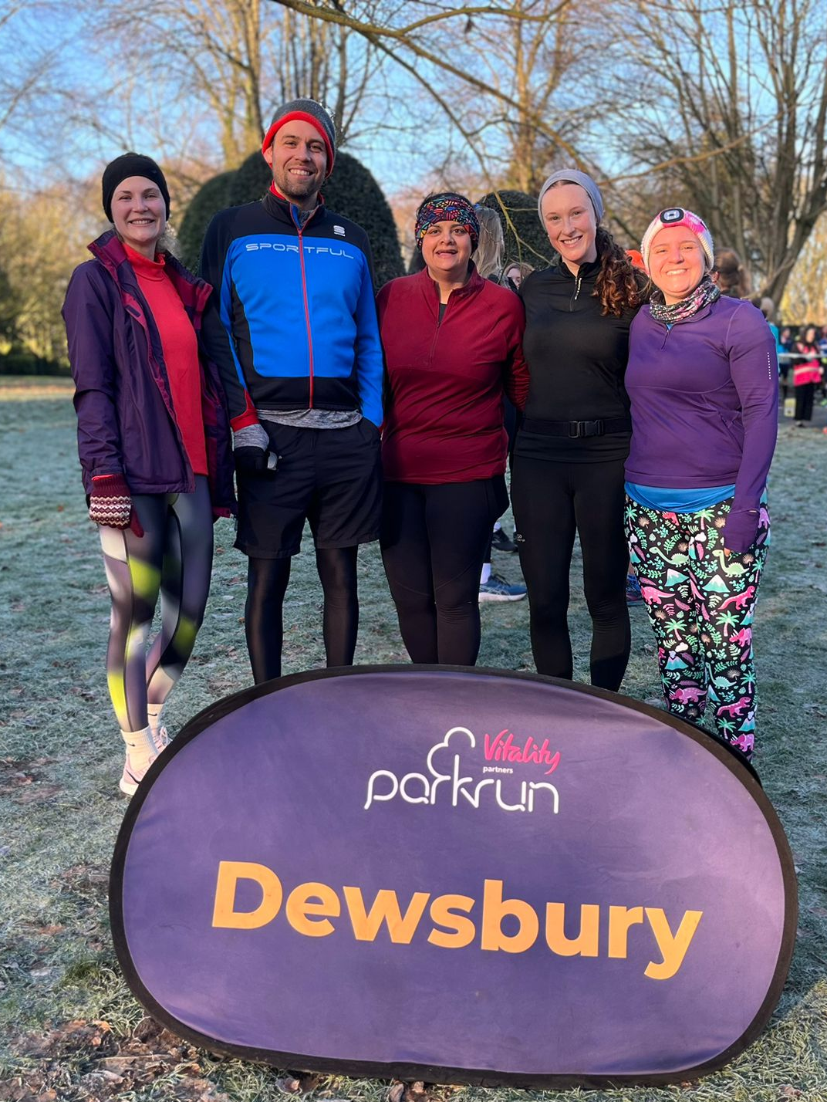
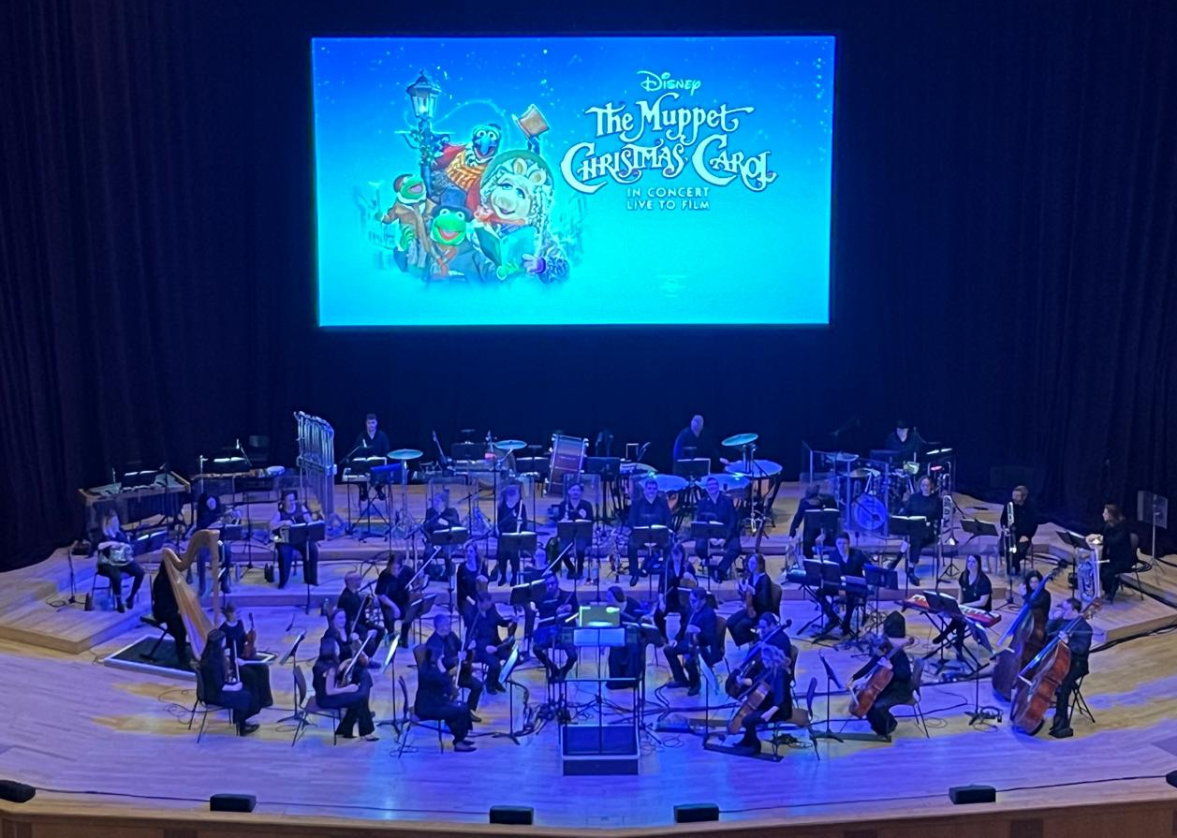
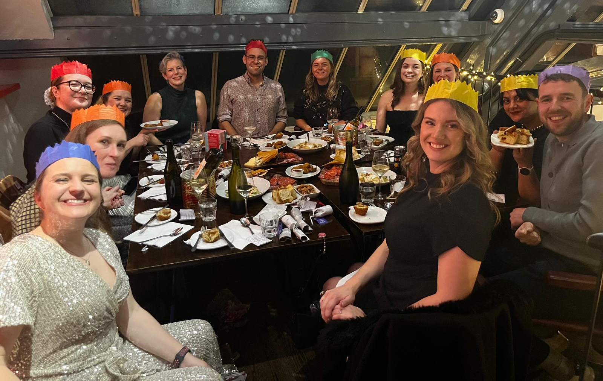
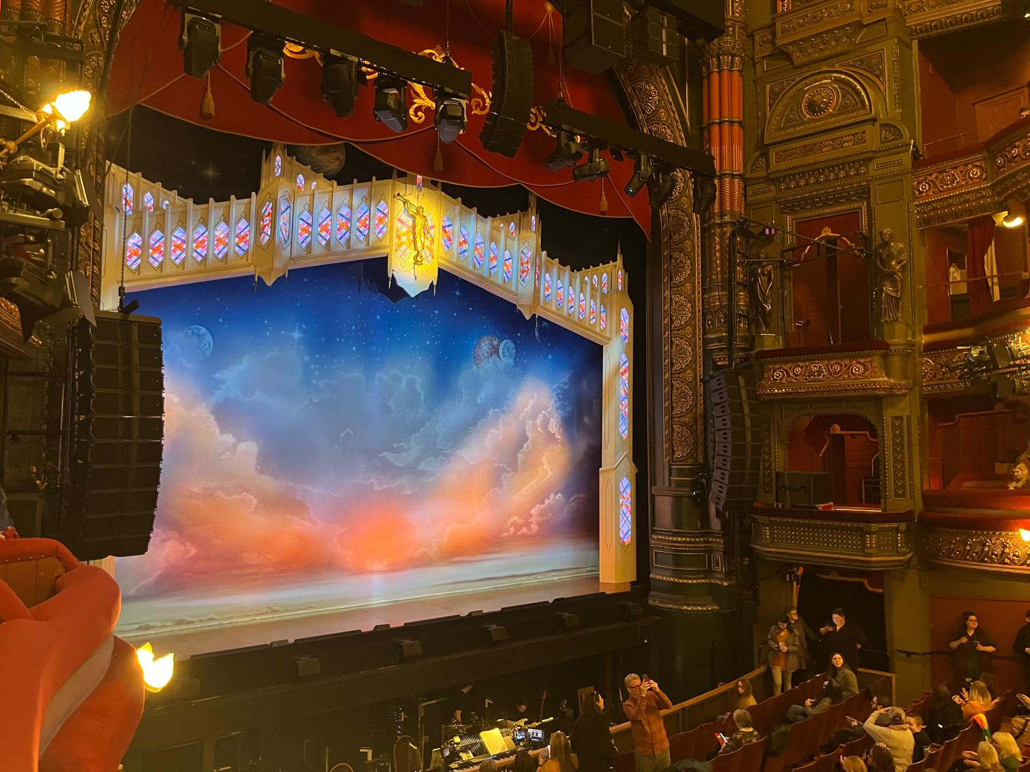

Slide 9
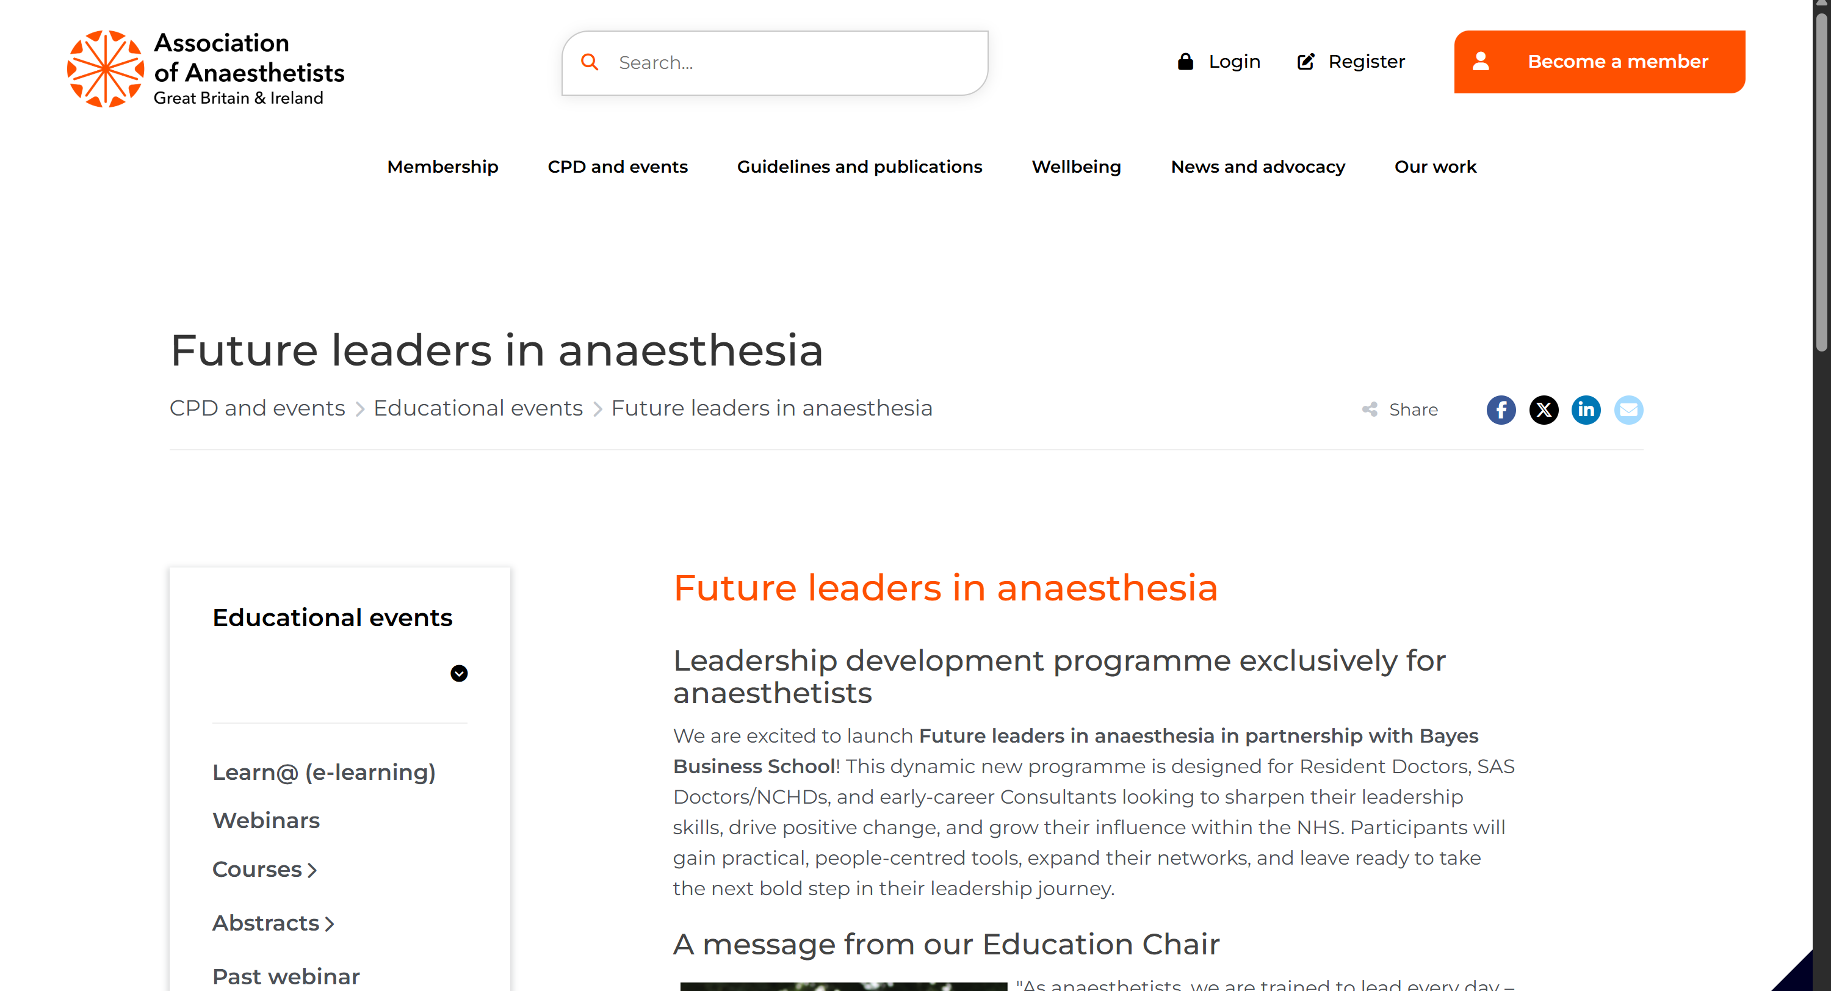
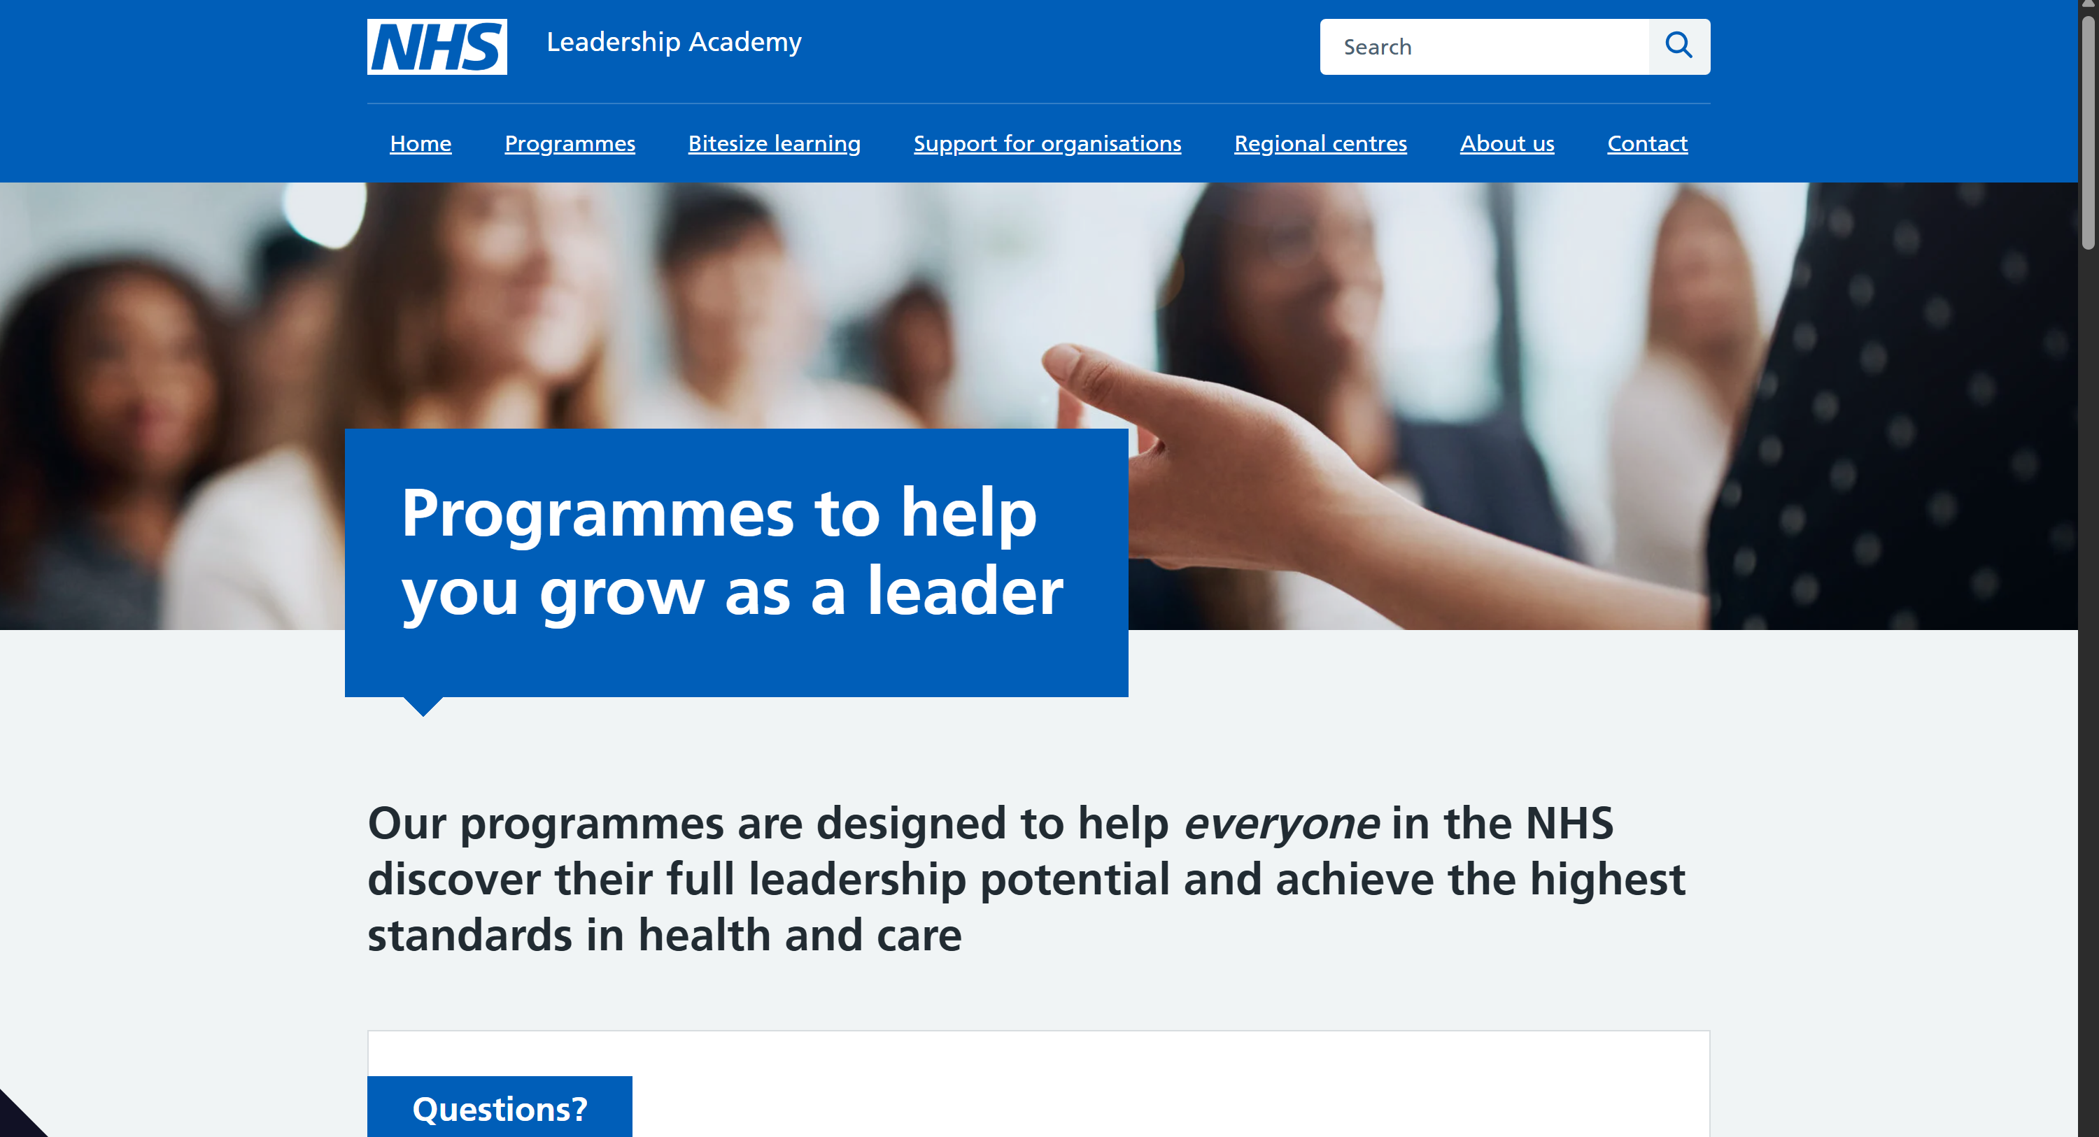
Other Leadership Courses
Association of Anaesthetists – Future Leaders in Anaesthesia (New for 2026)
NHS Leadership Academy

Slide 10

Thank you
Gillian.lever@nhs.net
GHASProject.co.uk
LinkedIn/BlueSky/Instagram

