Slide 1
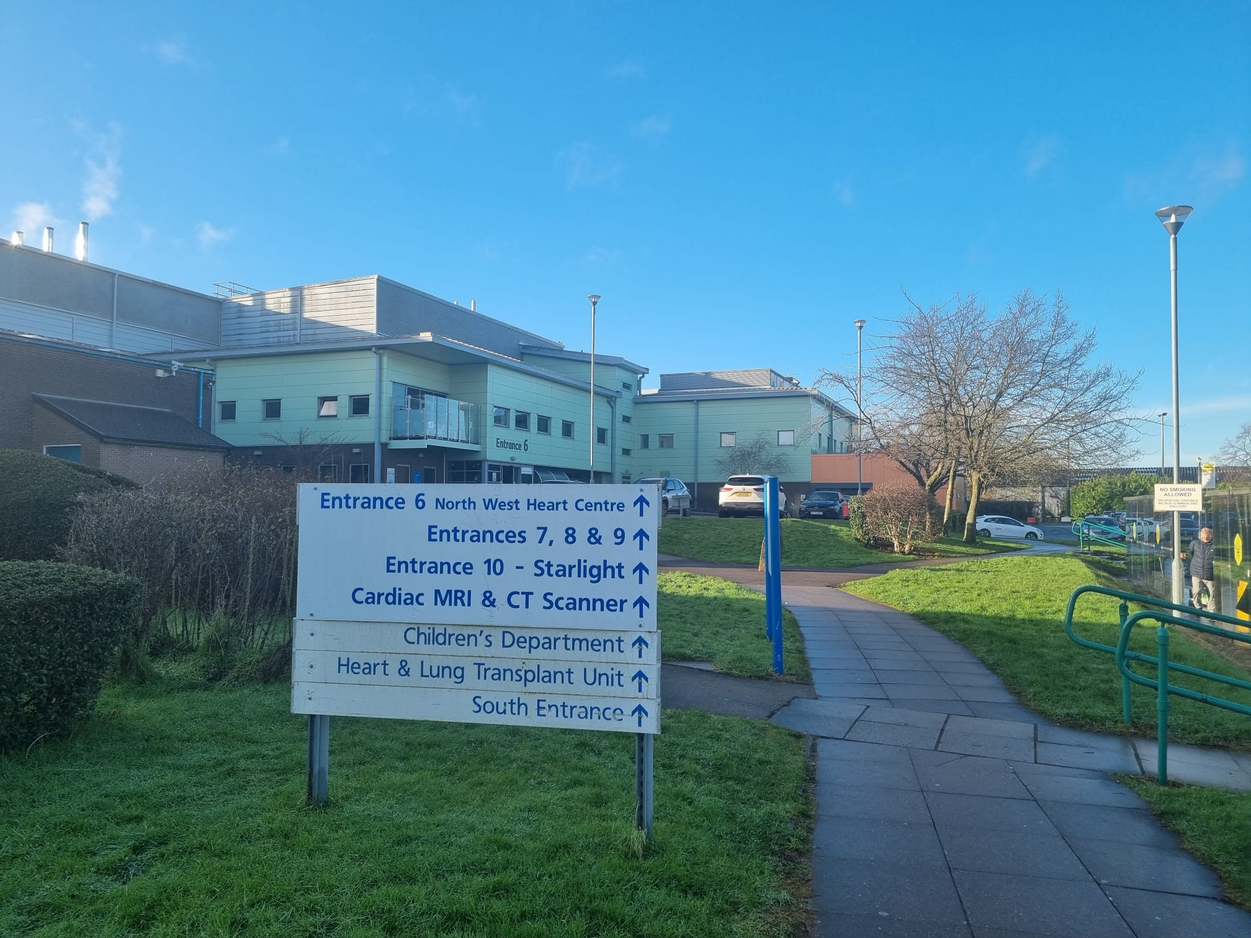
OOPT- In Search of New Horizon
-Venkat Jambunathan
Cardiac Anaesthesiologist

Slide 2
OOP
“There are opportunities for anaesthetists in training to undertake approved periods of time outside of the approved programme as experience, research, or training”

Slide 3
Why????
Broaden your clinical experience/ knowledge
New Skills
Bringing back New things
Networking / new destination to settle
Prepare yourself to be consultant anywhere

Slide 4
Types
OOPT- Time out of programme for approved clinical training
OOPR - Time out of programme for research
OOPE - Out of Programme Clinical Experience
OOPC - Taking a planned career break

Slide 5
OOPT
Prospectively approved
Preferably GMC approved Training Centre
12 Months ( Ideally ST6 to ST 7)
Last 6 months of training should be in your Deanery
Must map to capabilities identified in the stage 3 and/or special interest area(s)
Necessary documentation for ARCP

Slide 6

How???
Decide early – latest before end of ST5
Discuss with Programme ES
Keep TPD informed
Decide the place
Begin the approval process – long but not tedious

Slide 7
Where???
My Rationale were:
Fulfill the training needs like – Case load, Transplant, Mechanical Support and Teaching
Good Department – Discuss with previous fellows
Not far – Young family
Cost of Living

Slide 8
The Process
Visit the place
Job Advertised
Secure the
Fellowship
Get the OOPT
Approved

Slide 9
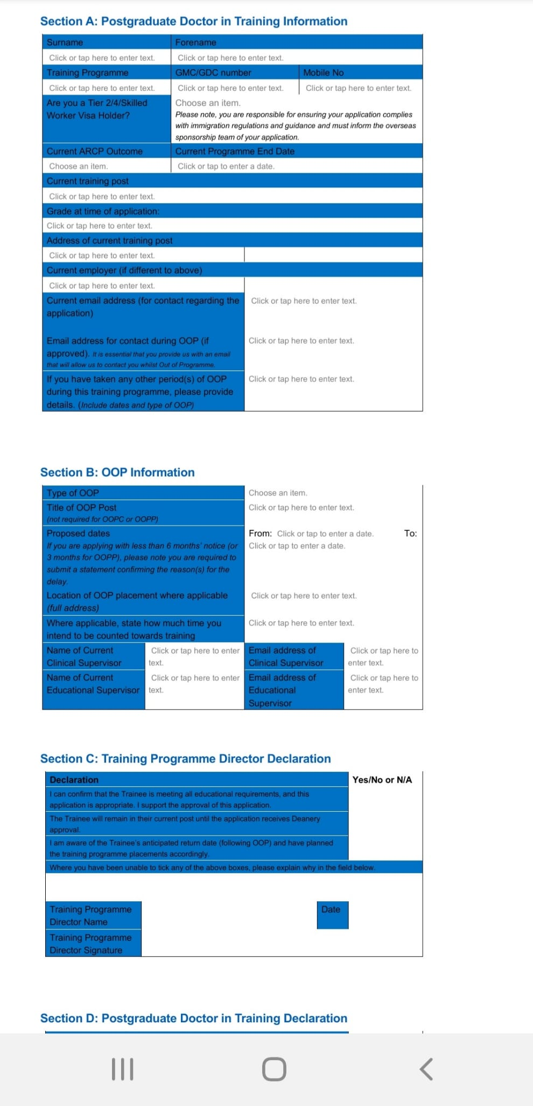
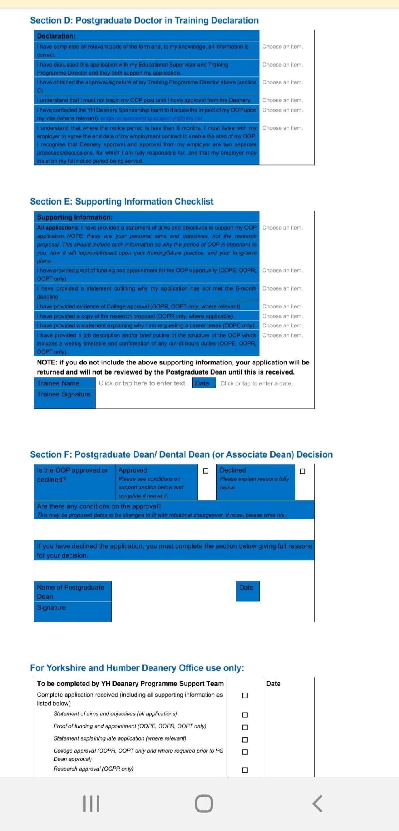
OOPT Approval
Six Months before anticipated start date
Application form – Google
Aim – Things you aim to achieve
Job Description from
the advert

Slide 10
Further steps….
Email TPD and copy ES
TPD forwards it to Deanery
You get an acknowledgement from deanery
Email the provisional appointment letter
Hurray…… Get the OOPT Approval Letter

Slide 11
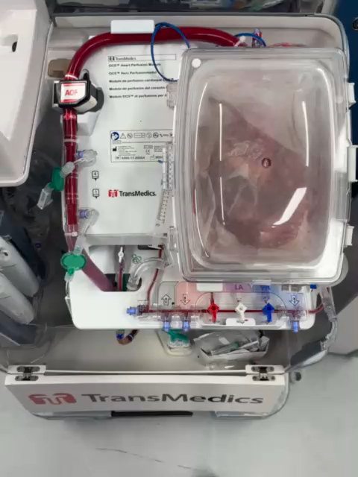
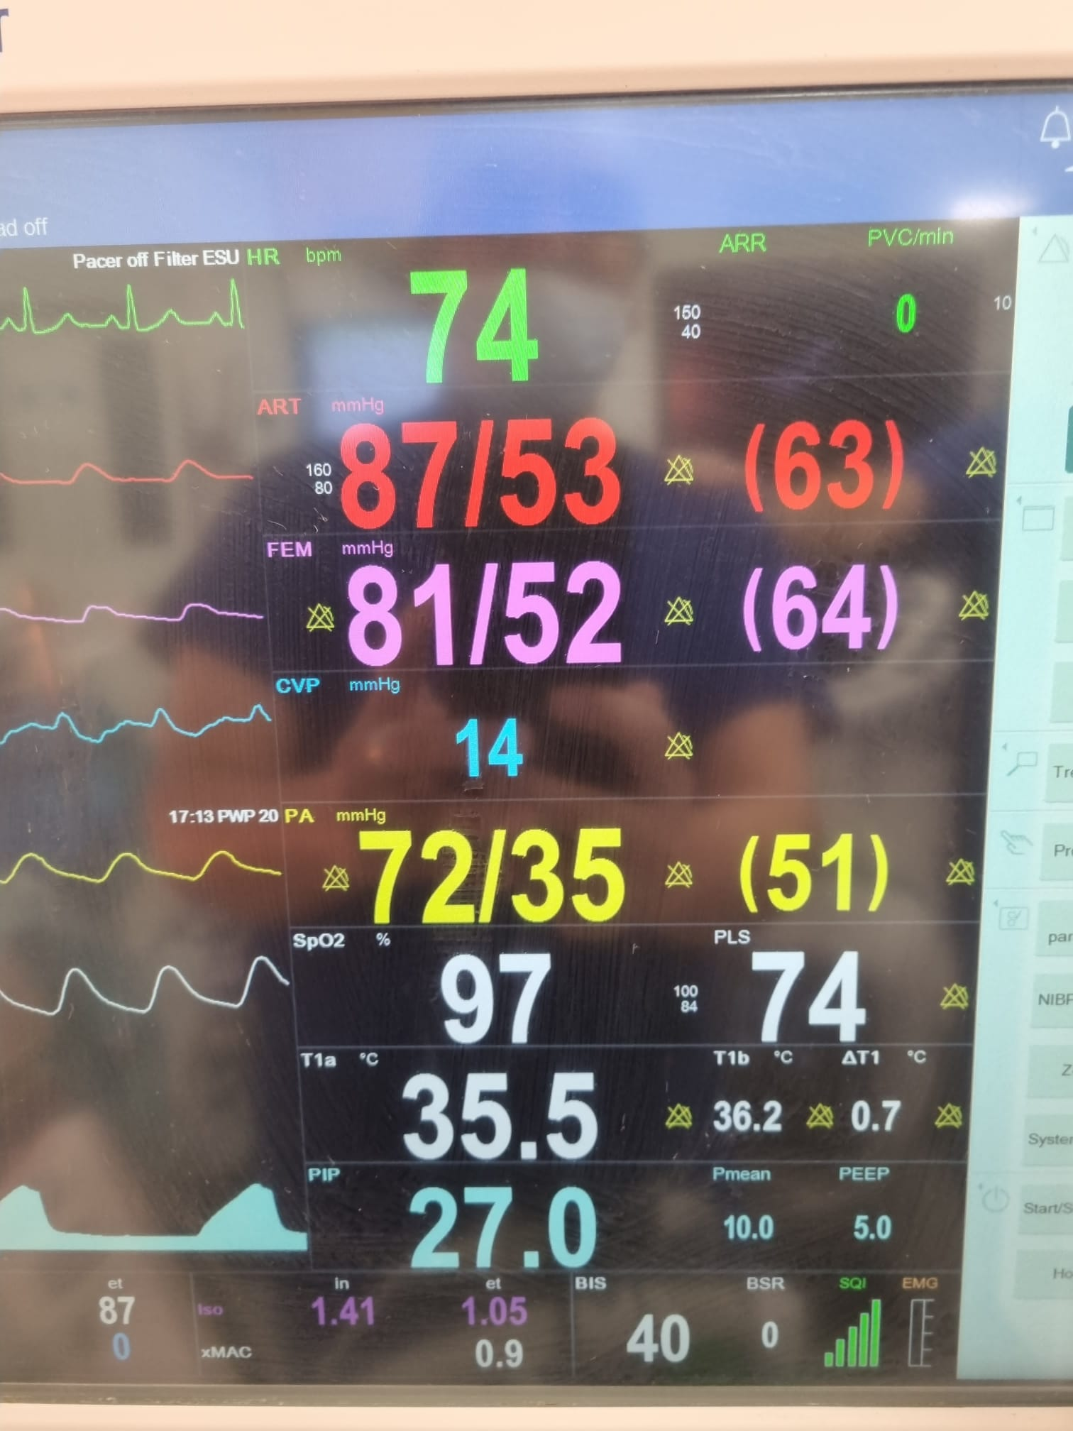
My fellowship exeprience

Slide 12
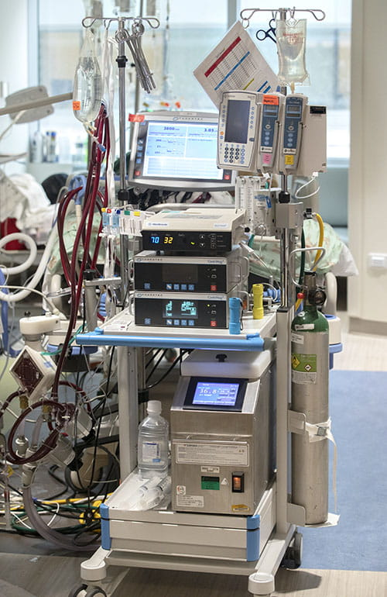
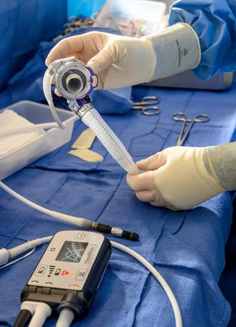
Mechanical support

Slide 13
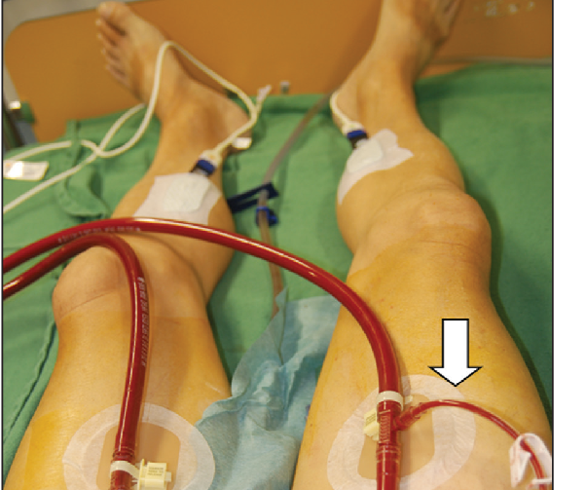
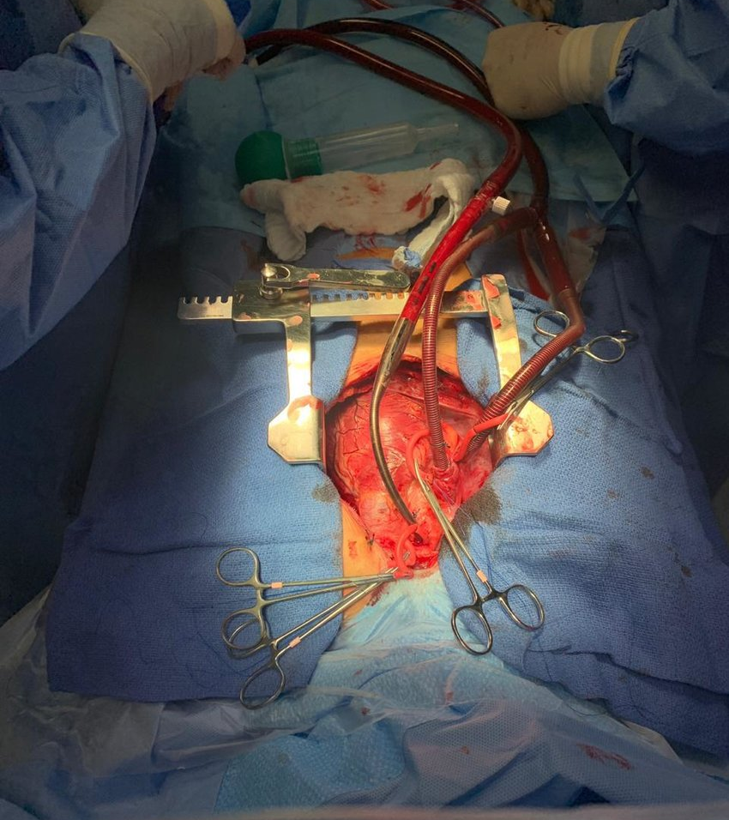
VV-ECMO and VA -ECMO

Slide 14
Anaesthesia in developing countries
Special Interest Area of training
Up to 6 months can be counted towards the CCT.
https://rcoa.ac.uk/documents/guide-anaesthetics-training-handbook/out-programme
A thing to ponder

Slide 15
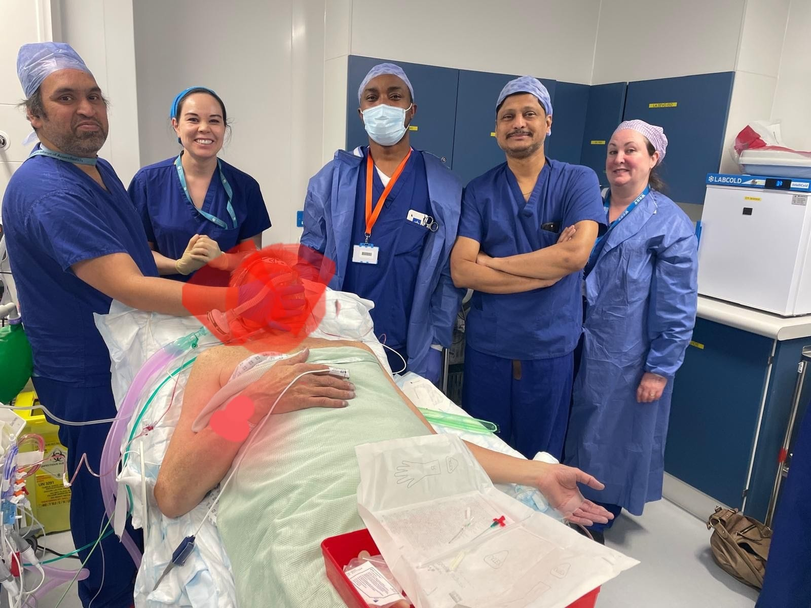
Thank You

