Slide 1

Less than Full time training
Dr Rima Sinha
(slides by Dr Laura Coles)

Slide 2

Rima Sinha ST6 (80% LTFT)
m.sinha1@nhs.net
wy.gasreps@gmail.com
Outgoing West LTFT Rep
Incoming West Trainee Chair
LTFT for Childcare and Work-life balance

Slide 3
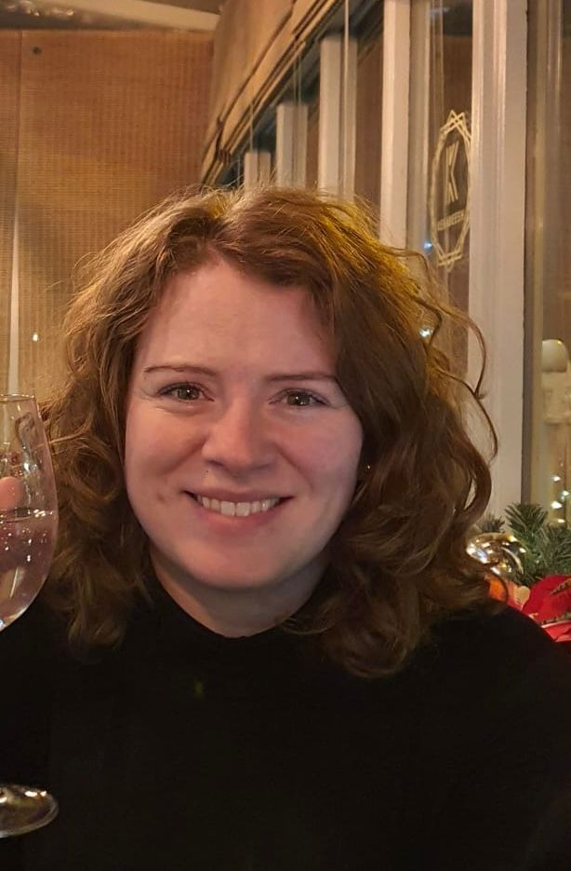
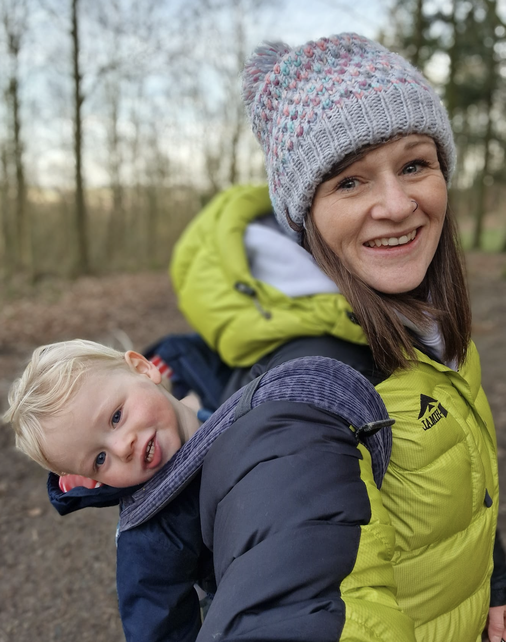
Your West LTFT Reps
Laura Coles ST5 Ruth Charlesworth ST5
Laura.coles8@nhs.net ruth.charlesworth2@nhs.net

Slide 4


Your South / East LTFT Reps
East South
TBC Iain Mooney ST5 Iain.mooney@nhs.net

Slide 5
How to apply
Types of rota - (slot share, non slot share, supernumerary)
Pay and common Rota pitfalls
Training progression and LTFT
Trainee reps and What’s app groups

Slide 6
LTFT applications
Anyone can now apply to train LTFT
Discuss with TPD
Given as much notice as possible – 16 weeks
Complete application from and send to school admin team
Stage 1
50% or 70% or 100%
Stage 2 and 3
50%, 60%, 70%, 80% or 100%

Slide 7
Rota types
LTFT in a full time slot
‘Slot share’
Supernumerary

Slide 8
Working out your rota
You should work your percentage of each shift type
If you share a rota slot you may only get 50% of the on-call shifts
DB rotas

Slide 9
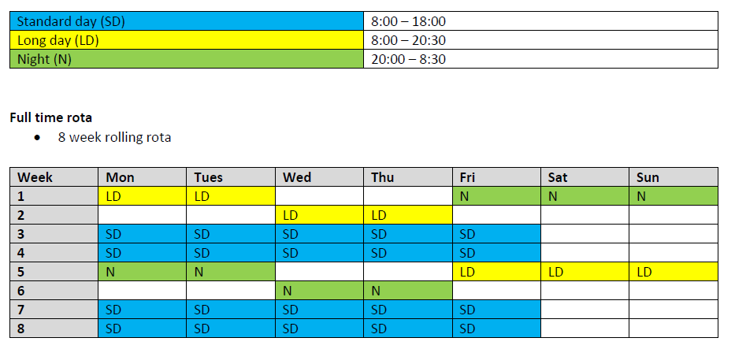
Full time rota

Slide 10
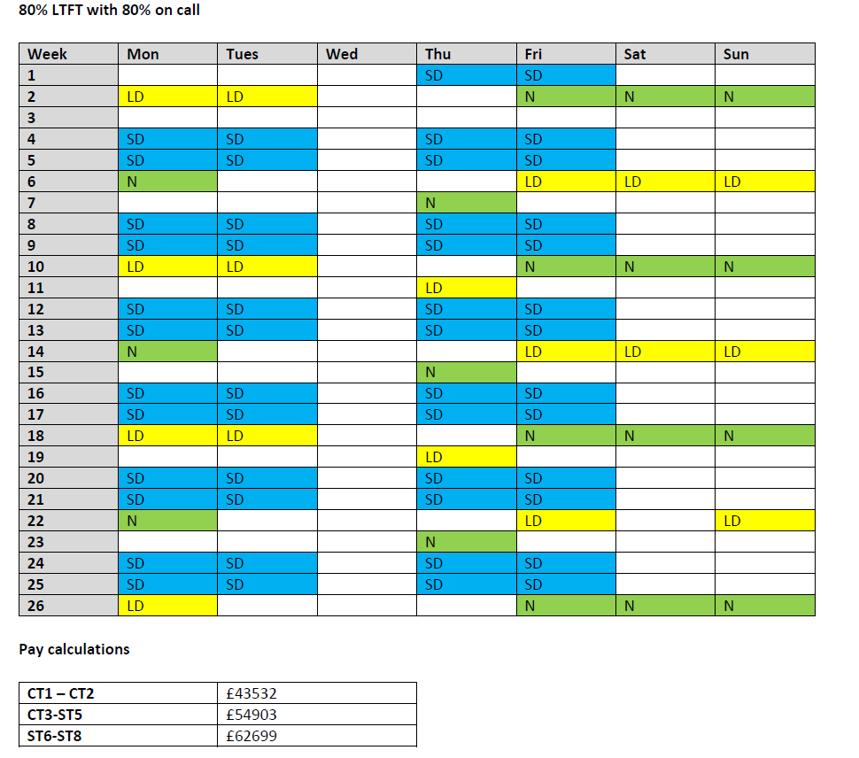
80% LTFT in a full time slot
Adjacent pay values are now inaccurate, but will provide relative comparison of income

Slide 11
Slot share
2 LTFT doctors are put in a single rota slot

Slide 12
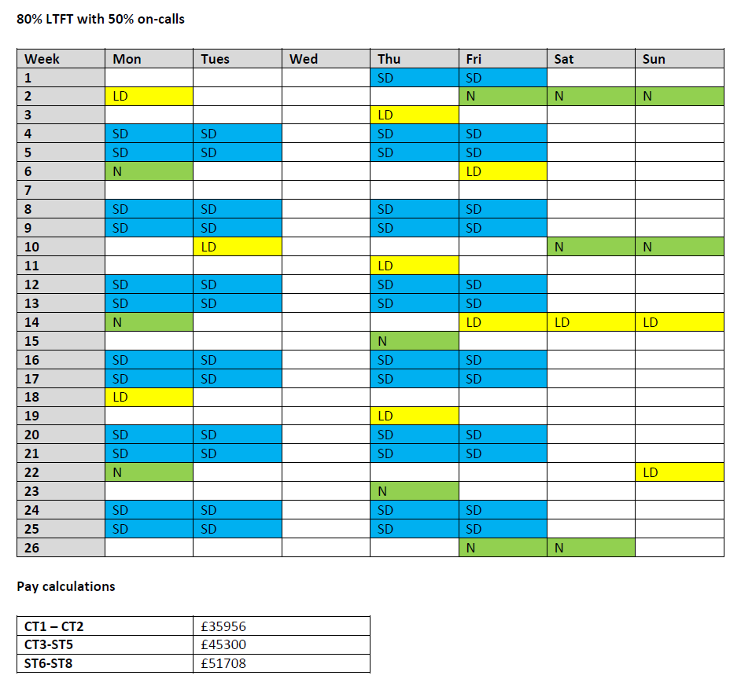
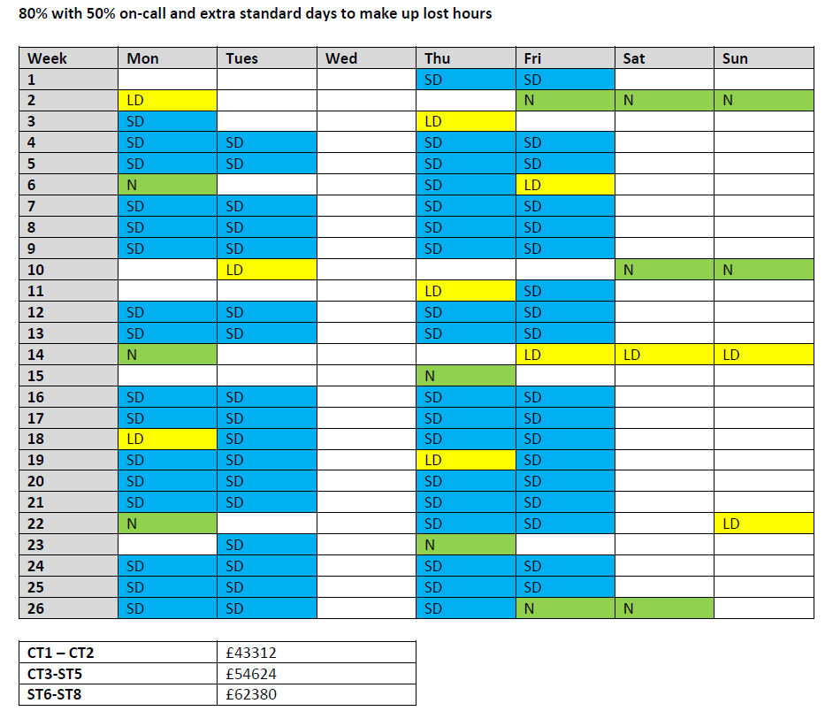
Adjacent pay values are now inaccurate, but will provide relative comparison of income
Adjacent pay values are now inaccurate, but will provide relative comparison of income

Slide 13
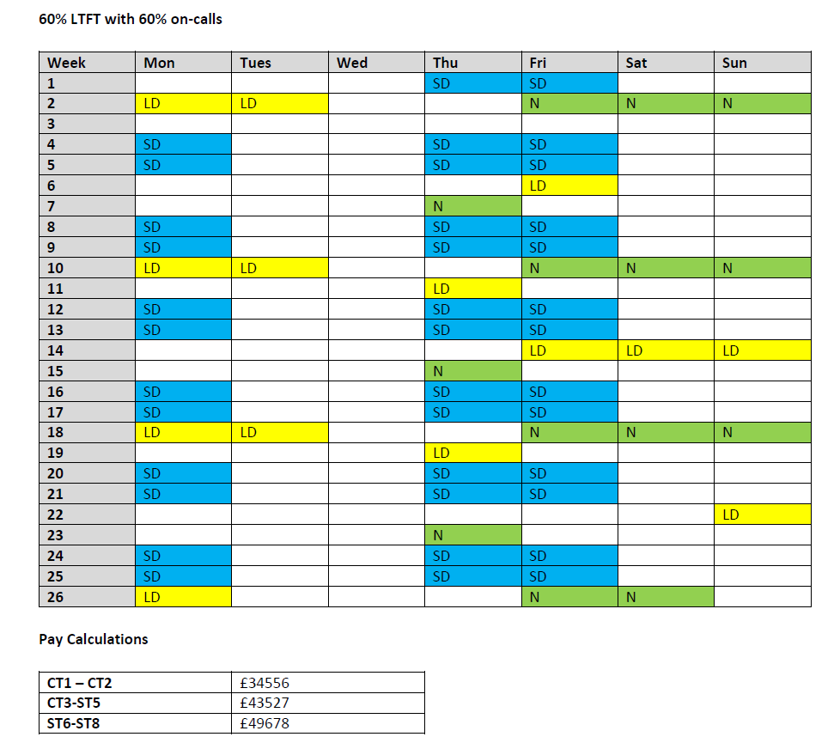
Adjacent pay values are now inaccurate, but will provide relative comparison of income

Slide 14
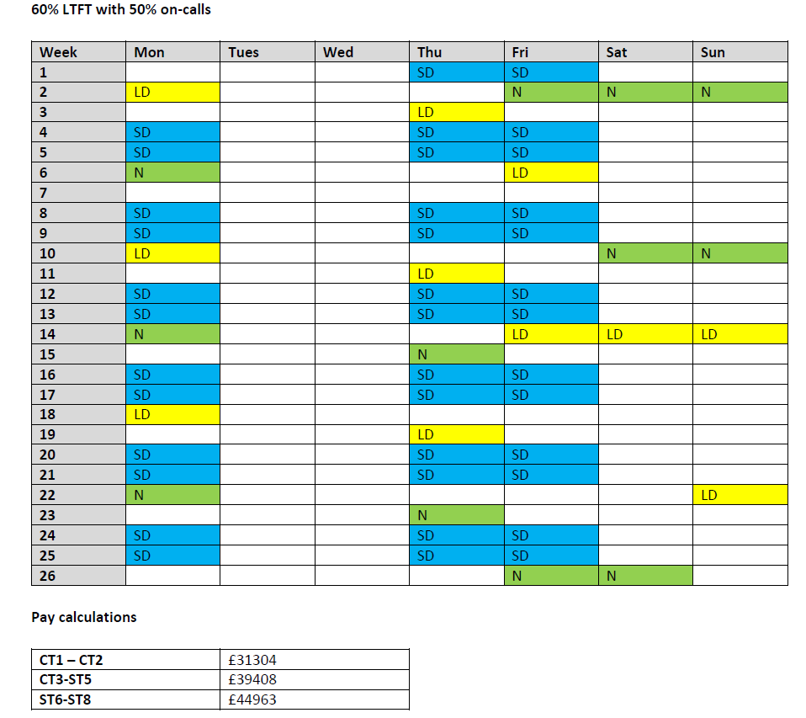
Adjacent pay values are now inaccurate, but will provide relative comparison of income

Slide 15
Common pitfalls
Fixed working days
Leave
Pay

Slide 16
Fixed working days
You are entitled to a fixed day off
Trusts are not obliged to honour the day, however most are accommodating particularly for health or caring responsibilities
Please be considerate if in a slot share

Slide 17
Leave and bank holidays
Pro rata annual leave and bank holidays
E.g. at 80% with over 5 years NHS service
32 days AL and 8 BHs x 0.8 = 40 x 0.8 = 32 days
Bank holidays
If you work the bank holiday your leave balance stays the same – you do not claim a lieu day
If you are on a zero day on the bank holiday your leave balance stays the same
If you are on a standard day on a bank holiday and you are off you use a day of your leave balance

Slide 18
Pay
Average hours
Weekend premium
LTFT premium
https://www.bma.org.uk/pay-and-contracts/pay/ltft/less-than-full-time-trainees-pay-explained

Slide 19
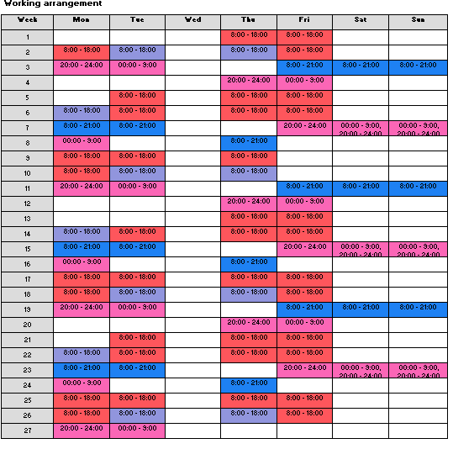
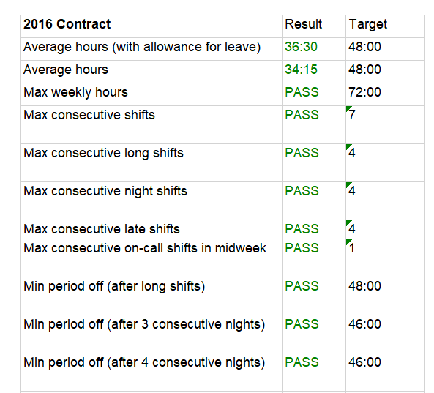
Average hours

Slide 20
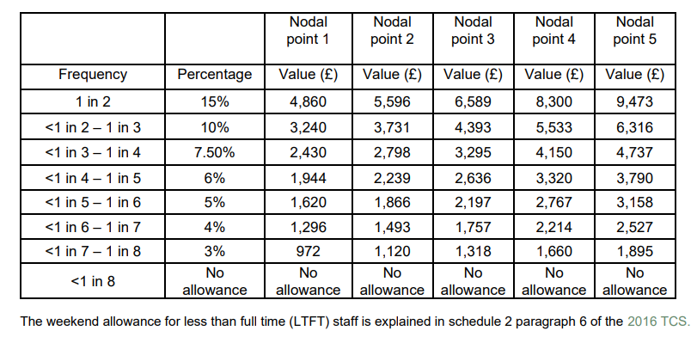
Weekend Premium
FT = 1 in 4 weekends
LTFT working 50% of weekends
Should get 50% of the amount from
<1-3 – 1 in 4 weekends
Not the 1 in 8
Split weekends for full premium

Slide 21
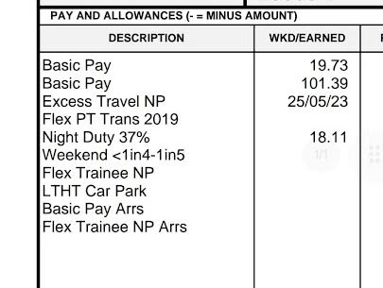
LTFT premium
Make sure it’s on your pay slip

Slide 22
Training time
Training will be prolonged
FT = 1 year
80% = 15 Months
70% = 17 Months
60% = 20 Months
50% = 24 Months

Slide 23
Pros and Cons
Pros
Work life balance
Wellbeing
Allow continuation of work during difficult personal circumstances
After CCT may be able to start on a higher consultant nodal pay point
Cons
Admin burden
Training takes longer
Added stress when you rotate

Slide 24






Slide 25
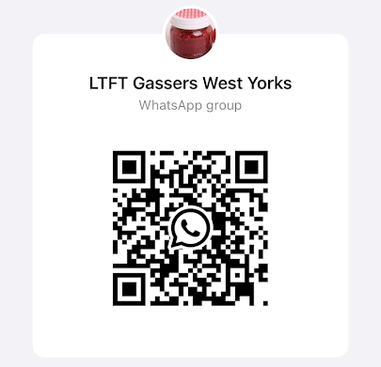
Questions

