Slide 1
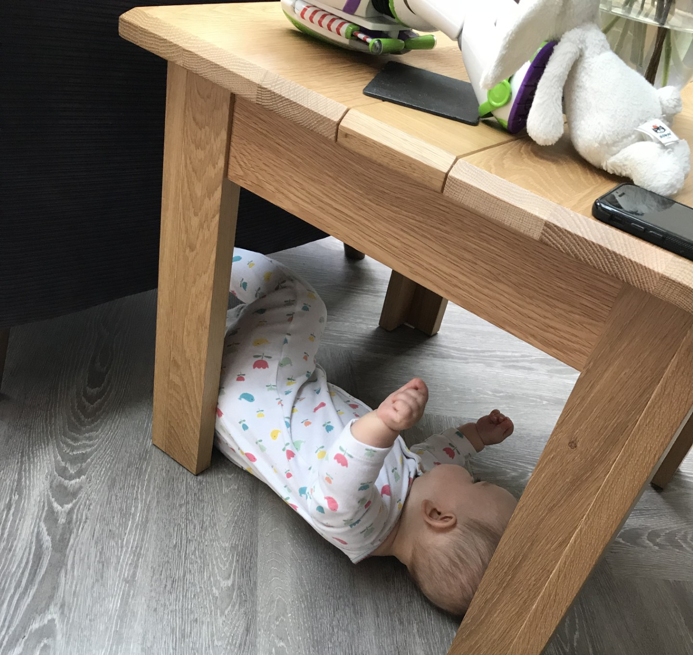
HELP! Things are not going as planned
Single take home message ask for help!

Slide 2



Do not edit
How to change the design
Which of these did not happen to me?
The Slido app must be installed on every computer you’re presenting from

Slide 3
SBA (Single Best Answer)
Which one didn’t happen to me?
Surgeon accidently extubated a patient as they travelled the table
Had to reintubate a patient when extubated someone on ICU against nursing advice
Failed the Primary OSCE
Argued about name of author from a famous article with Examiner, who turned out to be the author himself
Had a difficult intubation and at the end of case noted the huge head weave causing the restricted neck movement
Accidently gave a child a double dose paracetamol
Was greeted by CID one morning after patient incident
Shouted at by surgeon for giving the wrong drug all week but when the surgeon check guideline turns out was correct all along
Burst into tears at ARCP
When asked about their educational experience at consultant interview amongst many other things failed to say I have PG cert in Med Ed.
Call the patient the completely wrong name when try to extubate and after patient asked who is John?

Slide 4
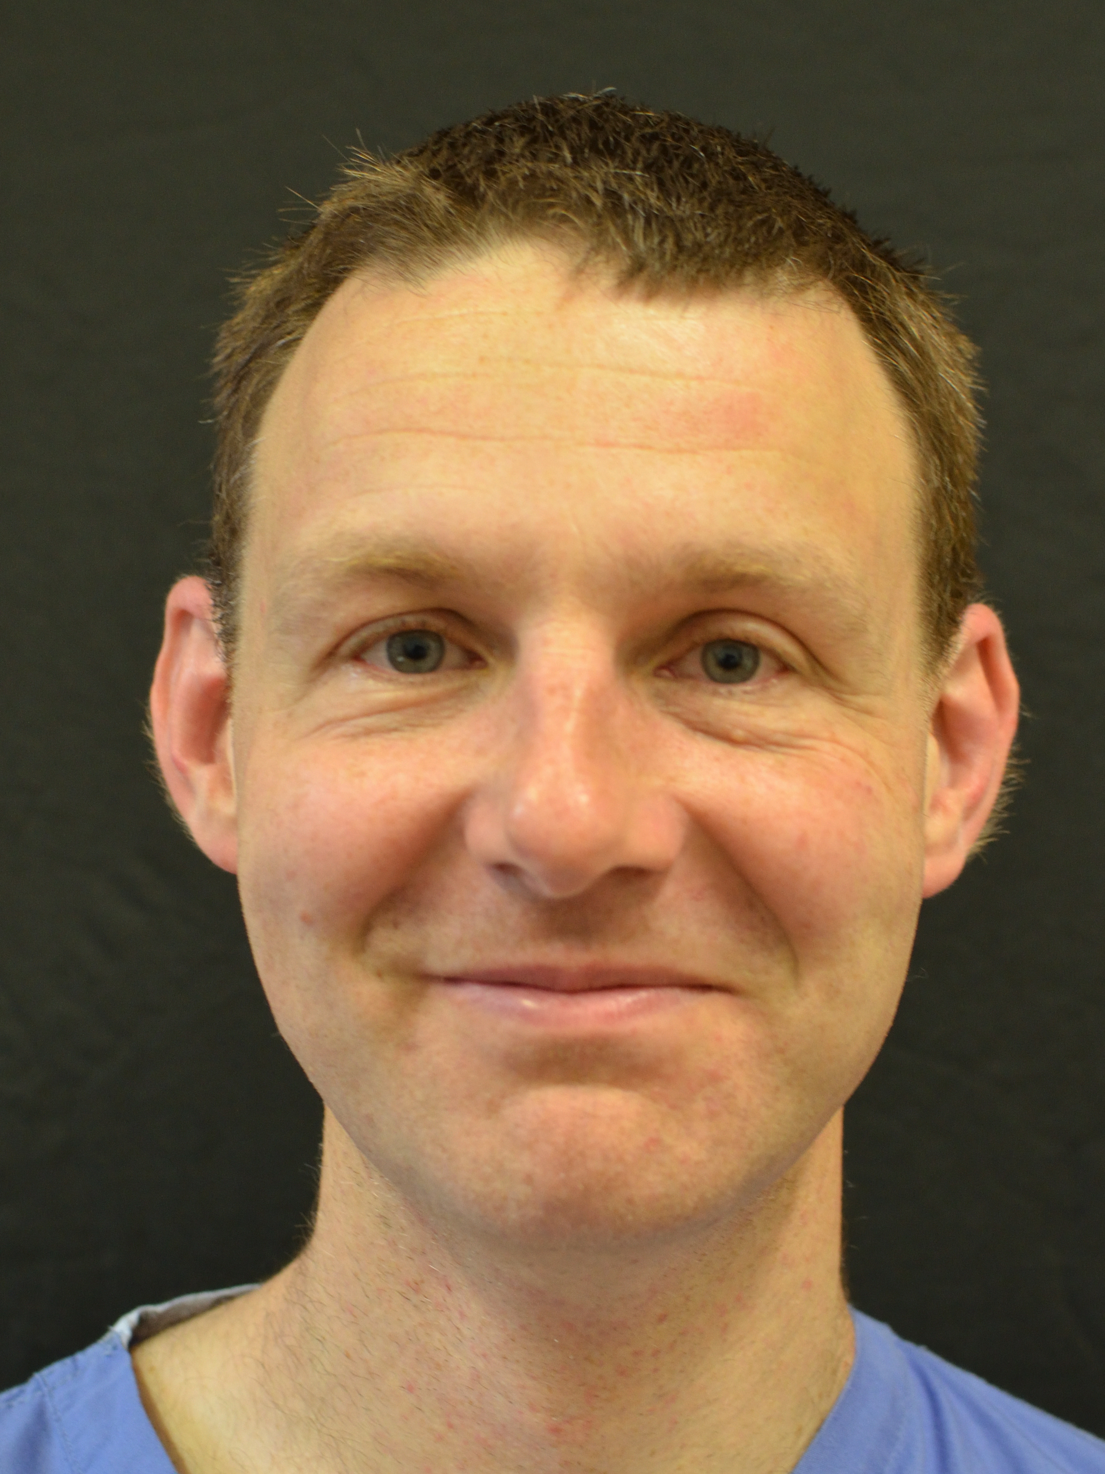
Dr Phil Jackson (with permission)
Previous Head of School

Slide 5
Do not edit
How to change the design
Which of these did not happen to me (2)?
The Slido app must be installed on every computer you’re presenting from

Slide 6
SBA (Single Best Answer)
Which one didn’t happen to me?
Spiral Tib / fib fracture during CT1 missing 2 months of training
Handed a toilet seat by patient during a ward round
Told an ODP if their vulgar language did not stop, they would not be working with them again – hence forth the "mum" look.
Called consultant to come in to do a case because too upset to continue due to finding out about a patient with permanent injury due to complication
Broke a patient's tooth during intubation and called Max-fax to review who pulled out another (lots of explaining to do)
Turn up to work in bright yellow flip flops after sustaining a burn injury
Laughed at supervising consultant when they threw notes at my feet because they were not filed properly then stood stamping feet in rage.
Missed a fracture on X-ray during EM placement
Had to wade through the sewage to get to labour ward rooms
Got blown off bike, breaking arm in the process
Had to take surgeon to ED as once completed surgery informed team, he thought he had an MI an hour ago

Slide 7
Dr Phil Jackson (with permission)
Previous Head of School

Slide 8
Who can help you?

Slide 9

Do not edit
How to change the design
Who can help you?
The Slido app must be installed on every computer you’re presenting from

Slide 10
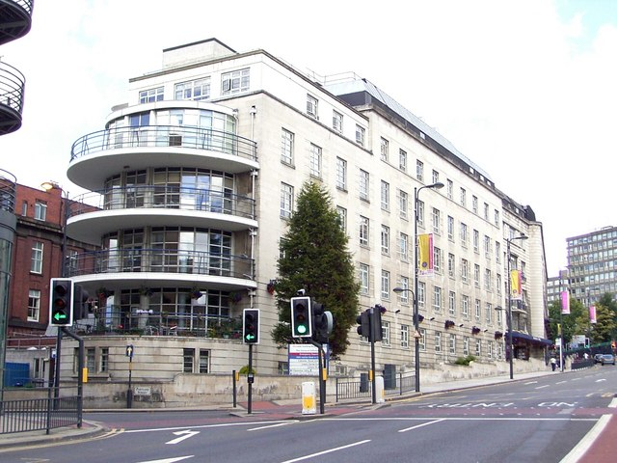
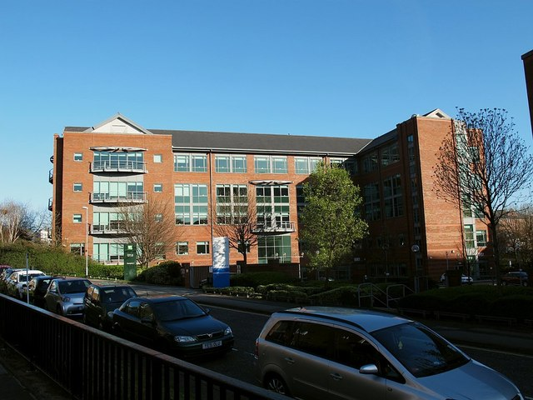
Who can help?
With in the hospital
Clinical supervisor
Educational supervisor
College Tutor
Clinical lead
Rota organiser (if applicable)
HR
Director of Medical education
School of anaesthesia
Training Programme Director
Deputy head of School – Dr Colhoun
Head of School – Dr Raj Sandhu
Programme Support
This Photo by Unknown Author is licensed under CC BY-SA
This Photo by Unknown Author is licensed under CC BY-SA

Slide 11
Management of Doctors in training
Education, Training & Progression
Support & Professional Development
Clinical Governance, Performance & Employment
Postgraduate Dean
Director of Medical Education
Medical Director
Postgraduate Schools incl. Foundation School
Deputy Directors of Medical Education
Clinical Director
Training Programme Director
Foundation Training Programme Director
College / Specialty Tutor
Accountable Consultant
Educational Supervisor
Multi-professional team, day-to-day supervision
Occupational Health
Clinical Supervisor
Medical Education Manager & team
HR, Medical Staffing/Personnel
Trainee learning
Learning environment
Trainee working

Slide 12
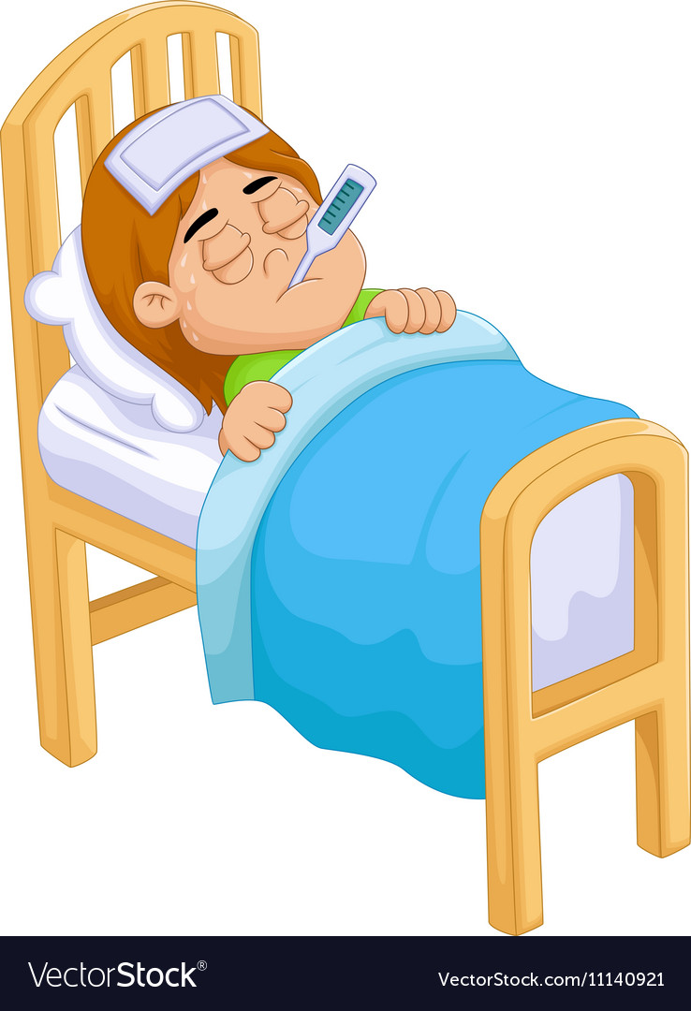
Health
Normal route for all
GP
Occupational Health
ES and CT
TPD
Self-referral for help
Sickness – report to trust via their policy
If off for extended period (>2 weeks) please let TPD know
Declare TOOT (Time Out Of Training) on Form R, at ARCP
This Photo by Unknown Author is licensed under CC BY-NC-ND

Slide 13


What support is there out there – self refer
Coaching
All Yorkshire and Humber trainees have the opportunity to have four-six sessions of free coaching with a senior educator/trainer.
Take Time Client Form 2023-24 (Version 2) (onlinesurveys.ac.uk)
OR
Coaching | Health Education Yorkshire and Humber (yorksandhumberdeanery.nhs.uk)
Workplace well being
Workplace.wellbeing@shsc.nhs.uk

Slide 14
Incidents / Complaints
Seek support from ES / CT
If you require extra support, contact your TPD
Reflect in your portfolio
You might need to talk about it / you might need some training
You might need to write a report please seek help for this ES/ CT
Defence union are good a proof reading these
Declare on your form R at ARCP
Incidents and complaints!

Slide 15
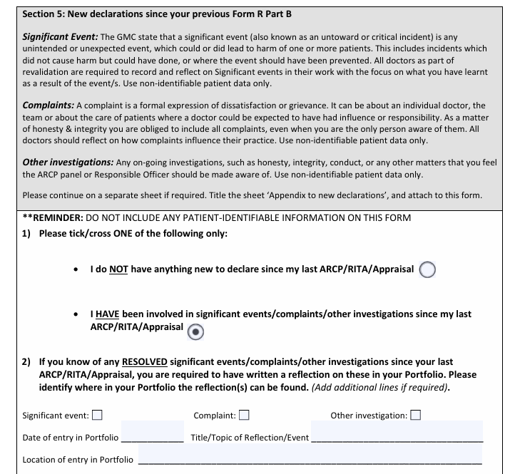
Form R part B

Slide 16


Exams
Make sure you check the YAIRN website teaching and mocks available within deanery
If you have an attempt let TPD know outcome
For first attempt external revision courses are not usually funded due to provision within the deanery
If you have had multiple failures at a written exam TPD may suggest a screening for dyslexia with your consent
Talk about it you will find lots of consultants and trainees didn’t get it first time or second
This Photo by Unknown Author is licensed under CC BY-NC-ND

Slide 17
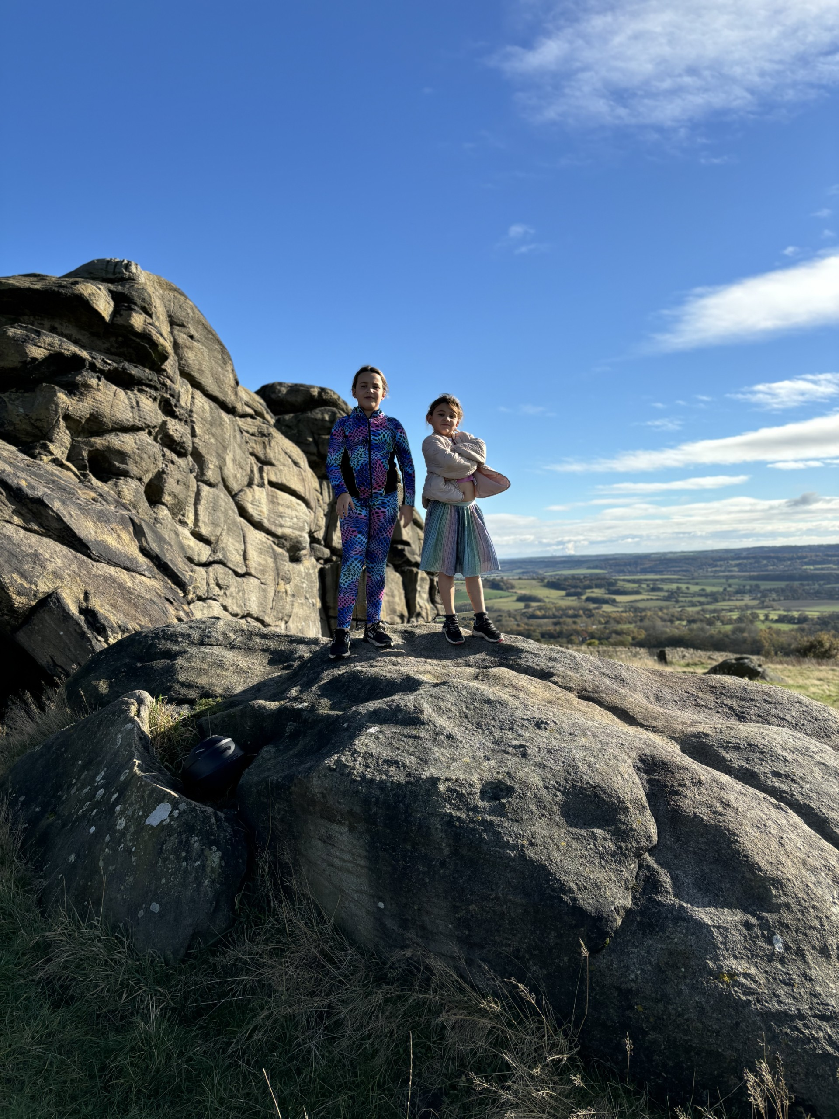
If we don’t know about it, we can't help you!

