Slide 1
ICU Research Opportunities
Dr Brendan Sloan
ICU Research Champion Mid Yorkshire Hospitals
NIHR Critical Care Lead for Yorkshire and the Humber

Slide 2
Types of research
Portfolio vs local
Commercial vs non-commercial
Single centre vs multicentre
Observational vs interventional
Novel trial designs – platform studies
Personal/personal legal representative/professional legal rep
Prospective vs deferred consent

Slide 3
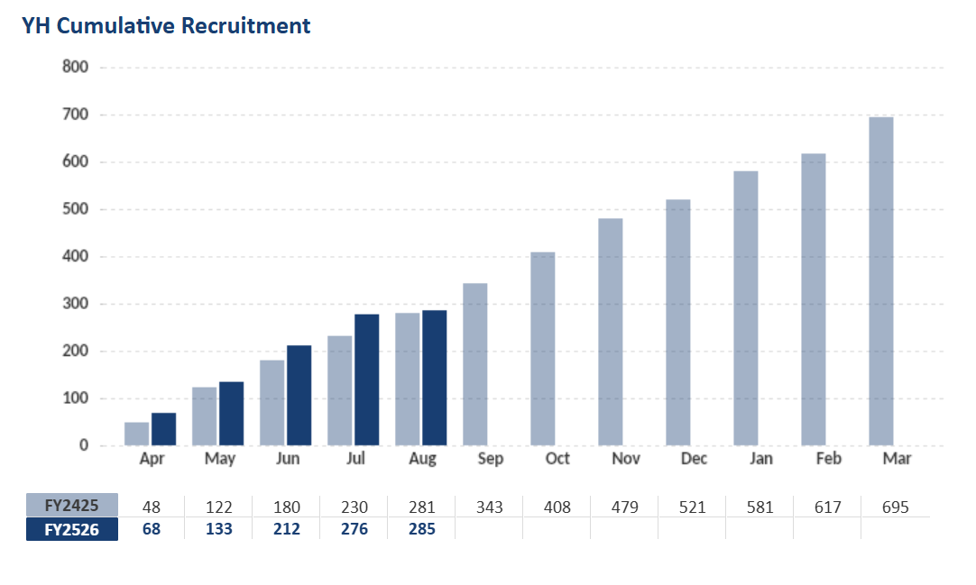
Research activity in Yorkshire and the Humber

Slide 4
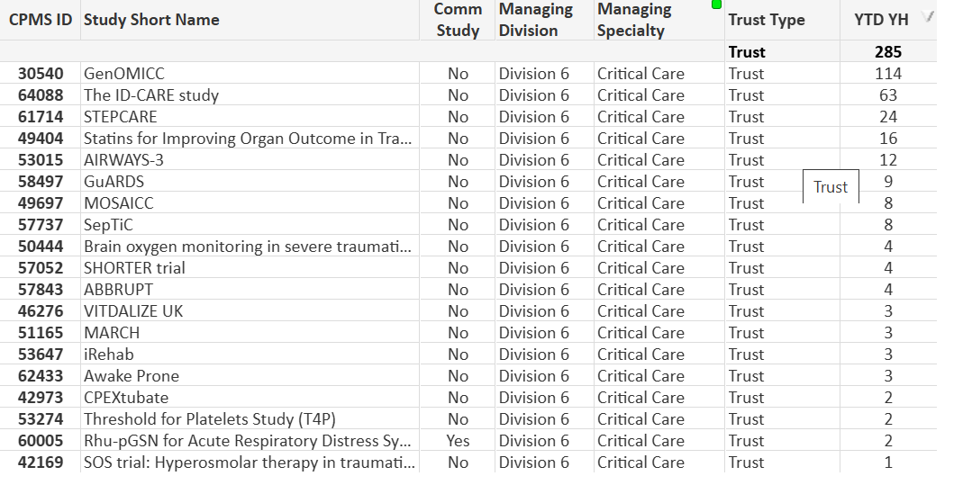
Research activity in Yorkshire and the Humber

Slide 5
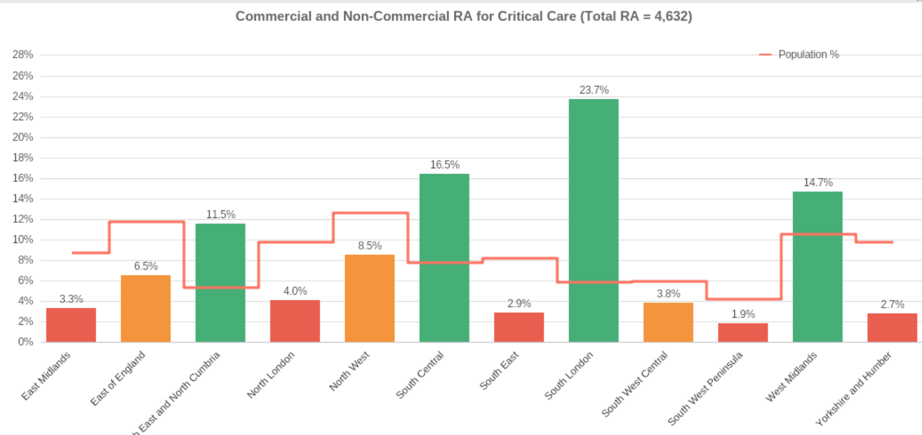
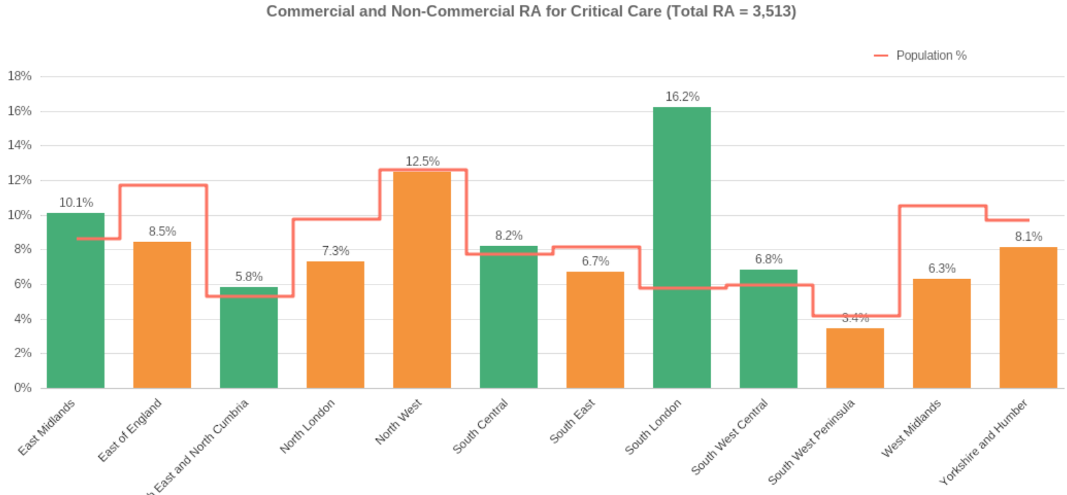
2015-16
Progress
2025-26

Slide 6
Examples of trials

Slide 7
GenOMICC
Observational study looking at the genetics of critical illness
Infectious disease, pancreatitis, burns
Single blood test and notes reviewed
Most units in region are open to recruitment

Slide 8
MOSAICC
Sodium bicarbonate for metabolic acidosis and renal failure
Investigating if bicarbonate use can reduce the need for renal replacement therapy
Deferred consent model
Open in Calderdale, Hull, Leeds, Mid Yorks, Sheffield, Rotherham and York

Slide 9
ABBRUPT
Amiodarone vs beta blockers for new AF
Using well-established treatments, but in an attempt to determine if one is superior
Emergency recruitment and subsequent consent
Running in Hull, Leeds, Mid Yorks and York

Slide 10
CORRECT – AWAKE-PRONE and UK-NAVA
Collaboration of respiratory trials
AWAKE-PRONE looks at the use of proning to reduce the need for intubation – Leeds, Mid Yorks, Rotherham, York
UK-NAVA looks at a novel ventilation mode to try and reduce ventilator time
Both heavily linked into physiotherapy colleagues

Slide 11
Upcoming studies
VIP-3 – family meetings for elderly patients
SPICE – dexmedetomidine for sedation
DALI-2 – antibiotic titres in critically ill patients
IMPACT – iron transfusion post-ICU discharge

Slide 12
How to get involved?
Co-investigator
  Signed on delegation legs, undertaking trial activity
Associate PI
  6 month program to understand more of the process of setting up/running trials
Principal Investigator
  Local lead for a study – difficult to achieve as a trainee

Slide 13
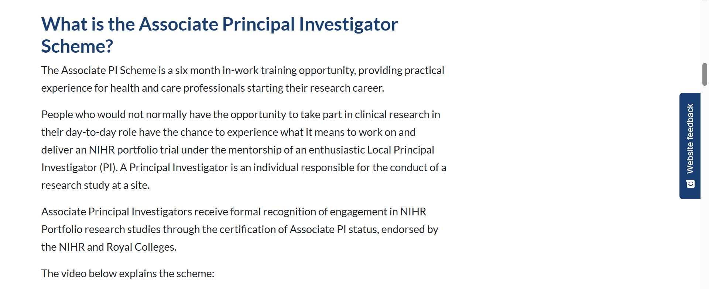
Associate PI program

Slide 14
Contacts
Airedale – Julian Hood
Barnsley – Rohan Farrimond
Bradford – Tom Lawton
Calderdale/Huddersfield – Aaron Corp
Doncaster – Ahijit Chowdhury
Grimsby/Scunthorpe – Jerry Thomas
Hull – Pete Campbell
Leeds – Andy Ratcliffe
Mid Yorkshire – Brendan Sloan
Rotherham – Anil Hormis
Sheffield – Max Richardson
York/Scarborough – Joe Carter

