Slide 1

Welcome to Intensive Care Training in Yorkshire
James Morgan
TPD West & East
4/9/25

Slide 2
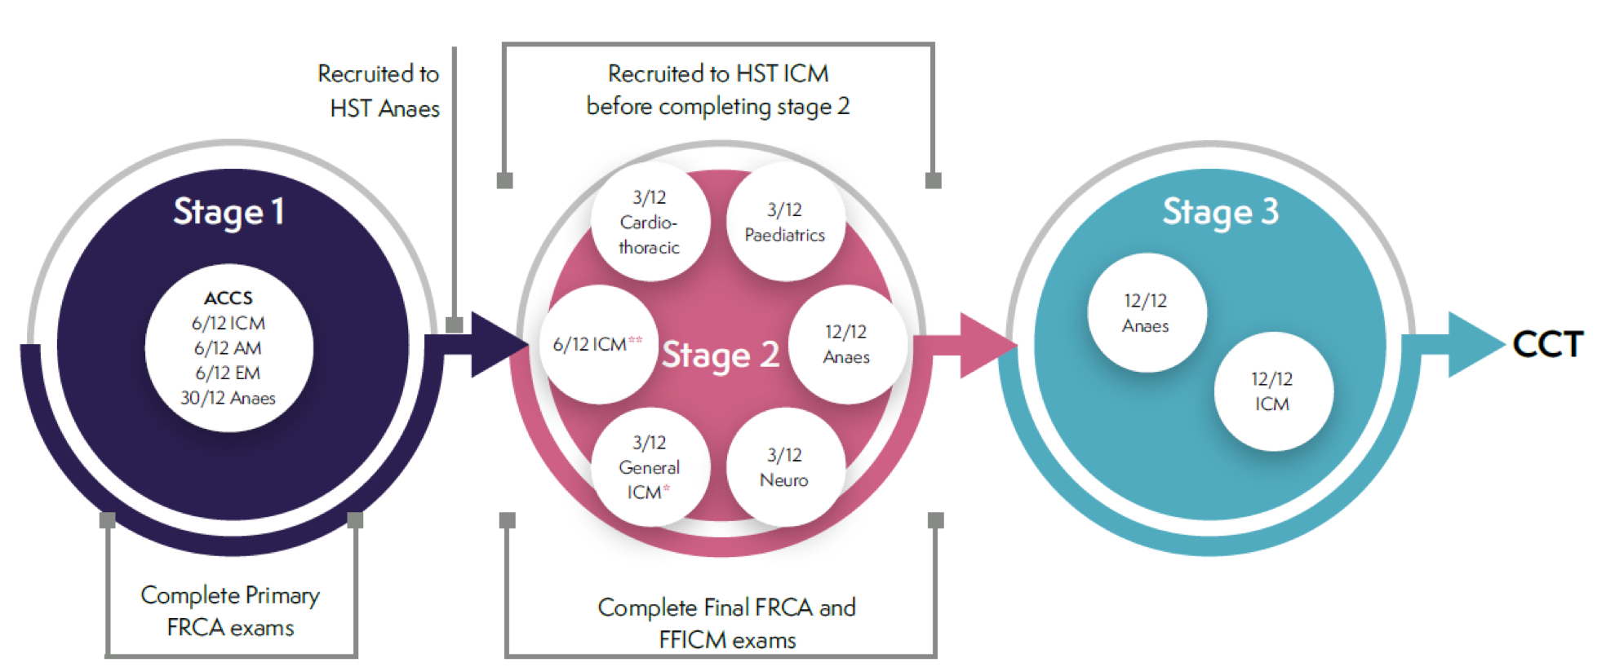
ICM - 7 years - 4/2/1
Spe
Special
Skills
12/12

Slide 3
ICM dual - 8 years - 4/2/2 (or 1.5)
Partner
Partner
SSY
specialty
specialty
12/12
12/12

Slide 4
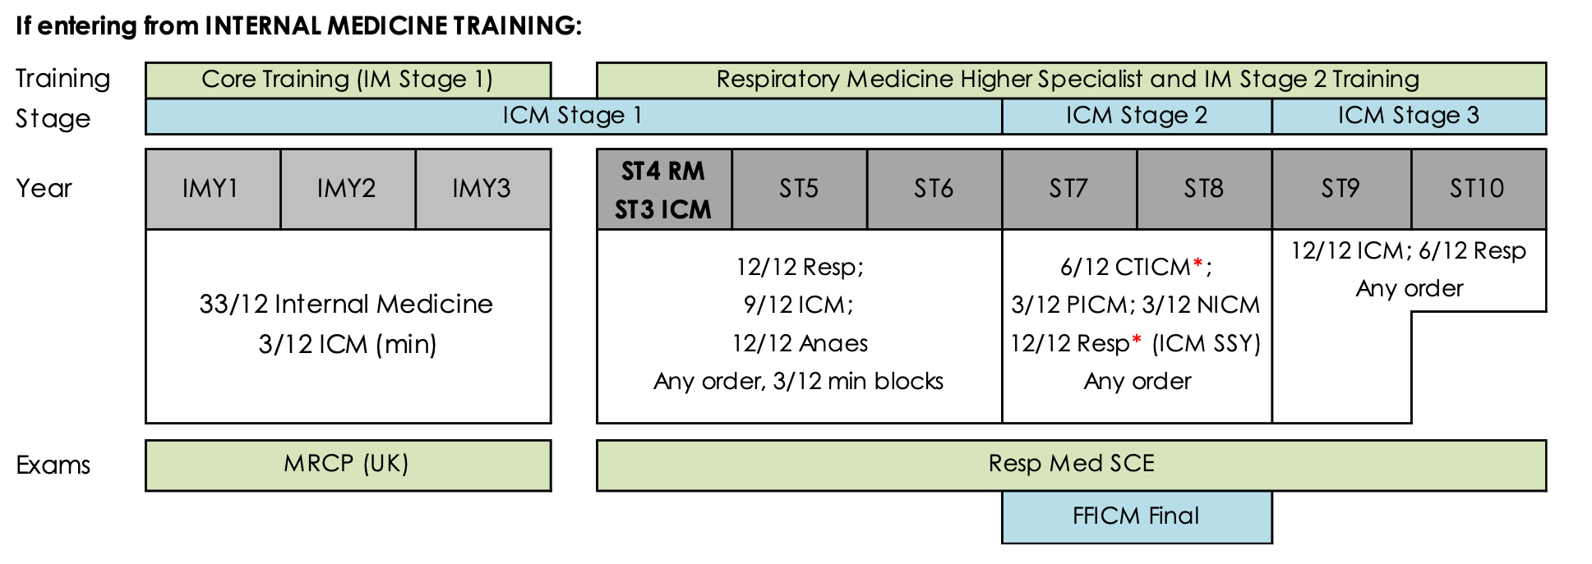
ICM/Respiratory/GIM – 6*/2/1.5 from IMT

Slide 5
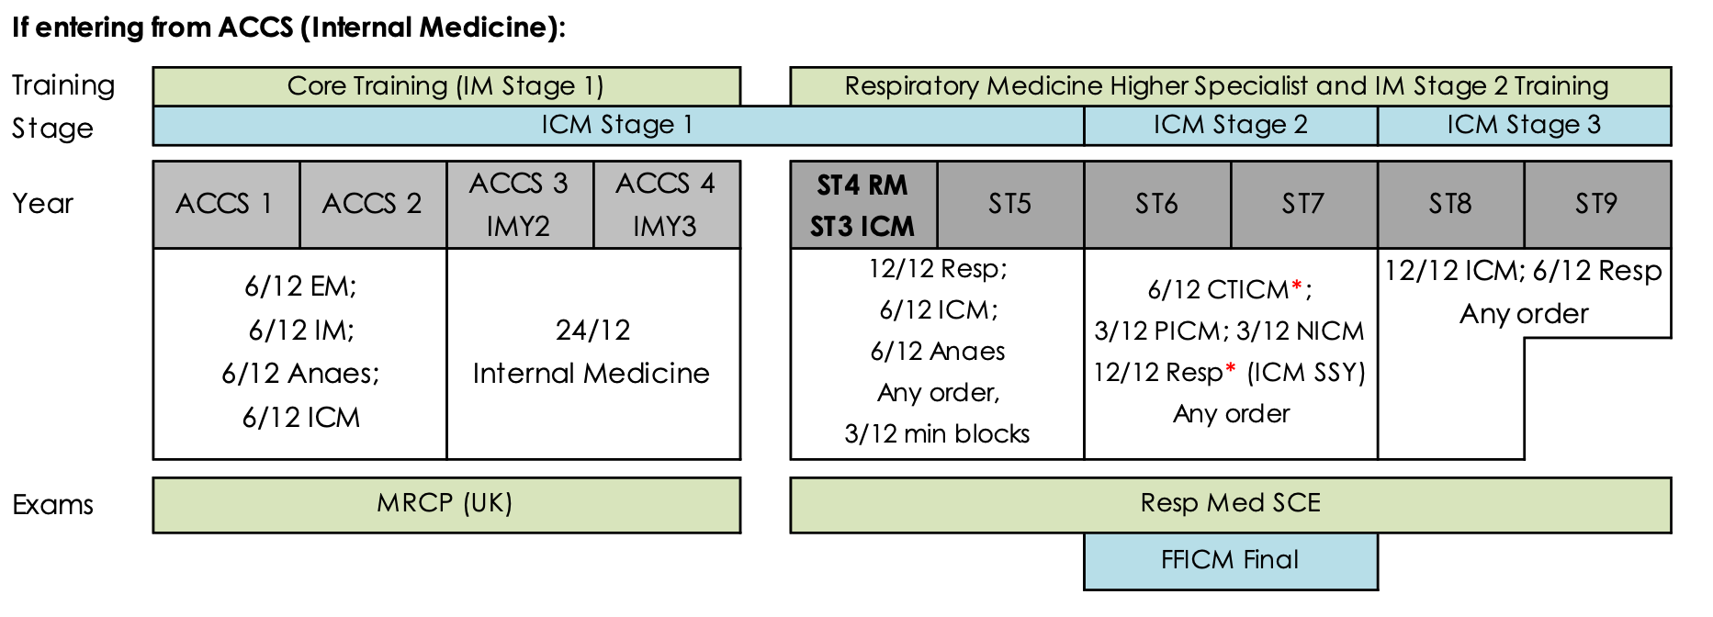
ICM/Respiratory/GIM from ACCS
6/2/1.5

Slide 6
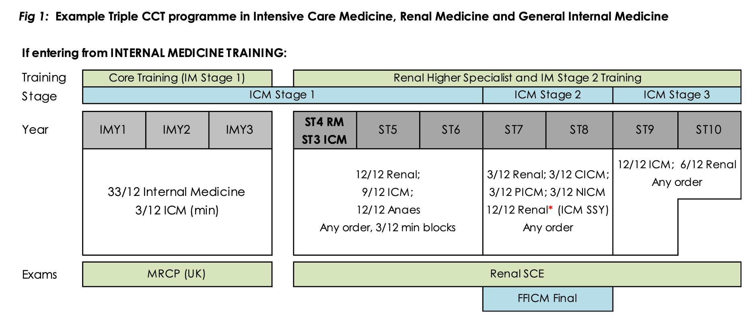
ICM/Renal/GIM - 6/2*/1.5 from IMT
(15 months renal in stage 2)

Slide 7
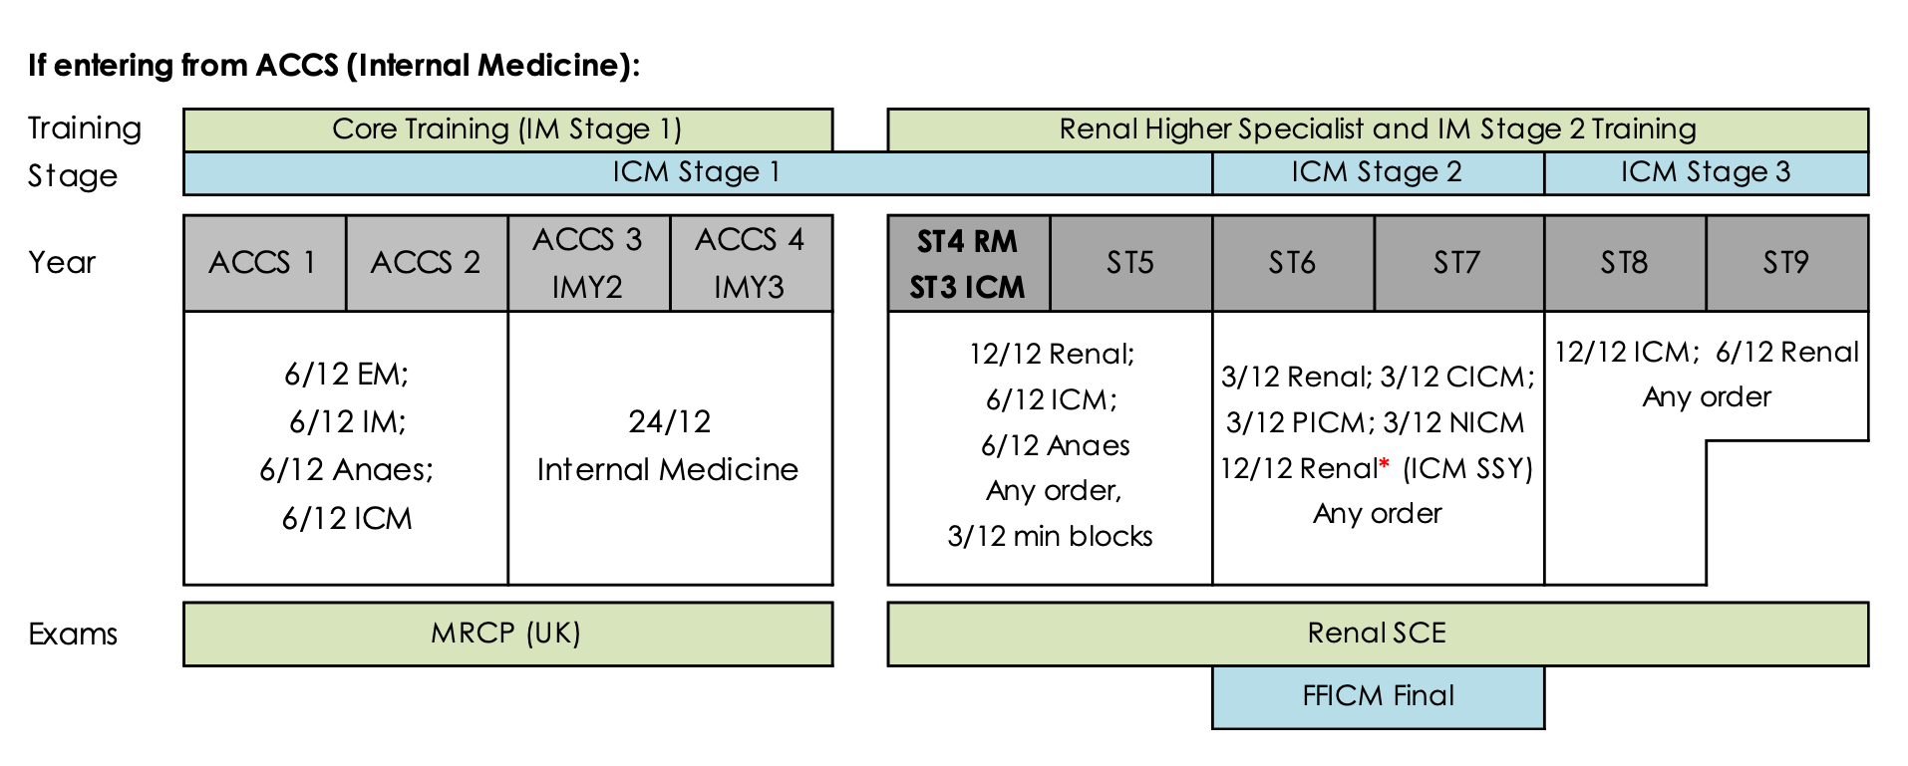
ICM/Renal/GIM from ACCS - 6/2/1.5
(15 months renal in stage 2)

Slide 8
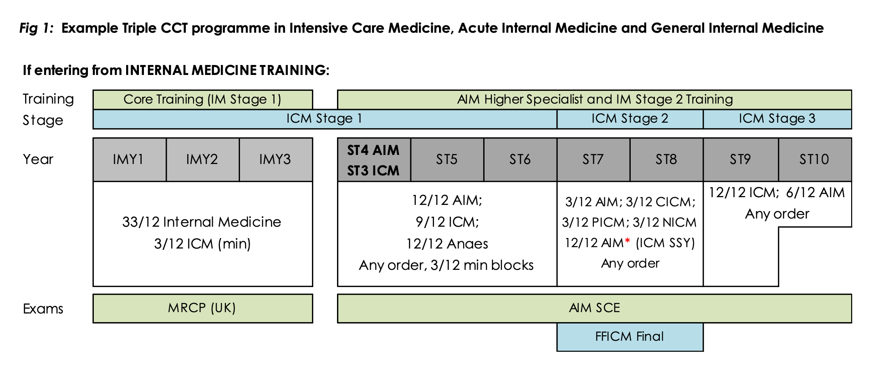
ICM/AIM/GIM from IMT - 6/2/1.5
(15 months AIM in stage 2)

Slide 9
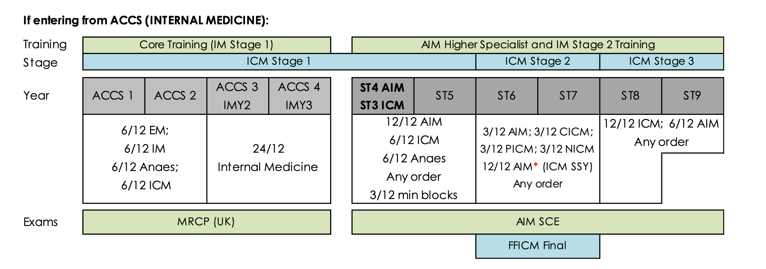
ICM/AIM/GIM from ACCS - 6/2/1.5
(15 months AIM in stage 2)

Slide 10
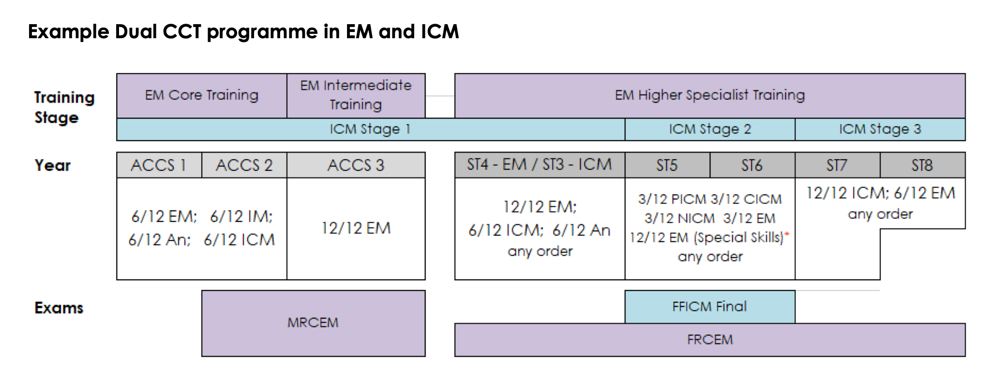
ICM/EM - 5/2/1.5 from ACCS
(15 months EM in stage 2)

Slide 11
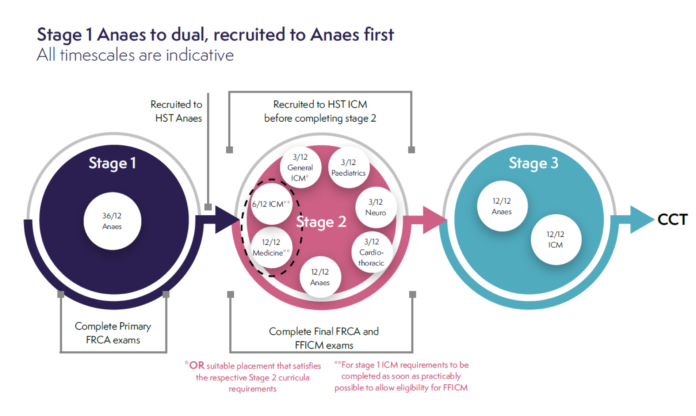
ICM/Anaesthesia -4.5/2/2

Slide 12
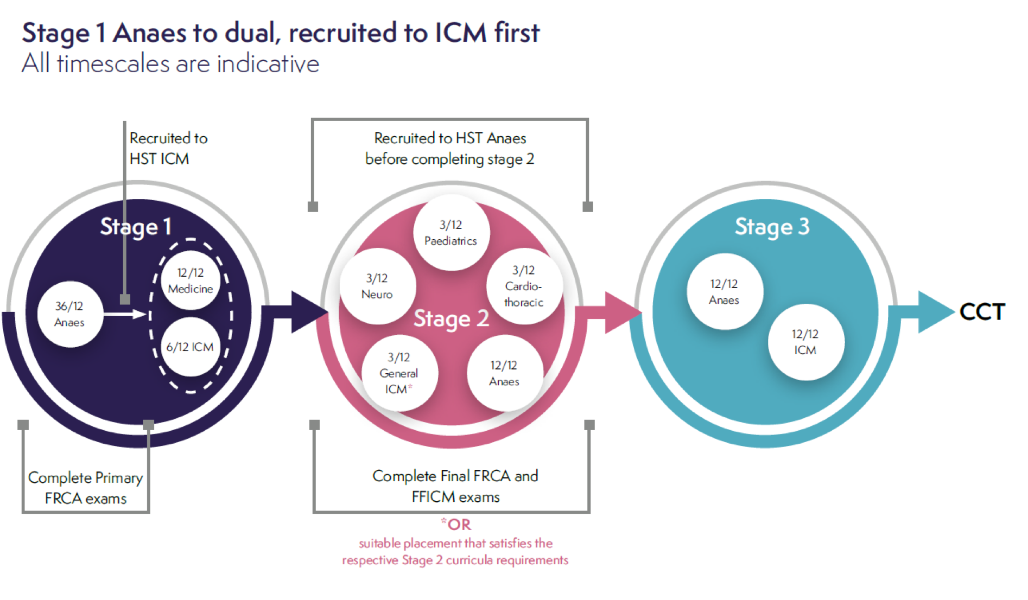
ICM/Anaesthesia – 4.5/2/2

Slide 13
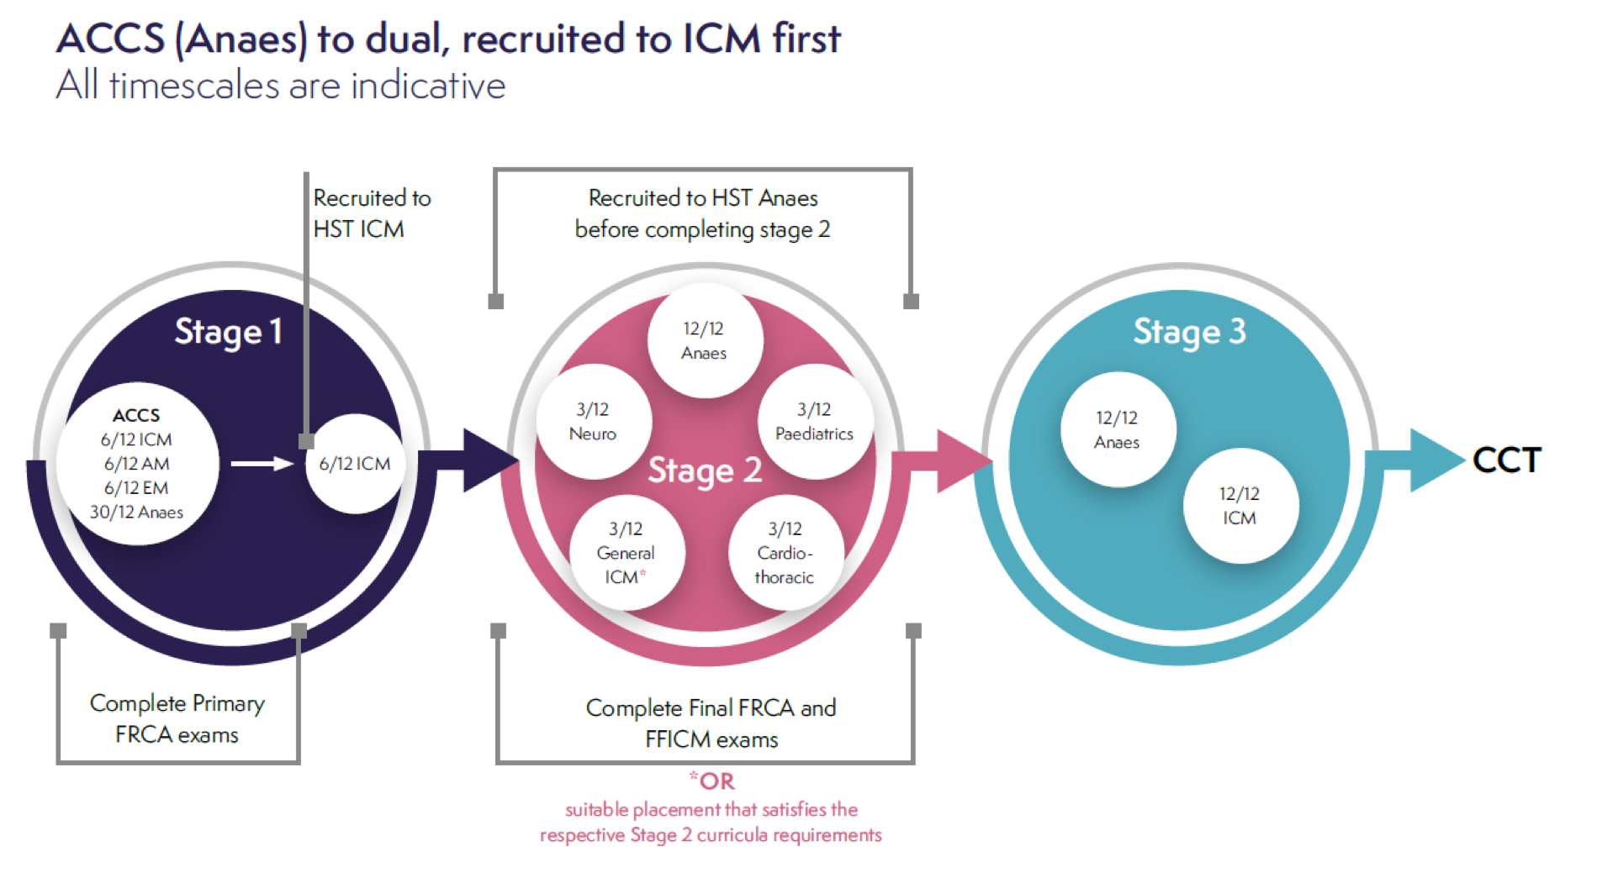
ICM/Anaesthesia – 4.5/2/2

Slide 14
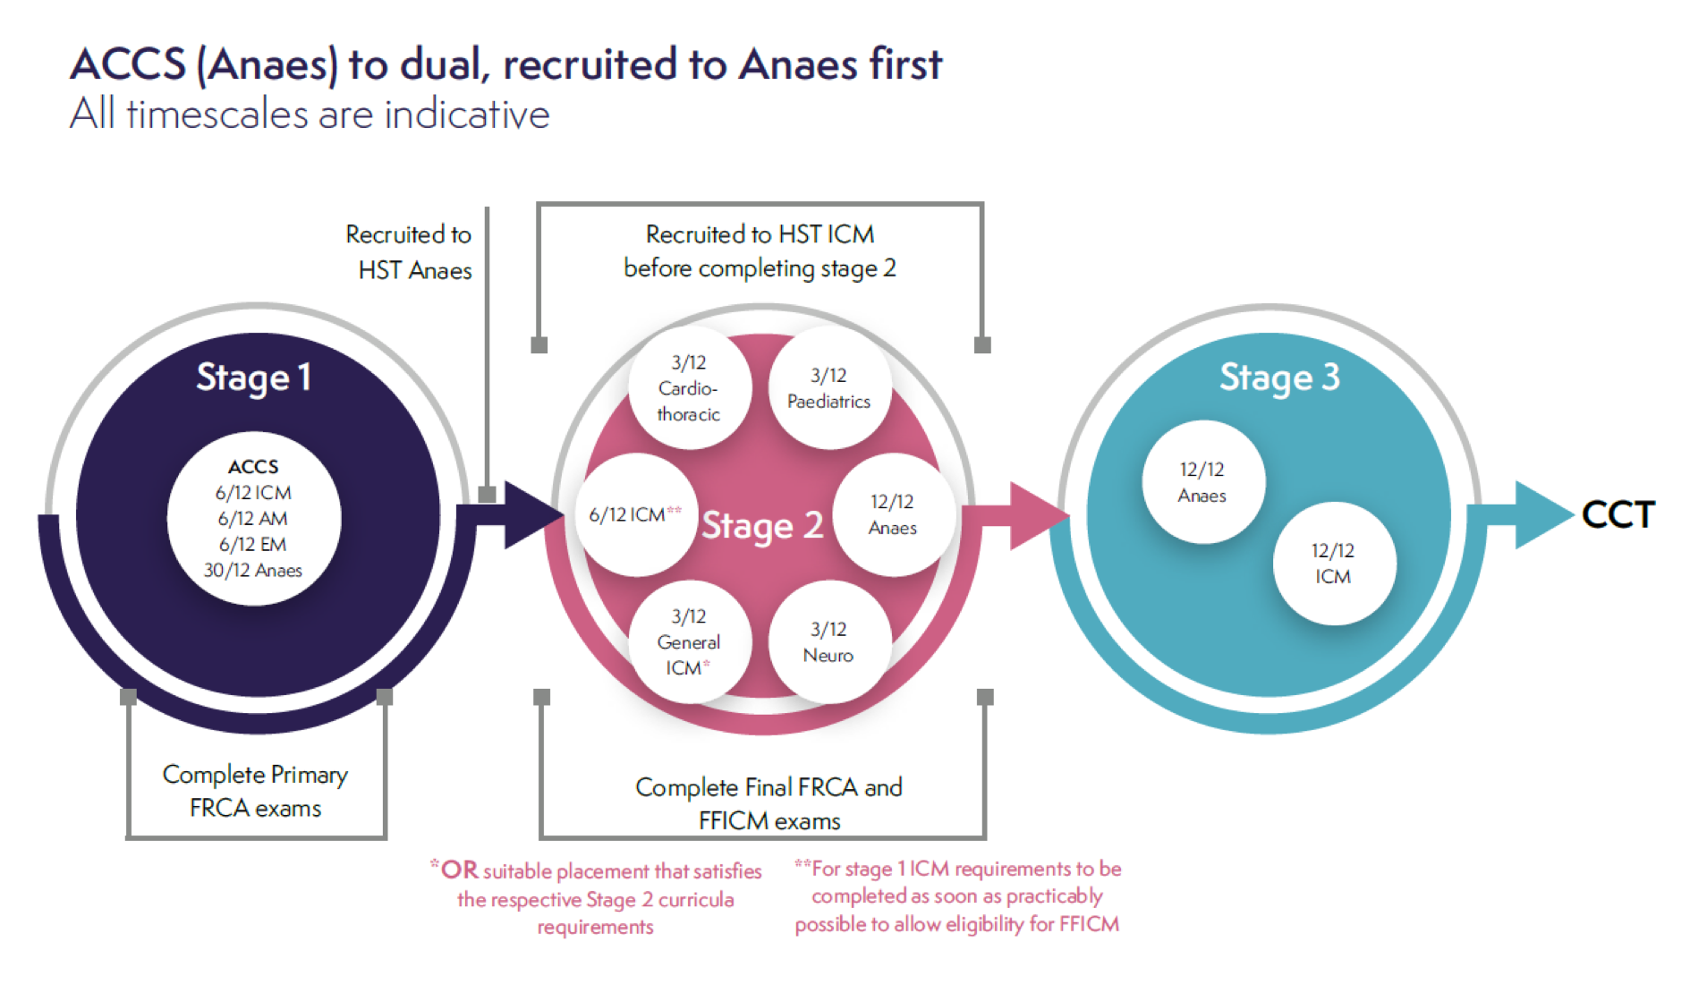
ICM/Anaesthesia – 4.5/2/2

Slide 15
Local Factors
West - PICU at Leeds General Infirmary
South - PICU at Sheffield Children’s Hospital
East - PICU at LGI or SCH (Hull has all other specialties)
Paeds / PICU for dual anaesthetists is 6 weeks paediatric anaesthesia and 6 weeks PICU
PICU for non-anaesthetists is 3/12 PICU
LTFT status needs proactive management for PICU/paeds

Slide 16
Sources of support
  Local Educational Supervisor
  Program Educational Supervisor (many did this scheme)
  FICM Faculty Tutor
  FICM Regional Advisor
  Training Program Directors – ICM (+- partner specialty)
  Head(s) of School
  Timing of seeking help

Slide 17

Thank you
      Questions? (Q&A later)
      james.morgan@bthft.nhs.uk

