Slide 1
Regional Teaching, Courses and Exams
Dr Selin Kabadayi
September 2025

Slide 2
Overview
YAIRN
Pan Deanery Regional Teaching
FUSIC Training
FFICM Exam and Courses
Regional Conferences
Resources
Courses
Other opportunities

Slide 3
YAIRN
Yorkshire and Humber Anaesthetics and ICM Regional Network
A single point of access for Educational Events, Courses and Teaching within the region
Access to a School Courses Calender
Access to Regional Teaching programmes
Information about available courses within the region
http://YAIRN.co.uk

Slide 4
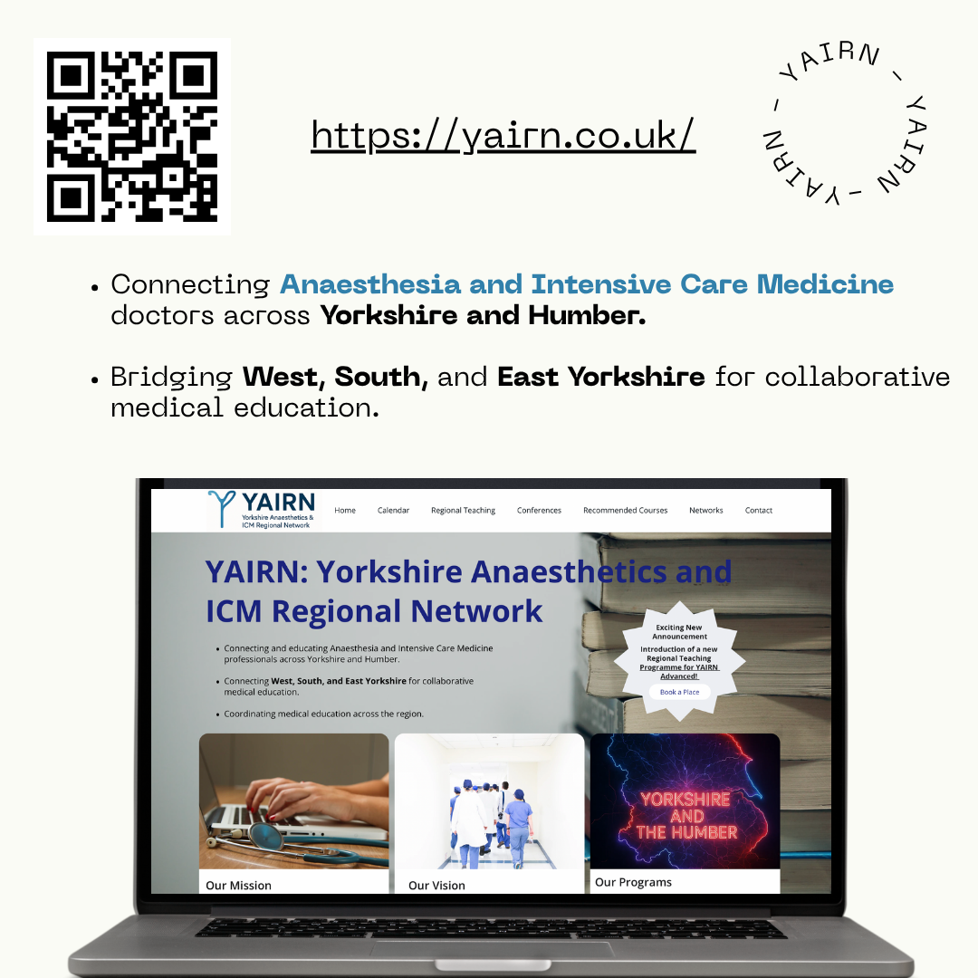
YAIRN

Slide 5
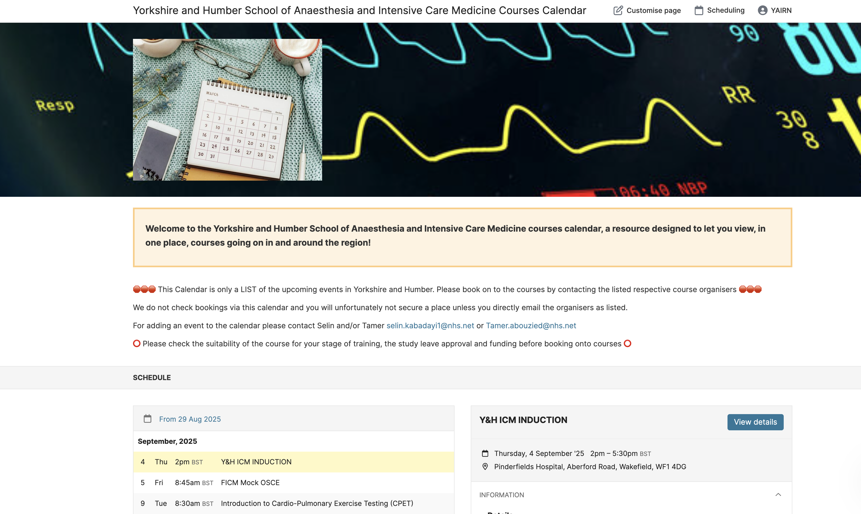
School Calender

Slide 6
Pan-deanery ICM teaching
Full day alternate months
Spread across hospitals within Y&H
Sheffield/Leeds/Hull/Bradford/Doncaster/York/Pinderfields/Barnsley/Harrogate)
2 year program to cover FICM curriculum
Stage 3 trainees will be involved in coordinating/running day

Slide 7
Pan-deanery teaching
Dates for your diaries:
September 19th 2025: Sheffield Northern: Haematology/Oncology/Endocrinology
Nov 20th 2025: SJUH: Liver & Gastro
Jan 16th 2026: Bradford: Transfer & Leadership Management
March 13th 2026: Barnsley PGME: Respiratory
https://yairn.co.uk/#regionalteaching

Slide 8



FUSIC training
Point of care ultrasound and echocardiography increasingly recognised as useful for ICM
Recommended that all trainees gain some formal training in POCUS
FUSIC is run by the ICS – specifically designed for critical care patients
Different modules – heart, lung, abdomen, vascular, DVT

Slide 9
FUSIC Heart/FICE
3 FUSIC accredited courses in Yorkshire
Leeds FUSIC Course – one course annually (next Nov 17th and 18th) in Leeds).
Barnsley – FUSIC SY: Nov 3-4th 2025 in Barnsley (FAMUS as well)
LACE: Leeds Advanced Critical Care Course – usually July
FUSIC-SY.co.uk
Mentors: email learning@ics.ac.uk if you are unable to locate your local FUCIS mentor
https://www.yorksandhumberdeanery.nhs.uk/anaesthesia/intensive_care_medicine/yorkshire_fice_training

Slide 10
FUSIC Heart
Register with ICS for each individual module
FUSIC course or online e-learning
Accreditation (first to last component) must be completed within 24 months
Logbook collection (first to last scan) must be completed within 12 months
Attend 1-2 day course (multiple across UK, content essentially identical) – online/f2f
Completed Summary Training Record document
10 directly supervised scans
40 logbook scans
Triggered assessment with FICE supervisor
Submit paperwork to ICS

Slide 11
FICE mentors
Barnsley | Dr Chau, Dr Lobaz, Dr Rohan Farrimond
Bradford | Dr Lawton, Dr Jundi, Dr Lawton
Harrogate | Dr Earl
Hull | Dr Rigg
Leeds Rotherham | Dr Beck, Dr Breen, Dr Powell, Dr Sira, Dr Young, Dr Sen Dr Shuker
Scarborough | Dr Sladkowski
Sheffield | Dr Bauchmuller, Dr Marko, Dr Parnell, Dr Rosser, Dr Cruickshanks
Wakefield | Dr Sandhu, Dr Sloan, Dr. Kabadayi, Dr Neep, Dr Bayliss, Dr Fadden, Dr Peeling
York | Dr Redman, Dr Chamberlain, Dr Prince, Dr Ferguson

Slide 12
When to do FUSIC
No specification as to when it is required in training program
Clear rules on timing of FFICM and base specialty exams
50 logbook scans is a significant undertaking
Consider upcoming placements, mentors, and external factors
Would recommend you don’t try to achieve this near exam time

Slide 13
Other ultrasound training
BSE Critical Care Echo
Other FUSIC modules
2 year program
More advanced than FICE, aimed more at cardiac centres, or for echocardiography leads
POCUS for lung, vascular, DVT and abdominal scans
FAME: Focused Acute Medicine Ultrasouind
Often very useful on ICU
Problems locally with finding mentors and supervisors
Not yet a FICM requirement (nor imminently likely)

Slide 14
FFICM exam
Integral part of ICM CCT Curriculum
No limit for the FFICM from the date of primary exam (previously was 10 year)
MCQ eligibility has moved into Stage 1
Be aware the standard level and content of the exam itself has not changed, and remains at being at the level of end of Stage 2 training
Full exam MUST be completed before starting Stage 3
MCQ paper ( 2 x per year - June or Jul/Jan), followed by OSCE/SOE (2 x per year - Oct/March or April )
Resources for candidates:
https://www.ficm.ac.uk/trainingexamsexaminations/resources-for-candidates

Slide 15
Practically
Stage 1 training covers ST3-4
If dual training with Anaesthetics, you need to get the FRCA to progress to ST5/Stage 2 ICM
If dual training with Medicine/EM, you will already have the MRCP/MRCEM
Advisable to try for first attempt at MCQ early in Stage 2 to maximise time/attempts, however discuss with your programme ES.

Slide 16
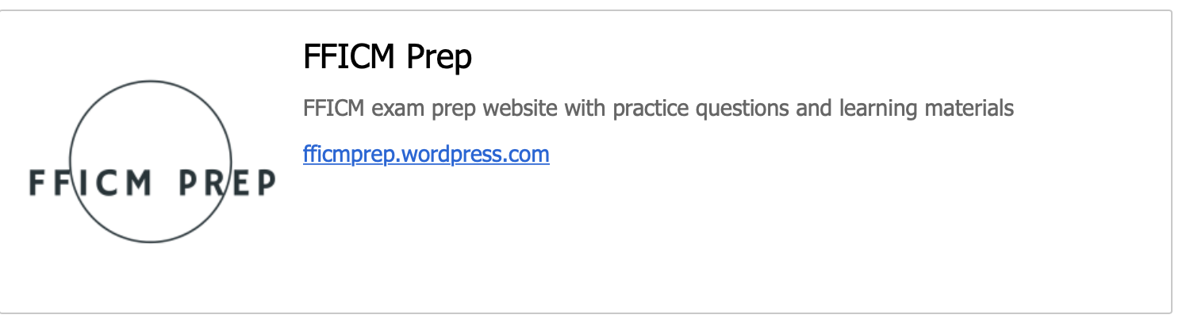
Exam courses
FFICM MCQ held January/July
FFICM SOE/OSCE held April/October
Written:
FFICM Prep SBA Question BANK
Mersey FICM SBA course
FFICM SOE/OSCE prep course
Details via the FICM website.
National courses
FFICM Prep Course
Alternates London/Leeds
Coventry, Stoke OSCE/SOE course
Local courses:
FIVA FFICM
OSCE course run in Sheffield

Slide 17
ICU Conferences
YICC: Yorkshire Intensive Care Conference
Great day every May
Yorkshire Wildlife Park
LACTIC
Leeds Acute and Intensive Care Conference
2 days ever Sep/Oct

Slide 18
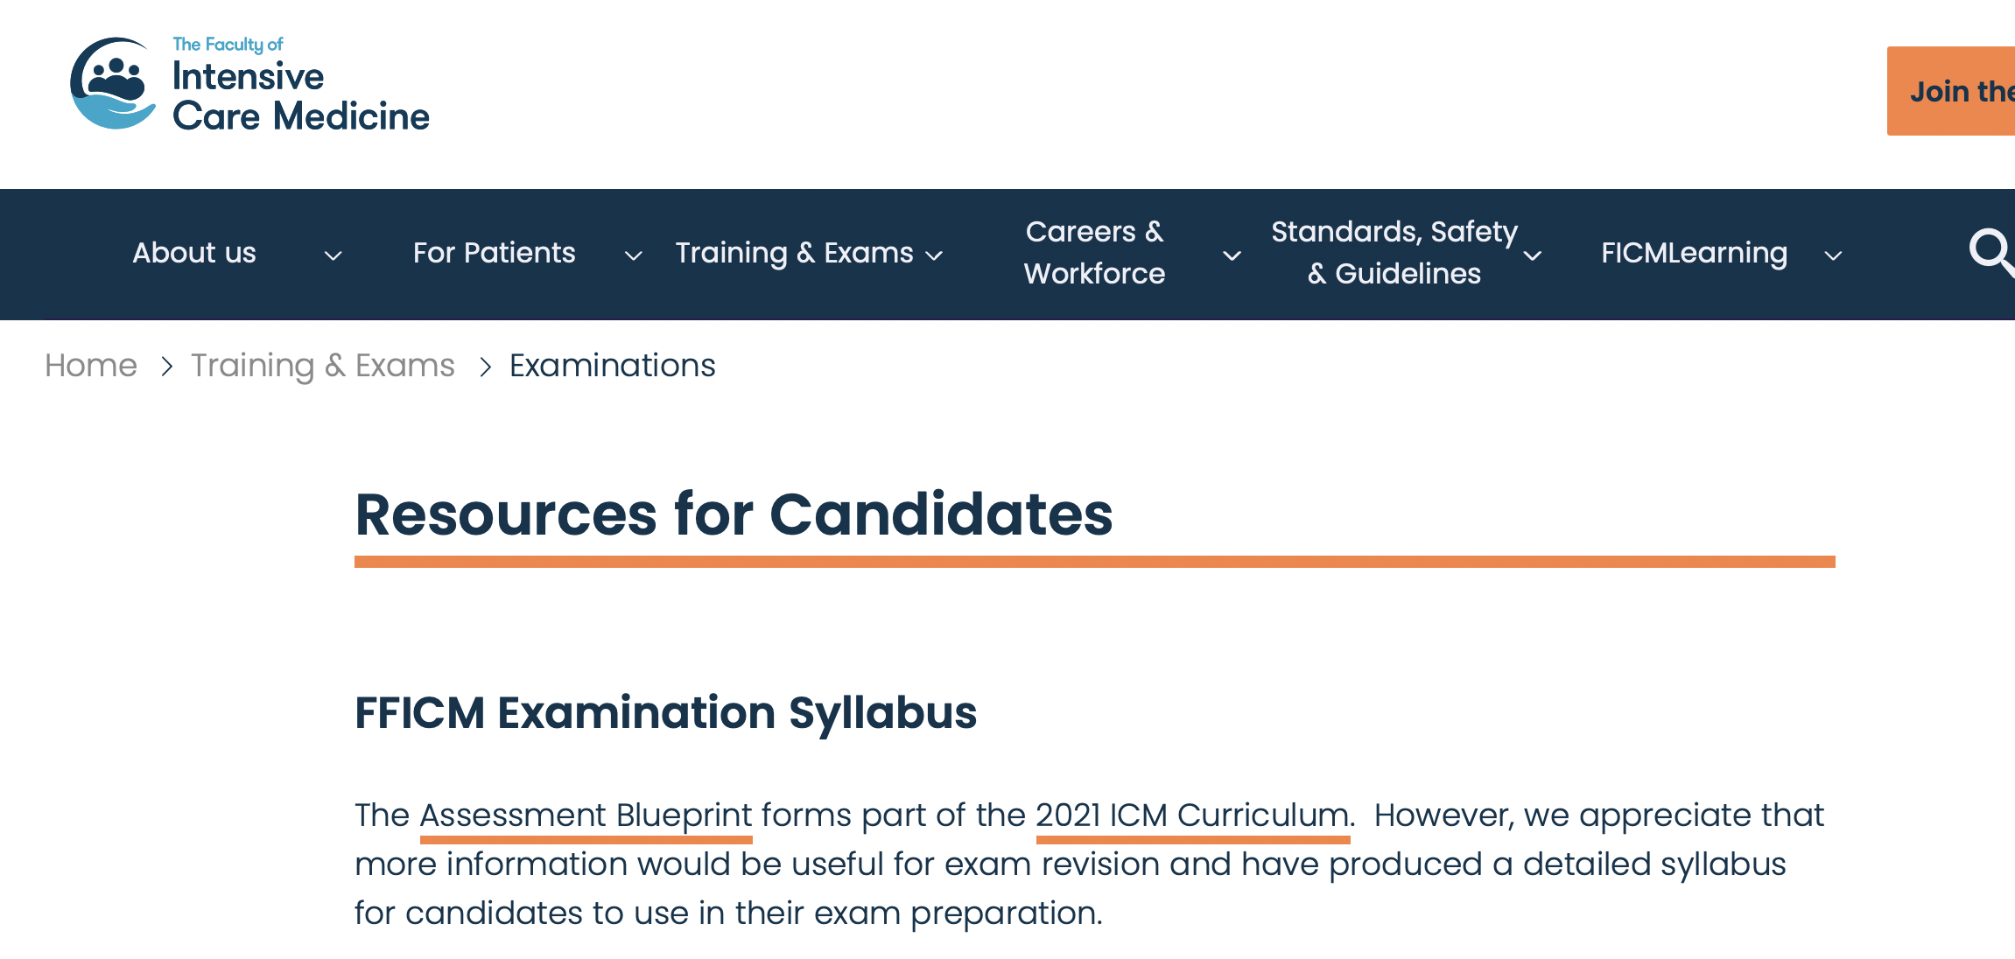
Resources
FICM website – example questions, examiners reports
BJA CPD articles
Guidance/statements from FICM/ICS
Oxford Desk Reference Critical Care
Online resources:
FICMLearning (case of the month, podcasts, webinars, resources for candidates sitting the exam)
https://www.ficm.ac.uk/ficmlearning
e-ICM on eLH
ECG: Life in the fast lane (litfl.com)
Imaging: radiologymasterclass.co.uk, radiopaedia.org
Derangedphysiology.com

Slide 19
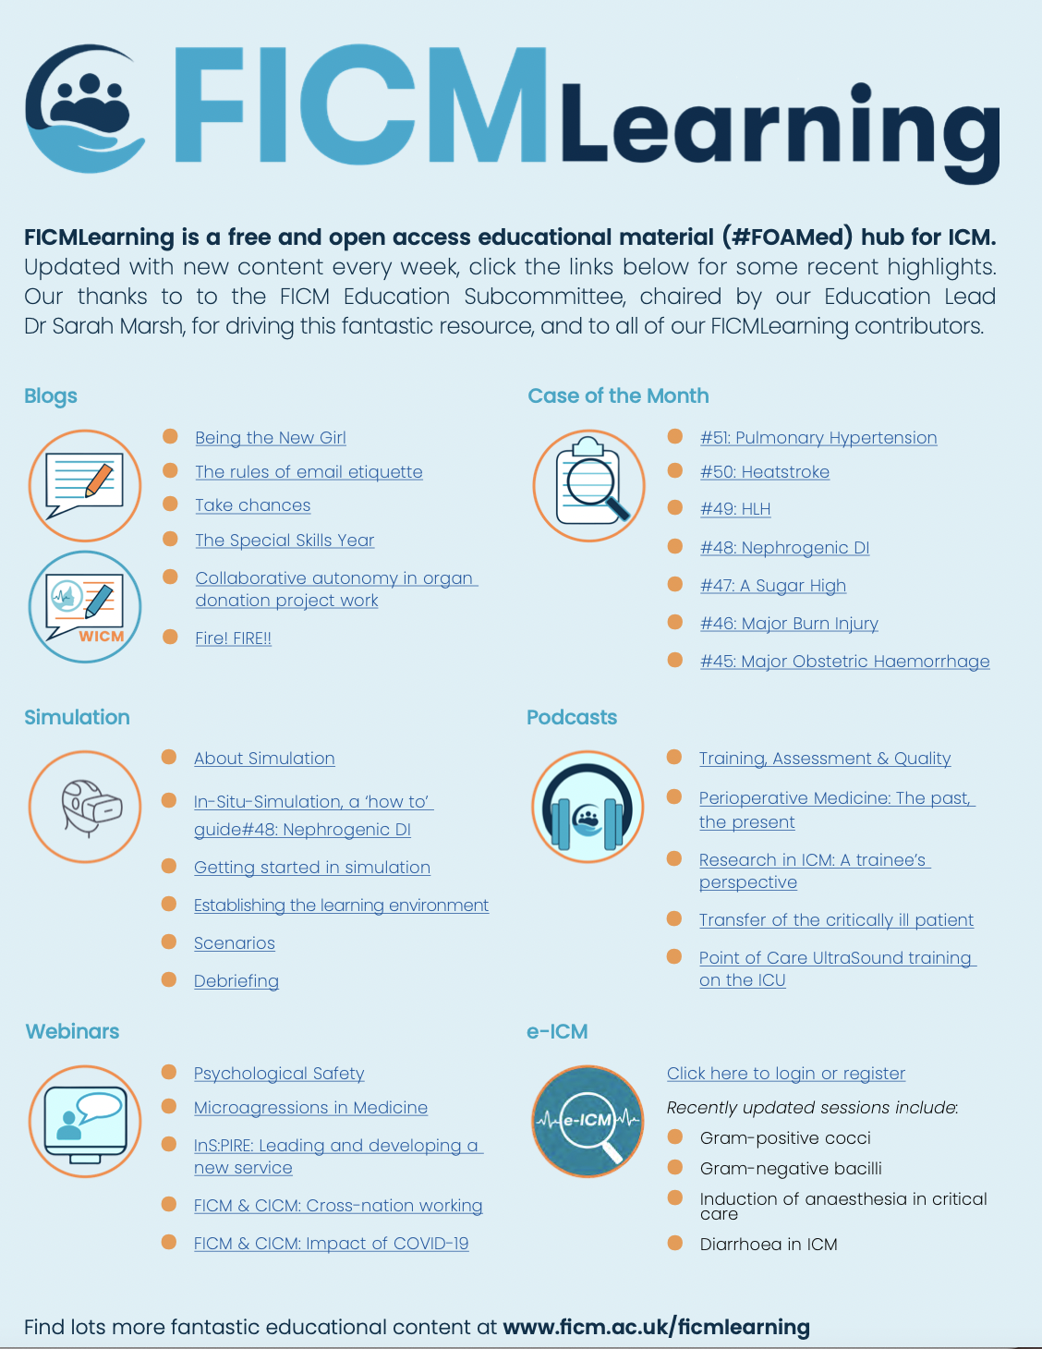

Slide 20
Courses:
Resus council courses
YOR-TRACH April 30th, 2025 (best to complete early in Stage 2 once you have some exposure to perc tracheostomies) . Annually in March
EPIC 2
Difficult Airway Course – September every year
ODT Deceased Donation Course (free for trainees), 2 day course, gets fully booked quickly)
https://www.odt.nhs.uk/deceased-donation/education-and-training/the-national-deceased-donation-course-for-icm-trainees/
ICU conferences – Yorkshire Intensive Care Conference annually, ICS, ESICM, Critical Care Reviews (CCR) in Belfas
Intensivists in Training course at the college usually in Oct
Funding – local courses where available
https://yairn.co.uk/recommended-courses

Slide 21
Other opportunities
Lots of research opportunities around the region
Ensure your GCP is up-to-date
https://www.nihr.ac.uk/health-and-care-professionals/learning-and-support/good-clinical-practice.htm
Critical Care Research Leads
Contribute to local pan-deanery teaching organization
STC rep opportunities
Education opportunities
Just ask!

Slide 22
Any Questions?

