Slide 1
ARCPs
Dr Rashmi Menon
Higher TPD for West Yorkshire
Dr M. Nauman Akhtar
ACCS and Core TPD East Yorkshire

Slide 2
ARCP process
ARCP success
Pitfalls

Slide 3
ARCP PROCESS
What, Why, When, Who

Slide 4
What is ARCP
The annual review of competence progression is a formal summative process that:
Reviews evidence provided by the trainee in their portfolio, and measures their progress, against the the objectives defined in the curriculum.

Slide 5
Why
It enables the trainee, the Postgraduate Dean and employers to document that the competences required are being gained at an appropriate rate and through appropriate experience.
It is also the annual process through which trainees meet medical revalidation requirements across their full scope of practice

Slide 6

When
At least once a year
no more than a maximum interval of 15 months to facilitate revalidation
May be more frequent if
adequate progress is not demonstrated
Critical progression point
Special circumstances-OOP/IDT/ML etc.

Slide 7
Who is in the ARCP panel
TPD
Postgraduate Dean or their representative (HoS)
RA or Deputy RA
Other educators (ES,CT)
Lay representative
Notes:
Purpose of lay representative is to ensure process is completely followed, it is fair consistent and transparent.

Slide 8
ARCP outcomes
Satisfactory Progress:
Outcome 1: Satisfactory progress is being made, and the trainee is developing competencies at the expected rate.
Outcome 6: The trainee has gained all the required competencies and is recommended for completion of the training program (and potentially for a certificate of completion of training (CCT) if applicable).
Developmental Outcomes:
Outcome 2: Development of specific competencies is needed, but no additional training time is required.
Outcome 3: Development of specific competencies is needed, and additional training time is required.
Other Outcomes:
Outcome 4:The trainee is released from the training program. This could be due to lack of progress or other reasons, potentially with or without specified competencies.
Outcome 5: Incomplete evidence was presented, and additional training time may be required to gather the necessary information.
Outcome 8:
The trainee is out of the program for a period, such as for research, a career break, or other approved leave (OOPE/OOPR/OOPC).

Slide 9
ARCP success

Slide 10
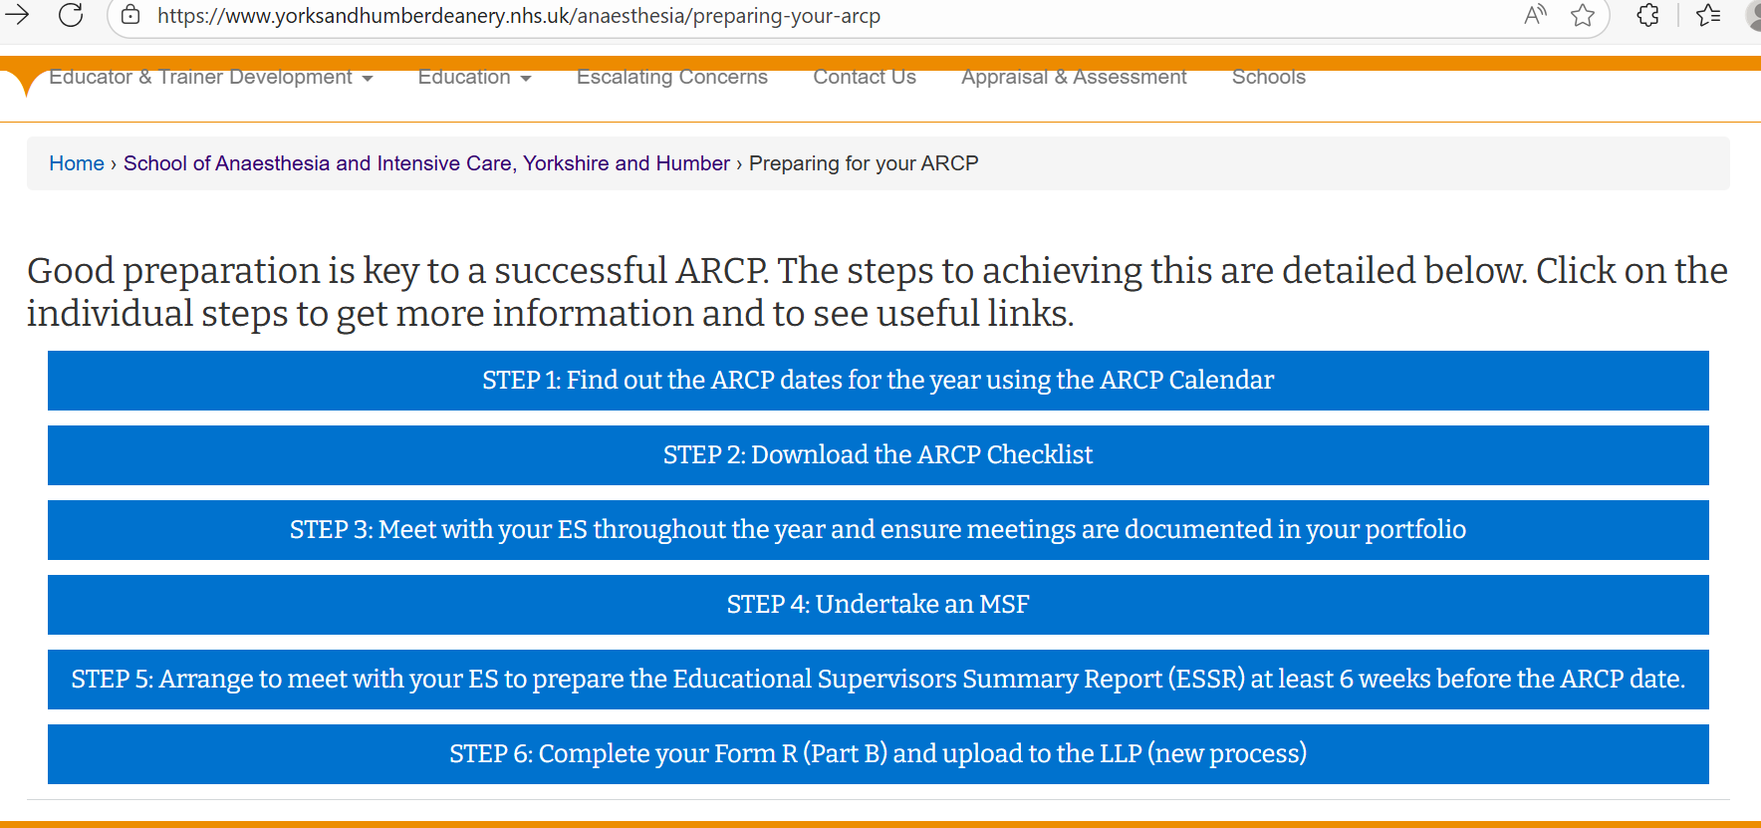

Slide 11
In simple terms
Know when is your ARCP
01
Know what evidence is needed
02
Plan ahead to collect this evidence
03
Submit evidence on time
04

Slide 12
When is my ARCP?
A year after you start your CT1/ST4
Usually Yearly thereafter
3-month notice
england.stp-arcp.yh@nhs.net
1 month notice

Slide 13
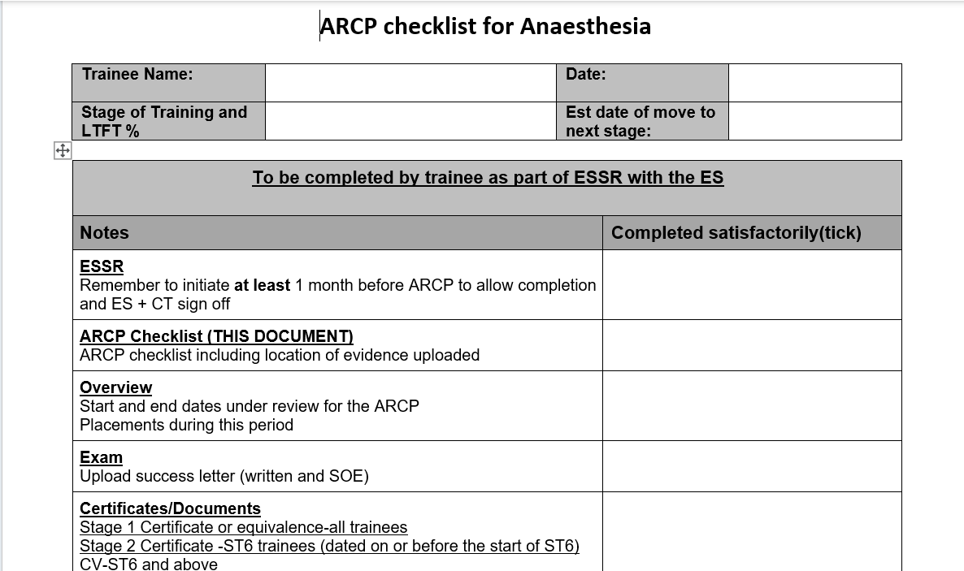
What evidence do I need?

Slide 14
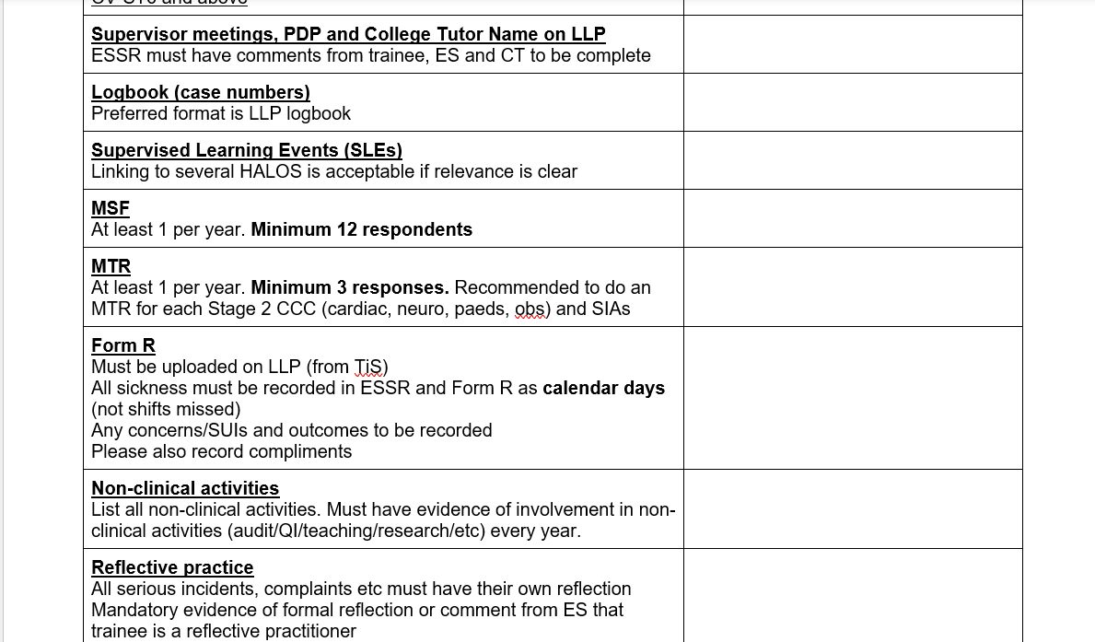

Slide 15
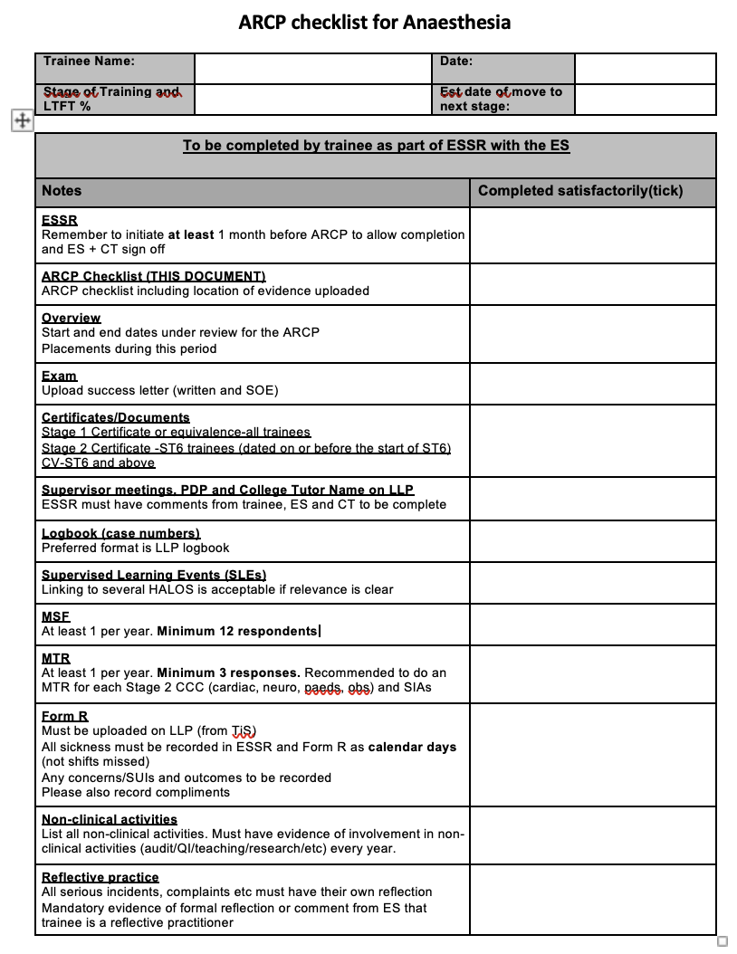

Slide 16
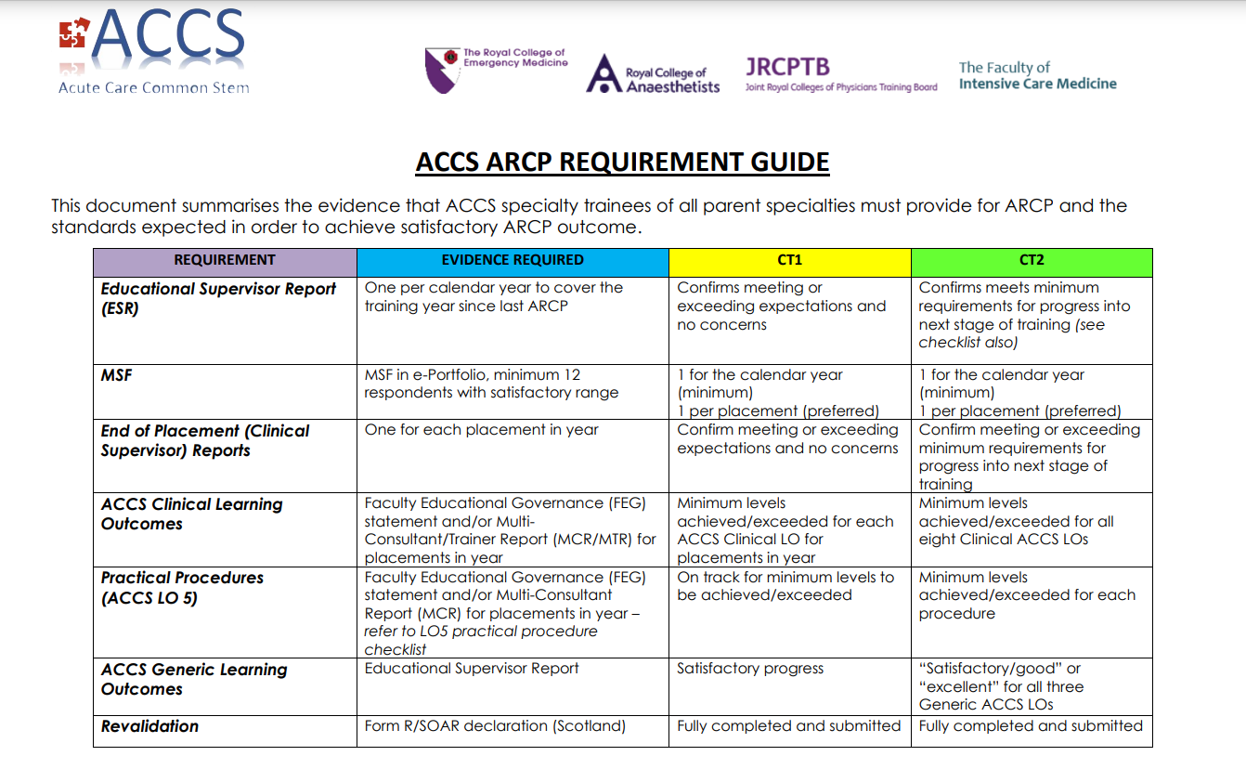

Slide 17
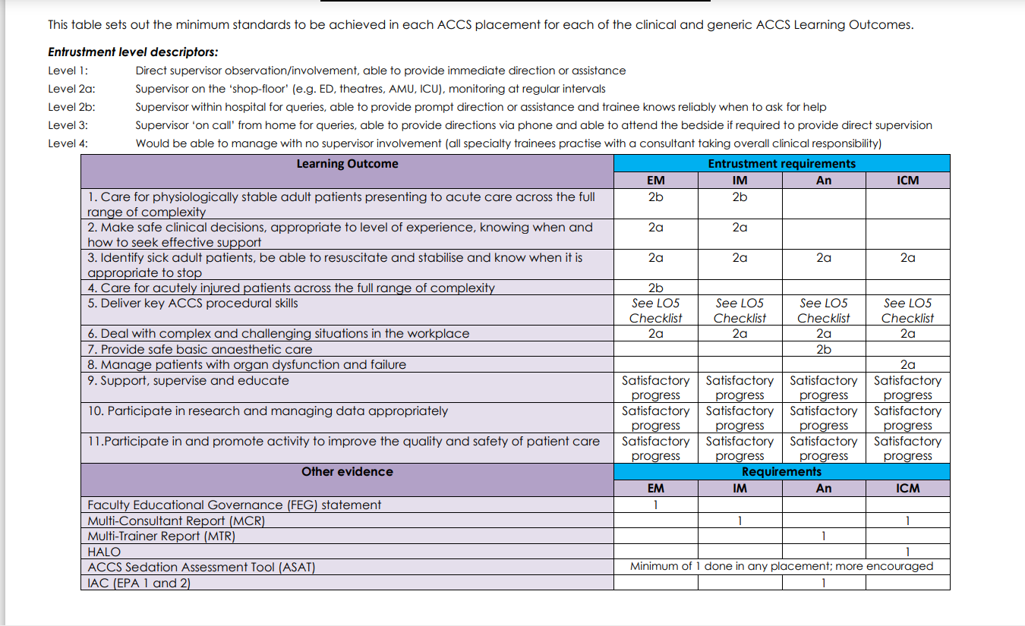

Slide 18
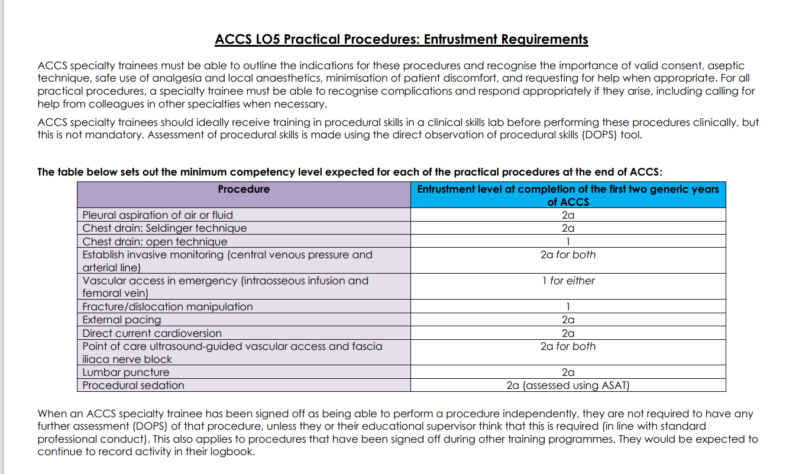

Slide 19
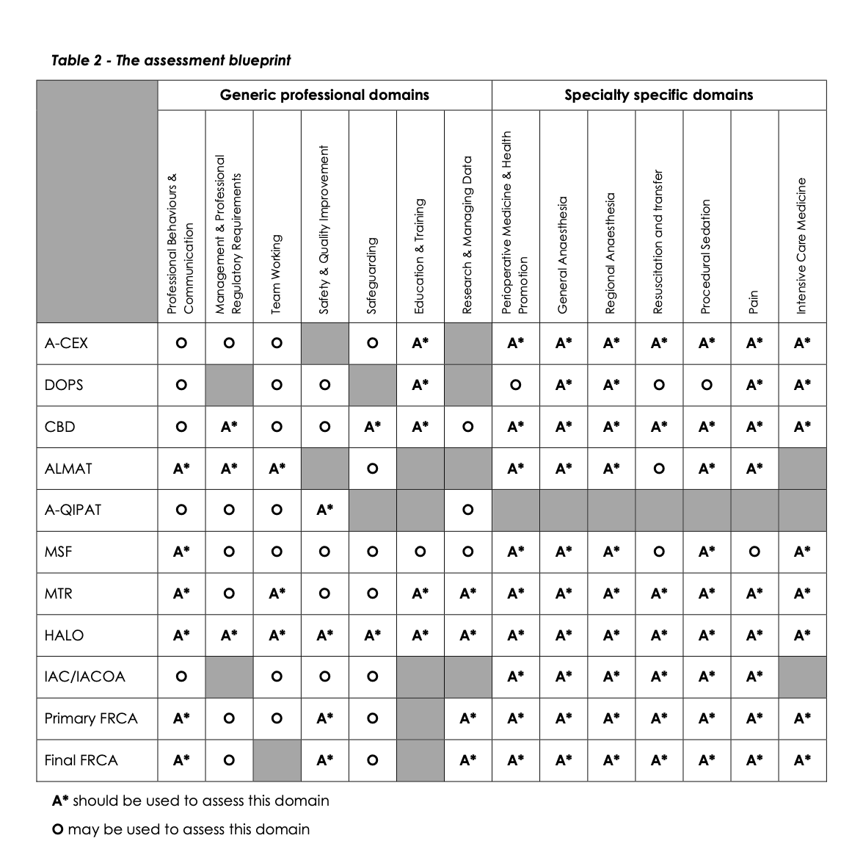
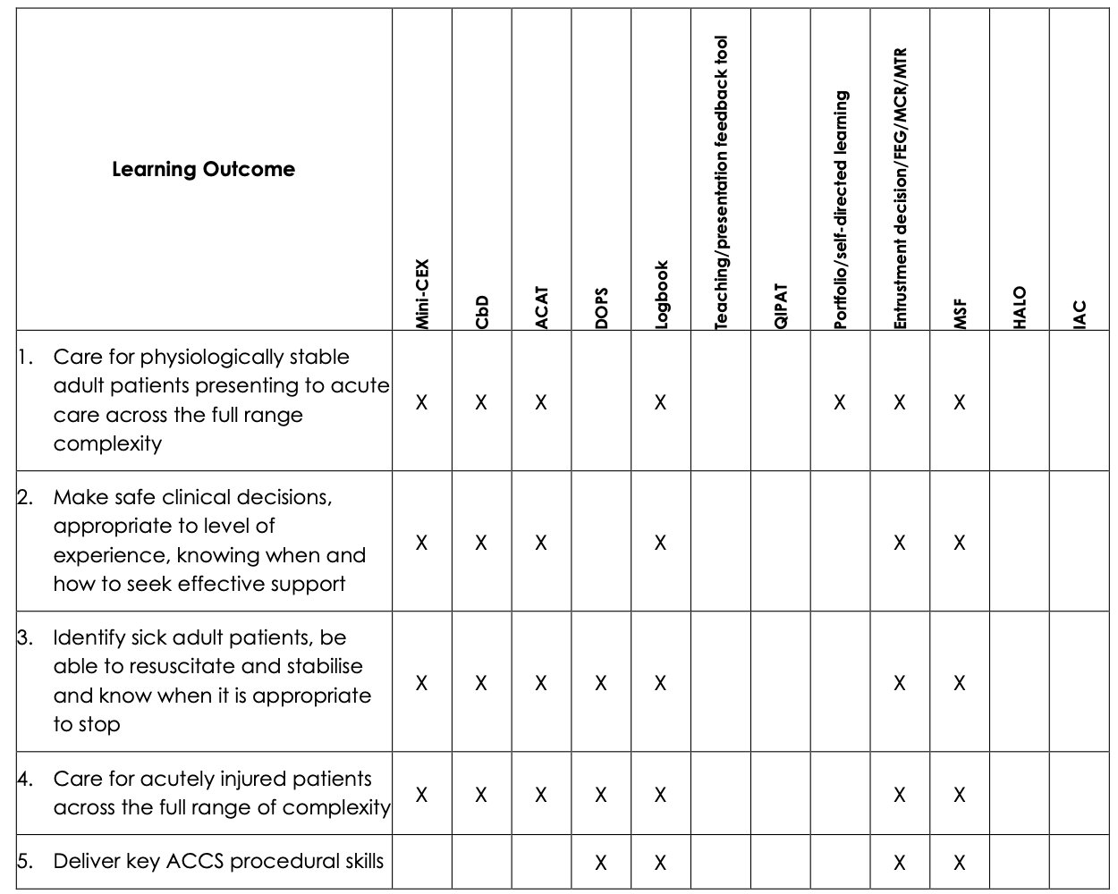
Assessment blueprints ST and CT

Slide 20
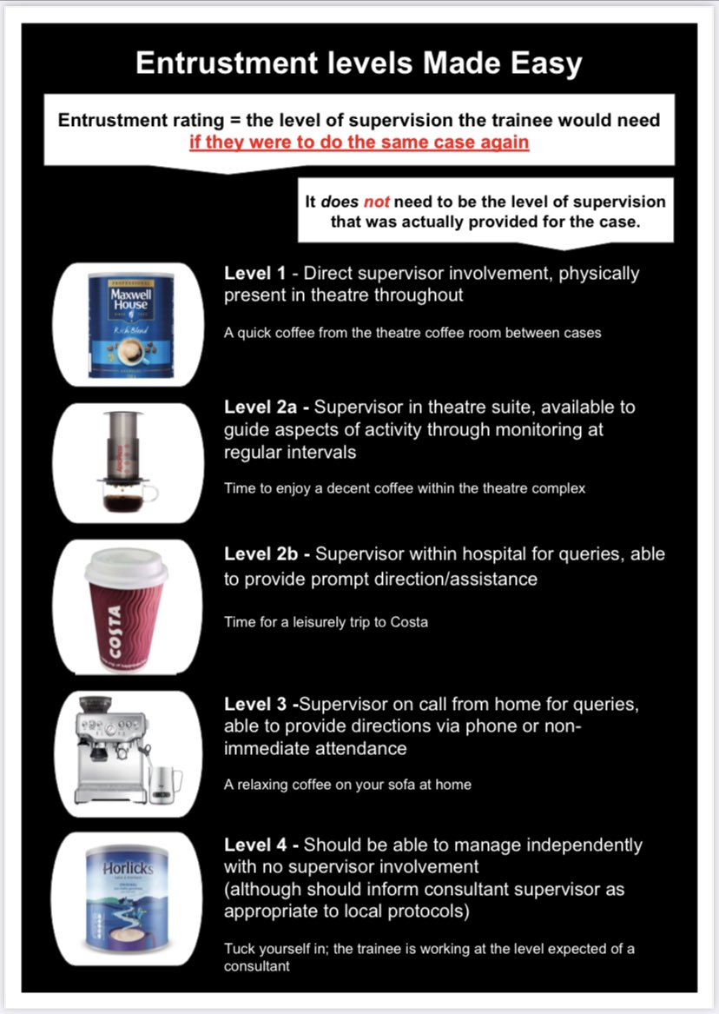
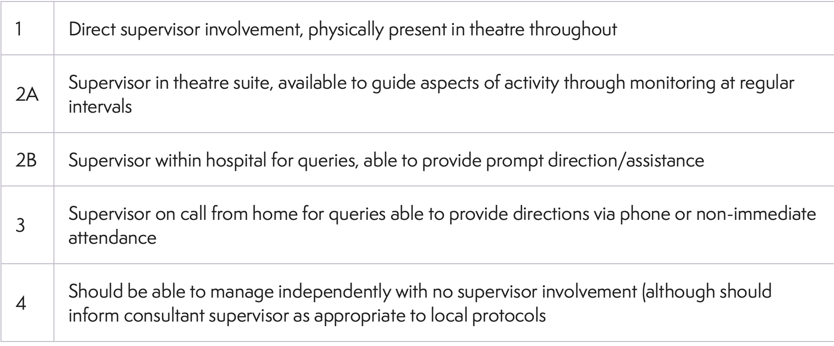
Show progress using SLE supervision levels

Slide 21
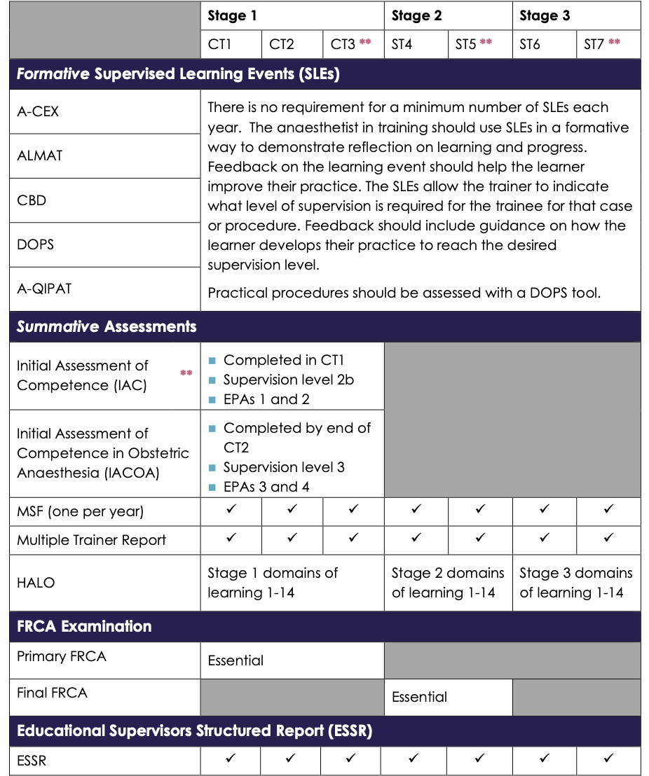
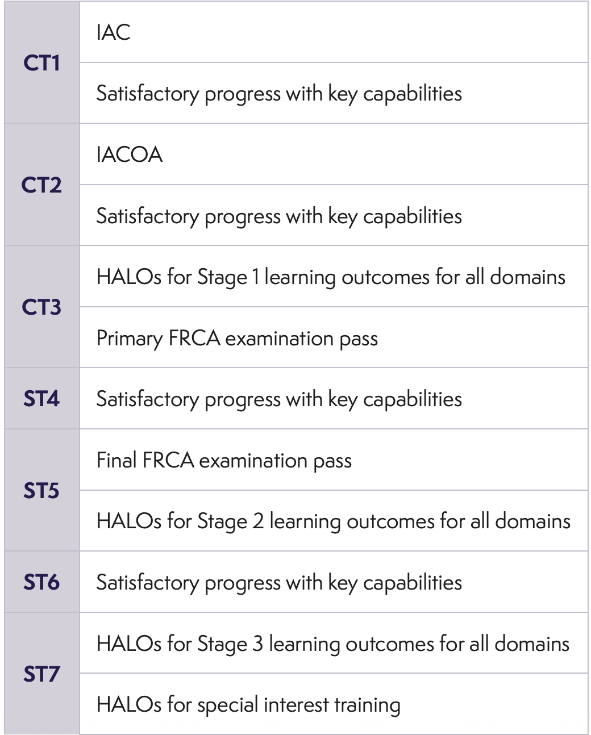
Stage of training requirements

Slide 22
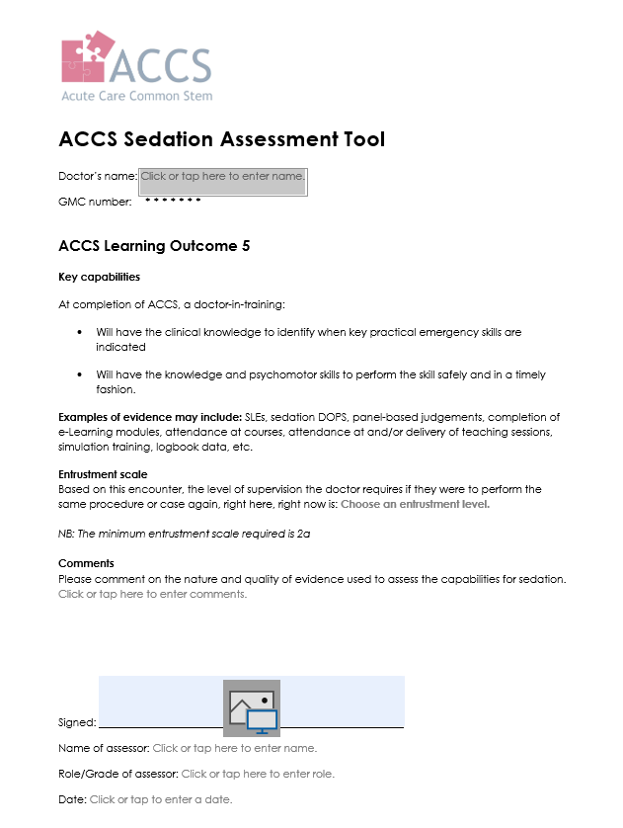
ASAT: Anaesthesia Sedation Assesment Tool
Notes:
Applicable to ACCS trainees

Slide 23
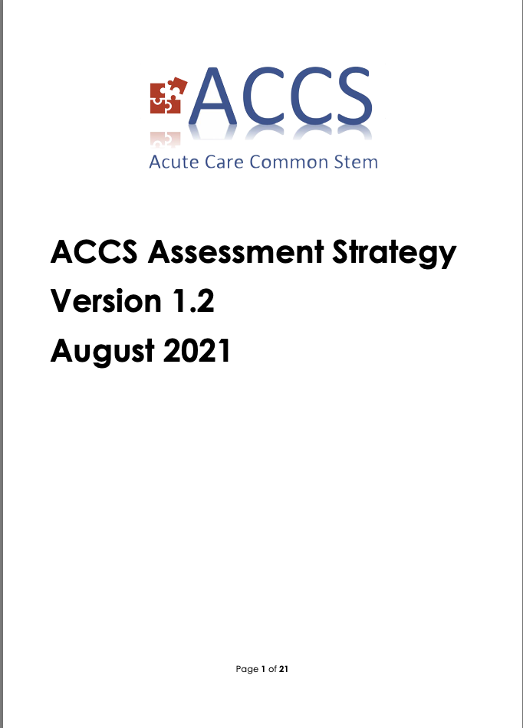


Slide 24
ESSR
End of placement summary Report, providing summary of trainee’s educational progress
Completion is mandatory for ARCP; it is the single most important document if completed accurately and fully
Generated by trainee - can be used as documentation of 3rd/final supervisory meeting (trainee can edit by returning to draft form)
All evidence on LLP that falls before date of generation automatically collated
Must be commented on/completed by ES
Sign off by College Tutor
Should be completed two weeks before ARCP date

Slide 25
How do I collect evidence?
Plan ahead
ES meeting-set SMART objectives
Collecting evidence throughout the year
Dont forget evidence from on calls esp important in Stage 3

Slide 26

When do I submit evidence?
Start the process early-4-6 weeks
Several steps-you/ES/CT/ARCP panel reviewer
Busy time-exams/rotations
Portfolio lockdown period

Slide 27
Pitfalls

Slide 28
Delayed submission
Incomplete submission-CT name not linked to ESSR-so no CT comments
Evidence present but not linked to ESSR
Form R not linked
Poor evidence of reflections
Communication

Slide 29
Summary

Slide 30
S
Use the checklists
Start the ESSR early
Communicate
Work on LLP through the year

