Slide 1



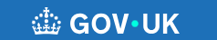
Help!!
What is out there
Dr Alison Colhoun
Deputy HoS
Interim South TPD

Slide 2

Health
GP
Self-referral options
Occupational health

Slide 3
What support is there out there – self refer
Coaching
All Yorkshire and Humber trainees have the opportunity to have four-six sessions of free coaching with a senior educator/trainer.
Take Time Client Form 2023-24 (Version 2) (onlinesurveys.ac.uk)
OR
Coaching | Health Education Yorkshire and Humber (yorksandhumberdeanery.nhs.uk)
Workplace well being
Workplace.wellbeing@shsc.nhs.uk

Slide 4
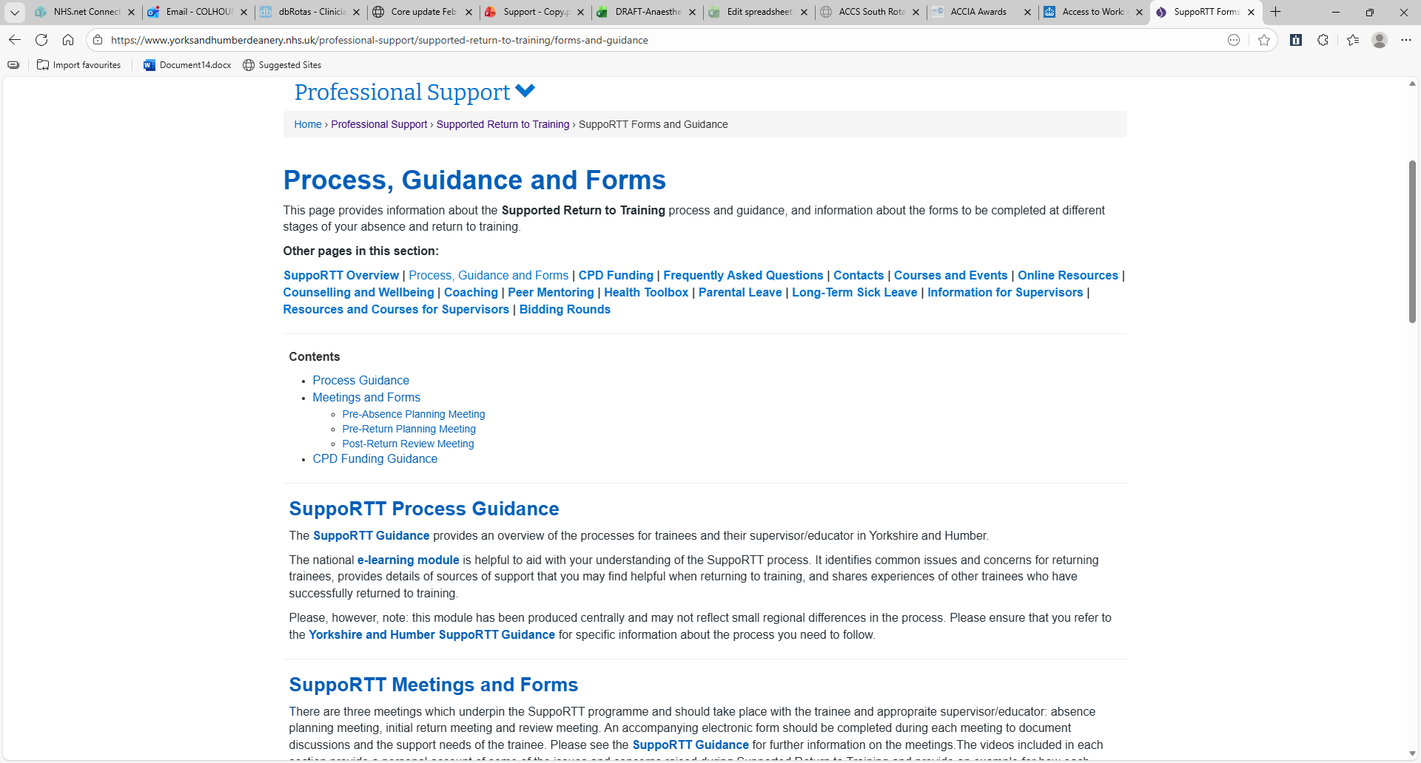

Returning to training after planned or unplanned absence
Planned
Pre –absence planning
Unplanned
Pre – return
Post return

Slide 5
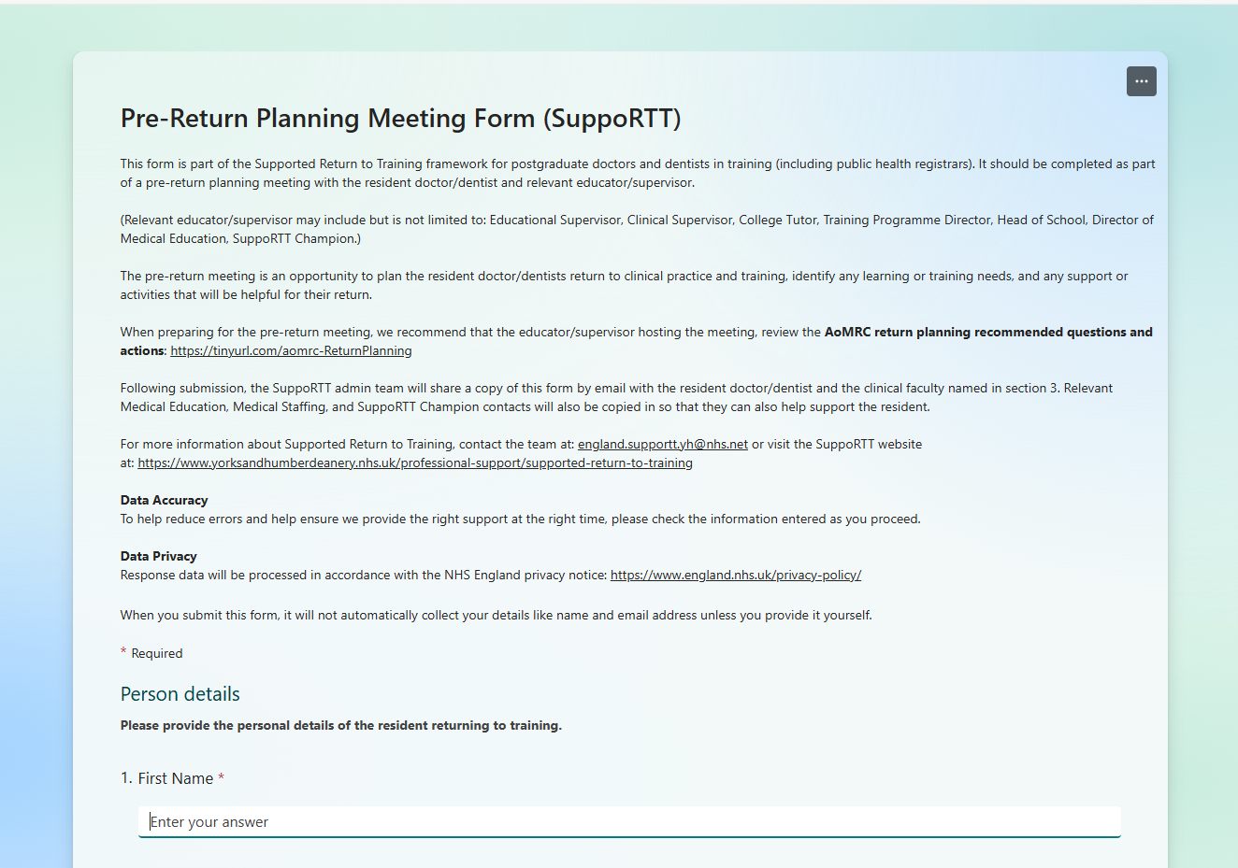
Pre return
Usually, 4 weeks phased RTW
Planned with ES or OH
depending on reason for absence
Think about duration SN period
Period enhance supervision
TPD often does pre –planning
Pre RTW done by TPD or ES
Post usually done by ES

Slide 6
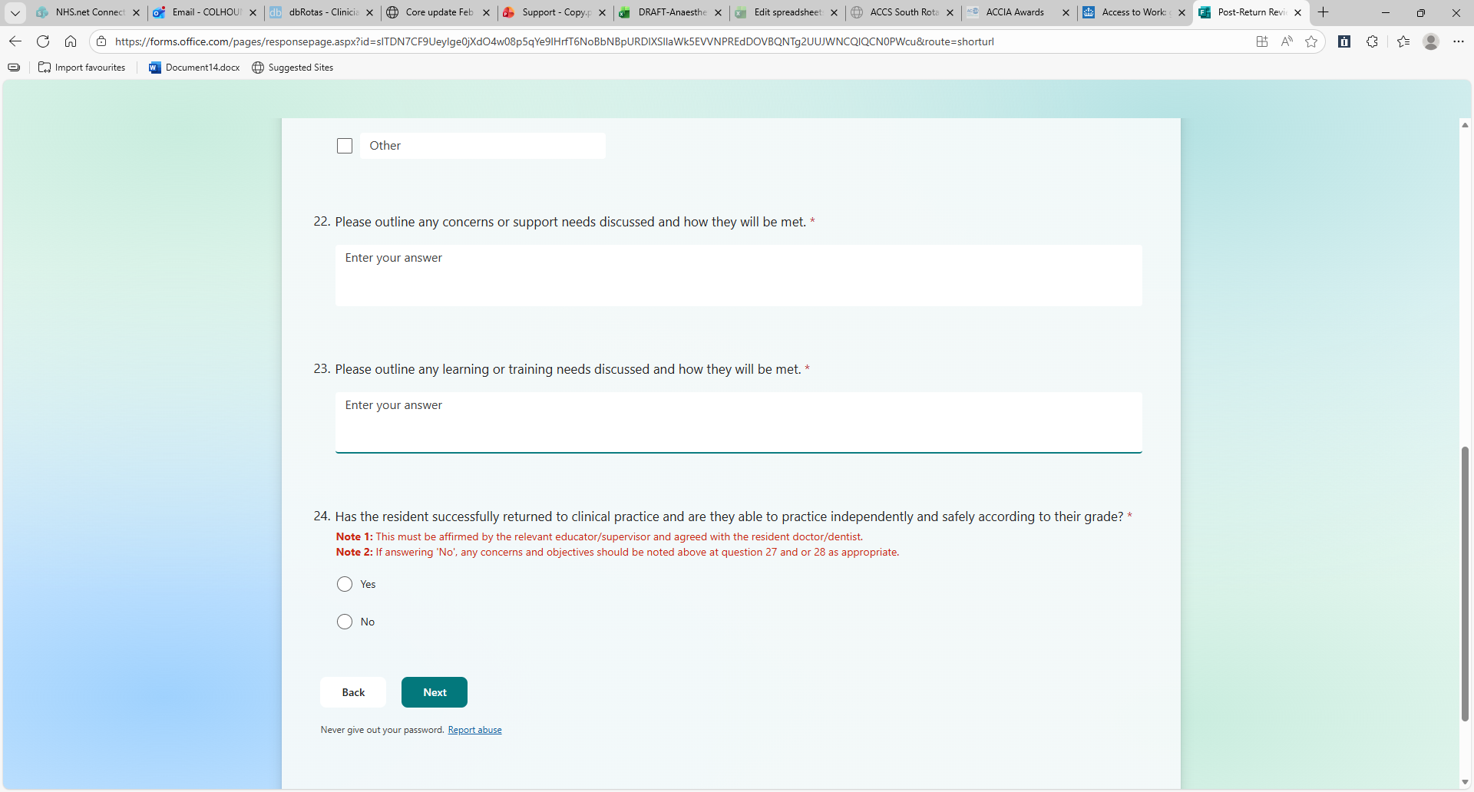
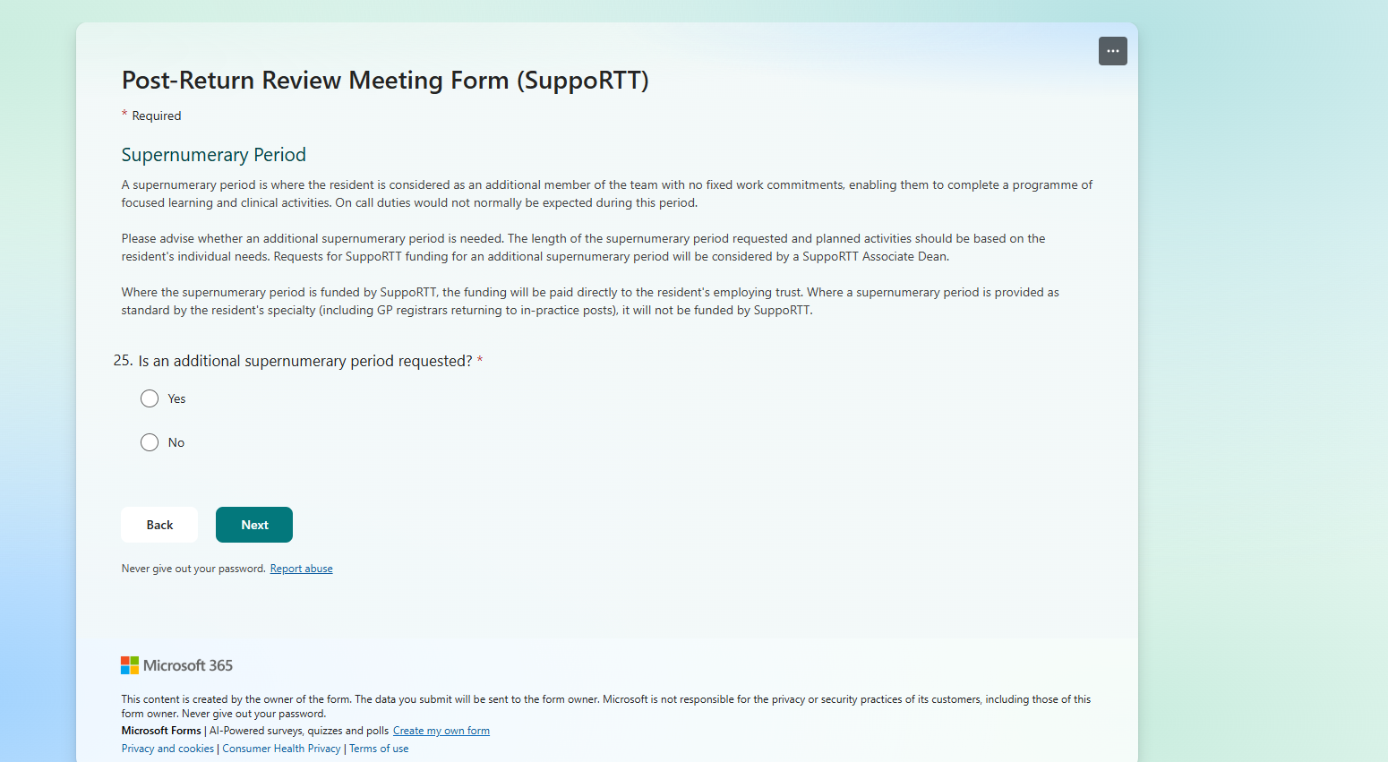
Post return
Have they met objectives
Do they require up to 10 days additional days SN?
Do they require addition enhanced supervision
Where extra time is needed a further meeting must be arranged to reassess

Slide 7
Coaching
Coaching | Health Education Yorkshire and Humber
Neuro-diversity coaching is accessed through access to work
Self-referral coachee must want to engage
Upto 6 session 60-90mins each
Register via deanery website
Coachee chooses a coach from their profiles

Slide 8
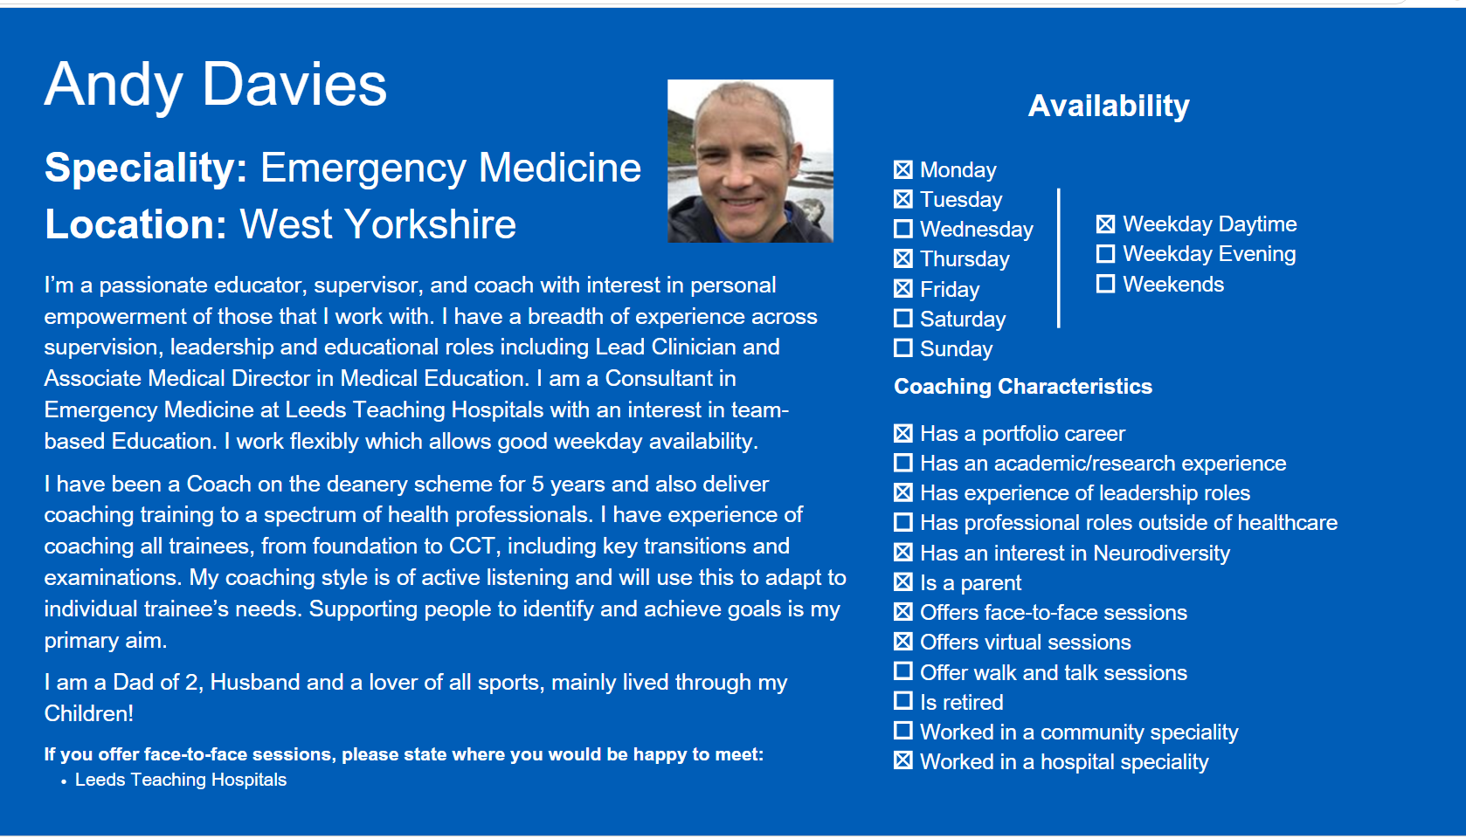

Slide 9
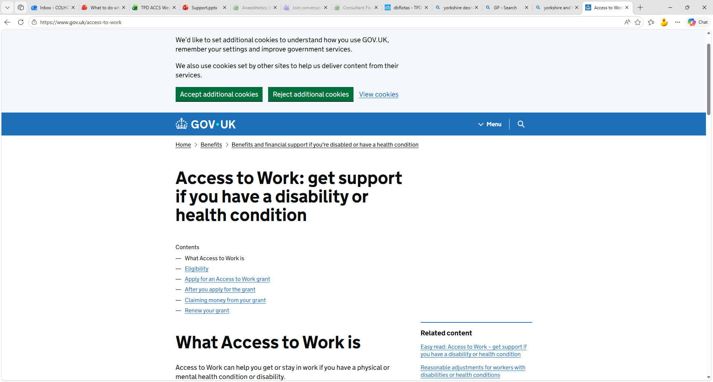

Slide 10
Access to work
Anyone in employment / Anywhere
Can be Temporary
Government funded
Specific to that job so rotational doctors need to reapply
Examples
Laptops
Taxi's
Mentor

Slide 11

Exams
Lots of local resources
Second attempt can request custom-made planning with TPD – funding of external courses
If repeated failure, consider ND screening

Slide 12
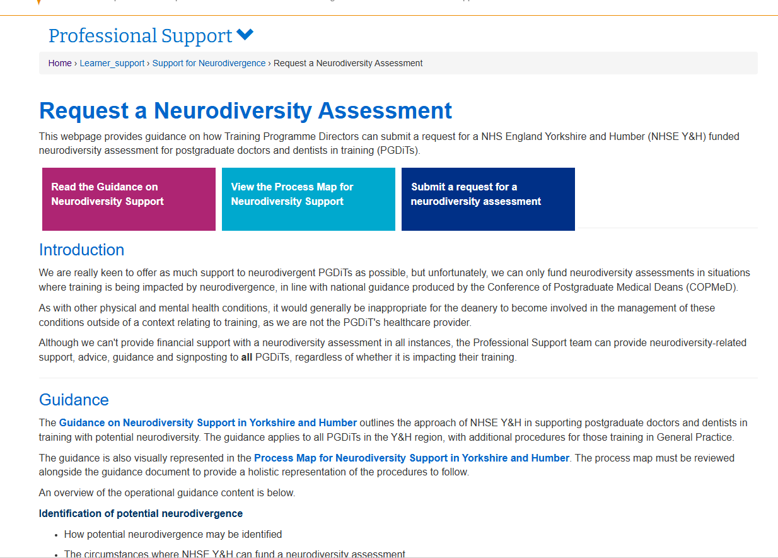
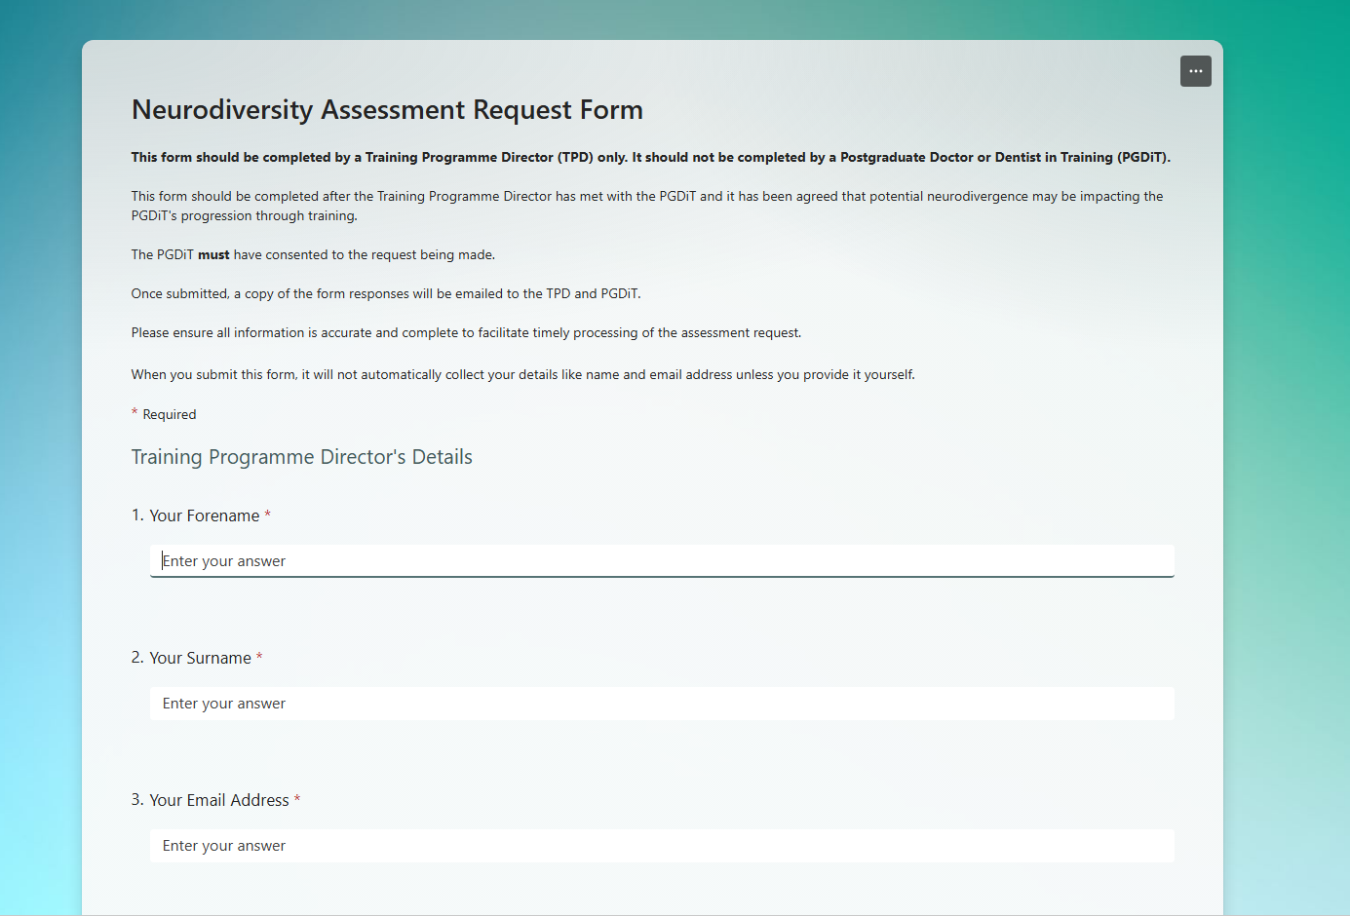
TPD can request ND assessment

Slide 13
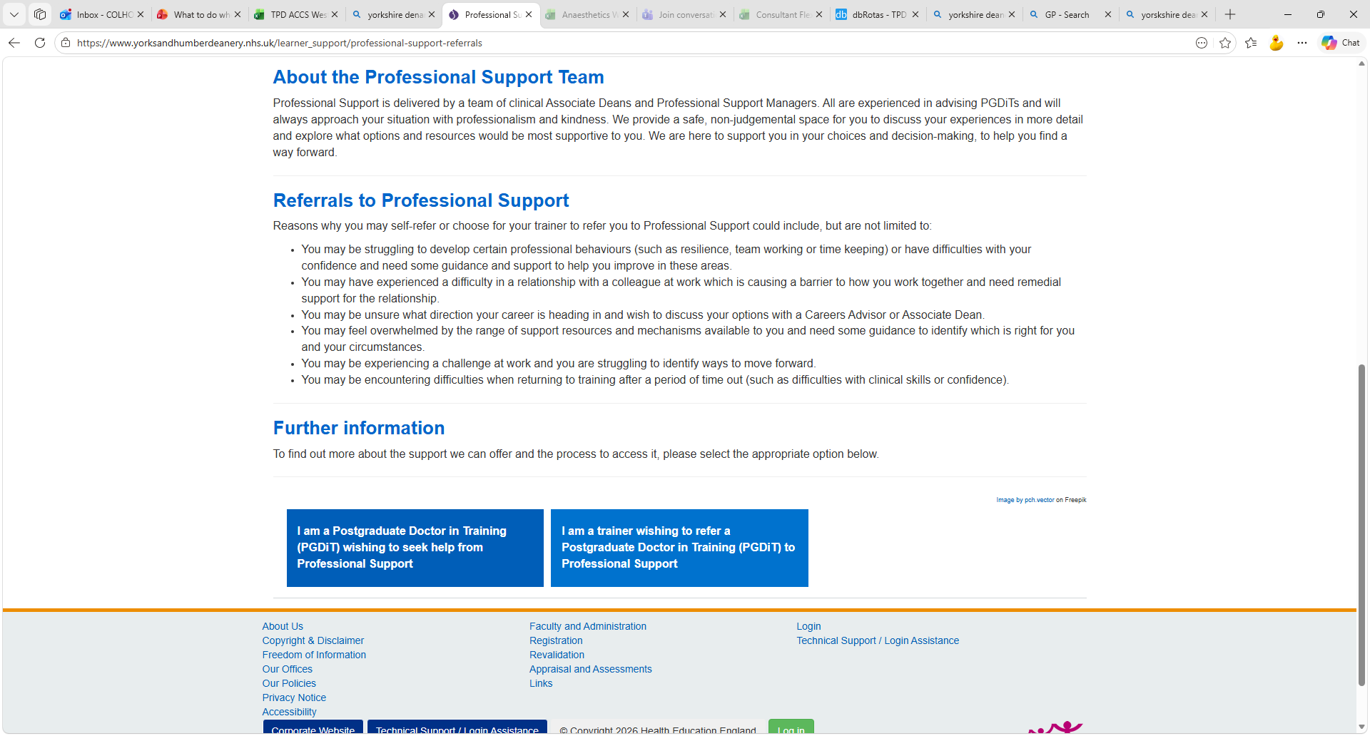
Professional support
Resident doctor can refer themselves
ES can refer them
Confidence
Resilience
Time keeping
Conflict at work
Career advice
Not sure what support you need
Difficulties in training
Issues returning to training after absence
Challenge at work

Slide 14
Example 1
ACCS CT2
History epilepsy
Unable to drive for 12 months due to seizures
When Lack of sleep increased seizures
2 concerns:
Night shifts
Next placement DGH placement

Slide 15
Example 2
CT4 ACCS 3 x failure at SBA examination
Feels they never have the chance to complete the paper in the time

Slide 16
Example 3
ST4
MTR concerns about communication repeatedly

Slide 17
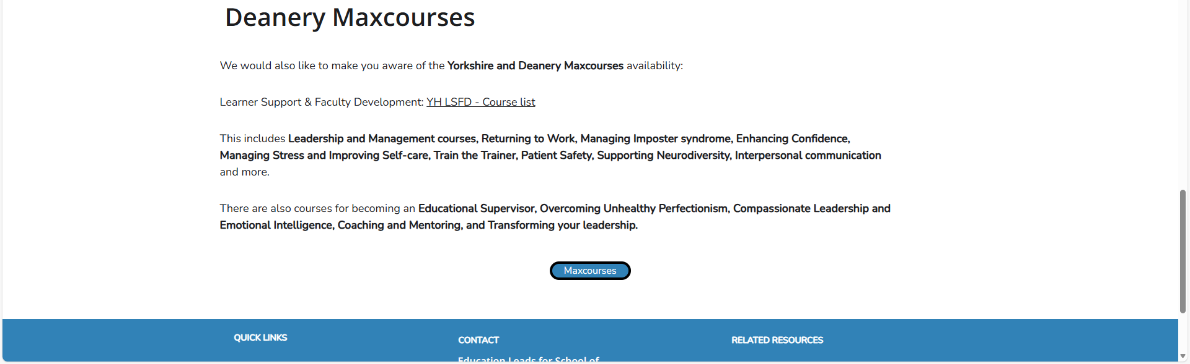
ES resources to help you
You can always ask CT TPD or refer to professional support
ES update sessions will be on YAIRN for 2027 when available
Links on YAIRN to Max courses

Slide 18


