Slide 1

How to prep your resident for ARCP how to do a good ESSR report, joining an ARCP panel
Dr Alison Colhoun
Deputy HoS
TPD West Core

Slide 2
Aims
By
By the end of this session, supervisors will be able to:
Understand
Understand the purpose of the ESSR
Know
Know what ARCP panels are looking for
Complete
Complete a high-quality, useful ESSR
Avoid
Avoid common pitfalls
Know
Know how to sign up for ARCP panel
Know
Know what is expected of you for ARCP panel member

Slide 3
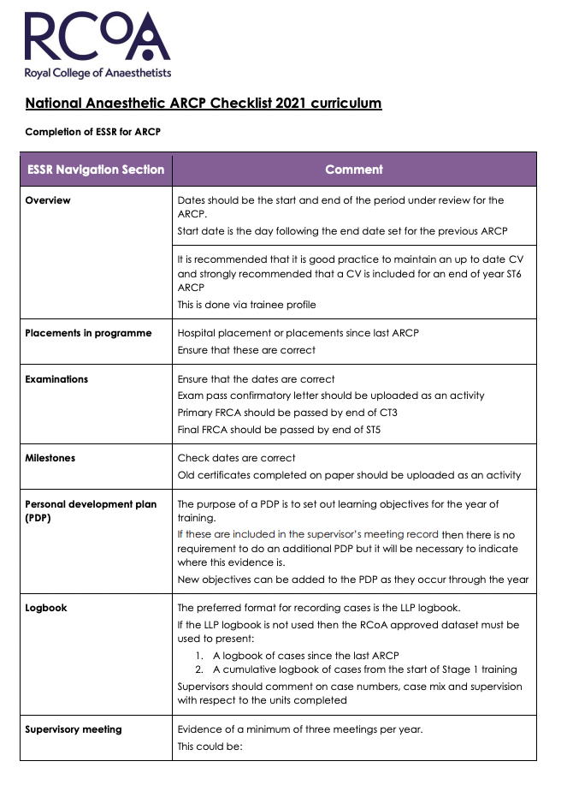
What should my resident do each year?
Check National ARCP check list
Minimum 3 x ES meetings (ESSR can count as third)
PDP
Logbook
MSF
MTR
SLEs
Non-clinical activities
Form R
Reflective practice

Slide 4
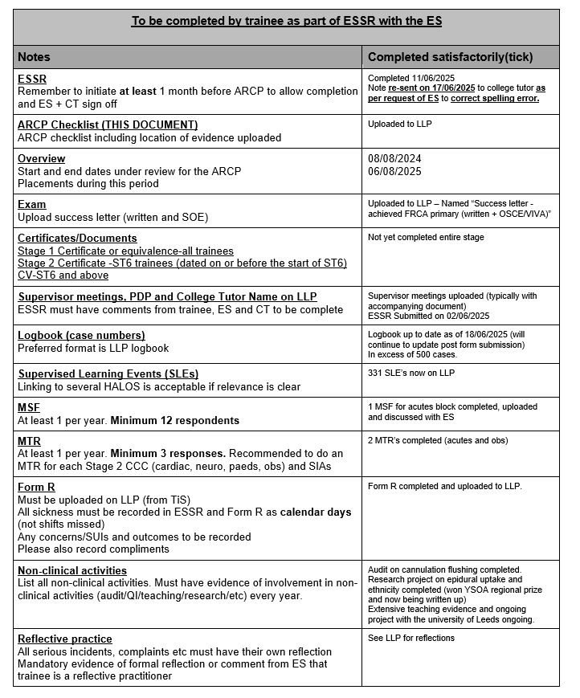

Slide 5


Slide 6
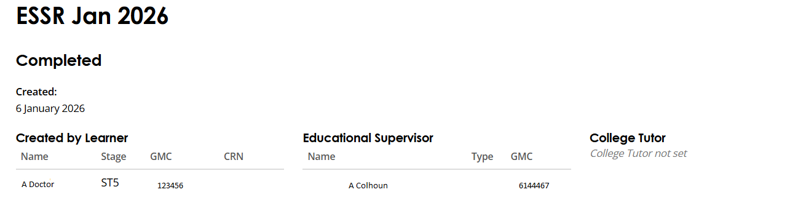

The ESSR

Slide 7
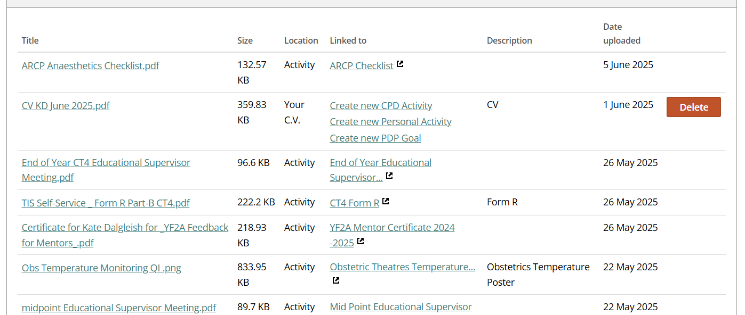
ES meetings resident to upload

Slide 8
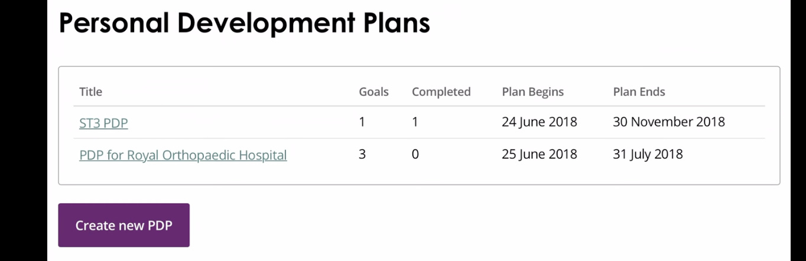
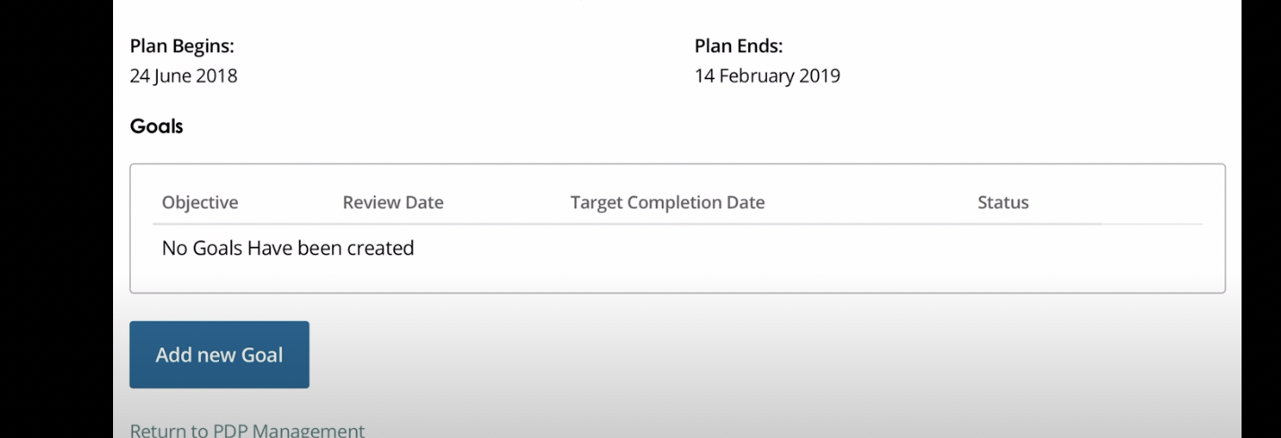
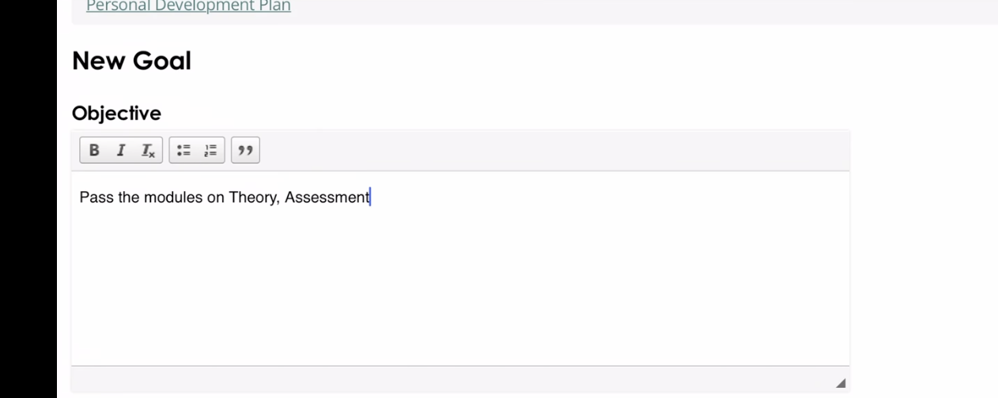
PDP – set the goals on LLP

Slide 9
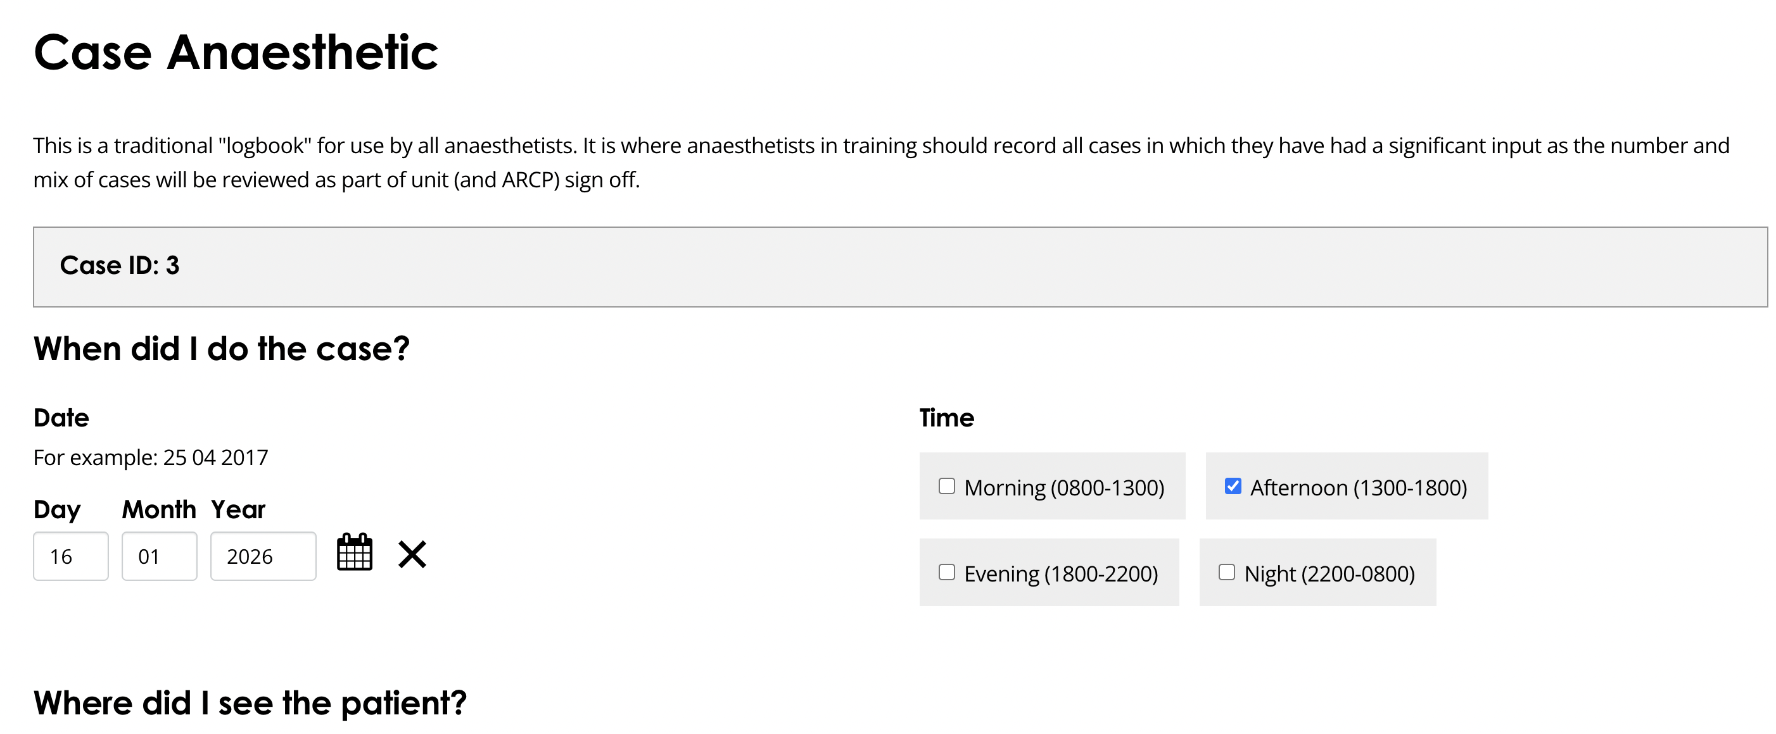
Logbook
Encourage RCOA
Comment on case numbers
Specialty mix – has the resident being doing speciality module this year such as cardiac where long cases and hence low number expeceted?
Supervision mix
  CT1 likely to have majority direct supervised
  At end stage 1 CT3/4 need to show obstetrics distant supervision so should have lots indirect in obstetrics
  ST7 1:1 ratio direct vs indirect as should be doing 50% work "solo"
Any areas to work on
  e.g. low paeds numbers
  Few epidurals etc

Slide 10

Exam and Milestones
Update on progress
Results in Document store
Encourage them to let TPD know results
Residents think RCOA magically tells TPD's
Check Milestones are complete if passed
  IAC
  IACOA
  Stage 1
  Stage 2
  Stage 3

Slide 11
SLE's /HALO's
Review progress
Are they at a critical progression point?
  CT1 EPA 1 and EPA 2
  CT2 EPA 3 and EPA 4
  ACCS trainees should refer to ACCS checklist requirements
  CT3 (ACCS CT4) All Stage 1 HALOs completed CCC obs paeds
  ST5 All Stage 2 HALOs completed CCC obs paeds neuro cardiac
  ST7 All Stage 3 HALOs completed. HALOs for SIAs CCC obs paeds
  SIA should total 12 months WTE
Have they met all the requirements?
If not, will they meet them by the end of the training year rather than ARCP? You must make a comment on this .

Slide 12
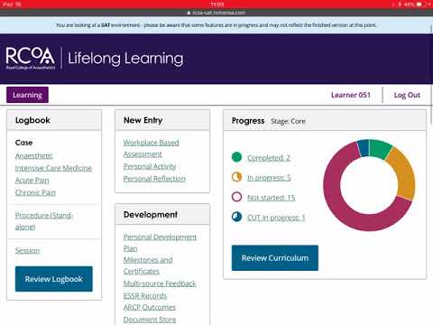
Check the donut

Slide 13
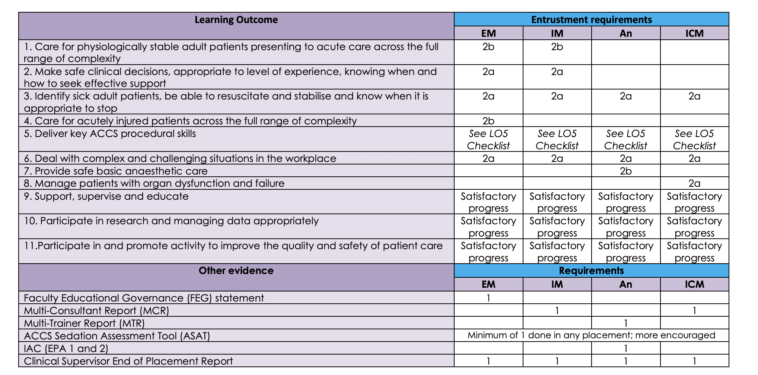

Slide 14
CCC
Completion of Capability Cluster
Stage 1
  Paeds and Obs (mandated by deanery not RCOA)
Stage 2
  Neuro, Cardiac, Obs, Paeds
Stage 3
  Paeds and Obs
Key Components of CCC Sign-Off
Evidence Collection:
  SLE's
  Logbook
  Personal activities
Key Capabilities (KCs): Demonstrate attainment
Multiple Trainer Report (MTR): with at least three respondents.

Slide 15
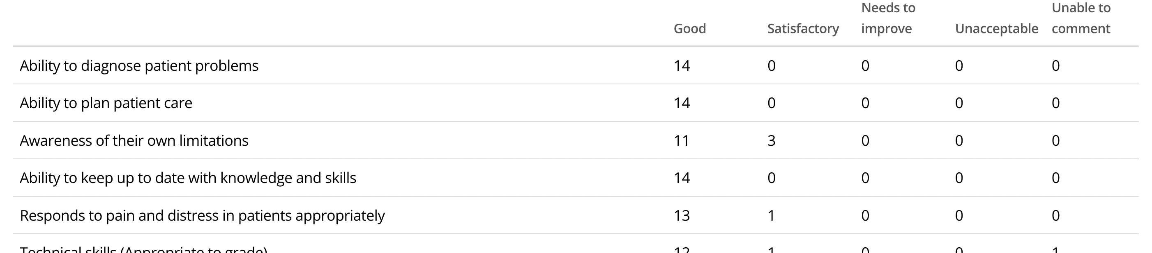
MSF
1 per Calander year
Even if LTFT
Min 12 respondents
Can stay open all year no excuses to not get 12

Slide 16
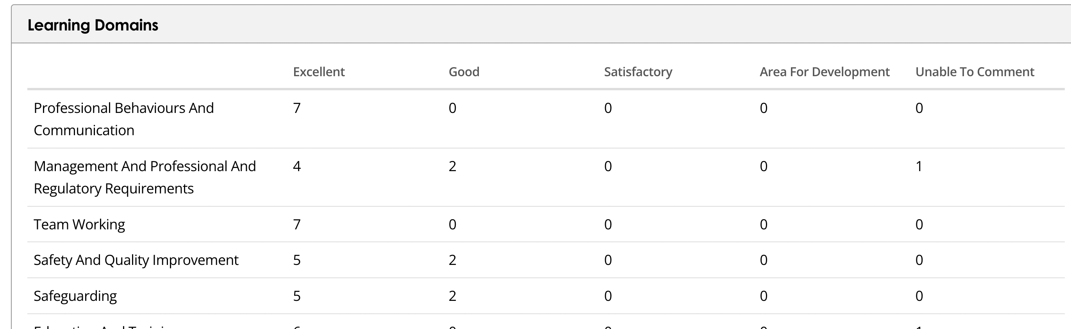
MTR
1 per year
ICM – MCR only

Slide 17
Non- clinical activities
Evidence of involvement with an audit or quality improvement project per stage of training is essential.
  This can include involvement with national or regional projects eg NAP or SNAP studies.
  Can continue projects
  The level of involvement reflect HALO: Safety and Quality Improvement.
  A-QIPAT can be used to document involvement with projects.
  Documentary evidence of annual involvement in clinical governance activity will be required.
  Mandatory training is a Trust and national requirement but it is not a requirement for ARCP evidence.

Slide 18
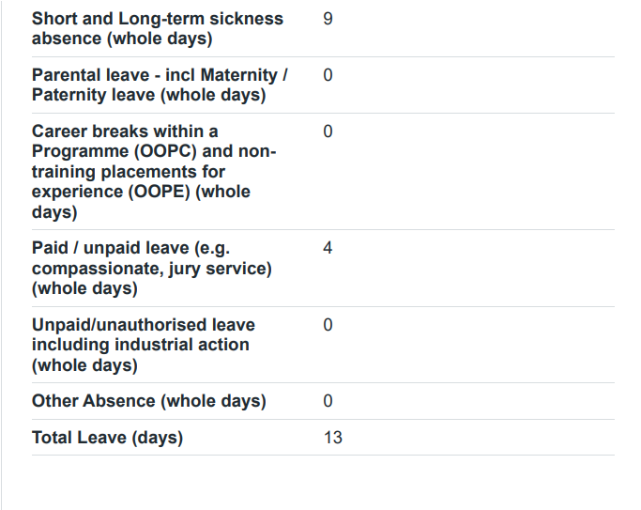
TOOT & Form R
Must have form R
Absences on ESSR should be same if not document this is your final review
If declare an incident / complaint
Check for reflection
Check for support needed

Slide 19
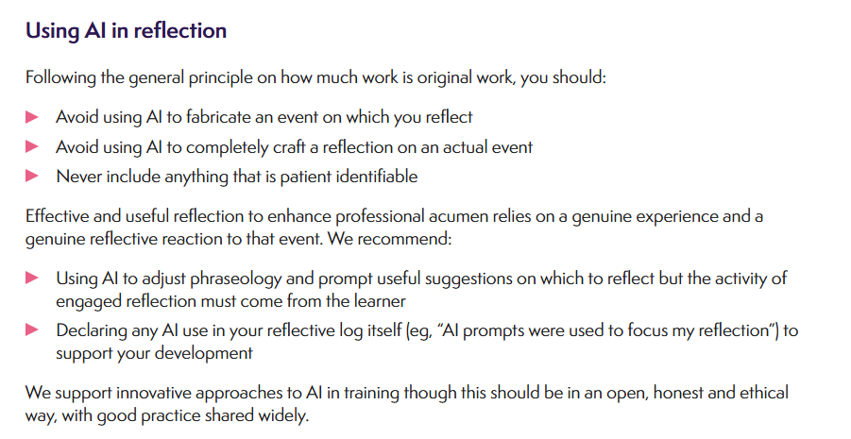
Reflection
No minimum

Slide 20
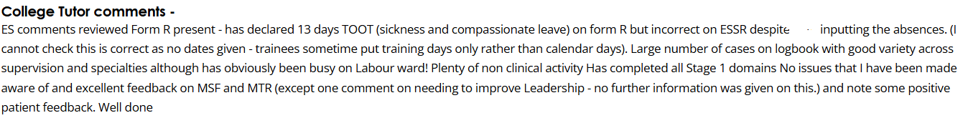
Final comments

Slide 21
Joining ARCP panel
All TPDS have panels June, July, Dec and Jan
South April and Oct
There will be a few ad hoc panels in between

Slide 22
TPDs
East
nauman.akhtar@nhs.net
andrew.horne3@nhs.net
South
michael.robinson20@nhs.net
deborah.kerr6@nhs.net
West
ICM
will.peat@nhs.net
alison.colhoun1@nhs.net
rashmi.menon@nhs.net
kris.bauchmuller@nhs.net
James.Morgan@bthft.nhs.uk

Slide 23

Expectation
Teams meetings
Usually start between 8 and 9.30 depending on which TPD's do school drop off first
Usually complete by 1-3pm depends on numbers Summer busy
Prior to the ARCP you are expected to review 3-5 resident doctors in detail
Comparing them to ARCP checklist
Then give your recommended outcome

Slide 24
Standard Outcomes
Outcome 1: Satisfactory Progress – You're meeting expectations and developing competencies at the expected rate.
Outcome 2: Development of Specific Competencies Required – Areas need improvement, but not with extra training time; targeted actions are given
Outcome 3: Inadequate Progress – You need an additional period of training (usually up to a year) to achieve required competencies.
Outcome 4: Released from Training – You may be released due to sustained lack of progress (W) or voluntary resignation (VR).
Outcome 5: Incomplete Evidence – Insufficient evidence was provided for the review.
Outcome 6: Certificate of Completion (CCT) – You've met all requirements and completed training.

Slide 25
Other outcomes
Outcome 7: Fixed-term specialty training. Used specifically for doctors in Locum Appointment for Training (LAT) or Fixed-term Specialty Training Appointment (FTSTA) posts.
Outcome 8: Out of Programme (OOP) – For career breaks, OPPC, OPPT, OPPE
Outcome 10 (10.1 & 10.2): COVID-19 related. Introduced to manage delays in capability acquisition (e.g., exam cancellations) specifically due to the pandemic.
Outcome 9: Top-up training. For doctors entering the specialist register through specific equivalency routes.
N1 – Sick
N2 – Parental leave
N21- Resignation without training issues
N22 -Resignation with training issues

Slide 26
Many other N codes inc
Dismissal
Suspension
Not in post long enough
Other

Slide 27
What do you get out of the day?
Better understanding of curriculum
Balance and reasoning of decisions
See good (and bad ) ESSR reviews
Improve your own ES reports
See some impressive portfolios
Certificate for the day
We have no concerns for people taking full day SL as prior preparation is needed

Slide 28
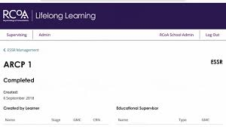
Questions

