Slide 1



School of Anaesthesia & ICM Educational Support
Dr. Selin Kabadayi & Dr. Tamer Abouzied Education Leads
Sep 1st, 2025
Pan-Deanery Induction

Slide 2
Educational School Updates
YAIRN
Course Calendar
Important courses
Exam preparation
Stage 1 teaching
Stage 2/3 teaching
Conferences
Blackboard
Educational SIA
Residents Awards

Slide 3

YAIRN
Yorkshire and Humber Anaesthetics and ICM Regional Network
A single point of access for Educational Events, Courses and Teaching within the region
Access to a School Courses Calender
Access to regional teaching programmes
Information about available courses within the region
http://YAIRN.co.uk

Slide 4
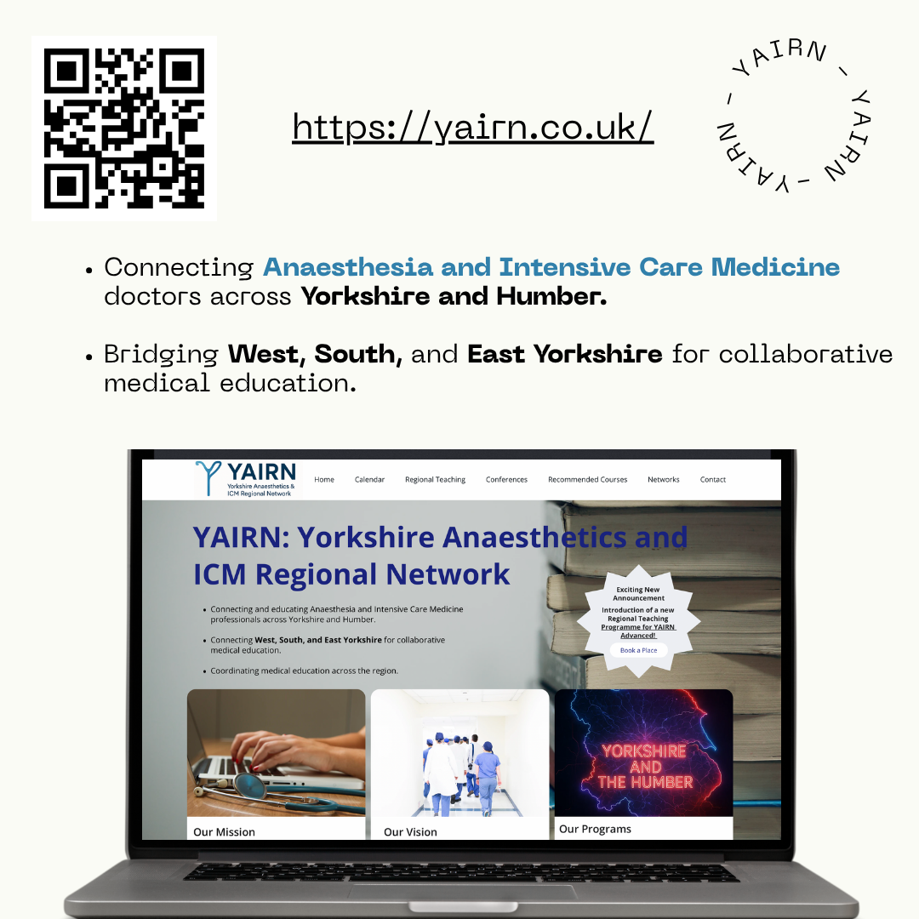

Slide 5
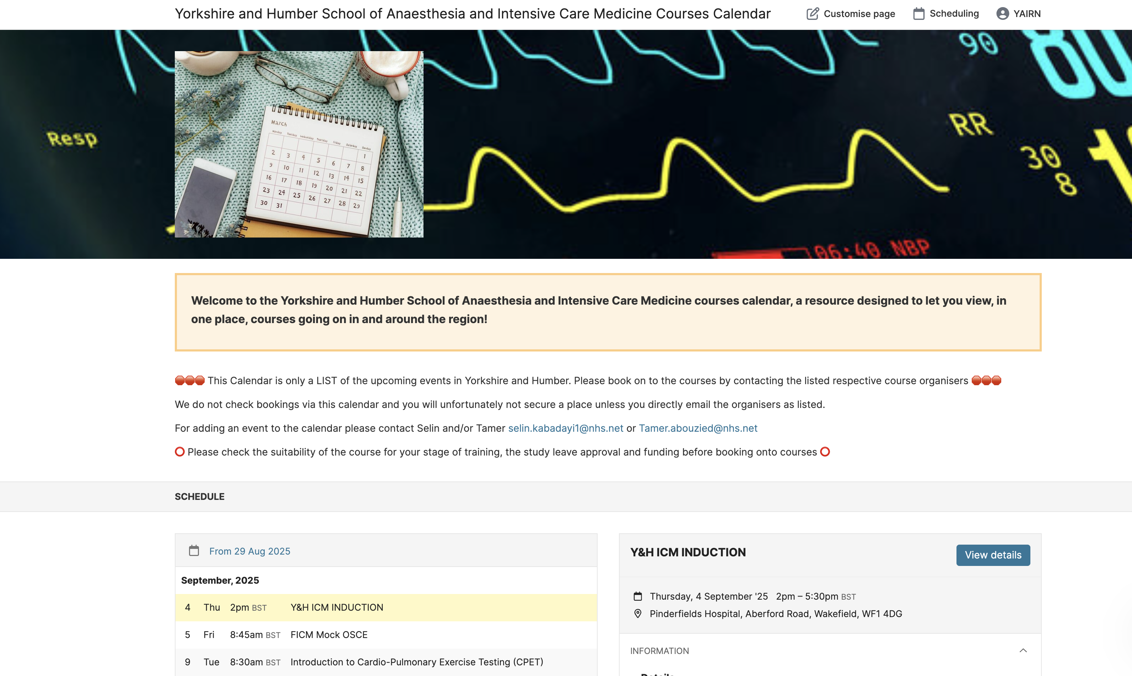
Course Calendar

Slide 6
Important courses:
Critical Incident Course
Critical Care Transfer Course
Obstetric Anaesthetic Emergencies Simulation
PROMPT/BOASTY
ALS (in region)
Stage 1 Trauma Course
Leeds Sedation Course
EPIC 1
Regional Anaesthesia courses:
RANT-Y
MYRAG
HRAC
HUM
ST4 Anaesthetic Interview Courses

Slide 7
Exam Course preparation
SPARK SBA
Virtual Primary FRCA SOE Revision Day (Hull) – frcaheadstart.org
Primary FRCA VYVA Preparation Exam Course
Primary FRCA OSCE Online Revision Course
Mock Primary FRCA OSCE (MYTT)

Slide 8
List of Stage 1 Recommended Courses:
https://www.yorksandhumberdeanery.nhs.uk/anaesthesia/regional-teaching-courses-and-study-leave/recommended-courses
List of Stage 2/3 Recommended Courses:
To be published soon
Can also be accessed from YAIRN.co.uk

Slide 9
Stage 1 teaching
Locally run in each hospital
Usually weekly novice teaching sessions
Allowing you to understand some basic concepts in pharmacology, physiology and physics
Often a combination of resident and consultant led
Often peer to peer
Found to be very beneficial by residents

Slide 10
Stage 2/3 Regional Teaching
YAIRN Advanced teaching programme
Pan-deanery teaching
Rotates every 2/3 months between regions within Y&H
Full day
Covers broad curriculum topics
There is also START: specialty trainee anaesthetic regional teaching in Sheffield.
½ day per month at STH
If you are post primary, you can ask for permission from your CT to attend YAIRN Advanced/START training sessions
All regional teaching is on YAIRN.co.uk with links to sign up

Slide 11
Locally run conferences
YATC
The Yorkshire Anaesthetics Trainee Conference is an annual conference for trainees with an exciting programme and trainee presentations.
It is normally in October.
YICC
Yorkshire Intensive Care Conference is annually at the Yorkshire Wildlife Park in May.
It is a super day of interesting sessions from national experts
LACTIC
The Leeds Acute and Intensive Care Conference is September 18-19th 2025.
2 day conference with excellent talks and workshops

Slide 12
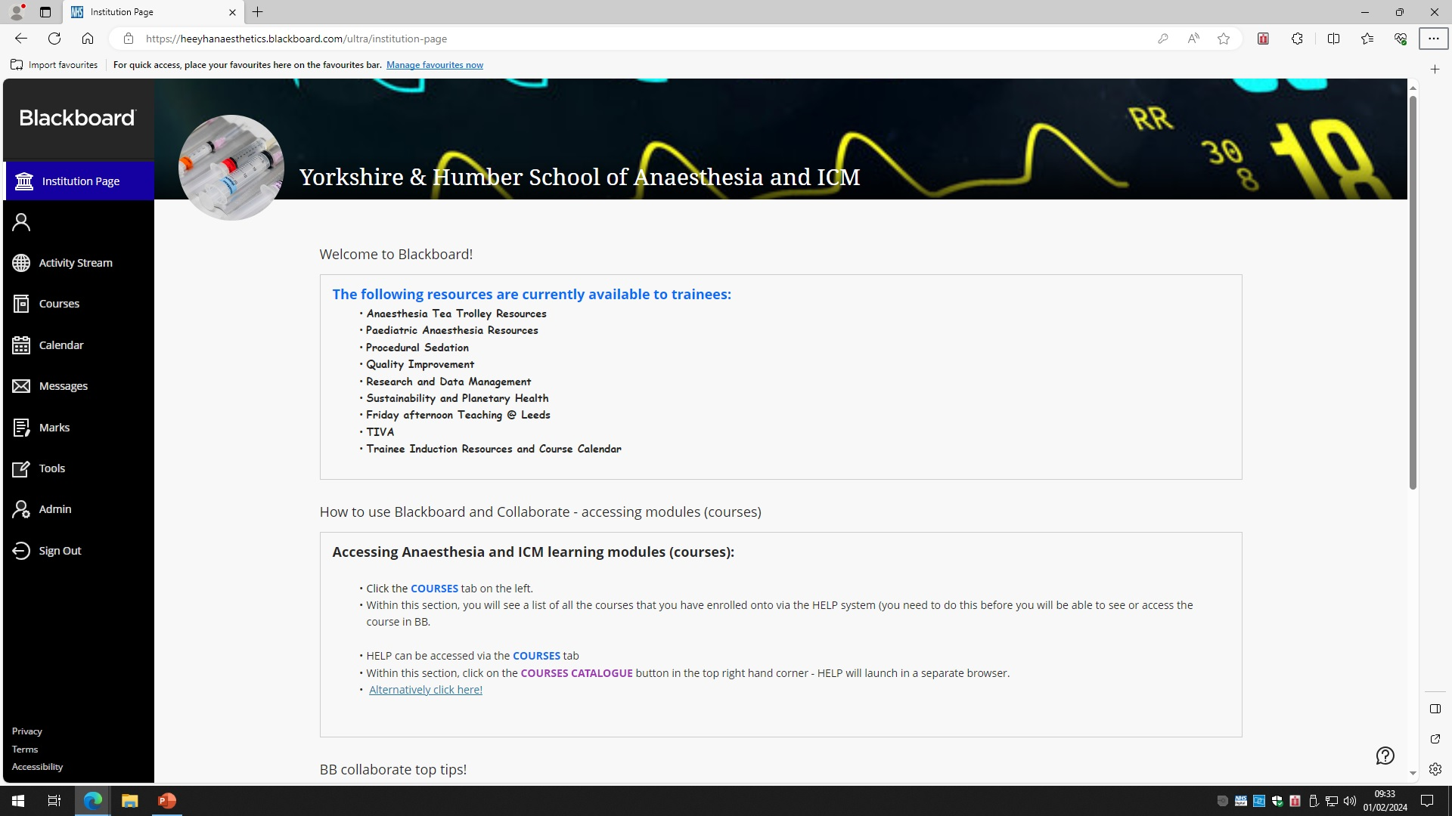
Blackboard

Slide 13
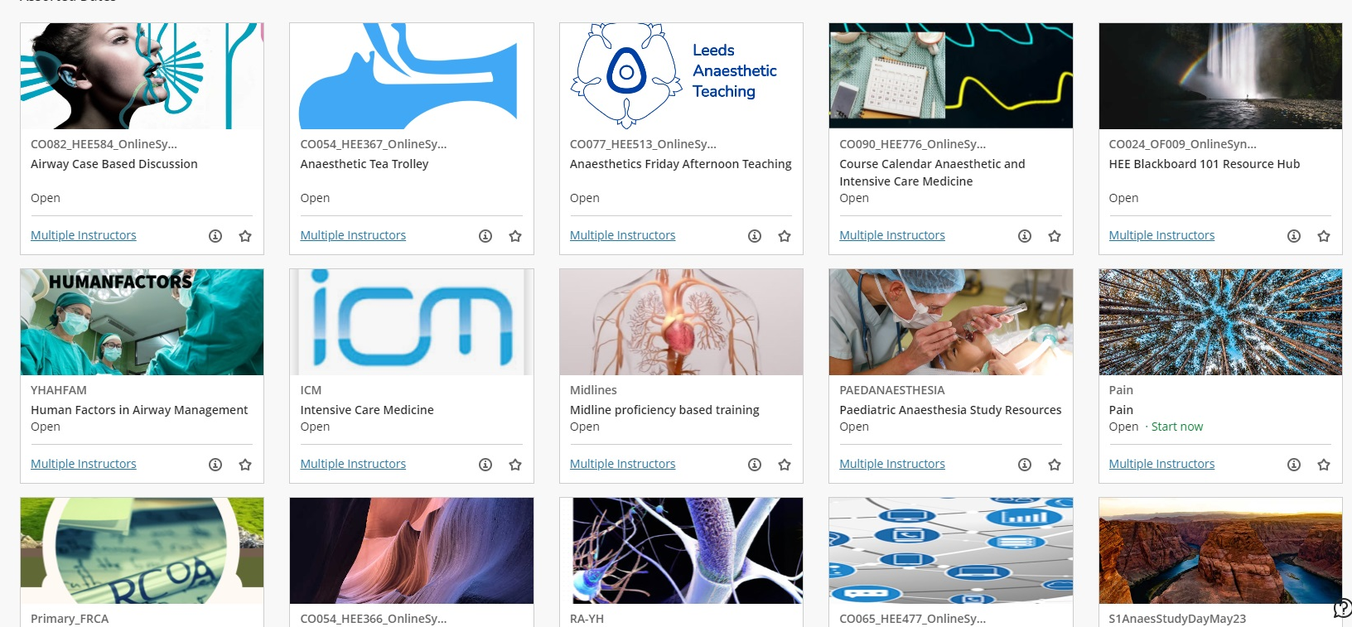
Useful modules for the new starter
Trainee Induction Resources
Course Calendar
Procedural Sedation
TIVA
Research and data management
Quality Improvement for Anaesthetists
Pain
Exam preparation courses

Slide 14
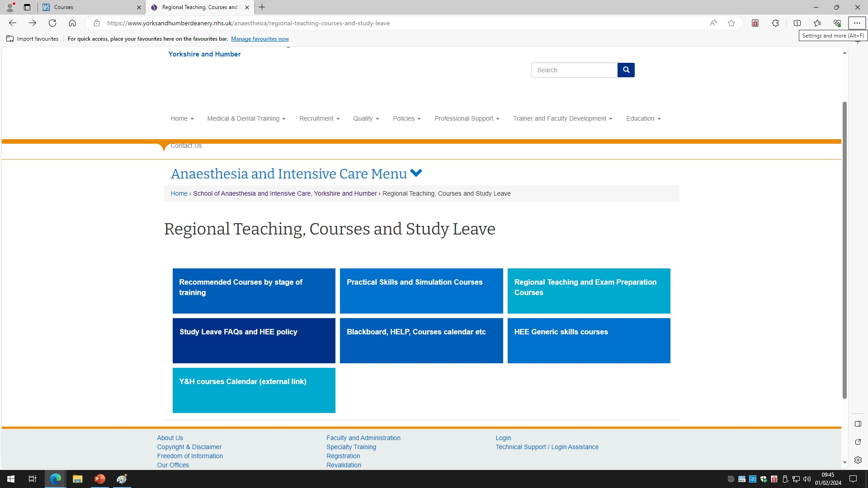
How to access?

Slide 15
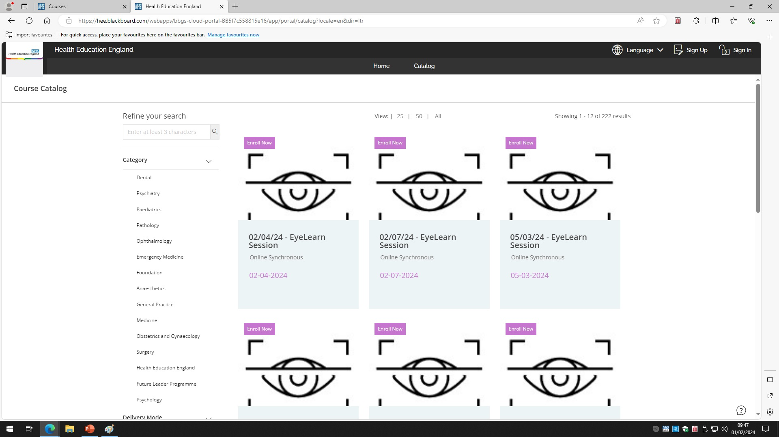

Slide 16
Educational SIA
One (?more) resident doctor Aug and Feb each year (12months in time whether LTFT or FT with one day per week for education) Aim first recruit Feb 26
Will deliver local teaching and education
Will contribute to regional teaching programme with the guidance of educational leads – Tamer and Selin
Met with HoS / deputy / educational lead to focus direction
Attend school board meetings to see direction of education
Attend East/ West or South STC meetings (dependant on doctor location)
Will be done alongside clinical SIA or stage 3 training
Competitive process by application of SIA education fellow (if significant interest)

Slide 17

Anaesthesia and ICM Residents Awards 2025
Non-clinical domains

Slide 18
Questions ?

