Slide 1



School of Anaesthesia & ICM Educational Support
Dr. Selin Kabadayi Education Lead
March 2026
ES Updates

Slide 2
Educational School Updates
YAIRN
Course Calendar
Important Courses
Exam preparation
YAIRN Advanced and YAIRN ICM Regional Teaching
Conferences
Blackboard
Upcoming ideas and projects
Run through of Education Website

Slide 3

YAIRN: http://YAIRN.co.uk
Yorkshire and Humber Anaesthetics and ICM Regional Network
A single point of access for Educational Events, Courses and Teaching within the region
Access to a School Courses Calender
Access to regional teaching programmes
Information about available courses within the region
Networks
YAIRN Core
YAIRN Advanced
YAIRN Exam
Yairn ICM

Slide 4


Slide 5
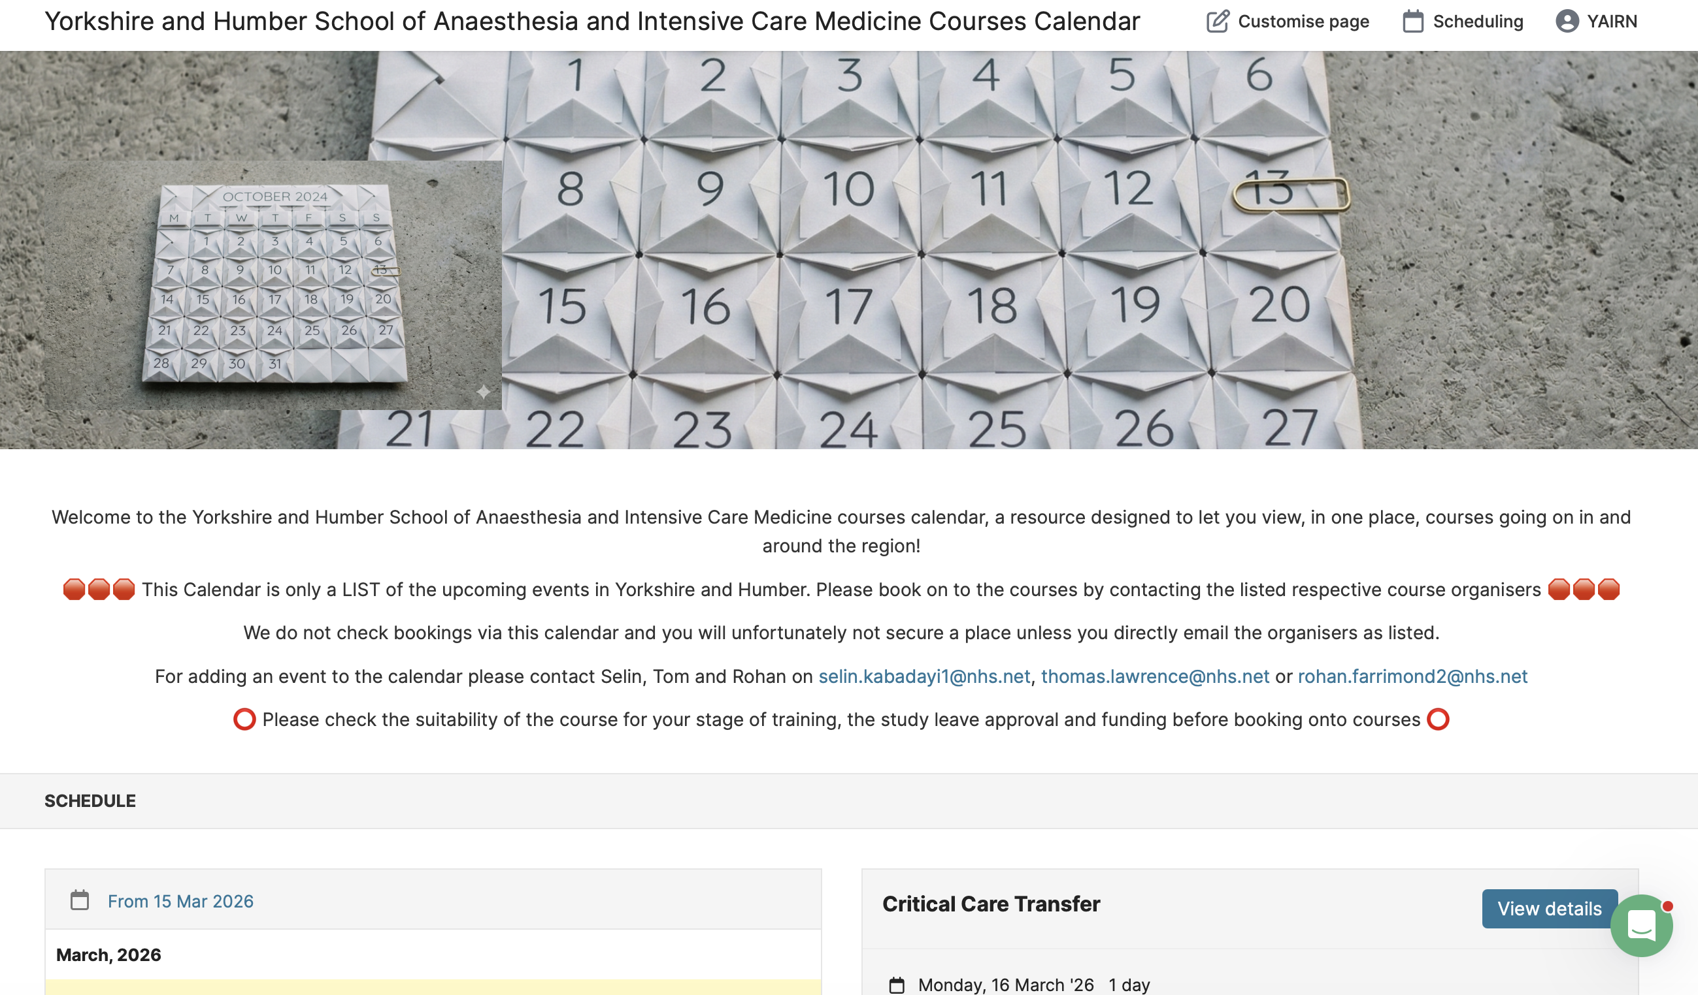
Course Calendar

Slide 6
Important courses Stage 1: YAIRN CORE
Critical Incident Course
Critical Care Transfer Course
Obstetric Anaesthetic Emergencies Simulation
PROMPT/BOASTY
ALS (in region)
Stage 1 Trauma Course
Leeds Sedation Course
EPIC 1
Regional Anaesthesia courses:
RANT-Y
MYRAG
HRAC
HUM
ST4 Anaesthetic Interview Courses

Slide 7
Important Courses: Stage 2 YAIRN ADvanced
Yorkshire Difficult Airway Workshop (YDAW)
East Yorkshire Difficult Airway Course
Regional
MYRAG
HRAC
HUM
Cadaveric course
CPET
Paeds
SPECS, SAFE, MEPA
EPIC 2
Obstetrics
TOAASTY, PROMPT
Trauma
Stage 2 Leeds and Sheffield Major Trauma Courses
Sheffield Children’s Advanced Trauma Course (CAT)

Slide 8
Deanery courses
Please also be aware of deanery courses too: https://www.maxcourse.co.uk/yhlsfd/guestCourseList.asp
This includes leadership and management courses, interview courses, managing imposter syndrome, enhancing confidence, managing stress, train the trainer, patient safety, communication, consultant interview courses, research and managing data
Explore the website to see what suits you at your point of training

Slide 9
YAIRN EXAM - Primary
SPARK SBA
Virtual Primary FRCA SOE Revision Day (Hull) – frcaheadstart.org
Primary FRCA VYVA Preparation Exam Course
Primary FRCA OSCE Online Revision Course
Mock Primary FRCA OSCE (MYTT, Barnsley, Hull, BRI)

Slide 10
YAIRN Exam - final
York Final Written Exam Revision Course
Hull Online FRCA Final Written Course
Sheffield FRCA Revision Written Course
CRQ Masterclass Teaching
VYVA Final FRCA SOE Prep Course
Virtual Final FRCA SOE Revision Day
Leeds Crammer

Slide 11
YAIRN EXAM - ficm
FFICM FIVA
FICM OSCE Prep COURSE
FICM Prep Course

Slide 12




Local resources to be aware of:
https://frcaheadstart.org
FFICM Prep https://fficmprep.wordpress.com
FUSIC SY: https://fusic-sy.co.uk
ORACLE: Online radiology for Critical Care and Acute Care

Slide 13
List of Stage 1-3 Recommended Courses:
https://www.yorksandhumberdeanery.nhs.uk/anaesthesia/regional-teaching-courses-and-study-leave/recommended-courses
Links to deanery website can be found here: https://yairn.co.uk/recommended-courses

Slide 14
Stage 1 teaching
Locally run in each hospital
Usually weekly novice teaching sessions
Allowing you to understand some basic concepts in pharmacology, physiology and physics
Often a combination of resident and consultant led
Often peer to peer
Found to be very beneficial by residents
Upcoming….Stage 1 Regional Teaching Programme

Slide 15
YAIRN Regional Teaching
YAIRN Advanced regional teaching programme for Anaesthesia
YAIRN ICM regional teaching programme for ICM
Pan-deanery teaching
Rotates every 2/3 months between regions within Y&H
Full day
Covers broad curriculum topics
There is also START: specialty trainee anaesthetic regional teaching in Sheffield.
½ day per month at STH
There is also East regional teaching – please look on https://yairn.co.uk/#regionalteaching
Post primary requires permission from CT to attend YAIRN Advanced/START training sessions
All regional teaching is on YAIRN.co.uk with links to sign up

Slide 16
Locally run conferences
YATC
The Yorkshire Anaesthetics Trainee Conference is an annual conference for trainees with an exciting programme and trainee presentations.
It is normally in October.
YICC
Yorkshire Intensive Care Conference is annually at the Yorkshire Wildlife Park in May.
May 14th and 15th, 2026
It is a super day of interesting sessions from national experts
LACTIC
The Leeds Acute and Intensive Care Conference is September 24th-25th 2026.
2 day conference with excellent talks and workshops

Slide 17
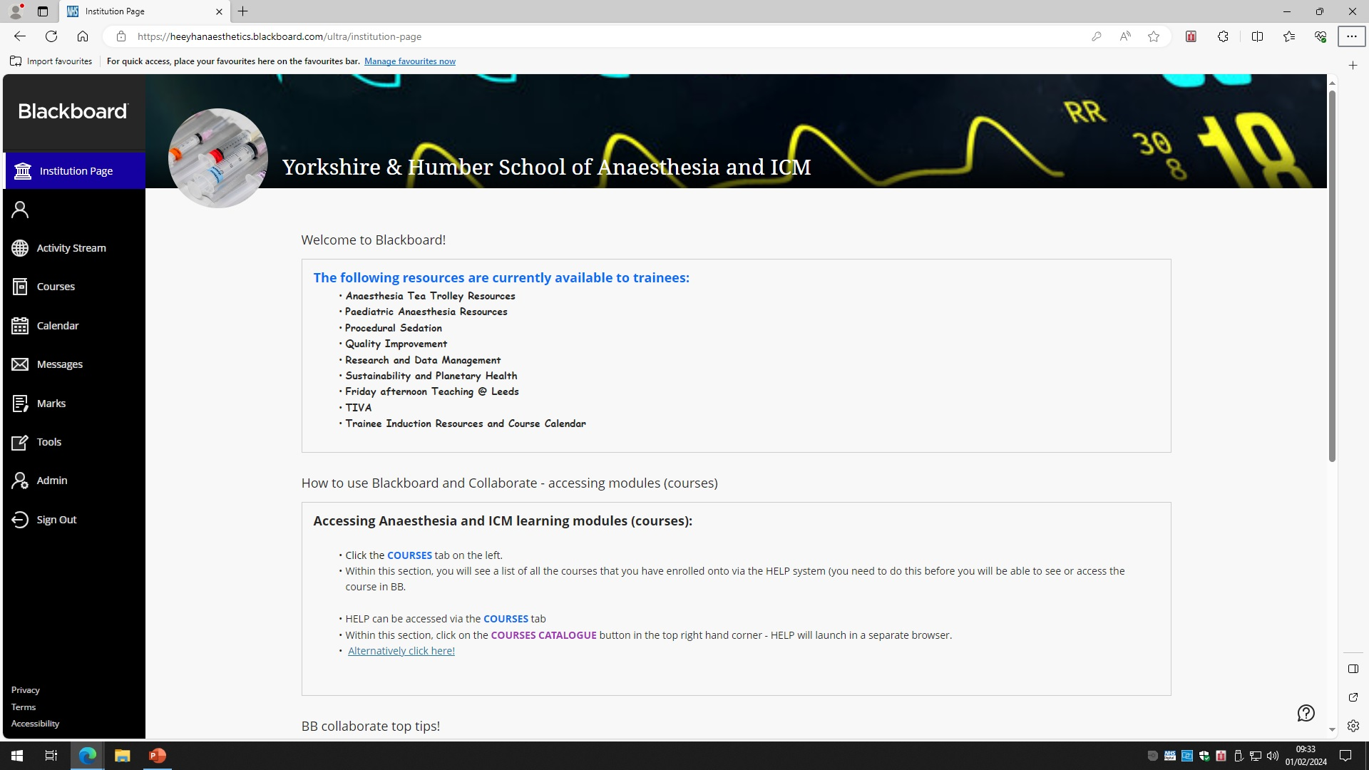
Blackboard

Slide 18
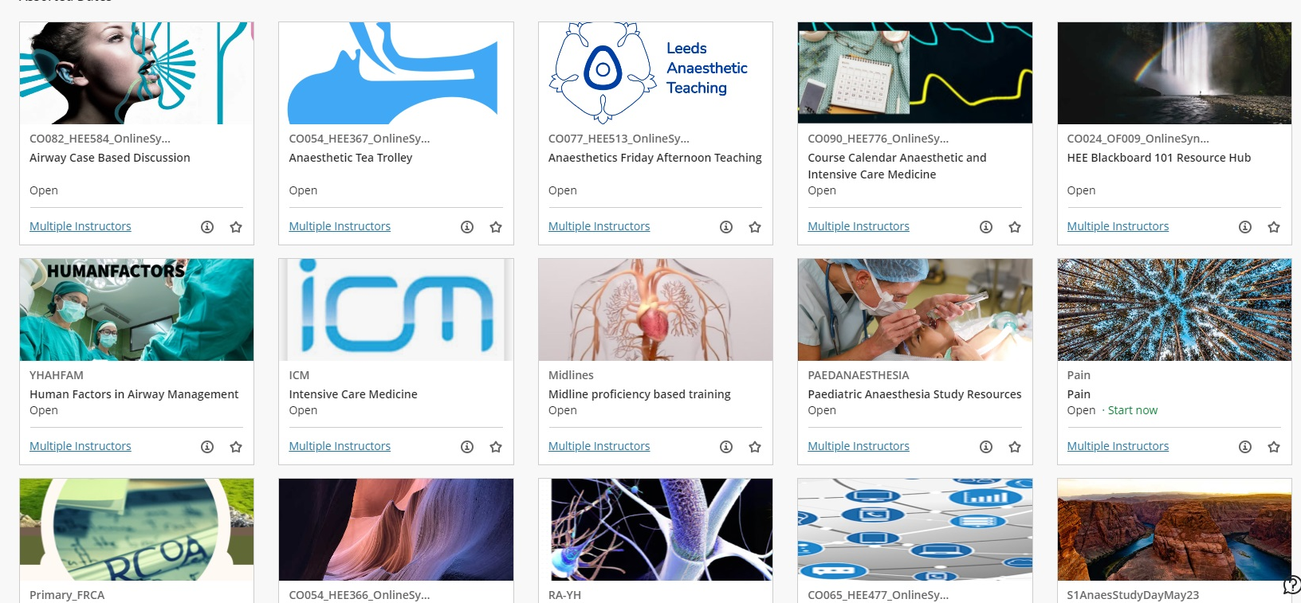
Useful modules for the new starter
Trainee Induction Resources
Course Calendar
Procedural Sedation
TIVA
Research and data management
Quality Improvement for Anaesthetists
Pain
Exam preparation courses

Slide 19
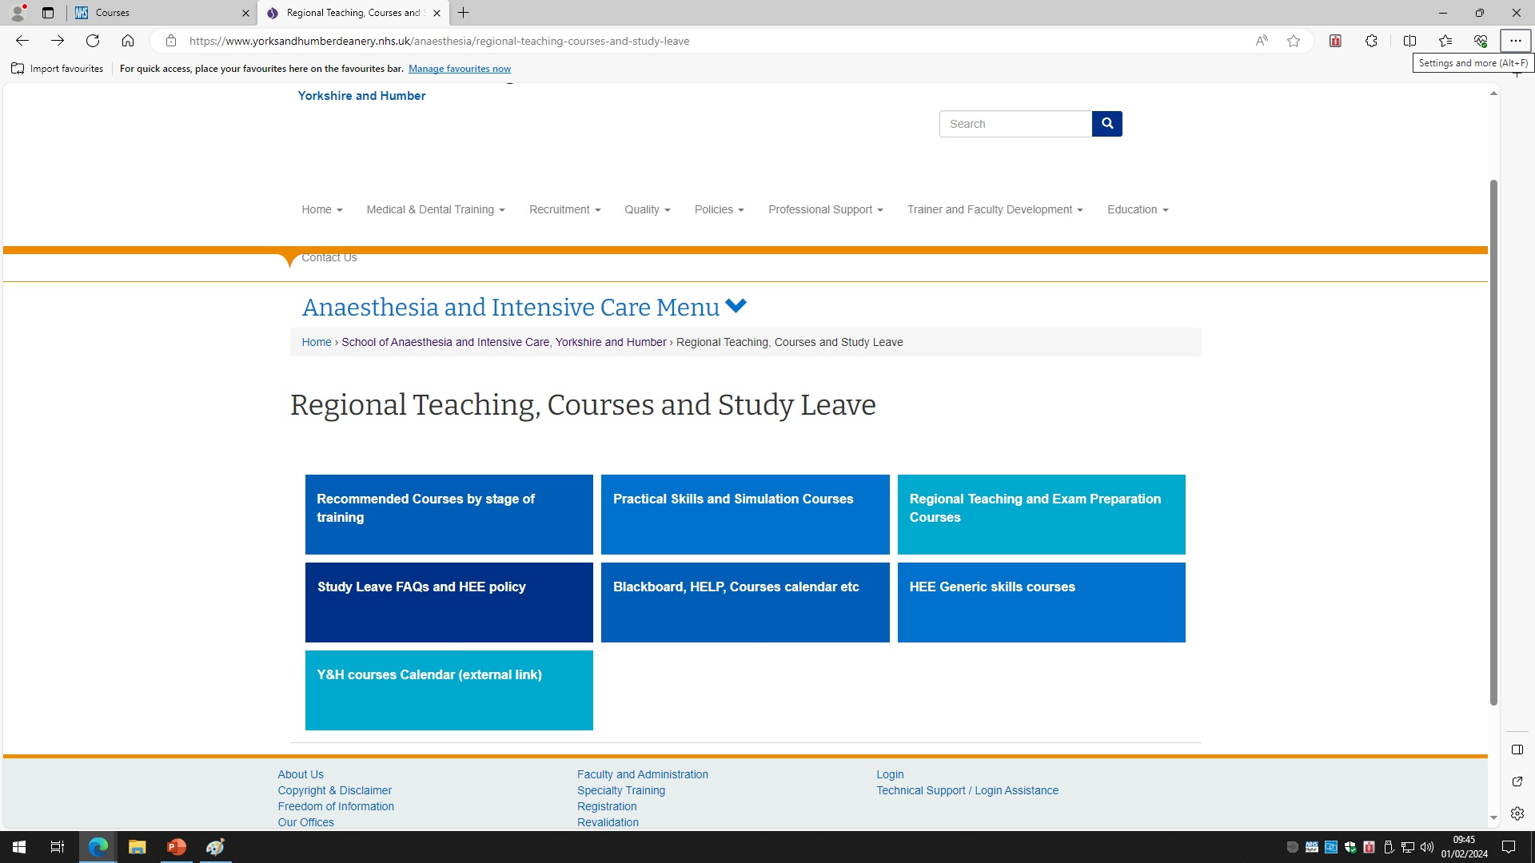
How to access?

Slide 20
Upcoming Plans and Events
SIA (AC to explain in more detail)
Quarterly Newsletter
Stage 1 Regional Teaching Programme
Educational Resources page on YAIRN.co.uk
Survey completed
Apps
Links to FOAM
2026 Yorkshire and Humber School of Anaesthesia and ICM School Conference – Nov TBC

Slide 21
YAIRN
Run through of education website:
https://yairn.co.uk

Slide 22
Questions ?

