Slide 1
Curriculum and Assessments:
Trainee Perspective
Dr Erica Morris
ST7 Anaesthesia & Intensive Care Medicine
Notes:
.’

Slide 2


Onboarding for the ICM CCT Programme!

Slide 3
You are now an Intensivist in Training (IiT)
Step 1: Read the ICM CCT Training Guide/save it
Step 2: Meet your RA/TPD – talk about what YOU need based on previous experience, individual circumstances and educational needs.
Step 3: Register with FICM as a IiT (there’s a pre-registration check list)
Step 4: Post registration you’ll receive;
Membership confirmation letter with CRN, payment (£175) etc
Access to Lifelong Learning Platform (LLP)
Confirmation of Postgraduate Training (sent to RA and TPD)

Slide 4
Your Faculty
Head of School & Lead for ICM
Dr. Raj Sandhu (Pinderfields - Wakefield)
Training programme directors (across whole Y&H)
Dr. James Morgan (West & East) (Bradford)
Dr. Kris Bauchmuller (South & East) (Shefield)
Regional Advisors
Dr. Richard Briscoe- West Yorkshire, Leeds & Bradford (Bradford)
Dr. Duncan Tarry- North-East Yorkshire & North Lincolnshire (York)
Dr. Helen Ellis - Sheffield & South Yorkshire (Sheffield)
Local
College & Faculty Tutors in each hospital
Educational & Clinical Supervisors
Same ES throughout training period

Slide 5
Get familiar with the programme
Organisation is key, aim to be efficient.
Get familiar with;
ICM CCT Curriculum
ICM Curriculum Assessment Guidance
FICM Lifelong Learning Platform (portfolio)

Slide 6


ICM CCT Curriculum

Slide 7
ICM CCT Curriculum
Stage 1 – CT1-ST4
Completion = at least 12 months each Anaesthesia, ICM and Internal medicine plus training programme exam.
Stage 2 – ST5-6
12 months ICM training in specialist areas of practice – eg paediatric ICM, neuro ICM, cardiac ICM
12 months – Specialist Skills Year
Completion of FFICM examination
Stage 3 – ST7
12 months – higher level management/administrative skills working towards autonomous practice

Slide 8
Special Skills Year
*Additional Medicine, Anaesthesia or Emergency Medicine
Home ventilation
Research
Cardiothoracic Intensive Care
Neuro Intensive Care
Paediatric Intensive Care
Echocardiography
ECMO
QI
Transfer
Education
PHEM

Slide 9

High-Level Learning Outcomes (HiLLOs)
Professionalism
Patient Safety and QI
Research and data interpretation
Teaching and training
Resuscitation, stabilisation and transfer
Investigation and management of the critically ill
Perioperative medicine inc pain mx
Consequences of critical illness and end of life care
Leadership & management
Anaesthesia
Medicine (ward based care)
Neuro-intensive care
Paediatric emergencies
Cardiothoracic ICM

Slide 10
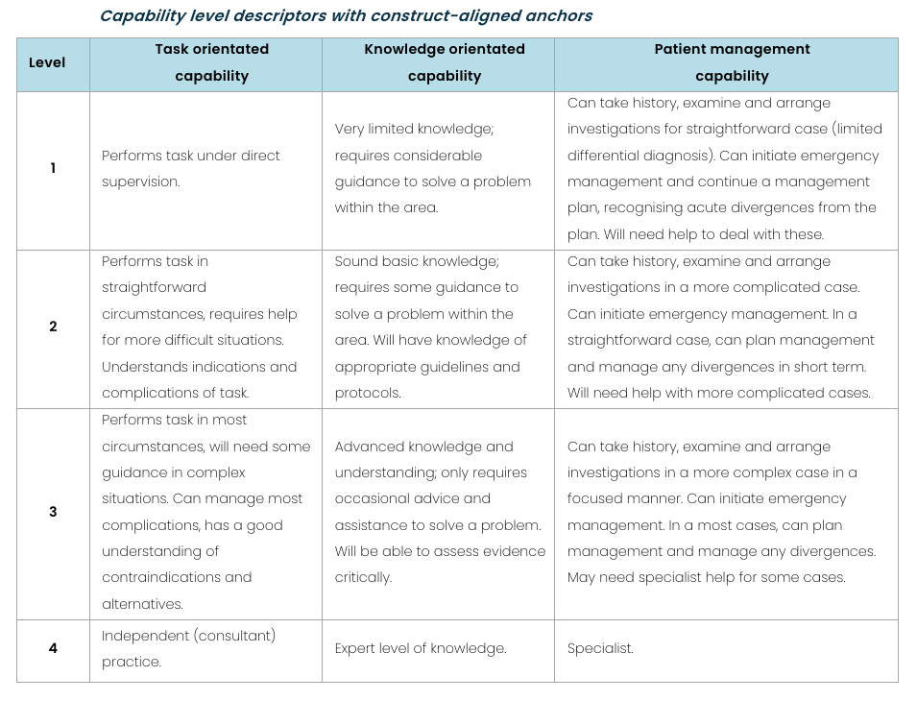
Entrustment scales

Slide 11
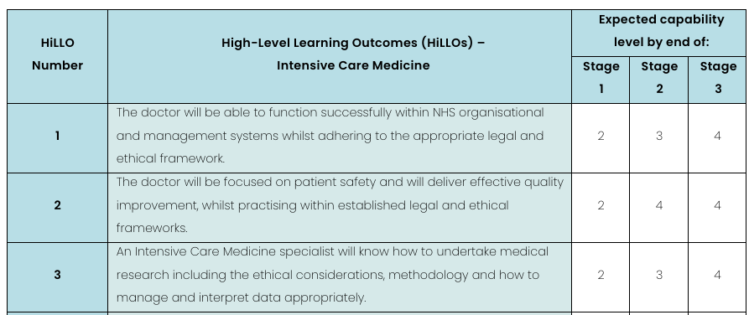
Know what you’re aiming for

Slide 12

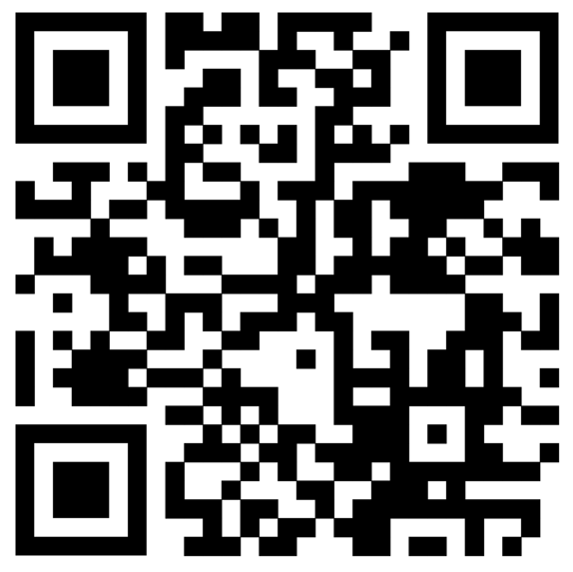
ICM CCT Assessment Guidance

Slide 13
Formative Assessments
Supervised Learning Events – SLEs
CEX, CBD, DOPS, ACAT
Use these to reinforce learning opportunities.
Should demonstrate a journey of progression, development and improvement towards independent practice by CCT.
No indicative numbers and an assessment can be linked to multiple HiLLOs (as relevant).
Crosslink from your parent specialty portfolio where relevant – particularly for HiLLOs 1-4 that focus on generic professional capabilities (GPCs), your other specialty will also be assessing these.

Slide 14
Summative Assessments
FFICM Examination
Learning Outcome Completion (LOC) forms – completion of HiLLO for stage of training

Slide 15
Other evidence
Development courses
Teaching sessions (attended and delivered)
Simulation
E-learning (e-lfh)
Multi-Source Feedback (MSF)
Multiple Consultant Reports (MCR)
Logbook (particularly procedures log)
Reflections

Slide 16
Tour of the portfolio

Slide 17
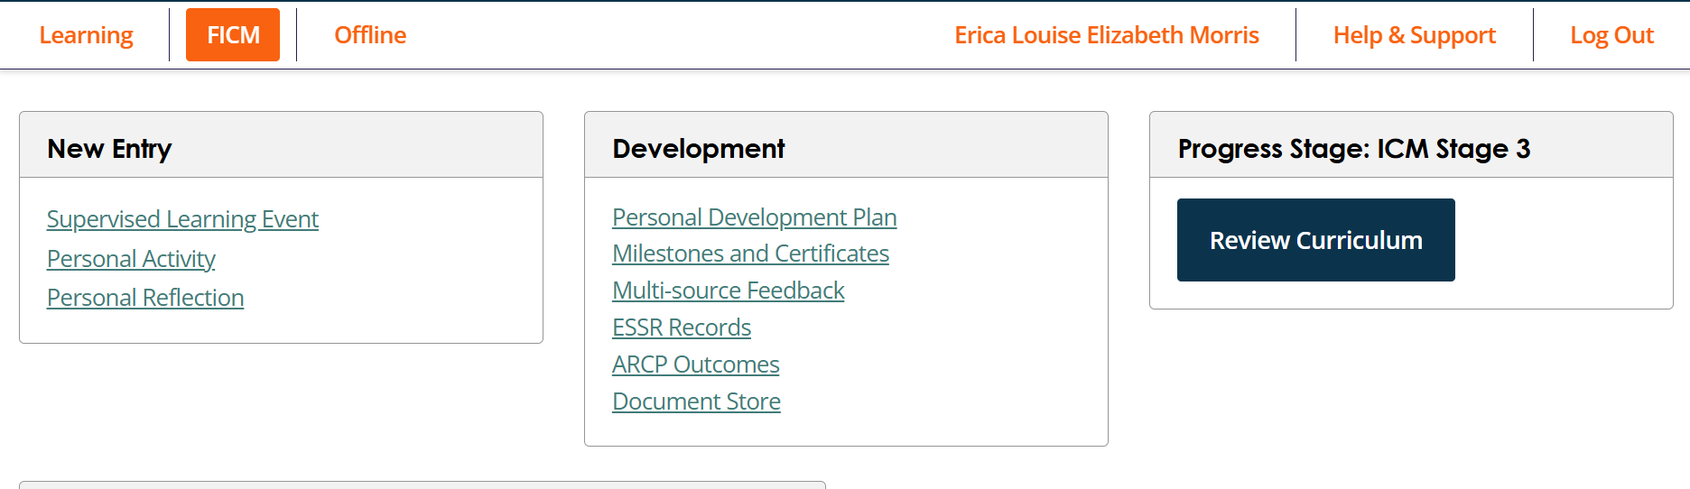
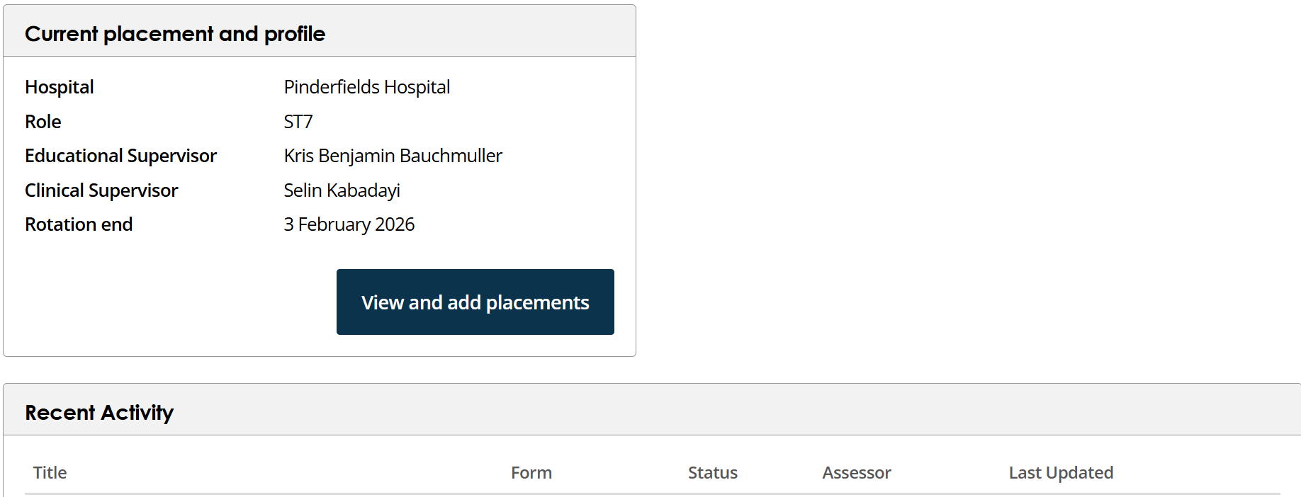
Access HiLLOs
Create Content
Official forms

Slide 18
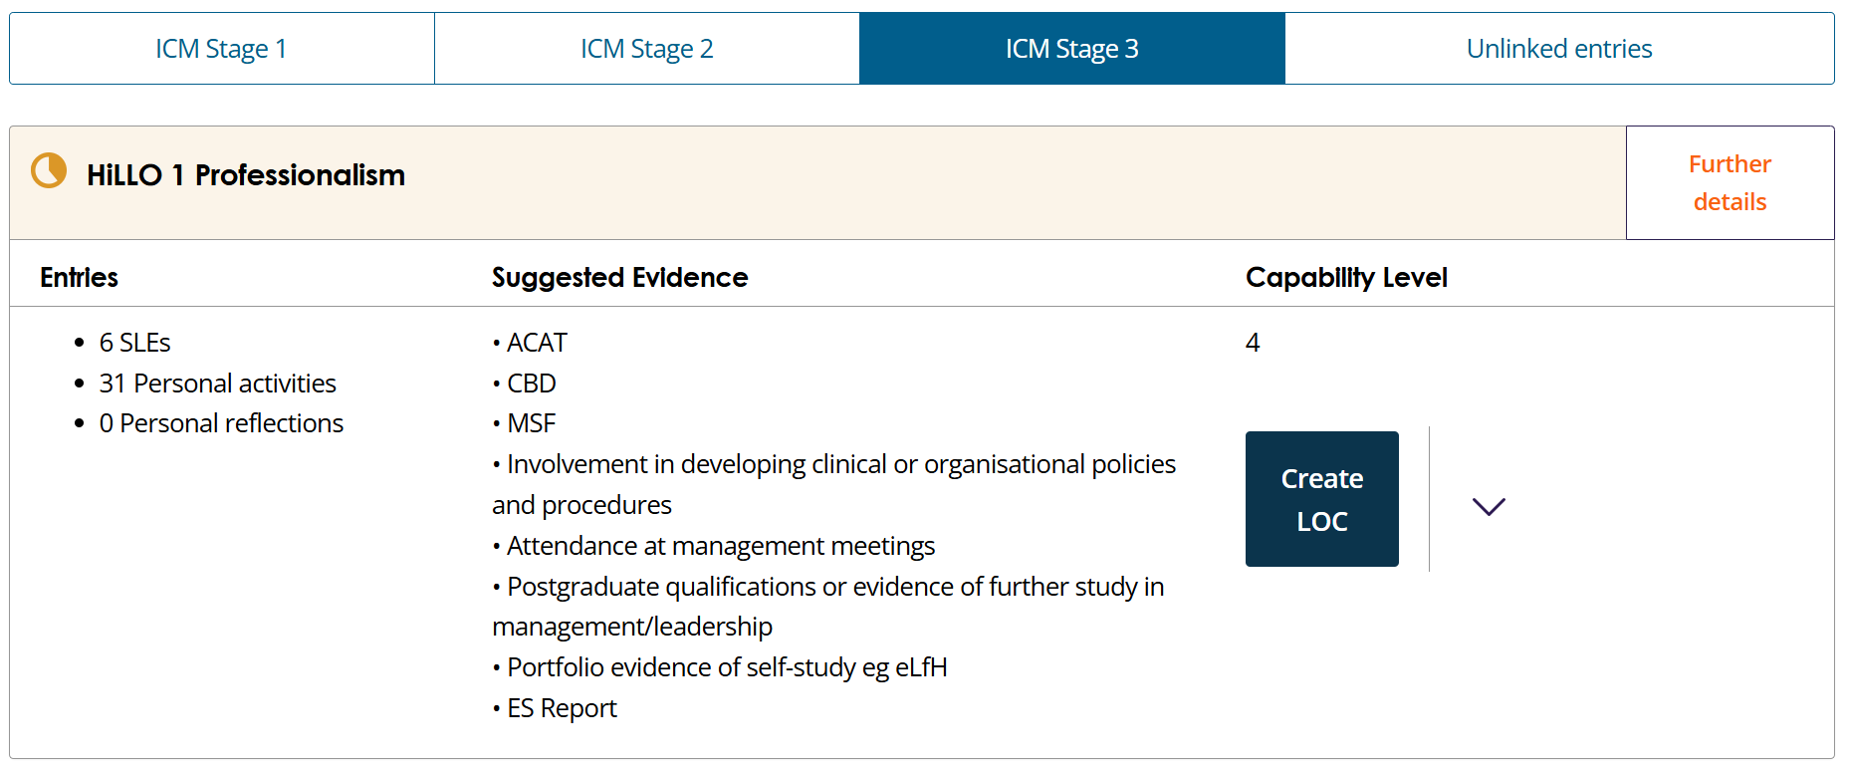
Same HiLLOs for each stage of training
Gives more information on each HiLLO
Red – no evidence
Yellow – in progress
Blue – LOC submitted
Green LOC Completed
See what has already been linked to this HiLLO

Slide 19
Personal Development Plan (PDP)
Essential tool for:
Organised (allow things to happen when you want them to)
Realistic (setting achievable goals
Personalised (focus on your interests – esp post FFICM)
Steady progression (aim to consistently, progress gradually up the spiral)
that can help you foster a
Healthy work life balance (look at what is going on in your personal life – does it fit with your work goals?)

Slide 20
Logbooks
Need to keep one throughout training – try and do it regularly.
No requirement to log every patient involvement but probably good practice to log:
Airway management
Procedures
Transfers
Trauma calls/cardiac arrests
Referrals/admissions
Options:
LLP logbook (Anaesthesia)
Sunderland ICCU Logbook.
Northwest ICU logbook
Excel spreadsheet
Anything you can upload to the LLP

Slide 21
Exams
Delivered by the RCoAs examinations department
Two sittings per year- Spring/Autumn
Can attempt MCQ from Stage 1
MCQ - Single best answer questions
SOE/OSCE - 1st sitting taken together
Must be taken within 3 years of MCQ pass
Need to complete FFICM to progress to Stage 3
Lots of revision support in the region

Slide 22


Study Leave
KEY POINTS
You are allowed 30 days per year to attend educational activities
You will only be funded to attend courses/activities required for Curriculum Delivery
There are recommended courses for each stage of training.
You must apply in advance according to the requirements of your local Post Graduate centre (usually 6-8 weeks). Applications less than 6 weeks in advance may be rejected when you try to claim the money back

Slide 23
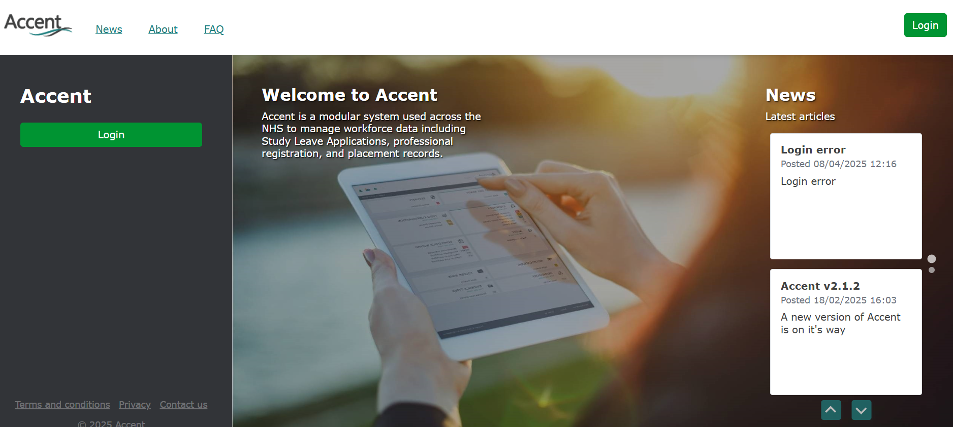
You need to create two accounts...
ACCENT – to request the leave and funding

Slide 24
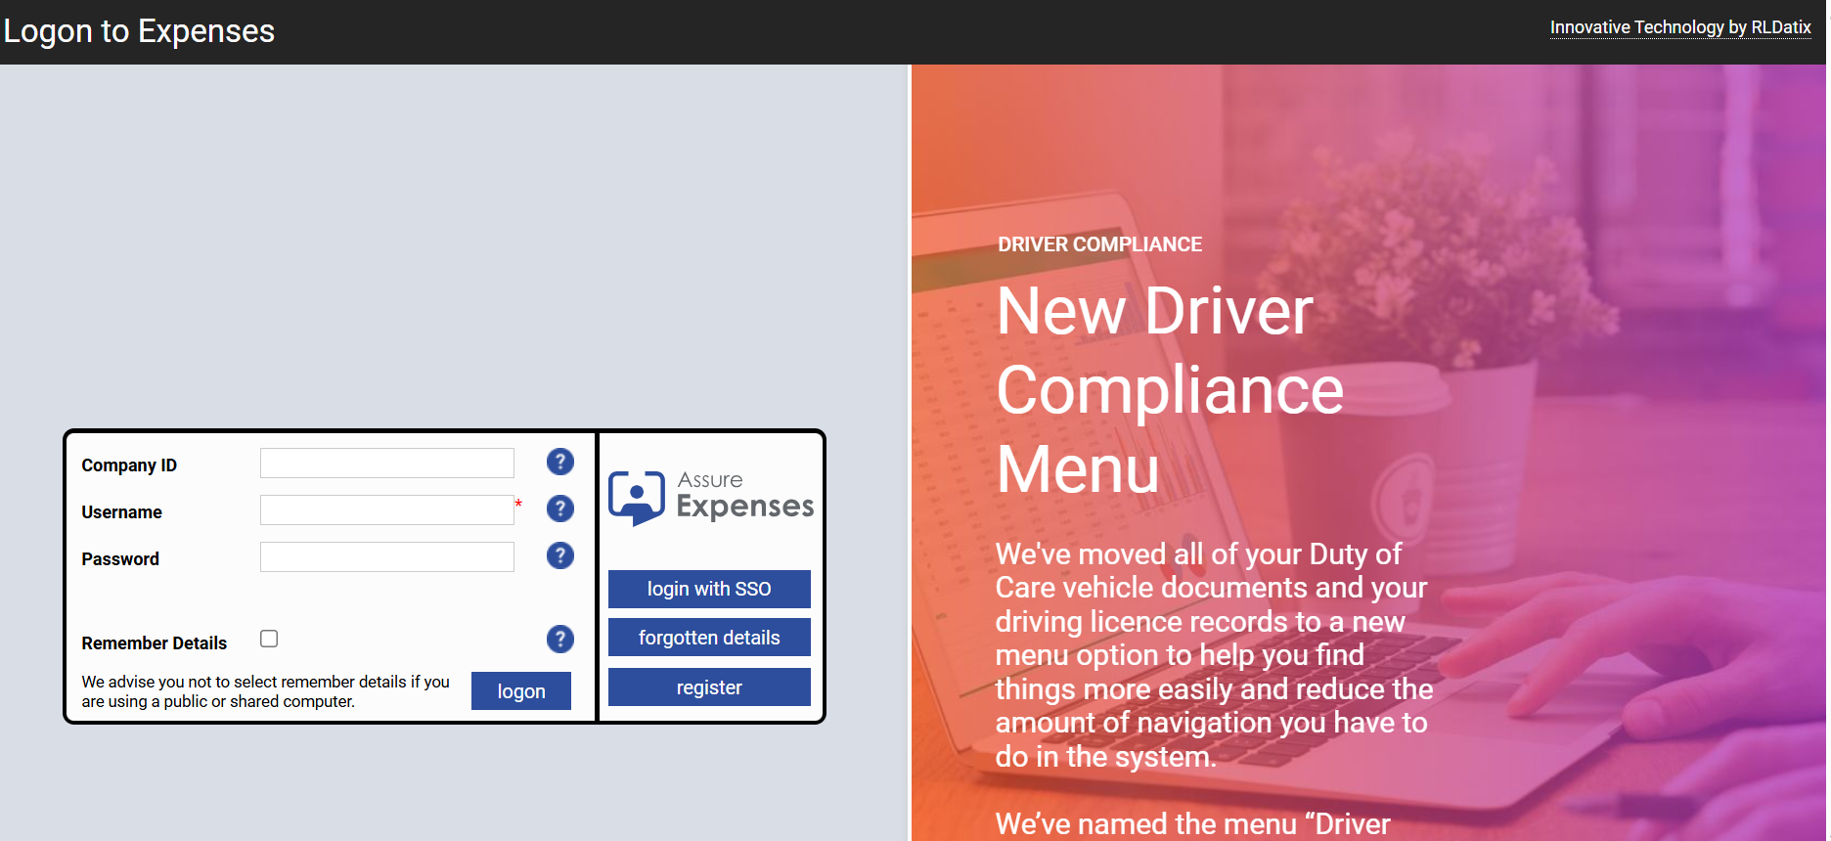
You need to create two accounts...
SEL-EXPENSES – to request reimbursement of fees and expenses

Slide 25
The SL admin…
Look for the course you want
Check that you can get time off/it will be funded (check rota/email TPD)
Apply for course (and pay)
Book leave via your hospital leave process
Request leave on ACCENT including the funding (educated guess, need this to get Sel-expenses)
Attend course
Apply for re-imbursement course fees and expenses on SEL-EXPENSES
Money appears in pay-check

Slide 26

Staying well
ICM is a challenging job
This training programme is challenging
Life can be challenging
Expect to have tough times
Know you are supported;
CS/ES/FT/TPDs/HoS/Reps
Y&H Professional support (QR code)
Your hospital ‘staff perks’ eg Vivup
Tough times can allow growth – eg coaching

Slide 27
Thank you

