Slide 1
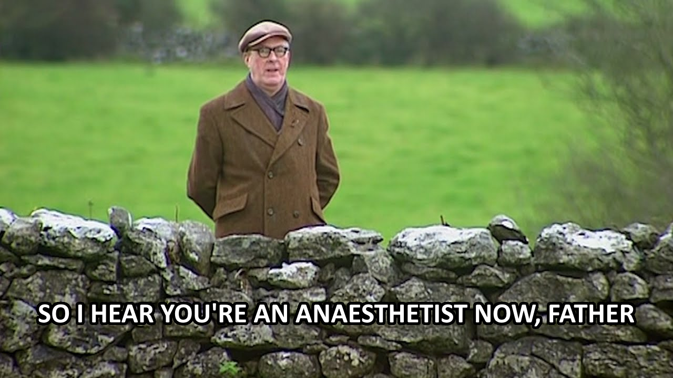
Ct1/accs2 and beyond
Dr Joe Gleeson-Buddhdev

Slide 2
Rough Structure of the year*
Time | Training | On Calls
February-May (First 3 months) | Completing IAC | None or acute theatres
May-August | Anaesthetics | Acute theatres
August-February | ICU | Acute theatres or ICU
* You may do ICU first then IAC
* If core trainee you may not do the full 6 months ICU in CT1
* If LTFT – IAC is competency based rather than time based so may still be doable in 3 months at 80%, but ICU is time-based so you need 6 months FTE
The only thing that is mandatory this year is the IAC

Slide 3
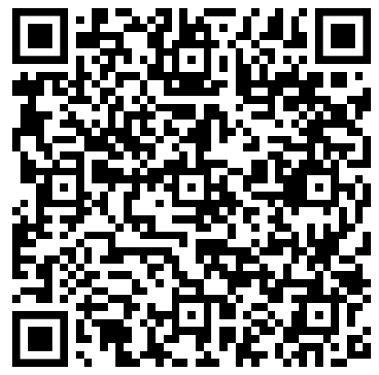
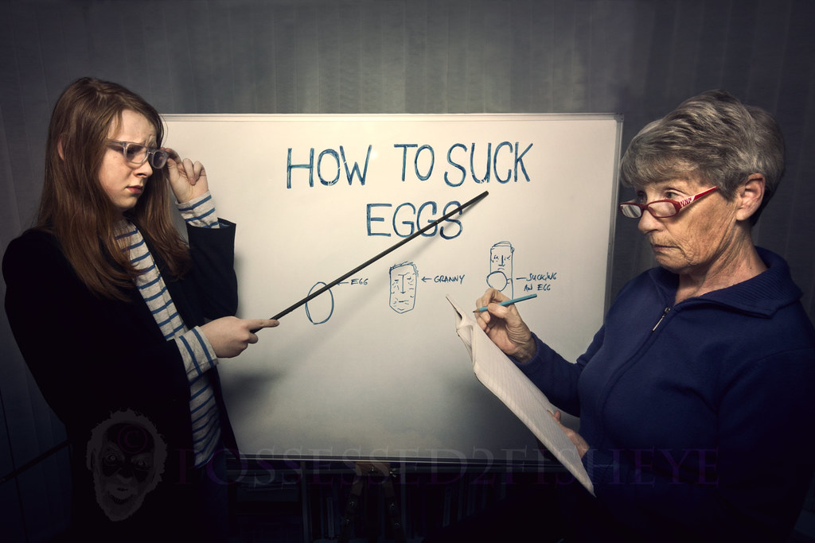
The iac
EPA 1 – Perform a preop assessment
EPA 2 – GA for ASA 1-2 uncomplicated surgery
Both supervision level 2B (supervisor in hospital)
Tips –
Send an SLE every day!
  Discuss entrustment level with the trainer at the time

Slide 4
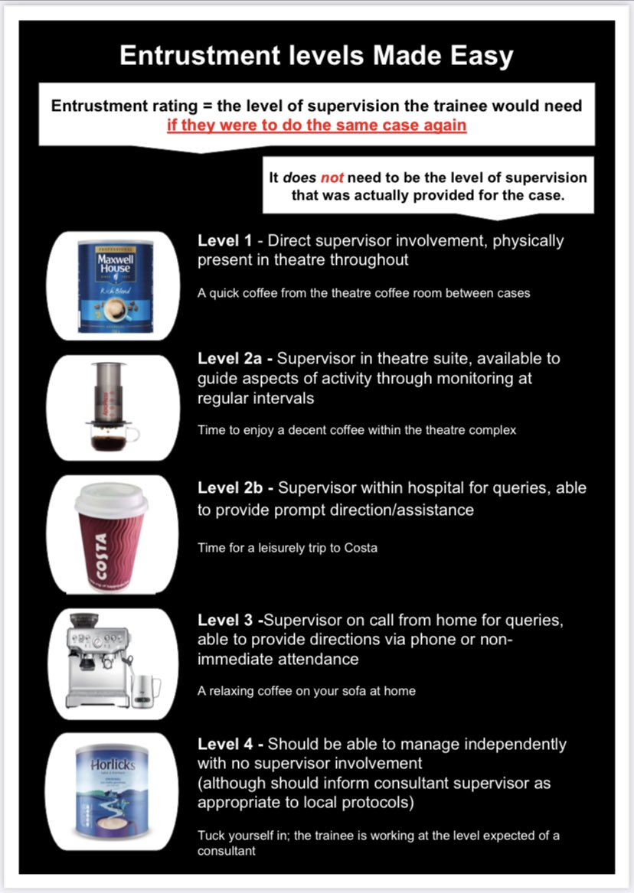

Slide 5
The iac
EPA 1 – Perform a preop assessment
EPA 2 – GA for ASA 1-2 uncomplicated surgery
Both supervision level 2B (supervisor in hospital)
Tips –
Send an SLE every day!
  Discuss entrustment level with the trainer at the time
Link SLEs to other bits of the curriculum (more later)
MTR needed – has to be initiated by your ES so time asking them to do this correctly!

Slide 6
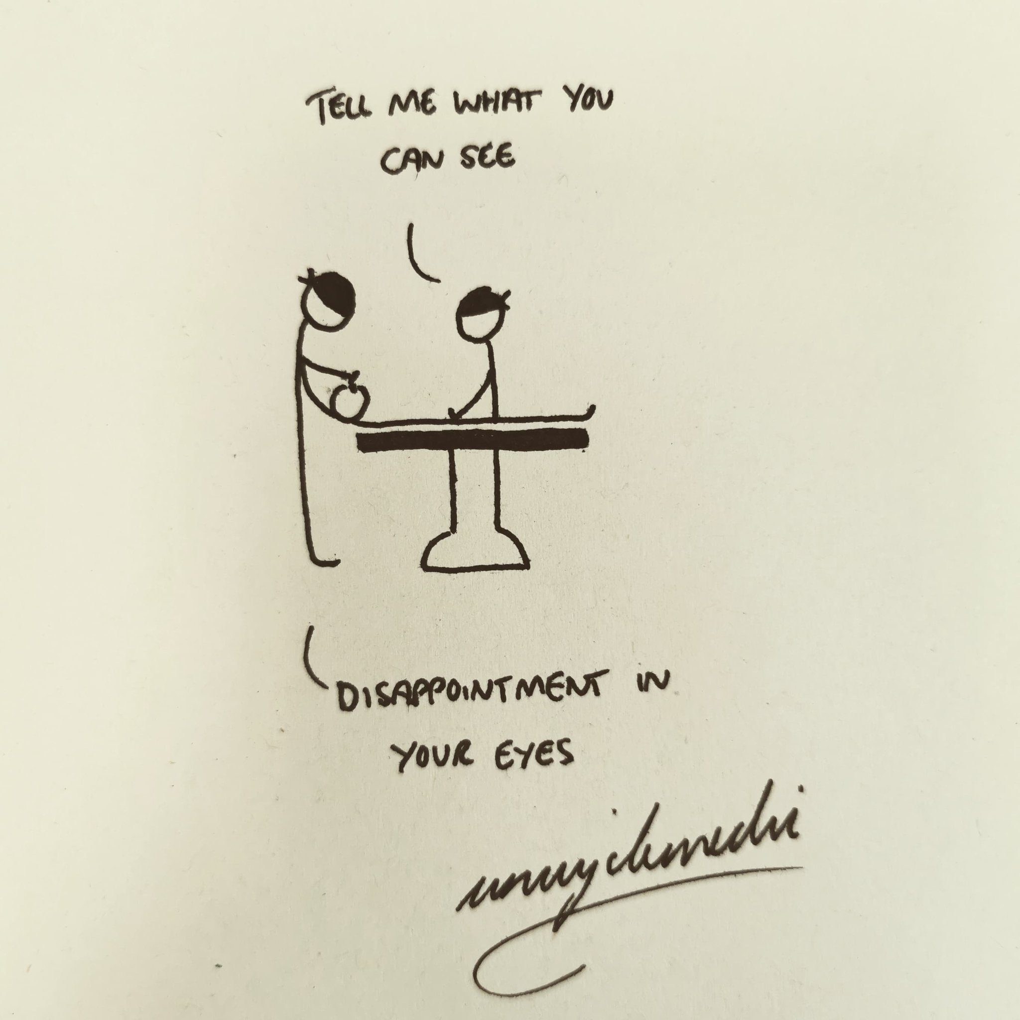
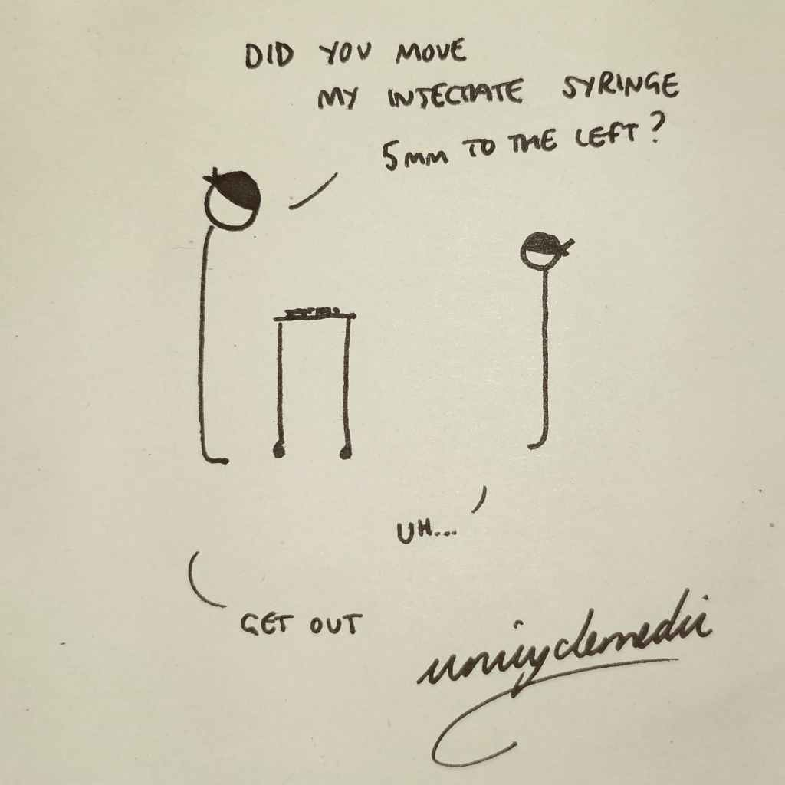
More iac tips
Expect to be tired
Expect to have days where nothing goes right
Expect everyone else to look like they know what they’re doing!
Anaesthetics is like making spag bol
Remember to enjoy it!

Slide 7
Stage 1
Rest of CT1/ACCS2 – consolidate & get exposure to other bits of anaesthetics, + ICU
CT2/ACCS 3 – obstetrics EPA 3 & 4 & work towards other HALOs
CT3/ACCS 4 – complete all HALOs
GPCs | Clinical
Professional Behaviours and Communication | Perioperative Medicine and Health Promotion
Management and Professional and Regulatory Requirements | General Anaesthesia
Team working | Regional Anaesthesia
Safety and Quality Improvement | Resuscitation and Transfer
Safeguarding | Procedural Sedation
Education and Training | Pain
Research and Managing Data | Intensive Care
CCC Paeds
CCC Obstetrics
Critical incidents
Airway
Obese
Elderly
Non-theatre anaesthesia
TIVA
Major Trauma

Slide 8

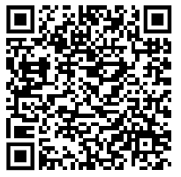
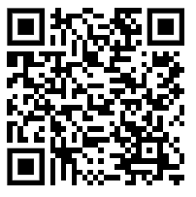

courses
Need to be proactive in looking & booking
Plenty of free courses
Sometimes need to pay up front & expense (get approval via Accent first then put claim into hospital)
Discretionary funding may be available on discussion with TPD, usually no more than 1 non-core course/conference in Stage 1
Deanery Courses List
Courses Calendar

Slide 9
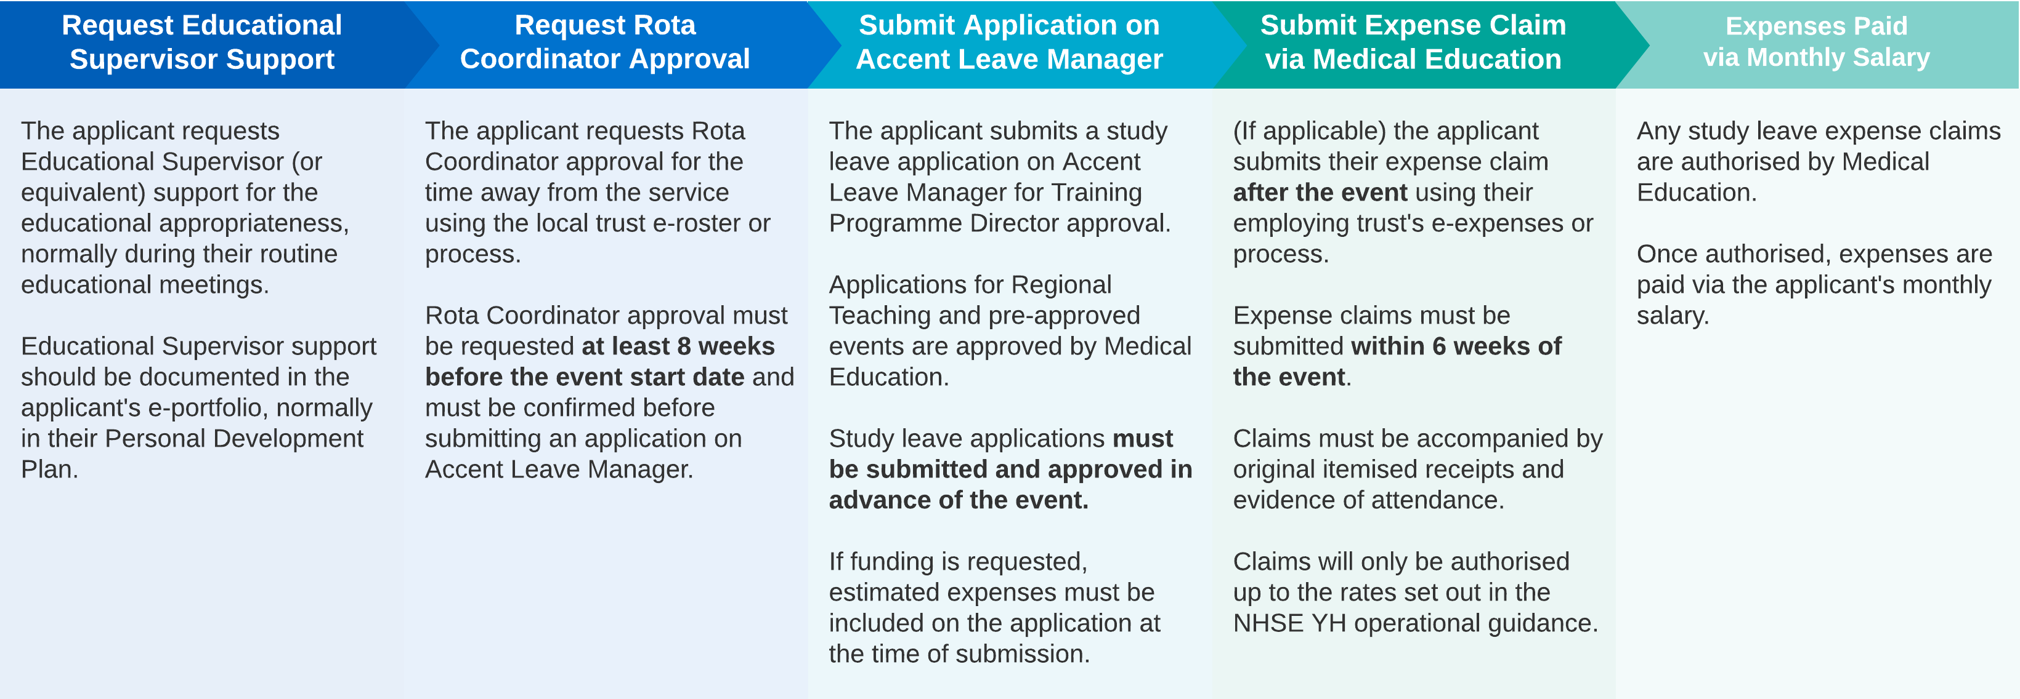
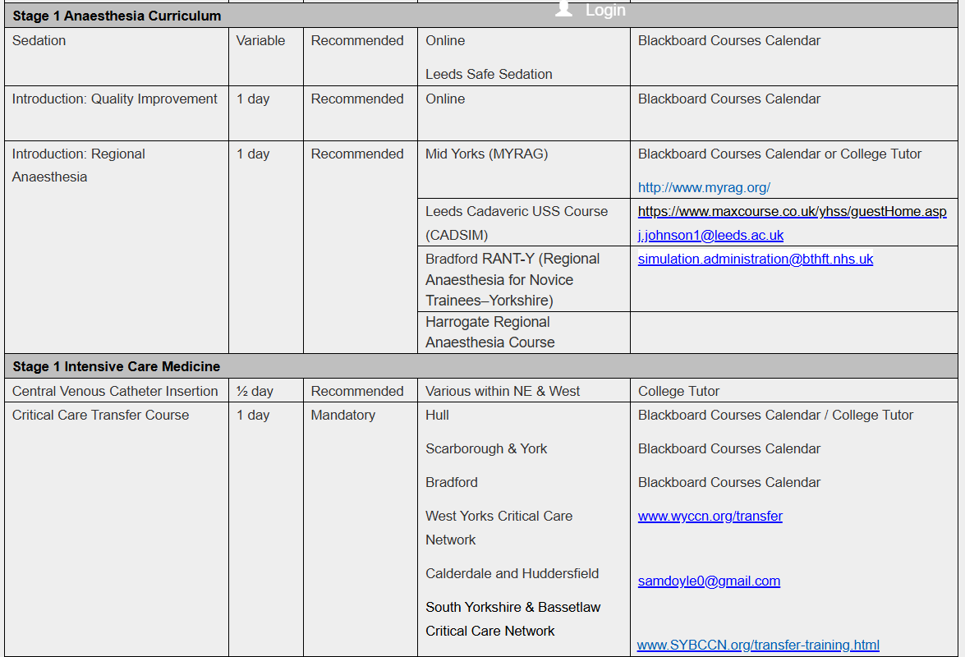
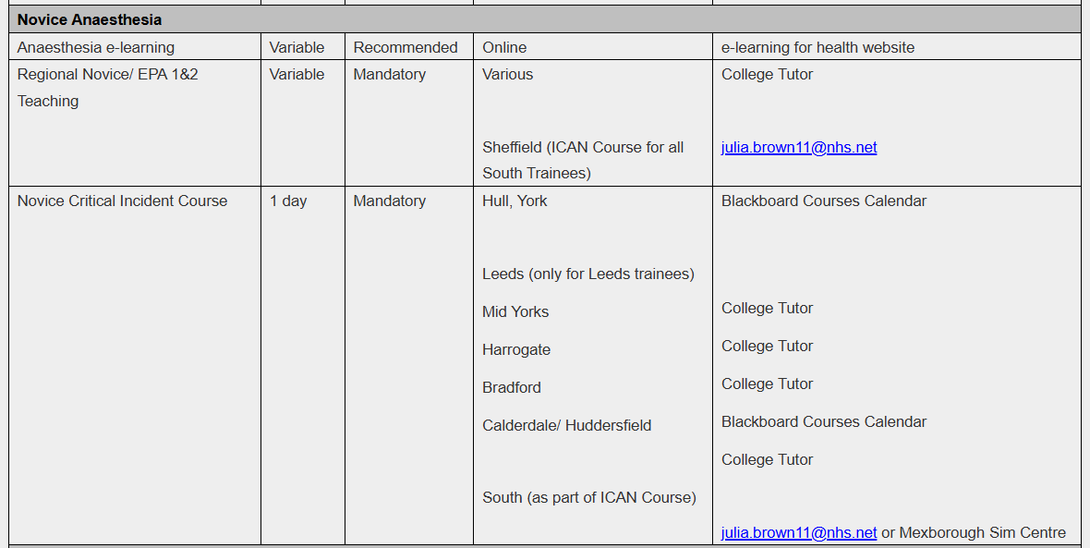
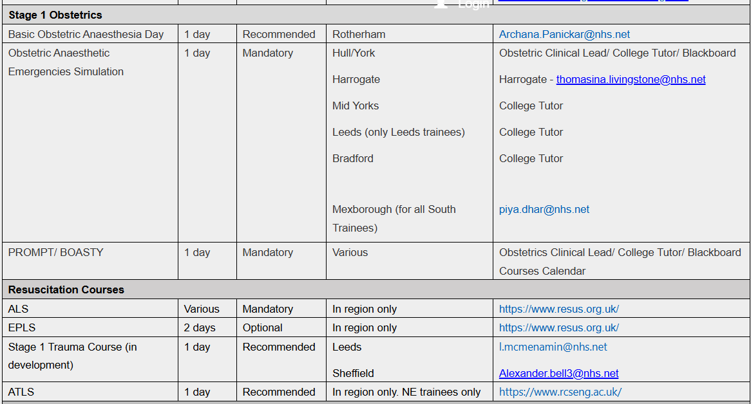

Slide 10
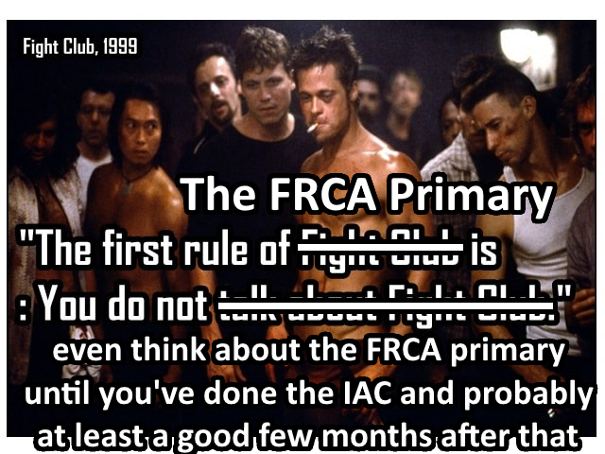
The exam

Slide 11
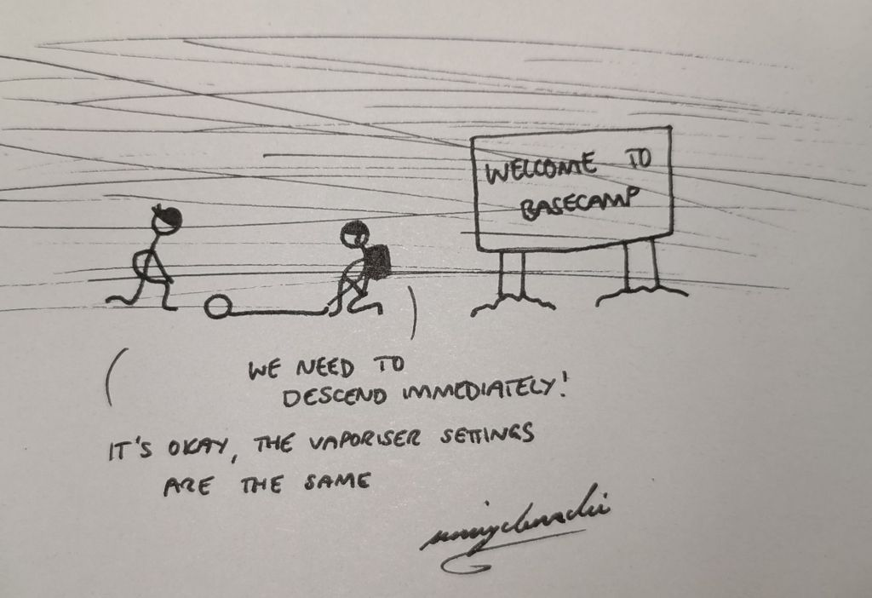
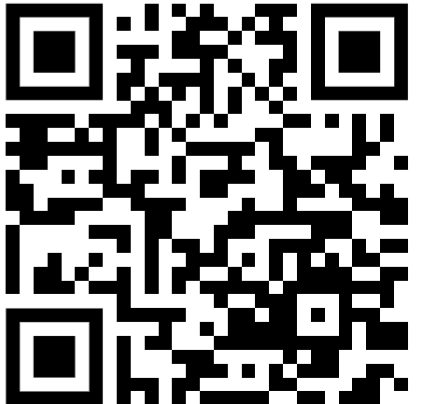
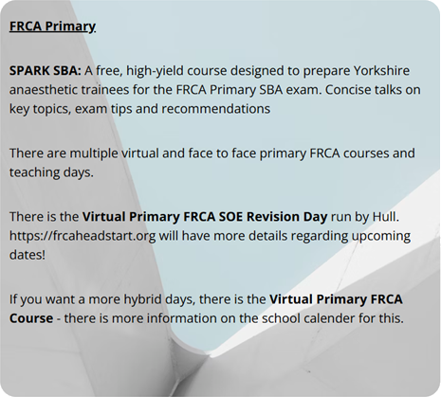
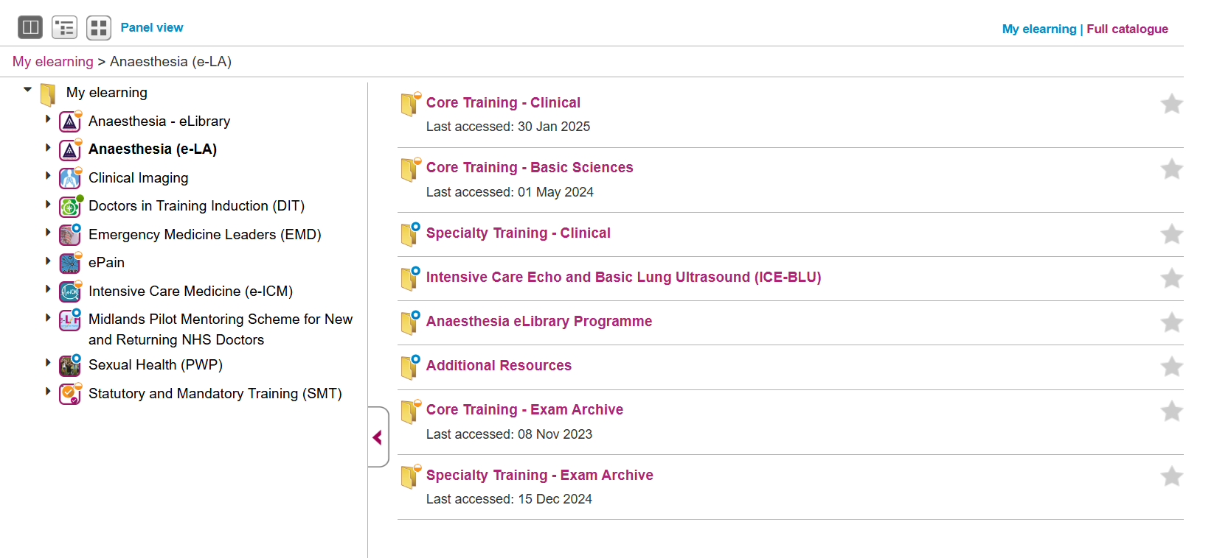
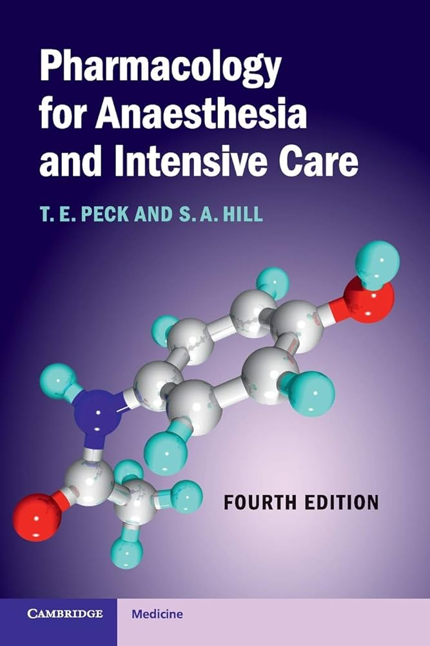
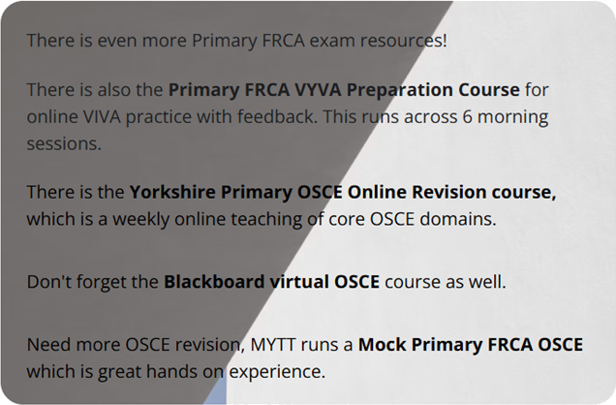
The exam
SBA then Viva + OSCE (may change!)
Physics, Physiology, Pharmacology, Clinical
SBA sittings – September, November, February
OSCE/Viva sittings – November, January, May
5 days independent study leave for the whole exam

Slide 12
Any questions?
jgleeson@doctors.org.uk

