Slide 1
ACCS CT1
Educational supervision
Dr Alison Colhoun
Deputy Head of School

Slide 2
The ACCS CT1 /2 years- in a nutshell!
6 months IM
6 months EM
6 months AN – EPA 1 & 2 IAC
6 months ICM – ICM HALO
All those in ACCS AN / ACCS ED and ACCS IM (no training programme in Yorkshire for this) should all have same competencies

Slide 3
Why so they need AN as ES for year one?
Career advice
Knowledge of training programme
Belonging
Courses / teaching etc

Slide 4
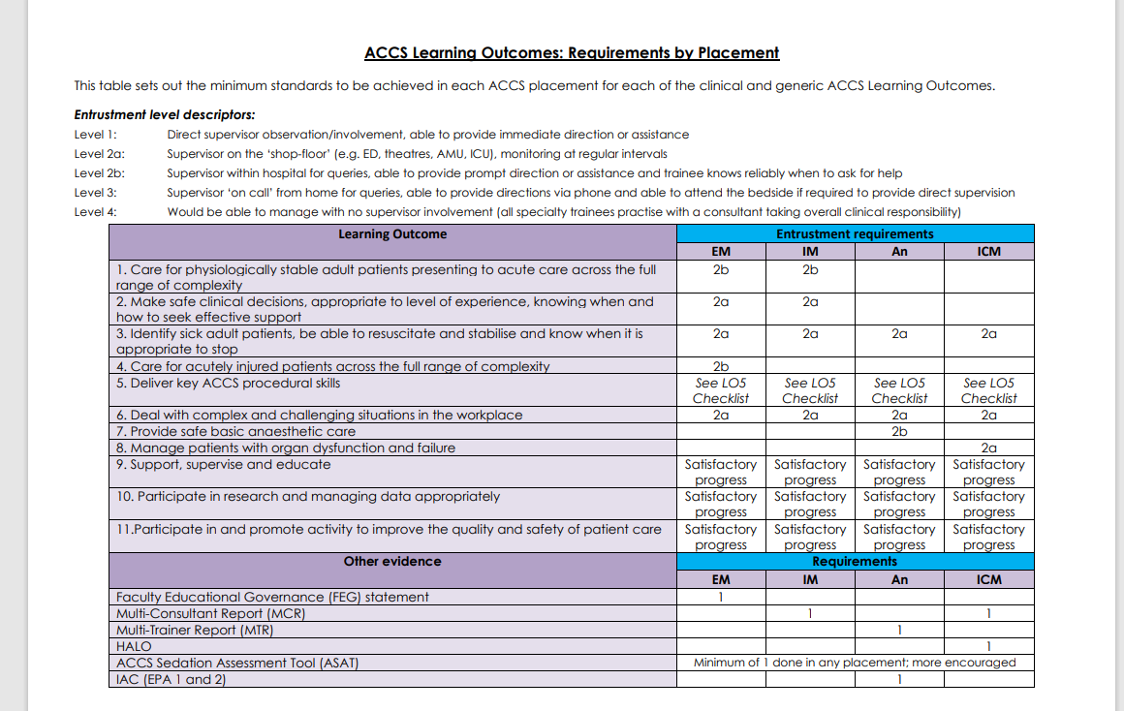
What must be done in year 1?

Slide 5
What must be done in year 1?

Slide 6
There are procedures in LO5 easier accessed in CT1
Pleural aspiration of air or fluid
Chest drain: Seldinger and open technique
Establish invasive monitoring (CVP and Art line)
Vascular access in emergency- IO, femoral vein
Lumbar puncture
Fracture/dislocation manipulation
External pacing
Point of care ultrasound- Vascular access and Fascia iliaca block

Slide 7
There are procedures in LO5 easier accessed in CT1
Pleural aspiration of air or fluid
Chest drain: Seldinger and open technique
Establish invasive monitoring (CVP and Art line)
Vascular access in emergency- IO, femoral vein
Lumbar puncture
Fracture/dislocation manipulation
External pacing
Point of care ultrasound- Vascular access and Fascia iliaca block

Slide 8
Easy wins for non-clinical LO 9-11
LO 9 Teaching - Med student teaching
LO10 Research and Data – GCP
LO 11 QI
  NHS improvement academy bronze award
  Need to do one QIPAP in 2 years

Slide 9
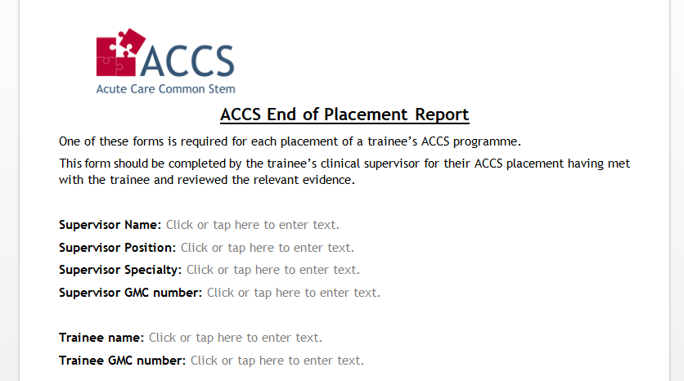
End of placement reports
These need to be downloaded from ACCS website (or RCOA website), completed by CS and uploaded to LLP

Slide 10
Sedation (recent changes) by end CT2
Ideally ASAT
However not on LLP
Will accept SLE with 2a supervision level by end CT2
HALO to be complete by end CT4

Slide 11
If you don’t remember anything else
You are their link to a specialty they really want to do
LO 1,2,4 complete
Add to all other LO except 7/8 (they are AN and ICM)

Slide 12
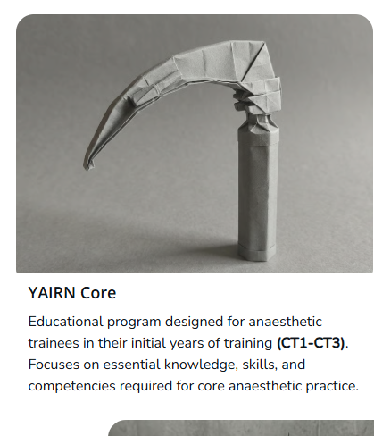
Progress for 2026-27
6 monthly pan deanery teaching in Hull and Leeds
South have CART
Include CT1's to increase base speciality belonging

Slide 13


