Slide 1
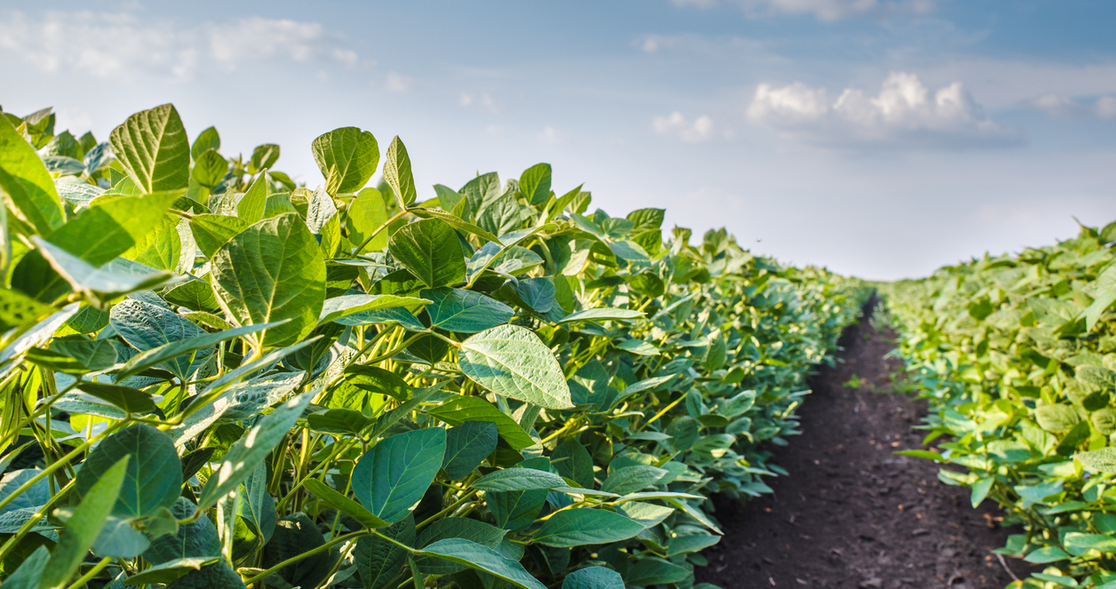
B-500 Continuous Batch Commercial Biodiesel Plant
Compact Biodiesel Production System
Florida Biodiesel, Inc. | 19 Years of Innovation

Slide 2
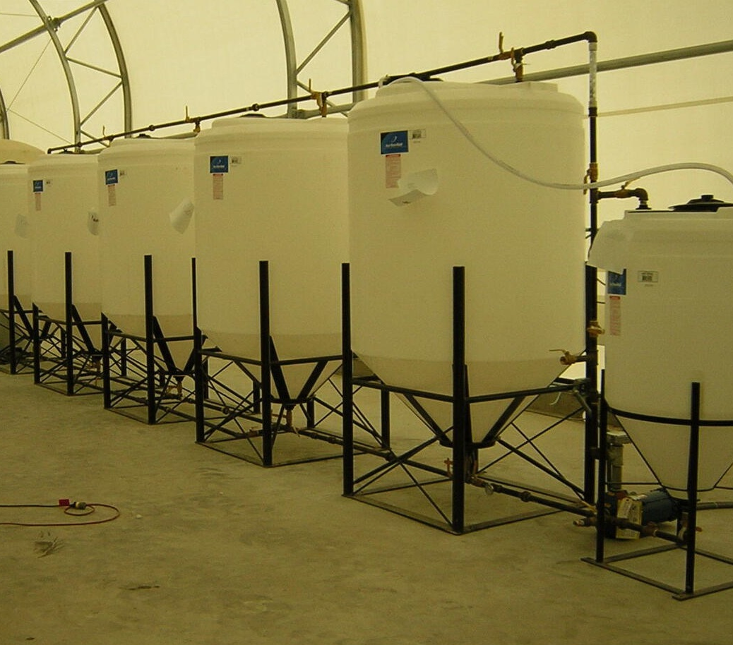
What is the B-500 Biodiesel Plant?
The B-500 is a fully automated, commercial-grade biodiesel production system designed to process 100 to 400 gallons of used cooking oil per batch.
Compact, efficient, and easy to operate, it allows businesses, municipalities, and organizations to produce ASTM-grade biodiesel safely and cost-effectively.
Key Points:
Batch capacity: 100–400 gallons
Fully automated operation
Minimal maintenance required
Compact footprint — fits into tight spaces
Simple installation and training

Slide 3
Key Features & Benefits
Plug-and-Play Design: Simple installation and startup
Fully Automated Process: Minimal operator involvement
High Conversion Efficiency: Consistently produces ASTM-grade biodiesel
Compact Footprint: Operates within limited space requirements
Low Operating Costs: Efficient energy and chemical usage
Flexible Batch Sizes: Process as little as 100 gallons or as much as 400 gallons per batch
Durable, Proven Technology: 19 years of successful installations
Manufactured in the U.S.A.

Slide 4
Who Uses the B-500 Plant?
Farms and agricultural cooperatives
Waste oil recycling companies
Restaurant chains and food service groups
Municipalities and public works departments
School districts and university campuses
Independent fuel producers
Disaster recovery and emergency energy providers
Unlock new revenue streams — or create your own fuel source.

Slide 5
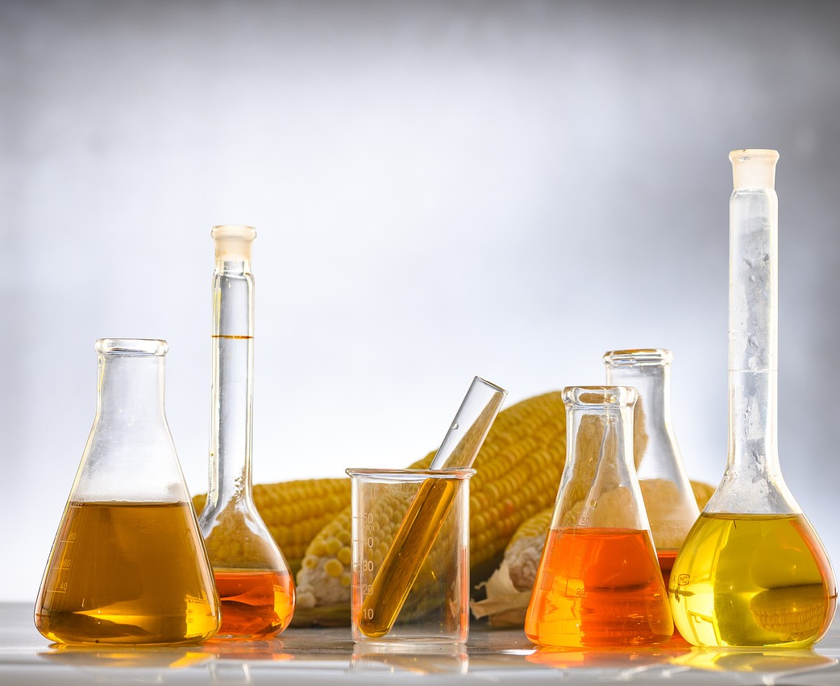
How the B-500 Plant Converts Waste Oil into Biodiesel
Process Flow:
Pre-Treatment:
  Removes impurities from used cooking oil to prepare for conversion.
Transesterification:
  The oil is chemically converted into biodiesel through a fully automated reaction process.
Separation and Purification:
  Biodiesel is separated from byproducts, polished, and ready for use or sale.

Slide 6
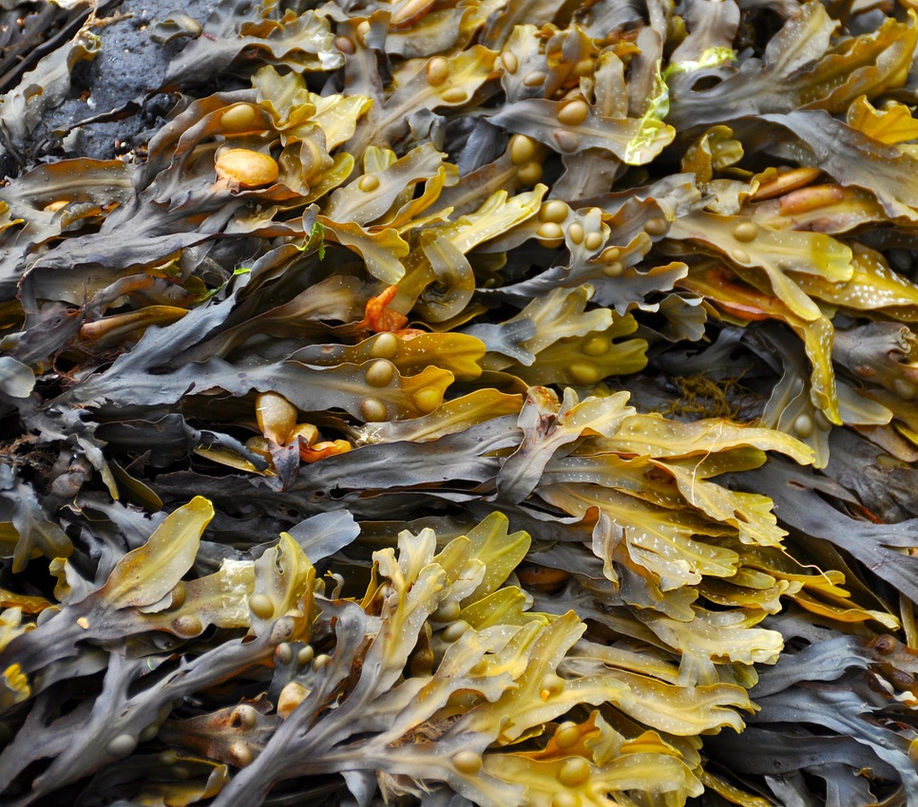
About the B-500 Plant
The B-500 Continuous Batch Biodiesel Plant produces 400-gallon batches of Biodiesel hourly and has the capacity to produce 2.3 million gallons of Biodiesel annually.
The B-500 Commercial Biodiesel processor is the heart of the plant, with the addition of separation & washing modules can operate 24/7.
B-500 Continuous Batch Commercial Biodiesel Plant Features:
1 – 110 Gallon HDP Inductor module
1 – 500 Gallon HDP Reactor module
4 – 500 Gallon HDP Separation modules
2 – 250 Gallon HDP Ion Dry Wash towers
1 – Methanol recovery module
1 – 112 GPM Explosion proof Methoxide/Biodiesel pump
2 – Biodiesel wash pumps
1 – Glycerin pump
SS temp gauge
Brass ball valves
External Heat Exchanger
Hardware installation kit (Black Steel)
Digital scales
Safety Kit (goggles, apron, & gloves)
Complete instructions

Slide 7
How It Pays Off for a High-Volume User
(per 1,000 gallons processed per week)*
Metric | Estimate
Waste oil or feedstock processed per week | 1,000 gallons
Biodiesel yield (90% avg.) | 900 gallons
Cost of chemicals to process feedstock per gallon | $1.00 (estimate)
Market value per gallon | $3.50 (or higher)
Weekly fuel value | $2,250
Monthly fuel value | $9,750
Annual fuel value | $117,000+
What this means…
Reduces diesel costs for tractors, generators, and on-site vehicles
May qualify for state or federal clean energy incentives/subsidies
Supports energy independence and local sustainability goals
* Actual results may vary depending on feedstock type, conversion efficiency, regional fuel pricing, and usage patterns.

Slide 8
A Smarter Fuel for a Changing World
Renewable & Sustainable: Made from waste oil, not fossil fuels
Reduces Emissions: Up to 75% lower carbon output vs. petroleum diesel
Energy Independence: Produce your own fuel and reduce reliance on outside suppliers
Lower Operating Costs: Save money on fuel by recycling your own waste
Supports Compliance: Aligns with green mandates and sustainability goals
Grant Opportunities: May qualify for government incentives or clean fuel funding
Biodiesel isn’t just a cleaner fuel — it’s a smarter business decision.

Slide 9

Proven Technology. Real-World Experience.
Florida Biodiesel, Inc. has been designing and delivering biodiesel production systems since 2006. Founded by a career chemist and process engineer, the company has supplied B-500 plants to customers across the U.S. and internationally.
We specialize in compact, automated biodiesel systems designed for real-world use — whether you're recycling waste oil or planning for off-grid fuel production.
We have made many innovative contributions to the Biodiesel industry including:
Designing the “vertical manifold” used in most modern Biodiesel processors.
Designing the “external heat exchanger” used on most plastic tank Biodiesel processors.
Designing the “Methanol recovery module” used to relieve pressure in Biodiesel processors to create closed loop systems.
Designing the “ECA-1 Hypochlorous acid manufacturing cell” producing 350 gallons of Hypochlorous acid per 24 hours.

Slide 10
Ready to Learn More?
Whether you're looking to create your own fuel source or explore a new revenue stream, we're here to help guide you through the possibilities.
Let’s talk about:
Your current waste oil volume and needs
Site requirements and installation
Shipping timelines and support
Contact:
Keith Parker
Managing Partner | Showcase Trading Company
Director, Business Development | Florida Biodiesel, Inc.
keith@showcasetradingcompany.com
info@floridabiodieselinc.com
Let’s turn your waste into clean, usable fuel — and your operation into something more sustainable.

