Slide 1






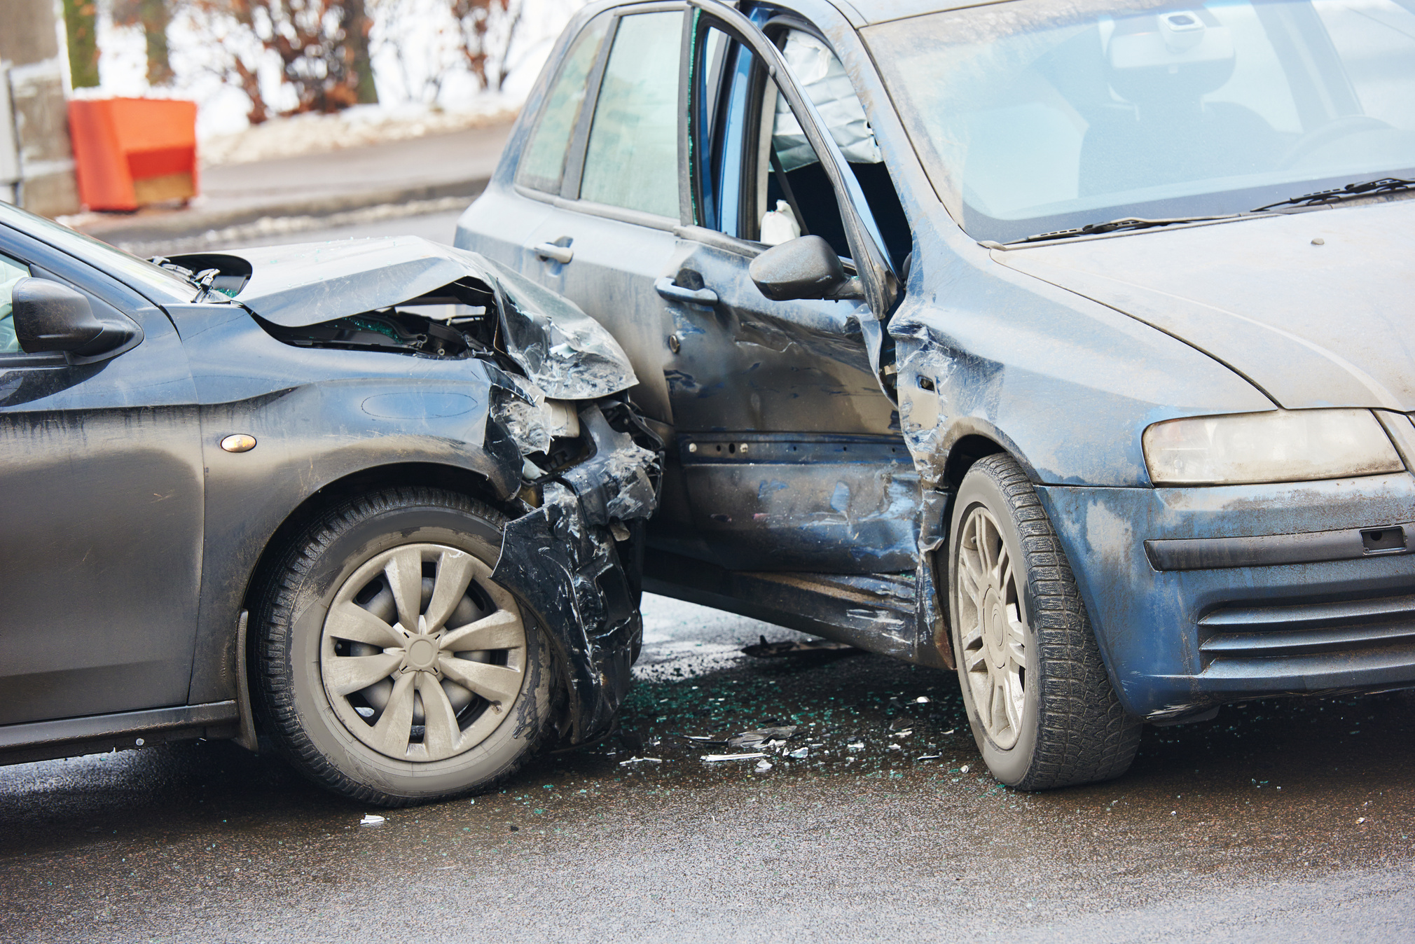


CSE:572 Data Mining Presentation,
Spring 2024
Predicting Traffic Collision Occurrence
and Severity
By group 33
Keyur Thakkar 1226695095
Ian McDonough 1216362030
Shagufta Memon 1229719168
Simran Panchal 1229148962

Slide 2

Addressing a Critical Urban Safety Challenge
Traffic Safety in Tempe: Each year, urban areas like Tempe face significant challenges due to traffic collisions, which not only claim lives but also impose heavy economic and emotional burdens on communities.
Data-Driven Decision Making: Leveraging machine learning with Tempe's extensive traffic data, this project aims to identify key factors contributing to collisions and predict their severity, thereby informing better traffic management and safety measures.

Slide 3



Contextualizing with Related Work
Current ML Applications:
  Evaluating expressway traffic crash severity by using logistic regression an explainable & supervised machine learning classifiers. by J.P.S. Shashiprabha Madushani, R.M. Kelum Sandamal, D.P.P. Meddage
  Evaluating the effectiveness of machine learning techniques in forecasting the severity of traffic accidents by Izuchukwu Chukwuma Obasi and Chizubem Benson
Our Niche:
  Novel application of machine learning to Tempe’s unique urban environment and traffic conditions.

Slide 4






Relevant Dataset
Data
Source
Dataset
Features
Class Distribution of Injury Severity
1.08 Crash Data Report (detail) from Tempe’s official records it has 48,882 incidents capturing varied collision events and 35 attributes ranging from driver details to environmental factors.
  Collision Details: Types of collision, weather conditions, and road surface conditions.
  Participant Details: Age and gender of drivers, including both involved parties.
No Injury: 33,243 instances
Possible Injury: 7,560 instances
Non-Incapacitating Injury: 4,411 instances
Suspected Minor Injury: 2,686 instances
Incapacitating Injury: 559 instances
Suspected Serious Injury: 285 instances
Fatal: 137 instances

Slide 5


Optimized Machine Learning Models for Traffic Collision Severity Prediction
 | Mean Accuracy | Standard Deviation
Random Forest | 72.6% | 0.0004
K-Nearest Neighbors | 71.2% | 0.0004
Logistic regression | 66.0% | 0.0033
Hypothesis: Machine learning models can effectively predict the severity of a traffic collision based on environmental factors, temporal factors, and details of involved parties.
To test this hypothesis, we elected to train Random Forest, KNN, and Logistic regression classifiers. Prior works have shown that these classifiers have a strong ability to handle complex, nonlinear data relationships typical in traffic datasets.
With a mean accuracy of 72.6% over a five fold analysis, the performance of our Random Forest classifier supports our hypothesis that machine learning models can effectively predict collision severity. Moreover, the standard deviation of accuracy was only 0.0004, indicating that our model is highly reliable.
Consistent with prior works, the Random Forest classifier was our best performing model and was emphasized for its ensemble approach, reducing variance, and avoiding overfitting while maintaining the integrity of the data’s complex structure. Additionally, the Random Forest classifier provides increased interpretability compared to alternatives.

Slide 6
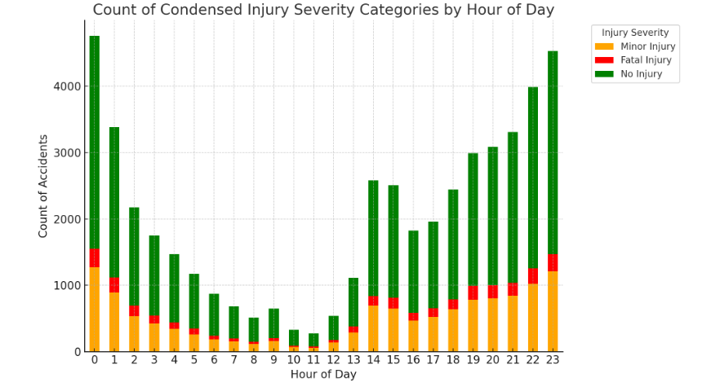
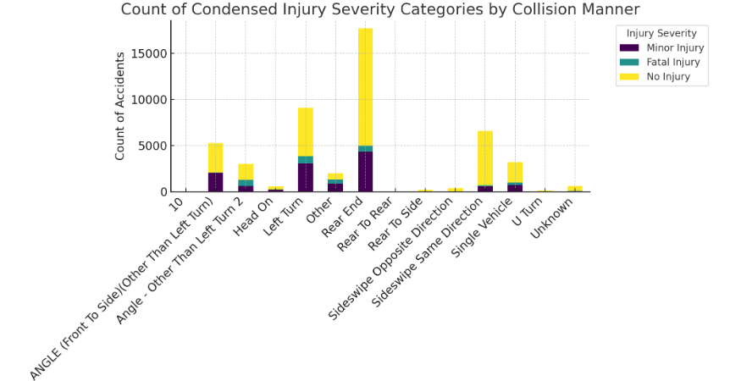
Model Performance and Hypothesis Verification:
Collisions are most likely in the late night/early morning
Rear end and left turn are the most common types of collisions. Angled collisions are more dangerous than other types of collisions

Slide 7
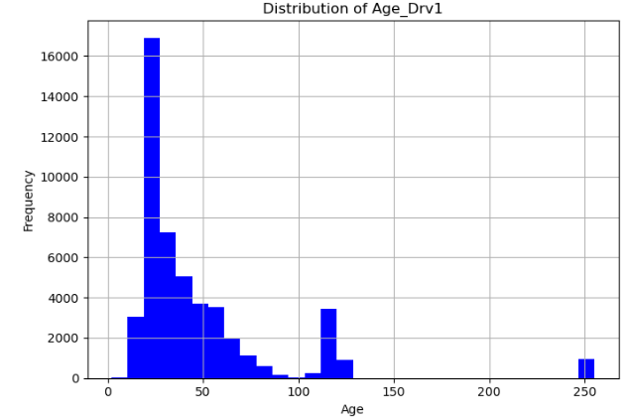
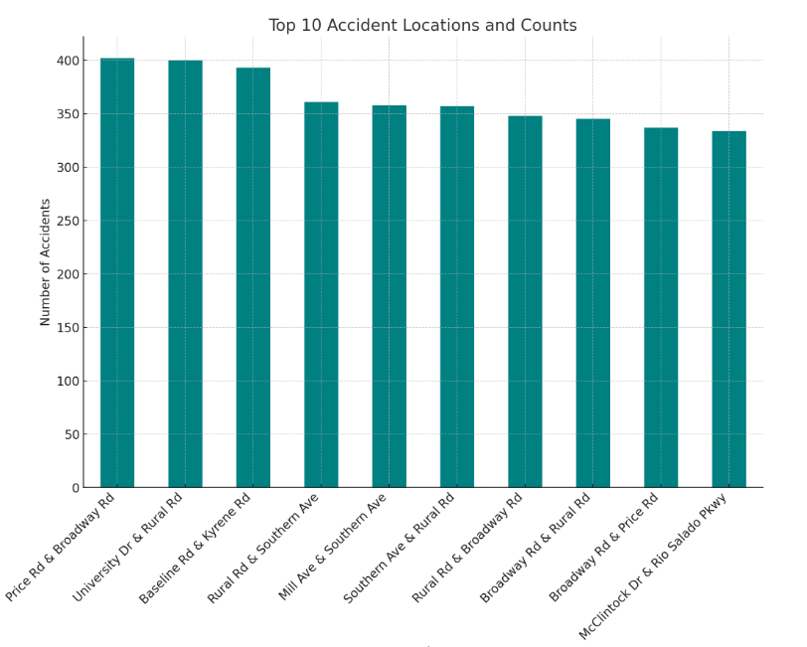
Model Performance and Hypothesis Verification:
This result shows how around
20-30 age accidents spikes which can be reduced by spreding awareness in age group.
Accident prone location in the city which could use some accident prevention measures.

Slide 8

Conclusion and Future Work
Model Efficacy: Highlight the predictive performance of the chosen machine learning models.
Significant Findings: Top ten location in Tempe where accidents happen and age group in which accident happen, with that we also discovered type of accident that is most fatal and time when most accidents happen and their severity.
Future work: Discuss the potential for developing a real-time prediction system for use by city traffic management and integration of real-time traffic data and broader geographic areas to enhance model robustness.

