Slide 1
Healthcare Mining: An AI-Powered Approach to Revolutionizing Information Retrieval in Healthcare
CSE 573 - SWM
Project Presentation
Group Members:
Sujith Ramprasad Tellakula (1229581862)
Ronit Patil (1230531746)
Vishnu Batla (1229798260)
Jay Mistry (1229662137)
Simran Panchal (1225347240)
Team 12
Project 2
Presentation Date: March 25th, 2024

Slide 2
In the vast landscape of digital healthcare information, individuals face significant challenges in locating precise, relevant, and credible information
Traditional search methods often yield results that are either too broad, outdated, or not sufficiently reliable for making informed health decisions
The complexity of medical terminology further exacerbates this issue, as does the dynamic nature of medical knowledge, where new insights and guidelines are constantly emerging. ”Healthcare Mining” addresses these critical gaps by leveraging artificial intelligence (AI) and machine learning (ML) technologies.
Our aim is to create a system that not only understands the nuanced queries of users but also ensures the relevance, credibility, and timeliness of the information provided.
Problem Definition

Slide 3
Utilizing AI and ML: The project harnesses the latest advancements in artificial intelligence and machine learning to transform healthcare information accessibility. Sophisticated NLP Techniques: By employing advanced natural language processing techniques, the system deciphers human language complexities for a more intuitive search experience aligned with user intent. Addressing Information Reliability: The project tackles the crucial issue of information reliability and timeliness in healthcare decision-making, ensuring users access credible and up-to-date information. Innovative Data Mining: "Healthcare Mining" innovatively filters and prioritizes information not only by relevance but also by credibility and recency, enhancing the accuracy of health information retrieval. Promising Future: "Healthcare Mining" represents the potential of technology to enhance healthcare information accessibility and reliability, promising a future where informed health decisions are universally achievable.
Introduction to Healthcare Mining

Slide 4
Our project leverages a comprehensive dataset compiled from various healthcare forums. The dataset, structured in JSON format for ease of processing, covers an extensive array of healthcare topics including diseases, symptoms, treatments, and medications. Key sources include: • WebMD • Patient.info • MedlinePlus Each entry in the dataset is enriched with metadata. This structured approach enables our ”Healthcare Mining” system to deliver precise, relevant, and up-to-date healthcare information.
Dataset Description

Slide 5
Natural Language Processing (NLP) has become pivotal, with tools like MetaMap translating biomedical text into structured data, aligning with the Unified Medical Language System (UMLS) to enhance data interoperability and semantic understanding.
Graph Theory applications, such as symptom relation graphs (SympGraph), analyze co-occurrence and relationships between medical terms, offering insight
Vector Space Models and Embedding Techniques transform textual information into vector representations, facilitating the application of machine learning algorithms for pattern recognition, trend analysis, and predictive modeling in healthcare contexts.
Retrieval and Ranking Algorithms have been refined to prioritize the relevance and credibility of information sources, incorporating user feedback and engagement
State-of-Art Methods & Algorithms

Slide 6
A. Data Collection and Preprocessing: Our data collection process leverages Beautiful Soup, Scrapy, AsyncIO, and Playwright for web scraping, to extract detailed healthcare information from various online sources. This phase involves: • Identifying Data Sources: Selecting authoritative and credible healthcare websites and forums for data extraction. • Web Scraping: Utilizing the above mentioned tools to navigate the DOM of web pages, extract relevant data, and handle the intricacies of HTML and XML parsing efficiently.
B. System Design and Development
Our system architecture is streamlined, focusing on the frontend
application developed with Streamlit, which directly interfaces
with OpenAI’s API.
Research and Development Plan

Slide 7
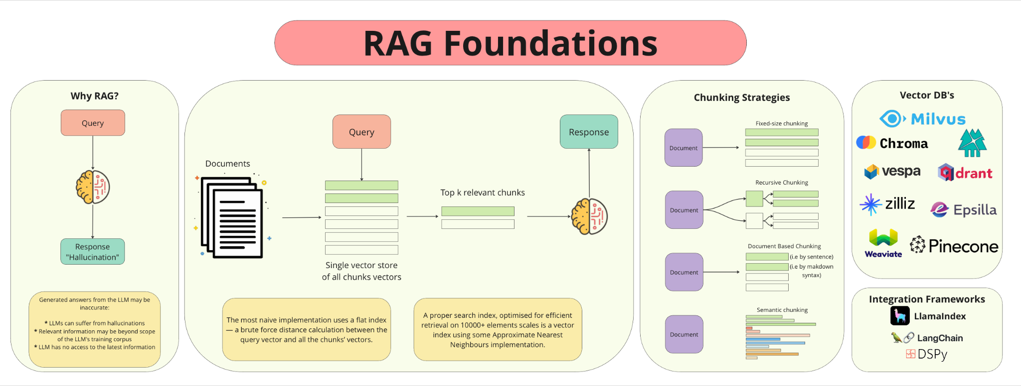
Streamlit as the UI Framework: Streamlit facilitates the creation of an interactive user interface, allowing users to input queries, upload files, and receive information in real-time.
Direct API Calls to OpenAI: The query embedding generation, is performed through direct calls to OpenAI’s API. This approach ensures efficient handling of user requests and leverages OpenAI’s powerful natural language processing capabilities.
C. Implementation of Algorithms Our Retrieval Agent
Developed using Langchain, is designed for advanced query processing and information retrieval. It employs a vector similarity search mechanism, crucial for matching user queries with the most relevant documents in our vector database.
Research and Development Plan

Slide 8
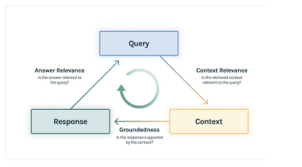
A. Technical Performance Metrics
Trulens Analysis: The core of our evaluation, Trulens, is used to assess Groundedness, Questions/Answer Relevance, and Question/Context Relevance.
This analysis allows us to gauge how well the system’s responses are rooted in the factual content of our database and their relevance to the user’s queries.
Figure shows the feedback functions we are incorporating in this project to obtain a qualitative analysis of our Retrieval agent’s responses.
Design of Experiments and Evaluation Plan
TruLens Feedback Functions

Slide 9
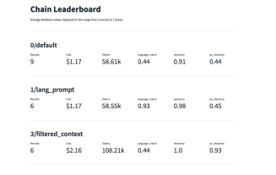
B. Iterative Refinement Process
Feedback obtained from the technical performance evaluation will guide the iterative refinement of our system. This process involves:
• Adjusting and optimizing the algorithmic approach based on Trulens metrics to enhance the accuracy and relevance of information retrieval.
• Continuously updating the database and retrieval mechanisms to incorporate the latest healthcare information and user feedback.
Design of Experiments and Evaluation Plan
Comparison between different Retrieval Chains

Slide 10
Project Plan: Tasks, Deadlines, Division of Work
Schedule | Task Description | Led By -
Feb 2 - Feb 10 | Initial Research | Everyone
Feb 11 - Feb 16 | Data Collection | Simran / Jay
Feb 17 - Feb 23 | System Design and Prototype Development | Sujith / Ronit
Feb 24 - Mar 5 | Algorithm Implementation and Testing | Sujith / Ronit
Mar 6 - Mar 15 | System Evaluation and Refinement | Vishnu/Ronit
Mar 16 - Mar 29 | Final report creation | Everyone
Mar 30 - Apr 5 | Proofreading and revisions | Everyone
Completed In Progress Scheduled

Slide 11
[1] Langchain Documentation: https://python.langchain.com/docs/get_started/introduction
[2] OpenAI API Documentation: https://platform.openai.com/docs/introduction
[3] Streamlit Documentation: https://docs.streamlit.io/
[4] Trulens Evaluation with Langchain Quickstart: https://www.trulens.org/trulens_eval/getting_started/quickstarts/langchain_quickstart/
[5] Anand V. Saurkar, Kedar G. Pathare, and Shweta A. Gode. An overview on web scraping techniques and tools. 2018.
[6] Parikshit Sondhi, Jimeng Sun, Hanghang Tong, and Chengxiang Zhai. Sympgraph: A framework for mining clinical notes through symptom relation graphs. In KDD’12 - 18th ACM SIGKDD International Conference on Knowledge Discovery and Data Mining, Proceedings of the ACM SIGKDD International Conference on Knowledge Discovery and Data Mining, pages 1167–1175, September 2012. 18th ACM SIGKDD International Conference on Knowledge Discovery and Data Mining, KDD 2012 ; Conference date: 12-08-2012 Through 16-08-2012.
[7] Illhoi Yoo, Jinbo Bi, and Xiaohua Hu, editors. 2019 IEEE International Conference on Bioinformatics and Biomedicine, BIBM 2019, San Diego, CA, USA, November 18-21, 2019. IEEE, 2019.
References

