Slide 1
2017 - 2023 Expedia Strategic Outlook
A future-oriented outlook and recommendations on Expedia’s future through market-oriented analysis, international expansion and considerations for effects of current global political and economic factors to the business.
November 26, 2023
Group: Data Alchemists
Notes:
•Your group plays the role of consultants to a business seeking to use big data analytics to improve its sales.
•You will advise them using visualizations to propose an approach and a solution based on the materials covered in class.
•The clients represent diverse business sectors including fast food, retail, tourism and automotive.
•The initial focus will be to provide recommendations for the US market, taking into consideration the current global political and economic factors that might affect their businesses.
•They are seeking intuitive market-oriented analysis, that will allow them to take quick action.

Slide 2
EXECUTIVE SUMMARY
This presentation provides a comprehensive analysis of Expedia's package sales trends, customer preferences, and strategic marketing recommendations for enhancing customer value perception and driving sales growth. Our insights reveal a significant shift towards individual bookings and the popularity of 'Trip' packages, indicating a consumer preference for flexible and personalized travel experiences.
To capitalize on these trends, we propose innovative marketing solutions such as the Interactive Package Customizer, Virtual Tours, and AI-Driven Personalization, which aim to enrich the customer experience and increase engagement. Analysis of price sensitivity and promotional impact suggests the effectiveness of targeted discounts and the potential for loyalty programs to maintain a stable customer base.
Our research also explores the potential for international market expansion, with Mauritius identified as a promising new destination based on its parallels to Cancun's success. We recommend leveraging Mauritius's unique offerings and robust digital infrastructure and open visas to offer competitive and culturally rich travel packages.
Finally, we outline the overall learnings regarding the role of promotions in sales growth, the increasing trend of individual bookings, and the positive outlook for 'Trip' package sales. These insights are crucial for informing future marketing strategies and expansion plans.
Economic, Social, Experiential and Functional values to Expedia Customers.
40%
73%
0%-15%
‘Trip’ packages purchased - most popular
Bookings made online
Range of discounts offered to customers
56%
1.7
6,622
Purchases made online
Average Number of Packages per Transaction
Total travel packages sold - a 38.33% market share compared to competitors
Notes:
Expedia provides a comprehensive range of values to its customers, underpinned by a strong online presence. A significant portion (73%) of bookings are made online, highlighting the platform's functional value through its convenience and accessibility. The popularity of 'Trip' packages, accounting for 40% of purchases, emphasizes the experiential value, offering customers tailored travel experiences. Economic value is showcased through competitive discounts ranging from 0% to 15%, contributing to the company's substantial market share of 38.33% in the travel package sector.
The average number of packages per transaction stands at 1.7, indicating that customers are finding multiple offerings that suit their needs, suggesting that Expedia's product variety and package customization options are resonating well with consumers. With a significant percentage of purchases made online, Expedia's digital platform strategy appears to be effective, though there is an opportunity to enhance the economic value through more aggressive discounting strategies to compete with other market players. Overall, Expedia's market position and service offerings suggest a strong alignment with customer needs across economic, functional, and experiential dimensions.

Slide 3
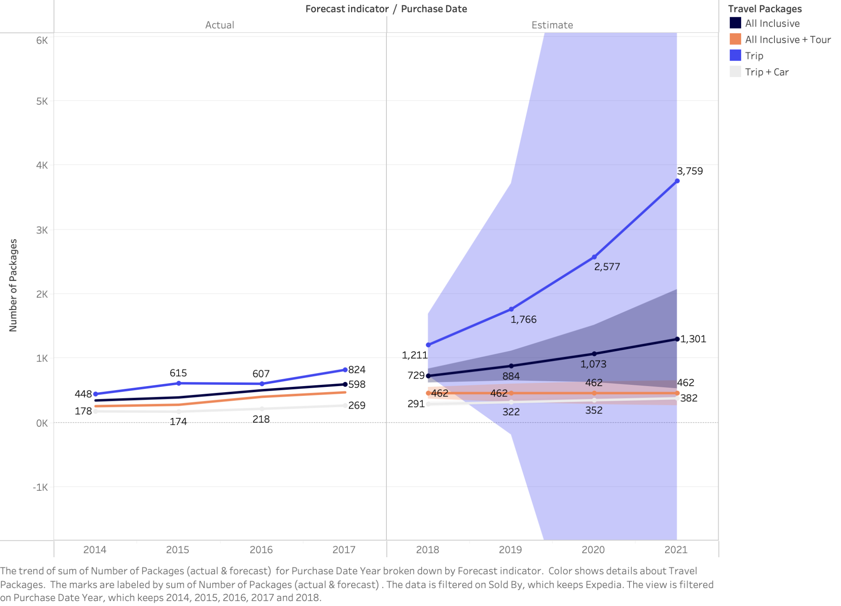
INTERNAL MARKETING INSIGHTS & INTERPRETATION
REDESIGNING THE 4PS TO ENHANCE CUSTOMER VALUE PERCEPTION
Expedia Package Sales
OUR PRODUCT
Exploring Expedia’s products, the ‘Trip' packages are forecasted to grow exponentially, revealing a consumer trend towards flexible travel options. This suggests a shift in consumer preferences towards simpler travel solutions over more complex packages.
Marketing solutions for Expedia based on product:
Interactive Package Customizer: an online tool that allows customers to build their own travel package, adding and removing elements like car rentals or tours to see how it affects the price, reinforcing the idea of personalized travel.
Virtual Tours: Using virtual reality (VR) or augmented reality (AR) to give potential customers a taste of the tours offered in the 'All Inclusive + Tour' package to pique their interest.
Notes:
Let’s talk about our products first. We should be looking at our product not only through the lens of where we are now but also where we want to go in the future. Right now, the most high-performing product is the ‘trip’ with the second-most productive product being ‘all inclusive’. ‘Trip + car’ and ‘All inclusive + tour’ have been performing significantly poorer. Thinking forward, we foresee our ‘trip’ package performing significantly better. This paints a picture on what we need to focus on as the more profitable customer preference to serve. However, let’s look at whether that matches our pricing model.

Slide 4
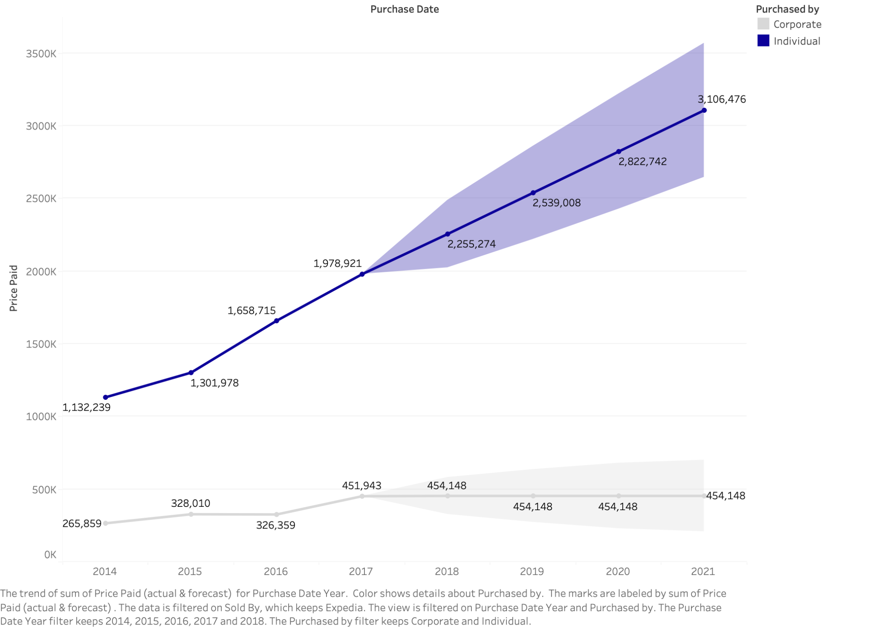
INTERNAL MARKETING INSIGHTS & INTERPRETATION
REDESIGNING THE 4PS TO ENHANCE CUSTOMER VALUE PERCEPTION
Price Paid by Customer Segment
OUR PRICE
Expedia's individual clients are a substantial and growing source of revenue, consistently outpacing corporate spending from 2014 to the present. This trend suggests that personal travel bookings through Expedia are a key driver of sales and may be reflective of successful marketing and product offerings tailored to individual travelers.
Marketing solutions for Expedia based on this pricing data:
Collaborative Travel Planning Tools: Implement collaborative tools that allow individuals to plan trips with friends or family, even if they are booking separately, simplifying group travel arrangements.
AI-Driven Personalization: Utilize artificial intelligence to offer individual customers personalized travel recommendations based on their past behavior, searches, and preferences, increasing the likelihood of purchase.
Notes:
How can a Marketing manager redesign the 4P’s (Product, Price, Promotion and Place) to enhance customer value perception?

Slide 5
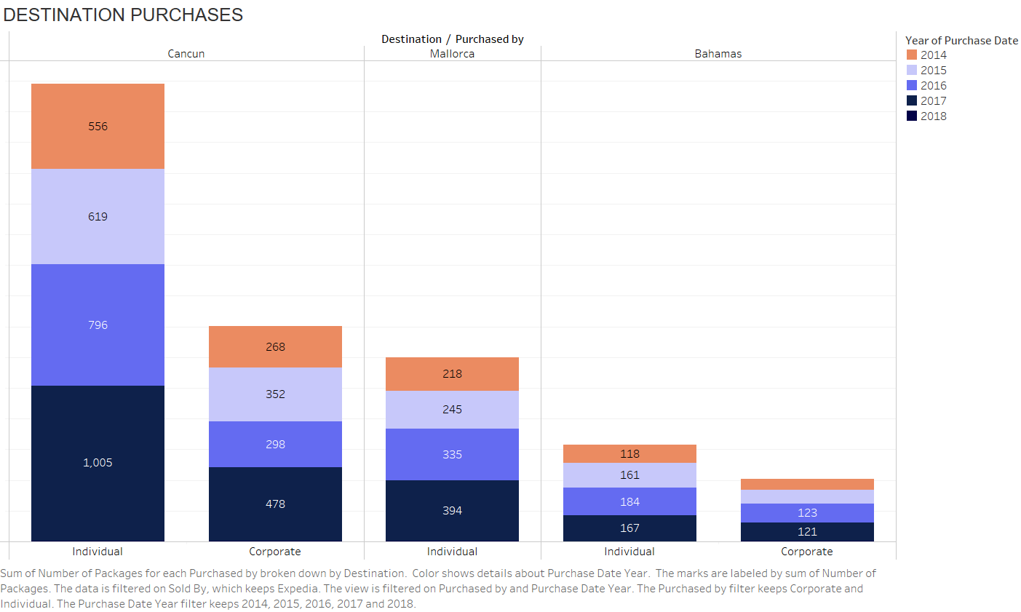
INTERNAL MARKETING INSIGHTS & INTERPRETATION
REDESIGNING THE 4PS TO ENHANCE CUSTOMER VALUE PERCEPTION
Customer Destinations Preferences
OUR ‘PLACE’
Expedia's data shows a strong lean towards individual packages, particularly to Cancun, which outperforms other destinations. This preference points to Cancun's appeal, potentially due to its rich offerings or value perception and helps us understand demand for similar destinations to offer for international expansion..
Marketing solutions for Expedia based on ‘place’ data:
Seasonal Specials and Festivals: Promote Cancun's seasonal events and festivals with special packages that align with these times, such as the Day of the Dead or the Whale Shark Season.
Interactive Itineraries: Use interactive itineraries on the Expedia site that allow users to explore different Cancun travel paths, adjusting their trip according to interests like history, nature, or relaxation.
Notes:
How can a Marketing manager redesign the 4P’s (Product, Price, Promotion and Place) to enhance customer value perception?

Slide 6
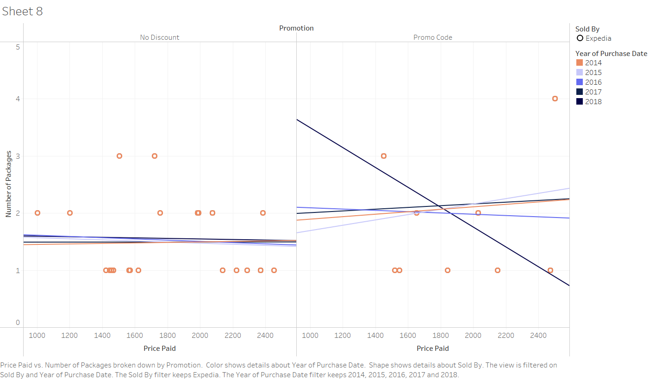
INTERNAL MARKETING INSIGHTS & INTERPRETATION
REDESIGNING THE 4PS TO ENHANCE CUSTOMER VALUE PERCEPTION
Price Paid by Customer Segment
OUR PROMOTION
Expedia's scatter plot compares the number of packages sold against the price paid by customers over several years, with an additional dimension illustrating the effect of promotions. The "No Discount" chart suggests a stable customer base that purchases packages without sensitivity to price changes. The steepness of the 2018 black line in “Promotion” chart, suggests that customers in 2018 responded well to discounts.
Marketing solutions for Expedia based on promotion data:
Leverage Price Elasticity: Since customers respond to discounts, Expedia could use dynamic pricing strategies to maximize sales during off-peak periods or in markets where price sensitivity is high.
Customer Retention: For the consistent customer base shown in the "No Discount" section, focus on loyalty programs that reward consistent bookings without discounts to maintain a steady revenue stream.
Notes:
How can a Marketing manager redesign the 4P’s (Product, Price, Promotion and Place) to enhance customer value perception?

Slide 7
4Ps IMPLICATIONS ON EXPEDIA
PLACE
PRICE
PRODUCT
PROMOTION
With a high percentage of bookings made online, the digital platform is a critical place to serve customers. The most profitable customers can be served through an easily navigable online booking system, possibly integrated with mobile platforms and AI, to enhance the convenience of planning and purchasing travel packages. Currently, the most popular locations are island nations with high GDP and ‘european-like’ experiences while also having local culture to dive into. Expansion to similar destinations like Cancun would be profitable and strategic for Expedia.
Price sensitivity varies among customer segments, with promotional strategies such as ‘discounts’ significantly boost sales. Profitable customers may not just be those who spend the most per transaction but those who engage in repeat business. A dynamic pricing strategy for expedia clients that offer value for money (economic value) and leverages ‘discounts’ effectively during off-peak periods could attract and retain these high-value customers. “Value is created/determined not by the price but by those who choose to pay” - Simon Sinek
The data suggests that 'Trip' packages are highly popular, indicating that customers value simplicity and personalization. The most profitable customers seem to be those seeking individualized travel experiences. To serve them, Expedia should further enhance its product offerings by creating customizable packages that allow these customers to tailor their travel according to their preferences. Customers are valuing experience in their purchasing decisions.
The data shows that ‘promotions’ lead to a substantial increase in sales, especially when targeted effectively by the right source. The most profitable customers are likely those who respond to these promotions - which, currently, are individual customers rather than corporate. Personalized marketing campaigns using customer data analytics, seasons and corporate ‘holiday’ seasons can increase the reach and effectiveness of promotions, leading to higher conversion rates.

Slide 8
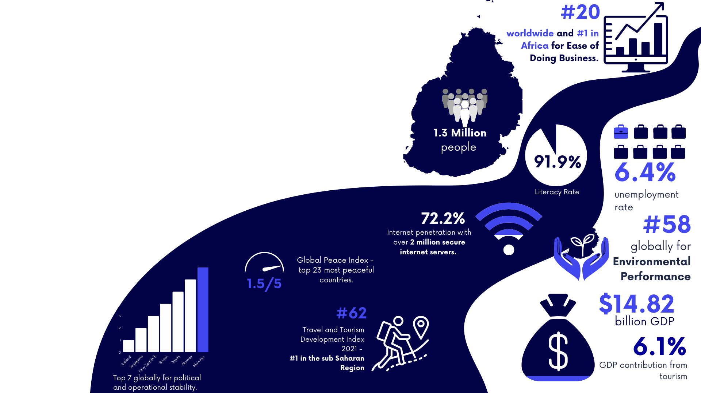
MAURITIUS
Cancun's success as an island destination on Expedia, driven by strong individual consumer sales, paves the way for exploring new markets like Mauritius. With its comparable advantages such as a skilled workforce, a tourism-reliant economy, and advanced technology infrastructure, Mauritius stands out as the next best strategic move for Expedia’s international market expansion. Mauritius emerges as a compelling candidate, mirroring Cancun's appeal with its own unique tapestry of white-sand beaches, lush landscapes, and a rich cultural heritage. The potential for individual consumer market growth in Mauritius is underscored by its attractive features, such as a high literacy rate indicating a skilled workforce, significant GDP contribution from tourism suggesting a ready market, and a robust Technological infrastructure ideal for digital engagement with Expedia clients..

Slide 9
IMPLICATIONS FOR MAURITIUS EXPANSION
Political & Economic: Stable governance and favorable business policies place Mauritius as an ideal market for expansion, with its high ranking in ease of doing business indicative of potential smooth operational setup. With tourism as a significant contributor to the GDP, the economic landscape of Mauritius promises ample opportunity for growth in the travel sector, mirroring the success seen in Cancun.
Socio-cultural & Technological: The high literacy rate suggests a market of well-educated consumers and a workforce capable of delivering high-quality service, augmenting the potential for premium travel experiences. Advanced internet infrastructure aligns with the global shift towards digital bookings, offering Expedia an engaged audience ready for online travel platforms.
Environmental & Legal: Commitment to sustainability, reflected in environmental performance, aligns with the growing trend of eco-conscious travel, offering a unique selling proposition. Supportive legal frameworks for tourism investments ensure that business ventures can thrive with reduced bureaucratic friction.
Product: Tailor travel packages to highlight the exclusive experiences of Mauritius, from luxury stays to eco-adventures, catering to the individual consumer's quest for unique and memorable trips.
Price: Strategically set competitive prices, drawing on data from Cancun’s performance, and adapt for seasonality and consumer demand patterns in Mauritius.
Place: Utilize Mauritius's robust technological landscape to facilitate seamless online and mobile bookings, enhancing customer convenience and capitalizing on the trend towards digital consumption.
Promotion: Craft targeted marketing campaigns that spotlight Mauritius’s cultural vibrancy and pristine natural environments, leveraging digital channels to reach a global audience seeking sustainable and culturally rich destinations.
Notes:
Product: Tailor travel packages to highlight the exclusive experiences of Mauritius, from luxury stays to eco-adventures, catering to the individual consumer's quest for unique and memorable trips.
Price: Strategically set competitive prices, drawing on data from Cancun’s performance, and adapt for seasonality and consumer demand patterns in Mauritius.
Place: Utilize Mauritius's robust technological landscape to facilitate seamless online and mobile bookings, enhancing customer convenience and capitalizing on the trend towards digital consumption.
Promotion: Craft targeted marketing campaigns that spotlight Mauritius’s cultural vibrancy and pristine natural environments, leveraging digital channels to reach a global audience seeking sustainable and culturally rich destinations.

Slide 10
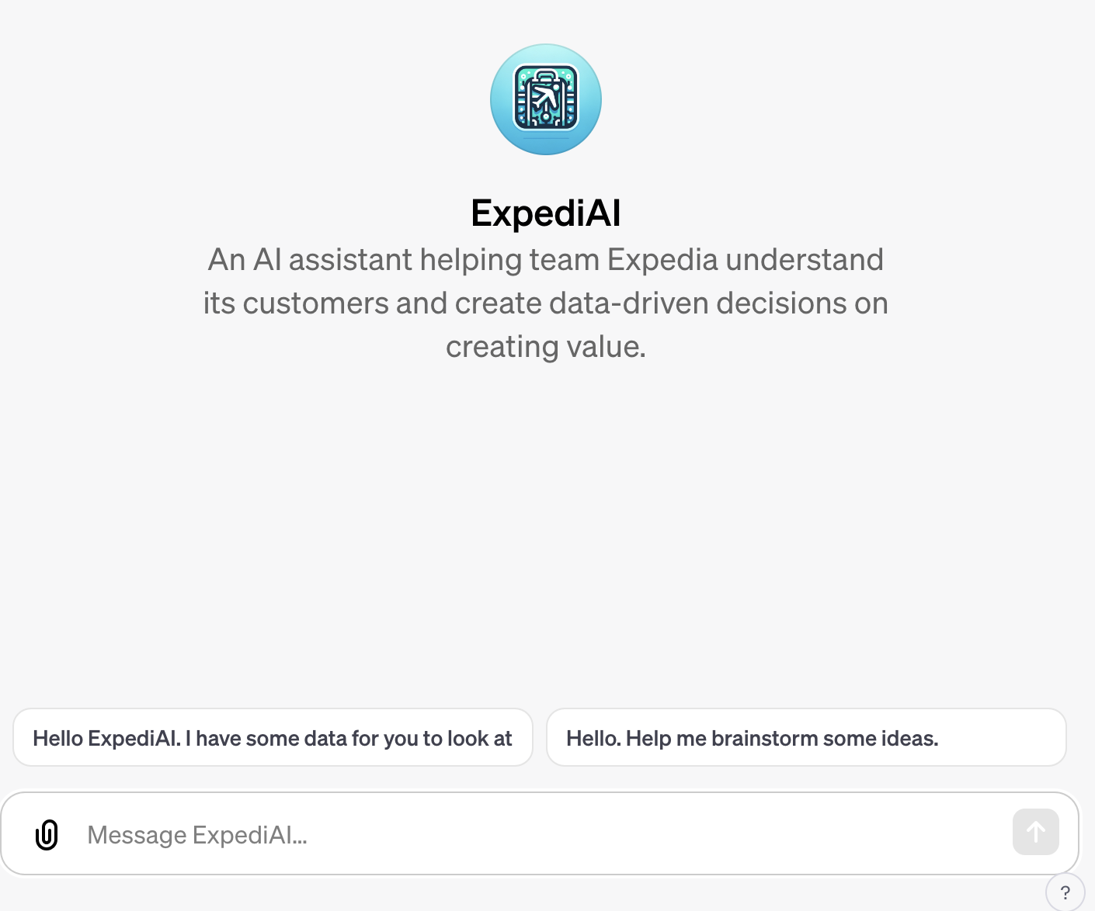
OVERALL LEARNINGS
Learning #1: The Impact of Promotions on Sales:
Promo codes significantly boost Expedia sales, especially in 2018, showing the existence of customer price sensitivity and the necessity for strategic discounts for maximum returns. For Expedia, this indicates the potential for promotions to attract and retain customers.
Learning #2: The Rising Trend in Individual Bookings:
We have witnessed a growth in individual bookings over corporate bookings to changing market dynamics, with solo and personalized travel gaining more traction towards 2018. There is an opportunity for Expedia to offer more tailored travel experiences.
Learning #3: Clear Forecasted Growth in Package Sales:
The positive forecast for sales in the ‘trips’ packages for individual customers signals market confidence. Expedia can leverage this trend by expanding its offerings and exploring new markets, while also being mindful of the risks associated with rapid expansion.
Using AI
The team created a custom GTP called ExpediAI that analyzes Expedia’s customer behaviour data, is aware of competitor data, and uses industry knowledge and best practices to help the Expedia team come up with creative business solutions.
The custom GPT chat can be found here. In case of access issues, please contact the team.

Slide 11
Global Peace Index Maps, visionofhumanity.org. Available at: visionofhumanity.org/maps
WIPO Global Innovation Index 2022, wipo.int. Available at: Global Innovation Index 2022
Passport Index - Mauritius, passportindex.org. Available at: passportindex.org/?country=mu
Mauritius Passport, passport.govmu.org. Available at: passport.govmu.org/passport
Mauritius Visa Policy, ivisa.com. Available at: ivisa.com/mauritius-visa-policy
IMF Mauritius Data, imf.org. Available at: imf.org/external/datamapper/profile/MUS/WEO
Real Estate & Hospitality in Mauritius, edbmauritius.org. Available at: edbmauritius.org/real-estate-hospitality
Mauritius Population Census 2022, statsmauritius.govmu.org. Available at: 2022 Population Census Main Results
World Bank Mauritius Overview, worldbank.org. Available at: worldbank.org/en/country/mauritius/overview
WIPO Global Innovation Index 2022, wipo.int. Available at: Global Innovation Index 2022
Digital Connectivity Indicators - Mauritius, statista.com. Available at: statista.com/digital-connectivity/mauritius
Travel & Tourism Development Index 2021, weforum.org. Available at: WEF Travel & Tourism Development 2021
PwC Mauritius Tax Summary, pwc.com. Available at: taxsummaries.pwc.com/mauritius
BTI Project Mauritius Report. Available at: BTI Mauritius Report
Appendix

Slide 12
© 2023 Expedia, Inc, an Expedia Group Company. All rights reserved. Confidential and proprietary

