Slide 1
BradleyOlson.net
Notes:
Review where we have been
Written so you may believe
BradleyOlson.net

Slide 2
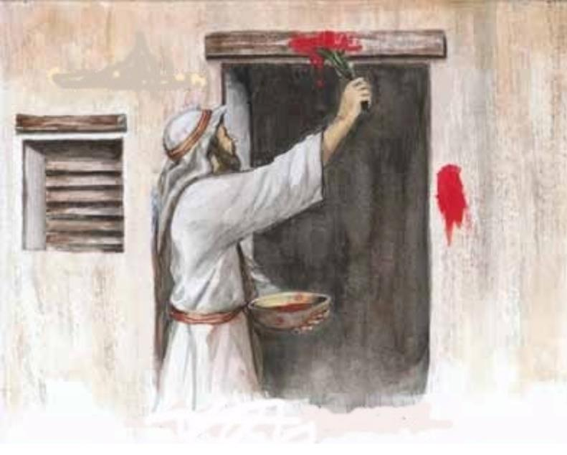
Festival of Passover
Notes:
Before Jesus and continuing In Jesus’ day – There were 3 festivals that each Jewish man was required to pilgrimage to Jerusalem at the Temple to attend- gather there
Each festival was meant to commemorate, remember and celebrate an important event(s) in the history of the Jewish people.
Two of these are in the Spring and one in the Fall.
The first one is Passover. The feast that remembers the last plague in Egypt when death passed over the children of Israel who applied the blood of lambs to their door.

Slide 3
Festival of Weeks (Pentecost)
Notes:
The second one is the festival of weeks or also called Pentecost. Because it was 50 days after the feast of first fruits. The feast of first fruits took place during the week long Passover celebration. The feast of first fruits and the feast of weeks both celebrated the harvest. 1 the barley harvest. One the wheat harvest.
The feast of weeks was meant to celebrate and thank God for all he has provided. This festival also became a time to celebrate the giving of the 10 commandments to the people of Israel. My understanding is it continues to be that to this day for the Jews.

Slide 4
Festival of Booths (Tents, Tabernacles)
Notes:
According to the Jewish historian Josephus, the feast or festival of booths also known as the festival of tents or tabernacles what was the most popular of the festivals.
It lasted 7 days in October.
People came from all over the land
they made tense of sticks and branches they dwelled in for one week
there were celebrations and parties throughout the week
There were various rights that were conducted- People gathered around the temple and worshipped, offered sacrifice corporately, and celebrated
At this festival the people celebrated God's provision and protection during the 40 years of wandering in the desert wilderness, celebrating that he will be their God and they will be his people and that God dwelled with them throughout the wilderness … so they make tents and dwell in them

Slide 5
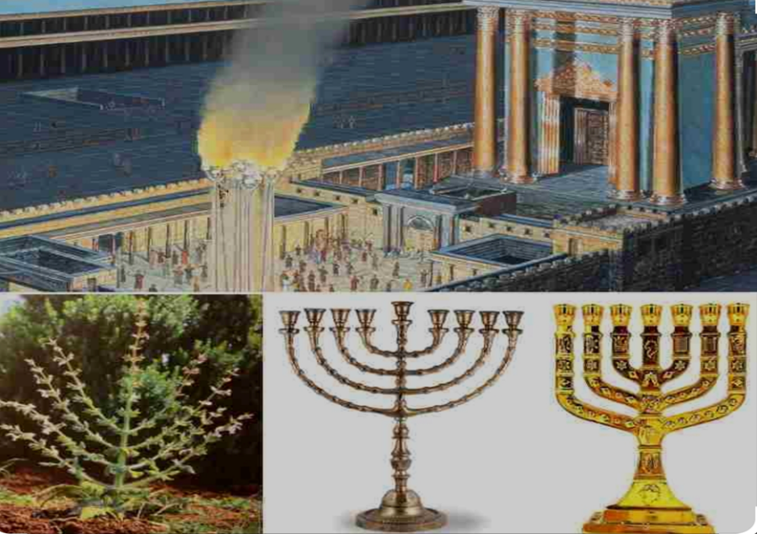
Light Ceremony
Notes:
One of the ceremonies or rights they conducted includes lighting of a Candelabra in the inner court of the temple to remind the people of the pillar of fire that guided their ancestors by night through the desert
This gives more meaning and a backdrop to the words Jesus uses in scripture about light…
John 8:12 – I am the light of the world….
Every Jew would be reminded of light guiding their ancestors through the wilderness every year… then Jesus comes along and says I am that light! How cool is that? Afternoon

Slide 6
Jesus Goes to the Festival of Tabernacles After this, Jesus went around in Galilee. He did not want^{[a]} to go about in Judea because the Jewish leaders there were looking for a way to kill him. ² But when the Jewish Festival of Tabernacles was near, ³ Jesus’ brothers said to him, “Leave Galilee and go to Judea, so that your disciples there may see the works you do. ⁴ No one who wants to become a public figure acts in secret. Since you are doing these things, show yourself to the world.” ⁵ For even his own brothers did not believe in him. ⁶ Therefore Jesus told them, “My time is not yet here; for you any time will do. ⁷ The world cannot hate you, but it hates me because I testify that its works are evil. ⁸ You go to the festival. I am not^{[b]} going up to this festival, because my time has not yet fully come.” ⁹ After he had said this, he stayed in Galilee.
John
7:1-9
Notes:
The first thing we want to comment on here is “after this”…. Which simply means after walking on water, after feeding thousands of people, after showing miracle after miracle, Jesus went around Galilee. Avoiding judea because the Jewish leaders were looking for a way to kill him.
So remember this is 6 months before Jesus is crucified. He has walked around the area for 2 1/2 years in a public ministry doing miracle after miracle and teaching to many. So by now he has become more irritating to the religious leaders and threatened them. Threatened them by challenging their authority and really scolding them for wrong ways of thinking and misinterpreting scripture and living as hypocrites.
My time has not come yet. This isn't the only time Jesus says this, even in the book of John. Chapter 2 verse 4, 7 verse 30, 8 verse 20, and in this passage both 7 verse 6 and 8 … This Harkins back also to Jesus telling his mother at the wedding at Cana “my hour has not come yet”
God’s Timing:
Remember in about 6 months from this time Jesus will be crucified
timing for Jesus means he will lay down his life at the exact moment he is supposed to
no biker gang is going to kill him before then
if Jesus went openly with his family to the festival leaders would arrest him or kill him and he knew this

Slide 7
Festival of Booths Danger Ahead

Slide 8
God’s Timing is Not My Timing and… God’s Timing is Always the Right Time
1.The Way Jesus Works:
Notes:
Have you ever experienced a time when God didn't do something you one or two but later could see God's timing? Different than yours? Wondering

Slide 9
¹⁰ However, after his brothers had left for the festival, he went also, not publicly, but in secret. ¹¹ Now at the festival the Jewish leaders were watching for Jesus and asking, “Where is he?” ¹² Among the crowds there was widespread whispering about him. Some said, “He is a good man.” Others replied, “No, he deceives the people.” ¹³ But no one would say anything publicly about him for fear of the leaders.
John
7:10-13
Notes:
Did Jesus lie to his brothers?
Information this is a passage of scripture that many skeptics use to disprove the truth of who Jesus is and disprove the integrity or inherency of scripture.
But the reality is, some old manuscripts say I am not yet going to the festival, including the word yet.
We also see in the context of the passage that Jesus says my time has not yet fully come in the second part
We also assume his own brothers would have called him out as a liar and a hypocrite just like Jesus was calling the Pharisees. But they did not. So they did not believe he lied
In the context of the gospel of John, lying is condemned throughout. So it is unlikely that John the writer would have written about Jesus as a liar.
So I don't think that this is proof that Jesus is a hypocrite and lied. I think there's a reasonable explanation in the context of the passage, chapter, and book of John to say otherwise.

Slide 10
Rabbi R.A & Rabbi Brad
Notes:
Now in this system of rabbis in training back then, it was common for only the smartest and best students to be approved or chosen to follow a rabbi as a disciple. And remember the disciple job is to become like the rabbi, in thinking and behavior. A young bright Jewish boy at age 13 or 14 would ask a certain rabbi if he could be a follower. There was a formal way of doing this and when asked the rabbi and others would consider whether to approve and allow him to follow or not. He had to be worthy of it.
This in itself is a beautiful contrast to the way Jesus gathered his disciples. He went out and got them. And as we know, they were not the smartest and brightest or most impressive boys of the bunch. That's the way Jesus does things.
Imagine there are two rabbis, we'll call them rabbi RA and rabbi Brad. Both of them get up to speak in the temple at the festival of booths….
When rabbi RA gets up he interprets the scriptures and people know he is a disciple of rabbi Bob. What he says and does and how he interprets the scripture and teaches are the words of rabbi bob
when rabbi Brad gets up and speaks he interprets the scriptures the way he was taught by his rabbi, we'll call him rabbi jim… he interprets the scripture and teaches the words of rabbi Jim.
The Jewish people were accustomed and assumed the teacher or rabbi had trained for many years walking in the dust of the rabbi. They would know their interpretation and teaching comes from there teacher. And if they didn't know that the rabbi might quote them and let them know this comes from rabbi Bob.

Slide 11
¹⁴ Not until halfway through the festival did Jesus go up to the temple courts and begin to teach. ¹⁵ The Jews there were amazed and asked, “How did this man get such learning without having been taught?” ¹⁶ Jesus answered, “My teaching is not my own. It comes from the one who sent me. ¹⁷ Anyone who chooses to do the will of God will find out whether my teaching comes from God or whether I speak on my own. ¹⁸ Whoever speaks on their own does so to gain personal glory, but he who seeks the glory of the one who sent him is a man of truth; there is nothing false about him. ¹⁹ Has not Moses given you the law? Yet not one of you keeps the law. Why are you trying to kill me?”
John
7:14-19
Notes:
The background of rabbinical training gives us more depth, meaning and light to jesus words when he stands up at the festival in the temple courts and begins to teach…
Jesus did not quote rabbi Jim, or rabbi Bob, and the people knew he did not train under any formal system of rabbinical training. He did not train under some great rabbi. And Jesus lets them know. Clearly. Why they were so amazed at his teaching because of the source.
Jesus don't need no stinking rabbi!
Just another example of Jesus bucking the norm and irritating the system

Slide 12
²⁰ “You are demon-possessed,” the crowd answered. “Who is trying to kill you?” ²¹ Jesus said to them, “I did one miracle, and you are all amazed. ²² Yet, because Moses gave you circumcision (though actually it did not come from Moses, but from the patriarchs), you circumcise a boy on the Sabbath. ²³ Now if a boy can be circumcised on the Sabbath so that the law of Moses may not be broken, why are you angry with me for healing a man’s whole body on the Sabbath? ²⁴ Stop judging by mere appearances, but instead judge correctly.”
John
7:20-24
Notes:
Jesus performed a miracle healing a lame man back in chapter 5. And he was challenged by the religious leaders for violating the law and working on the Sabbath.
The Healing at the Pool
5 Some time later, Jesus went up to Jerusalem for one of the Jewish festivals. 2 Now there is in Jerusalem near the Sheep Gate a pool, which in Aramaic is called Bethesda[a] and which is surrounded by five covered colonnades. 3 Here a great number of disabled people used to lie—the blind, the lame, the paralyzed. [4] [b] 5 One who was there had been an invalid for thirty-eight years. 6 When Jesus saw him lying there and learned that he had been in this condition for a long time, he asked him, “Do you want to get well?”
7 “Sir,” the invalid replied, “I have no one to help me into the pool when the water is stirred. While I am trying to get in, someone else goes down ahead of me.”
8 Then Jesus said to him, “Get up! Pick up your mat and walk.” 9 At once the man was cured; he picked up his mat and walked.
The day on which this took place was a Sabbath, 10 and so the Jewish leaders said to the man who had been healed, “It is the Sabbath; the law forbids you to carry your mat.”
11 But he replied, “The man who made me well said to me, ‘Pick up your mat and walk.’ ”
12 So they asked him, “Who is this fellow who told you to pick it up and walk?”
13 The man who was healed had no idea who it was, for Jesus had slipped away into the crowd that was there.
14 Later Jesus found him at the temple and said to him, “See, you are well again. Stop sinning or something worse may happen to you.” 15 The man went away and told the Jewish leaders that it was Jesus who had made him well.
The Authority of the Son
16 So, because Jesus was doing these things on the Sabbath, the Jewish leaders began to persecute him. 17 In his defense Jesus said to them, “My Father is always at his work to this very day, and I too am working.” 18 For this reason they tried all the more to kill him; not only was he breaking the Sabbath, but he was even calling God his own Father, making himself equal with God.

Slide 13
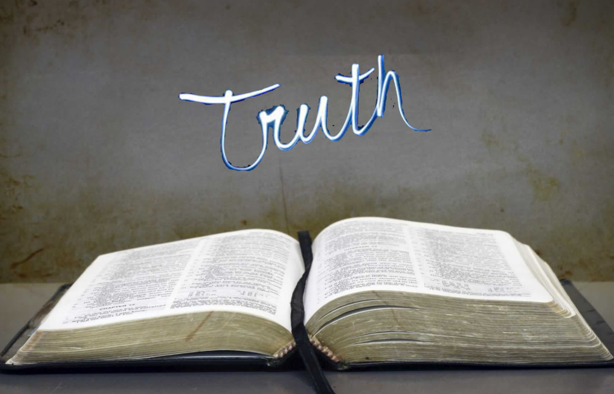
God’s Truth… Hard Truth… Pointing Out Our Flaws… Challenging Us to Be Better
2.What Jesus Teaches (vs.16, 21-24):
Notes:
But look at the last part he says:
²⁴ Stop judging by mere appearances, but instead judge correctly.” (NIV)
²⁴ Look beneath the surface so you can judge correctly.” (NLT)
The Message: Don’t be hypercritical; use your head—and heart!—to discern what is right, to test what is authentically right.”
²⁴ Do not judge by the outward appearance, but judge ^{[a]}with righteous judgment.” (NASB)

Slide 14
²⁵ At that point some of the people of Jerusalem began to ask, “Isn’t this the man they are trying to kill? ²⁶ Here he is, speaking publicly, and they are not saying a word to him. Have the authorities really concluded that he is the Messiah? ²⁷ But we know where this man is from; when the Messiah comes, no one will know where he is from.” ²⁸ Then Jesus, still teaching in the temple courts, cried out, “Yes, you know me, and you know where I am from. I am not here on my own authority, but he who sent me is true. You do not know him, ²⁹ but I know him because I am from him and he sent me.”
John
7:25-29
Notes:
Again Jesus restates and reiterates who he is. Making it more and more clear. Which only ticks off the religious leaders and confuses and divides the people. they are looking for a Messiah much different than he.

Slide 15
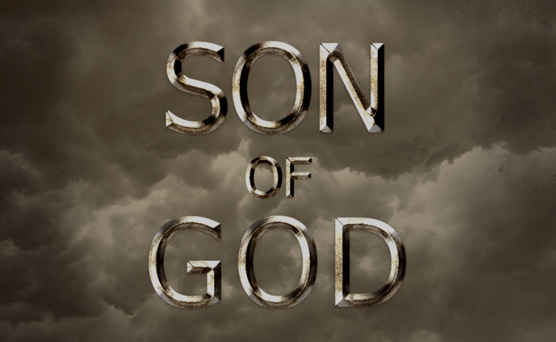
The Son of God… Messiah
3.Who Jesus Says He Is (vs.28):

Slide 16
³⁰ At this they tried to seize him, but no one laid a hand on him, because his hour had not yet come. ³¹ Still, many in the crowd believed in him. They said, “When the Messiah comes, will he perform more signs than this man?” ³² The Pharisees heard the crowd whispering such things about him. Then the chief priests and the Pharisees sent temple guards to arrest him. ³³ Jesus said, “I am with you for only a short time, and then I am going to the one who sent me. ³⁴ You will look for me, but you will not find me; and where I am, you cannot come.” ³⁵ The Jews said to one another, “Where does this man intend to go that we cannot find him? Will he go where our people live scattered among the Greeks, and teach the Greeks? ³⁶ What did he mean when he said, ‘You will look for me, but you will not find me,’ and ‘Where I am, you cannot come’?”
John
7:30-36

Slide 17
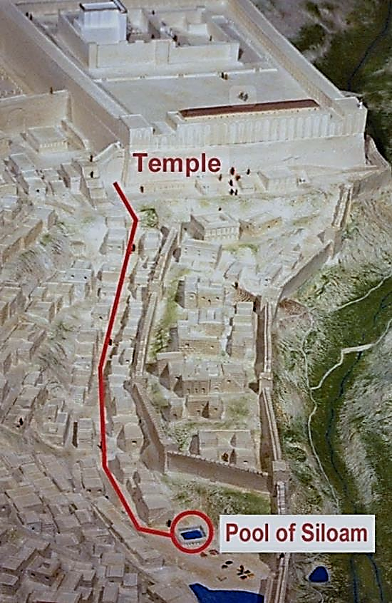
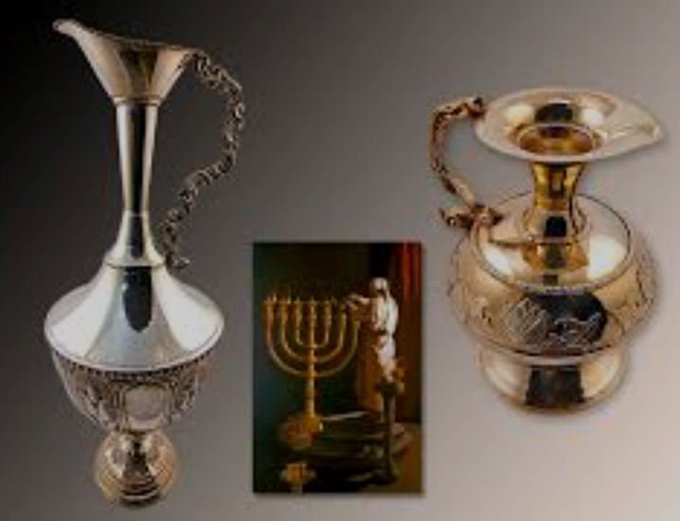
Ceremony of Water
Notes:
Water was drawn from the Pool of Siloam, brought to the Temple, poured on the altar, and berakhot (blessings) were said, thanking the LORD Most High for rain. That same pool of water would be the site where the blind man was healed and Messiah's healing ministry would expand.
The people gathered would have been expecting to see the synagogue leaders circling the altar 7 times and they were used to watching the outpouring of water. But they would not have been expecting the Rabbi from Nazareth to declare that He is the source of all Water! His words reveal that He is One with the Creator! And not just any old water, Living Water!
The waters would cleanse, purify, and usher in a new reality. The Messiah had come, was standing before them, and He would fill those who believed in Him with His Living Water.

Slide 18
³⁷ On the last and greatest day of the festival, Jesus stood and said in a loud voice, “Let anyone who is thirsty come to me and drink. ³⁸ Whoever believes in me, as Scripture has said, rivers of living water will flow from within them.”^{[c]} ³⁹ By this he meant the Spirit, whom those who believed in him were later to receive. Up to that time the Spirit had not been given, since Jesus had not yet been glorified.
John
7:37-39
Notes:
The people gathered would have been expecting to see the synagogue leaders circling the altar 7 times and they were used to watching the outpouring of water. But they would not have been expecting the Rabbi from Nazareth to declare that He is the source of all Water! His words reveal that He is One with the Creator! And not just any old water, Living Water!
“In words reminiscent of those in [John]4:10, Jesus gives the invitation to the thirsty to come to [H]im and drink. There is the implication that the thirsty soul will find that Jesus fills the need that cannot be supplied elsewhere. The appropriateness of the words at this feast is that, throughout the seven days, libations were made in the Temple with water brought from the pool of Siloam (Sukkot.4:9), but on the eighth day no water was poured, and this would make Jesus’ claim all the more impressive.”
The waters would cleanse, purify, and usher in a new reality. The Messiah had come, was standing before them, and He would fill those who believed in Him with His Living Water. True “Rain” come through me! Flows from me!

Slide 19
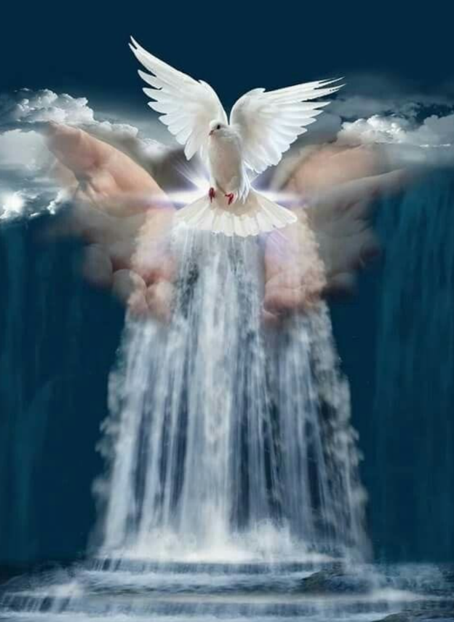
Streams of Living Water
4.What Jesus Provides (vs.37-38):

Slide 20
⁴⁰ On hearing his words, some of the people said, “Surely this man is the Prophet.” ⁴¹ Others said, “He is the Messiah.” Still others asked, “How can the Messiah come from Galilee? ⁴² Does not Scripture say that the Messiah will come from David’s descendants and from Bethlehem, the town where David lived?” ⁴³ Thus the people were divided because of Jesus. ⁴⁴ Some wanted to seize him, but no one laid a hand on him.
John
7:40-44

Slide 21
⁴⁵ Finally the temple guards went back to the chief priests and the Pharisees, who asked them, “Why didn’t you bring him in?” ⁴⁶ “No one ever spoke the way this man does,” the guards replied. ⁴⁷ “You mean he has deceived you also?” the Pharisees retorted. ⁴⁸ “Have any of the rulers or of the Pharisees believed in him? ⁴⁹ No! But this mob that knows nothing of the law—there is a curse on them.” ⁵⁰ Nicodemus, who had gone to Jesus earlier and who was one of their own number, asked, ⁵¹ “Does our law condemn a man without first hearing him to find out what he has been doing?” ⁵² They replied, “Are you from Galilee, too? Look into it, and you will find that a prophet does not come out of Galilee.”
John
7:45-52

Slide 22
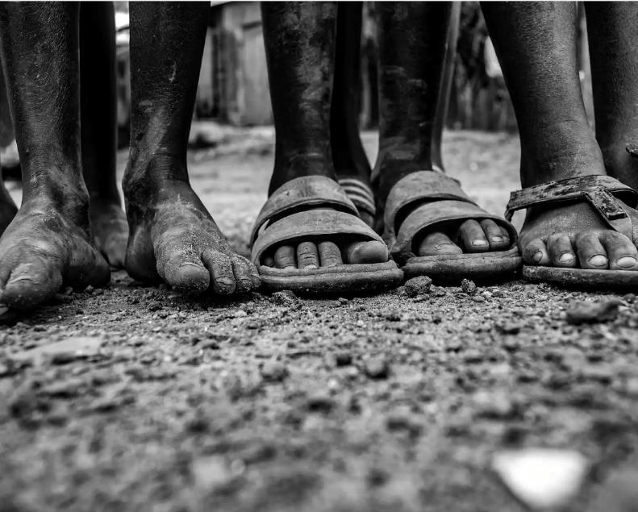
Walking in the Dust of the Rabbi
5.What Are
You Going To Do About It?
Notes:
Each of us has to decide what are we going to do with Jesus? Who is he to us? We argue today about who Jesus is just as they did when Jesus stood up in the temple court that day.
It’s the saying, “be covered in your rabbi’s dust.”
“…one of the most pervasive and fast-spreading stories to flood the church in recent years. The idea is that as you walked behind your rabbi, he would kick up dust and you would become caked in it and so following your rabbi closely came to symbolize your commitment and zeal.”
If we are his disciples, I think a good question to ask ourselves is how closely do we follow our rabbi? Are we close enough to experience the dust of our am I gathering on us?

Slide 23
Accept Responsibility: Look at the hard truths Jesus teaches Reject Passivity: Do something about them Lead Courageously: Help other do the same Anticipate the Lord’s Well-Done: Do it for a greater purpose
4 Pillars

Slide 24
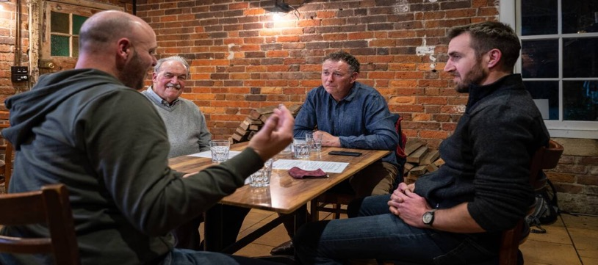
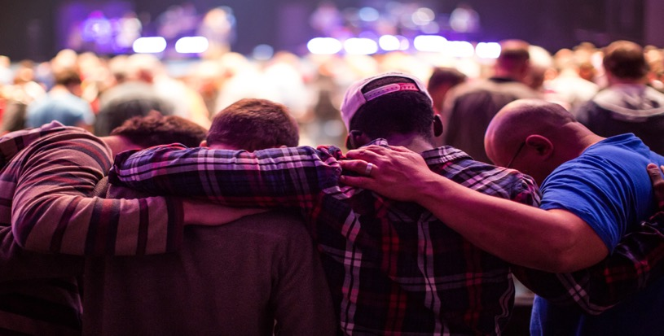
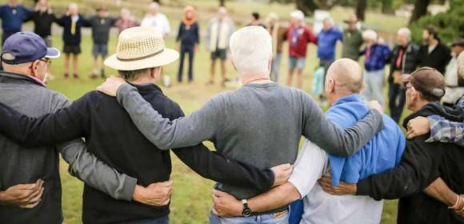
Iron Men Table Rules
1. Act Confidentially: what’s said at the table, stays at the table
2. Speak Personally: share experiences, not advice
3. Listen Deeply: walk alongside each other, not fix each other
4. Trust Boldly; take risks, be vulnerable, be transparent
5. Love Clearly: care, respect, accept

