Slide 1
BradleyOlson.net
Notes:
Review where we have been
Written so you may believe
BradleyOlson.net

Slide 2
Good Morning
And Welcome

Slide 3
Thank you!
For Breakfast
Thorsen Table
Breakfast
Next week the Nash Table
Thank You!

Slide 4
6:30 AM—7:00 AM IN THEAQUARIUM ROOM
ALL MEN WELCOME!

Slide 5
6:30 AM—7:00 AM IN THE AQUARIUM ROOM
ALL MEN WELCOME!

Slide 7
Welcome Brad Olson

Slide 8
How do we love? John 13 Bradleyolson.net

Slide 9
What is love?
Notes:
“Love is when Mommy sees Daddy on the toilet and she doesn’t think it’s gross.” Mark – age 6
“Love is like an avalanche where you have to run for your life.” – John, age 9
“I think you’re supposed to get shot with an arrow or something, but the rest of it isn’t supposed to be so painful.” – Manuel, age 8
“No one is sure why it happens, but I heard it has something to do with how you smell. That’s why perfume and deodorant are so popular.” – Mae, age 9
“Love is the most important thing in the world, but baseball is pretty good too.” – Greg, age 8
“I’m not rushing into being in love. I’m finding fourth grade hard enough.” – Regina, age 10
“Most men are brainless, so you might have to try more than once to find a live one.” – Angie, age 10
“Love is foolish…but I still might try it sometime.” – Floyd, age 9
“Love will find you, even if you are trying to hide from it. I been trying to hide from it since I was five, but the girls keep finding me.” – Dave, age 8
The Bible says we are to love one another. Sounds good, but can we do it? Whoever said, "I love mankind; it's people I can’t stand," was about right.
People are just irritating. I agree with the guy who said, "To live above with those we love, oh, how that will be glory. To live below with those we know, now that's another story.
Even people at church can be difficult to love. Sometimes we sing a chorus in church: "I'm so glad you're a part of the family of God," and then we look at the person beside us and sing, "I'm surprised you're part of the family of God.“
Sometimes it's hard enough to love our own family. One guy told his wife that if she had really loved him she would have married someone else.
How do we make love a dominating characteristic of our lives?

Slide 10
Modern Culture and love
Notes:
Love songs have a robust history that traces back centuries. In fact, the oldest known love song is that of Shu-Sin, which was discovered in the library of Ashurbanipal in Mesopotamia and dates back to 2000 BCE. Later, love ballads were popularized by the 8th-century tunes of medieval Arab female slaves in Spain. Overall, it has been estimated that more than 100 million love songs have been recorded.
Between 57% and 67% of songs are about love, depending on the study. This includes songs from every decade since the 1960s.
A 2018 study found that 67.3% of lyrics from top-40 songs between 1960 and 2010 were about love or relationships.
A psychology of music study found that 67% of lyrics in every song since the 1960s are about love.
A study found that 60% of modern songs and half of classic songs are about love and relationships.

Slide 11
Jesus Washes His Disciples’ Feet
13 It was just before the Passover Festival. Jesus knew that the hour had come for him to leave this world and go to the Father. Having loved his own who were in the world, he loved them to the end.
² The evening meal was in progress, and the devil had already prompted Judas, the son of Simon Iscariot, to betray Jesus. ³ Jesus knew that the Father had put all things under his power, and that he had come from God and was returning to God; ⁴ so he got up from the meal, took off his outer clothing, and wrapped a towel around his waist. ⁵ After that, he poured water into a basin and began to wash his disciples’ feet, drying them with the towel that was wrapped around him.
⁶ He came to Simon Peter, who said to him, “Lord, are you going to wash my feet?”
⁷ Jesus replied, “You do not realize now what I am doing, but later you will understand.”
⁸ “No,” said Peter, “you shall never wash my feet.”
Jesus answered, “Unless I wash you, you have no part with me.”
⁹ “Then, Lord,” Simon Peter replied, “not just my feet but my hands and my head as well!”
¹⁰ Jesus answered, “Those who have had a bath need only to wash their feet; their whole body is clean. And you are clean, though not every one of you.” ¹¹ For he knew who was going to betray him, and that was why he said not every one was clean.
¹² When he had finished washing their feet, he put on his clothes and returned to his place. “Do you understand what I have done for you?” he asked them. ¹³ “You call me ‘Teacher’ and ‘Lord,’ and rightly so, for that is what I am. ¹⁴ Now that I, your Lord and Teacher, have washed your feet, you also should wash one another’s feet. ¹⁵ I have set you an example that you should do as I have done for you. ¹⁶ Very truly I tell you, no servant is greater than his master, nor is a messenger greater than the one who sent him. ¹⁷ Now that you know these things, you will be blessed if you do them.

Slide 12
Jesus Predicts His Betrayal
¹⁸ “I am not referring to all of you; I know those I have chosen. But this is to fulfill this passage of Scripture: ‘He who shared my bread has turned^{[a]} against me.’^{[b]}
¹⁹ “I am telling you now before it happens, so that when it does happen you will believe that I am who I am. ²⁰ Very truly I tell you, whoever accepts anyone I send accepts me; and whoever accepts me accepts the one who sent me.”
²¹ After he had said this, Jesus was troubled in spirit and testified, “Very truly I tell you, one of you is going to betray me.”
²² His disciples stared at one another, at a loss to know which of them he meant. ²³ One of them, the disciple whom Jesus loved, was reclining next to him. ²⁴ Simon Peter motioned to this disciple and said, “Ask him which one he means.”
²⁵ Leaning back against Jesus, he asked him, “Lord, who is it?”
²⁶ Jesus answered, “It is the one to whom I will give this piece of bread when I have dipped it in the dish.” Then, dipping the piece of bread, he gave it to Judas, the son of Simon Iscariot. ²⁷ As soon as Judas took the bread, Satan entered into him.
So Jesus told him, “What you are about to do, do quickly.” ²⁸ But no one at the meal understood why Jesus said this to him. ²⁹ Since Judas had charge of the money, some thought Jesus was telling him to buy what was needed for the festival, or to give something to the poor. ³⁰ As soon as Judas had taken the bread, he went out. And it was night.
Jesus Predicts Peter’s Denial
³¹ When he was gone, Jesus said, “Now the Son of Man is glorified and God is glorified in him. ³² If God is glorified in him,^{[c]} God will glorify the Son in himself, and will glorify him at once.
³³ “My children, I will be with you only a little longer. You will look for me, and just as I told the Jews, so I tell you now: Where I am going, you cannot come.
³⁴ “A new command I give you: Love one another. As I have loved you, so you must love one another. ³⁵ By this everyone will know that you are my disciples, if you love one another.”
³⁶ Simon Peter asked him, “Lord, where are you going?”
Jesus replied, “Where I am going, you cannot follow now, but you will follow later.”
³⁷ Peter asked, “Lord, why can’t I follow you now? I will lay down my life for you.”
³⁸ Then Jesus answered, “Will you really lay down your life for me? Very truly I tell you, before the rooster crows, you will disown me three times!

Slide 13
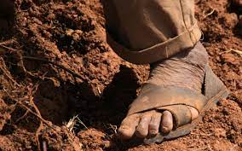
The culture
Notes:
HOUSING - In Palestine in the time of Jesus, houses were made of clay bricks or stones held together with mud and straw, and had dirt floors. - You average family lived in one-room, two-level dwellings with living quarters separated from and raised above the animal stalls. Jewish extended families often lived together. - The poor lived in one-room houses built of mud brick on a stone foundation. External steps led up to the flat roof which provided storage space and somewhere to sit. Inside the house a raised platform at one end of the room provided quarters for eating and sleeping. The lower level was used mainly as a stable. - Some items in the house included a table, a spinning wheel, wooden bowls, an olive oil lamp.
FOOD - Seasonal vegetables (e.g. beans, onions, lentils, leeks, cucumbers), flavoured with herbs and salt, and bread (made from wheat or barley flour) provided the basis of a staple diet. - There would also have been fruit (though not the citrus fruits for which Palestine is known today), together with nuts, honey and cheese. - Fish were plentiful, especially around Galilee, and could be preserved by drying and salting.
The Jews of Galilee, where Jesus grew up, were essentially a rural people. The great majority lived in the many small towns and villages scattered throughout the countryside. They worked the land, tended their flocks, and plied their trades, seldom venturing more than a day’s journey from home. However, many went to Jerusalem, some as often as every year, to celebrate the Passover. And that was no small journey, up to 70 miles on foot each way!
Archaeology continues to uncover details of life in Jesus' times. Travel was limited: by foot or donkey.
During Biblical times, sandals were mostly made of untreated leather and had cords or laces made of fine leather or dry grass.

Slide 14
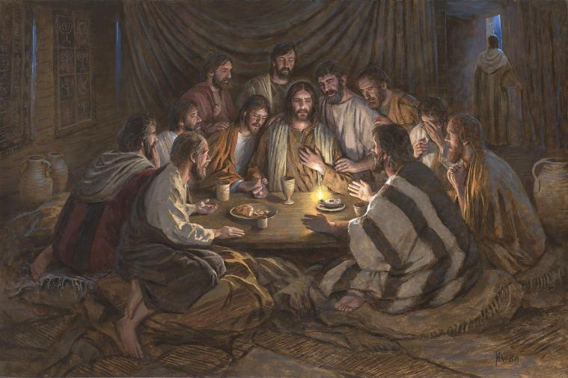
The event
Passover
Notes:
Significance of the Passover Meal
During Passover, the celebration of Israel’s deliverance from Egyptian bondage, Jesus dined with His disciples in the Upper Room.
This meal was no ordinary feast; it represented the new covenant between God and humanity through Jesus’ sacrifice. As they gathered in Jerusalem, the Passover meal unfolded into an intimate moment where Jesus taught important lessons on servanthood and love.
Historical and Cultural Background
The Gospels describe the Upper Room as the private, secluded space chosen by Jesus to have a final meal with His disciples. This setting in Jerusalem provided a backdrop of Jewish religious traditions and Roman political tension.
In the intimate setting of the Last Supper, Jesus performs the unexpected act of washing His disciples’ feet, an act laden with symbolism and instructive for understanding the nature of true servanthood.
This extraordinary gesture overturns social norms and preconceptions about mastery and servitude, setting the stage for a discussion on the importance of humility and service in the life of a believer.
The chapter proceeds to unveil the looming betrayal of Judas Iscariot and foreshadows Peter’s denial, both serving as contrasting backdrops to the love and fidelity that Jesus exemplifies.
By the chapter’s close, Jesus articulates a new commandment to His followers, urging them to love one another just as He has loved them—a principle that would become central to Christian ethics.
In essence, John 13 provides a blueprint for living a life that mirrors the heart of Christian doctrine—love and humble service

Slide 15
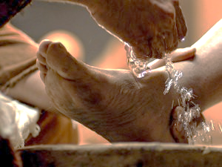
The Symbol
Washing Feet
Redefines Leadership
Notes:
In John chapter thirteen, the act of Jesus washing the disciples’ feet stands as a multifaceted symbol, rich in meaning and lessons in servitude and humility.
Servanthood and Humility: When Jesus took on the role of a servant, He provided a profound example of humility. This act was traditionally performed by the lowest of servants, yet He chose to perform this service Himself.
Water and Cleansing: The use of water in the washing of feet symbolizes purification. In a spiritual context, it represents the cleansing of one’s life from the impurities of sin. The hands of Jesus, which poured the water and washed the feet, signify the personal touch of Christ in the believer’s purification process.
Cultural Context – Dirty Feet: During that time, feet would become exceptionally dirty from the dusty roads. Washing them was a necessity, which makes the task Jesus performed all the more
It is important, before we even turn to Jesus’ words, to remember exactly when and where Jesus said these things. Sometimes, when and where we say something is as important to the meaning as the actual words that we say. And that’s true in John 13. John 13 begins in the upper room. Jesus is there with all of his disciples. Thomas, who will doubt the resurrection is there. Peter, who will deny knowing Jesus after he is arrested, is there. And Judas, who will betray Jesus and hand him over to those wanting to kill him, is there. And Jesus, knowing all that is to come, washed each of their feet.
Washing a person’s feet in that culture was the appointed task of a servant. We have probably heard this before. Jesus was humbling himself, and doing the work of a servant here. But stop to think about what that means now, looking back. Jesus washed Judas’s feet, knowing he would betray him. He washed Peter’s feet, knowing he would deny knowing him. He washed Thomas’s feet, knowing he would doubt him. Jesus knew all this would happen. He predicted it. But he still got on his knees and washed their feet.
If you want a picture of love, picture Jesus on his knees, washing the feet of his betrayer, Judas. That’s love, isn’t it? And Jesus tells us that this is what we need to do for one another. Love one another, as he has loved us.
The service Jesus demonstrated goes beyond mere action; it’s an invitation to a lifestyle of humility and caring for others, exemplifying that leadership is rooted in serving others selflessly.
In John 13, Jesus conveys a powerful message about servanthood. He demonstrates through His actions that serving others is not a sign of weakness but rather a profound commandment for His followers.
Jesus sets the example by washing His disciples’ feet, an act of humility typically reserved for servants.
Serve: His actions redefine the concept of leadership within the community of believers.

Slide 16
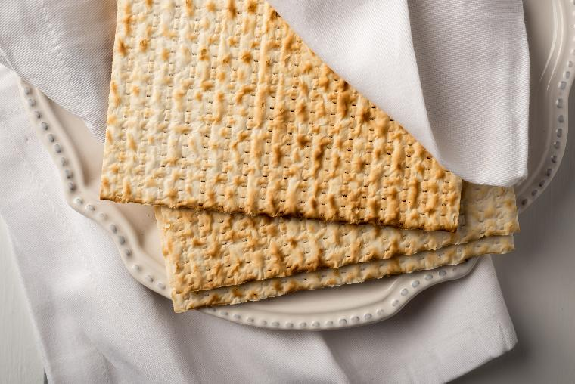
The event
Final Instructions Before the Final Goodbye
Notes:
So as Jesus’s public ministry closes, and John turns now to the last day before Jesus dies, he looks back and says: in all his ministry, Jesus has been showing peculiar, revealing, saving, forgiving, patient, confirming, guiding love to his own. Verse 1b: “Having loved his own who were in the world. . . .” That’s what he’s been doing. And John looks forward from this point and says that Jesus will now love them to the end. Verse 1c: “He loved them to the end.”
He’s not denying that Jesus loved the world. John 3:16 says he did. But John is talking here about his unique and special love for his people — like a husband has a unique love for his wife. “Having loved his own who were in the world, he loved them to the end.” Everything we see him doing new in chapter 13 is part of this love. And if you belong to Jesus, feel everything he says and does here as said to you and done for you in a very intentional, personal, effective way.

Slide 17
A new command
What’s So New About It?
Notes:
An invitation to a lifestyle of humility and caring for others
Even though we have the freedom to set our own priorities, Jesus made a point of defining certain ones of them for us: "'Love the Lord your God with all your heart, with all your soul, and with all your mind.' This is the greatest and most important commandment. The second is like it: 'Love your neighbor as yourself'" (Matt. 22:37-39). Love, then, is not a gray area the Scriptures. Jesus gave love priority over all other Christian virtues. Every thought, response, and act of goodwill must first pass through the fine filter of love, or it means nothing at all.
In "Strength to Love", Martin Luther King, Jr., encouraged us to realize that "our responsibility as Christians is to discover the meaning of this command and seek passionately to live it out in our daily lives." But why love? What makes it so important?
But we might wonder, what’s new about it? The commandment to love wasn’t new, of course. It’s mentioned often in the Old Testament. The greatest commandment is to love God, and the next is to love our neighbor. These are repeated often in the Old Testament. They are not new. But Jesus’ commandment is. What’s new about it? Not love. But loving just as Jesus loved. The new part of this is that we are commanded to love one another just as Jesus has loved us

Slide 18
What does love look like?
Eros
Philos
Storge
Agape
The heart of agape
Notes:
4 types of love in Bible- 7 in Greek culture 100+ times Agape is used in the NT
KINDS OF LOVE
Eros refers to physical or sexual love.
The word eros was commonly used in the Greek-speaking world of New Testament times. The word itself is not found in the pages of the New Testament. The concept of physical love, however—expressed in the context of marriage—is found and affirmed in the New Testament (see 1 Cor. 7:5; Heb. 13:4).
Philos means warm affection or friendship.
Philos was commonly used with reference to friendships or family relationships. For example, it was used in Matthew 10:37 to indicate love for father and mother or son and daughter. Philos was the word used of Jesus’ love for His friend Lazarus (John 11:3,36) and His love for His disciple (John 20:2).
1. A related word, storgē, means “family devotion.” Storgē is not a common word in the New Testament. In Romans 12:10, it is compounded with philos (philostorgoi) and can be translated “devoted” (NASB) or “brotherly affection” (ESV).
Agapē is the sacrificial, unconditional love of God.
In the New Testament, agapē is the highest form of love. But outside of the New Testament, the word was rarely used. Prior to New Testament times, agapē did not carry any special significance as a higher kind of love. Thus, it’s the New Testament understanding of the unique nature of God’s love—not the word’s usage in the Greek-speaking world of the first century—that gives the word agapē its special meaning.
What Agape Means in the Bible
To the Greeks, proper agape meant a general empathy or lovingkindness for all people. Though in the Bible, Christians are indeed expected to care for all in the name of Christ, Christianity took this a step further. Biblical writers used God as the standard for true agape.

Slide 19
The heart of agape
Highest Value
Highest Value
______________
13:34
“A new command I give you: Love one another. As I have loved you, so you must love one another. ³⁵ By this everyone will know that you are my disciples, if you love one another.”
________________________
________________________
_______________
_________________
__________
_____________
____________
Notes:
Last words to beloved people…. Most important
A. Love values the other person
Let's not confuse Christian love with its modern counterfeits - lust, sentimentality, and gratification. While love is a wonderful, warm feeling, it is not only a feeling. In fact, according to the Bible, love is primarily an active interest in the well-being of another person. Love acts for the benefit of others. According to William Barclay love "is the spirit in the heart that will never seek anything but the highest good of its fellow man.“
God loved us not because we had something to offer him, but rather because He had something to offer us. "For God loved the world in this way: He gave His One and Only Son, so that everyone who believes in Him will not perish but have eternal life" (John 3:16). God loved us so that He could demonstrate His mercy to us in the person of His Son.
Dr. W.A. Criswell, former pastor of First Baptist Church, Dallas, Texas, officiated at a lot of weddings. The nervous groom would always say, "Dr. Criswell, how much do I owe you for this?" And he'd always smile and look at the groom and say, "Aw, just pay me what she's worth." Dr. Criswell made a lot of money from weddings, because to each man his new bride was of extravagant value.
In like manner, everyone around us is of incredible value to God as a potential object of His mercy. His one and only Son died in their place. Because people matter so much to him, they ought to matter to us. And, we, therefore, need to love them as he loves them.

Slide 20
Selfless humility (13:4-5)
Highest Value
Selfless Humility
… ⁴ so he got up from the meal, took off his outer clothing, and wrapped a towel around his waist. ⁵ After that, he poured water into a basin and began to wash his disciples’ feet, drying them with the towel that was wrapped around him.
________________________
________________________
_______________
_________________
____________
_____________
___________
The heart of agape
Notes:
freedom from pride or arrogance
Humility is the quality of being modest and not thinking you are better than others. It can also mean having an accurate view of yourself and being open-minded.
Explanation
Humility comes from the Latin word humilis, which means "low" or "small".
It can involve being free from pride and having a low view of your own importance.
Humility can also mean being aware of your imperfections and working to live with them productively.
In a religious context, humility can mean recognizing a deity and submitting to it.
Humility can also mean caring about others and looking out for their best interests.

Slide 21
Philippians 2:5-7
5 In your relationships with one another, have the same mindset as Christ Jesus:
6 Who, being in very nature God,
did not consider equality with God something to be used to his own advantage;
7 rather, he made himself nothing
by taking the very nature of a servant,
being made in human likeness.

Slide 22
Reflection of God
Highest Value
Selfless Humility
13:34-35
³⁴ “A new command I give you: Love one another. As I have loved you, so you must love one another. ³⁵ By this everyone will know that you are my disciples, if you love one another.”
Visible Reflection
________________________
_______________
__________________
___________
_____________
____________
The heart of agape
Notes:
God’s plan- to develop people who reflect his character
Followers of Christ are to be known by the way they love.
Jesus commanded His followers: “Just as I have loved you, you are also to love one another. By this everyone will know that you are my disciples, if you love one another” (John 13:34-35, CSB). The word Jesus used for love is the verb form of agapē. The pattern of our love is “as I have loved you.” In other words, we are to be known by our self-giving, sacrificial, unconditional love for one another. Paul, in 1 Corinthians 13, describes what such love looks like, practically speaking.
From the very beginning, God's plan was to develop a people that reflected his character. And what is his character? Love. "God is love, and the one who remains in love remains in God, and God remains in him. In this, love is perfected with us so that we may have confidence in the day of judgment; for we are as He is in this world" (1 John 4:16-17). Believers are God's advertisement to a watching society as to how individuals could best live in that society. In fact, Christian love will always be the best apologetic that the church has.
Now remember, he is trying to show them the kind of person who is qualified or suitable for the high calling of verse 20: “Truly, truly, I say to you, whoever receives the one I send receives me, and whoever receives me receives the one who sent me.” In other words, he’s saying something like this: I am going away (verse 1), and you are about to become my representatives, my ambassadors, on the earth to take my words, and my salvation, and my own presence to the world on my behalf. If people receive you, they receive me.

Slide 23
Intentional Actions
Highest Value
Selfless Humility
13:20
²⁰ Very truly I tell you, whoever accepts anyone I send accepts me; and whoever accepts me accepts the one who sent me.”
Visible Reflection
Intentional Action
To My Neighbor
_________________
_______________
___________
_____________
____________
The heart of agape
Notes:
Love is not a feeling- intentional- choice
Author and lecturer Leo Buscaglia once talked about a contest he was asked to judge. The purpose of the contest was to find the most caring child.
The winner was a four year old child whose next door neighbor was an elderly gentleman who had recently lost his wife.
Upon seeing the man cry, the little boy went into the old gentleman’s yard, climbed onto his lap, and just sat there.
When his Mother asked what he had said to the neighbor, the little boy said,
“Nothing, I just helped him cry.”

Slide 24
One Another
Highest Value
Selfless Humility
13:34
³⁴ Love one another. As I have loved you, so you must love one another.
Visible Reflection
Intentional Action
One Another
_________________
___________
_____________
____________
The heart of agape
Notes:
: Love one another. As I have loved you, so you must love one another. ³⁵ By this everyone will know that you are my disciples, if you love one another.”
But we might wonder, what’s new about it? The commandment to love wasn’t new, of course. It’s mentioned often in the Old Testament. The greatest commandment is to love God, and the next is to love our neighbor. These are repeated often in the Old Testament. They are not new. But Jesus’ commandment is. What’s new about it? Not love. But loving just as Jesus loved.
The new part of this is that we are commanded to love one another just as Jesus has loved us. And that means loving those who doubt us, and deny knowing us, and even those who betray us. Because that’s what Jesus did for us. He loved us, and loves us, even when we doubt, deny, or betray him. And now, simply put, he asks us to do the same for others. It’s not always easy. But it is always important. Always commanded. And always should be done.
The old commandment, from Leviticus, is to love our neighbor as our self. But the new commandment, from Jesus, is to love even those who are not our neighbors. Jesus loved lepers, for example, who were considered unclean and unloved by God. Jesus loved tax collectors, even calling one to be his disciple. Jesus loved Samaritans. He loved prostitutes. He loved the poor. He loved those that society didn’t even see. He considered them all our neighbors. All loved by God. And all deserving of our love. Jesus completely redefined who our neighbor is. Our neighbor is now anyone and everyone we have an opportunity to love.
But not only that, Jesus taught us to love even our enemies. Just as he did. Now, this does not mean that we accept or agree with what they are doing. Love according to Jesus doesn’t mean accepting actions that are wrong. Jesus met people where they were, but didn’t leave them there. He called them to repent. He loved them, and forgave them, but also invited them to change their ways. Jesus never loved sin. But he always loved sinners. He still does. And he shows us how to do the same.

Slide 25
Risks of Vulnerability
Highest Value
Selfless Humility
13:1-2
It was just before the Passover Festival. Jesus knew that the hour had come for him to leave this world and go to the Father. Having loved his own who were in the world, he loved them to the end.
² The evening meal was in progress…
Visible Reflection
Intentional Action
One Another
Risks Vulnerability
___________
_____________
____________
The heart of agape
Notes:
Intimate- means RISK of wounding
In other words, love opens up its life to another person. It goes beyond sentimental feelings. It breaks down barriers. It exposes the heart.
Think about Jesus. He left the glory of heaven to come to earth. He veiled His divinity and took on humanity. And what did it get him? "He came to His own, and His own people did not receive Him" (John 1:11). Can you imagine being away on a business trip for a week, coming home, and your family not recognizing you? That's similar to what Jesus experienced when he came to earth. Surely that must have hurt. Then, as Jesus hung on the cross, dying for these people that he loved, they hurled abuses, scorn, and ridicule. His heart was broken. And yet, He forgave them.

Slide 26
Vulnerability = able to be wounded
Brene Brown:
“[Love is] waking every day and loving someone who may or may not love us back, whose safety we can’t ensure, who may stay in our lives or may leave without a moment’s notice, who may be loyal to the day they die or betray us tomorrow — that’s vulnerability.”
Notes:
And vulnerability is the next thing that Jesus teaches us about love. The word “vulnerable” literally means “able to be wounded.” When we are vulnerable, we open ourselves up to the possibility of being wounded. And that is exactly what Jesus teaches us – that we should open ourselves up to one another in love, even if it opens us up to the possibility of being wounded.
That’s what Jesus did, right? Jesus loved Judas, who betrayed him. He loved Peter, who denied knowing him. He loved Thomas, who doubted him. He loved those who abandoned him, and even those who crucified him. Jesus loved in a way that opened him up to these wounds. And he teaches us to do the same.
Brene Brown goes on to say that:
“To love is to be vulnerable, to give someone your heart and say, ‘I know this could hurt so bad, but I’m willing to do it.’ And there is an increasing number of people in the world today that are not willing to take that risk. They’d rather never know love than to know hurt or grief, and that is a huge price to pay.”

Slide 27
C.S.Lewis
"To love is to be vulnerable. Love anything, and your heart will certainly be wrung and possibly broken. If you want to make sure of keeping it intact, you must give your heart to no one, not even to an animal. Wrap it carefully round with hobbies and little luxuries. Avoid all entanglements. Lock it up safe in the casket or coffin of your selfishness. But in that casket - safe, dark, motionless, airless - it will change. It will not be broken. Instead, it will become unbreakable, impenetrable, irredeemable.”

Slide 28
Persevering
13:1
Jesus knew that the hour had come for him to leave this world and go to the Father. Having loved his own who were in the world, he loved them to the end.
Highest Value
Selfless Humility
Visible Reflection
Intentional Action
One Another
Risks Vulnerability
Persevering
_____________
____________
The heart of agape
Notes:
continuing in a course of action despite difficulty or delay in achieving success.
"she has been a remarkably steadfast and persevering woman"
Synonyms of persevere
persist.
hang in there.
carry on.
gut it out.
hang on.
keep up.
follow through (with)
dig in.
“Grit”

Slide 29
Perseverance
José Moreno Hernández
“Grit”
Notes:
José Moreno Hernández (born August 7, 1962) is a Mexican-American engineer [3] and astronaut.
José Hernández shares how the moon landing and his family inspired his improbable journey from harvesting fruit in Mexico to becoming one of the first Mexican
It's based on the true story of NASA astronaut José Hernández, who in 2009 made a 14 day mission to outer space on Space Shuttle Discovery, finally realizing his dream.
“NASA rejected me not once, not twice, not even 3 or 4 times—11 rejections. It wasn't until the 12th time that I got selected.” At the time of his sixth rejection from NASA, Hernández was an engineer working at Lawrence Livermore National Laboratory in Livermore, California.

Slide 30
Unconditional
13:2-3
Having loved his own who were in the world, he loved them to the end.
² The evening meal was in progress, and the devil had already prompted Judas, the son of Simon Iscariot, to betray Jesus.
Highest Value
Selfless Humility
Visible Reflection
Intentional Action
One Another
Risks Vulnerability
Persevering
Unconditional
___________
____________
The heart of agape
Notes:
Unconditional love, simply put, is love without strings attached- without limitations or conditions- It's love you offer freely. You don't base it on what someone does for you in return. You simply love them and want nothing more than their happiness

Slide 31
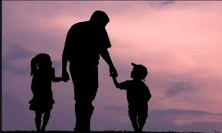
Unconditional
absolute
sheer
utter
complete
simple
pure
total
definite
Notes:
Unconditional love, simply put, is love without strings attached- without limitations or conditions- It's love you offer freely. You don't base it on what someone does for you in return. You simply love them and want nothing more than their happiness
Like a father’s love for his children

Slide 32
Empathy
____________
Highest Value
Selfless Humility
13:5
⁵ After that, he poured water into a basin and began to wash his disciples’ feet, drying them with the towel that was wrapped around him.
________________________
Visible Reflection
Intentional Action
________________
Risks Vulnerability
One Another
Persevering
Unconditional
___________
Empathic
The heart of agape
Notes:
When Ira Gillett, missionary to East Africa, returned home to report on his activities overseas, he related an interesting phenomenon. Repeatedly, Gillett had noticed how groups of Africans would walk past government hospitals and travel many extra miles to receive medical treatment at the missionary compound. He finally asked a particular group why they walked the extra distance when the same treatments were available at the government clinics. The reply: "The medicines may be the same but the hands are different.
Theological Point: God calls us to a life of love that is deeper than human feelings or emotions. Love is a committed, thoughtful decision to serve God and our neighbors. This kind of love compels us to work for the well-being of all people—those whom we find easy to love and those whom we find difficult to love.

Slide 33
Table questions
How is the condition of your “Heart of Agape” Love?
What characteristic of Agape love discussed today needs work in you?
How good are you at reflecting the character of God? What do you need to work on to grow in this way?
What does it mean to love?
Who do you find hard to love? How do you love them?
What work of love is there for you to do in your own life?
How do we make love a dominating characteristic of our lives?

Slide 34
4 Pillars of IronMen
Accept Responsibility: Accept the new command as the highest of calling Reject Passivity: Show love with intention and action Lead Courageously: For a watching world to see Anticipate the Lord’s Well-Done: Remember God wants to build character that reflects Him

Slide 35
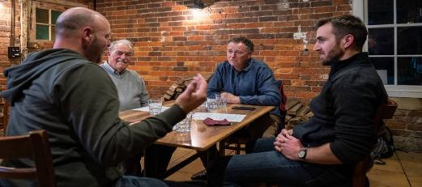
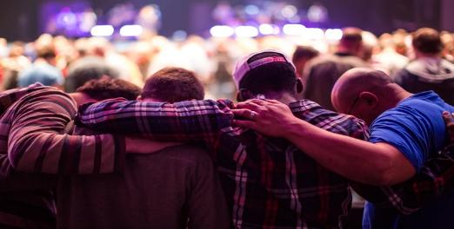
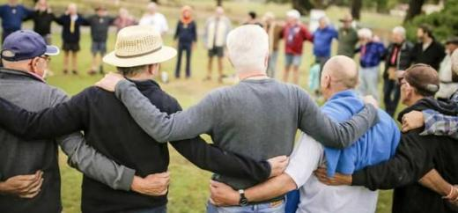
Iron Men Table Rules
1. Act Confidentially: what’s said at the table, stays at the table
2. Speak Personally: share experiences, not advice
3. Listen Deeply: walk alongside each other, not fix each other
4. Trust Boldly; take risks, be vulnerable, be transparent
5. Love Clearly: care, respect, accept

Slide 36
Good Morning
And Welcome
Table Discussion

