Slide 1
Good Morning
And Welcome

Slide 2
BradleyOlson.net
6:30 AM—7:00 AM IN THEAQUARIUM ROOM
ALL MEN WELCOME!

Slide 3
Character
THE
TITUS
TEN
Of a Man
6:30 AM—7:00 AM IN THEAQUARIUM ROOM
ALL MEN WELCOME!
BradleyOlson.net

Slide 4
What Does Culture Tell Us A Real Man Is?
What Makes a Man?

Slide 5
When I look through the lens of Scripture- I see what God values and desires for us- not what our culture tells us- and it often looks upside-down
God’s Eye View
Notes:
Think Upside-down –
God’s kingdom always looks upside-down from our kingdom

Slide 6
I Kings 2:2
2 When the time drew near for David to die, he gave a charge to Solomon his son.
2 “I am about to go the way of all the earth,” he said. “So be strong, act like a man, 3 and observe what the Lord your God requires: Walk in obedience to him, and keep his decrees and commands, his laws and regulations
The Bible Calls Us to Act Like A Man… Be A Man
I Cor. 16:13
¹³ Be on your guard; stand firm in the faith; be courageous (act like men); be strong. ¹⁴ Do everything in love.
Notes:
I Cor 16:13- as Paul ends his letter instructing the church in Corinth
In some translations- original Greek translation = “act like men” = be courageous

Slide 7
2 Peter 1:5-8
Make Every Effort
⁵ who through faith are shielded by God’s power until the coming of the salvation that is ready to be revealed in the last time. ⁶ In all this you greatly rejoice, though now for a little while you may have had to suffer grief in all kinds of trials. ⁷ These have come so that the proven genuineness of your faith—of greater worth than gold, which perishes even though refined by fire—may result in praise, glory and honor when Jesus Christ is revealed.
The Bible Calls Us To Cultivate Christian Character…Work At It
Notes:
Developing Christ-like character does not happen passively
Work towards = growth demands effort

Slide 8
Phil. 2:12-13
It is a continual effort
¹² Therefore, my dear friends, as you have always obeyed—not only in my presence, but now much more in my absence—continue to work out your salvation with fear and trembling, ¹³ for it is God who works in you to will and to act in order to fulfill his good purpose.
The Bible Calls Us To Cultivate Christian Character…Work At It
Notes:
Developing Christ-like character does not happen passively
Work towards = growth demands effort
What does it mean to work out your salvation?

Slide 9
Titus 1:5
⁵ The reason I left you in Crete was that you might put in order what was left unfinished and appoint elders in every town, as I directed you.
The Church Needs Leaders of Godly Character…

Slide 10
Titus 1:6-9
⁶ An elder must be blameless, faithful to his wife, a man whose children believe^{[b]} and are not open to the charge of being wild and disobedient. ⁷ Since an overseer manages God’s household, he must be blameless—not overbearing, not quick-tempered, not given to drunkenness, not violent, not pursuing dishonest gain. ⁸ Rather, he must be hospitable, one who loves what is good, who is self-controlled, upright, holy and disciplined. ⁹ He must hold firmly to the trustworthy message as it has been taught, so that he can encourage others by sound doctrine and refute those who oppose it.
The Church Needs Leaders of Godly Character… NOT the Intelligent, Talented, Or Popular

Slide 11
Character Makes a Man
Most men have never been given a greater vision of what it means to be a man’s man
Notes:
2 Peter 1:5
⁵ In view of all this, make every effort to respond to God’s promises. Supplement your faith with a generous provision of moral excellence
A manly man is courageous- not an option- a necessity

Slide 12
Men of Godly Character Are:
Blameless – Titus 1:6
Not without blemish
Unquestionable integrity
Model for other believers
The same in public & private
Notes:
⁶ An elder must be blameless, faithful to his wife, a man whose children believe^{[b]} and are not open to the charge of being wild and disobedient.
At home and in community
What does it mean?

Slide 13
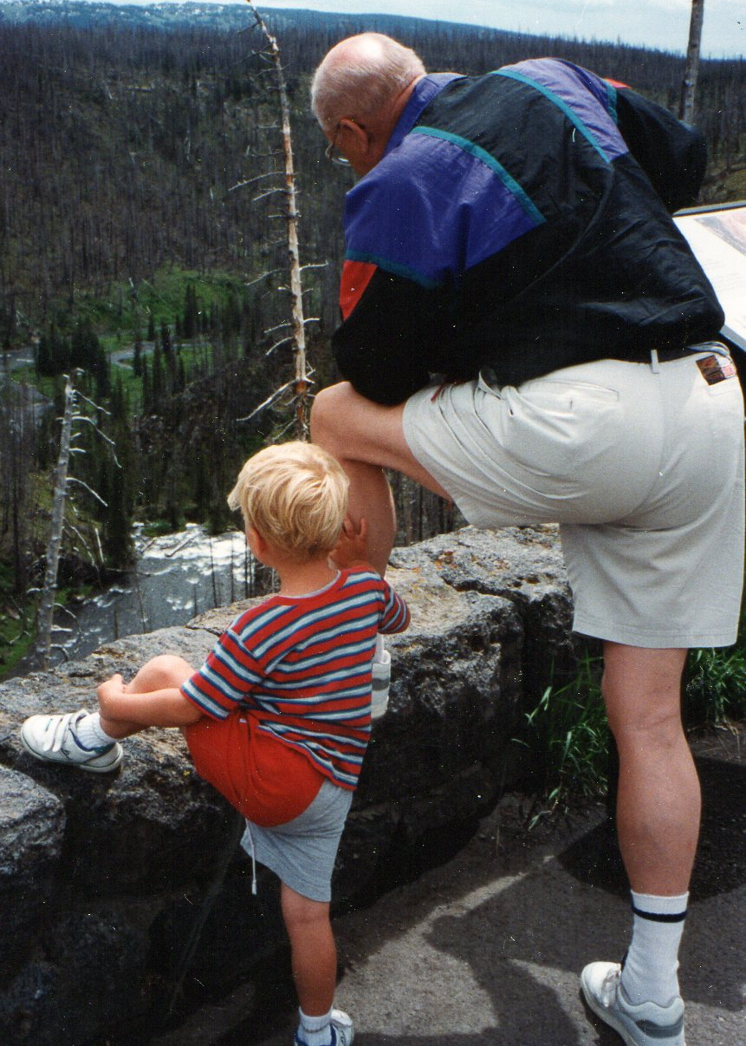
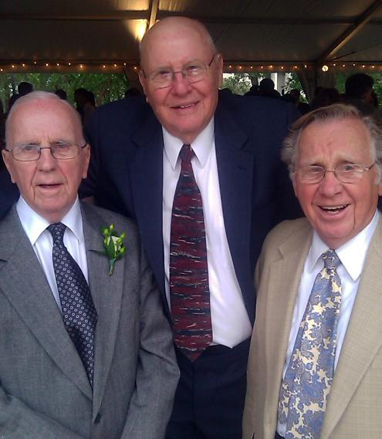
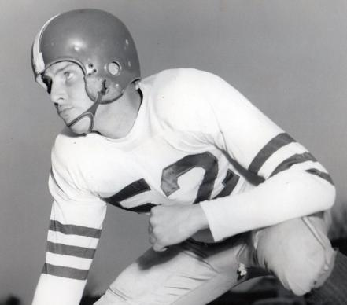
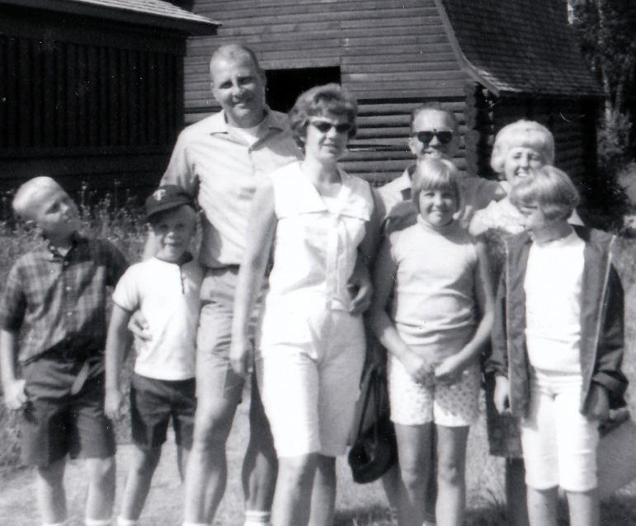
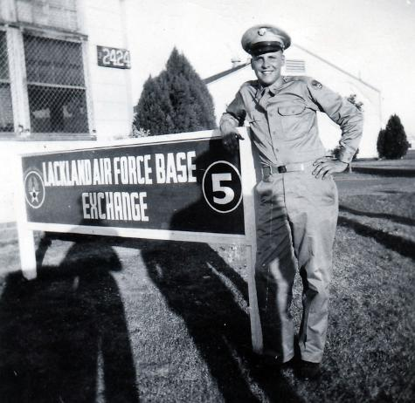
Warren Olson
Notes:
Blameless – Titus 1:6
Not without blemish
Unquestionable integrity
Model for other believers
The same in public & private

Slide 14
We Are
Called to Pursue a
Life of Blamelessness
Notes:
Pursue
Not just Be
Work at it

Slide 15
Character ~ Integrity
Means Living in Alignment
Thoughts
(Rom.12:2)
Rom.12:2
Do not conform to the pattern of this world, but be transformed by the renewing of your mind.
Desires
(Mat.6:24)
Mat.6:24
Wherever your treasure is, there the desires of your heart will also be.
Titus 2:2
Teach the older men to exercise self-control, to be worthy of respect, and to live wisely. They must have sound faith and be filled with love and patience.
Behaviors
(Titus 2:2)
Notes:
Romans 12:2- Do not conform to the pattern of this world, but be transformed by the renewing of your mind.
Matthew 6:24- Wherever your treasure is, there the desires of your heart will also be.
Titus 2:2 - Teach the older men to exercise self-control, to be worthy of respect, and to live wisely. They must have sound faith and be filled with love and patience.

Slide 16
Men of Godly Character Are:
2. Self-Controlled – Titus 1:8
Mentioned 5x in Titus
Urge young men to learn
Do it in small ways first
Character = Discipline
Notes:
⁸ Rather, he must be hospitable, one who loves what is good, who is self-controlled, upright, holy and disciplined.
Strong character = strong self-discipline
Destroy character with no self-discipline – infidelity- tax evasion- wicked tongue

Slide 17
Be mean
Have an affair
Gossip-slander
Steal
Cheat
Lie
Be a drunk
Be 2-faced
Live angry
How Can We Destroy Character?
Live With No Self-Control!
Notes:
Look at these things in little ways

Slide 18
Develop Your Emotional Intelligence
Notes:
Emotional Intelligence (EI) is the ability to manage both your own emotions and understand the emotions of people around you. There are five key elements to EI: self-awareness, self-regulation, motivation, empathy, and social skills.

Slide 19
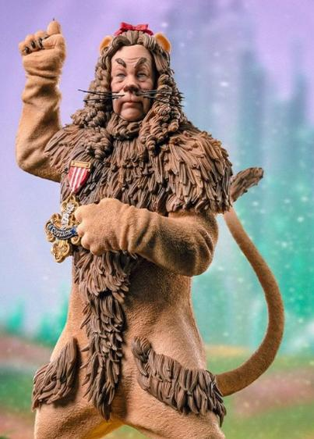
Men of Godly Character Are:
3. Courageous– Ps. 28:1
“The wicked flee
though no one pursues,
but the righteous are as
bold as a lion.”
Notes:
Courage seems to be one of these universally valued attributes. Simply, we tend to hold courage in higher regard than cowardice in general.
God calls for courage - Satan loves passivity
We all suffer when men don’t have courage- family- work – church
What is the purpose of courage?
Courage helps us take risks, think things through, and accomplish our goals. It also helps us to believe in ourselves and our actions. It helps us be aware of our fears, and how to work with them to achieve what we need to do.

Slide 20
Anger
Bossy
Never Cry
Hard
Fight
Win
Daredevil
Fearless
How Does Culture Define Courage?
Notes:
In one of these studies (McMillan & Rachman, 1988), paratrooper trainees defined as courageous evidenced as much physiological arousal prior to a training jump as those defined as fearful, but were equally likely as those defined as fearless (who did not show physiological arousal) to complete the jump. Thus, according to Rachman and colleagues, courage is unique from fearlessness in that the courageous individual completes the same act as the fearless individual, despite experiencing fear.

Slide 21
“mental or moral strength to venture, persevere, and withstand danger, fear, or difficulty.”
Merriam-Webster dictionary defines courage as:

Slide 22
How Do We Grow In Courage?
Courage is a collection of 4 skill sets:
Vulnerability
Clarity of Values
Trust
Rising skills – Rising Strong
These can be taught, developed, learned
Notes:
Courage is like a muscle. The more we exercise it, the stronger it gets.
Research demonstrates that courage is a collection of 4 skill sets (vulnerability, clarity of values, trust and rising skills) that can be taught, developed, learned, and measured.
Vulnerability is risk, uncertainty, and emotional exposure. If you want braver leaders, you must cultivate a culture where people are willing to do hard things, have difficult conversations, fail, recover, and start again. start by debunking the myths of vulnerability. We have to challenge the idea that vulnerability is weakness. Vulnerability is not knowing victory or defeat, it’s understanding the necessity of both; it’s engaging. It’s being all in. It’s Daring Greatly.

Slide 23
How Do We Grow In Courage?
Have constructive and tough conversations
Giving and receiving meaningful feedback
Building trust with people
Taking more smart risks
Sharing bold ideas
Resetting after setbacks
Dealing with conflict
Facilitating accountability
Leading through uncertainty
Putting values into practice Brene Brown
Notes:
Staying brave and constructive in tough conversations
Giving and receiving meaningful feedback
Building trust in their teams
Taking more smart risks
Sharing bold ideas with confidence
Resetting after setbacks
Dealing with conflict rather than avoiding it
Facilitating accountability rather than turning to blame or back-channeling
Leading through uncertainty
Putting values into practice

Slide 24
Courage Grows Out Of Our
Confidence in Christ
2 Timothy 1:7 ~ For God gave us a spirit not of fear but of power and love and self-control.
Notes:
2 Timothy 1:7 ~ For God gave us a spirit not of fear but of power and love and self-control.
Courage is the enforcing virtue, the one that makes possible all the other virtues common to exceptional leaders: honesty, integrity, confidence, compassion, and humility. In short, leaders who lack courage aren’t leaders.

Slide 25
Character Makes a Man
Growing in character must
be a constant- compelling-
life-long commitment
Notes:
Not a paycheck- provision does not make a man
Growing in character must be a constant- compelling- life-long commitment

Slide 26
“Conduct is what we do; character is what we are. Conduct is the outward life. Character is the unseen life, hidden within, yet evidenced by that which is seen. Conduct is external, seen from without; character is internal, operating within. In the economy of grace, conduct is the offspring of character. Character is the state of the heart, conduct is the outward expression. Character is the root of the tree, conduct, the fruit is bears”
E.M. Bounds

Slide 27
It’s your job to:
grow in character
Prioritize your
goals
Be a courageous
leader
Take action
The 4 Pillars
Anticipate the
Lord’s Well
Done
Accept
Responsibility
Reject
Passivity
Lead
Courageously

Slide 28
What men in your life have demonstrated manly character? What have you learned from them?
From Titus, what areas of character growth do need help in?
What specific ways can you cultivate growth in those areas?
Are there any habits, sin, deficiencies that you are tolerating instead of working to overcome?
Ask Yourself

