Slide 1
3 C’s of Marriage
Bradley Olson, Psy.D.,M.Div
BradleyOlson.net

Slide 2
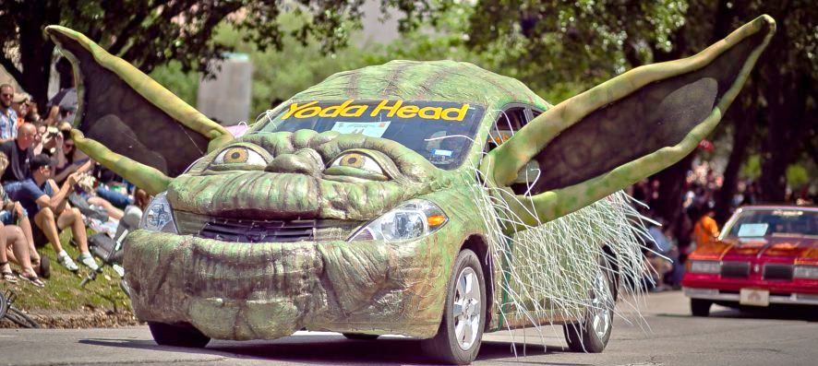
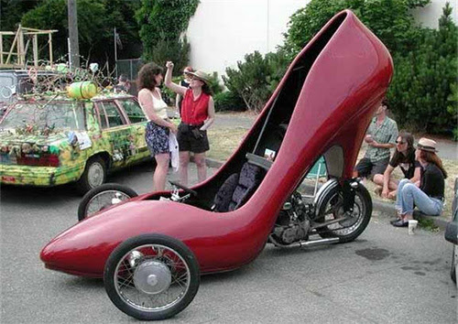
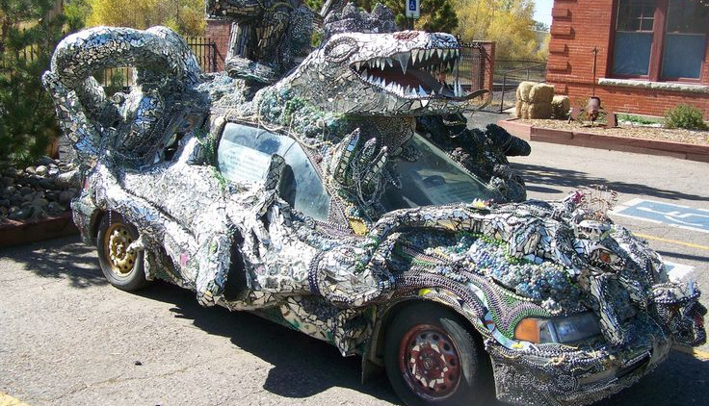

Slide 3
YOU
MARRIAGE
ME
We all make our own mess
We have the exact marriage we intended

Slide 4
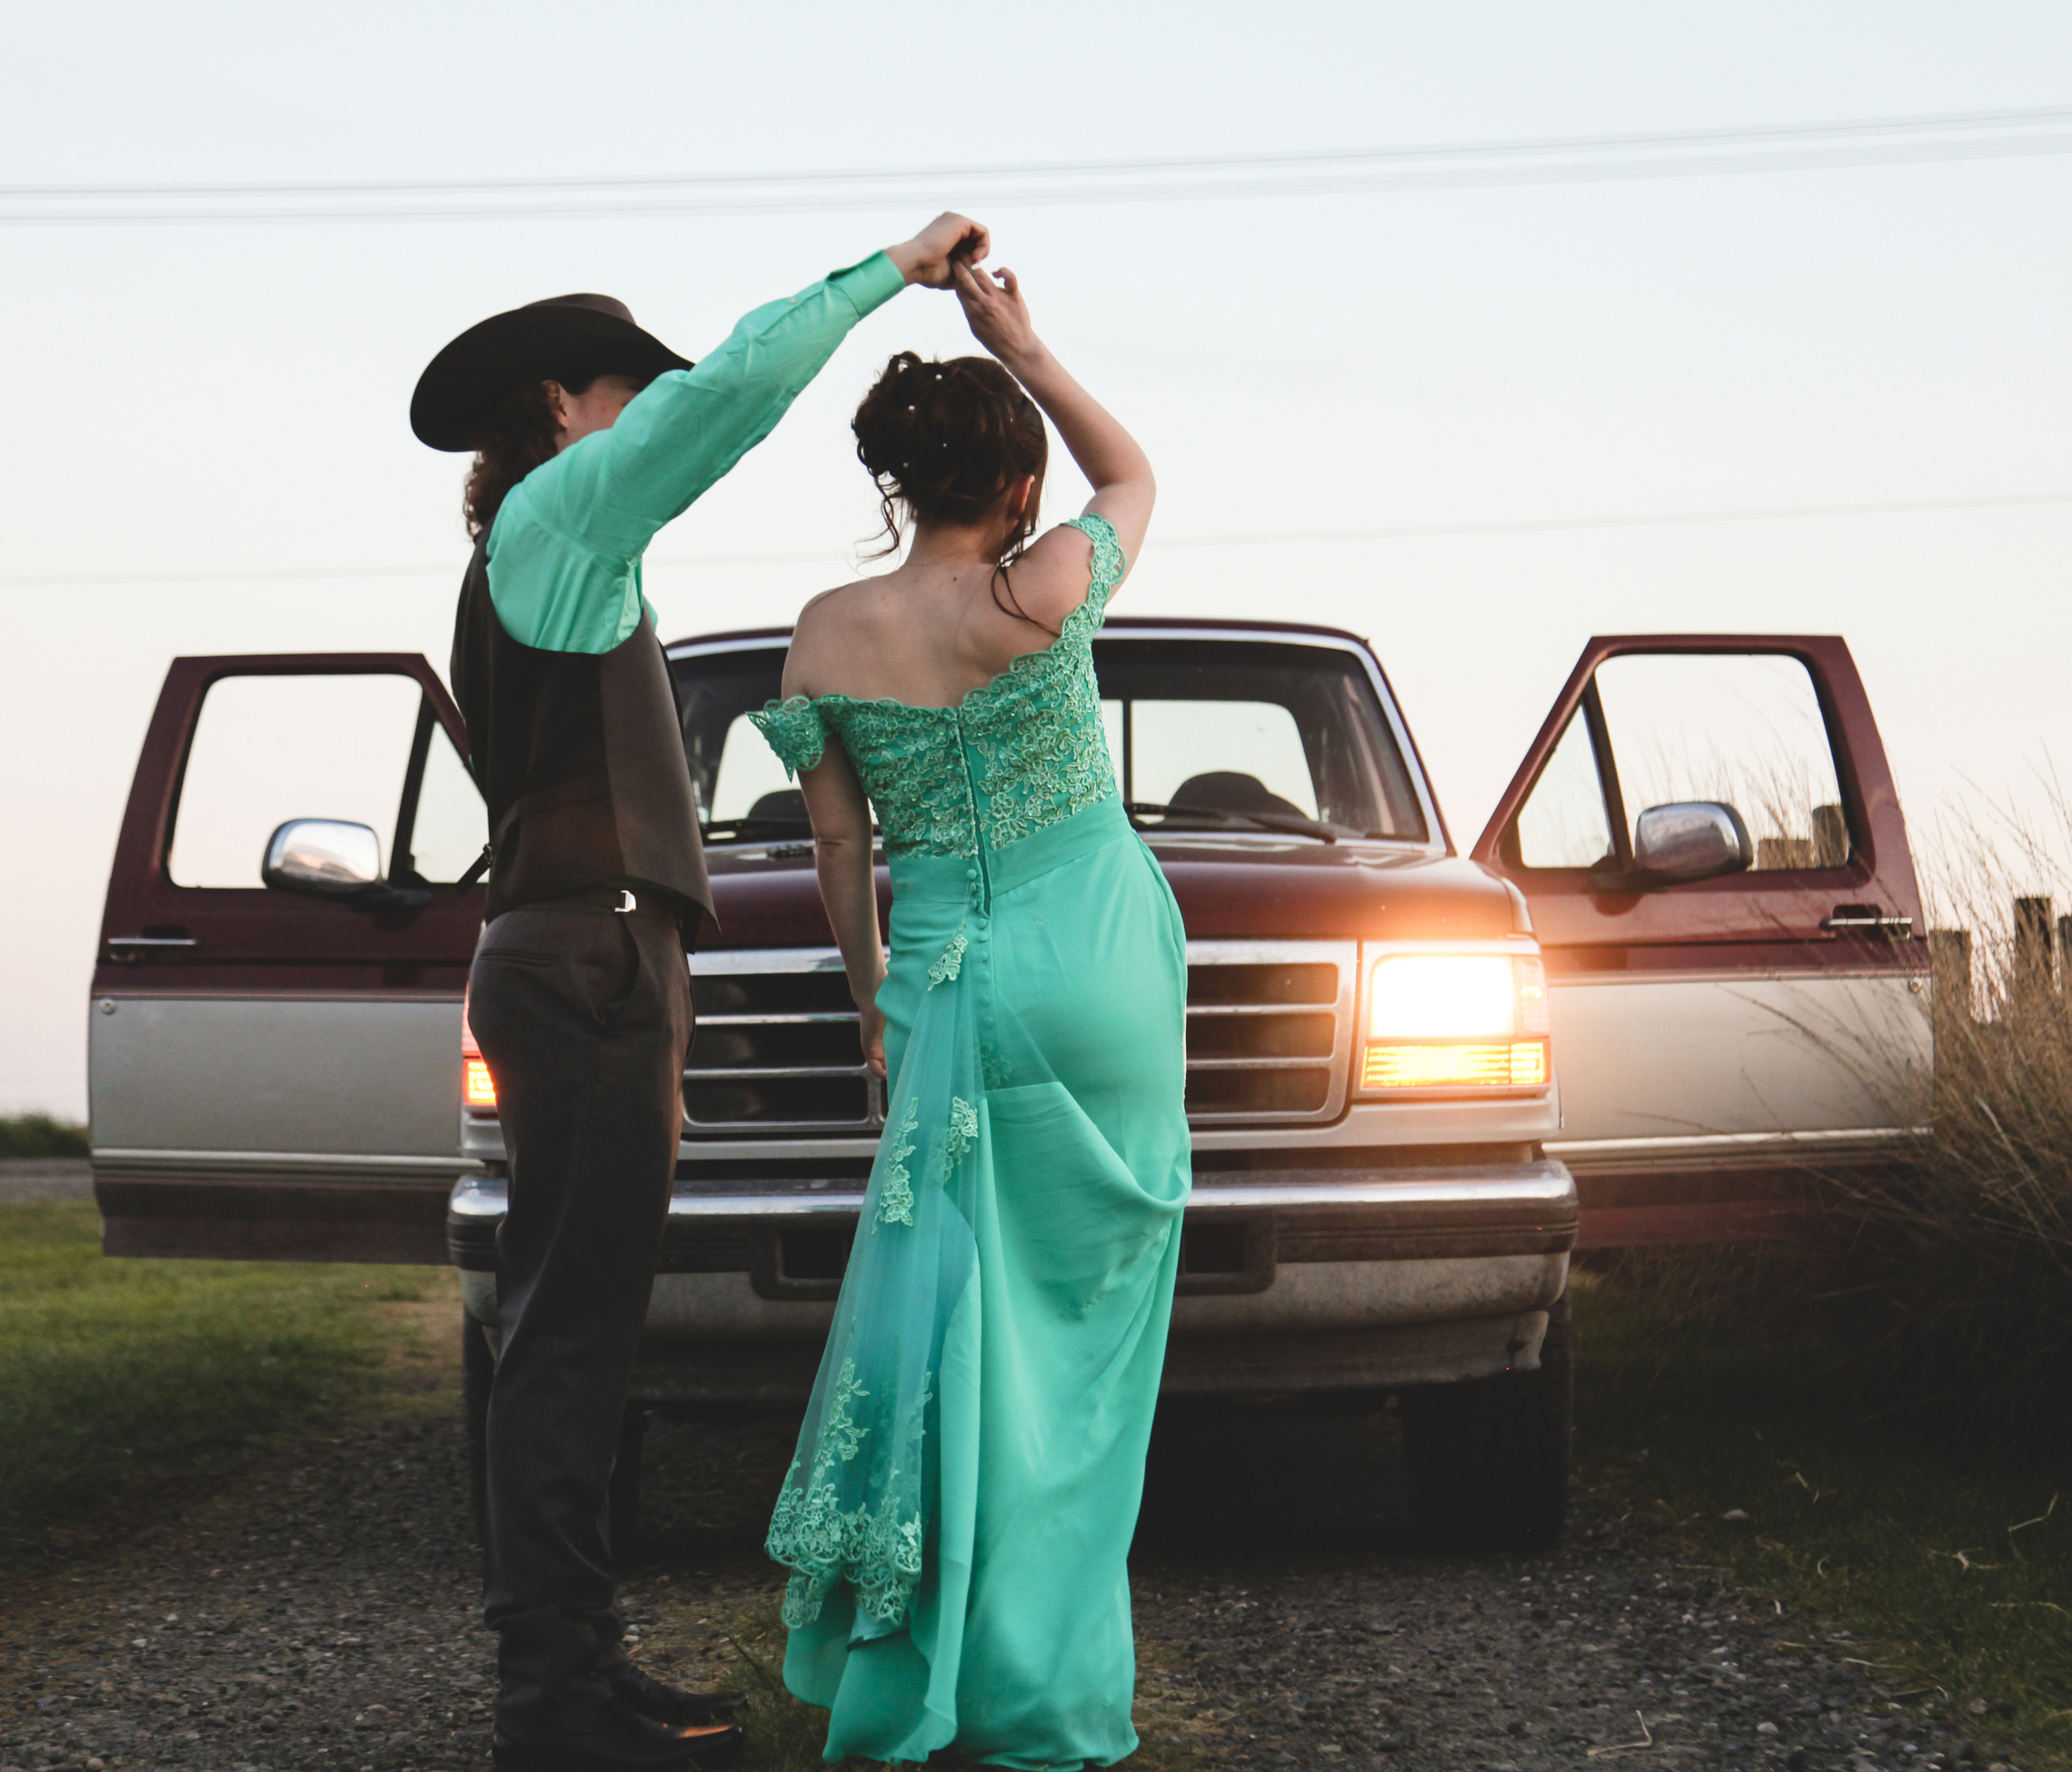
Marriage is a Dance

Slide 5
Fixing Me Fixes Us

Slide 6
Set Realistic Expectations
Some realistic expectations include…
Sharing responsibilities around the house
Showing respect to each other
Speaking kindly
Saying “I love you” often
Trusting each other
Time spent together
Notes:
Grow to be like Christ:
Philippians 2:1-4
New Living Translation
2 Is there any encouragement from belonging to Christ? Any comfort from his love? Any fellowship together in the Spirit? Are your hearts tender and compassionate? ² Then make me truly happy by agreeing wholeheartedly with each other, loving one another, and working together with one mind and purpose.
³ Don’t be selfish; don’t try to impress others. Be humble, thinking of others as better than yourselves. ⁴ Don’t look out only for your own interests, but take an interest in others, too.
Choose Love:
John 15:12
New Living Translation
¹² This is my commandment: Love each other in the same way I have loved you.
Mt 22:36-40
³⁶ “Teacher, which is the most important commandment in the law of Moses?”
³⁷ Jesus replied, “‘You must love the Lord your God with all your heart, all your soul, and all your mind.’^{[e]} ³⁸ This is the first and greatest commandment. ³⁹ A second is equally important: ‘Love your neighbor as yourself.’^{[f]} ⁴⁰ The entire law and all the demands of the prophets are based on these two commandments.”
Walk Together:
Ecc. 4:9-12
Two people are better off than one, for they can help each other succeed. ¹⁰ If one person falls, the other can reach out and help. But someone who falls alone is in real trouble. ¹¹ Likewise, two people lying close together can keep each other warm. But how can one be warm alone? ¹² A person standing alone can be attacked and defeated, but two can stand back-to-back and conquer. Three are even better, for a triple-braided cord is not easily broken.
Be Servant Partners:
1 Corinthians 7:33-35 New Living Translation
³³ But a married man has to think about his earthly responsibilities and how to please his wife. ³⁴ His interests are divided. In the same way, a woman who is no longer married or has never been married can be devoted to the Lord and holy in body and in spirit. But a married woman has to think about her earthly responsibilities and how to please her husband. ³⁵ I am saying this for your benefit, not to place restrictions on you. I want you to do whatever will help you serve the Lord best, with as few distractions as possible.

Slide 7
Realistic Expectations
Some biblical expectations include…
Grow to be More like Christ – Phil: 2:1-4
Choose Love – John 15:12
Walk Together – Ecc. 4:9-12
Be Servant Partners – I Cor. 33-35
Notes:
Grow to be like Christ:
Philippians 2:1-4
New Living Translation
2 Is there any encouragement from belonging to Christ? Any comfort from his love? Any fellowship together in the Spirit? Are your hearts tender and compassionate? ² Then make me truly happy by agreeing wholeheartedly with each other, loving one another, and working together with one mind and purpose.
³ Don’t be selfish; don’t try to impress others. Be humble, thinking of others as better than yourselves. ⁴ Don’t look out only for your own interests, but take an interest in others, too.
Choose Love:
John 15:12
New Living Translation
¹² This is my commandment: Love each other in the same way I have loved you.
Mt 22:36-40
³⁶ “Teacher, which is the most important commandment in the law of Moses?”
³⁷ Jesus replied, “‘You must love the Lord your God with all your heart, all your soul, and all your mind.’^{[e]} ³⁸ This is the first and greatest commandment. ³⁹ A second is equally important: ‘Love your neighbor as yourself.’^{[f]} ⁴⁰ The entire law and all the demands of the prophets are based on these two commandments.”
Walk Together:
Ecc. 4:9-12
Two people are better off than one, for they can help each other succeed. ¹⁰ If one person falls, the other can reach out and help. But someone who falls alone is in real trouble. ¹¹ Likewise, two people lying close together can keep each other warm. But how can one be warm alone? ¹² A person standing alone can be attacked and defeated, but two can stand back-to-back and conquer. Three are even better, for a triple-braided cord is not easily broken.
Be Servant Partners:
1 Corinthians 7:33-35 New Living Translation
³³ But a married man has to think about his earthly responsibilities and how to please his wife. ³⁴ His interests are divided. In the same way, a woman who is no longer married or has never been married can be devoted to the Lord and holy in body and in spirit. But a married woman has to think about her earthly responsibilities and how to please her husband. ³⁵ I am saying this for your benefit, not to place restrictions on you. I want you to do whatever will help you serve the Lord best, with as few distractions as possible.

Slide 8
Communication

Slide 9
We’re in trouble when I expect my spouse to…
“Read my mind”
Agree with me always
Have no personal space
“Complete” me
Never change
Be the source of happiness
Never be apart
Be the center of life
Play by my family rules
Parent like me
Spend money the same
Harmful Expectations

Slide 10
Power of Words
The Power to Destroy (Prov. 18:21; James 3)
The Power of Words to Build Up (Eph. 4:29; Prov. 12:25)
The Timing of Words (Prov. 18:13, 15:23)

Slide 11
Respect Small Talk
Cliché
Fact
Opinion
Emotion
Transparency

Slide 12
Listen Beyond Words

Slide 13
“They may forget what you said, but they will never forget how you made them feel.”
– Carl W. Buechner

Slide 14
We “Worship” Them
But they are just “indicator lights”
Notes:
Feelings are not facts
Feelings are not the goal for everyone
Feelings are not the only way we connect
This is the conflict in marriage: 1 person feels…. 1 person thinks… both are stuck in judgments

Slide 15
Mad
Irritated
Rage
Sad
Down
Depressed
Pleased
Glad
Joyful
Disappointed
Hurt
Wounded
Hesitant
Afraid
Panic
Warm
Tender
Loving

Slide 16
Emotional Regulation Required
Mad
Sad
Glad
Hurt
Afraid
Tender
Proverbs 29:22
An angry person starts fights; a hot-tempered person commits all kinds of sin.
Notes:
What feelings scare you the most?
What is your “go-to” feeling?
What do you believe about intense emotions?
Can someone “make you feel” something?
We learn from a young age how to express feelings
We develop beliefs about feelings that hurt us
Some feelings are more comfortable to some than others
The more I suppress a feeling, the harder it is to express it
Over-expressed feelings are often out of control feelings

Slide 17
Wisdom
Emotions - Reason
Emotions - Reason
Emotions - Reason
Notes:
What feelings scare you the most?
What is your “go-to” feeling?
What do you believe about intense emotions?
Can someone “make you feel” something?
We learn from a young age how to express feelings
We develop beliefs about feelings that hurt us
Some feelings are more comfortable to some than others
The more I suppress a feeling, the harder it is to express it
Over-expressed feelings are often out of control feelings

Slide 18
Conflict

Slide 19
62%
of Conflicts are UNRESOLVABLE!

Slide 20
Biblical Principles of Conflict
Face It
Matthew 18:15 “If your brother sins against you, go and tell him his fault, between you and him alone."
Galatians 6:1 "Brothers, if anyone is caught in any transgression, you who are spiritual should restore him in a spirit of gentleness.
Tell the Truth
Eph. 4:15 “Instead, we will speak the truth in love, growing in every way more and more like Christ, who is the head of his body, the church.”
2 Cor.13:8 “For we cannot oppose the truth, but must always stand for the truth.”
Notes:
Face It
Matthew 18:15 “If your brother sins against you, go and tell him his fault, between you and him alone."
Galatians 6:1 "Brothers, if anyone is caught in any transgression, you who are spiritual should restore him in a spirit of gentleness.
Tell the Truth
Eph. 4:15 “Instead, we will speak the truth in love, growing in every way more and more like Christ, who is the head of his body, the church.”
2 Cor.13:8 “For we cannot oppose the truth, but must always stand for the truth.”

Slide 21
Biblical Principles of Conflict
Be Kind
Eph.4:31-32
^{31 ”}Get rid of all bitterness, rage, anger, harsh words, and slander, as well as all types of evil behavior. ³² Instead, be kind to each other, tenderhearted, forgiving one another, just as God through Christ has forgiven you.”
Have Humility
Phil.2:3
“Don’t be selfish; don’t try to impress others. Be humble, thinking of others as better than yourselves.”
Notes:
Be Kind
Eph.4:31-32
^{31 ”}Get rid of all bitterness, rage, anger, harsh words, and slander, as well as all types of evil behavior. ³² Instead, be kind to each other, tenderhearted, forgiving one another, just as God through Christ has forgiven you.”
Have Humility
Phil.2:3
“Don’t be selfish; don’t try to impress others. Be humble, thinking of others as better than yourselves.”

Slide 22
Stop Using Subtle Fighting Words
You
Should/Shouldn’t
Can’t
Have To
Never
Always
Need
They invite defensiveness
They abdicate responsibility
They foster helplessness
Notes:
They invite defensiveness
They abdicate responsibility
They foster helplessness

Slide 23
Fight Fairly- the goal is not to win
No Name Calling
Don’t Drag Up the Past
Don’t Involve Others
Stick to the Subject
No hitting below the belt
Take a “Time Out” when needed- come back to work it out
Listen- seek first to understand, before being understood
Agree to disagree
Soften the Start-Up
Accept Influence from Each Other
Fight Fair

Slide 24
Proverbs 15:3
The path you start on will determine where you end…
How a conversation starts determines where it goes

Slide 25
Criticism
Contempt
Defensiveness
Stonewalling
4 Horsemen

Slide 30
The only way to intimacy
is through conflict

Slide 31
Delivering with confidence
Connection

Slide 32
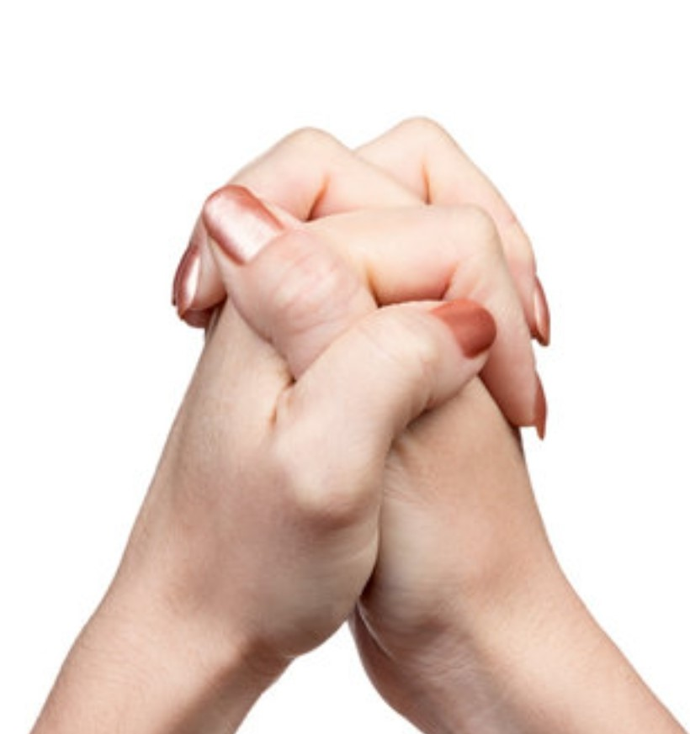
Healthy Internal Boundaries
What Intimacy Looks Like

Slide 33
Marriages don’t end because of 1 big thing or event
Little Things Turn Big Ships
Focus on
the 5:1 Ratio
PSO
vs.
NSO
Notes:
Little compromises turn into big problems. Little things turn into big things.
We don’t think about this sometimes. We’ll say, “It’s all right. This is just a minor infraction.” But we’re not thinking about the repercussions yet.
In the Bible we find story after story of lifelong repercussions that came as a result of a single decision. Adam ate of the forbidden fruit, and it cost him paradise. Esau compromised for a single meal and lost his birthright. Samson’s sexual compromises cost him his strength, his eyes, and ultimately his life.
Are there some small areas where you’re making compromises now?
Deal with those, because the Lord is revealing them for your own good. Little compromises turn into big problems. Jesus said, “If you are faithful in little things, you will be faithful in large ones. But if you are dishonest in little things, you won’t be honest with greater responsibilities” (Luke 16:10 NLT).

Slide 34
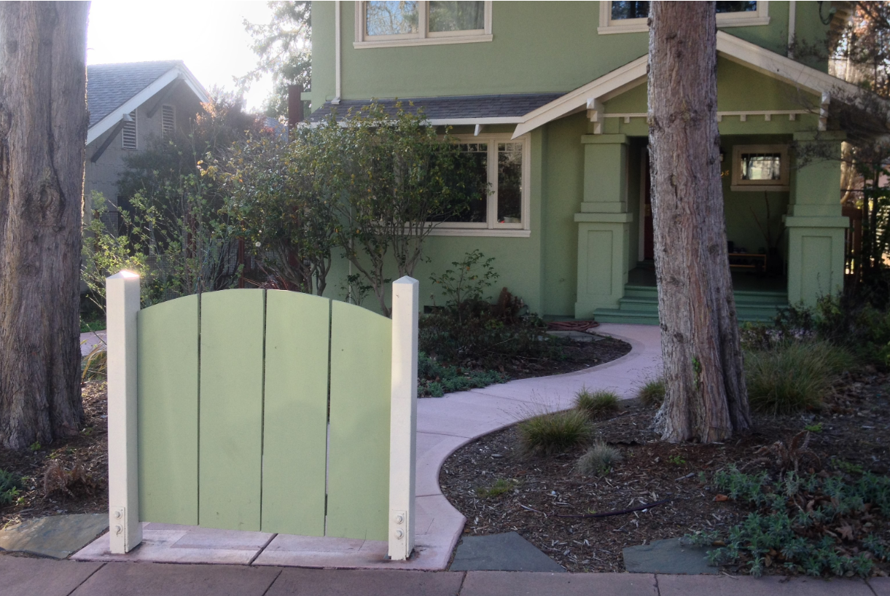
Boundaries

Slide 35
Healthy Internal Boundaries
I Know What Is My…
Job
Control
Responsibility
Power

Slide 36
Healthy Boundary Principles
We teach the world how to treat us
People take from us whatever we are willing to give
We learn by living
We are all required to carry our own backpacks
I own what I allow

Slide 37
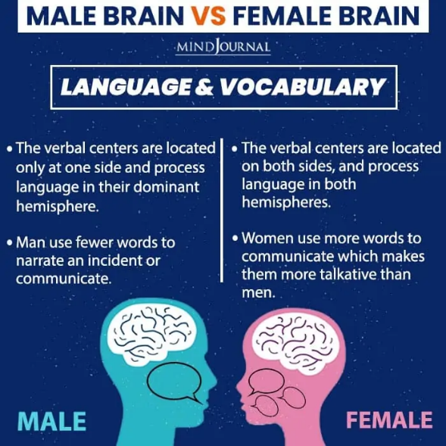
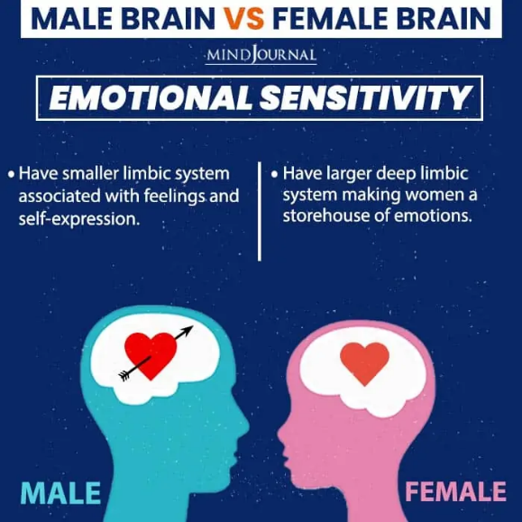
Notes:
Language. Two sections of the brain responsible for language were found to be larger in women than in men, indicating one reason that women typically excel in language-based subjects and in language-associated thinking. According to recent researches, women speak three times more than men… A woman says about 20 thousand words per day, that is 13 thousands more, than a man does. Women also speak much quicker, than men. Additionally, men typically only process language in their dominant hemisphere, whereas women process language in both hemispheres.
And another fact: simple speech act causes emission of hormones in a woman’s brain, giving her same sensations, which a drug addict feels after he receives a long-awaited dose.
Men tend to use more concise, short language, while women lean toward a lengthy, detailed manner. Think of it this way, men are bullet points, and women are paragraphs.

Slide 38
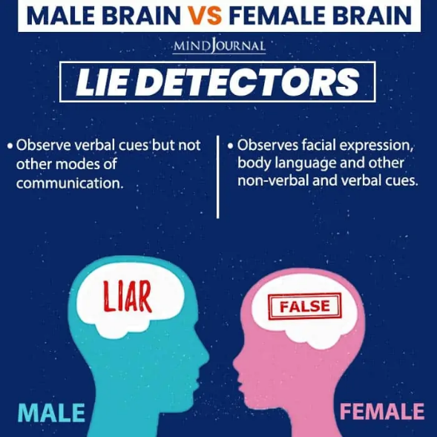
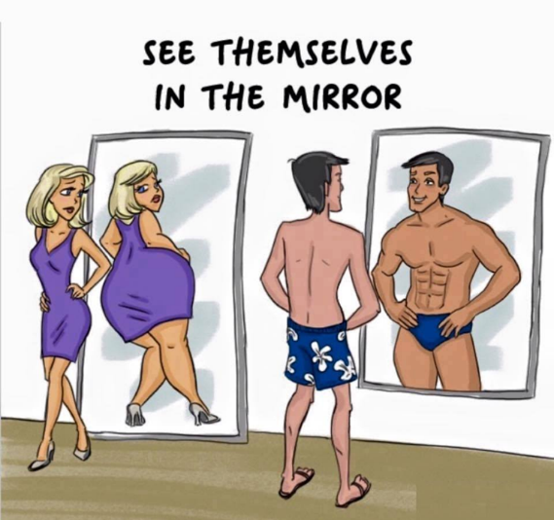
Notes:
Language. Two sections of the brain responsible for language were found to be larger in women than in men, indicating one reason that women typically excel in language-based subjects and in language-associated thinking. According to recent researches, women speak three times more than men… A woman says about 20 thousand words per day, that is 13 thousands more, than a man does. Women also speak much quicker, than men. Additionally, men typically only process language in their dominant hemisphere, whereas women process language in both hemispheres.
And another fact: simple speech act causes emission of hormones in a woman’s brain, giving her same sensations, which a drug addict feels after he receives a long-awaited dose.
Men tend to use more concise, short language, while women lean toward a lengthy, detailed manner. Think of it this way, men are bullet points, and women are paragraphs.

Slide 39
Men vs. Women
Men
Women
Drive - Libido
Thoughts
Visual
Connection
Focus
Response
1. Sexual Fulfillment
2. Recreational Companion
3. Attractive Spouse
4. Domestic Support
5. Admiration
1. Affection
2. Conversation
3. Honesty and Openness
4. Financial Support
5. Family Commitment
Women have sex after feeling connected –
Men typically have sex to feel connected

Slide 40
Gottman’s Magic 6 Hours
Companions Do Little Things
1: Partings
2: Reunions
3: Admiration/Appreciation
4: Physical Touch
5: Date Night
6: Check-In

Slide 41
Love Languages
Acts of Service: doing things that make life easier or more enjoyable
Physical Touch: receiving affection through touch
Quality Time: prioritize undivided attention
Gift Giving: feels special connection receiving thoughtful gift
Words of Affirmation: kind and uplifting words

Slide 42
Q & A

