Slide 1
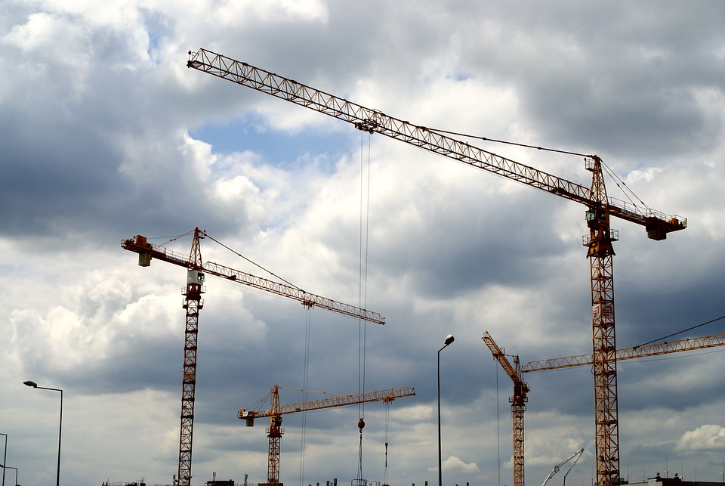
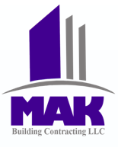
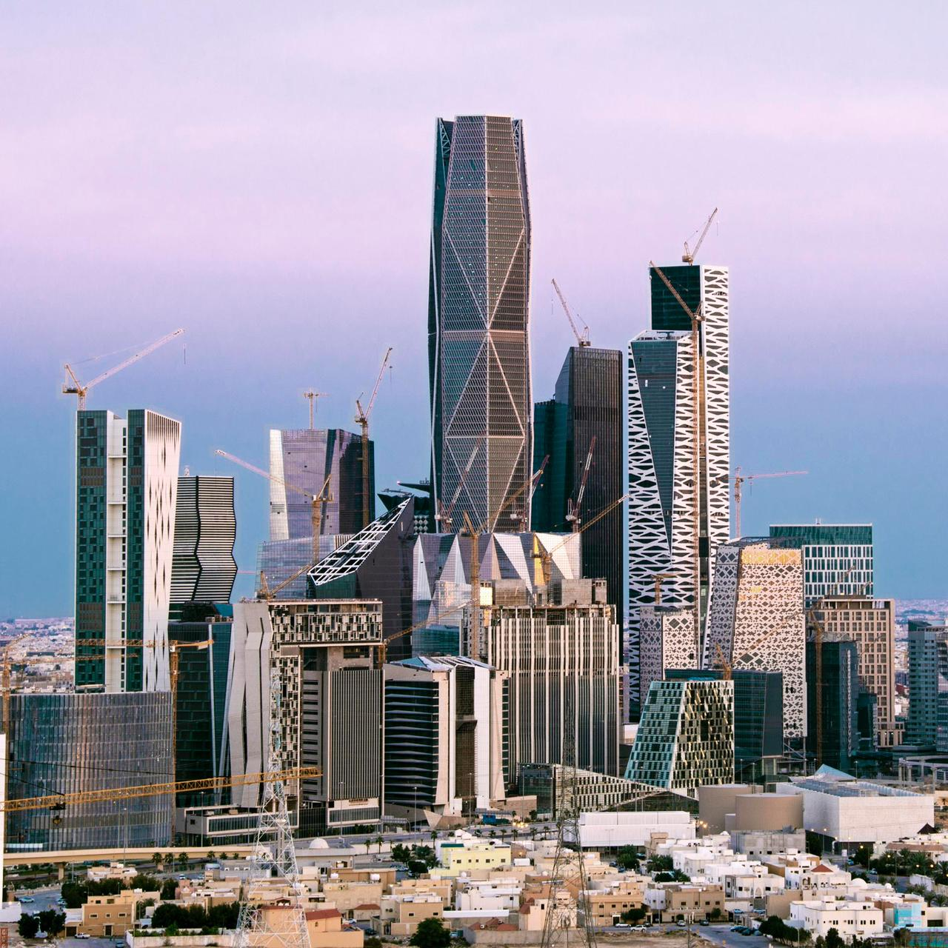
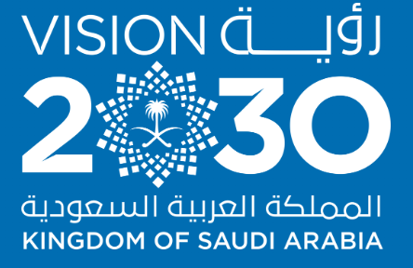
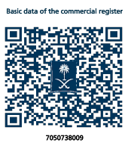
Company Profile
Flooring Works Specialist in the UAE & KSA
Flooring Specialist
Since 2008

Slide 2
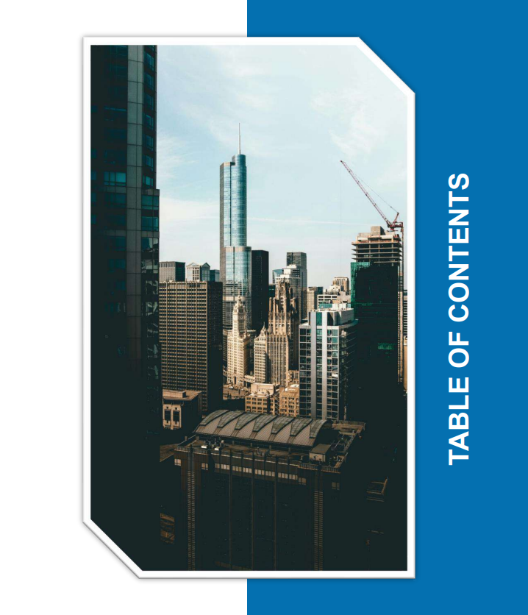
01
Our Company
About Us
Why MAK Constructions LLC co. ?
Mission, Vision & Values
Founder’s Message
Management
Company Philosophy
Client Philosophy
Social Responsibility
Sustainability
Our Policy
02
Industries & Sector
Commercial & Retails
Corporate Offices
Technology
Residential
Health Care & Pharmaceuticals
Education
Banks
Entertainment
Hotel & Restaurants
Food And Beverages
Industrial
Oil & Gas
makconstructionsksa.com

Slide 3
03
Services
05
Our Clients
-Concrete & Flooring: Concrete Finishing, Screed & Self-Leveling, Epoxy Coatings, Industrial Flooring
-Waterproofing & Insulation: Waterproofing & Rockwool Thermal Insulation
-Architectural Cladding: Supply & Installation of GRC, GRG, GRP & UHPC
-Interior Fit-Outs: Gypsum Decorations, Drywall Partitions, Glass, Aluminum, Steel & Carpentry Works
-Finishing Works: Marble, Tiles, Swimming Pools & Painting
-MEP & Maintenance: Electrical, Plumbing & Annual Maintenance Contracts (AMC)
04
Our Projects
06
Our Certificates
makconstructionsksa.com

Slide 4
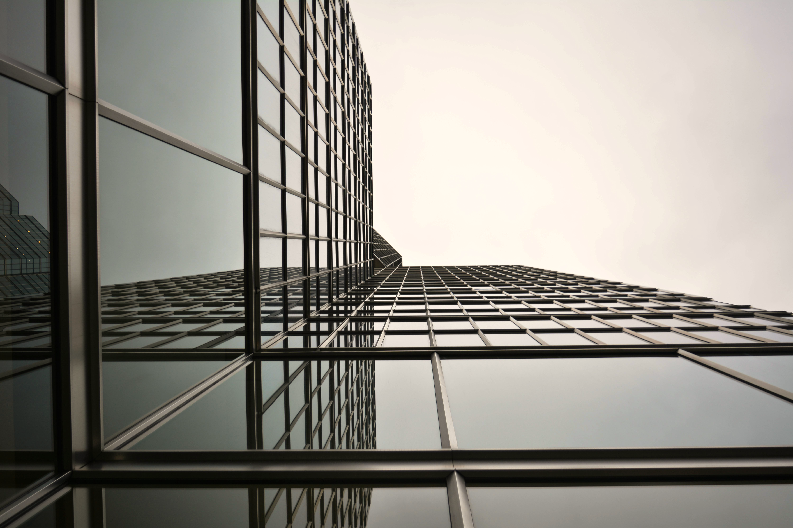

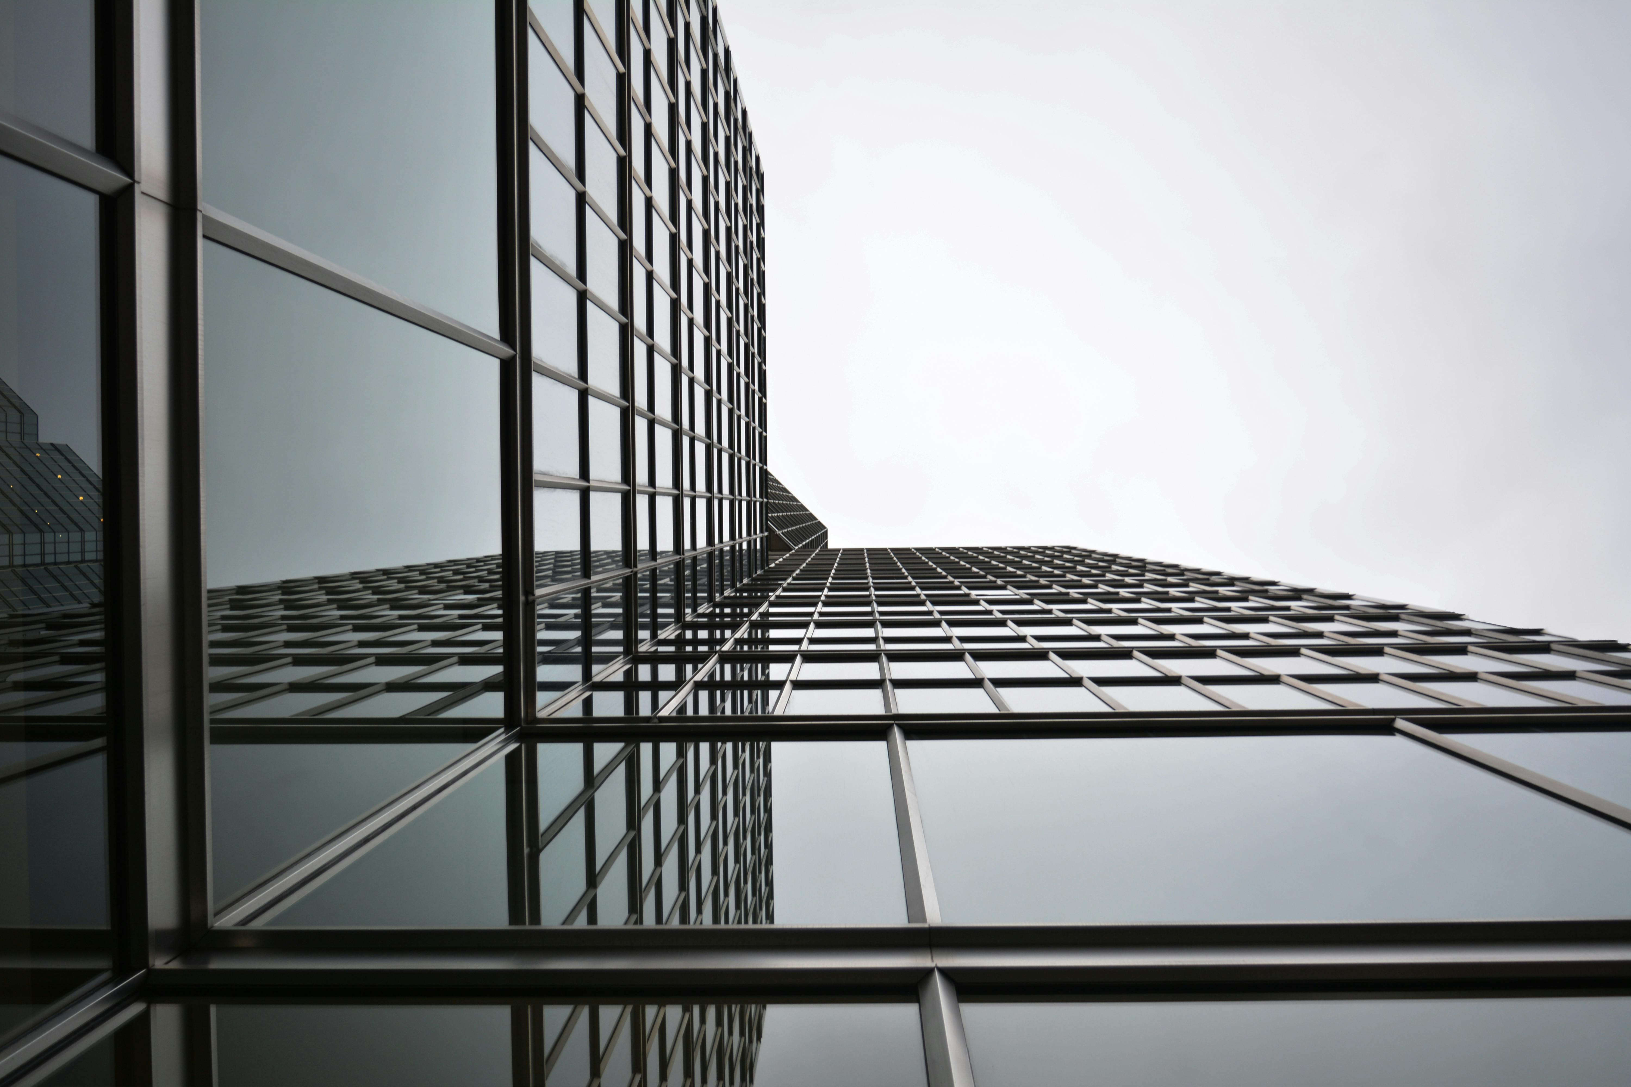
Company Profile
ABOUT US
MAK Building Contracting LLC is a UAE-based specialist construction contractor established in 2008, with operations in both the United Arab Emirates and the Kingdom of Saudi Arabia (KSA). The company specializes in concrete finishing, screed works, self-leveling systems, epoxy flooring, waterproofing, and related flooring solutions. MAK has successfully delivered projects across residential, commercial, hospitality, healthcare, educational, and infrastructure sectors, working alongside reputed main contractors and consultants in the region.
Backed by a management team with over 20 years of industry experience, MAK operates with qualified engineers, supervisors, and skilled technicians, ensuring strict adherence to quality, safety, and project specifications. The company is committed to reliable execution, technical precision, and timely delivery, maintaining a strong track record and long-term client relationships across the UAE and KSA construction markets.
makconstructionsksa.com

Slide 5
Company Profile
WHY MAK CONSTRUCTIONS LLC ?
Established in 2008, MAK Building Contracting LLC delivers high-quality construction and flooring solutions across the UAE and KSA. With over 20 years of combined management experience, we specialize in concrete finishing, screed works, self-leveling, epoxy flooring, waterproofing, and a wide range of specialized architectural services including partitions, gypsum works, micro cement, GRC/GRG/UHPC elements, and interior fit-outs.
Our expertise also includes preventive and corrective maintenance, ensuring long-term durability and performance for all installations. MAK is committed to technical excellence, safety compliance, and timely project delivery, providing turnkey solutions that meet both aesthetic and functional requirements, and earning trust from our clients across commercial, industrial, and institutional projects.
makconstructionsksa.com

Slide 6
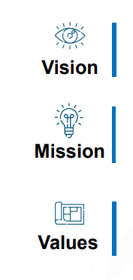
Company Profile
Our VISION is to establish our footprint in the KSA & UAE as a reliable support Construction company and be the industry leader providing professional services to our customers On Time, On Target and Within Budget
Our Mission is to provide our clients with timely, cost-effective and comprehensive Construction solutions by integrating the latest in techniques, tools and qualified personnel for global competitiveness.
SHAPE IDEAS
CONFIDENCE
COMMITMENT
COLLECTIVNESS
COOPERATION
CONTRIBUTION
ACCOUNTABILITY
CONTINOUS IMPROVMENT
SHARE OF BENEFITS
makconstructionsksa.com

Slide 7
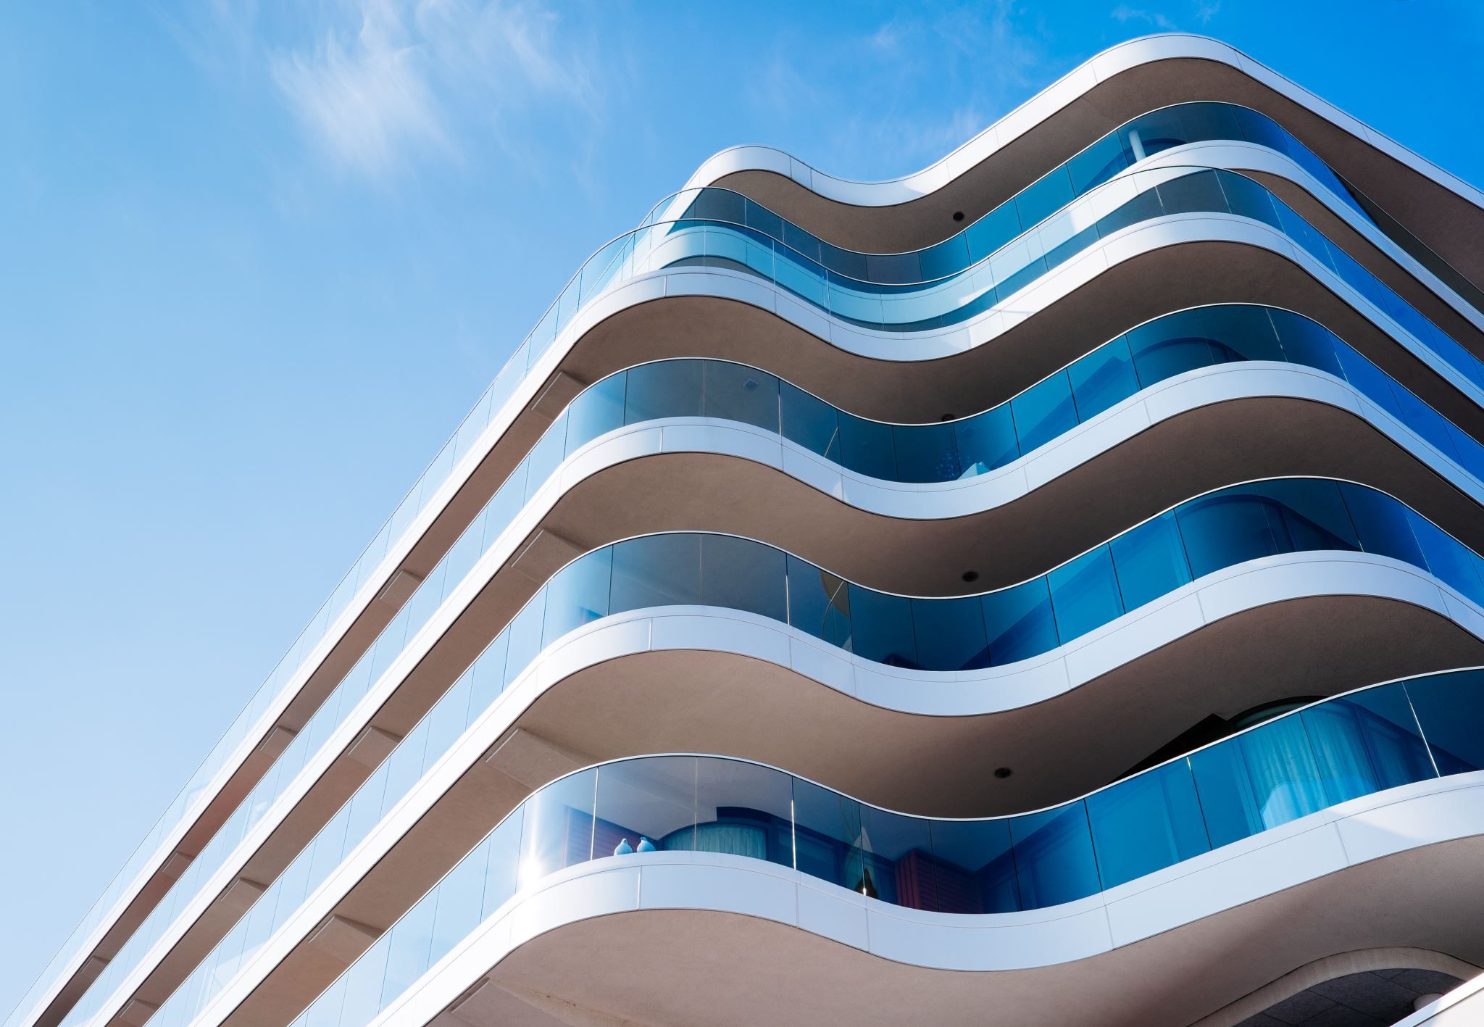
Company Profile
COMPANY PHILOSOPHY
we believe that people who work together as a team, rather than individually, achieve the best results - because they enjoy their work.
PHILOSOPHY
CLIENT PHILOSOPHY
We understand the unique needs of each client and tailor our solutions accordingly. Committed to delivering exceptional value, we provide timely, custom-tailored solutions to meet the specific demands of every project.
SOCIAL RESPONSIBILITY
It is our responsibility to support Saudi Vision 2030 by hiring and training our Saudi workforce, by strengthening our communities, and by adopting a “Go Green” strategy for sustainability
makconstructionsksa.com

Slide 8
Company Profile
FOUNDER’S MESSAGE
MANAGEMENT
We leverage our industry expertise to deliver exceptional construction services. Our skilled team excels at planning and executing challenging projects on time and within budget, ensuring 100% customer satisfaction through cost-effective, high-quality solutions.
As the founder, I recall a comment from a management seminar - that it is often challenging to articulate “WHO WE REALY ARE" I wholeheartedly agree, and I aim to capture our essence in this message.
We are a multidisciplinary team of professionals that work in coordination to channel in the best way in order to position. Consolidate and maintain its corporate image and prestige. We add value for our customers by anticipating and identifying their needs and providing cost-effective solutions and services. They will see us as a leader in the industry. We will provide an environment that challenges our employees to learn, grow and prosper in an atmosphere of respect and recognition. Our employees will be proud to work for a profitable and thriving employee-owned company. we take pride in our work and our organization.
makconstructionsksa.com

Slide 9

Company Profile
SUSTAINABILITY
Safety Policy
Environmental Policy
Quality Policy
Procurement Policy
IMS Policy
makconstructionsksa.com

Slide 10
Company Profile
SAFETY POLICY
While safety is critical to both the success of our clients’ projects and the strength MAK Construction LLC. Engineer’s, is individual worker well-being that drives us. We achieve results by pushing safety and health means and methods well beyond established industry standards.
Zero Accident Policy - We strive to provide safe and healthy working conditions and to always establish and insist upon safe practices, by all employees and subcontractors.
Our philosophy is that each Incident/accident is preventable. We robustly adhere with all regulations set forth by client and governmental agencies.
We ensure safety cultures by conducting periodic safety awareness meetings and safety trainings for all the project participants
PHILOSOPHY
makconstructionsksa.com

Slide 11
Company Profile
ENVIROMENTAL POLICY
MAK Construction LLC management acknowledges the environmental impacts that may arise from its corporate activities, products, and services. As a core principle we are committed to operating within the limits of nature and environmental protection, without causing harm.
Specifically, MAK Construction LLC takes measures to reduce natural resource use, manage hazardous and nonhazardous waste, recycle where possible, protect natural habitats, and prevent pollution. Objectives and targets for continuous improvement have been set, with responsibilities assigned and supported through training.
To maintain the sustainability and effectiveness of the Environmental Management System MAK Construction LLC conducts internal audits and reviews by top management. MAK Construction LLC also encourages its subcontractors and suppliers to adopt ISO 14001 principles. The company's Environmental Policy is publicly available on its website.
In summary, Our management is fully committed to implementing and resourcing its Environmental Management System to ensure environmentally responsible operations and continual improvement.
PHILOSOPHY
makconstructionsksa.com

Slide 12
Company Profile
QUALITY POLICY
MAK Construction LLC offers a wide range of foundation engineering services within the Kingdom of Saudi Arabia & United Arab Emirates , including general and specialized solutions such as shoring systems, foundation systems, and ground improvement. The company draws on its technical expertise and support resources to deliver these services.
MAK Constructions LLC is known for its innovative and leadership approach in the field. The company aims to achieve economic success and continued business growth by providing high-quality, cost-effective products and services to its customers, enabled by the application of advanced technology in its foundation engineering operations.
MAK Constructions LLC quality policy covers all of its offices, operational locations, and project sites. To pursue its quality goals, the company has committed to:
Ensuring that the delivery of expected quality outcomes is a core value across all business operations.
Complying with all applicable legal, statutory, regulatory, and customer requirements across its operations.
Implementing and maintaining an Integrated Management System (IMS) that meets the requirements for ISO 9001 certification.
Continuously improving its management system through effective monitoring and review, to adapt to changes in legislation, standards, operational needs, and customer expectations.
PHILOSOPHY
makconstructionsksa.com

Slide 13
Company Profile
5. Establishing defined quality targets and objectives, which are measured and reviewed as part of the management review process and communicated clearly to all stakeholders.
6. Allocating the necessary resources for the effective implementation of the IMS across all business locations.
7. Ensuring the availability of adequately qualified or trained personnel, as well as calibrated equipment, across operational locations to achieve expected quality outcomes.
8. Providing necessary instruction, training, and supervision to employees, suppliers, and subcontractors to support the achievement of quality objectives.
9. Collaborating with customers, interested parties, suppliers, and subcontractors to continuously improve quality performance. It is the duty Ourmanagement at all levels to promote, adopt, and maintain effective quality management principles in the design, construction, operation, and maintenance of all its plant, equipment, and facilities.
PHILOSOPHY
makconstructionsksa.com

Slide 14
Company Profile
IMS POLICY
(ISO 9001:2015, ISO 14001:2015 & ISO 45001:2018)
MAK Constructions LLC is a comprehensive service provider, offering design, development, construction, and commissioning for a wide range of projects, including transportation, irrigation, power, buildings, structures, ports, and oil and gas. Quality, environmental stewardship, health, and safety are integral to Huda Arabia Private Limited Co. business philosophy.
By implementation of Quality, Environmental, Health & Safety Management Systems, we are committed to:
• Adhere to the requirements of Integrated Management System, and continually improving the effectiveness of the Integrated Management System, thereby giving most qualitative, cost-effective, consistent services, and ensure customer satisfaction
• Conduct our business with integrity, applying ethical principles to our relationships with customers, employees, suppliers, and other interested parties
• Contribute to sustainable development by promoting greater environmental, health and safety practices
• Achieve sustainable growth through protection of environment, promoting pollution prevention practices, and conserving resources with eco-friendly & eco-efficient process
• Create an injury-free and healthy workplace by eliminating or reducing Hazards and at-risk behaviors by control of OH&S risks using the hierarchy of controls and promote wellness
• Comply & satisfy with all applicable legal & other compliance obligations
• Communicate the Policy to all employees working in our organization
• Implement collective decision-making process in management system improvement activities
PHILOSOPHY
makconstructionsksa.com

Slide 15
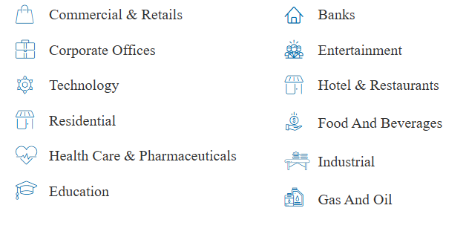
Company Profile
EXPERTISE & INDUSTRIES
makconstructionsksa.com

Slide 16
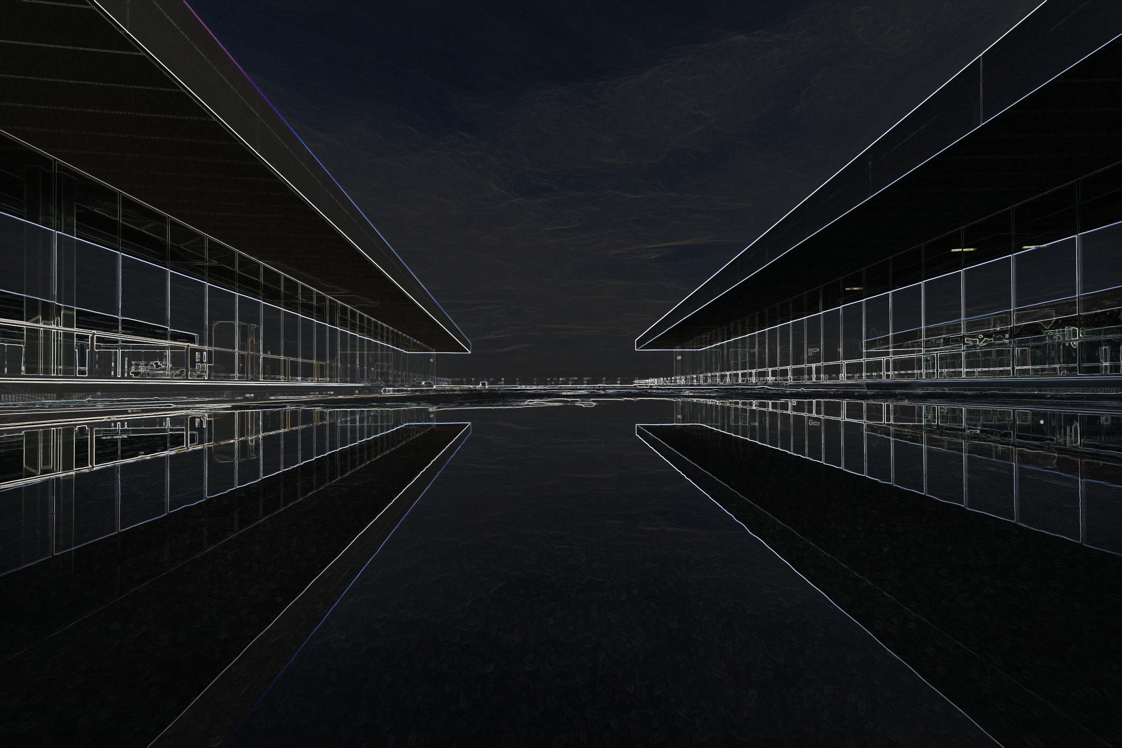
OUR SERVICES
Flooring Specialist
Since 2008

Slide 17
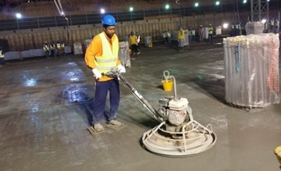
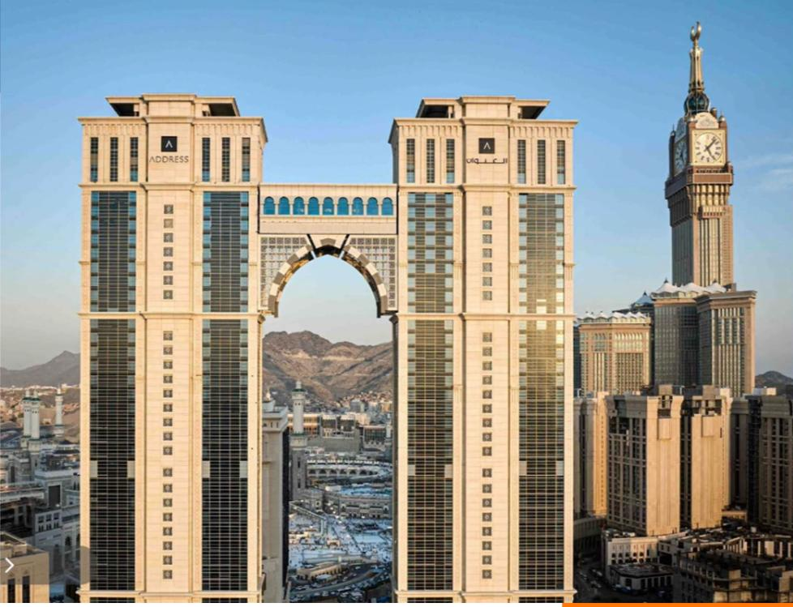
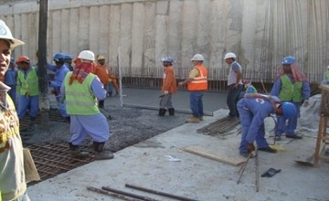
Company Profile
Our Services
MAK Constructions LLC is a leading contracting firm based in UAE Since 2008 & KSA, with extensive experience delivering large-scale, complex projects throughout the region. The company excels at managing fast-paced schedules, upholding rigorous construction standards, and fostering effective collaboration among project team members, making it one of the best construction companies in the region.
SERVICES
Flooring specialist services
Specialized Architectural services
Maintenance Services
makconstructionsksa.com

Slide 18
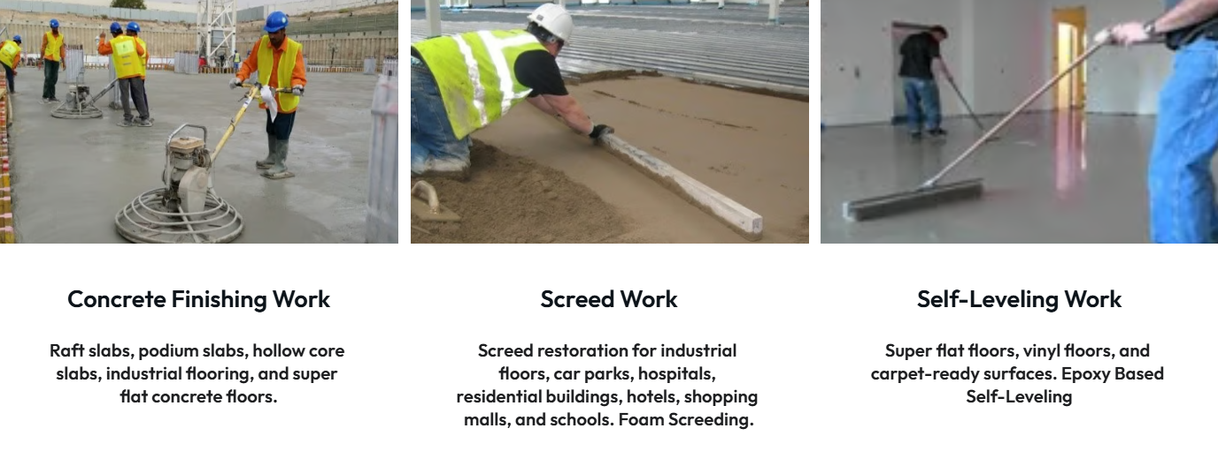
Company Profile
Flooring Specialist Services
SERVICES
makconstructionsksa.com

Slide 19
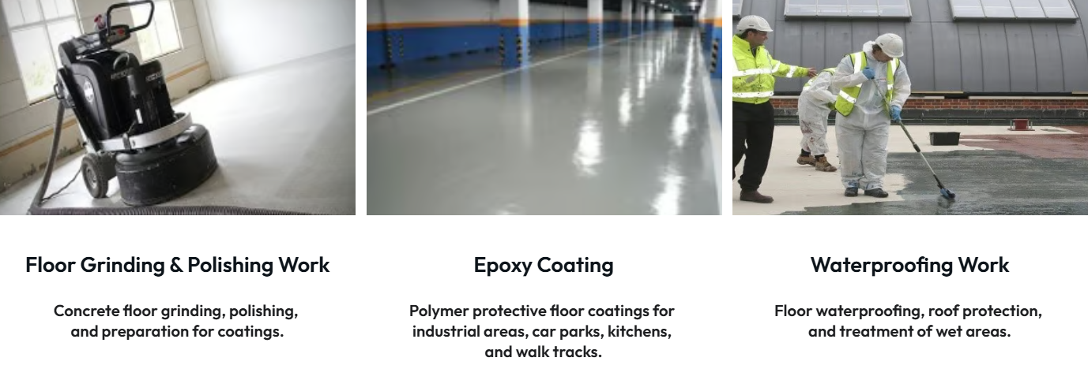
Company Profile
Flooring Specialist Services
SERVICES
makconstructionsksa.com

Slide 20
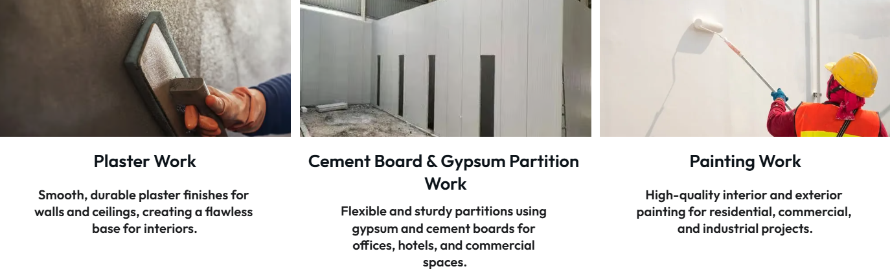
Company Profile
Flooring Specialist Services
SERVICES
makconstructionsksa.com

Slide 21
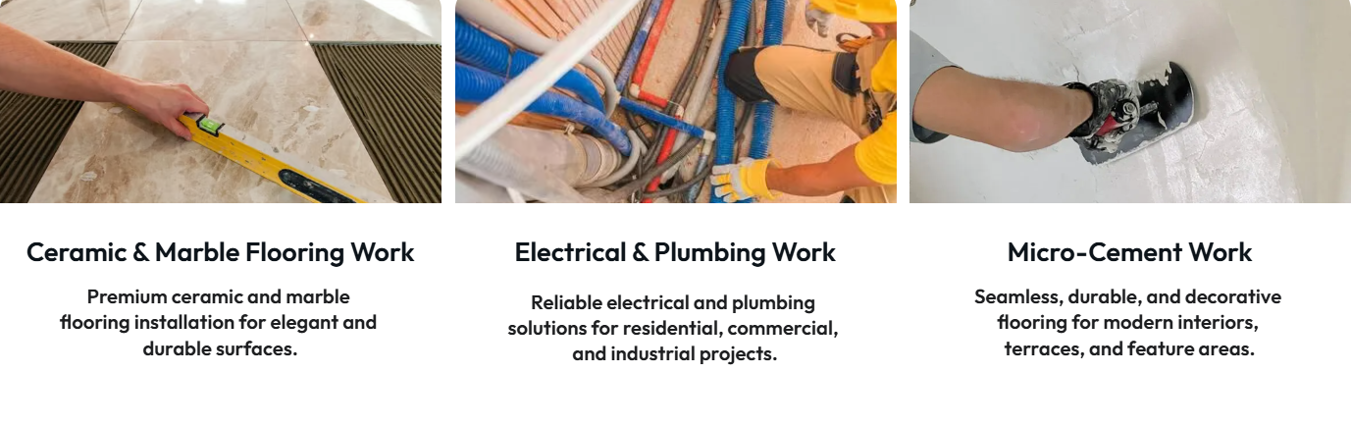
Company Profile
Flooring Specialist Services
SERVICES
makconstructionsksa.com

Slide 22
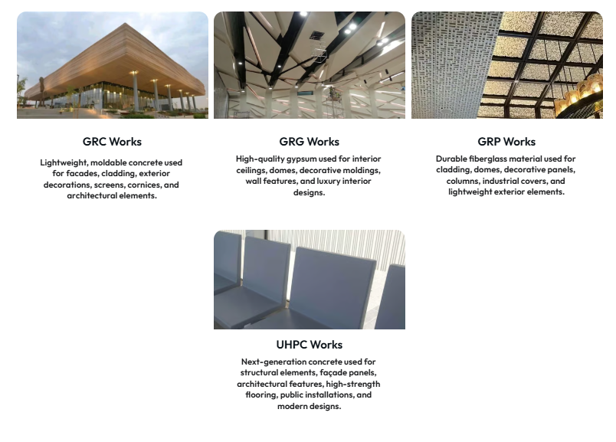
Company Profile
Specialized Architectural Services
SERVICES
makconstructionsksa.com

Slide 23
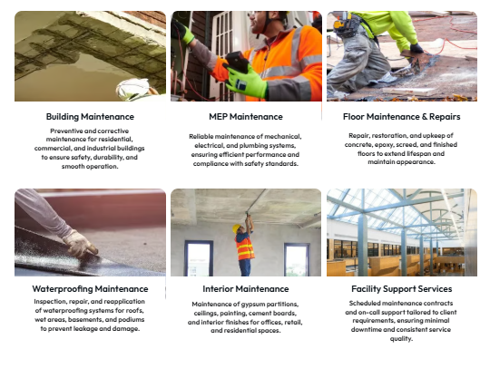
Company Profile
Maintenance Services
SERVICES
makconstructionsksa.com

Slide 24
OUR PROJECTS
Flooring Specialist
Services
Since 2008

Slide 25
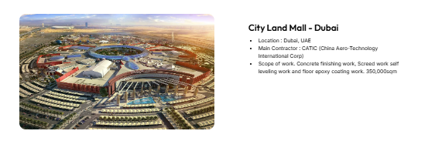
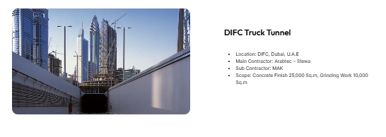
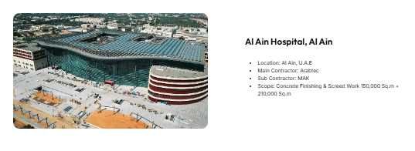
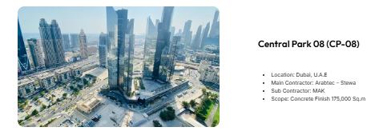
Company Profile
OUR PROJECTS
PROJECTS
makconstructionsksa.com

Slide 26
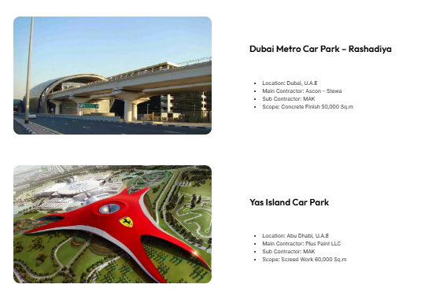
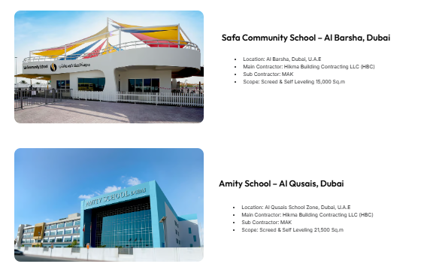
Company Profile
OUR PROJECTS
PROJECTS
makconstructionsksa.com

Slide 27
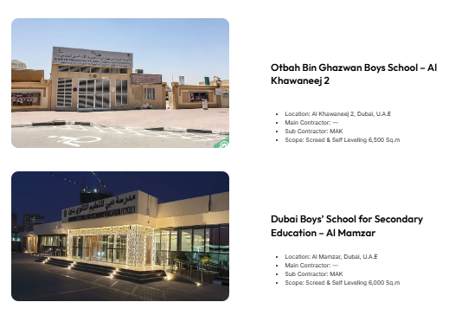
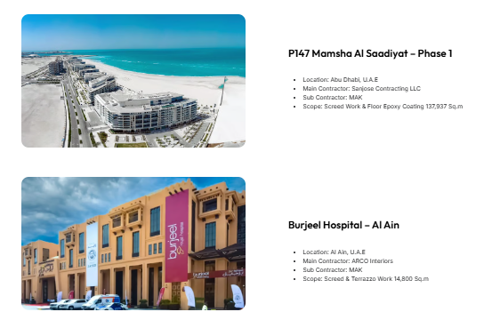
Company Profile
OUR PROJECTS
PROJECTS
makconstructionsksa.com

Slide 28
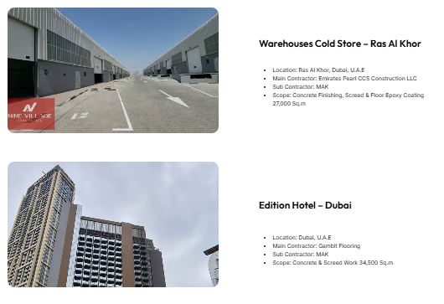
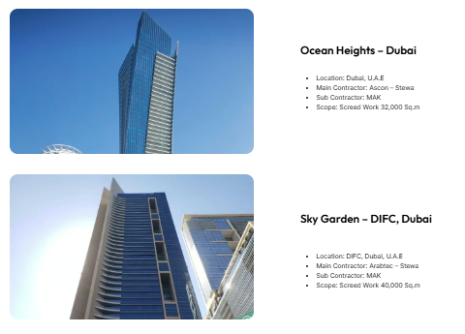
Company Profile
OUR PROJECTS
PROJECTS
makconstructionsksa.com

Slide 29
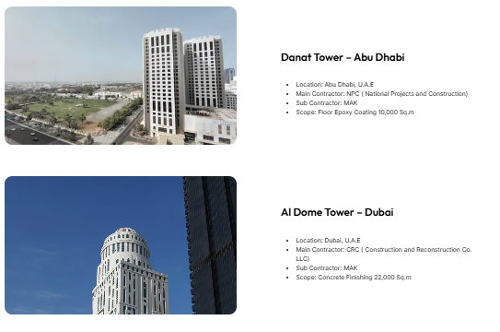
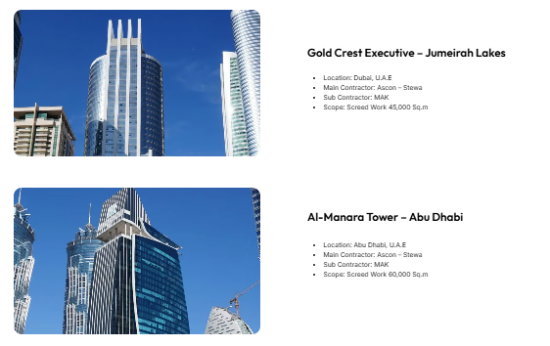
Company Profile
OUR PROJECTS
PROJECTS
makconstructionsksa.com

Slide 30
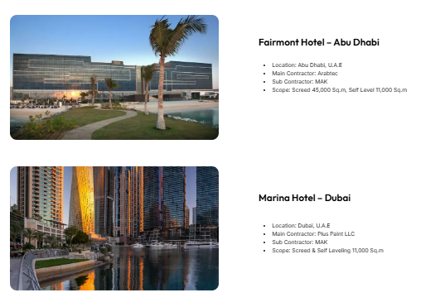
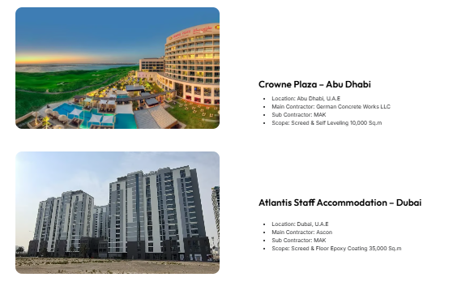
Company Profile
OUR PROJECTS
PROJECTS
makconstructionsksa.com

Slide 31
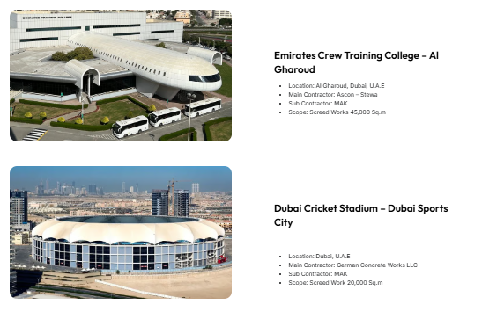
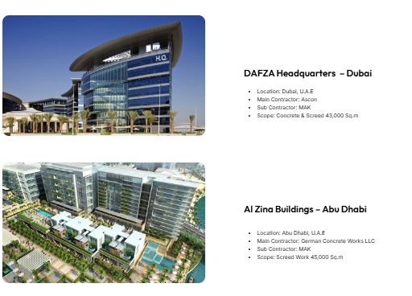
Company Profile
OUR PROJECTS
PROJECTS
makconstructionsksa.com

Slide 32
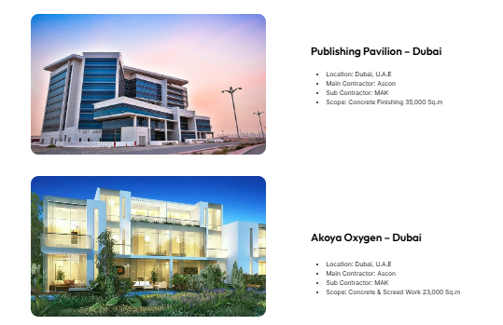
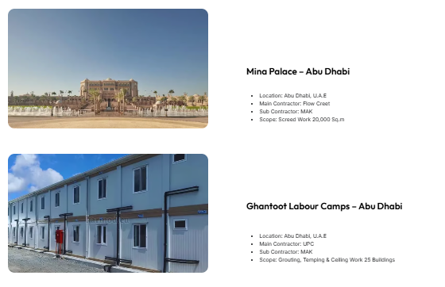
Company Profile
OUR PROJECTS
PROJECTS
makconstructionsksa.com

Slide 33
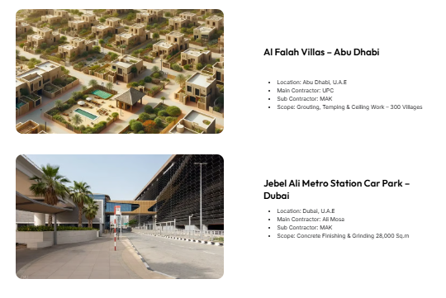
Company Profile
OUR PROJECTS
PROJECTS
makconstructionsksa.com

Slide 34
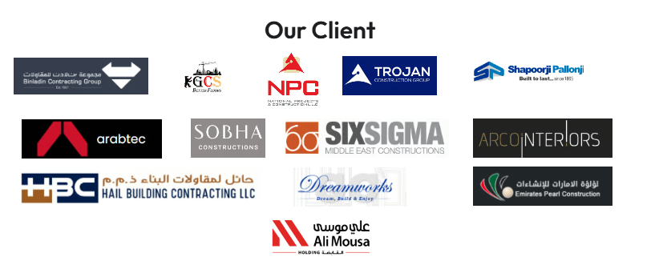
Company Profile
makconstructionsksa.com

Slide 35
OUR CERTIFICATES
Flooring Specialist
Services
Since 2008

Slide 36
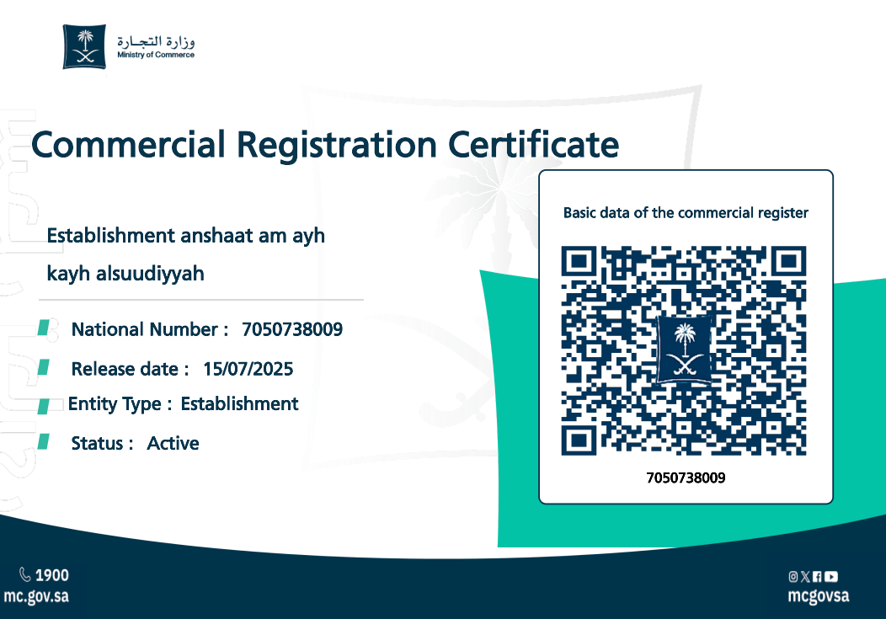
Company Profile
CERTIFICATES
makconstructionsksa.com

Slide 37
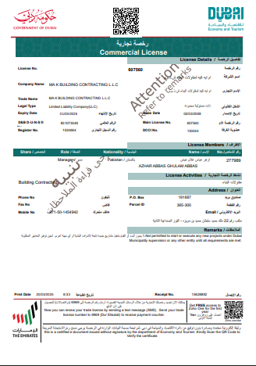
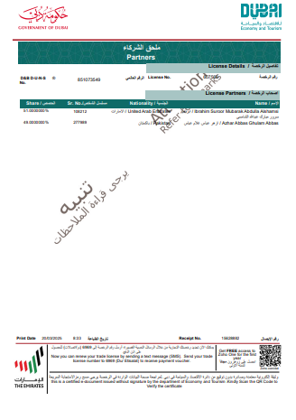
Company Profile
CERTIFICATES
makconstructionsksa.com

Slide 38
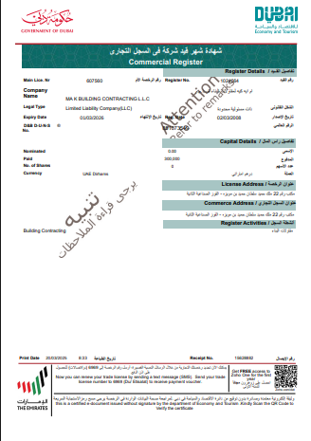
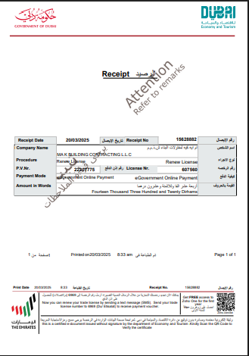
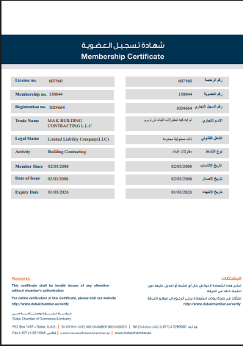
Company Profile
CERTIFICATES
makconstructionsksa.com

Slide 39
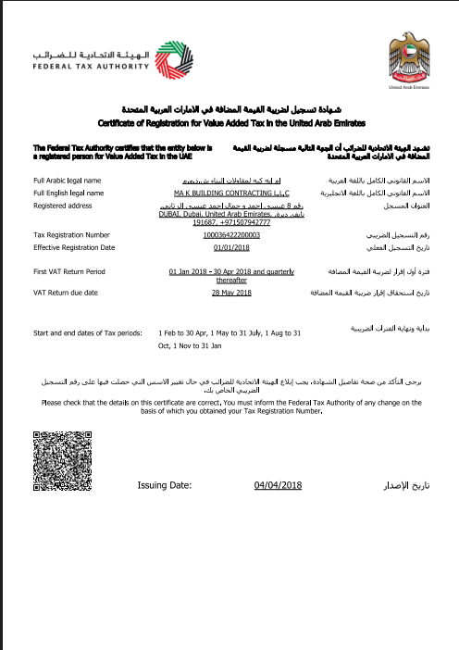
Company Profile
CERTIFICATES
makconstructionsksa.com

Slide 40

Al Satwa, Dubai, UAE
As Sulimaiya, Riyadh, KSA
info@makconstructionksa.com
info@makcontractinguae.com
UAE Contact
+971-50-7942777
+971-56-773999
KSA Contact
+966-509907884
+966-53-8854127
Flooring Specialist
Since 2008

