Slide 1
Welcome
To
EKKLESIA

Slide 2
Names in the Bible
and
Their Biblical Meanings
With Metaphysical Understandings.

Slide 3
From Donna Irizarry:
Jordan -
The name Jordan: Summary
Meaning
Descender, Descending
Etymology
From the verb ירד (yarad), to descend.
Related names
• Via ירד (yarad): Ararat, Jared, Marduk, Raddai

Slide 4
The name Jordan in the Bible
The Jordan is the famous river of Canaan, which flows from the Sea of Galilee south to the Salt Sea (Genesis 13:10). The Jordan is rather shallow and relatively easy to cross. The Oxford Companion of the Bible states that the principle source of the Jordan is the precipitation on Mount Hermon and three springs, while it also receives water from two tributaries (of which only the Jabbok is mentioned by name in the Bible).
The Jordan region was first settled by Lot (Genesis 13:10) and later Lot's descendants the Ammonites and Moabites took control over the region east of the Jordan (Numbers 22:1, Judges 10:9). This brought them in perpetual conflict with the tribes of Reuben, Gad and Manasseh, which settled there after the conquest (Joshua 22:21), even though YHWH had specifically told them not to (Deuteronomy 2:9, 2:19).
The Jordan was famously crossed by Joshua as the inaugurative act of Israel's conquest of the Promised Land (Joshua 3:17). In order to facilitate this crossing, the Lord held back the water of the Jordan by means of the Ark of the Covenant (Joshua 3:16) and much later, the mantle of Elijah achieved the same thing, twice (2 Kings 2:8 and 2:14). The splitting of the Jordan is comparable to that of the Sea of Reeds, which was achieved by the staff of Moses (Exodus 14:16) and ultimately to the second creation day, when the primordial waters were divided by means of the expanse (Genesis 1:6). Although in certain times of the year the Jordan could be a formidable natural barrier for advancing armies, the Aramean general Naaman thought it a ridiculous trickle compared to Abanah and Pharpar, the rivers of Damascus (2 Kings 10:12). Though relatively small, the Jordan was still somewhat of a natural barrier, and the inheritance of Judah was the most protected of all the tribes. The northern and Transjordanian tribes were picked off by the Assyrians, while the kingdom of Judah lasted a good century and a half longer, until the Babylonians conquered it in 586 BC. Ezekiel's ideal and restored Israel, consisting of all twelve tribes, was situated entirely west of the Jordan (Ezekiel 47:18).

Slide 5
Etymology of the name Jordan
The name Jordan comes from the common verb ירד (yarad) meaning to go down:
Excerpted from: Abarim Publications' Biblical Dictionary
ירד
The verb ירד (yarad) means to go down or descend, either literally down a mountain or figuratively away from a place of prominence. The noun מורד (morad) means descent or refers to something that hangs.
The final letter nun upon which this name ends may be a remnant of the common waw-nun extension that personalizes or localizes a root.
Jordan meaning
For a meaning of the name Jordan NOBSE Study Bible Name List reads The Descender. BDB Theological Dictionary and Jones' Dictionary of Old Testament Proper Names both propose Descending.

Slide 6
Ezekiel
The name Ezekiel: Summary
Meaning
God Strengthens
Etymology
From (1) the verb חזק (hazaq), to be strong, and (2) the word אל ('el), God.
Related names
• Via חזק (hazaq): Hezekiah, Hizki
• Via אל ('el): See the 'browse by form' menu for a long list of 'el-names.
The name Ezekiel in the Bible
The name Ezekiel is assigned twice in the Bible. The lesser-known Ezekiel is a priest in the time of King David (1 Chronicles 24:16). In English Bibles this man is often referred to as Jehezkel or Jehezekel, but in Hebrew his name is identical to the famous Ezekiel. And the famous Ezekiel should be called Jehezkel or Jehezekel as well, because that's a much closer transliteration. But we're used to Ezekiel, so Ezekiel it is.
The famous Ezekiel is the author of the Book of Ezekiel, and a major prophet of Israel who lived and worked among the exiles in Babylon. A curious detail is that the name of Ezekiel the prophet is mentioned only two times in the entire Bible, in Ezekiel 1:3 and 24:24.

Slide 7
Etymology of the name Ezekiel
The name Ezekiel is a compound of two elements. The second part is אל (El), the common abbreviation of Elohim:
Excerpted from: Abarim Publications' Biblical Dictionary
אל אלה
In names אל ('el) usually refers to אלהים ('elohim), that is Elohim, or God, also known as אלה ('eloah). In English, the words 'God' and 'god' exclusively refer to the deity but in Hebrew the words אל ('l) and אלה ('lh) are far more common and may express approach and negation, acts of wailing and pointing, and may even mean oak or terebinth.
Ezekiel meaning
For a meaning of the name Ezekiel, BDB Theological Dictionary proposes God Strengthened, and NOBSE Study Bible Name List reads the similar God Strengthens. Jones' Dictionary of Old Testament Proper Names has Strength Of God, God Strengthens or Strengthened By God.

Slide 8
Rachel
The name Rachel: Summary
Meaning
Ewe
Etymology
From the noun רחל (rahel), ewe.
Related names
• Via רחל (rahel): Aharhel
The name Rachel in the Bible
Rachel is one of four arch-mothers of Israel (Genesis 29:6). She is one of two wives of Jacob, sister of Jacob's first wife Leah (note that in the later Levitical code the marrying two sisters became prohibited — Leviticus 18:18); daughter of Laban, who is the son of Bethuel, who is the son of Nahor, the brother of Abraham.

Slide 9
The two sons of Rachel are Joseph and Benjamin, and Rachel dies while giving birth to the latter. Rachel names her youngest son Ben-Oni but Jacob changes his name into Benjamin. Rachel is buried by the way to Bethlehem Ephrath (Genesis 35:19).
Rachel's name appears in Greek in the New Testament (spelled Ραχηλ), in the harrowing observation of Jeremiah 31:5 of Rachel weeping over her children, which Matthew applies to Herod's massacre of the infants of Bethlehem (MATTHEW 2:18).
Etymology of the name Rachel
The name Rachel is identical to the word רחל (rahel) meaning ewe:
Excerpted from: Abarim Publications' Biblical Dictionary
רחל
The noun רחל (rahel) means ewe (a female sheep). It occurs only four times in the Old Testament, which suggests that it describes a specific sort of ewe.
NOBSE Study Bible Name List and Jones' Dictionary of Old Testament Proper Names agree: The name Rachel means Ewe.
Still, it must be noted that sheep and such are mentioned very often in the Bible — Israel was an agricultural society, after all — yet our word occurs only four times. This suggests that it doesn't simply refer to any old ewe but rather a special kind or one in a rare fix. What fix that might be is unknown, but it this rare word that is so famously used in Isaiah 53:7: "Like a sheep — רחל (rahel) — that is silent before its shearers, so did he not open his mouth".

Slide 10
Hezekiah
Meaning
Yah Strengthens
Etymology
From (1) the verb חזק (hazaq), to be strong, and (2) יה (yah), the shortened name of the Lord.
Related names
• Via חזק (hazaq): Ezekiel, Hizki
• Via יה (yah): See the 'browse by form' menu for a long list of yah-names.
The name Hezekiah in the Bible
The name Hezekiah or Hizkiah is spelled in four slightly different ways in the Hebrew Bible: Most often as חזקיהו (Hezekiahu) and almost as much in the future form יחזקיהו (Yehezekiahu). And both forms also occur in the truncated forms חזקיה (Hezekiah) and יחזקיה (Yehezekiah).

Slide 11
The name Hezekiah or Hizkiah is assigned to four different men in the Bible
When Hezekiah becomes mortally ill, the prophet Isaiah comes to see him and Hezekiah is promised another fifteen years of life (20:6). As an additional sign, the shadow on the stairway of Ahaz moves in the opposite direction (20:11). News of Hezekiah's miraculous recovery spreads far enough for king Merodach-baladan of Babylon to hear about it, and he sends a delegation to Judah to see what the deal is, and probably more so to investigate the strange behavior of the sun (2 Chronicles 32:31). Hezekiah proudly shows the Babylonians all his treasures, upon which Isaiah declares that the Babylonians will return to take his wealth by force (2 Kings 20:17).
There are probably quite a few meanings lodged in these proceedings but it's highly significant that the exile of the Jews to Babylon ties directly into Hezekiah's careless exposures, which ties directly into his miraculous recovery (see perhaps MATTHEW 7:6 and 8:4). An alternative, and possible preferable reading is that Hezekiah didn't goof up at all but brilliantly secured the Yahwistic tradition by enticing the Babylonians to absorb it (2 Kings 20:18). Something similar was undertaken by Paul (ACTS 25:11) and the concept itself features predominantly in the story of Jonah (Jonah 1:17).
After twenty-nine years of rule, Hezekiah dies and is succeeded by his son Manasseh (2 Kings 18:2, 20:21). And since Hezekiah is an ancestor of Christ, he's also mentioned in the Greek New Testament, as Εζεκιας; Ezekias (MATTHEW 1:9 and 1:10).

Slide 12
Etymology of the name Hezekiah
The name Hezekiah consists of two elements. The final part is formed by the appellative יה (Yah) = יהו (Yahu) = יו (Yu), which in turn is an abbreviated form of יהוה, YHWH, or Yahweh.
The first part of the name Hezekiah comes from the verb חזק (hazaq), meaning to be or become strong:
Excerpted from: Abarim Publications' Biblical Dictionary
חזק
The verb חזק (hazaq) means to be or become firm, strong or courageous. Adjective חזק (hazaq) means strong. Nouns חזקה (hezqa), חזק (hezeq) and חזק (hozeq) mean strength. Noun חזקה (hozqa) means force or violence.
Jabbok
The name Jabbok: Summary
Meaning
He Will Empty, Emptying
Etymology
From the verb בקק (baqaq), to be empty.
Related names
• Via בקק (baqaq): Azbuk, Bakbuk, Bakbukiah, Bukki, Bukkiah, Habakkuk

Slide 13
The name Jabbok in the Bible
The river Jabbok starts in the mountains of Gilead and pours out into the Jordan, from the east. Its modern name is Wadi Zurkah, which means Blue River. In the Bible the river Jabbok is most pronounced for being the river on which banks Jacob encounters the Angel of YHWH, and is transformed from being a person named Jacob to a nation named Israel (Genesis 32:22).
Excerpted from: Abarim Publications' Biblical Dictionary
בקק
Verbs בקק (baqaq) and בוק (boq) mean to be or become empty (of items, lands, etc.). Nouns בוקה (buqa) and מבוקה (mebuqa) both mean emptiness. Noun בקבק (baqbuq) means flask.
A second verb בקק (baqaq) means to be luxuriant and may either be imported from a cognate language or else refer to a proverbial wealth of bottles to empty.
There was probably also a verb בקה (baqa) that meant to search, scout out or examine, with a similarly spelled noun meaning gnat. Perhaps the link with the previous was accidental but perhaps the erratic flight of the gnat reminded observers of vainly criss-crossing an emptied land in search of something that was no longer there. Or perhaps the gnat was proverbial for something that required careful straining (see Matthew 23:24).

Slide 14
Names chosen by: Darryl Manning – Metaphysical understanding by: Dr. Roy E. Richmond
Cana – reediness.
By Roy: the root words of Cana (Gk. Heb) means place of reeds, reed, cane, staff, spear, measuring rod, rule, balance, hollow tube.
Metaphysically, Cana meaning place of reeds, reed, measuring rod, rule, balance are metaphors in the body and is symbolized by the larynx. Cana of Galilee is the power center in consciousness. The larynx originates and measures the volume and character of the sounds of the voice. Galilee (circle, a circuit, rolling energy) furnishes the vibratory force that acts through the place of reeds. "Cana," "reed," "measuring rod," "rule," and "balance" all represent symbols that pertain to various aspects of the body and consciousness.
The term "Cana," meaning place of reeds, can be interpreted as a place in our being where there is flexibility and sensitivity, much like the reeds by a river. This can be compared to the larynx in the human body, which is positioned in a way that allows for flexibility and modulation of sound.
The reed itself represents the ability to be flexible and attuned to vibrations, much like how the larynx originates and modulates the sounds produced by the voice.

Slide 15
The measuring rod, rule, and balance symbolize precision and equilibrium. In the context of the larynx, these could be seen as representing the ability to control and balance the volume, tone, and pitch of one's voice.
Galilee, on the other hand, symbolizes a center of power and energy in consciousness. The circular, rolling energy associated with Galilee represents a continuous flow of vibratory force that influences and acts through the larynx, the place of reeds.
These metaphors suggest that the larynx, as a physical and symbolic representation, serves as a point of connection between the flexible, sensitive aspects of our being (reeds) and the precise, balanced control of our voice (measuring rod, rule, balance). Through this center, the energetic forces of consciousness (Galilee) flow and manifest in the form of voice and expression.

Slide 16
Lazarus – God helper of God is helper.
Roy: Metaphysical understanding - Lazarus refers to the part of the consciousness that is helped by Spirit, though apparently utterly neglected by the man himself. The raising of Lazarus, the brother of Mary and Martha, signifies the restoring to consciousness of the idea of youth, which is asleep in the subconsciousness, or tomb of the body. People grow old because they let the youth idea fall asleep. This idea is not dead, but is sleeping, and the understanding I AM (Jesus) goes to awaken it. This awakening of youthful energies is necessary to one in the regeneration. The body cannot be refined and made like its Creator, eternal, until all the thoughts necessary to its perpetuation are revived in it. Eternal youth is one of these God-given ideas that man loves. Jesus loved Lazarus.
The outer senses say that this vitalizing force is dead, that it has been dead for so long that it has gone into dissolution, decay, but the keener knowledge of the spiritual man proclaims, "Our friend Lazarus is fallen asleep; but I . . . awake him out of sleep." Bringing this sleeping life to outer consciousness is no easy task. Jesus groaned in spirit and was troubled at the prospect. The higher must enter into sympathy and love with the lower to bring about the awakening--"Jesus wept." But there must be more than sympathy and love--"Take ye away the stone." The "stone" that holds the sleeping life in the tomb of matter in subconsciousness is the belief in the permanency of present material laws. This "stone" must be rolled away through faith. The man who wants the inner life to spring forth must believe in the reality of spiritual powers and must exercise his faith by invoking in prayer the presence of the invisible but omnipresent God. This reveals to consciousness the glory of Spirit, and the person has witness in itself of a power that it knew not.

Slide 17
Martha – Mistress
Roy: Martha also means of a family, wife, lady, governess, domestic, who becomes bitter, and rebellious one.
Martha and Mary represent the outer and the inner phases, respectively, of the soul's activity in welcoming the inner spiritual teacher. The person, established in love, is always quick to discern the presence of true thoughts, and it welcomes the spiritual man, or teacher, who brings Truth. It is also in a receptive attitude toward understanding,
Martha represents the outer activity of the person that is receiving the Voice of Spirit; Mary represents the inner or person of receptivity. Martha desires to show her love by service; Mary shows hers by learning at Jesus' feet.
Both activities are necessary, but we should take heed that in our desire to serve we do not forget our times of communion with our indwelling Father. We should not set greater value on active service than on quiet, loving receptivity to the Spirit of truth within us.
Martha can also be said to represent the material consciousness, and Mary the spiritual.

Slide 18
Pharisees – separatist (to separate).
Roy – Metaphysical, the Pharisees were the religiously educated of Jesus' day, and to their awareness all who claimed to do the works of the Lord were not genuine, authentic, or true; unless they were members of the Pharisee cult. No matter how good the work of the outsider, the Pharisee always attributed it to a bad power; hence they said, “Jesus was of a devil.”
In individual consciousness Pharisees represent thoughts that arise out of the subconsciousness, binding man to external forms of religion without giving him understanding of their real meaning (John 3:1).
The Pharisees, are the religious thoughts pertaining to the realm of form, do not know that Truth comes into expression in the consciousness through understanding; they seek a "sign" in the external realm. No sign of the presence of Spirit can be given to the pharisaical state of awareness, for the things of Spirit are spiritually discerned, and they did not nor do not seek the things of Spirit.
The remainder of Darryl’s words are Judas – celebrated, Israel – he will rule as God, Philip – fond of horses, Galilee – a circle, Satan – the accuser, Zebedee – giving., Thomas – the twin, Matthew – to war.

Slide 19
Names submitted by Esther:
Nephilim - Roy: I could not find this name, anywhere in the Bible.
Wikipedia sates: The Nephilim (/ˈnɛfɪˌlɪm/; Hebrew: נְפִילִים Nəfīlīm) are mysterious beings or people in the Hebrew Bible who are described as being large and strong. The Hebrew word Nephilim means "giants"; some understand it to mean "the fallen ones" but this is a misunderstanding of The Hebrew. Their origins are disputed. Some, including the author of the Book of Enoch, view them as offspring of fallen people. Others view them as offspring of the descendants of Seth and Cain.
The Nephilim, can be understood as a powerful symbol of the ongoing struggle between our spiritual nature and carnal instincts, urging us to embrace our Spirit and rise above the obstacles that stand in the way of our spiritual growth and evolution, that are often see to be giants in our lives.
Jezreel –
Roy: God will sow, to disseminate, plant, fructify (set), God scatters, whom God sows, seed of God, God of fruitfulness, virility of God, God’s offspring, and children of God. The name Jezreel speaks of Words of Truth (seeds) brought into mans conscious thinking brain or brought to his or her attention by the inspiration of the Voice of Spirit within them (Whom God Sows and God scatters).
Judith - Roy: Judith is mentioned one time in the Sacred Scripture: after going through several root words, I found OT:3063 Yehuwdah, meaning celebrated. Judith is the feminine of Judah, which signifies the outer-sense person, who with outer sense allows all they say, pray and give praise to comes from outer senses.

Slide 20
Elizabeth:
Roy: Elisabeth means God of the oath, my God is my oath, an ascertainer and seeker of God; God of the oath, and God’s oath. Metaphysically, she symbolizes a person in the feminine of love consciousness. Her name carries the full assurance in the person or feminine, love consciousness, that God is a God of Truth and keeps perception and view of man; in other words, the inner conviction of the person that the working out of the creative Spiritual activity that reveals the law of the Spirit of abundant Life in man's consciousness is inevitable and sure.
Michelle Waters: Job - to hate or to be hostile. An object of enmity. He that weeps or cries. Persecuted. He who turns. Object of hostility.
Roy: Job, persecuted, afflicted, adverse desire, a coming back, restored to one’s spiritual sense, converted. The transition of man from personal, formal intellectual righteousness, which is the basis of all self-righteousness, to a true inner change of heart awareness and an entrance into the real righteousness of Father, which deals with the very thoughts and intents of the innermost subconsciousness.
Aram – a citadel, to be elevated.
Eliphaz – twist, be strong, the body as rolled together, and powerful. From OT:6337 Paz – pure gold, hence gold itself, God of Gold.
Temanite The right hand or side of a person or object as the stronger or more dexterous.
Roy: Teman refers to the subconscious in Man. Temanite signifies a thought of strength and purification that springs from the subconsciousness when corrected by receiving the engrafted Logos Word.

Slide 21
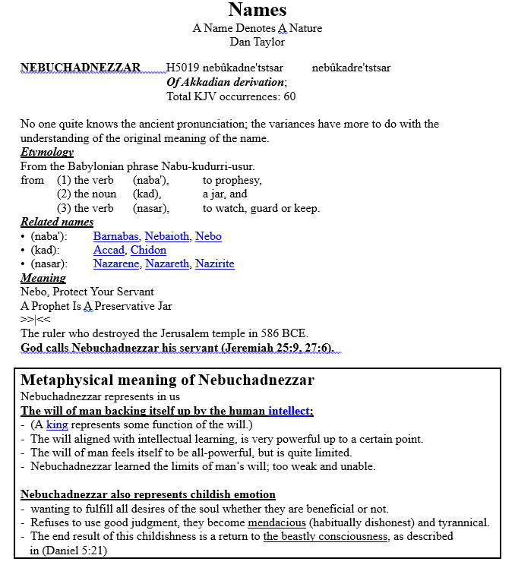
Dan Taylor:

Slide 22
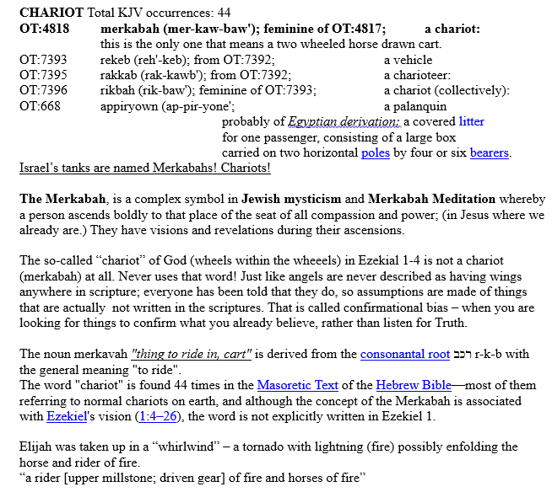

Slide 25
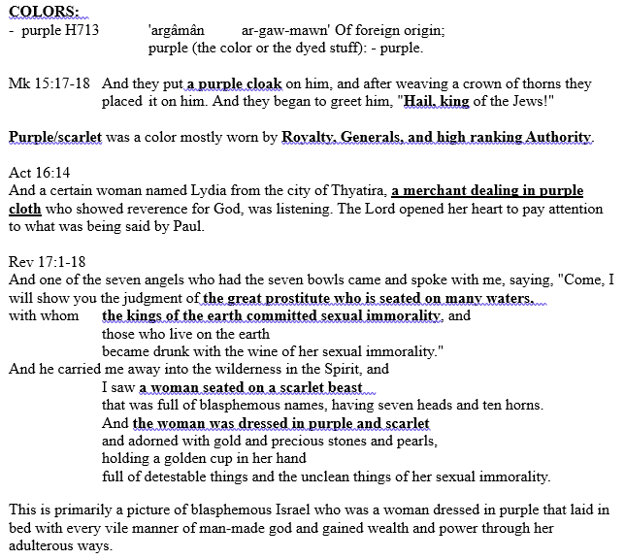

Slide 28
Connie: Benjamin Gen 35:18 OT:1144

Slide 29
Ben-oni

Slide 30
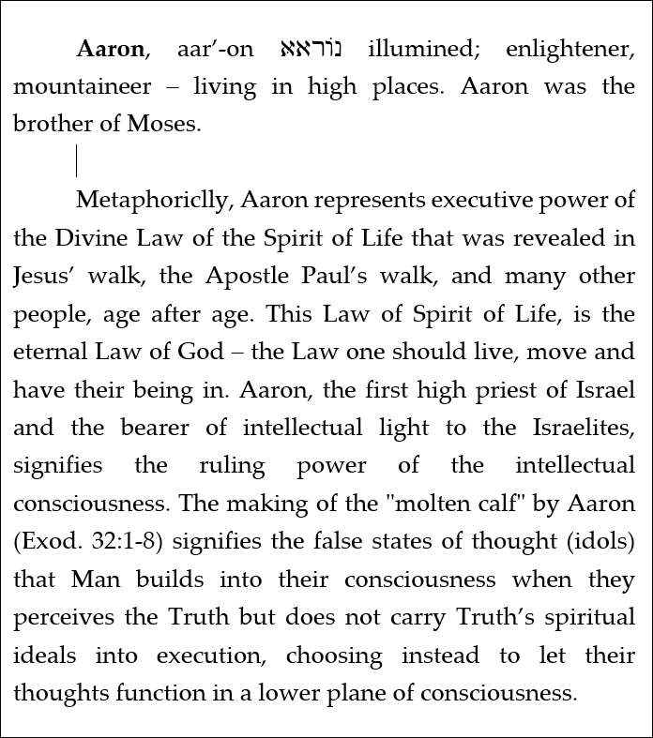
A few from Roy’s Tree of Life Concordance: to show you the goal of searching the meanings of these words: find the allegorical, metaphysical, spiritual, and parabolical meanings.

Slide 31
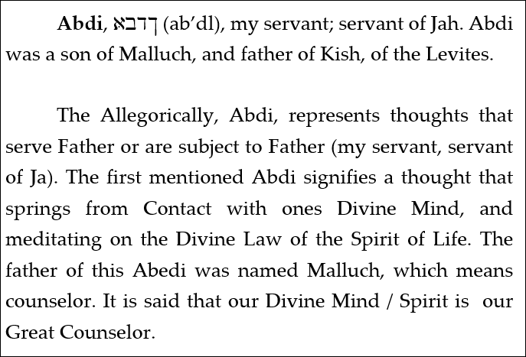

Slide 32
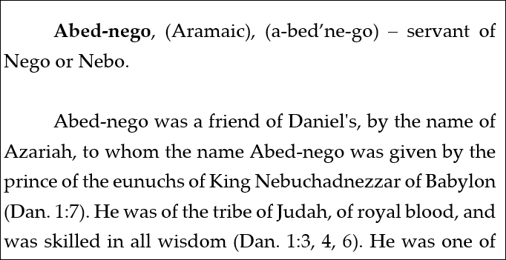
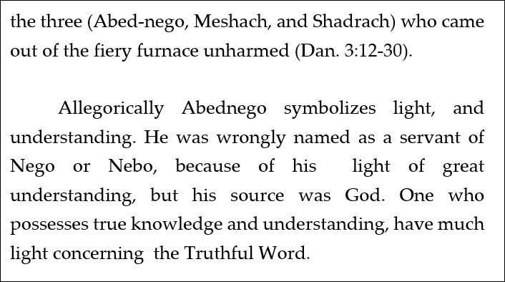

Slide 33
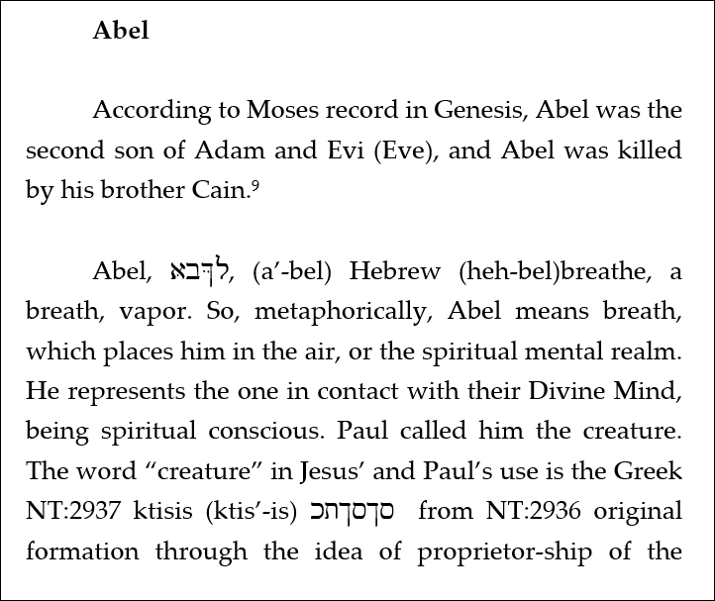
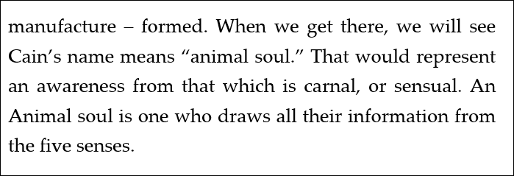

Slide 35
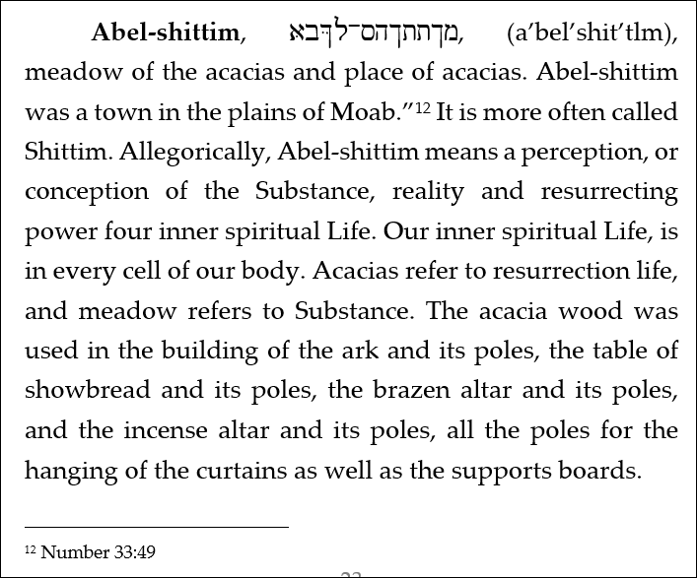

Slide 36
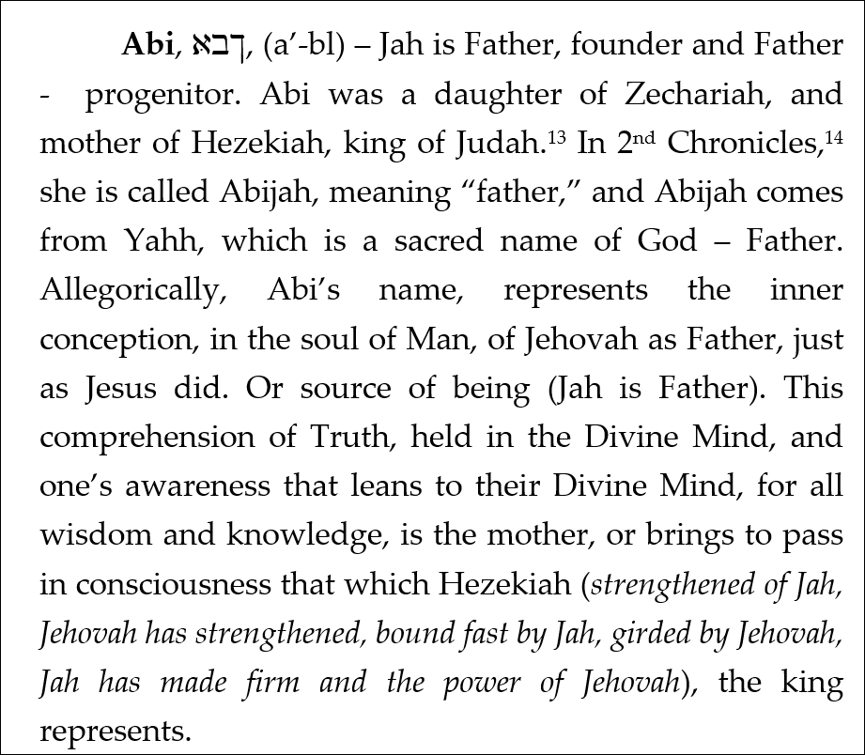

Slide 37
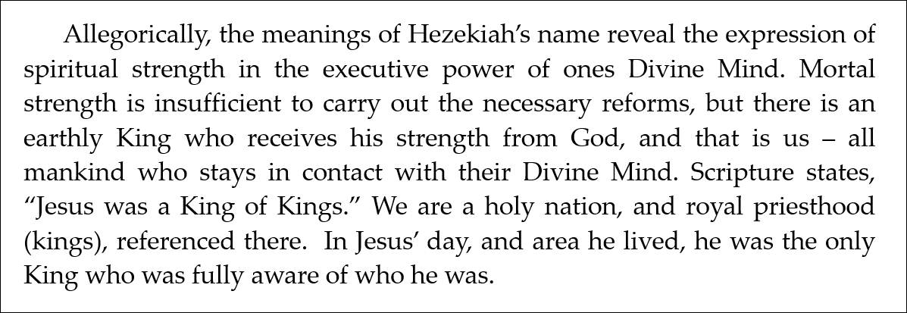

Slide 38
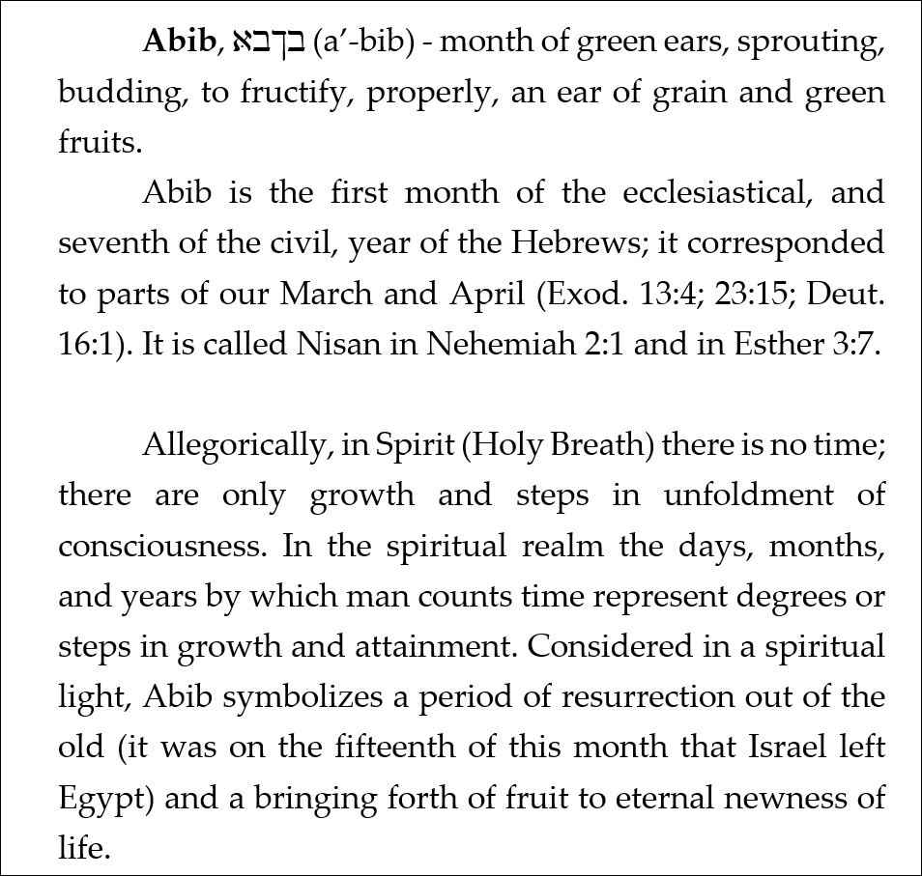

Slide 39
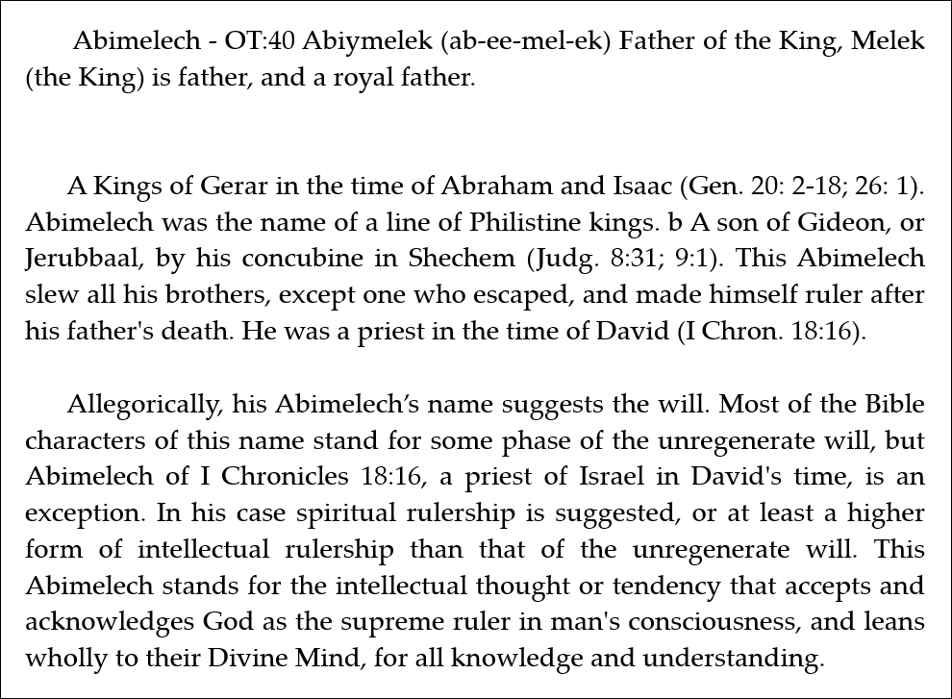

Slide 40
