Slide 2
EKKLESIA Course 2: Learning to use the PC Bible Program to Search Hebrew and Greek

Slide 3
NT:9999 NOTE: inserted word (x); This word was added by the translators for better readability in the English. There is no actual word in the Greek text. The word may be displayed in italics, or in parentheses or other brackets, to indicate that it is not in the original text. (Biblesoft's New Exhaustive Strong's Numbers and Concordance with Expanded Greek-Hebrew Dictionary. Copyright © 1994, 2003, 2006 Biblesoft, Inc. and International Bible Translators, Inc.)

Slide 4
What are the 9999 numbered words?

Slide 5
A Point of Interest: There are at least 23 verse in scripture, where Jesus asked people to follow him. The word follow comes from Akoloutheo meaning, to be in the same way with. Live as he did, relate to Father as he did, relate to people the way he did, go within like he did, and so forth.

Slide 6
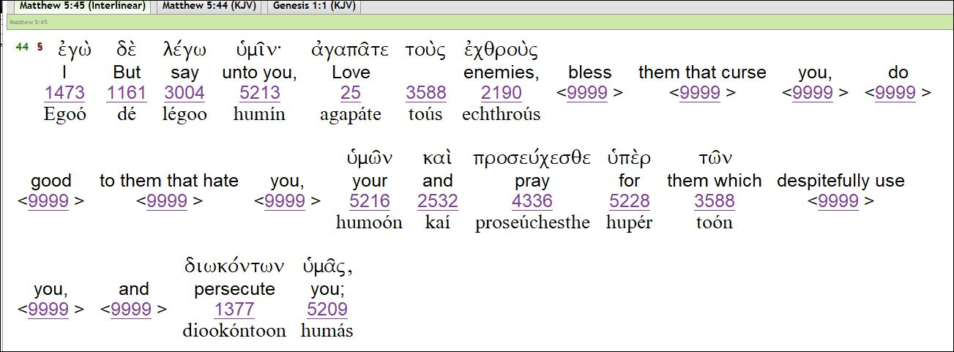
Another "find" from Connie: The word "enemies, is supposed to be translated as "hateful." The word "persecute" comes from NT:1249 diakonos - serve, run errands, do for or teach. And, all the 9999 words were added to this verse.
The correct rendition of Matthew 5:4 is, "I say to you, love those who are hateful to you; also speak blessing for them which serve you as teachers, pastors or any other service to you."

Slide 7
Text submission by the Student’s and Dr. Roy E. Richmond: 2nd Timothy 3:16

Slide 8
Acts 8:37

Slide 9
Acts 9:5-6

Slide 10
Romans 8:1

Slide 11
Revelation 21:5
Kaina – NT:2637 kainos’ new as in fresh – not new as in something that never was. Our awareness needs a freshness to take place, by removing the old beliefs of ourselves and of Father. The throne is us, and “he that sat upon,” infers “a rest with us.”

Slide 12
John 5:3-4

Slide 13
Luke 4:8 – this was Jesus having a conversation with himself, on the top of the Synagogue in Jerusalem. He had two questions to answer: Am I who Father says I am – “A Son of God,” and “Am I to stay here and take over the kingdoms of the world, or give up my breath on the cross the Jews and Romans will put me on?

Slide 14
Luke 9:55-56 In verse 54, it is recorded of Jesus two disciples, James and John say, Lord, will you that we command fire from heaven, and consume them, even as Elias did? The word “rebuked” means to forbade (forbid) them to speak that way.

Slide 15
Mark 6:11 – Jesus never spoke this way toward people.

Slide 16
Mark 9:45-46 – The word “hell,” was wrongly used; there is not such “place.” The Greek word is NT:1067 geena (gheh'-en-nah); of Hebrew origin [OT:1516 and OT:2011]; valley of (the son of) Hinnom; ge-henna (or Ge-Hinnom), a valley of Jerusalem – a garbage dump that is still there. It was where they threw their garbage, dead bodies that had no place of their own to be buried, fire burned all the time, and there were worms that fed on the flesh of the dead, that seemed to never die. Also, the false god Molech was placed there, where they burned babies on it’s hot arms as a sacrifice.

Slide 17
Mark 15:27-28

Slide 18
Matthew 17:21 They wrote this verse and added it, to enforce the false belief in devils and demons. If you believe in entities of “evil,” enough, you will project them into what you see with your physical eyes. Many people have been labeled as “demon possessed,” when in fact they are mentally ill. Jesus never cast out a “devil,” “evil spirit,” or any other made-up entity by the Catholic Religion. Every mentioned of a “evil entity,” came from a play called, “Dante's Hell,” or Dante's Inferno.”

Slide 19
Matthew 20:16 then we find Matthew 22:14
Why would Matthew 20:16, show the words to be added, and Matthew 22:14 translate the verse as though it were in the original text?
There were several people who worked on one book; each may have been assigned different chapters to translate. One may of seen the words were added, and properly placed the numbers there, and the others chose to place the Greek numbers for the words that were added. I am not absolute on that, but it seems correct to me.
If Matthew 22:14, is the correct text, then the proper translation would be, “All are Holy (Saints) but few chose to live Holy. The Greeks did not have a number for “all,” so they always used “many”. Called comes from Saints, and chosen can be chose or chosen.

Slide 20
Matthew 18:20 – the only thing that was lost with Mankind, was their awareness of who Father is, and who they are, as a Son or a Daughter of Father – Spirit – Breath.

Slide 21
Romans 12:2 – If it was by the renewing of your mind, then you would have to do the renewing. There is only one Mind – the Divine Mind of Father that is in Jesus, Paul, John, you, and all other people. So, we are transformed in our awareness, by making contact with our Divine Mind within – go within.

Slide 22
Ephesians 5:22

Slide 23
1 John 5:7 – There is not Trinity – “The Lord our God is One.” Deut. 6:4 – “one” in Hebrew is OT:259 ‘echad – meaning united – One. Jesus even said, the first thing we needed to know is the Lord our God our Lord is one.
Spirit is Breath – Water is the Logos of the Word, and Blood translates to be Kinship (hence, “you are my blood). Logos; the creative Spiritual activity that reveals the law of the Spirit of abundant Life in all of us. We are the living Water / Logos, and we live as One in Kinship with Father.

Slide 24
Colossians 1:14
Col. 1:14 “We have a fixed position of oneness with Father, who drives away our mistaken identity.” The word “sins” is not correct. It is hamartia, meaning a sin (singular) – which is a mistaken identity, properly to miss the mark of who we are – a Son or a Daughter of Father.

Slide 25
There was no such words as Virgin in the Bible. It is a maiden, damsel, and unmarried daughter and one set apart for an intended purpose.
The word “wilderness,” is eremos in the Greek, it implies going to a place to be alone, which is what Jesus did as recorded in Luke chapter 4. He withdrew from the crowds and went to sit at the top of the Synagogue to have a talk with Father.

Slide 26
Acts 8:37 I’ve shown this one to the class – several people sent it to me.

Slide 27
From: Darryl Manning Acts 10:6

Slide 31
What does the word “mystery” mean?

Slide 32
Are we a living Soul, or a life-giving Spirit?
We are not a Soul.
Adam was made a living being with Breath (Spirit). We are Visible Spirit, with Life giving Power.

Slide 33
Revelation 21:23

Slide 34
Mark 11:26

Slide 35
From Donna Irizarry:

Slide 37
From Dan Taylor

Slide 39
This story of Lazarus being raised from the dead, shows where sometimes, the additions were helpful –very rarely though.

Slide 40
Dan, You discovered a very large Gold Boulder of Truth – Jesus did not go to heaven as was supposed. Of course he was already with Father. He went somewhere else to help another people, and then came back to share what Paul and the Apostle had not yet seen with wide-open-eye. He taught Paul, then John, and then the other disciples. Wowsers!

Slide 41
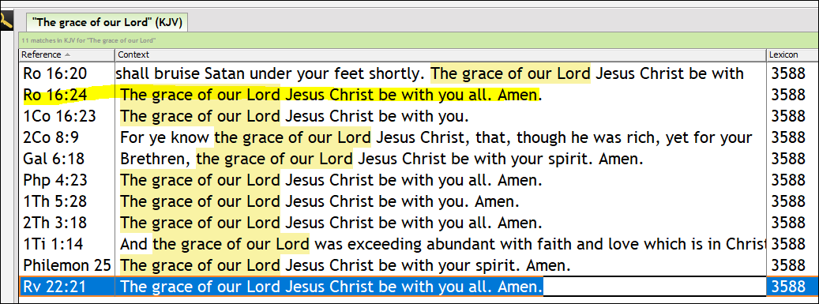
The following verses have these words fully written out or in various forms. Therefore, I can see why the translators would add this to the end of the book of Romans and Paul’s others books.

Slide 42
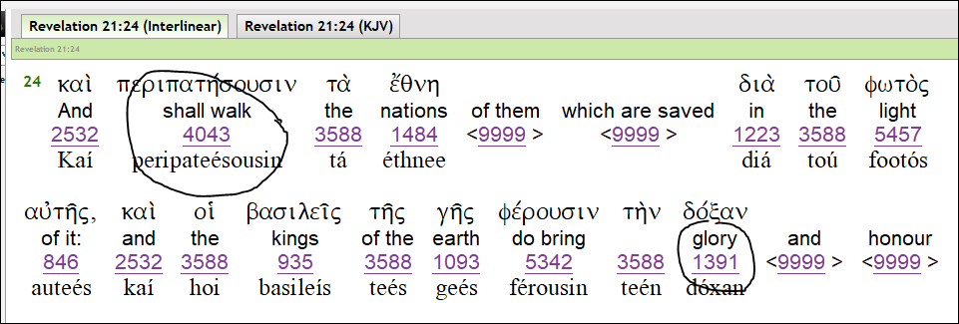

Slide 43
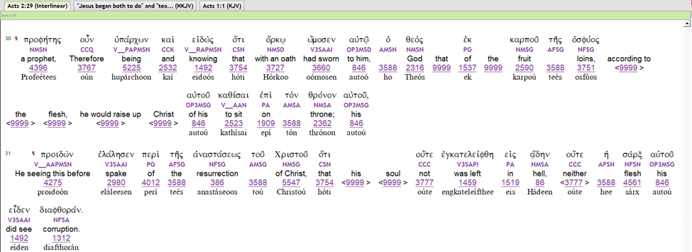
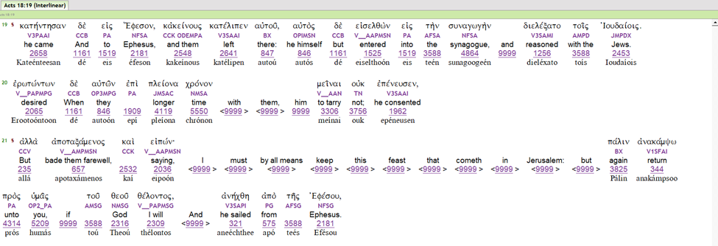

Slide 44
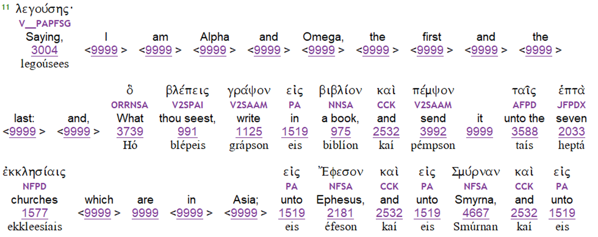
Revelation/ search for added text:
Chapter 1

Slide 45
Revelation Chapter 2
Chapter 12
The word “woe,” was translated from NT:3759 ouai (oo’-ah’-ee) a primary exclamation of grief, as in feeling sorry for a person or situation. Not a term of judgment or punishment.

Slide 46
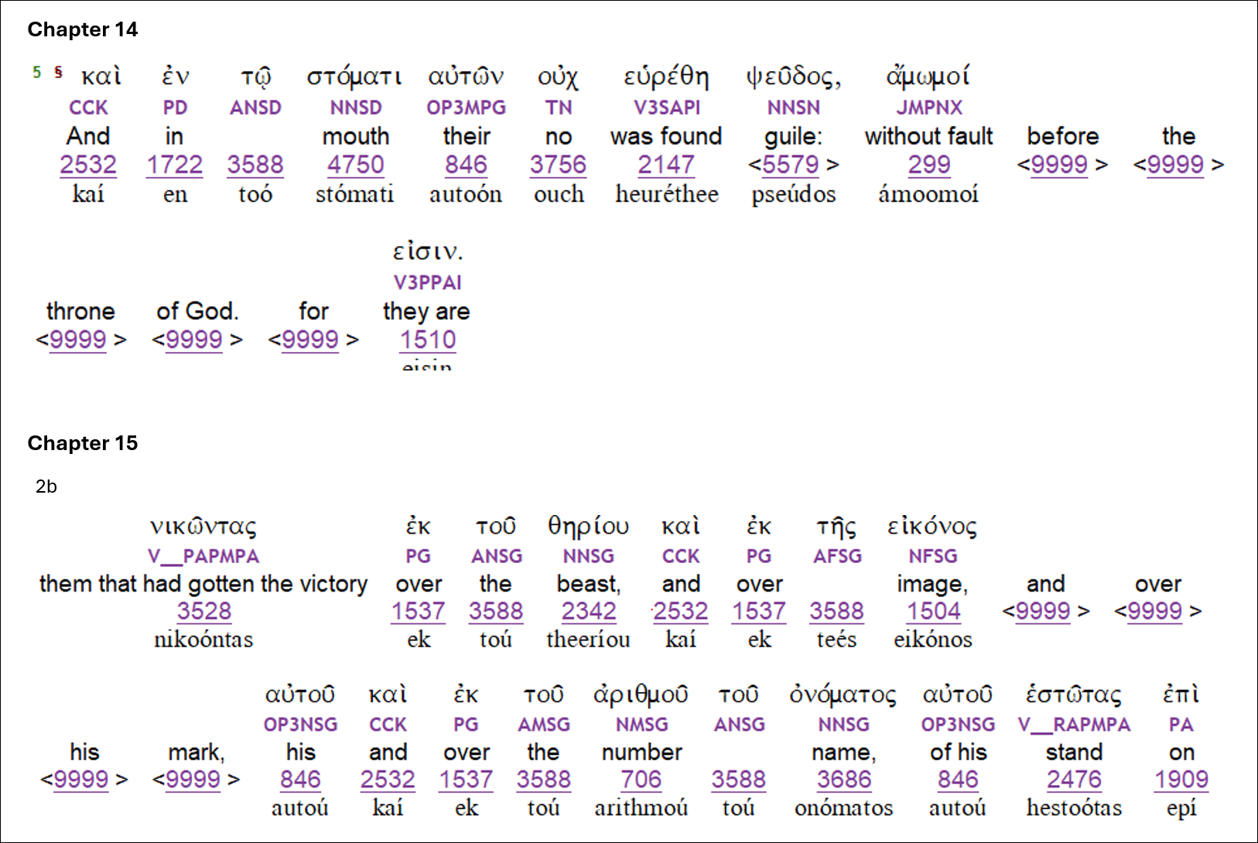

Slide 48
John 1:1-3
In principle thought I was the spoken word.
So then, as the word I was one with God.
And as the spoken word, I was God.
The same was in the highest thought of the heart of God.
All things were generated through God.
And apart from God was not anything which was generated.
Paraphrase:
In God’s first and only design and principle thought, I was God’s spoken voice in awareness.
I AM the first word uttered, that was already and always spoken.
So then, as the once and always conscious expression, I was one and in union with deity.
And as the spoken word not returning void, emanating into everywhere and when, I was God in and as all things; God all in all!
This same spoken word of God is the original thought in the heart of God.
God is the generative source through which all creation comes.
Outside of God, no generative source exists through which anything may have being!
Written by Dan Taylor

Slide 49
By Barry Miller: John 1:1-3
1 Within the foundation of all creation existed the divine reason implicit in the cosmos, ordering and giving reason; and the eternal and unchanging truth, present from the time of creation, available to everyone who seeks it, existed with God the Father of all; and Father/God/Divine Breath existed as the eternal and unchanging truth, present from the time of creation, available to everyone who seeks Him.
2 This existed within the foundation of all creation within the Father of all.
3 He, Himself was the channel through which the whole came into being, apart from He, Himself came into being not one thing that came into being.

Slide 50
John 1:1 In the first-fruit man, Jesus and an in every age after, before the foundation of the world, existed the Spirit of Father; and the Spirit of man originated from Father and Father was and is the Source of Spirit; Father is Spirit-Breath. 2 Man eternally existed in a relationship of eternal Oneness and rest, as the face of God. 3 Jesus’ mission and mandate was to reveal truth to Man so that all mankind would rise, from a state of non-existence, to become aware of their oneness with, in and of Father. Without what Jesus did and what he revealed, Man was not able to rise or wake up from a life of non-existence, to live out of their Holy Spirit.
Dr. Roy E. Richmond Tree of Life Bible Translations

Slide 51
More to be added to this Power Point, as we complete our last four classes. The final document will be sent to the students, to replace this one.

Slide 52
More Resources of Tree of Life Ministries International:
Dr. Roy E. Richmond
Web page: www.DrRoyERichmond.com
Email: drroyerichmond@cox.net
Face Book: Roy E. Richmond
YouTube: https://www.youtube.com/@DrRoyRichmondOklahoma
Podcast: Apple; Spotify; Listen Notes; PodBean; and many more Podcast Platforms
Books: LuLu printing company: https://www.lulu.com/spotlight/royrichmond
Books: Amazon Prime (Dr. Roy E. Richmond): More @ Amazon Prime (Roy E. Richmond)

