Slide 1
AI Resources for Learning & Development
Maximizing the use of artificial intelligence for Rapid Development.
Notes:
This work is completely designed by me, Boni Kreider.
I’ve used this framework in another business.
While not all these steps will apply in each learning setting, the theory behind the steps are still relevant.
The goal of this PPTX is a blended course with CBTs (computer-based training) and ILT (instructor led training).
This method ensures the delivery of content is almost identical each time it is presented.
To that end, facilitators are also trained on HOW to use this method and how to grow in their delivery skills using this process.

Slide 2
Course Completion Criteria
The course Completion Criteria indicator shows NOT MET.
It changes to COMPLETED after you:
  Watch all the slides for your portion of the training
  Listen to all the audio for your portion of the training
  Pass 100% of the assessment questions
If a retake is required, you cannot simply retake the exam. You must COMPLETELY close your current browser to reset your computer cookies and then relaunch the CBT in a fresh instance on your browser of choice. Depending on the requirements set by the business (the above check list), repeat the needed elements to attempt to meet the completion criteria.
Notes:
Course Requirements
The basic design of this slide is a template, except for the check boxed requirements as they are variable in every presentation.
This is critical so that learners know what is expected of them.
These are identified by the business stakeholders before the build ever starts.

Slide 3
PREPARE ME AGENDA / PRETEST
Notes:
Prepare Me - Key mechanisms include:
Encourages deep processing: The act of trying to guess an answer, even unsuccessfully, stimulates active retrieval processes and encourages learners to seek the correct information.
Directs attention: Pretesting signals which concepts are most important, focusing a student's attention during subsequent instruction and leading to more effective encoding.
Highlights knowledge gaps: By revealing what a student does not know, a pretest can increase motivation to learn and correct those misconceptions.
Reduces mind-wandering: Some studies have found that pretesting helps keep learners more focused during instruction, leading to better outcomes on tests.
Corporate & Higher learning
Trainers perform the action of presenting, showing, describing, or explaining something to a group of people. This is used in both CBT (computer-based training) and ILT (instructor led training using CBTs as prompts and guides for training).
Introduce and explain why they are in the class in the first place
Administer the pre-learning test and do not provide the correct answers.
This graphic is purposeful in that training must scaffold on top of prior learning. The pretraining test is an indicator of what will be taught/learned. The positive effect of pretesting, known as the "pretesting effect," is a well-documented phenomenon in cognitive science. Taking a low-stakes test on new material before a lesson, lecture, or training session primes the brain to learn. This improves memory for the information, even if learners get most of the pretest questions wrong (so it is NOT graded and only correct/incorrect answers are given).
Two studies reported a 12% and a 9% advantage on final exam questions.

Slide 4
Question 1
What is the brain's role in learning?
Answer
The brain helps learners understand and retain information in their long-term memory by actively processing new information and integrating it with what is already stored in the long-term memory. [FB: Correct]
Distractors
The brain’s working memory has unlimited capacity and the cognitive load is limitless, making it easy recall the information later on. [FB: Incorrect]
The brain cannot overload the working memory so every detail of content is important and won’t interfere with the learning processes as it makes truly relevant content more obvious. [FB: Incorrect]
The brain does not process problem-solving scenarios well because it does not help develop thinking skills that can be transferred to the real world. [FB: Incorrect]
Notes:
Writing Questions
When writing exam questions for adults, it is crucial to focus on higher-level thinking, relevance, and clear communication, moving beyond simple memorization.
Adults often bring prior experience to the learning process, so the questions should assess how they can apply, analyze, and synthesize information in a meaningful context.
Example:
What is the brain's role in learning?
The brain is the primary tool for learning, and effective eLearning design should match how the learner's brain functions. Creating "brain-friendly" content helps learners understand and retain information in their long-term memory. [FB: Correct]

Slide 5
SECTION 2 – tell me
Notes:
Tell Me Why
Corporate & Higher learning
Explain what new skills and knowledge they’ll walk away with
Entice with a 10,000-foot level introductory “hook” to the topic
Language Writing Style - 1
Comply with any internal branding.
Write directly, simply and clearly. To accomplish this, keep sentences short. It is important to not give the reader more ideas or information than can be handled at one time.
Avoid jargon.
If you are addressing a multicultural audience, avoid culture-specific slang, colloquialisms and examples.
Be sensitive to the fact that many learners are not native English speakers.
Write as you talk. Informal language and contractions (e.g. don’t, we’re) can be used if allowed in company branding.
Minimize the use of compound sentences. When you see a colon or semi-colon, examine the sentence to see if it could be made simpler and clearer by breaking it into shorter sentences.
Use personal pronouns (e.g. “you”) to refer to learners. This personalizes instruction and involves your reader.
Use bulleted lists often.
Use the active voice. In a passive construction, the agent of the action often disappears from the scene. Use the passive voice only when the active voice is unduly awkward. Active voice sentences have a subject that performs the action, while passive voice sentences have a subject that receives the action.
Leave “white space” by making more slides.

Slide 6
Show me how
Notes:
Show Me How
Corporate & Higher learning
Facilitators perform the action of teaching a specific technical or people skill and includes training soft-skills behavior.
Introduce a new topic and show the necessary systems/screens/fields for that topic.
Show a CBT that demonstrates the process.
Graphics
AI generated, realistic looking photos, are easy to create.
Ai brings a vibrant and unique look and feel for each presentation, customizing colors, persons, and backgrounds.
Never reuse an AI generated photo outside of the existing CBT. Be creative!
This photo has never existed before until I created it using AI ☺
Animation
It has to be practical and purposeful, not random or childish.
In this example, the click actually ticks for over 50 seconds while audio and instructions are played.

Slide 7
Embedded Video or CBT
Tips for SMEs when Delivering Information
Be sure coach your SME on what to say and not to say when recording. We don’t use aggressive words like “hit the enter button” but rather, if it is a keyboard action: “press the enter key” and if it is a software action done with a mouse: “click the enter button”.
Also, it is often necessary to remind the SME:
  To first say what they are going to do, and then second do the action.
  To NOT speak when a browser or application’s spinning circle (counterclockwise spinning circle typically signifies that the browser is resolving the hostname or connecting to the server and clockwise spinning indicates that the browser is actively loading the webpage and its associated resources) is actively working. In video production, those pieces are cut out or sped up.
  To resize their screen to fit into a 4x3 size (not 16x9) – depending on what application renders the video
  To not to scroll or randomly click their screen
  To be in a TEST region (if not possible, make note that everything has to be “scrubbed”)
  That it is okay to redo sentences and there is no need to rush when repeating.
Notes:
Chunk Learning for SME Accuracy
In the context of instructional design, video "chunking" refers to the process of breaking down information into smaller, more manageable pieces or "chunks".
Improved Cognitive Load: Cognitive science research indicates that working memory has a limited capacity. By breaking information into chunks, you can reduce the amount of information learners need to process at one time, making it easier to understand and remember.
Enhanced Learning and Retention: Chunking helps learners to more easily grasp and recall information. It facilitates the efficient transfer of knowledge and skills.
Better Content Organization: Chunking helps instructional designers organize content in a logical and progressive sequence. You can structure a course with modules, lessons, and topics, moving from broader to more specific chunks of information.
Improved Screen Design (especially for eLearning): Chunking helps avoid overwhelming learners with too much text on a single screen, especially important for digital learning experiences. It ensures that each screen presents a manageable amount of related information, guiding learners to focus on key points.
Greater Focus on Key Information: By breaking down content, instructional designers can emphasize "need to know" topics and present information more consistently.
Agile Authoring for Control and Speed
Agile authoring in instructional design involves using iterative and collaborative methods to develop learning materials, similar to software development. It emphasizes flexibility, continuous improvement, and stakeholder involvement to create effective and engaging training. This approach contrasts with more rigid, linear methods like ADDIE, allowing for quicker adaptation to feedback and changing needs. Chunks are agile and can be sent for review while other pieces of a build are developed.

Slide 8
Job Aid
Notes:
Connect Me
Corporate learning
The learners take turns finding and reading the job aids out loud.
The trainer connects the dots between the job aid(s) and the steps/screens/etc.
For ensuring consistency and staying current, job aids should function as a single source of knowledge because they are designed for immediate reference during a task, while training materials are for foundational learning.
Multiple, unmanaged versions of training or reference material can lead to "tribal knowledge," where different team members develop their own versions of a process, resulting in inconsistent output and confusion.
All training points TO job aids, and doesn’t provide any NEW information, only expounds upon the existing information.
Higher learning
IF A GROUP: The learners take turns finding and reading the text out loud.
IF INDIVIDUALLY: The learner finds and reads the text.

Slide 9
Let me try
Notes:
Let Me Try
Corporate learning
The trainer only assists if asked or when they see/hear egregious errors.
This is the self-discovery phase of the learner's development.
Struggle enhances learning.
Be careful not to handhold too much. But balance that with the fact some learners require more assistance.
Be gracious to provide help when asked.
Learners do independent navigation on the topic, using required tools. They practice updating, thinking, answering, or solving. We expect students may need help and we encourage them to do so.
Higher learning
IF A GROUP and INDIVIDUALLY: dedicated time during class where there is independent work using the walkthrough up next.

Slide 10
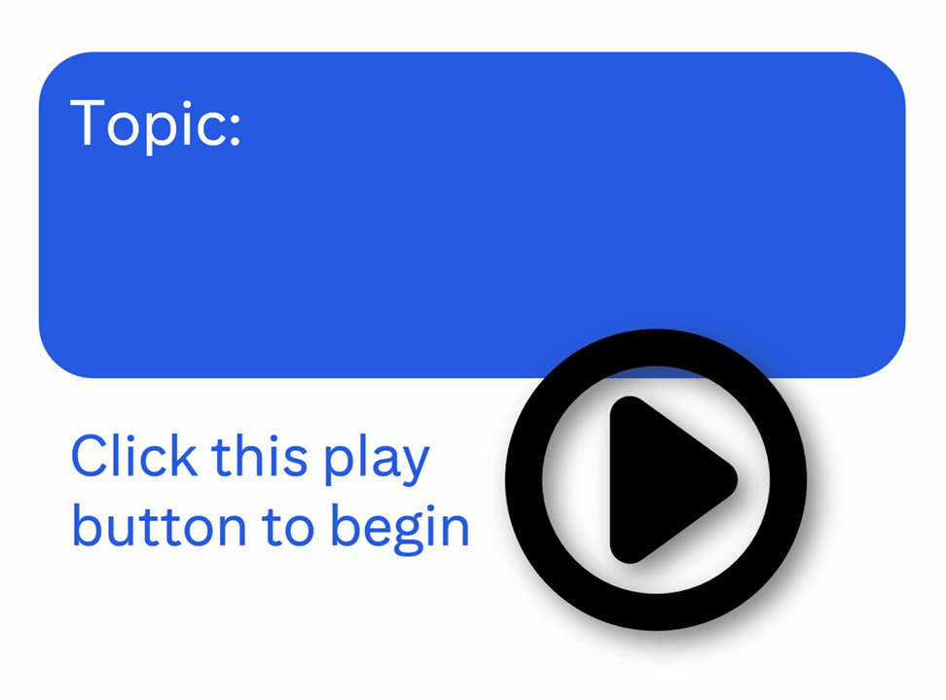
Notes:
Scneario Walk Through
Because CBTs should utilize a mix of media, including videos, graphics, audio, and animations, to cater to different learning styles and keep content dynamic and engaging, AND because gamification, at its most simple definition in the workplace, is overcoming something within a set of rules, I prefer to use the interchangeable terms: interactive simulations and scenario walk-throughs (as seen in this learning step Let Me, and further actioned in Observe Me, Debrief Me, Integrate Me, Grade Me, Evaluate Me, and Support Me.).
Corporate learning & Higher learning
An example of a link to an Adobe Captivate walk-through.
These hotspots allow for an actual look/feel of a real system.
This provides repeatable and consistent training to all users.

Slide 11
Notes:
Observe Me
Corporate learning
This critical step is the foundation for future conversations.
This is a scenario-based call and the learner role plays the topic with another human partner.
This practice time requires the learner to mentally transform instructions and thoughts into words and actions, without getting tongue tied.
Higher learning
IF A GROUP: if the activity requires interaction with other humans, then practice still applies. This can be a chat board, it can be in person, be creative.

Slide 12
Notes:
Debrief Me
Corporate learning
Perform the action of partnering with learners in a thought-provoking and creative process that inspires them to maximize their personal and professional potential.
Ask thought provoking questions (that are provided) that involve process or critical thinking.
At this point learners should feel confident enough to “fish for themselves.”
This step is for the partner from the prior step to provide peer feedback and coaching on both soft and technical skills. Topics for discussion are limited to politeness, tone, cadence, accuracy of information, adherence to the order of processing steps, and anything scenario based. This is professional, detailed, and encouraging with suggestions where improvement can be made.
Higher learning
IF A GROUP: this is a great opportunity for the entire group to meet and discuss
IF INDIVIDUALLY: This is a great opportunity for an instructor video

Slide 13
Notes:
Check Me
Corporate learning
Section quiz, if required.
Learners retrieve answers from MEMORY, and use tools if needed. This self-check reveals memory and process gaps. It shows the learner what they need to review for proficiency of the topic or where to see clarity on understanding a particular piece of a process.
Higher learning
IF A GROUP: oral pop quizzes are intimidating but can be made less embarrassing by making it collaborative (phone a friend) OR even by making 2 teams and having the teams come up with a single answer.
IF INDIVIDUALLY: The learner can create their own video answering some questions and uploading / others can give feedback on that video

Slide 14
Notes:
Integrate Me
Corporate learning
Perform the action of helping others reach an agreement or solution without getting directly involved in the process or discussion.
You are present but not actively involved beyond being a moderator.
This is a good time to check your emails.
This is a repeat of the observe/debrief me section, but this time, it is all learning to date on the specific topic. Demonstrate the feedback being applied, using all soft and technical skills and treating the conversation as if it were real. Note: there are NO difficult callers. This practice is for a “happy-path” process/call.
Higher learning
IF A GROUP or INDIVIDUALLY: these are compound questions or If / And / Then scenarios

Slide 15
Notes:
Review Me
Corporate learning
Ask questions to help guide the learner toward the intended goal that they have already learned.
Being the autodidacts that our learners are, they will use these steps to show what they’ve learned through testing, and relearn and self-teach during journaling.
Each learner practices individual memory encoding and/or do a group After Action Review (AAR).
Personal: practice memory encoding by creating a journal of notes only by memory. Do not copy anything! This self-check reveals any remaining learning gaps.
Group AAR: compare actual versus intended results with action steps (this is the Debrief Me step but more stimulating).
Higher learning
same

Slide 16
Notes:
Grade Me
Corporate learning
At this point we have completed the apprentice stage and are marching learners toward being completely autodidactic – encouraging them to be highly motivated and to pursue additional knowledge through self-study using various resources like job aids and other online courses. This step is to witness and understand if the learning process is working. A proctor's main duty is to ensure the fairness and honesty of the testing environment. You will perform the action of watching and monitoring learners during exams and unstructured, self-study time. This can become a disciplinary function.
Each module exam is critical to the agent success on the final exam in the future Evaluate Me step.
Higher learning
An autodidact - self-taught through self-study without formal guidance.
An apprentice - receives formal guidance/instruction.
Results
At the completion of the exam, instant results are provided.

Slide 17
Notes:
Certify Me
Corporate learning
This is the attestation to a topic. It is not always needed or included. It depends on reporting and what the stakeholders identify as their ROI proof.
An attestation indicates the learner understands the material and that they can perform the task(s) learned in each module. This self-attestation indicates each learner personally certifies that they have proficient knowledge to handle a real conversation on this topic.
Higher learning
Same

Slide 18
Notes:
Evaluate Me
Corporate learning
This is a final exam on each series.
There could also be simulated calls on various topics learned. They are performed just like the INTEGRATE ME step but this one is graded.
Higher learning
Same

Slide 19
Notes:
Support Me
Corporate learning
This is a series of live calls taken within a controlled environment where human help is observing and available for help if needed.
This allows the learner to grow their proficiency while being supported by tenured staff.
Higher learning
Applies if there is an internship or apprenticeship.

Slide 20
Closing branded slide
Notes:
Branding
Corporate learning
Branding is essential for consistency.
Higher learning
Same.

