Slide 1
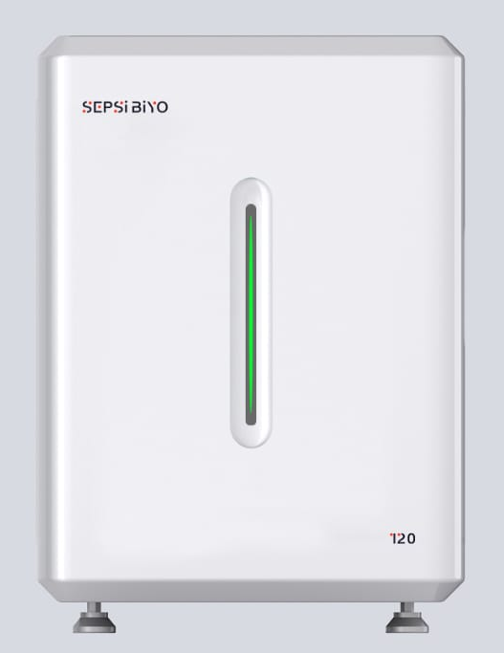
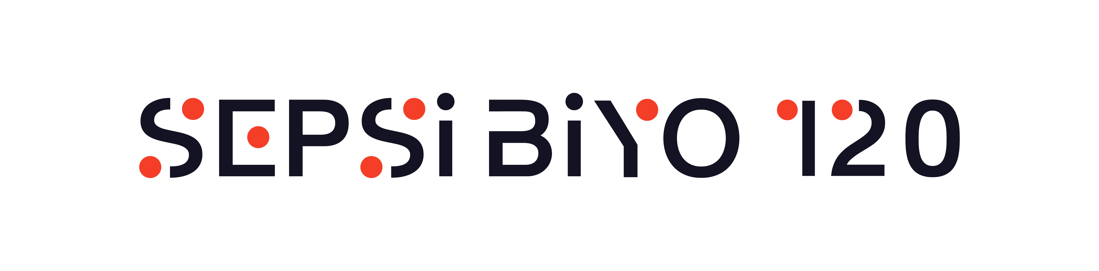
SEPSİBİYO 120 MODEL AUTOMATİC BLOOD CULTURE DEVICE
120 Bottle Capacity,
Colorometric study method,
Setting a specific incubation time for each bottle and changing this time during incubation,
Seamless integration (Managing four devices with a single computer),
Algorithm that reduces Blood Culture time to five days,
Real-time Growth Curve Chart,
Measurement every ten minutes with an independent sensor in each cell,
Turkish Menu,
Patient login with barkode Scanner,
Sound, Light, and colour Warning System,
Correct TAT ,
Bidirectional LIS connection,
Independent heat technology for each bottle,
Hosmed Grup Medikal Sağlık Hizmetleri Ltd.Şti.
Nasuh Akar Mah. 1404 Sok. No:3/ A Çankaya – ANKARA
Eposta: hosmedgrupqgmail.com
www.sepsibiyo.com

Slide 2
SEPSİBİYO BLOOD CULTURE BOTTLE FEATURES
Pediatric Bottle,
Sample quantity between 3ml-5 ml
Sample amount between 0.5 ml-3 ml
Minimum detection limit 5 CFU
Contains Factor X, Resin and SPS ( See the prospectuse for other content information).
Aerob Bottle,
Sample quantity between 3ml-5 ml
40 ml amount of liquid medium
Minimum detection limit 5 CFU
Contains Factor x,Factor V ,Resin and SPS (See the prospectuse for other content information).
Anaerob Bottle
Sample quantity between 3ml-5 ml
40 ml amount of liquid medium
Minimum detection limit 5 CFU
Contains Factor x, Factor V ,Resin and SPS (See the prospectuse for other content information).
Hosmed Grup Medikal Sağlık Hizmetleri Ltd.Şti.
Nasuh Akar Mah. 1404 Sok. No:3/ A Çankaya – ANKARA
Eposta: hosmedgrupqgmail.com
www.sepsibiyo.com

