Slide 1


PSYCHOSIS
Dr Dapo Olafimihan
Clinical Psychologist
Notes:
Covering what it is, history, treatment, considerations when working with someone who has this diagnosis

Slide 2
NEUROSIS PSYCHOSIS
Depression
Anxiety
OCD
Phobia
Notes:
Neurosis in MH services, research are categories as ‘common mental health disorders’
Note that personality disorders are treated/considered more on the severe end also, but don’t fit well into this frame.

Slide 3
PSYCHOSIS:
Defining features:
  Hallucinations (e.g. hearing voices)
  Delusions (bizarre)
  DSM-V adds - two or more of one of the following: disorganised speech (frequent derailment/incoherent), catatonia/grossly disorganised behaviour, negative symptoms (avolition, diminished emotional expression, self-neglect).
  Experiencing this “for a significant period of time during a 1-month period”
Notes:
Negative symptoms - reduce your baselines functioning in a way that’s unhelpful
Positive symptoms - elevates baseline function in a way that’s unhelpful

Slide 4
NEUROSIS PSYCHOSIS
Depression
Anxiety
OCD
Phobia
Schizophrenia
Schizoaffective disorder
Delusional disorder
Somatic Symptom Disorder
Post-partum Psychosis
Single episode psychosis
Substance-induced psychosis
Notes:
Post traumatic psychosis

Slide 5
ONSET & CAUSES
Onset typically, early adulthood 21-25 (males), 25-30 (females)18 – 35 - “young person’s illness”
Prevalence = 0.7% (2016)
Life expectancy = Average - 15 years
Trauma
  E.g, loss, neglect, childbirth, brain injury
Heritability - 50 - 80% (Hilker et al., 2018)
Autoimmune encephalitis
Drug use
  THC
Notes:
https://www.frontiersin.org/journals/genetics/articles/10.3389/fgene.2023.1163361/full

Slide 6
HALLUCINATIONS
Sensory experiences not confirmed in reality
  Auditory (e.g. voices)
  Olfactory
  Tactile
  Visual
  Gustatory
    “She tried to poison me...tastes like petrol”

Slide 7
DELUSIONS
Previously 4 main major types of delusions (note how many of these are spoken of in colloquial terms!)
Delusions of Grandeur
Persecutory Delusions (most common)
Erotomania
Somatic (Somatosensory)
Notes:
(Grandiose Delusions) -Beliefs of being the queen

Slide 8
BIT OF FUN..
With the person next to you, name as many films as you can that depict psychosis/schizophrenia

Slide 9
CRIMINALITY? VIOLENCE?
Link? Not necessarily.
Most with psychosis are not violent.
Hallucinations
  Threats
  Delusions
  Erotomania, Persecutory
Notes:
Whiting et al 2021 meta analysis -
24 individual studies of a modest increased risk of perpetration of violence in people with schizophrenia, but it provides the necessary context – that over a period of around four decades, this amounts to no more than 1 in 4 men and 1 in 10 women with schizophrenia for serious violent outcomes. (
“The meta-analysis included 24 studies of violence perpetration outcomes in 15 countries over 4 decades (N = 51 309 individuals with schizophrenia spectrum disorders; reported mean age of 21 to 54 years at follow-up; of those studies that reported outcomes separately by sex, there were 19 976 male individuals and 14 275 female individuals). There was an increase in risk of violence perpetration in men with schizophrenia and other psychoses (pooled odds ratio [OR], 4.5; 95% CI, 3.6-5.6) with substantial heterogeneity (I² = 85%; 95% CI, 77-91). The risk was also elevated in women (pooled OR, 10.2; 95% CI, 7.1-14.6), with substantial heterogeneity (I² = 66%; 95% CI, 31-83). Odds of perpetrating sexual offenses (OR, 5.1; 95% CI, 3.8-6.8) and homicide (OR, 17.7; 95% CI, 13.9-22.6) were also investigated. Three studies found increased relative risks of arson but data were not pooled for this analysis owing to heterogeneity of outcomes. Absolute risks of violence perpetration in register-based studies were less than 1 in 20 in women with schizophrenia spectrum disorders and less than 1 in 4 in men over a 35-year period.”
Can give a case example of a man who believed the Tamil Tigers were trying to recruit him.
- Running scared, tried opening random car doors to use as a getaway vehicle, threatened to hurt others who get close.
Culturally we have gotten used to talking about psychosis in this way, need always helpful.

Slide 10

Folie á deux
  Extremely rare, debated even (re-categorised in DSM-V), but there are some case examples of this.
Notes:
Pronounced - folly a durhh
AKA – Shared delusional disorder:
A delusional disorder shared by two or more people with close emotional links. Only one of the people suffers from a genuine psychotic disorder; the delusions are induced in the other(s) and usually disappear when the people are separated (ICD-10, DSM-IV)
Now re-categorised under DSM-V Section 298.9: Other specific schizophrenia spectrum and other psychotic disorder.
Under ICD-10 & ICD-11, this illness is diagnosed as an induced delusional disorder.

Slide 11





PSYCHOSIS: CULTURAL-HISTORICAL CONSIDERATIONS
‘Madness’
Divinity
Asylums
Racial disparities in the UK
Notes:
A 2012 study found that, in 41 movies studied, a majority of schizophrenic characters displayed violent behaviour toward others and themselves, and almost a third of those characters displayed homicidal tendencies.
Hearing voice - ‘voices from god’
Or this represents jinn or demons
Racial disparities:
- Rates of psychotic disorders, such as schizophrenia, can be as much as 5 times higher in some ethnic minority groups such as people of black Caribbean or African heritage in the UK. More likely to be treated medically that other groups. Something that older generations are quite aware of.

Slide 12
CULTURAL CONSIDERATIONS: SPIRITUALITY
Reflections in religious texts
Hearing from God?
Hearing from dead relatives?
Delusions of healing?
Notes:
Psychosis
Bible: Mark 5:1 onwards:
³ This man lived in the tombs, and no one could bind him anymore, not even with a chain. ⁴ For he had often been chained hand and foot, but he tore the chains apart and broke the irons on his feet. No one was strong enough to subdue him. ⁵ Night and day among the tombs and in the hills he would cry out and cut himself with stones.
⁶ When he saw Jesus from a distance, he ran and fell on his knees in front of him. ⁷ He shouted at the top of his voice, “What do you want with me, Jesus, Son of the Most High God? In God’s name don’t torture me!” ⁸ For Jesus had said to him, “Come out of this man, you impure spirit!”
⁹ Then Jesus asked him, “What is your name?”
“My name is Legion,” he replied, “for we are many.” ¹⁰ And he begged Jesus again and again not to send them out of the area.
Quran 2:275
(275) Those who consume interest will stand ˹on Judgment Day˺ like those driven to madness by Satan's touch. That is because they say, “Trade is no di...

Slide 13
TREATMENT IN UK MH SERVICES

Slide 14
HISTORY OF DIAGNOSIS & TREATMENT
Asylums
1808
Antipsychotics (France – 1952)
‘Care in the Community Policy’ (1980s/1990s)
CMHT & Secure services (shake up)
Notes:
Before the building of the Victorian asylums there was only one hospital for people with mental illness in the UK: the Bethlem.
County Asylums Act, 1808 - Victorian age on both sides of the Atlantic built large institutional asylums into which people with schizophrenia were confined often for many years and sometimes for life.
Faced with the seemingly intractable problem of an incurable condition that led to disturbed behaviour, in the 1930s the Nazi regime in Germany embarked on an ambitious programme to eradicate schizophrenia from the race by the use of euthanasia.
Asylums were shut down in 1980s/1990 (Thatcher’s government), the ‘Care in the Community’ policy. All were gone by 2015.
Antipsychotic medication: a new dawn
In the middle of the 20th century scientists developing new types of antihistamine drugs found that the new drugs were also effective in controlling the psychotic symptoms of schizophrenia. This was the first generation of the new antipsychotics or neuroleptic drugs called typical antipsychotics
1952 two French psychiatrists, Jean Delay and Paul Deniker tried prescribing chlorpromazine for schizophrenia and found that it had a calming effect on their patients that was significantly different from the effects of the tranquillisers that had been widely used before for this condition. Rather than simply blunting the effect of the hallucinations this drug did actually seem to reduce the symptoms altogether:
chlorpromazine, haloperidol and flupenthixol were not without their problems and tended to cause more problems with side effects than the more modern ones.
The early drugs had profound sedating effects and could cause tremors in the arms and legs similar to those caused by Parkinsons disease along with other physical side effects. These effects were known as extra-pyrimidal symptoms by psychiatrists. Fortunately the tremors responded well to some of the anti-Parkinsons drugs available at the time but the sedating effect had no easy remedy and led to a considerable reduction in the quality of life for many sufferers.
Previous treatment lacked effectiveness
The beneficial humanitarian effect of the antipsychotic drugs should not be underestimated. Before the introduction of these drugs in the UK about 70% of people with a diagnosis of schizophrenia were continuously confined in mental hospitals often for years at a time: today it is only about 5% and the average length of stay in hospital is measured in months

Slide 15
SERVICES
CMHT
Acute Ward
Forensic services:
Low & Medium Secure Services
High Secure Services (4 nationally)
Notes:
In high secure are the folks that there are films, books and news reports about:
- Ian Huntley
- Ronnie Kray (?)
-
Can be sectioned to hospital under the MHA 2003, to reside in hospital under the care of treatment team.
People can live their whole lives there. Not uncommon to meet patients who had been there for 20 years plus
10 years ago, push to move more people out of Broadmoor to Medium & Low secure

Slide 16
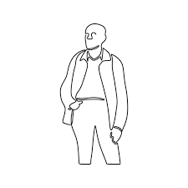
Case Example: David
Age 52
Schizophrenia (‘remitting & relapsing’)
Diagnosed in late 90s
Low Secure Unit, sectioned under MHA 37/41, hospital with crown court order
Significant Relationships
Treatment plan (key areas):
  OT
  Psychology
  Psychiatry
Notes:
Working with him for 18 months
When psychotic, experienced ‘flight of ideas’ with a grandiose delusional quality, ‘catatonia’ and hallucinations (hearing voices).
Had lived in mental health institutions on and off for 20s years. First experience involved being held down by police.
Medication worked to minimise psychotic symptoms (still there we thought, but in a minor way), but the side effects were dreadful – weight gain/hunger, sleep disruption, constipation .
CMHT were reluctant to consider alternatives, so he disengaged with treatment, he deteriorated, cycle repeats.
Eventually told that he would be given injection via depot delivery, slow releasing
He had committed a crime in hospital when he attacked a nurse and the nurse pressed charges, which led to his section being 3 to 37/41 due to concerns about public safety.
- Consider stigma, view of self (crazy, criminal, etc),
Likeable on the ward, but staff noticed he would be frustrated and sarcastic around ward-based rules that were poorly explained. Especially if it involved his girlfriend who he’d visit during leave.
- “Internal fight against being instituationalised”
Had an extensive knowledge of antipsychotic meds, skeptical of psychology
Clozapine treatment (once optimised) was life changing for him. Said he didn’t mind this on depot, reported side effects, but that they were more manageable. Engaged well with psychology and OT to think through his trauma and future life in the community.
Not untypical in many ways - Consider if working with folks who have felt like ‘guinea pigs’, seen significant changes in workplace attitudes wary of treatment, esp medication, wary of health care professionals, and carry stigma of madness, potential for violence and then what means for us.
He out and living life in the community, wanted to do some construction work.

Slide 17

TREATMENT
Often involves:
  OT
  SLT
  Medicine - Psychiatrist (typically, RC)
  Psychology
  Nursing
  Social Work
Notes:
Bio – Psychiatrist, SLT, OT
Psychology – Clin/Counselling Psych, Forensic Psych, High Intensity CBT,
Social – familial support, social workers,
Some overlap:
Psychology – psychiatrists, psycho, nursing
Bio – GP, SP
RCs can expanded to include other professions

Slide 18
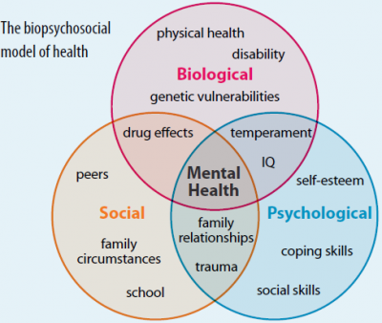

Slide 19
SOCIAL
Housing
Benefits
Meaningful activity
Employment/return to employment
Relationships (childcare, carer assessments)
Notes:
Greater risks of exploitation, violence, substance misuse in this community,
How do we need to consider in their social situation that minimises the likelihood of this happening?
Finding disability-friendly employers | Disability charity Scope UK
OT bit of a crossover between all of them

Slide 20
PSYCHOLOGICAL
CBT for Psychosis
Trauma work
Family Therapy
‘Hearing Voices’ groups
Notes:
CBT for psychosis is based on an understanding of how people make sense of their experiences and why some people become distressed by them.
- Building awareness of triggers,
- Making sense of delusions
Building insight – delusion work
Family therapy in psychosis
When someone is ‘floridly psychotic’, typically having someone’s medical input optimised helps FIRST

Slide 21
BIOLOGICAL
Antipsychotic medication (aka psychotropics)
Mood stabilisers (e.g. schizoaffective disorders)
Sleep
Diet
Physical Exercise
Notes:
Largely coming from a medical standpoint
GAME: Name as many as you can:
Antipsychotics
-
Mood stabilisers
-
Sleep medication
- Zopiclone

Slide 22
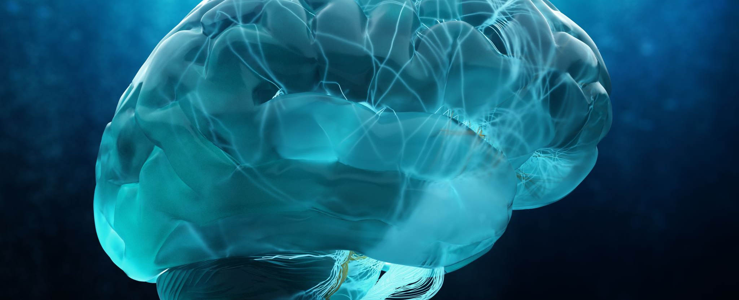
What are Antipsychotic meds are doing in the brain?

Slide 23
THE BIG PLAYERS
DOPAMINE
Trace amines
SEROTONIN
GPCPs
Histamine
Notes:
Evidence suggests that various mental illness are linked to neurotransmitter receptor signaling pathways
Pathways involving: dopamine, serotonin, GPCPs, trace amines and histamines

Slide 24
Serotonin | Dopamine
An inhibitory neurotransmitter | An excitatory neurotransmitter
Regulate Mood | Regulate Motivation
Associated with feelings of happiness, focus, and calm | Associated with feelings of rewards, motivation, and being productive
Contributes to sleep and digestion | Important for normal movement and balance
Deficiency is linked with sensitivity to pain, aggressiveness, anxiety, and depression. | Deficiency is linked with sensitivity to memory loss, low sex drive, poor digestion, and poor cognition.

Slide 25

DOPAMINERGIC
PATHWAY
Post-mortem brains of patients with schizophrenia reveal abnormally high levels of dopamine (plus uncreased metabolites and D2 receptors)
Amphetamines (MDMA, Meth) works on this pathway
Symptoms of psychosis diminish when stimulation in dopamine receptors reduce
Notes:
Post-mortem brains of patients with schizophrenia reveal abnormally high levels of dopamine (plus uncreased metabolites and D2 receptors) – in ventral striatum
Antidepressant medication works to increase availability of one of the neurotransmitters (monoamines. E.g. noradrenaline)
Be concerned when a patient with psychosis is on antipsychotics and using substances as well.

Slide 26
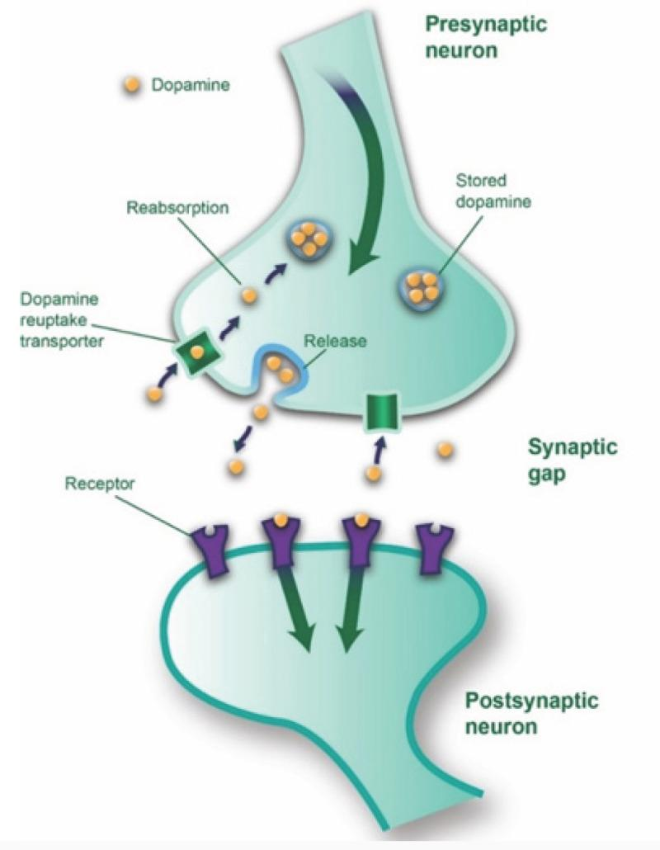
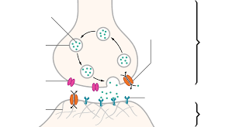
Notes:
Neurotransmitter pathway.
Interaction between two neurons passing one to the other – synapse is the gap in between
One gives, one receives.
Medications impact the amount of chemical being released, or impacts the amount being received.
Impacting on particular receptors (D1, D2, D3, D4)

Slide 27
GUESS THE MEDS?
Name as many antipsychotic meds as you can!
Notes:
Aripiprazole
Clozapine
Olanzapine
Chlorpromazine
Risperidone
Haloperidol – 1st gen
Fluphenazine
Promazine
Quetiapine
Droperidol
Penfluridol – 1st gen
Thioperamide
Promazine

Slide 28
GUESS THE MEDS?
Aripiprazole
Clozapine
Olanzapine
Chlorpromazine
Risperidone
Haloperidol
Fluphenazine
Promazine
Quetiapine
Droperidol
Penfluridol
Thioperamide
Promazine
Notes:
Aripiprazole
Clozapine
Olanzapine
Chlorpromazine
Risperidone
Haloperidol – 1st gen
Fluphenazine
Promazine
Quetiapine
Droperidol
Penfluridol – 1st gen
Thioperamide
Promazine

Slide 29
POTENTIAL SIDE EFFECTS
Myocarditis
Weight gain
Disrupted BP
Erectile Dysfunction
Reduced cognitive ability
Constipation
Low or high blood pressure
Fast heartbeat
Fever
Dizziness or fainting
Headache
Drowsiness or sedation
Notes:
So we want to get this right!
Get it wrong, greater risk of disengagement

Slide 30
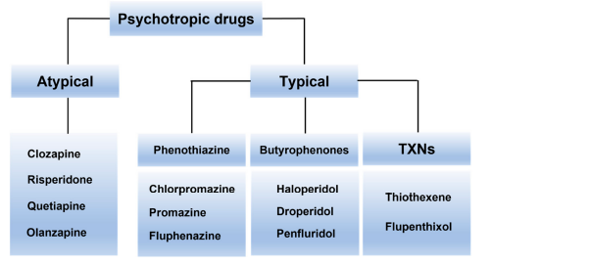
Notes:
Atypical drugs (aka new generation) appear to more commonly used. As effective as the 1st gen, but with less side effects. Including: ziprasidone, paliperidone, and aripiprazole
Typically all working on dopaminergic pathway
Clozapine is considered a drug for ‘treatment resistant’ psychosis
- Requires a higher clinical demand as greater monitoring is required, including regular blood tests are required as it can reduce the number of white blood cells in your body.

Slide 31
‘TREATMENT-RESISTANT PSYCHOSIS’

Slide 32
Notes:
Atypical drugs (aka new generation) appear to more commonly used. As effective as the 1st gen, but with less side effects. Including: ziprasidone, paliperidone, and aripiprazole
Typically all working on dopaminergic pathway
Clozapine is considered a drug for ‘treatment resistant’ psychosis
- Requires a higher clinical demand as greater monitoring is required, including regular blood tests are required as it can reduce the number of white blood cells in your body.

Slide 33
PATIENT DISCUSSION & MEDICAL REVIEWS
Questions to ask:
Times of day when patient is most alert & able to engage
Medical review: might include changes to the type, administration, timing
Medication administration - Depot medication vs oral (self-administered), etc
Changes in the times of day.

Slide 34
PATIENT DISCUSSION & MEDICAL REVIEWS
It’s perfectly reasonable to request a medical review asking that the patient wants to engage better in the morning for work/structured activity. So, could the drowsy meds be taken at night instead/late afternoon?
Where possible, health teams would consider this. Can include this in care plans if they know what a patient’s goals might be.

Slide 35
PSYCHOSIS IN NEURO SERVICES

Slide 36
PSYCHOSIS FOLLOWING TBI
Aka Posttraumatic psychosis
1 in 20
Some – early, MOST – later
Early signs before psychotic symptoms emerge:
  affective instability, bizarre behaviour, performance decline at school or work, social withdrawal, and antisocial behavior
Typically:
  Delusional Disorder Or Schizphrenic symptoms
Notes:
Some debate in large studies, some reports 2 – 3x higher psychosis in tbi compared to gen pop, or 60% increase post TBI. Others do not report high amounts of psychosis in tbi patients compared to gen pop, when controlled for substance misuse disorders
In practice, the sometimes-long latency between TBI and the subsequent development of psychosis makes the required temporal association for the diagnosis of psychosis due to TBI difficult to establish.
There are tricky confounders with this: the large latency period, using family hx psych disorder as inclusion criterion, bidirectional relationships.
In fact, posttraumatic psychosis demonstrates a bimodal latency period, with a relative minority of patients developing hallucinations and delusions symptoms in the early period after TBI and a larger subset first developing such symptoms years-sometimes decades-after injury, with the mean onset of psychosis after TBI being four to five years.
Delusional disorder occurs about twice as often as schizophrenia-like psychosis, tends to occur late, and often features misidentification themes
Less common prodromal symptoms include: formal though disorder, avolition and affective flattening
Left hemisphere-particularly left temporal-injuries are more commonly associated with the schizophrenia-like psychosis form of posttraumatic psychosis; right-sided injuries are more frequently associated with its delusional disorder form. A history of another pre-TBI neurologic disorder may also increase the risk of posttraumatic psychosis.
MRI and CT scans typically show abnormality in the temporal and frontal regions. Abnormal EEG in 70 – 87% of cases. Focal temporal or frontal slowing is most common

Slide 37

COMPLEX RELATIONSHIP
Notes:
Relationship between TBI and psychosis is complex and appears to be influenced strongly by patient-specific factors. Some debate in large studies, some reports 2 – 3x higher psychosis in tbi compared to gen pop, or 60% increase post TBI. Others do not report high amounts of psychosis in tbi patients compared to gen pop, when controlled for substance misuse disorders
In practice, the sometimes-long latency between TBI and the subsequent development of psychosis makes the required temporal association for the diagnosis of psychosis due to TBI difficult to establish.
There are tricky confounders with this: the large latency period, using family hx psych disorder as inclusion criterion, bidirectional relationships, genetics.
Re. genetics:
In some cases, TBI may act as a stressor in a stress-diathesis model of schizophrenia, interacting with underlying genetic susceptibility to produce psychosis. Studies on family history of schizophrenia as a risk factor for psychosis after TBI support this model.
For example, childhood head trauma, which occurs more frequently in schizophrenic patients than in depressive, bipolar, and non-psychiatric controls could be interpreted as a marker of impaired caretaking, with schizophrenic patients placed at higher risk of early TBI merely by virtue of being offspring of parents with schizophrenia

Slide 38
COMPLEX RELATIONSHIP
So.. Assessment should include a comprehensive history of
pre-injury risk factors
Notes:
neurodevelopmental and psychiatric history, substance use disorders, and family history of psychosis.
Careful probing of the weeks and months prior to TBI

Slide 39
Encephalitis

Slide 40
LEWY BODY DEMENTIA
2nd most common
Three common presentations, where all three eventually develop
  Movement disorder
  Cog/memory
  Neuropsych – hallucinations, behavioural, reduction in cog fx (planning,
Atypical antipsychotics are encouraged – Quetiapine & Clozapine
Significant side effects highlighted to treating teams/ RCs
Notes:
The disease burden associated with psychosis in LBD patients is significantly higher compared to other types of dementia or even to LBD without psychosis.
Some individuals will start out with a movement disorder leading to the diagnosis of Parkinson’s disease and later develop dementia. This is diagnosed as Parkinson’s disease dementia.
Another group of individuals will start out with a cognitive/memory disorder that may be mistaken for AD, but over time two or more distinctive features become apparent, leading to the diagnosis of ‘dementia with Lewy bodies’ (DLB).
Lastly, a small group will first present with neuropsychiatric symptoms, which can include hallucinations, behavioral problems, and difficulty with complex mental activities, also leading to an initial diagnosis of DLB.
If addition of pharmacological agents is required, consideration should be given to acetylcholinesterase inhibitors, pimavanserin Effective care management processes should include consideration of de-prescribing any offending agents including anticholinergics and dopaminergic agents, followed by nonpharmacological and low risk pharmacological approach
Atypical antipsychotics such as quetiapine or clozapine ought to be considered
Side effects of these medications should be considered prior to selection and initiation of a medication regimen.

Slide 41
LEWY BODY DEMENTIA
Treatment
- Atypical antipsychotics are encouraged – Quetiapine & Clozapine
Significant side effects highlighted to treating teams
Notes:
he most common symptoms of LBD include: Impaired thinking, such as loss of executive function (planning, processing information), memory, or the ability to understand visual information
Fluctuations in cognition, attention, or alertness
Problems with movement, including tremors, stiffness, slowness, and difficulty walking
Visual hallucinations (seeing things that are not present)
Sleep disorders, such as acting out one’s dreams while asleep
Behavioral and mood symptoms, including depression, apathy, anxiety, agitation, delusions, or paranoia
Changes in autonomic body functions, such as blood pressure control, temperature regulation, and bladder and bowel function
Cholinesterase inhibitors are sometimes effective in treating hallucinations and other psychiatric symptoms of LBD. In addition, newer ‘atypical’ antipsychotic medications may be tried. Most LBD experts prefer quetiapine or clozapine when treatment is necessary for safety or quality of life concerns.
While older ‘traditional’ antipsychotic medications such as thorazine and haloperidol are commonly prescribed for Alzheimer’s patients with disruptive behavior, these medications may cause severe side effects in those with LBD. For this reason, older traditional antipsychotic medications like haloperidol should be avoided.
WARNING Up to 50% of LBD patients treated with any antipsychotic medication may have a severe reaction, such as worsening confusion, heavy sedation, and increased or possibly irreversible parkinsonism. If severe fever or muscle rigidity occurs, contact your doctor immediately; you may have a potentially life-threatening condition that is treated by stopping the medication.

