Slide 1
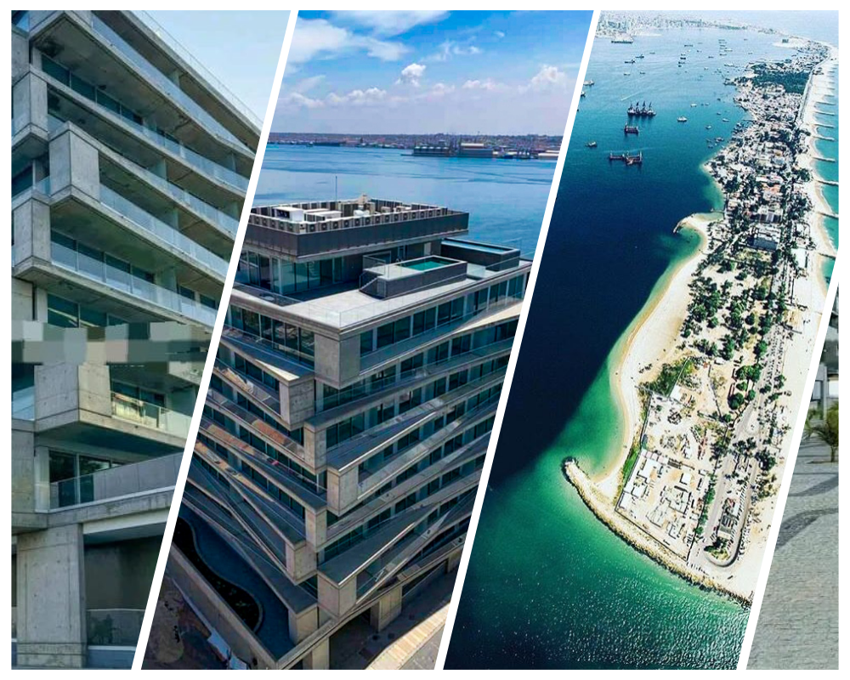
Luxusimmobilien in Luanda Bay
Nelson João Dikíla
Continental Capital Connect

Slide 2
Contents
Luxurious Residential Building
Amenities
01
02
Property Details
Exclusive Investment Opportunity
03
04

Slide 3
Luxurious Residential Building

Slide 4
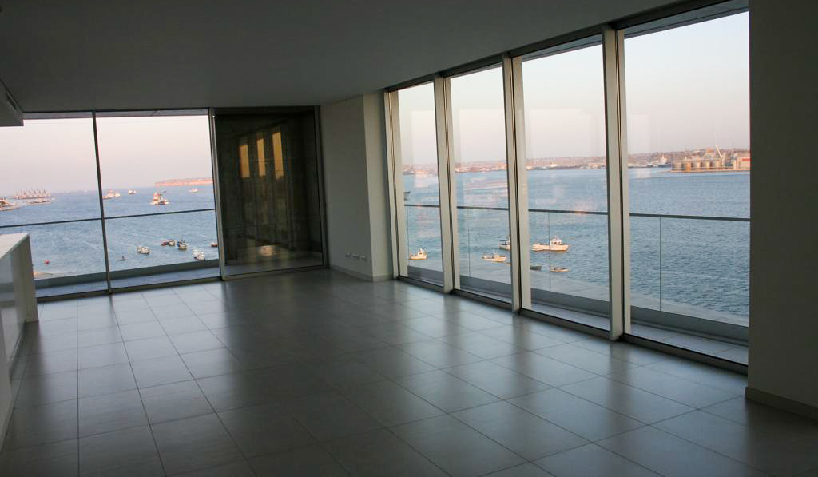
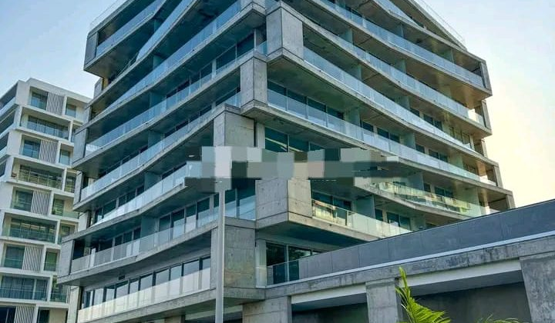
Apartments and Penthouse Suites
Spacious Layouts
High-End Finishes
Panoramic Views
Ranging from 1-bedroom to 4-bedroom units.
51 apartamentos: T1, T2 e T3 com varandas espaçosas e vistas maravilhosas.
3 suites penthouse: Cada uma com piscina privada e mobiliário exclusivo.
Featuring premium materials and modern design.
7 andares com arquitetura moderna.
Fornecimento de energia: Dois geradores garantem eletricidade contínua.
Abastecimento de água: Infraestrutura autossuficiente e fiável.
Overlooking the stunning Luanda Bay coastline.
infra-estruturas completas e comodidades de primeira classe.

Slide 5
Building Infrastructure
01
High-end Amenities
02
Sustainable Design
03
Convenient Location
Includes state-of-the-art fitness center, swimming pool, and concierge services.
Utilizes renewable energy sources and eco-friendly construction materials.
Close proximity to shopping, dining, and transportation hubs.

Slide 6
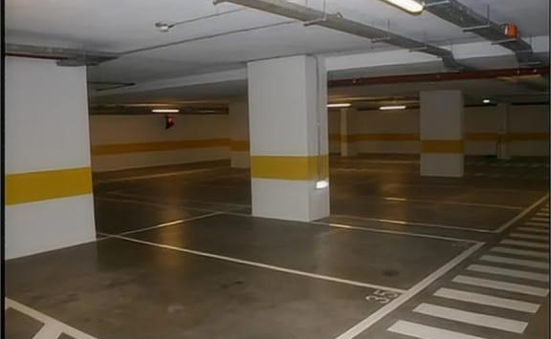
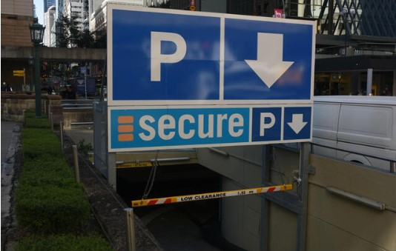
Parking Facilities
01
02
03
Ample Parking Spaces
Secure Parking
Visitor Parking
Spacious underground parking with designated spots for residents.
24/7 surveillance and controlled access for parking area.
Dedicated visitor parking to accommodate guests.

Slide 7
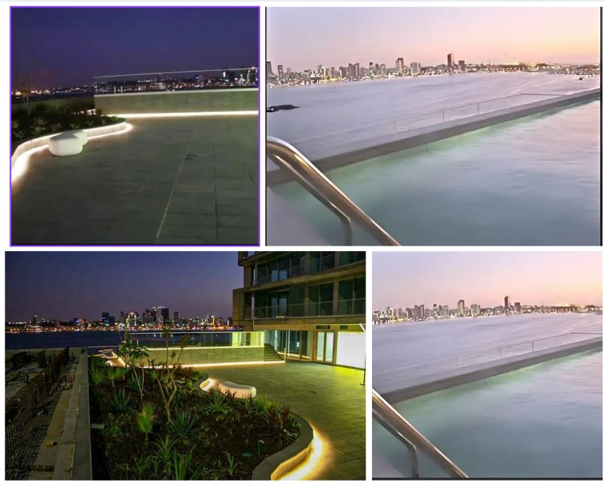
Amenities

Slide 8
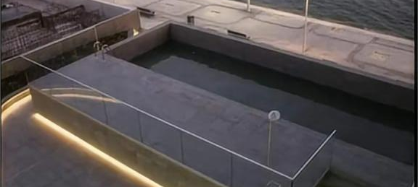
Swimming Pools
Infinity Pools
Lap Pools
Children's Pools
Stunning ocean-view infinity pools for luxurious relaxation.
Lap pools for fitness enthusiasts to maintain their routine.
Dedicated children's pools for family-friendly enjoyment.

Slide 9
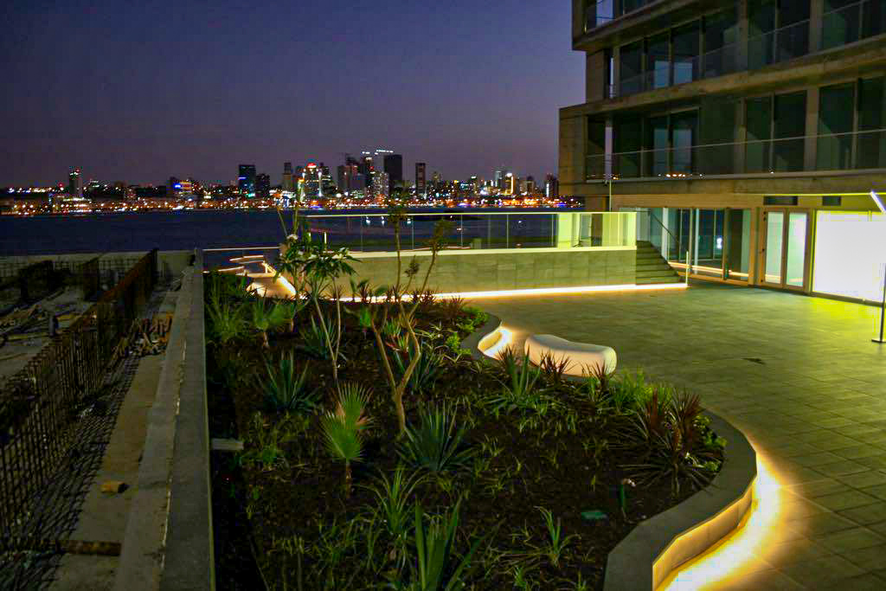
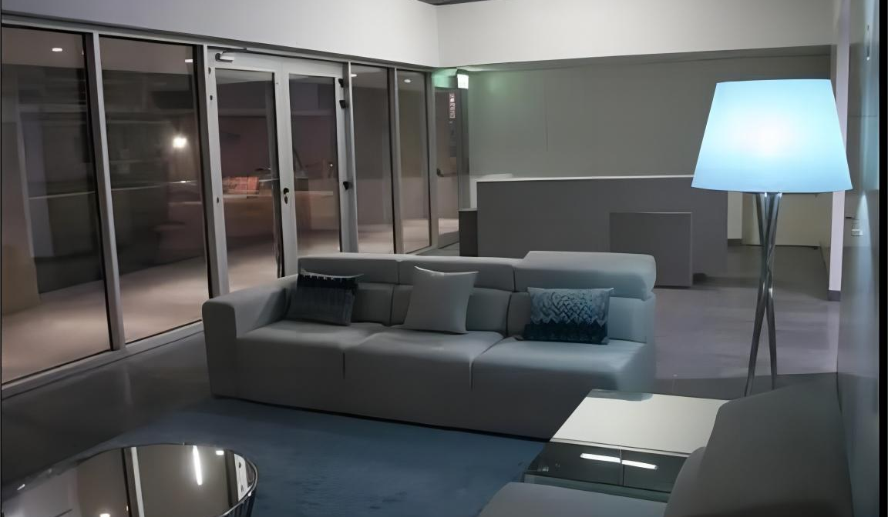
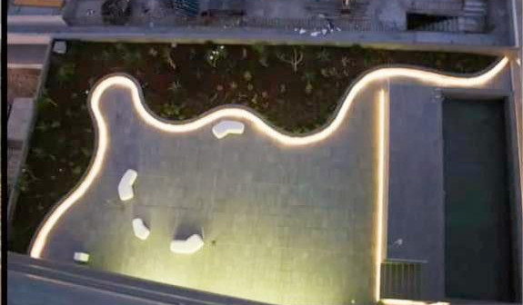
SPA & Fitness Center
Relaxing Spa Treatments
State-of-the-Art Fitness Facilities
Yoga and Meditation Studios
Indulge in soothing massages and rejuvenating facials.
Fully-equipped gym with the latest exercise equipment.
Peaceful spaces for mindfulness and wellness practices.

Slide 10
Lounge Area
Elegant Furnishings
Plush seating and sophisticated decor create a refined ambiance.
Panoramic Views
Floor-to-ceiling windows offer breathtaking vistas of Luanda Bay.
Exclusive Access
Residents-only lounge area provides a private, tranquil retreat.

Slide 11
Property Details

Slide 12
Total Area
1,200 sq. meters
The property offers a spacious total area of 1,200 square meters, providing ample space for luxurious living.
Expansive Grounds
The property sits on expansive grounds, offering privacy and room for outdoor amenities.

Slide 13
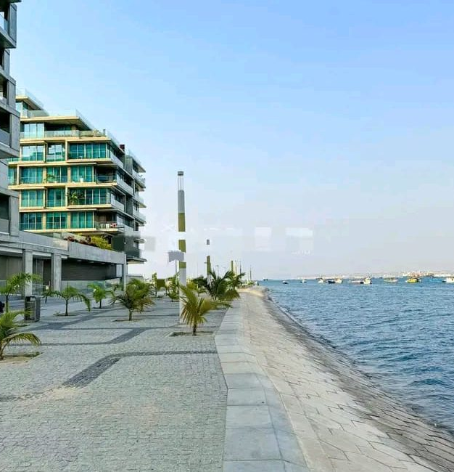
Total Area
Flexible Layout
The flexible layout allows for customization to suit the owner's preferences and lifestyle.

Slide 14
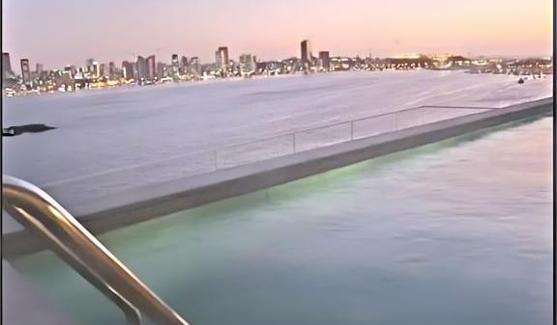
Purchase Price
Exclusive Waterfront Residences
Premium Amenities
Flexible Financing Options
Luxurious properties with breathtaking ocean views in Luanda Bay.
9,155 m² of total area
Gated community with world-class facilities and services.
Customized payment plans to suit your investment needs.
Purchase price: 180,000,000 USD.

Slide 15
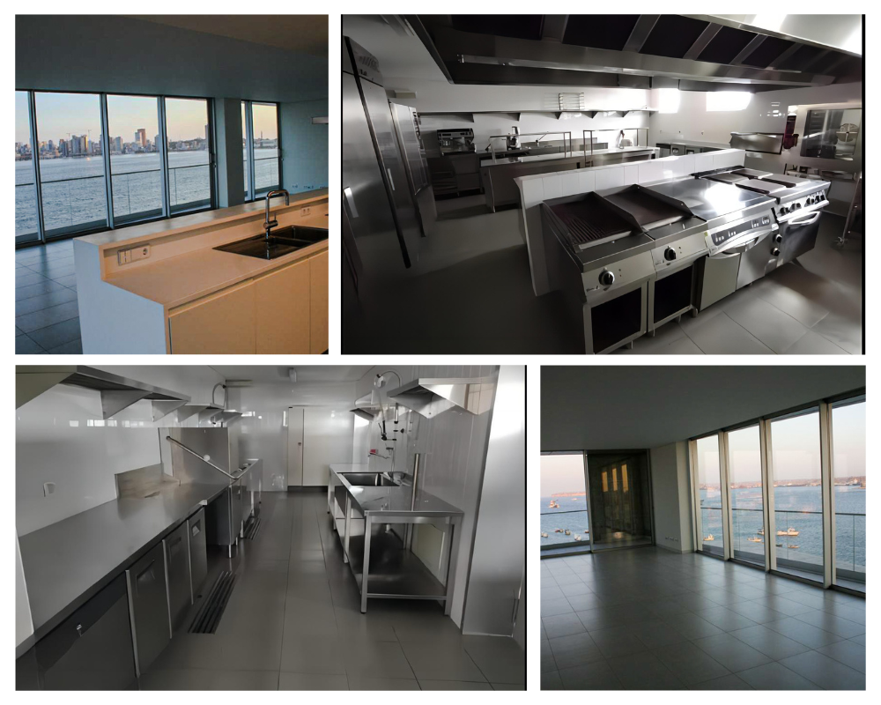
Exclusive Investment Opportunity

Slide 16
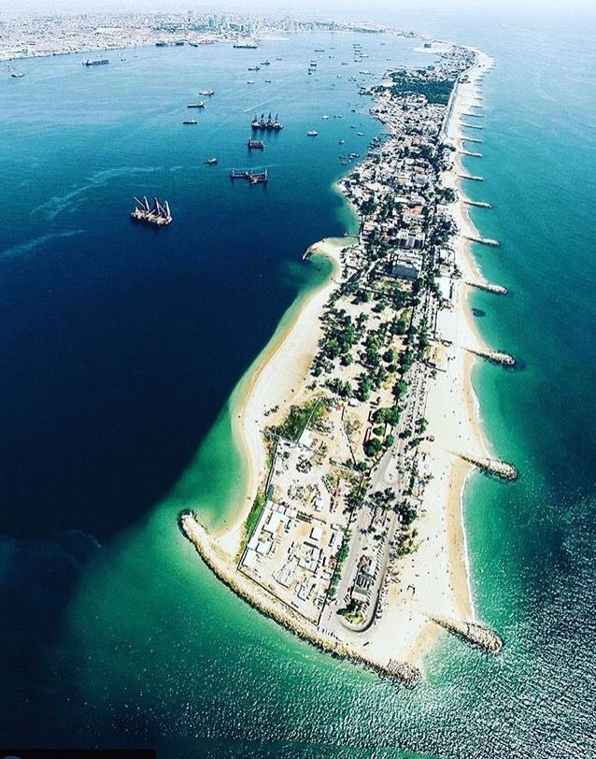
Unparalleled Location
Prime Waterfront
Situated in the heart of Luanda Bay, offering stunning ocean views.
Upscale Amenities
Luxurious facilities including private beach, marina, and world-class dining.
Emerging Market
Luanda's rapidly growing economy presents a unique investment opportunity.

Slide 17
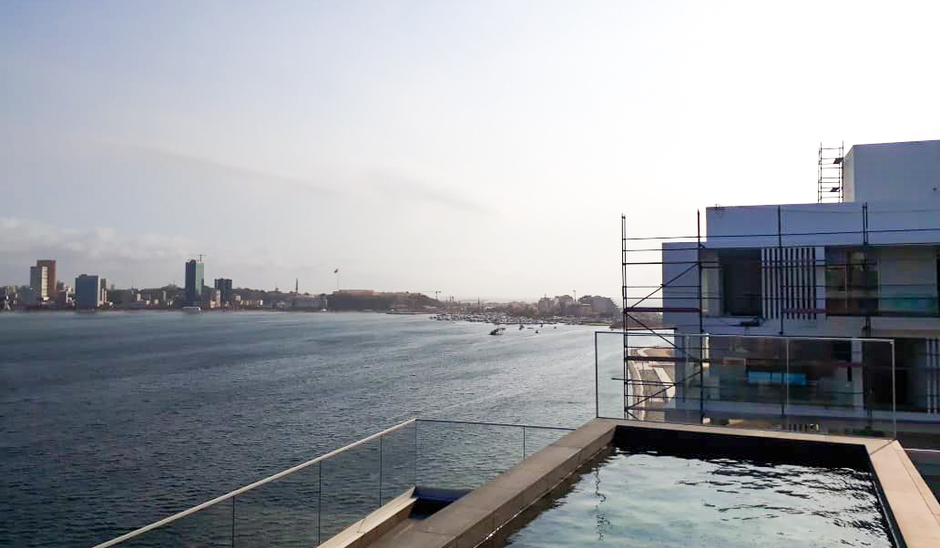
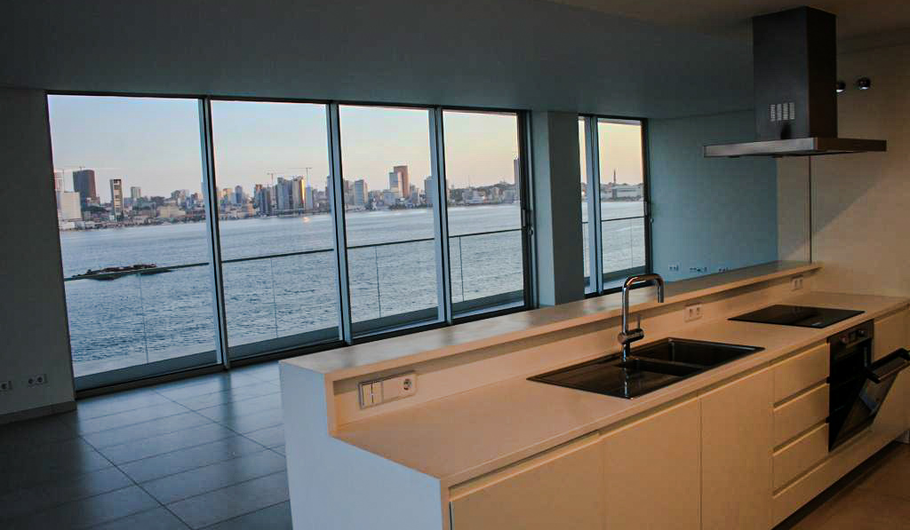
Luxury Living
Exquisite Waterfront Residences
Unparalleled Amenities
Prime Location
Elegant high-end apartments with stunning ocean views.
Comprehensive on-site facilities for a premium lifestyle.
Situated in the heart of Luanda Bay's prestigious district.

Slide 18
Contact Us
Luxury Properties
Explore our exclusive collection of high-end real estate in Luanda Bay.
Personalized Consultation
Speak with our experts to find your dream property.
Secure Investment
Invest in the thriving Luanda Bay real estate market.

Slide 19
Thank You
Get in touch and book your visit:Nelson João DikílaProject and Relationship ManagerContinental Capital ConnectPhone: [+244 926 018 253]Email: [joao.dikila@continentalcapitalconnect.com]Don't miss out on this unique investment opportunity!
Continental Capital Connnect

