Slide 1
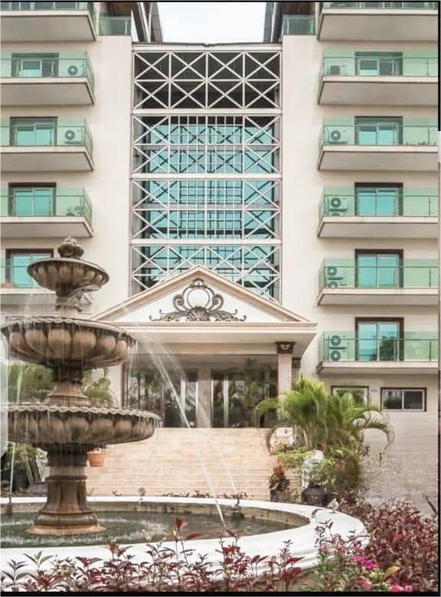
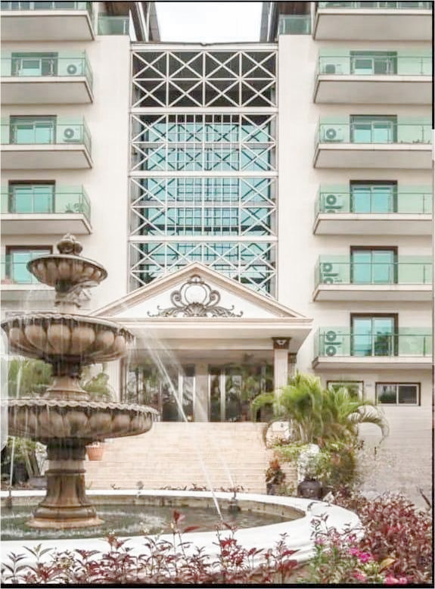
FOR SALE – Blue Wind Building
Nelson João Dikíla

Slide 2
Contents
01
Property Overview
02
Location and Surroundings
03
Benefits for Investors
04
Pricing and Contact
05
Conclusion

Slide 3
Property Overview
01

Slide 4
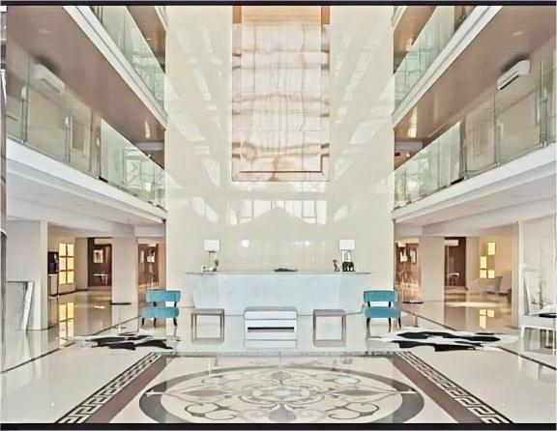
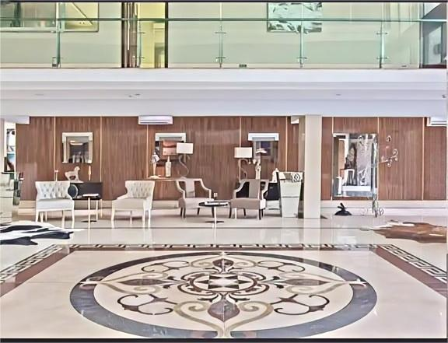
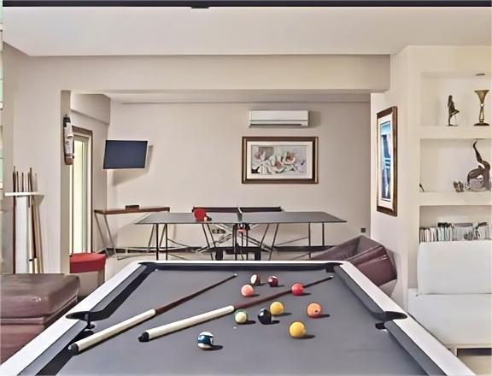
Apartments
Spacious Units
Ranging from 1-3 bedrooms with ample living space.
Modern Amenities
Fully equipped kitchens, in-unit laundry, and balconies.
Convenient Location
Close to public transportation and local attractions.

Slide 5
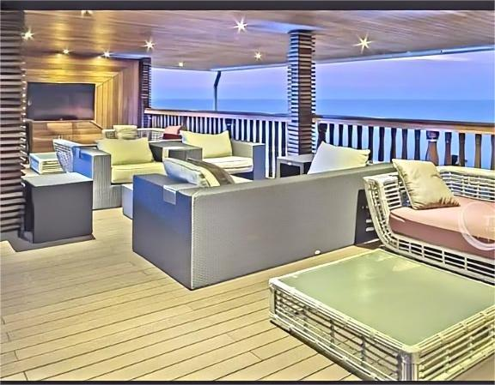
Rooftop Leisure Area
Panoramic Views
Outdoor Lounge
Rooftop Garden
Enjoy sweeping vistas of the city skyline.
Relax in the open-air seating area.
Lush greenery and tranquil ambiance.

Slide 6
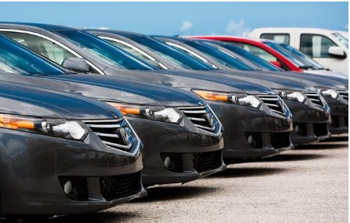
Parking
Ample Parking Spaces
The property offers ample parking spaces to accommodate tenants and visitors.
Covered Parking
The building features a covered parking area to protect vehicles from the elements.
Title
Secure Parking
The parking facilities are well-lit and secured for the safety of all users.

Slide 7
Location and Surroundings
02

Slide 8
Exclusive Location
Prime Neighborhood
Situated in a prestigious commercial district.
Convenient Accessibility
Close proximity to major transportation hubs.
Thriving Business Environment
Surrounded by established companies and startups.

Slide 9
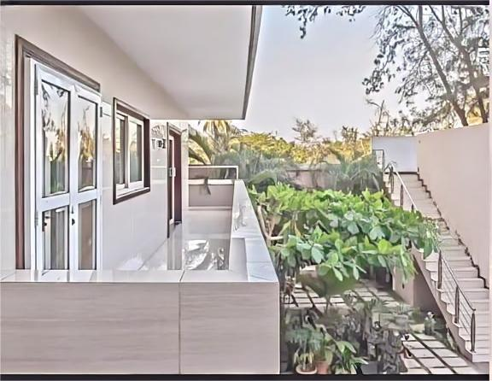
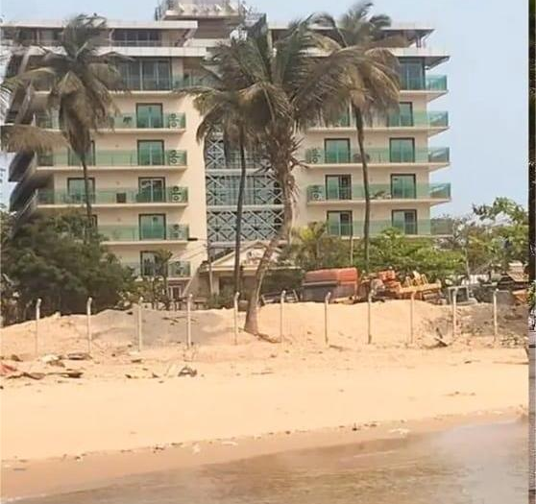
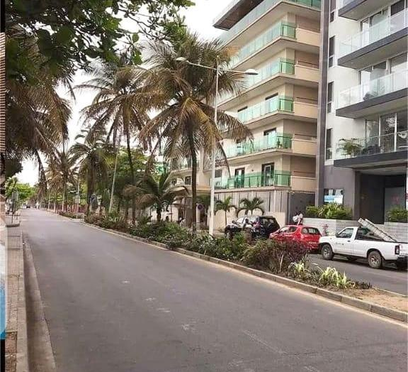
Surrounding Area
Prime Location
Vibrant Neighborhood
Excellent Connectivity

Slide 10
Benefits for Investors
03

Slide 11
Premium Location
Centralized Accessibility
  Convenient access to major transportation hubs.
Prestigious Neighborhood
  Surrounded by high-end residential and commercial developments.
Potential for Appreciation
  Desirable location likely to see increased property values over time.

Slide 12
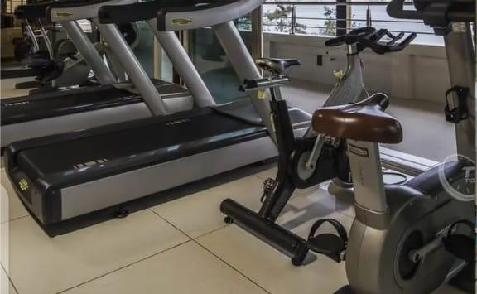
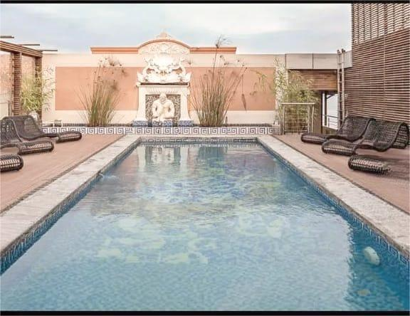
Luxury Leisure Facilities
01
02
03
Spacious Amenities
Exclusive Clubhouse
Outdoor Recreation
Expansive fitness center and spa for relaxation.
Private clubhouse with dining and entertainment options.
Landscaped gardens and jogging trails for leisure.

Slide 13
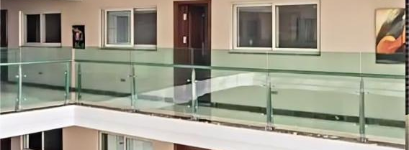
Variety of Apartments
01
Spacious Layouts
02
Flexible Floorplans
03
Premium Finishes
Ranging from studios to 3-bedrooms to accommodate diverse needs.
Customizable designs to suit individual preferences and lifestyles.
High-quality materials and modern appliances for a luxurious living experience.

Slide 14
Pricing and Contact
04

Slide 15

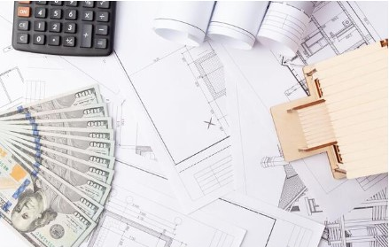
Price
$80 Million
Negotiable
Includes Parking
The Blue Wind Building is listed for sale at $80 million.
The price is negotiable based on market conditions and buyer interest.
The sale price includes a private parking lot with 20 spaces.

Slide 16

Contact Information
Prime Location
Flexible Lease Terms
Experienced Property Management
Situated in the heart of the city.
Customizable to meet your business needs.
Dedicated team to assist with inquiries.

Slide 17
Conclusion
05

Slide 18


Seize the Opportunity
Ideal Investment
Positive Outlook
Timely Decision
Attractive location and modern design make this an excellent investment opportunity.
Strong market demand and growth potential suggest a promising future for this property.
Act now to secure this valuable asset before it is gone.

Slide 19

Thank You
Nelson João Dikíla
Projects and Relationship Manager
Continental Capital Connect
Phone: +244 926 018 253
Email:joao.dikila@continentalcapitalconnect.com
Continental Capital Connect

