Slide 1
6000 hectare farm
In Icolo and Bengo
Nelson João Dikíla

Slide 2
Contents
Location
Animals
Infrastructure
01
02
03
Slaughterhouse
Equipment
Renewable energies
04
05
06

Slide 3
Location
01

Slide 4
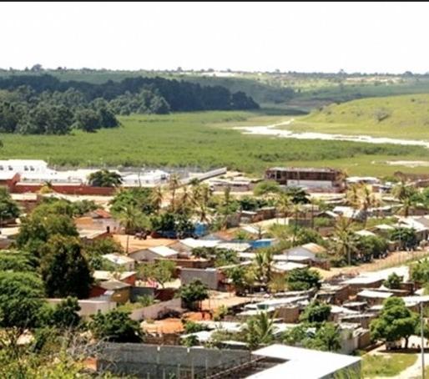
Cassoneca Commune, Ícolo e Bengo Municipality, Luanda
01
Strategic location
The farm is located in Cassoneca Commune, Ícolo e Bengo Municipality, Luanda, providing easy access to transport and resources.
02
Fertile land
The region is known for its rich, arable soil, which makes it an ideal location for large-scale agricultural operations.

Slide 5
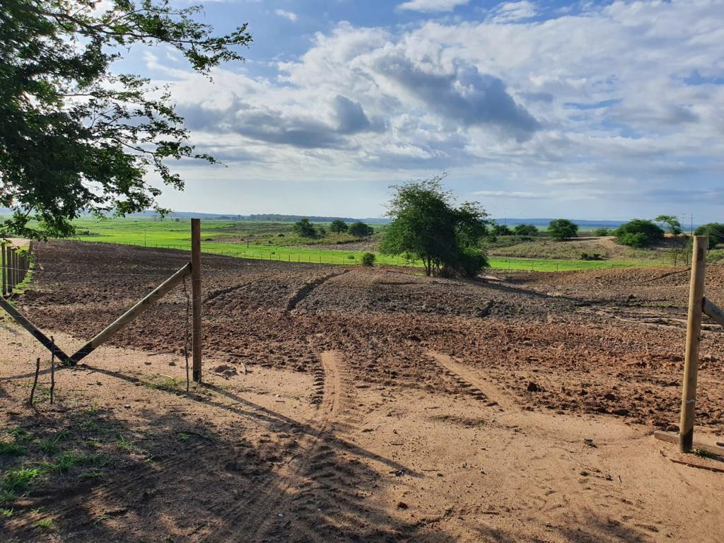
Cassoneca Commune, Ícolo e Bengo Municipality, Luanda
Proximity to infrastructures
The farm is close to the main roads, railways and ports, which facilitates efficient distribution and logistics.

Slide 6
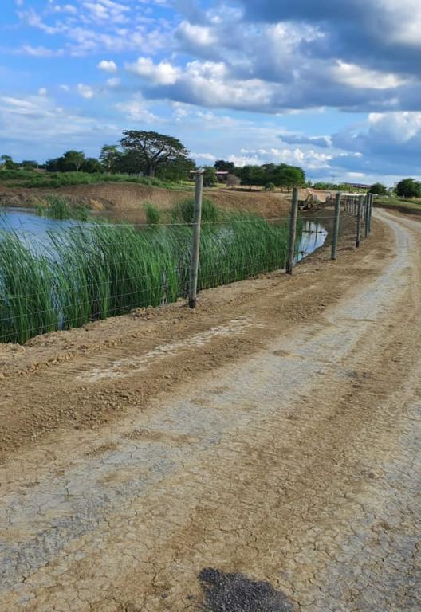
Structured area on the edge of 2000 hectares
01
Strategic location
The farm is located in a strategic area with access to natural resources and infrastructure.
02
Favourable topography
The farm's terrain is flat, making it easy to carry out agricultural activities.

Slide 7
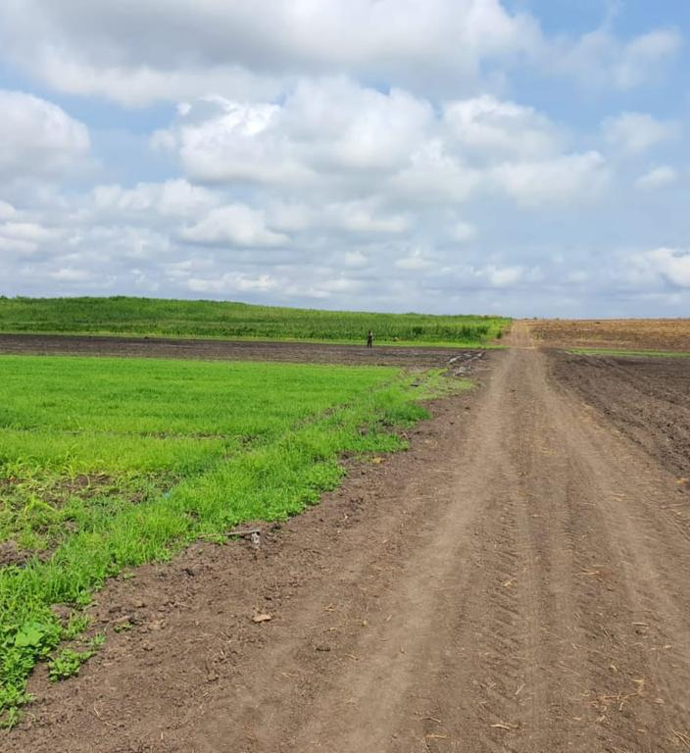
Structured area on the edge of 2000 hectares
Proximity to motorways
The farm is close to major motorways, making it easy to transport production.

Slide 8
Animals
02

Slide 9
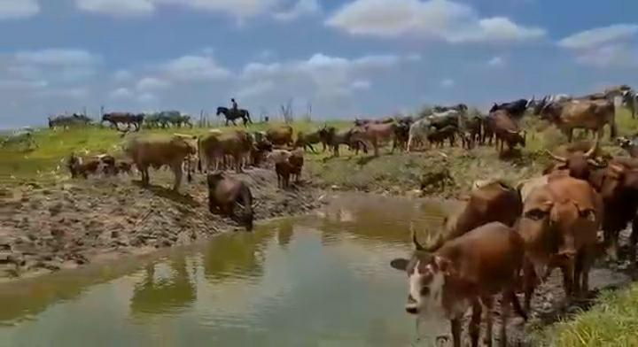
210 Cattle
Different breeds
Pasture management
Herd health
A variety of cattle breeds raised for meat and milk production.
Efficient rotational grazing to maximise pasture use.
Complete veterinary care and vaccination programme for livestock.

Slide 10
200 Goats
Various breeds
The farm is home to a variety of goat breeds for milk and meat production.
Pasture management
Rotational grazing optimises forage utilisation and animal health.
Breeding programme
Selective breeding improves desirable traits such as high milk production and disease resistance.

Slide 11
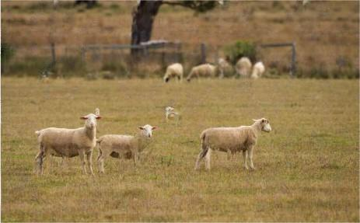
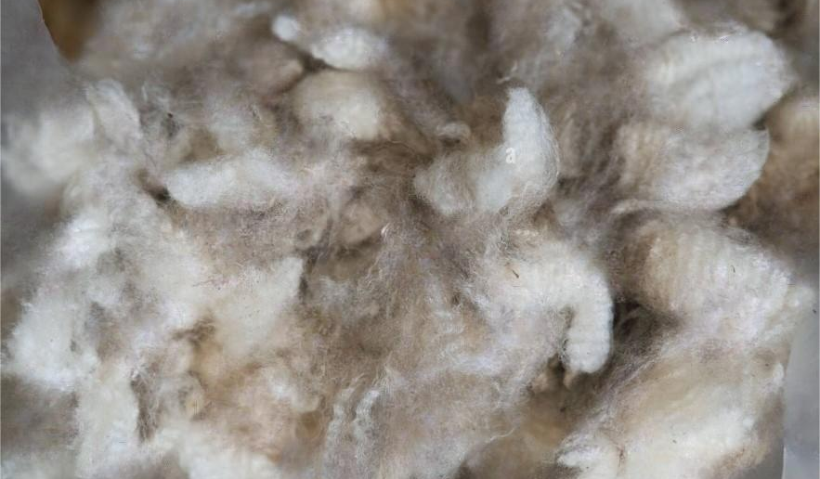
100 Sheep
Thriving flock
Wool production
Creation programme
The farm's 100 sheep graze peacefully on the extensive 6000 hectare estate.
The sheep provide a constant supply of high-quality wool for the farm's operations.
A selective breeding programme ensures the continued health and productivity of the sheep flock.

Slide 12
Infrastructure
03

Slide 13
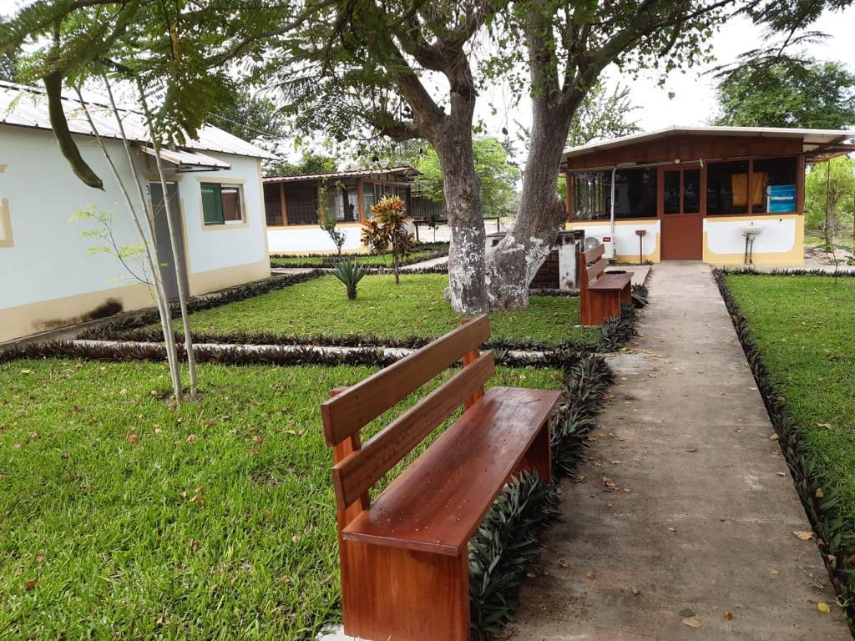
2 bedroom villa (en-suite)
01
Comfortable living
02
Efficient layout
03
Extensive amenities
Two-bedroom suites with modern facilities for staff accommodation.
Optimised floor plans to maximise space and functionality.
Equipped with essential facilities to support daily operations.

Slide 14
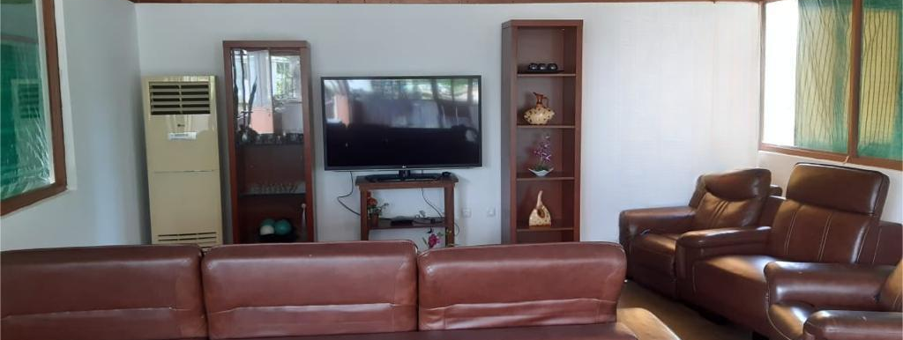
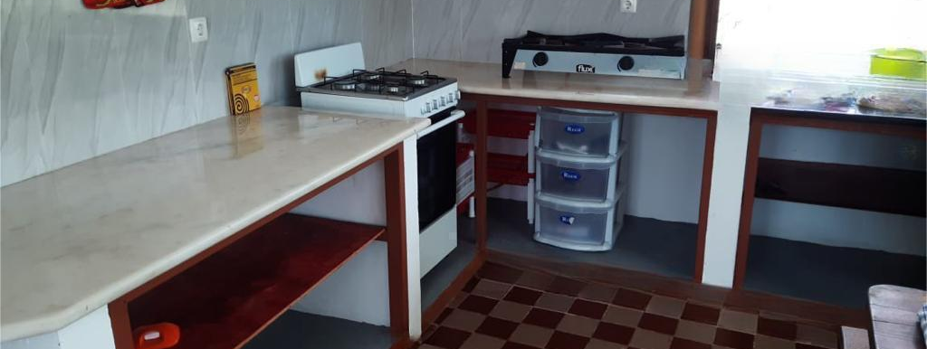
4 Housing for employees
Comfortable houses
Leisure areas
Modern, well-equipped houses for the farm's employees.
Recreation and socialising areas for employees and their families.

Slide 15
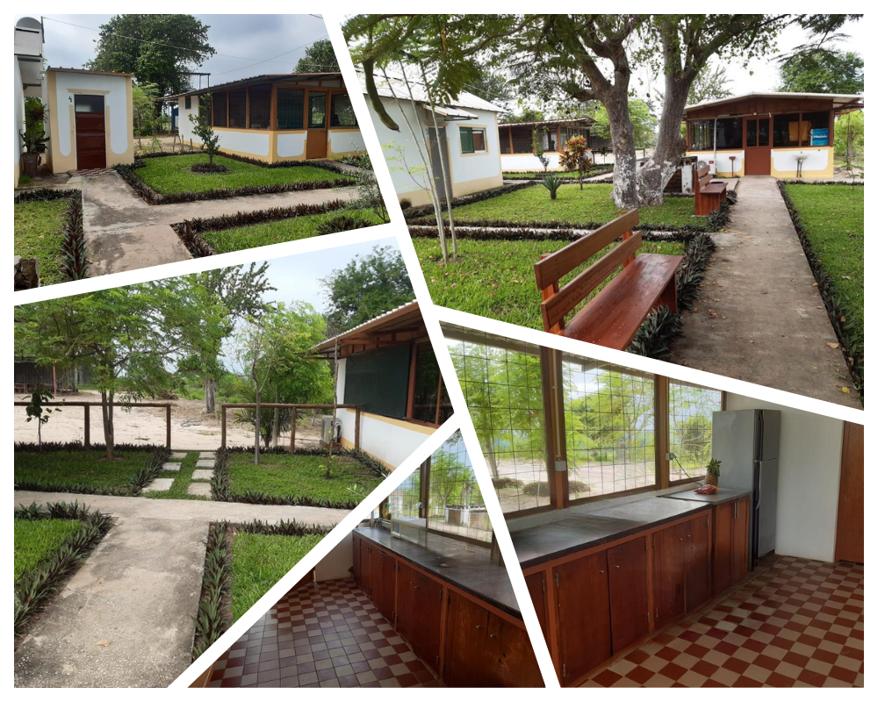
4 Housing for employees
01
Basic services
Access to essential services such as water, energy and sanitation.
02
Security
Security system to protect employees and their families.

Slide 16
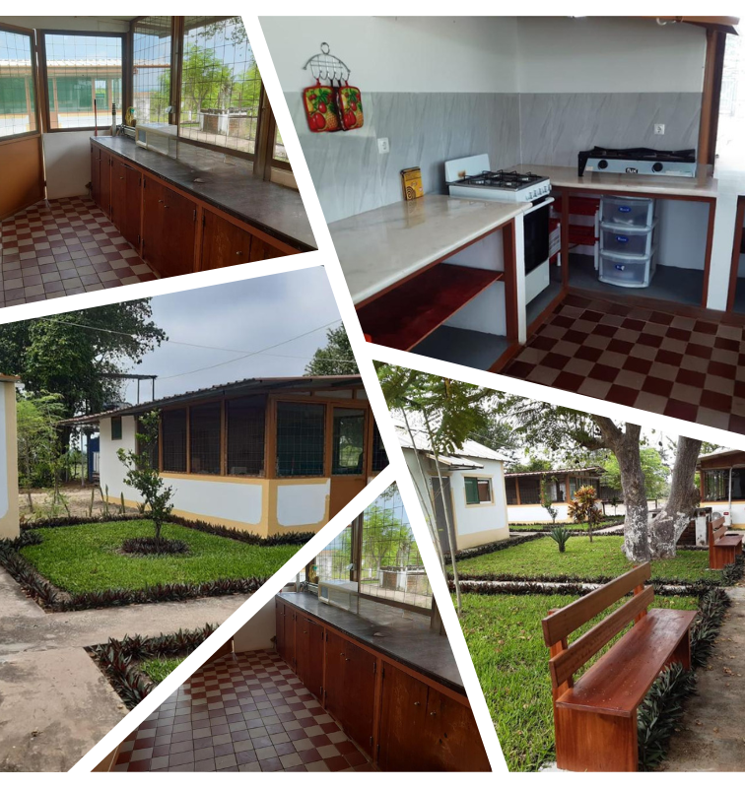
1 House including a pharmacy for animal care
Living facilities
01
Accommodation for farm staff, including a pharmacy for veterinary care of the animals.
Health infrastructure
02
Medical and pharmaceutical facilities for workers and farm animals.

Slide 17
1 House including a pharmacy for animal care
Support resources
Support services, such as water, energy and sanitation, to ensure the operation of the farm.

Slide 18
Slaughterhouse
04

Slide 19
Slaughterhouse with meat preservation room with all slaughtering materials
Slaughter equipment
Modern and efficient slaughtering equipment to guarantee the quality of the meat.
Quality Control
Strict quality control at every stage of the slaughter process.
Adequate Facilities
Facilities designed to meet the highest standards of safety and hygiene.

Slide 20
Equipment
05

Slide 21
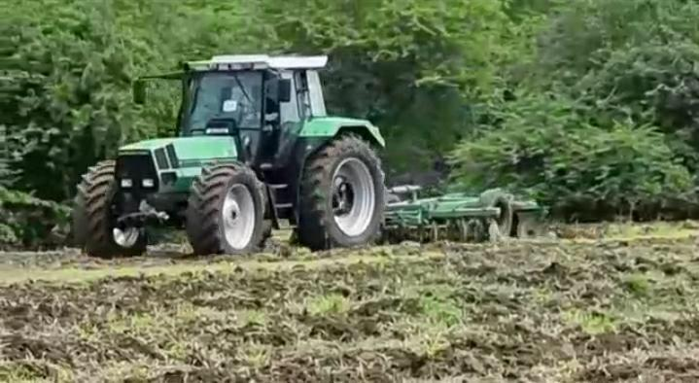
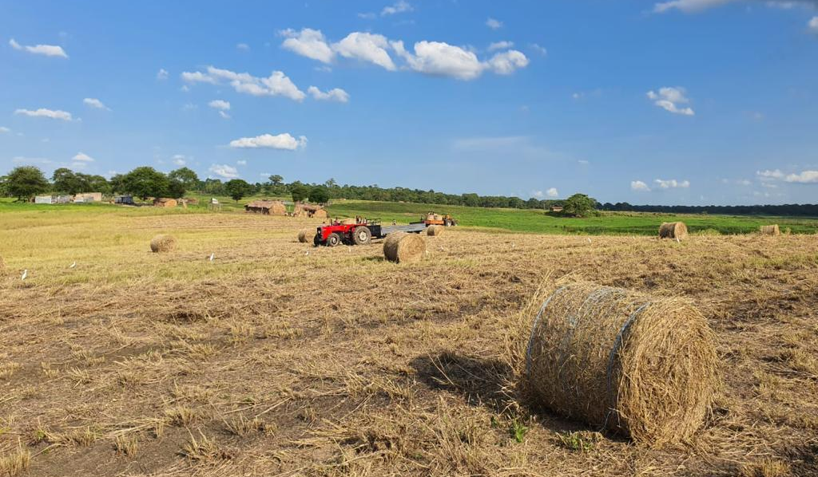
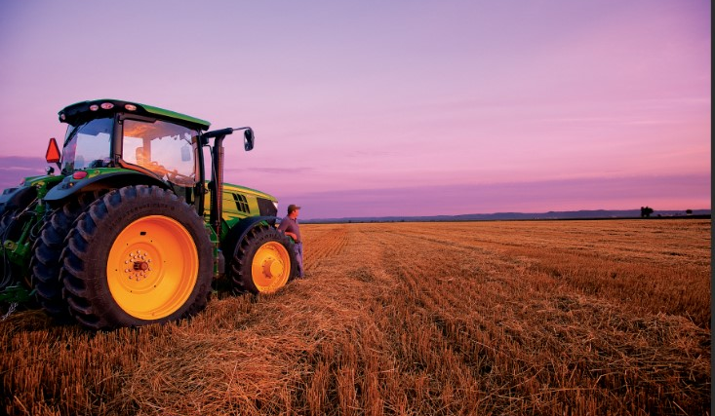
3 Tractors with Casamba; Plough, Alfaia brand Djon-Deeler, Newland
Tractor with trailer
Charrua
Djon-Deeler brand implement
Essential equipment for ploughing and soil preparation.
Agricultural implement for turning over and levelling the soil.
Agricultural machine for sowing and planting.

Slide 22
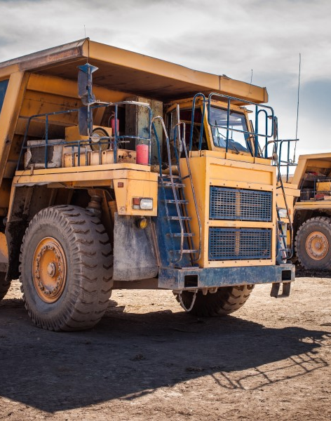
1 Damper lorry, 1 van
Heavy-duty tipper lorry
Transport large volumes of materials efficiently across the farm.
Utility vehicle
Versatile transport for workers and supplies on the property.

Slide 23
3 Power Transformers (200 to 500KVAS), 3 Generators (100 to 500KVAS)
High-capacity transformers
Use transformers with power ratings of between 200 and 500 KVAs to support the electrical needs of the 6000 hectare farm.
Versatile generators
Install generators with capacities between 100 and 500 KVAs to provide reliable backup power throughout the extensive agricultural area.

Slide 24
Renewable energies
06

Slide 25
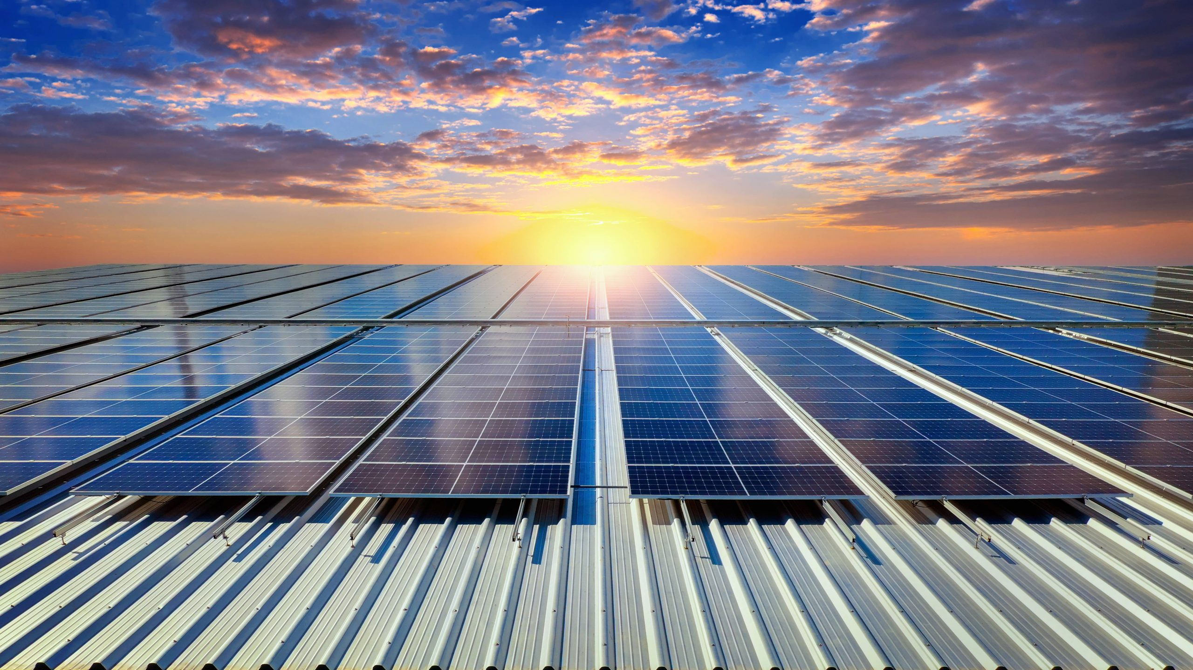
100 solar panels, installed throughout the farm
Clean Energy Generation
Cost reduction
Environmental sustainability
Renewable energy production through solar panels installed throughout the property.
Significant reduction in conventional electricity costs.
Contribution to the preservation of the environment with the adoption of solar energy.

Slide 26
5 motor pumps installed throughout the farm, including the pivot irrigation system
Renewable Energy
Use of solar energy to power the motor pumps and pivot irrigation system.
Energy Efficiency
High-efficiency motor pumps to reduce energy consumption.
Sustainability
Adoption of sustainable practices for water and energy management on the farm.
The farm has all the necessary documents for sale. The price is 5,000,000 USD (negotiable), payable according to commercial bank exchange rates.
For more information, please contact us directly: Email:projects@continentalcapitalconnect.com

Slide 27
Thank You
Continental Capital Connect
Connecting Visionaries, Empowering Opportunities.

