Slide 1

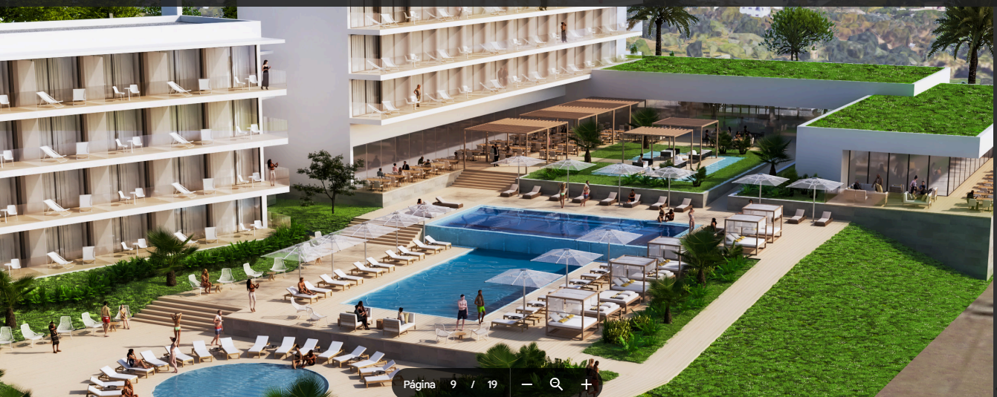
Aparthotel Alvor
Benvindo Tambuila

Slide 2
Content
01
02
03
04
Overview
Benefits of investment
Why Alvor?
Next steps

Slide 3
Overview
PART 01

Slide 4
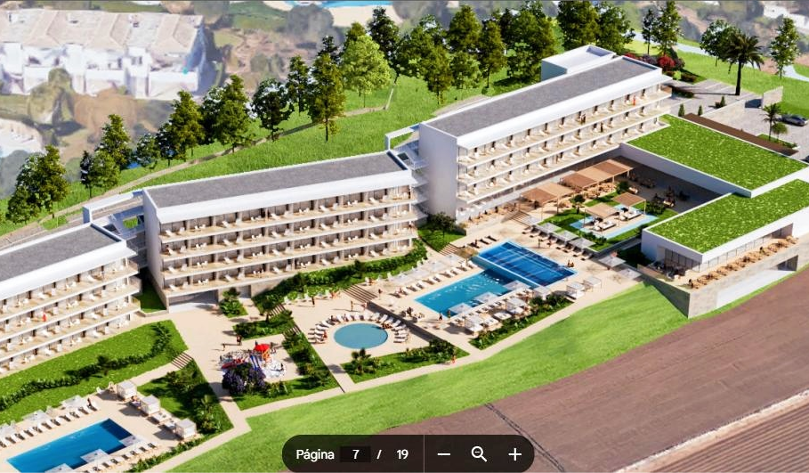
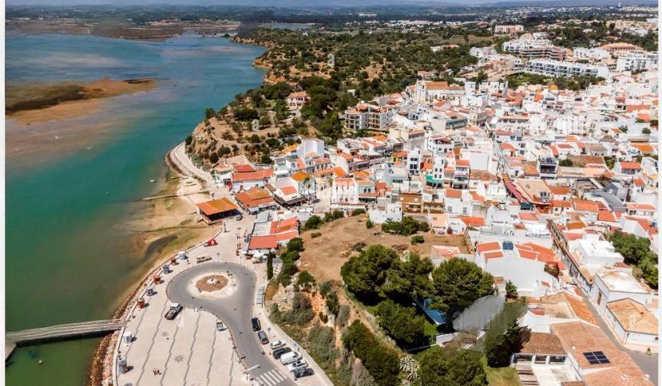
Exclusive investment opportunity
Mix
Location
Approval
Convenience and cost-effectiveness
Alvor's vibrant cross
PIP-approved development

Slide 5
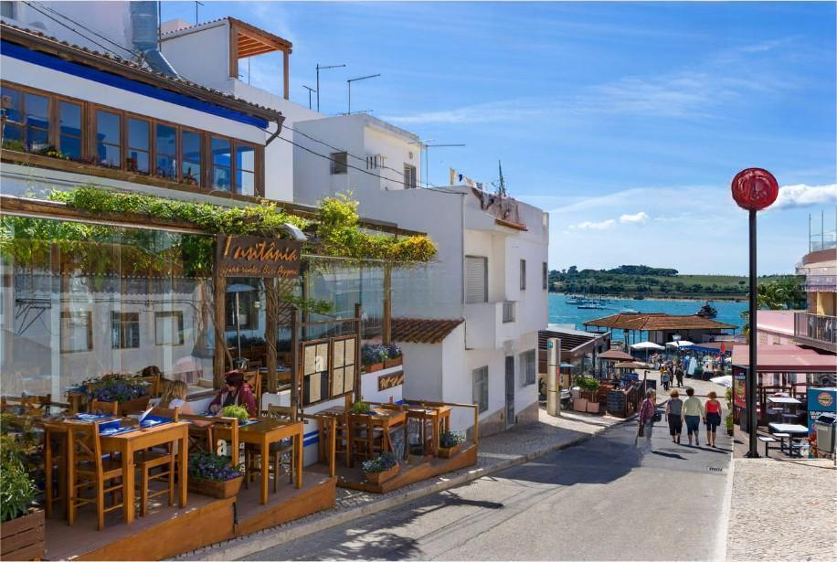
Project details
Location
Approval
Concept
Strategic coastal city
All permits in place
Residential flats with hotel services

Slide 6
Benefits of investment
PART 02

Slide 7

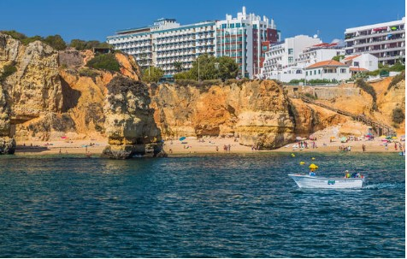
Market attractiveness
01
02
03
Tourism
Demand
Occupation
Booming business and leisure
Versatile high-end accommodation
Strong all year round

Slide 8

Sources of income
01
Rentals
02
Flexibility
03
ROI
Short term, long term, long term
Customisable operational models
Significant potential for profitability

Slide 9
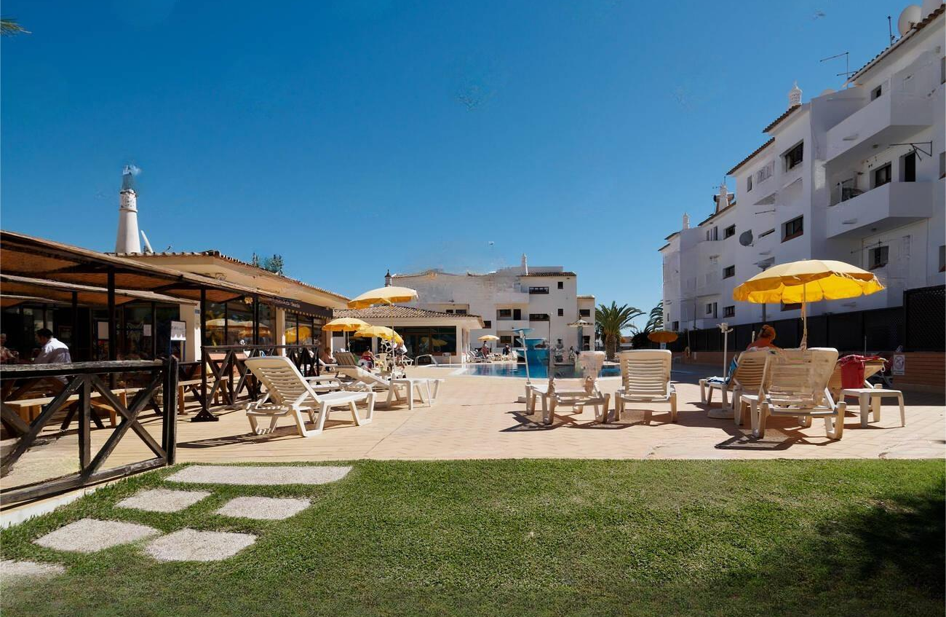
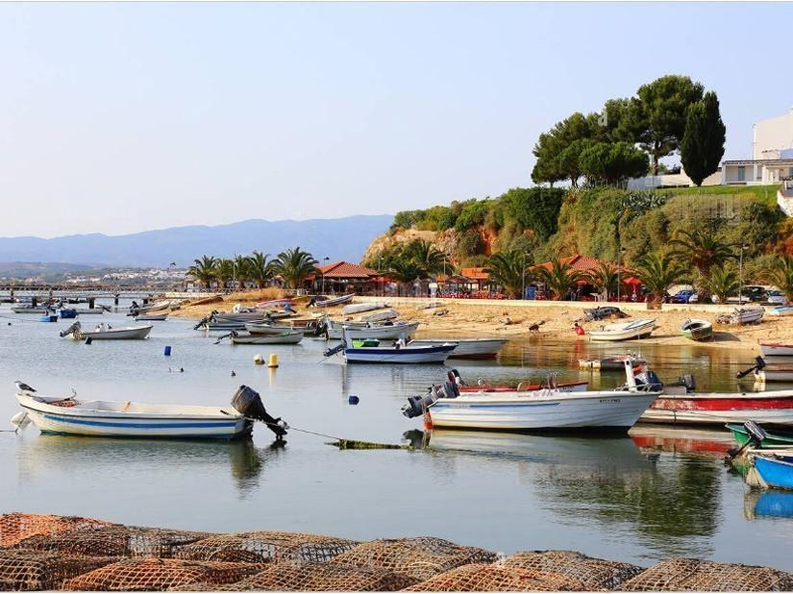
Prepared for the future
01
02
03
Adaptability
Investors
Growth
Developments in market trends
Local and international opportunities
Sustainable and scalable

Slide 10
Why Alvor?
PART 03

Slide 11
Attractiveness of the destination
Tourism
  World-class attraction
Government
  Favourable development policies
Lifestyle
  Natural beauty and modern comforts

Slide 12
Next steps
PART 04

Slide 13
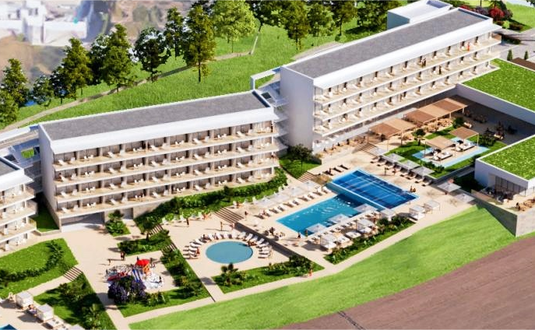
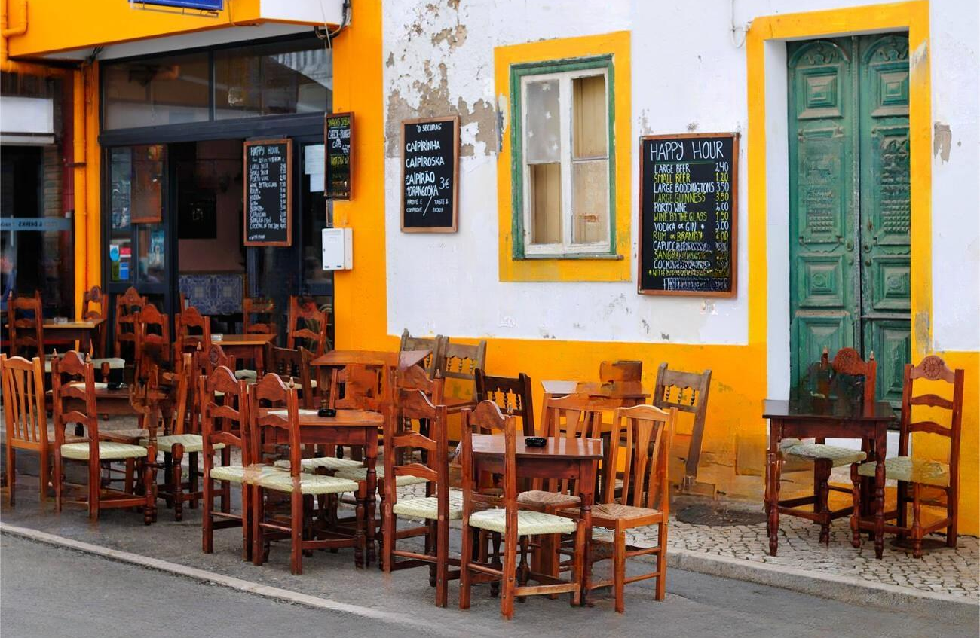

Secure your investment
01
02
03
Details
Personalisation
Consultation
Architecture and finance
Tailored to your objectives
Guidance from a team of experts

Slide 14


Thank you
Continental Capital Connect

